Slide 1
AD & I Meeting – 06 Jan., 2012
Baseline Technical Review structure:
  Evaluate Technical Performance and state of development
  Evaluate and compare cost and choose Baseline Technology
Agenda Scheme - For each proposal:
  1) presentation of the proposal with a description of what is to be changed and why,
  2) summary of the R&D in support of the change,
  3) summary of the interfaces and the impact on related systems and components, especially CFS
  4) thorough explanation of the cost impact.
SCRF Technical Area webex 11 Jan, 2012

Slide 2
Initial List of proposals (~25 each)
‘Post-TTC’ meeting, 08 Dec, 2011.
  Responses and suggestions from Technical Group Leaders
Topics Covered:
  Cavity (Rongli Geng)
  Cavity Integration (Hitoshi Hayano)
  Cryomodule (Paolo Pierini)
  Cryogenics (Tom Peterson)
  HLRF (Shigeki Fukuda)
Topics Missed (or partially covered):
  Cavity / Cryomodule Testing (Hitoshi Hayano)
  Main Linac Integration (Chris Adolphsen)
For Today

Slide 3
SB2009 is the baseline
TeV and RDR 9mA are upgrades,
  to be done after initial construction and operation. Important.
Everyone must use the official parameter set.
It is in EDMS: *925325

Slide 4
To be discussed - and decided at KEK BTR (1)
Recheck and Reconfirm basic linac parameters, layout and interfaces
Linac length: 5 considerations; Timing, key item, must be done last
Gradient overheads
  31.5 average operational gradient is our baseline; there is no proposal at present to reduce that although CM availability is to be considered.
  A broken technical component vs a gradient performance degradation.
  Adopt a statistical approach to cavity degradation
Power overheads

Slide 5
To be discussed – and decided at KEK BTR (2)
Technology/Technical choices:
Power distribution
Modulator technology
Cryomodule technology (cavity integration)
CFS requirements/criteria and tunnel slope impact
To be evaluated:
  impact on CFS: tunnel layout and space requirements, mechanical and electrical
  Impact on cost

Slide 6
Technical Changes: Re-Proposed
See Red parts (Further details with EXCEL sheets by Marc Ross – TO BE UPDATED )
Tech. Area | Main Subjects | Description
ML Integration | Parameters and layout | Confirmed including alignment tolerance CM and Q periodicity: → 8+4Q4+8 requiring additional ML length ( ~ 100 m) >> back to 9+4Q4+9 How we shall keep additional backup 400 m w/o utility? >> need more precise discussions for purpose New request from CFS: 0.5 ~ 1 % tunnel tilting
Cavity performance | Yield Gradient spread Degradation | For example: 1st pass: 60% and 2nd pass: 70% 31.5 +/- 20 % confirmed Assume 1/10 cavities to degrade dG => 20 % Adopt a statistical approach to cavity degradation; <> and rms
Cavity integration | Envelope | Tuner type, coupler warm-flange, beam pipe flange, magnetic shield (inside/outside), LHe tank etc.
Cryomodule | Envelope/interface Unit 5 K radiation shield | Piping interface with flange?, inter-connect condition, etc, 8+4Q4+8 (or original 9 +4Q4+9) Simplification
Cryogenics | Unit capacity | 5 → 4 units / linac or not?
RF power | Configuration | DRFS/RDR in mountain site, >> back to RDR-RF unit KCS/RDR in flat land
Cost | (Conversion) | (PPP)

Slide 7
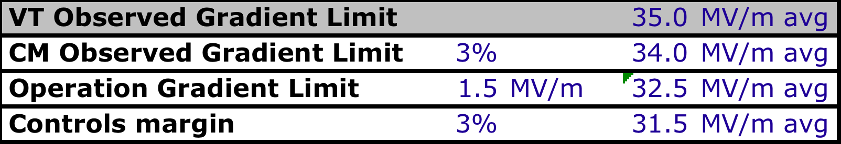
Dividing up the Pie
Data from FLASH modules

Slide 8
HLRF System Update:
Optimum Tunnel for Japanese Mountain Site has ‘NATM’ highway-type cross-section:
‘KAMABOKO’ cross-section

Slide 9
KAMABOKO tunnel
Is very much preferred by Japanese CFS experts; for hard-rock → blasting technology
  >90% Japanese tunnels constructed using related techniques: NOT TBM
  Reflected in cost
Allows a cost-effective parallel HLRF support-enclosure
  Like RDR twin tunnel
RDR technology is cheaper than DRFS
  Klystron is cost-driver – R & D is needed and will continue
  1:12 ratio (800:10000 KW)

Slide 10
Current status of Tunnel construction in Japan
According to tunnel construction database Japan Tunnel Association
Others
Utility conduit
Water way
Road
Railway
Number of construction
1980 1985 1990 1995 2000 2005 2008

Slide 11
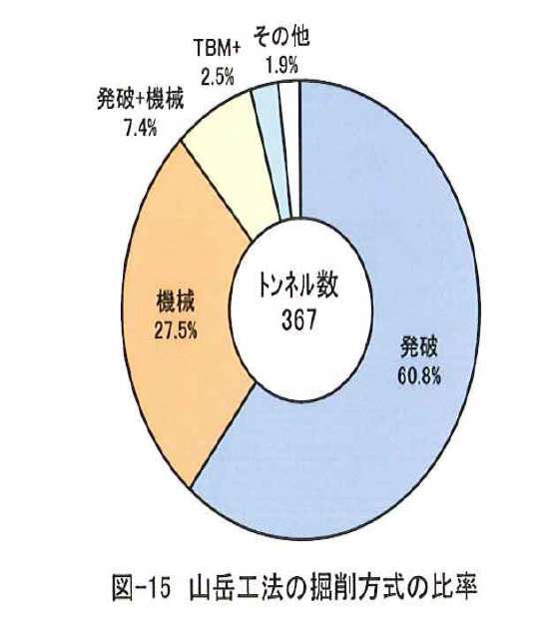

Current status of Tunnel construction in Japan
Mountainous site tunnel achievement
Many tunnels are constructed by NATM
TBM case is not so many as NATM
TBM
Others
B & M
Blasting
Machine
NATM
Machine
Upper and lower
Long bench
Number
NATM
Blasting
Full face with short bench
Full face
Blasting
Machine
Full face
Short Bench
Long Bench

Slide 12
re-Proposed Technical Changes
RDR 10 MW RF System adapted for SB2009 baseline is proposed:
  (Reduced bunch # and gradient spread)
  Adopt KCS 2/3 HLRF scheme w reduced pulse length
  4 ½ cryomodules per 10 MW multi-beam klystron
  i.e. 39 cavities powered by one 10 MW MBK
  6 mA beam current
(Retain 9-8-9 cryomodule configuration)
This solution fits the KAMABOKO tunnel configuration well
Only one linac beam parameter set is needed

Slide 13
TDR Parameters: *925325

Slide 14
Agenda Proposed for SCRF BTR at KEK (1/19)
Date | Technical Area | Subjects to be discussed | Conveners / - Presenters
9:00 - 19/AM-1 | 1. Introduction Welcome Address PM’s report | a) Japanese status and scope for ILC b) Summary of design update proposal | Ross - Suzuki - Yamamoto
10:15 - | Break / photo
10:45 - 19/AM-2 | 2. ML Integration | a) Beam dynamics: Quadrupole/BPM periodicity, Quad. Location, Alignment and beam tunability, Bunch spacing limit specially on KCS (requirement of DR beam dynamics) b) Availability, reliability, and backup CM 3 % longer (400 m) tunnel empty or equiped? c) Comments and requests from CFS and Cost Group | Adolphsen Yokoya/Kubo TBD Kuchler & Dugan
12:15 - | lunch
13;30 - 19/PM-1 | 3. HLRF/LLRF | KCS/DRR-unit HLRF system configuration including backup PS and utilities with the single tunnel design LLRF overheadw/gradient spread, and w/ (989 or 888) cavity-strings Marx generator AC power and cooling w/ gradient spreads Adaptability against cavity degradation after installation into cryomodule by using circulator & powe distribution system, Low-power and high-power option review, Tunable power distribution system Comments from CFS and Cost Group | Fukuda/Nantista TBD - Kuchler and Dugan
15:15 - | break
15:45 - 19/PM-2 | 4. Cryomodule and Cavity-string Assembly | a) Cryomodule envelope/interface b) CM-string configuration w/(989 or 888) cavity-st. assembly c) Simplification of 5K radiation-shield, flow reversal or not d) Split-yoke and conduction-cooled SC quadrupoles e) Alignment scheme with EXFEL approach, f) Comments and requests from CFS and Cost group | Pierini TBD Kuchler & Dugan
18:00 - | Dinner

Slide 15
Agenda Proposed for SCRF BTR at KEK (1/20)
Date | Technical Area | Subjects to be fixed | Presenters/Conveners
9:00 - 20/AM-1 | 5. Cryogenics systems | Location and possible reduction of the number of cryogenics plants Capacity optimization and heat balance with crymodule heat-load | Peterson
9:40 - | break
10:00 - 20/AM-2 | 6-1. Cavity integration 6-2. Cavity and Cryomodule test | Cavity envelope/interface Tuner, coupler, beam-flange, magnetic shield, and LHe tank, Cavity delivery condition with LHe-tank Power coupler conditioning strategy Cold test: what fraction is to be cold-tested? Wha is to be tested? Comments from Cost Group | Hayano TBD - Dugan
12:15 - | Lunch
13:30 - 20/PM-1 | 7. Cavity gradient | Cavity production and process recipe Define production yield including new parameters such as radiation Gradien spread of 31.5 MV.m +/-20% w/sorting method Gradient degradation after assembly into the cryomodule | Geng Ginsburg TBD
15:00 - | break
15:30 - 20/PM-2 | 8. Costing-status overview 9. General Discussion and conclusion | Current status for SCRF costing overview Discussion summary and decision | Walker Dugan Yamamoto
17:30 | SCRF BTR complete

Slide 16
Japan:
Reports from Japan remain positive and encouraging.
Redouble our effort to work toward a realistic, useful, project plan.
  ILC may really come to pass and everyone should think about that.
  Site visit
The cost estimate we prepare for TDR in 2012 will be the one used in the 'cost book' that helps define in-kind contribution
R&D on performance and cost risk reduction to be supported - please help prioritize
We still have a long way to go; but are making progress.

