Slide 1
ML Layout
Beam dynamics: Quadrupole/BPM periodicity, Q location, alignment, and beam tunability, Bunch spacing limit specially on KCS (requirement of DR beam dynamics)
One quad/bpm/corrector pair per three cryomodules. Quad package at center of CM. Speed of corrector response for fast average orbit control ?
If keep 989 CM configuration and shafts as in RDR, linac lattice and layout stay the same except for undulator region (moved to the end of the linac).
For KCS, have more shafts - locations of Service End Boxes will change some to even out number of klystrons per KCS feed so lattice needs to be updated
KEY DECISION: 989 vs 888, which is partly and rf overhead issue (could also run the klystron at somewhat higher power).

Slide 2
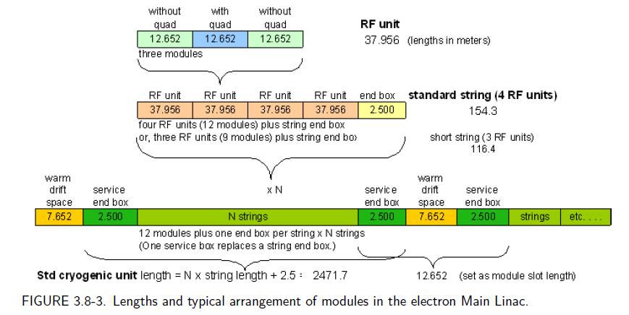

Slide 3
ML Overhead
Availability, reliability, and backup of cryomodules to be required
3% longer tunnel - empty, not equipped.
New overhead based on expected cryomodule performance. Availability analysis used a fairly short cryomodule lifetime – and this was a basis for a 3% longer linac tunnel in the RDR.
How much length to include – assume ML optics in this region ?

Slide 4
ML Diagnostics
The principal main linac beam diagnostic is the suite of beam position monitors: a sub-micron single-bunch resolution BPM with is located adjacent to each quadrupole magnet. (This was achieved with a 70 mm aperture )
For beam size monitoring, a single laser wire is located in each of the warm sections between main linac cryogenics units (about every 2.5 km).
Upstream quadrupole magnets are varied to make local measurements of the beam emittances.
The main linacs do not contain any equipment for intra-train trajectory control. Such trajectory control is implemented only in the warm regions upstream and downstream of the main linacs and in the undulator section.

Slide 5
ML Diagnostics
There are no diagnostics for measuring energy or energy spread in the main linacs. These measurements are made upstream and downstream of the main linacs and in the undulator section.
There are no beam abort systems in the main linacs. Machine protection in the linac is ensured by verifying the state of the main linac hardware (both RF and magnets) prior to beam extraction from the RTML, and by verifying that the orbit in each damping ring is correct.
The limiting aperture along the main linacs is the 70 mm diameter cavity iris.

Slide 6
Benno List 12/15/11 Main Linac Treaty Points
Main Linac lengths are subject to change (final numbers after BTR at KEK, 19./20.1.2012), current estimates based on RDR lattice
Electron Linac final energy and length need final numbers for positron source undulator; currently, ELIN has 4 x 26 cavities more for 3.33GeV additional energy.
All alpha/beta functions based on RDR lattices
Treaty point TEML2PS between electron ML and undulator section assigns the whole undulator protection section with fast beam abort to positron source, not ML ??

Slide 7
Treaty Points between RTML and Main Linac
The treaty points between RTML and Main Linac follow the convention used in the RDR, where the transition occurs 2.5m in front of the first cryomodule, where the 2.5m are reserved for cryogenic installations. The Twiss functions at this treaty point have been taken from the RDR lattice.
Question: in the KCS version, is the RTML RDR like

Slide 8
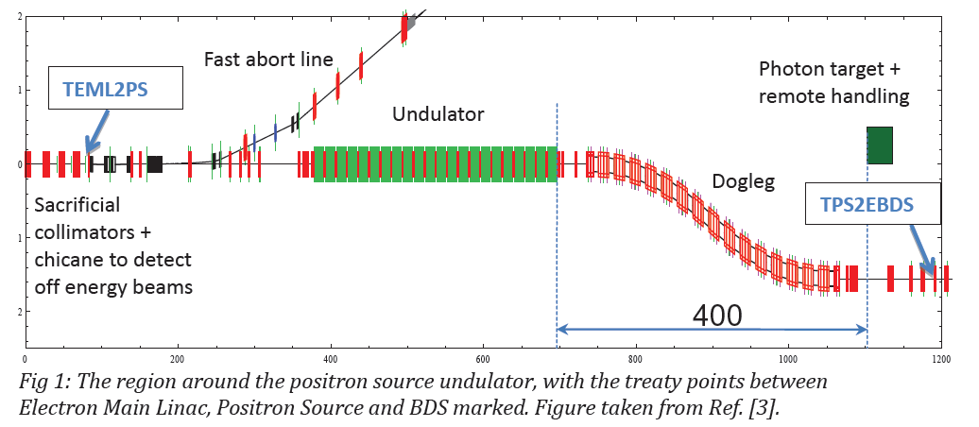
12/16/11 Treaty Points between Main Linac and Positron Source / BDS
The Machine Protection System and Collimation section (MPSCOL) that marked the beginning of the BDS in the RDR is now owned by the Main Linac. - Why not e+ system ?
Therefore, the Treaty Points that mark the end of the Main Linac are now located at the end of the MPSCOL section [2], just before the half-quadrupole QF90.

Slide 9
Nick’s List
Top-level parameters for the linacs: this should now include 10Hz operation mode.
ML lattice layout (including cold box locations etc), which should give us the total length. This is obviously important for CFS but also for global timing considerations.
Locations of services, shafts, cryoplants, etc.
Lattice file description (i.e. MAD), defining the default optics
Tables of required tolerances (beam dynamics driven)
Component counts (cryomodules, HLRF related, power supplies, vacuum etc)
Beam vacuum specifications

