Slide 1
HOM heating at the IP and in QD0
Update 2012
Sasha Novokhatski
MDI Meeting
SALC, January 12, 2012

Slide 2
Outline
ILC beam parameters
ILC interaction region geometry
Beam fields
Wake potentials and loss power
Trapped and propagating modes
Frequency spectrum
Resistive wake fields
Total power loss

Slide 3
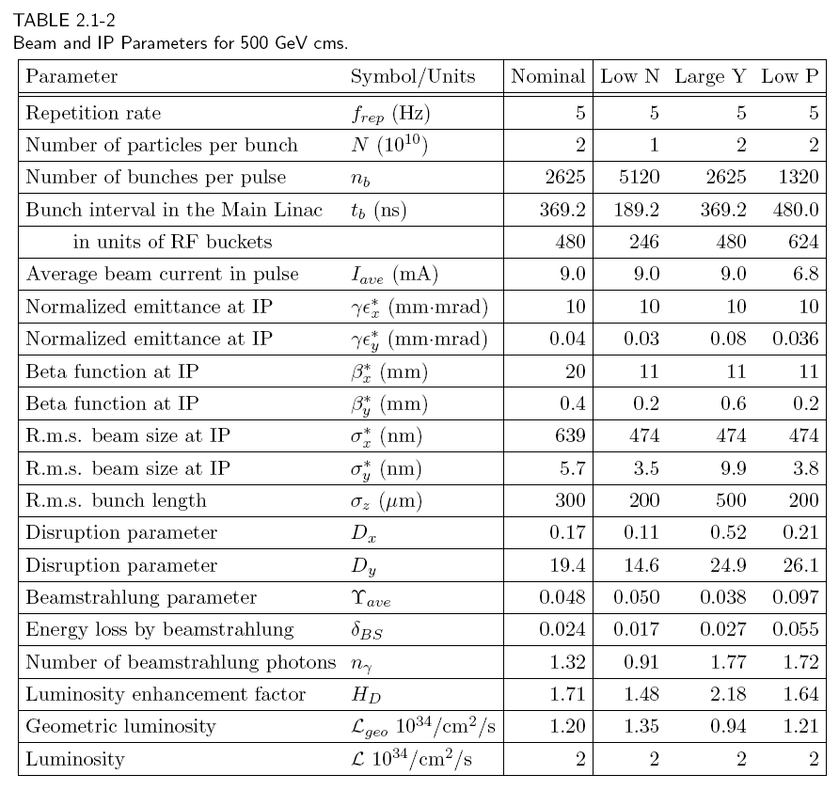
ILC beam parameters
INTERNATIONAL LINEAR COLLIDER
REFERENCE DESIGN REPORT
AUGUST, 2007
Bunch charge = 3.2 nC
Bunch length = 0.2-0.3 mm
Bunch spacing = 369.2 ns
Beam current in a pulse 9 mA
Duty ratio=200

Slide 4
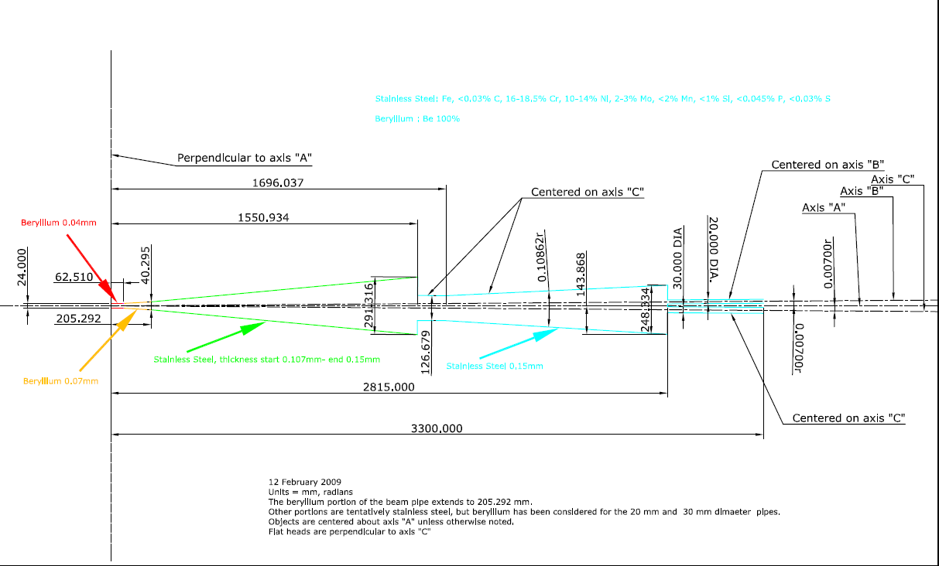
ILC IR geometry from Marco Oriunno
Comments from Takhashi Maruyama:
The thickness of the cylindrical beam pipe is 400 microns,
and of the conical section is 700 microns.
There are no bellows, flanges, BPMs, pumping holes, …

Slide 5
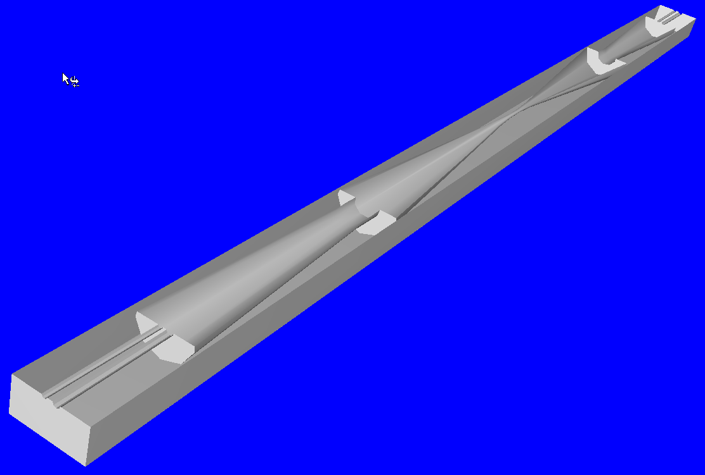
3-D stl model from Marco Oriunno

Slide 6
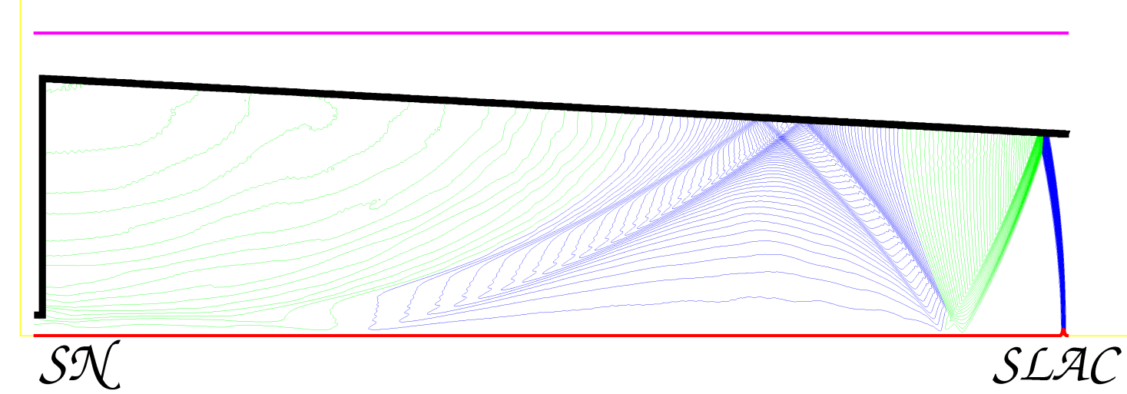
Wake fields and a bunch field
V

Slide 7
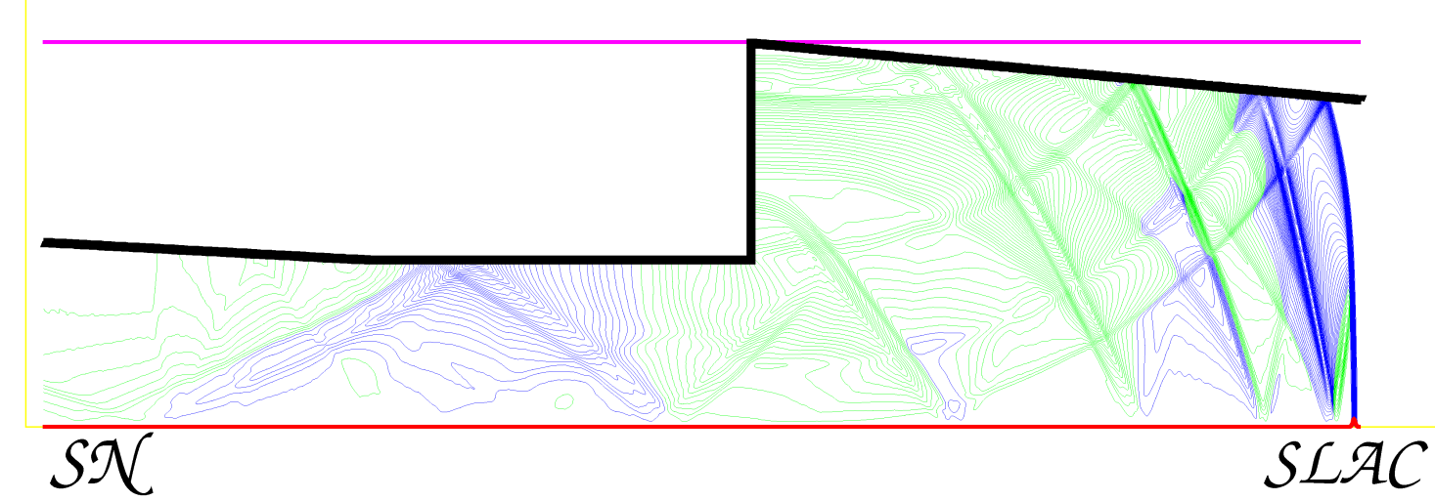
After a second chamber step
V

Slide 8
Bunch field
Electric field at the beam pipe wall
High electric field at the wall.

Slide 9
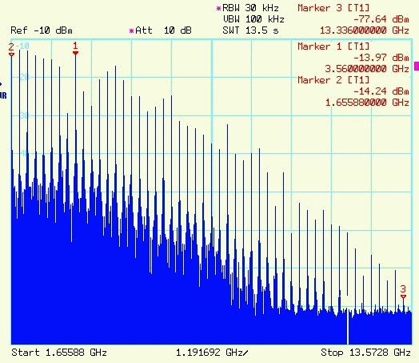
Beam spectrum
Bunch spectrum goes to higher frequency with shorter bunches
Example from PEP-II
Bunch spacing resonances

Slide 10
Wake potentials and Green’s function
Wake potential describes the integrated effect of the wake fields
and can be calculated in the time domain by solving Maxwell’s equations.
Wake potential of a point charge is a Green’s function to calculate fields of any bunch distribution

Slide 11
Short range wake potential (0.2 mm bunch)
Calculated with a code “NOVO”

Slide 12
Bunch Loss Factor
Beam energy loss is calculated by
Single bunch loss factor is normalized to a bunch charge and usually measured in V/pC.

Slide 13
Loss factor of IR vs bunch length
NOVO calculations

Slide 14
Loss frequency integral
We introduce loss frequency integral of a single bunch
Full integration gives the loss factor:

Slide 15
Loss frequency integral of IR

Slide 16
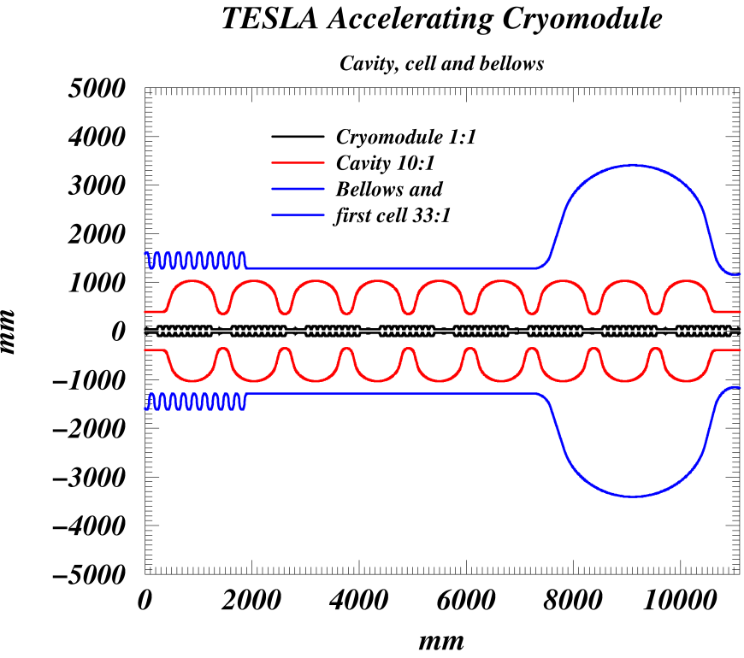
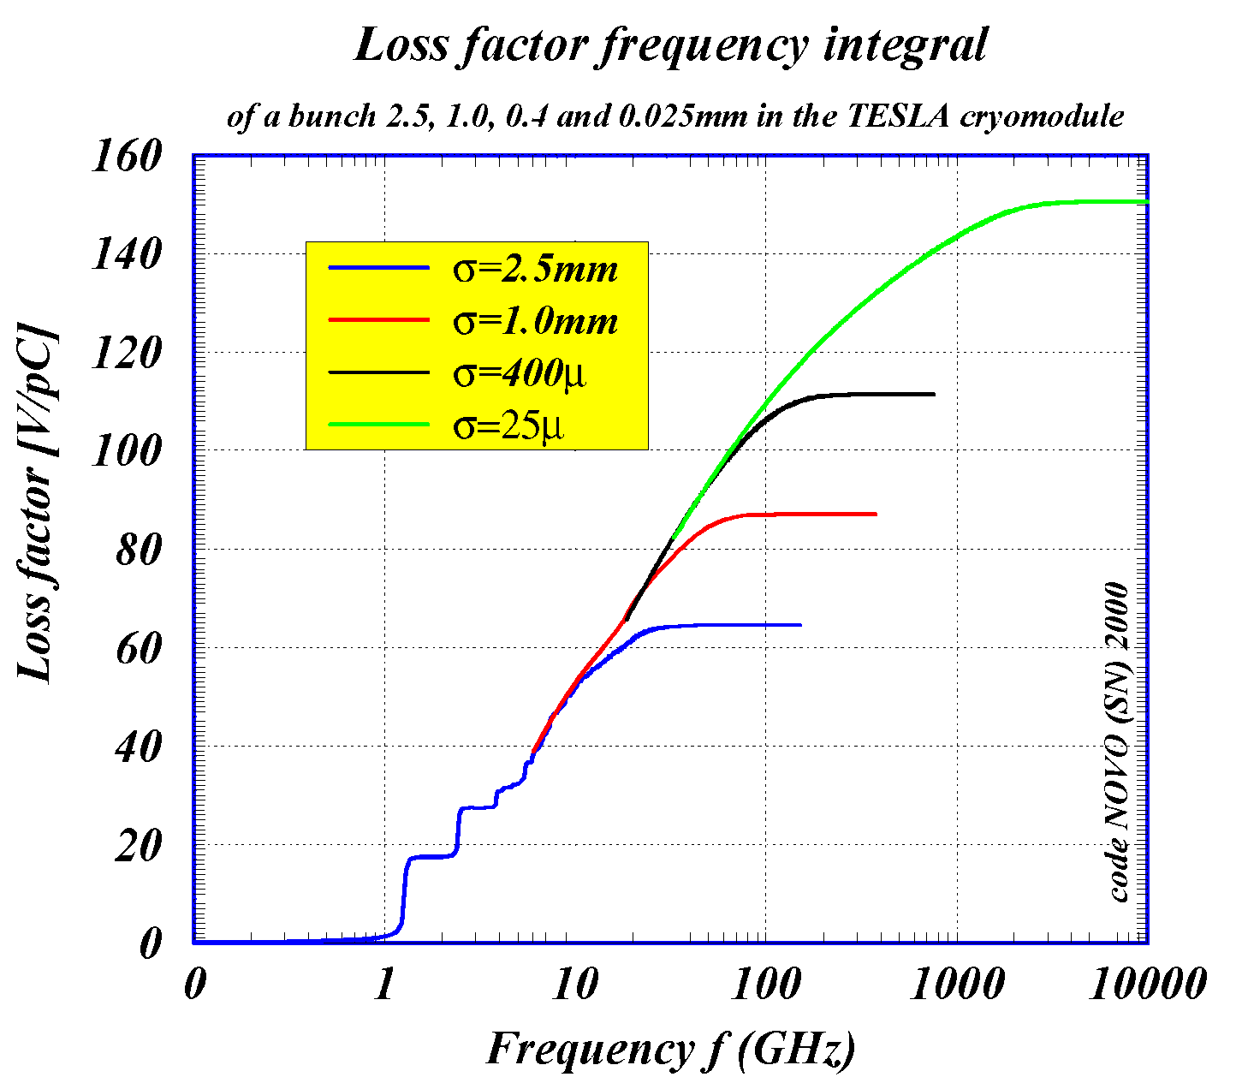
Comparison with loss frequency integral of the ILC (TESLA ) cryo-module
IR produce almost same amount of wake fields as one cryomodule

Slide 17
Power loss of a train of bunches
IR is a large “cavity”.
Some of the fields excited in the IR can be trapped and absorbed there. Other part can leave IR, travel along the beam pipes and absorbed.
Trapped modes may have high Q-value and keep the fields from the previous bunches.
Modes with higher frequencies can leave the region.

Slide 18
Longitudinal impedance
A Fourier transform of a Green’s function gives a longitudinal coupling impedance
We can use wake potential to calculate longitudinal impedance

Slide 19
Long-range wake potential
20 m after a bunch

Slide 20
Cut-off frequency
Cut-off frequency is the maximum frequency of captured modes in a cavity.
It is determined by the size of a beam pipe.
For E01 mode
ILC IR: a=10mm=0.01m
f=11.47 GHz

Slide 21
Trapped modes of IR
cut-off
frequency

Slide 22
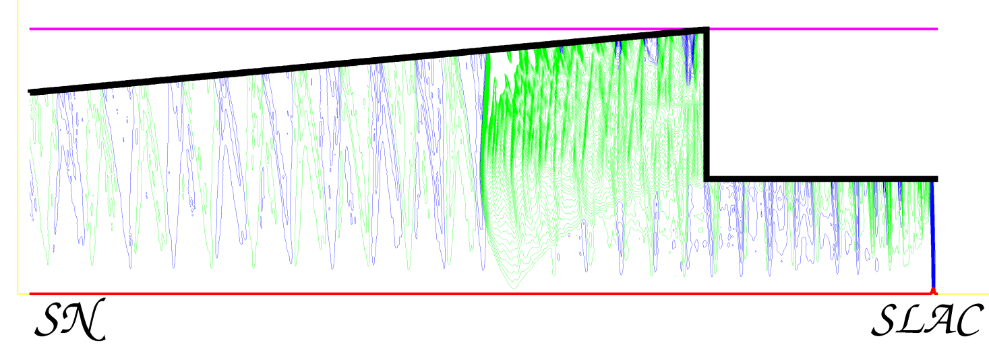
Wake fields in the corner
V

Slide 23
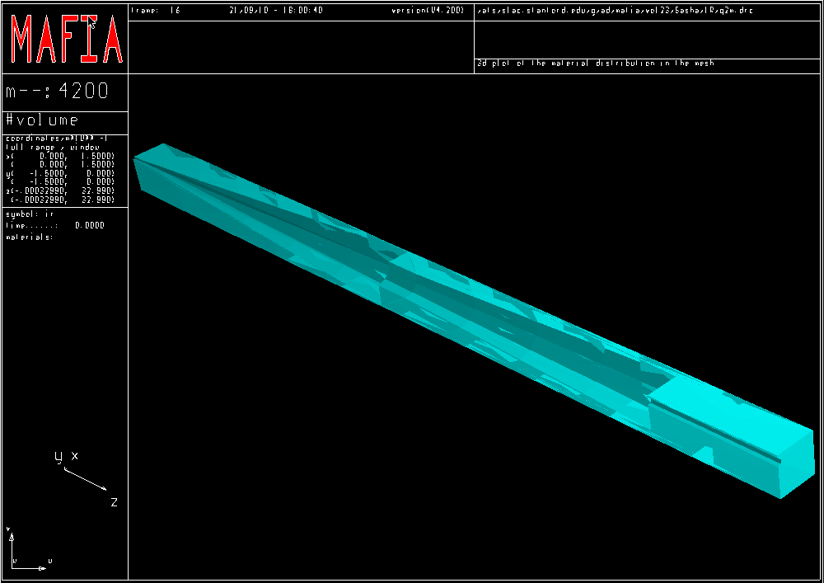
½ * ½ * ½ model for MAFIA simulations

Slide 24
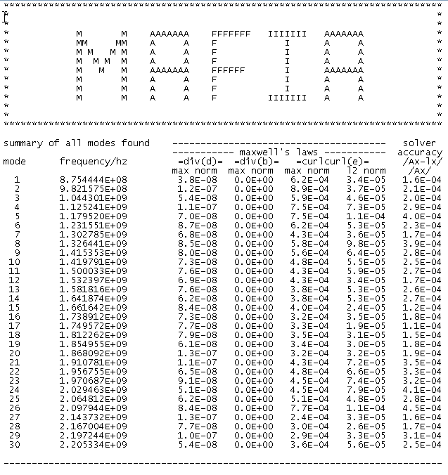
MAFIA simulations

Slide 25
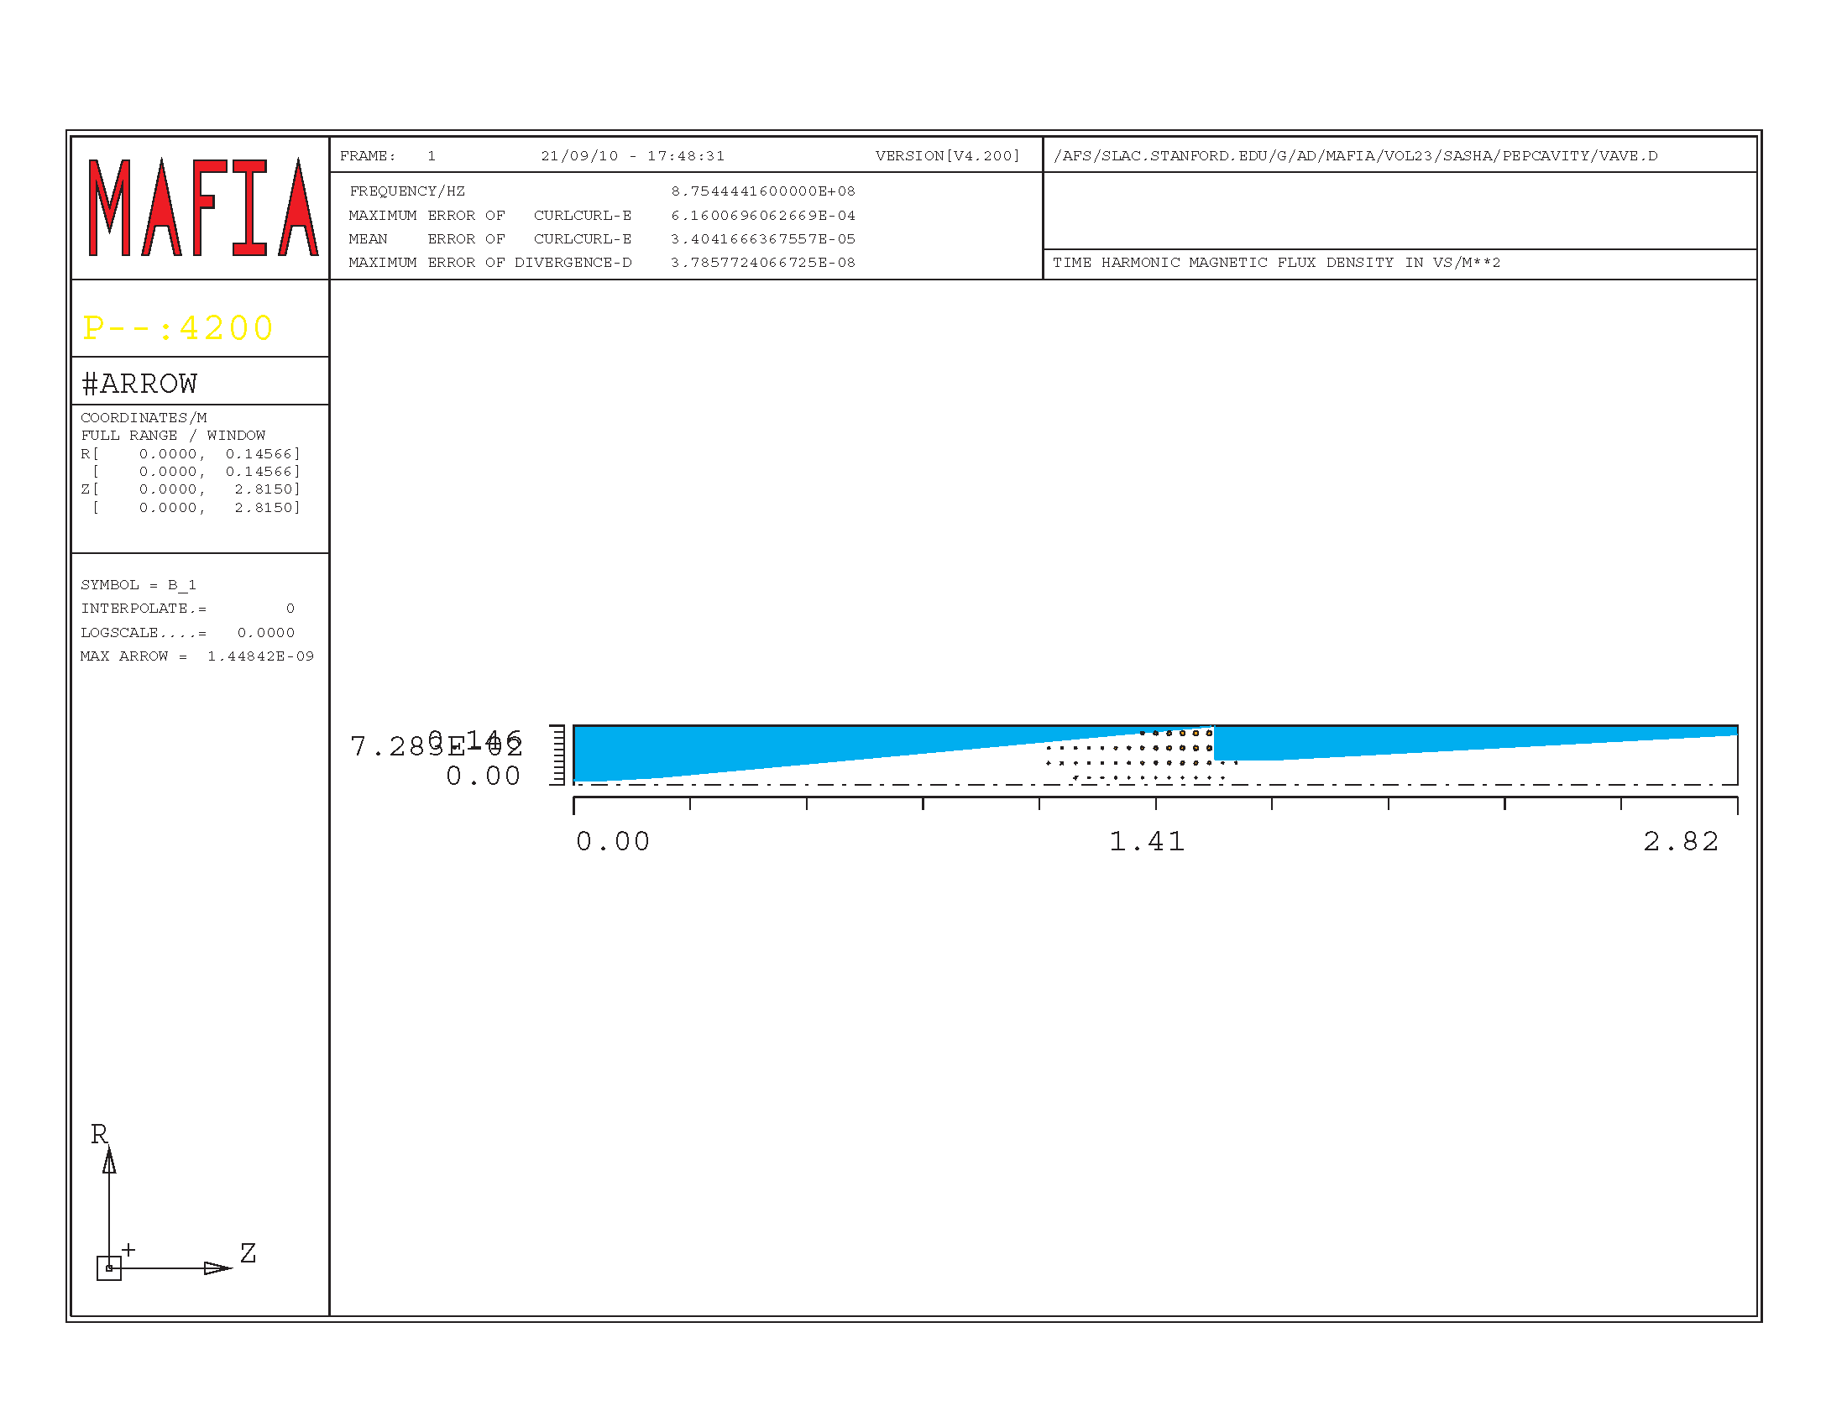
Second mode

Slide 26
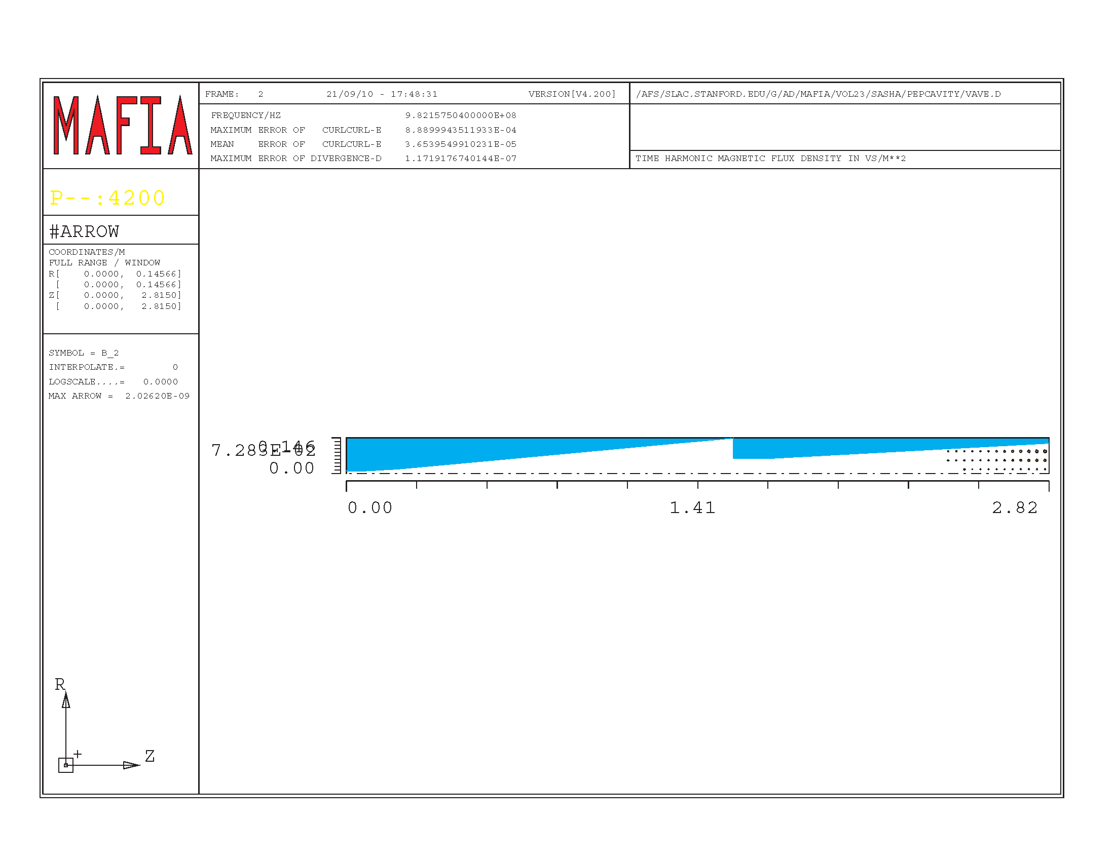
Other mode

Slide 27
Interaction with one mode
Mode voltage decay
Loaded time decay
or filling time
Loaded Q-value
which includes coupling
Bunch spacing
Mode survives to
the next bunch if
and loaded Q

Slide 28
Coherent and incoherent excitation
Incoherent
Coherent at resonance
condition
Loss power
Loss factor
If the bunch spacing is equal to mode decay time the coherent power is only two times larger than incoherent power

Slide 29
Total loss power (all trapped modes)
Total power
Trapped mode frequency range 0.85 – 11.5 GHz
Bunch spacing 369.2 ns
Loaded Q
990 - 13300
Average power is 200 times smaller

Slide 30
Loss integral and cut-off frequency

Slide 31
Power loss in a pulse (two beams)

Slide 32
Resistive-wall wake fields
(Losses of image currents)
conductivity /Ohm/mm
Al 35000
Cu 58000
SS 1400
Au 48800
Be 25000
Ni 14600
NEG 55-1000

Slide 33
Fields in Be chamber. Bunch 0.2 mm

Slide 34
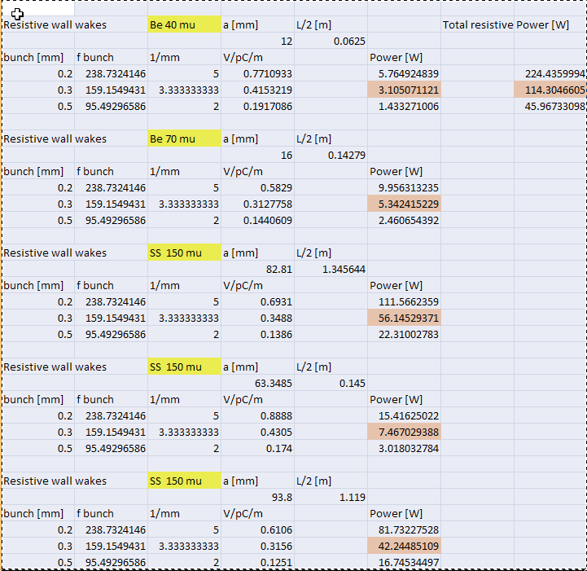
Power loss due to resistive wall. Not so much.
X 5 (NEG) =600 W

Slide 35
QD0
Resistive loss:
Preliminary calculations for a tube of a diameter of 20.8 mm and length of 3.651 m gives 200 W pulsed losses or 1 W averaged power.
A tube of 36 mm dissipate 0.6 W averaged power.
Input pipe:
Diameter=20.8mm
Length= 3651mm
Output pipe
Diameter=36 mm
Length=3651mm

Slide 36
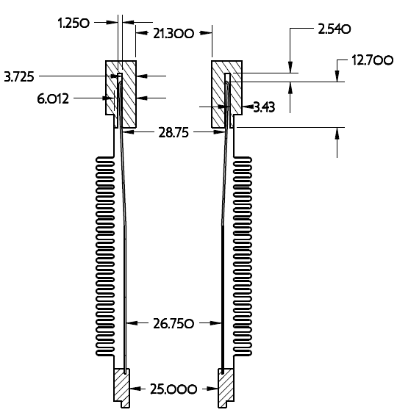
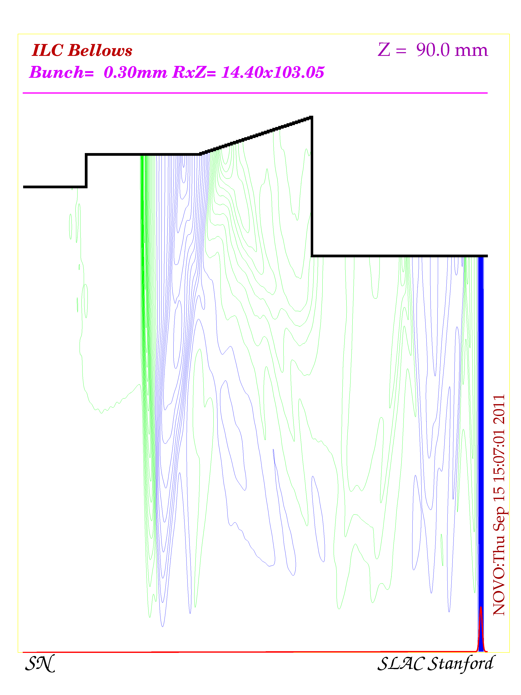
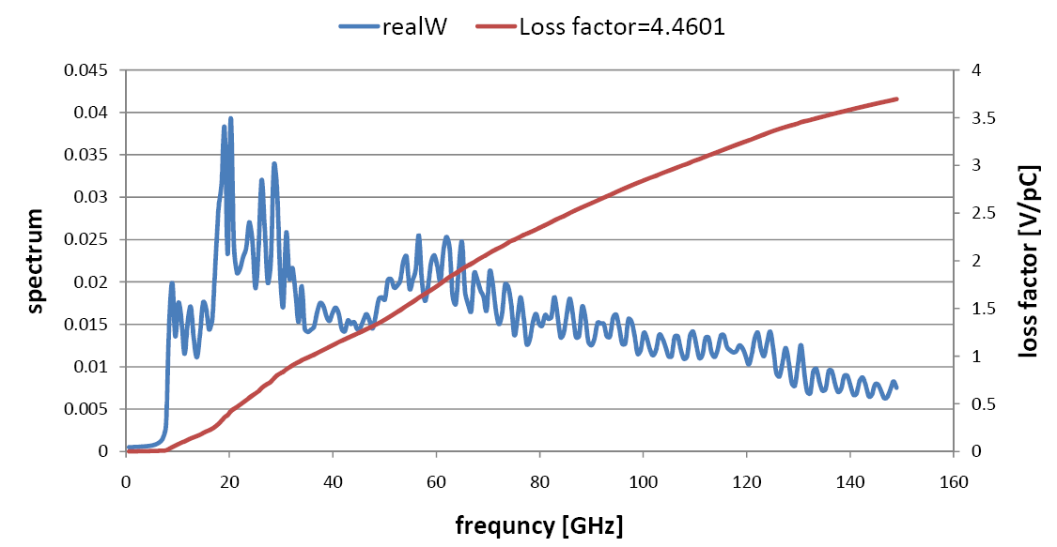
QD0 bellows
A bellows produces an additional power of 0.6 W (averaged).

Slide 37
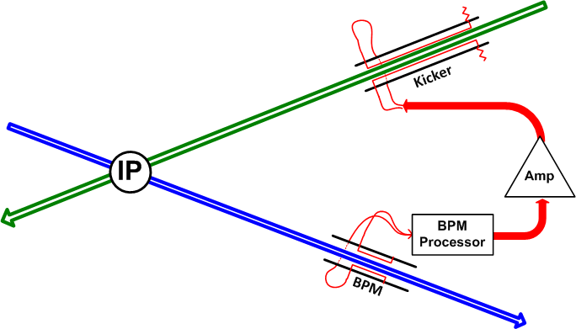
ILC Intra-Train Feedback Steve Smith 9 September 2011
Block diagram of feedback system. The deflection of the outgoing beam (blue) leaving the IP is measured in the BPM. Signal flow is in red. The kicker steers the incoming beam (green) into collision at the IP.

Slide 38
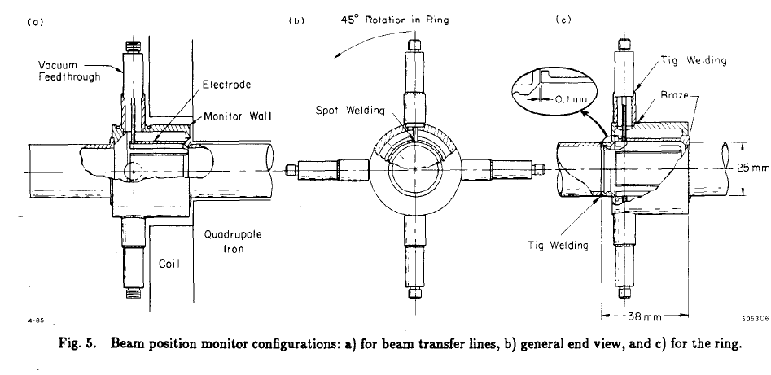
SLAC strip-line BPMs

Slide 39
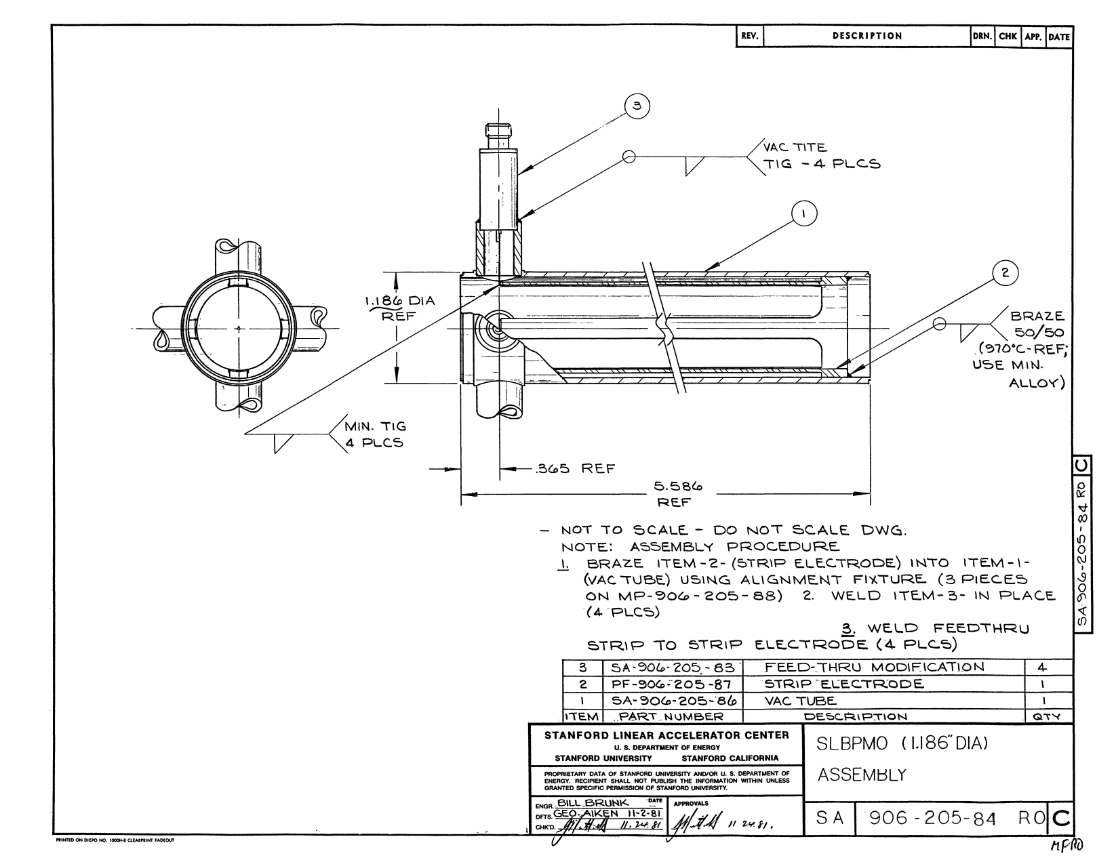
SLAC drawings

Slide 40
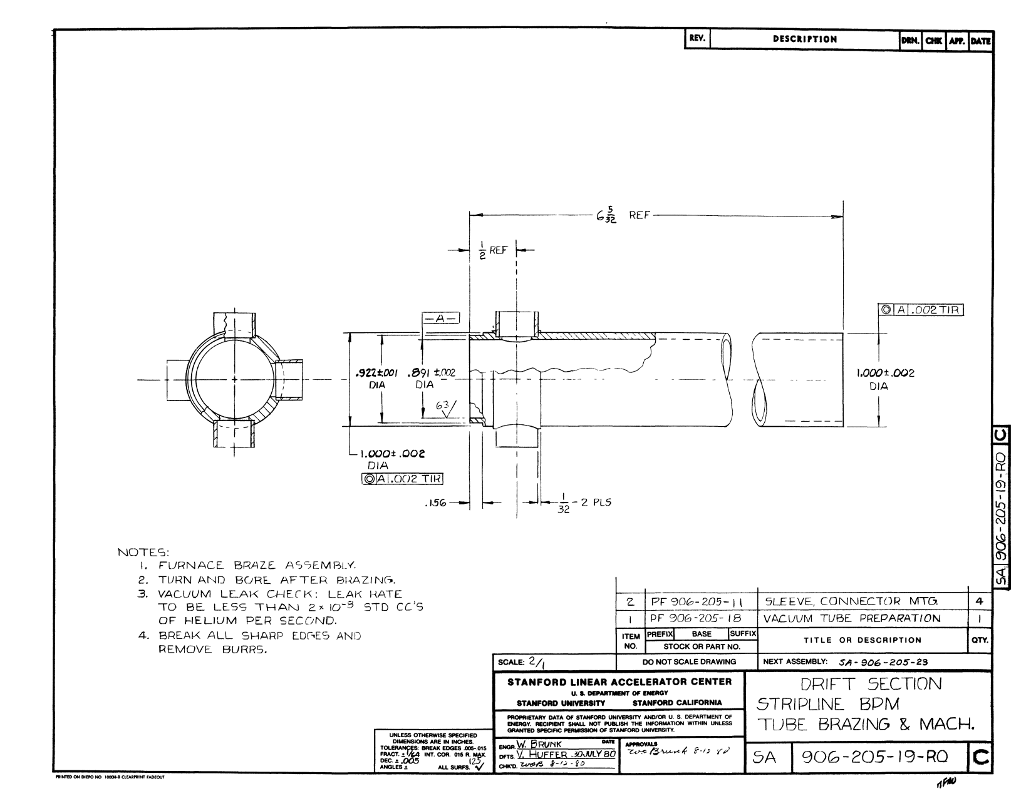
SLAC drawings

Slide 41





IMPEDANCES OF STRIP-LINE BEAM-POSITION MONITORS
KING-YUEN NG

Slide 42
Strip-line BPM Loss factor=2.6133[V/pC]
A BPM produces an additional power of 0.4 W (averaged).

Slide 43
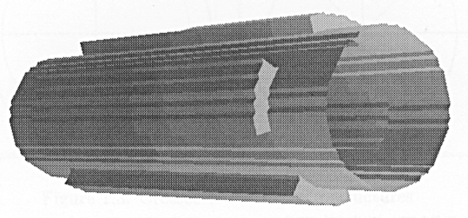
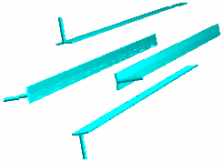
Strip-line kicker

Slide 44
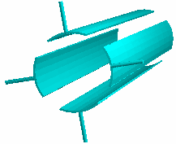
Strip-line kicker

Slide 45
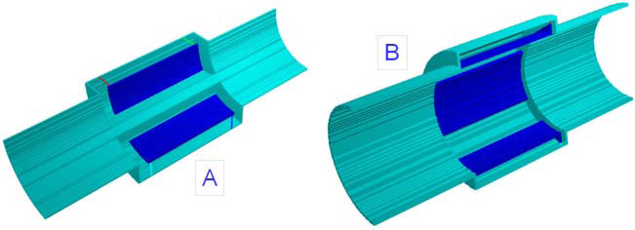
MAFIA models

Slide 46
Summary
The amount of beam energy loss in IR is almost equal to the energy loss in one accelerating cryo-module.
Additional energy spread accumulated in the IR is very small.
Spectrum of the wake fields is limited to 300 GHz
Average power of the wake fields excited in IR is around 30 W for nominal parameters (6 kW pulsed)
In the QD0 region the additional losses are of 4W (averaged) . BPMs and kickers must be added.

