Slide 1
FNI Meeting
Outlines:
Current status of FNI detector and results
New designs of neutron convertor
New material for collimator: Boron-loaded Polyethylene
Discussion: Next step test with Am-Be neutron source

Slide 2
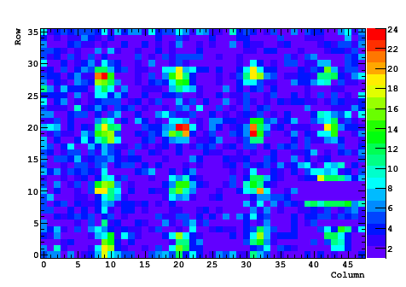
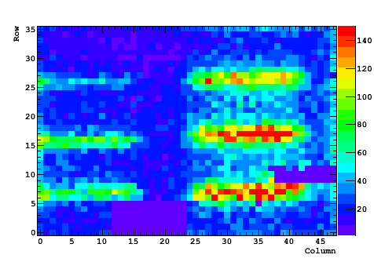
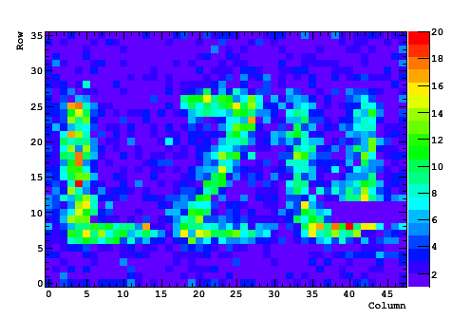
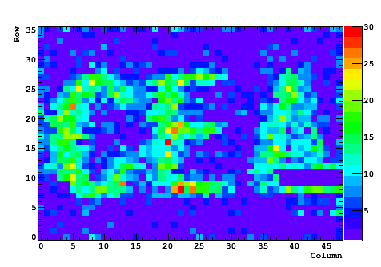
Current results
The Imaging are mainly come from X-rays

Slide 3
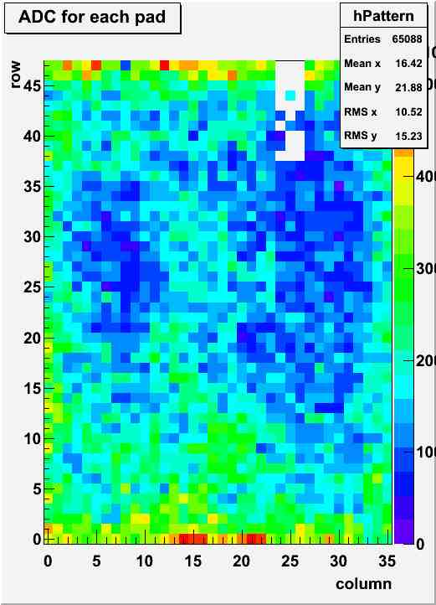
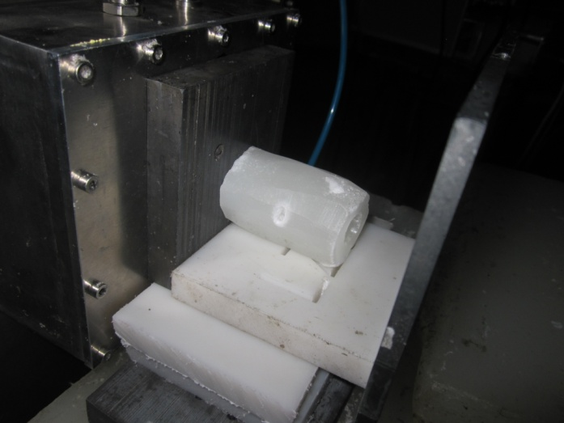
Current results
Thickness of paraffin: 5cm，
Diameter of hole: 7mm
X and gamma rays are shielded by Lead(front and back).
The unclear imaging of the hole is caused by:
very low detection efficiency of the detector for neutron;
Cosmic muon’s influence.

Slide 4
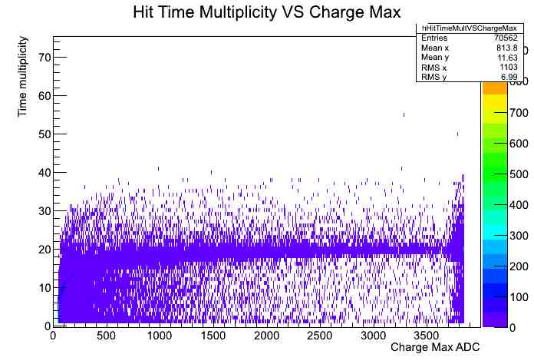
Current design
Neutron Events
X and gamma rays events

Slide 5
Current Design -- Conclusion
Neutrons are detected by FNI detector;
No clear neutron imaging, the reason is caused by the low detection efficiency and cosmic muon’s influence;
Detection efficiency need to be improved;
With 200 um polyethylene: 0.06%
New design: 10% (estimated, in principle, if the thicker structure used, the detection efficiency can be higher)

Slide 6
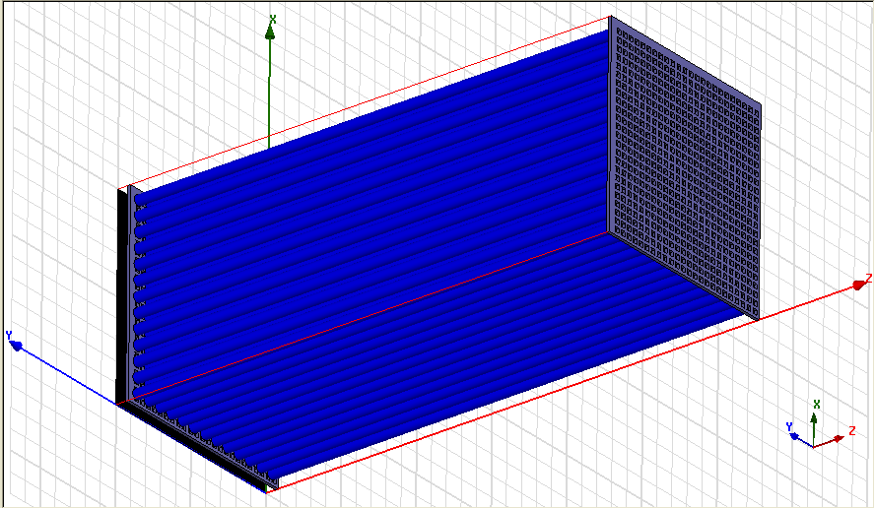
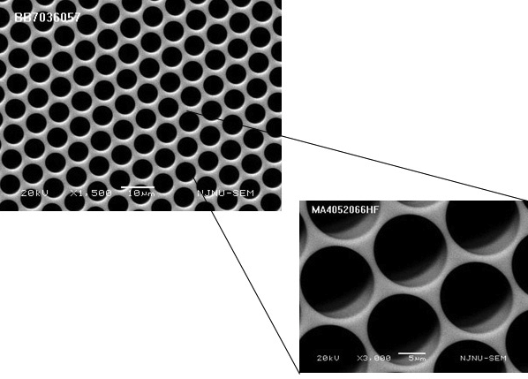
2. New Convertor Design -- two ideas
Design 1: Polyethylene pillars (Blue). Top and
bottom are metal mesh, which are served as
electrodes.
Design2: Polyethylene with hole. Top and
bottom covered by metal/copper which
Served as electrodes.
Note: Huaya is doing the simulation of this new ideas and optimize the dimensions.

Slide 7
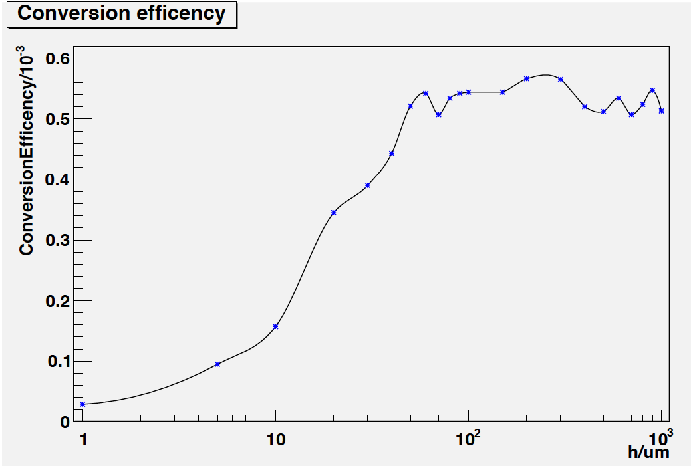
2. New convertor design -- conversion efficiency
Lvxing An’s Simulation results:
Energy of incident neutron: 2 MeV
Convertor: bulk Polyethylene
Conclusion:
Based this simulation, the diameter of the pillar and the thickness of the wall in the new
design should be chosen about 200 um for 2 MeV neutron. But for the 14 MeV neutron,
it should be chosen more thicker than this value. The value will be obtained soon.

Slide 8
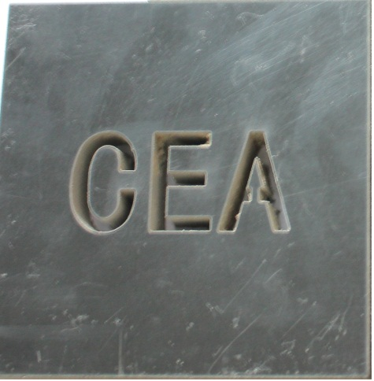
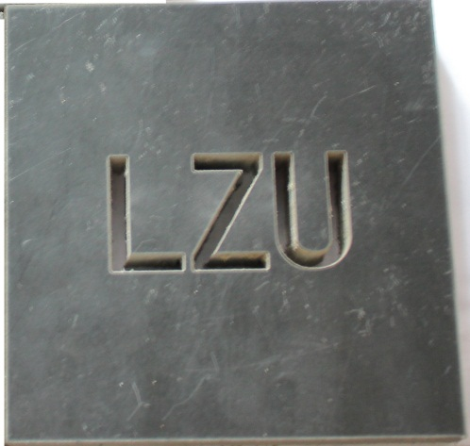
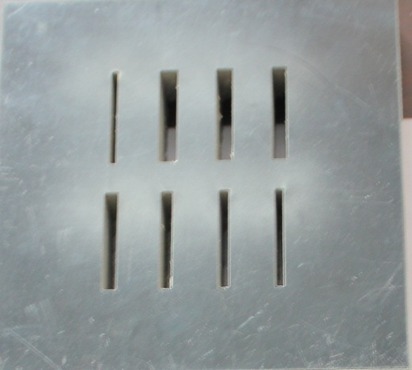
3. New collimation material -- Boron-loaded polyethylene

Slide 9
4. Next step test
Continue testing it with Am-Be neutron source
Once it is done, test it with 14 MeV neutrons

