Slide 1
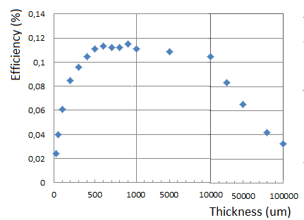
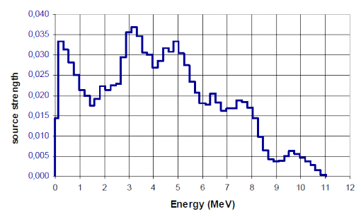
Geant4 simulation for converter efficiency
Neutron→proton recoiling efficiency in a polyethylene [C₂H₄]_{n} layer coming from ²⁴¹Am-⁹Be source
Incident neutron spectrum
According to ISO 8529^{(*)}

Slide 2
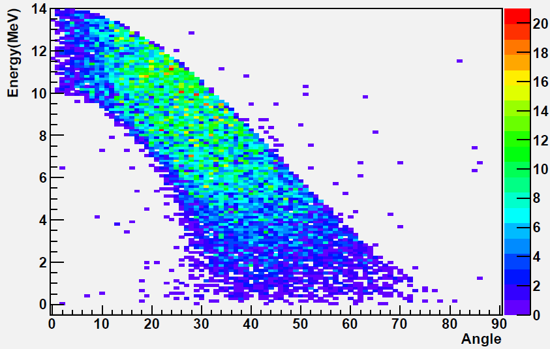
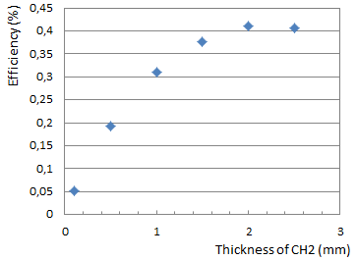
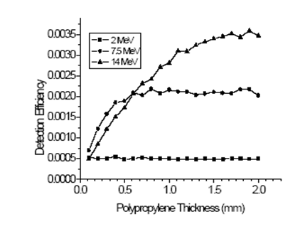
Geant4 simulation for converter efficiency
Neutron→proton recoiling efficiency in a polyethylene [C₂H₄]_{n} layer coming from 14MeV neutron

Slide 3
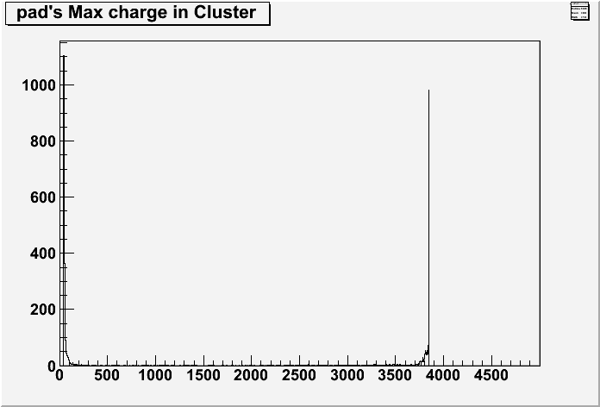
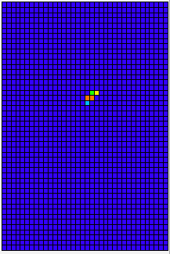
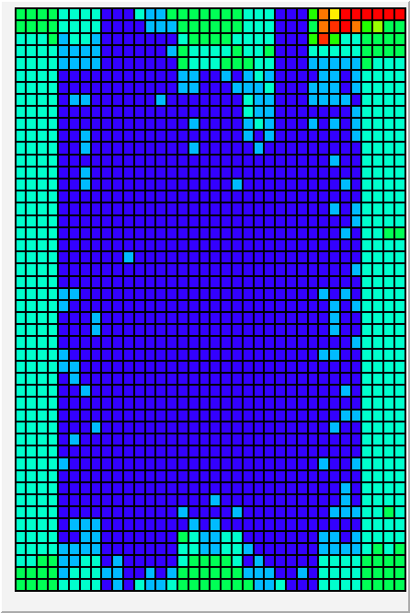
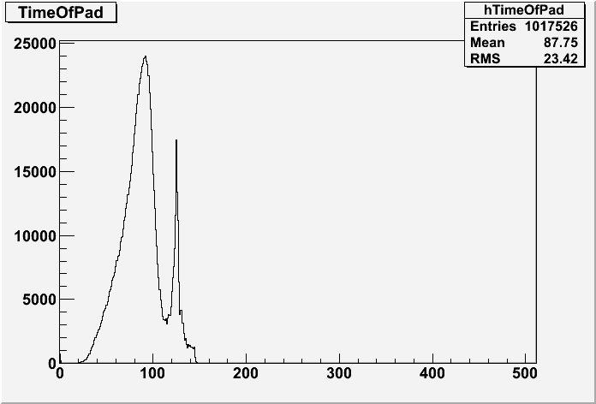
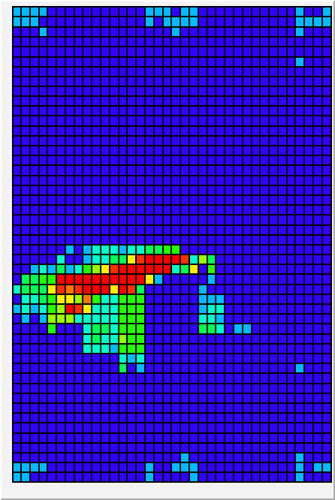
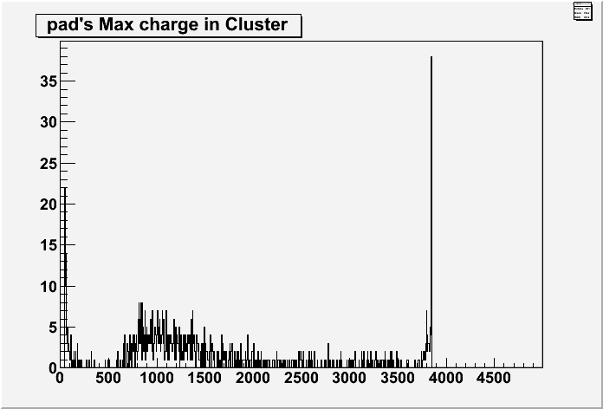
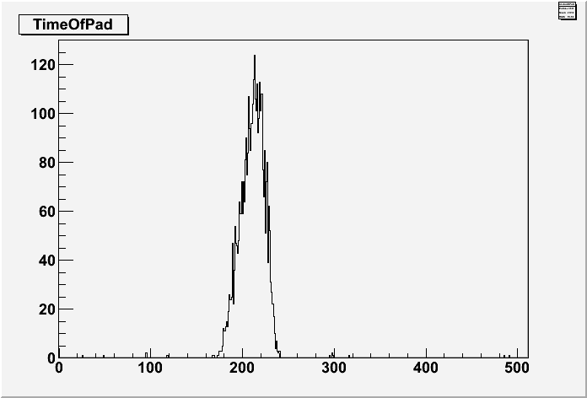
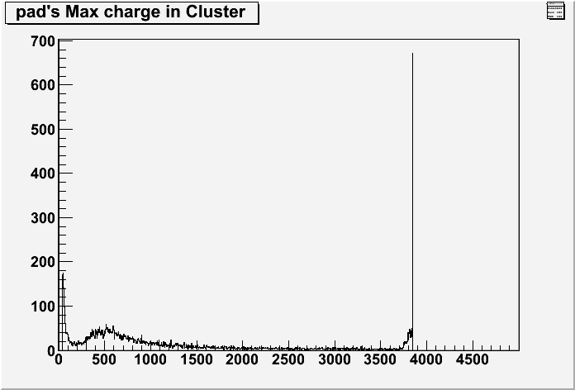
Data analysis and results
Electronic Gain = 120 fc
Vmesh = 300V
Operating gas gain < 1500 and electronics full-scale gain set ≥ 360 fC in order to cut the gamma-rays and cosmics events
Electronic Gain = 120 fc
Vmesh = 350V
Electronic Gain = 360 fc
Vmesh = 300V
Electronic Gain = 360 fc
Vmesh = 300V
Electronic Gain = 600 fc
Vmesh = 320V

Slide 4
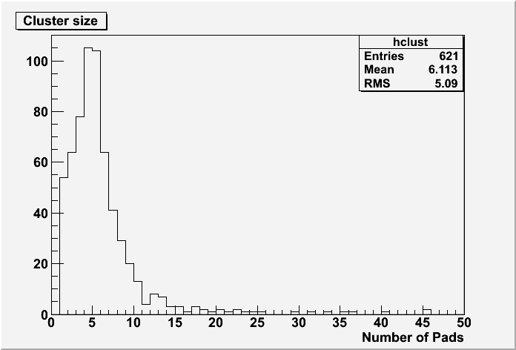
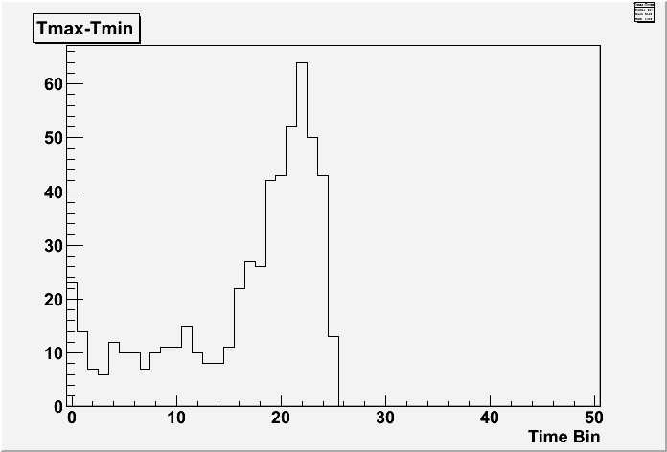
Data analysis and results
64mm plastic(polyethylene) in front of the detector
Vmesh = 300V Electronic Gain = 360
Cluster size is maximum at ~5
Uniform time spectrum

