Slide 1
First Experience of MICROMEGAS data analysis with MarlinTPC
D. Attié, P. Colas, W. Wang
Saclay
G. De Lentdecker
Université Libre de Bruxelles
M. Dixit, N. Shiell, P. Hayman
Carleton
S. Bhattacharya, N. Majumdar, S. Mukhopadhyay
Saha Institute of Nuclear Physics, Kolkata
With the kind help of K. Fujii
KEK

Slide 2
MarlinTPC installation
MarlinTPC installation:
  Use version v01-13-01 of ILCSOFT
  + HEAD version of MarlinTPC
  + HEAD version of CEDViewer
  Installation succeeded on different machines (Saclay, Carleton, CERN) and different OS (SL5, Ubuntu 11.10, Fedora 16)
Installation succeeded BUT:
  There is not much documentation
  Difficulties for those who work on some central machines where they are not admin (and not at CERN nor DESY)
  Not straightforward to install all the required packages needed when running on his own laptop
    some of the development libraries had to be installed
  We will come with a more detailed list later ;-)

Slide 3
KalTest and KalDet
Installation of KalTest and KalDet:
  The code needed to use the Kalman Filter (written by K. Fuji)
  Now it is installed with MarlinTPC
  Straightforward to use it with MICROMEGAS data ;-)

Slide 4
Status
Current status
  Run on 2010 data
  Able to reconstruct Pulses, Hits (without PRF)
  Able to reconstruct tracks with the KalmanFilter:
  See tracks with CEDViewer:

Slide 5
Typical Processor sequence
<execute>
<processor name="MyAIDAProcessor"/>
<processor name="MyConditionsProcessor"/>
<processor name="MyAFTERRawDataConverterProcessor"/>
<processor name="MyPedestalSubtractorProcessor"/>
<processor name="MyPulseFinderProcessor"/>
<processor name="MyChannelMapperProcessor"/>
<processor name="MyHitTrackFinderTopoProcessor"/>
<!--processor name="MyRowBasedHitFinderProcessor"/-->
<processor name="MyTrackSeederProcessor"/>
<processor name="MyTrackMakingKalmanFilterProcessor"/>
<!--processor name="MyTrackerRawViewer"/-->
<processor name="MyRootFileProcessor"/>
<processor name="MyLCIOOutputProcessor"/>
// using the parabolic fit
Currently trying both
// no PRF computation

Slide 6
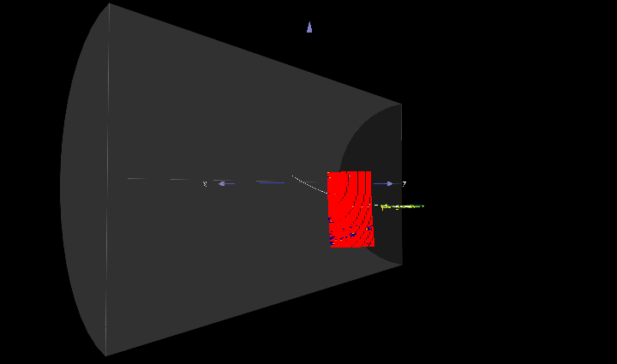
CEDViewer
Detector not at the right place, due to wrong
numbering scheme in our GEAR file: fixed
Track Reconstruction with
Kalman Fiter works !

Slide 7
Ongoing developments:
We have to go through all the processors of the sequence to understand what they do exactly and to optimize the various parameters for MICROMEGAS data
  Validate hits (e.g charge and time) with respect to our usual reconstruction code
Add “PRF Processor” in MarlinTPC to reconstruct correctly hit position
And repeat the analysis performed in the past with FTPC with MarlinTPC to get spatial resolution, etc.
Produce correct channel mapping in LCIO format for 2011 and future data

