Slide 1
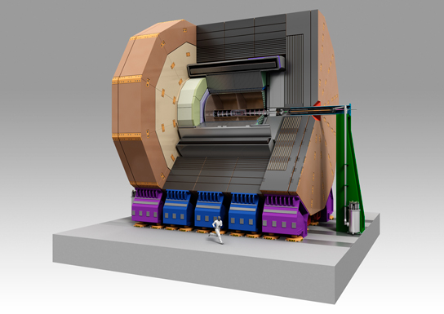

Simulation of the Hybrid ECAL
ILD Workshop @ Kyushu University
May 23rd-25th, 2012
Tamaki Yoshioka and Hiraku Ueno
Kyushu University

Slide 2
Motivation for the Hybrid ECAL
A solution to make the ECAL with a reasonable cost while keeping the performance as much as possible would be mixture of the Silicon layers and Scintillator-strip layers.
→Hybrid ECAL
We have started the simulation study in order to evaluate the Hybrid ECAL performance.

Slide 3
Hybrid ECAL Configuration

Slide 4
ECAL Parameters
We have studied the Hybrid ECAL with the following parameters. We have also studied the ScECAL and SiECAL for comparison.
Notice that the absorber thickness and number of layers are same for all ECAL and different from those of default values.
 | Active Layer Thickness | Absorber Thickness | Number of Layers
Hybrid ECAL | Scintillator : 2.0mm Silicon : 0.5mm | 2.1mm for inner 20 layers 3.5mm for outer 7 layers | 27
ScECAL | Scintillator : 2.0mm
SiECAL | Silicon : 0.5mm

Slide 5
Calibration
Calibration constants should be determined in order to convert the energy deposit in the active layers to the actual energy. We have employed the standard calibration method in Marlin.
  10 GeV photon for ECAL
  10 GeV KL for HCAL
  10 GeV Muon for MIP calibration
Calibration method for the Hybrid ECAL is not trivial; Calibration constants for Silicon layers and Scintillator layers should be determined separately.

Slide 6
Calibration Method for Hybrid ECAL
There are four calibration constants for the Hybrid ECAL. We assumed the relation between the calibration constants by taking into account their radiation length.
→Then these constants can be represented by a single parameter.

Slide 7
ECAL Performances
In order to check the calibration method, we have evaluated the energy resolution and linearity of the ECALs by using 1~50GeV photons.
The performances of all ECALs are almost same.
  →The calibration method works well.

Slide 8
Other Calibrations
HCAL calibration and MIP calibration are performed by following the standard calibration method in Marlin.

Slide 9
Jet Energy Resolutions
 | RMS90(cosθ<0.7)
SiECAL | 27.20±0.26%
Hybrid ECAL | 27.41±0.26%
ScECAL | 27.64±0.26%
Notice that the performances of SiECAL and ScECALwith current configuration are almost same for Z-pole events.

Slide 10
Summary and Future Plans
We have established a calibration method for the Hybrid ECAL.
→ Will look for another better method.
We have evaluated the jet energy resolution for Z-pole events.
  →Hybrid ECAL works well.
Performance of ScECAL would be degraded by “ghost” hits due to the strip structure as jet energy increases.
  →Will study higher jet energies. We expect the “ghost” hits can be removed with the support of the silicon layers in the case of the alternate structure.
We will repeat same procedure with various Hybrid ECAL configurations.

