Slide 1
ILD Vertex Detector
Y. Sugimoto
2012/5/24
ILD Workshop @Fukuoka

Slide 2
Outline
Performance goal
Baseline design
  Design parameters
  Pixel technology options
  Ladders
  Support structure
  Cooling system
  Installation and alignment
Future prospects
  Detector upgrade with beam energy
  R&D needed

Slide 3
Performance goal
Excellent impact parameter resolution
σ_{IP} < 5 ⊕ 10/psin^{3/2}θ [μm]
Large acceptance
max |cosθ| ≅ 0.96 (L1–L3)
≅ 0.9 (outermost layer)
Low pixel occupancy: ≲few%

Slide 4
Design parameters
Overall design
  Each ladder has sensors on both sides ~2 mm apart
  Three layers of the double-sided ladders make the vertex detector
  Rin = 16 mm, Rout = 60 mm
  Material budget ~ 0.3%X₀/ladder = 0.15%X₀/layer
Software baseline parameters
  Conservative parameters which have been demonstrated or seem within our reach will be used
  It should be noted that the MOKKA simulation model is independent of sensor technology option
  Difference in sensor technologies (point resolution, etc.) matters only in digitization and reconstruction phase, or in the background study

Slide 5
Design parameters
 | R (mm) | |Z| (mm) | |cosθ| | σ (μm) | Readout time (μs) (for CMOS)
Layer 1 | 16 | 62.5 | 0.97 | 2.8 | 50
Layer 2 | 18 | 62.5 | 0.96 | 6 | 10
Layer 3 | 37 | 125 | 0.96 | 4 | 100
Layer 4 | 39 | 125 | 0.95 | 4 | 100
Layer 5 | 58 | 125 | 0.91 | 4 | 100
Layer 6 | 60 | 125 | 0.90 | 4 | 100

Slide 6
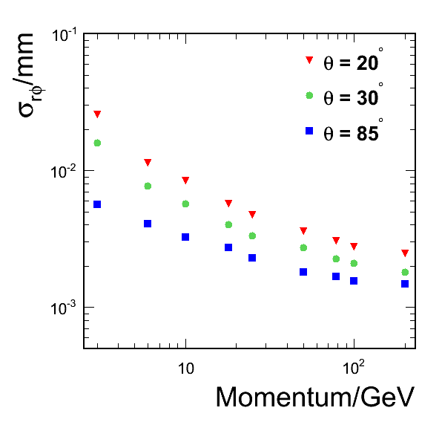
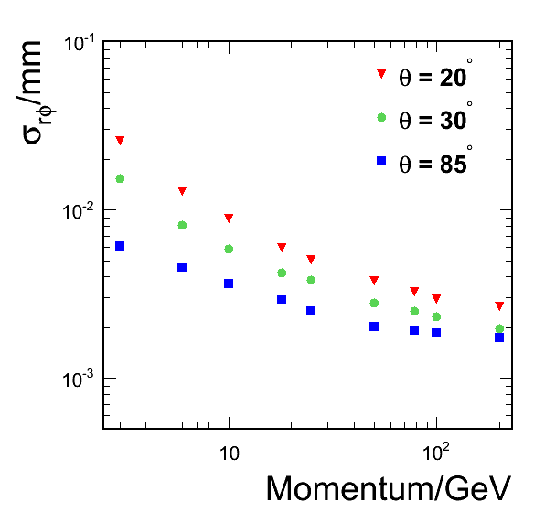
Design parameters
Impact parameter resolution
  Difference is very small
3 μm resolution
New parameter

Slide 7
Pixel technology options
Three sensor technology options seem to satisfy the requirements and are studied actively
  CMOS
  FPCCD
  DEPFET
Details of each sensor technologies will be presented in different talks later
Each technology has pros and cons
  Hybrid design using different sensor options in one vertex detector is not excluded
Alternative technology options for future upgrade
  ISIS
  3D sensors

Slide 8


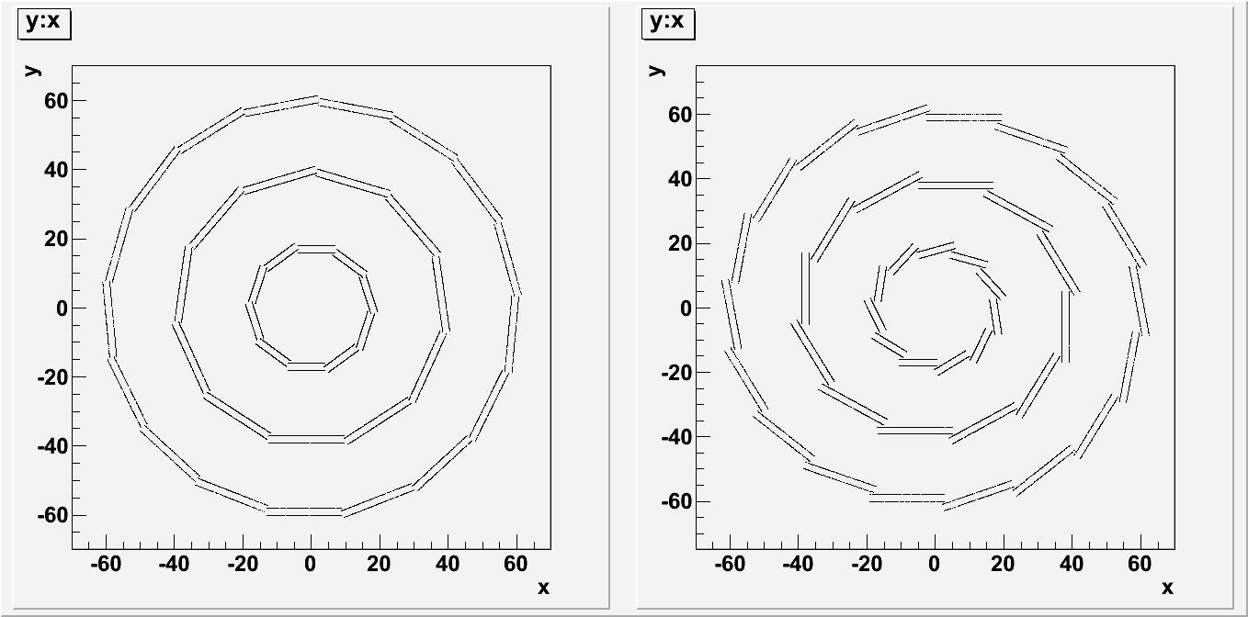
Ladders
Baseline design
  Rigid foam (SiC or C) core sandwiched by thin (50μm) Si sensors
  SiC core option is actively studied by PLUME collaboration
  Carbon core option is proposed by FPCCD group
Alternative design
  Single sided ladders (5 layers) with or without (DEPFET) support
Ladder overlapping in the baseline design
  Two possible ways: layer by layer or ladder by ladder
  Layer by layer overlapping will be used in the simulation
 | Width (mm) | # of ladders
Layer 1,2 | 11 | 10
Layer 3,4 | 22 | 11
Layer 5,6 | 22 | 17

Slide 9
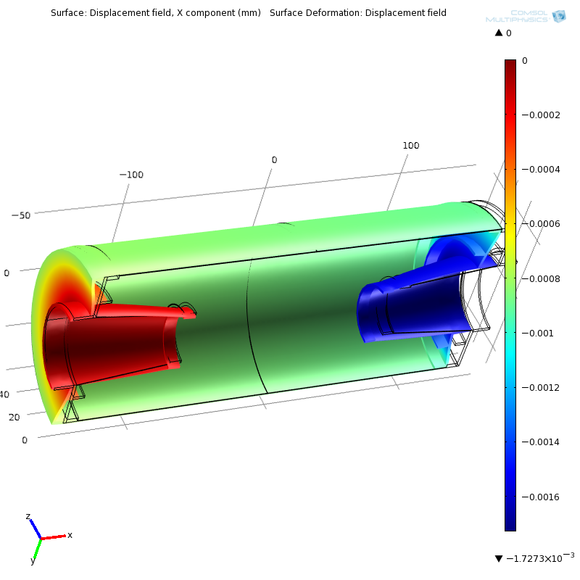
Support structure
Design in ILD simulation model
  Similar to SLD vertex detector
  2 mm thick Be end plate, 0.5 mm thick Be support shell
  Kapton+Cu flexible cables
  Ladders
  1 cm thick foam of the cryostat
Maximum deformation
< 2um with 1kgF

Slide 10
Cooling system
Two-phase CO2 cooling system
  Cooling power of ~300J/g
  Thin (OD~2mm) cooling tube on the end plate
  Studied by FPCCD group (P>50W inside the cryostat): target temperature = −40℃
Gas cooling system
  Applicable for low power consumption sensors

Slide 11
Installation and alignment
Installation
  ILD vertex detector is supported by the beam pipe, and the beam pipe is supported by the inner support tube
  Integrated to ILD detector as a part of the “inner Si trackers” inside the inner support tube
Alignment
  Pre-alignment by optical survey during assembly
  Precise alignment is achieved by beam-base alignment

Slide 12
Detector upgrade with energy
Vertex detector is relatively easy to replace
Detector upgrade with energy upgrade is reasonable
Particularly at 1TeV where beam background is expected to increase by factor 5, new sensor technologies with much shorter readout time could be used ➔ R&D should be continued

Slide 13
R&D needed
R&D towards the baseline design
R&D for better performance
What R&D should be put in the common chapter?
Detail will be discussed in each option talk

