Slide 1
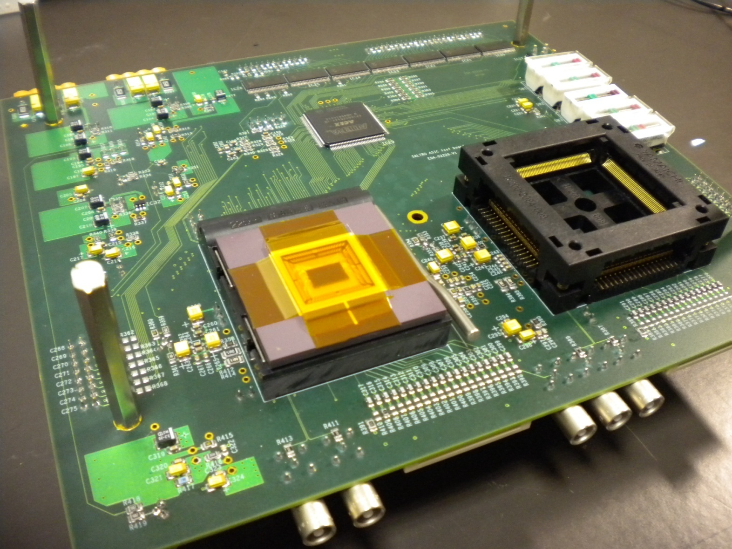

Super-ALTRO Demonstrator Test Results
M. De Gaspari
22nd November 2011
27th March 2012
LC Power Distribution & Pulsing Workshop, May 2011

Slide 2
Introduction
First test results already presented in October 2011, see:
http://ilcagenda.linearcollider.org/materialDisplay.py?contribId=3&materialId=slides&confId=5365
Or see:
http://indico.cern.ch/conferenceDisplay.py?confId=155595
New test conditions:
Sampling clock frequency increased to 40MHz (design target), readout clock 40MHz.
Chip PGA3: the inputs of the PASA are not bonded. This avoids noise injection from the ground plane of the test board.
Chip PGA4: all inputs bonded.
Measurements presented today:
Analog noise
Digital power consumption
Chip power consumption and power pulsing measurements
M. De Gaspari
22nd November 2011
27th March 2012

Slide 3
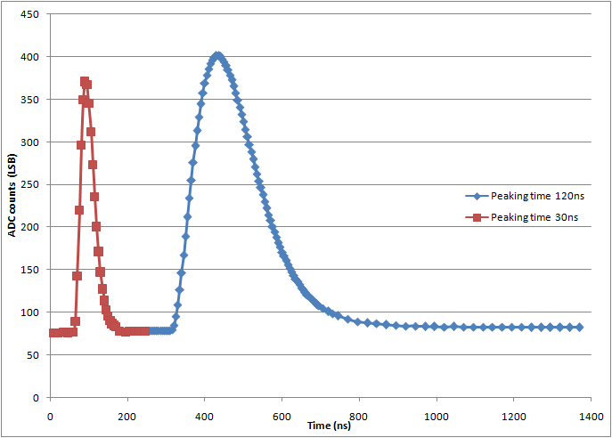
Acquired pulses
Examples of acquisitions at 30ns and 120ns shaping time.
Sampling frequency 40MHz. Signal scan with a granularity of 5ns.
M. De Gaspari
22nd November 2011
27th March 2012

Slide 4
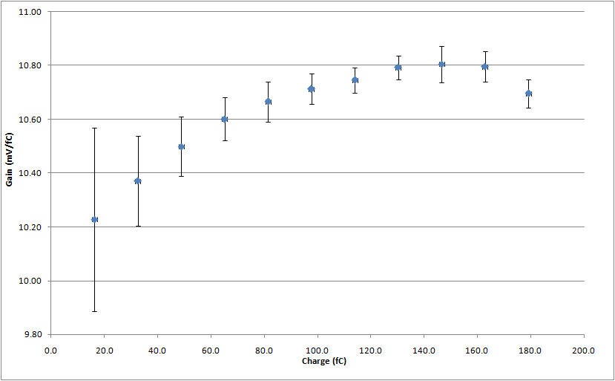
Gain measurement
PASA configuration: 12mV/fC, 120ns, High polarity
Measured gain 10.6mV/fC±1.9%
M. De Gaspari
22nd November 2011
27th March 2012

Slide 5
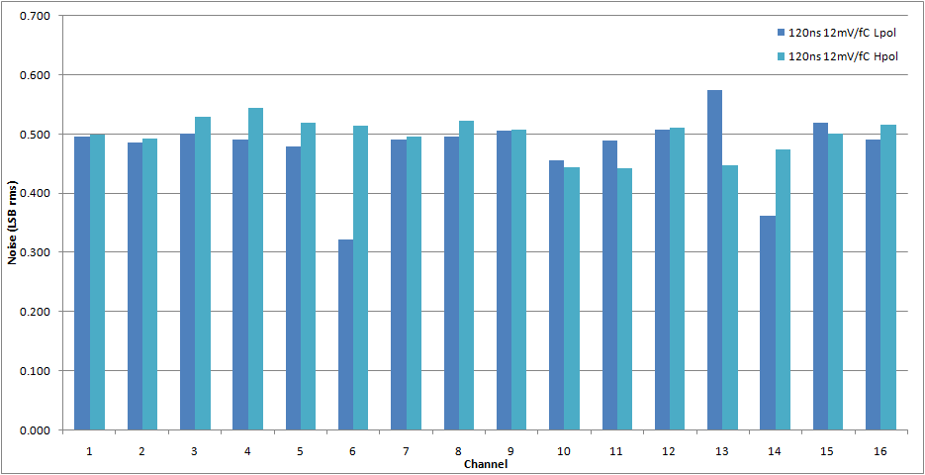
Baseline noise: PGA3
PGA3: inputs not bonded
Noise constant across channels
M. De Gaspari
22nd November 2011
27th March 2012

Slide 6
Noise summary
 | Config | 120ns L 12 | 120ns L 27 | 30ns L 12 | 30ns L 27 | 120ns H 12 | 30ns H 12
PGA3 | Noise LSB | 0.480 | 0.655 | 0.526 | 0.683 | 0.498 | 0.504
 | Noise fC | 0.088 | 0.051 | 0.103 | 0.059 | 0.092 | 0.100
 | Noise e- | 547 | 316 | 641 | 370 | 574 | 625
PGA4 | Noise LSB | 0.709 | 1.346 | 1.475 | 3.263 | 0.668 | 1.279
 | Noise fC | 0.129 | 0.104 | 0.287 | 0.283 | 0.123 | 0.254
 | Noise e- | 809 | 649 | 1796 | 1768 | 770 | 1587
Measured baseline noise averaged over 16 channels. Shaping 30-120ns, Gain 12-27mV/fC, signal polarity H/L.
(H = negative input charge => MPGD, L = positive input charge => wire chamber)
M. De Gaspari
22nd November 2011
27th March 2012

Slide 7
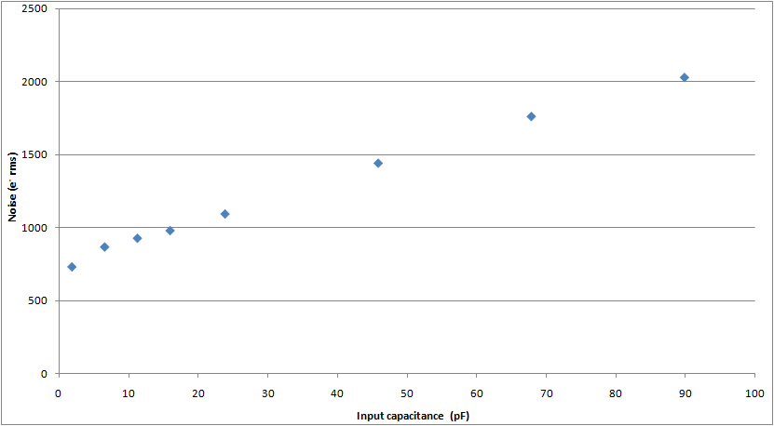
Baseline noise: PGA4
Measured baseline noise for different input capacitances.
PGA4, Channel 0, 120ns, 12mV/fC
M. De Gaspari
22nd November 2011
27th March 2012

Slide 8
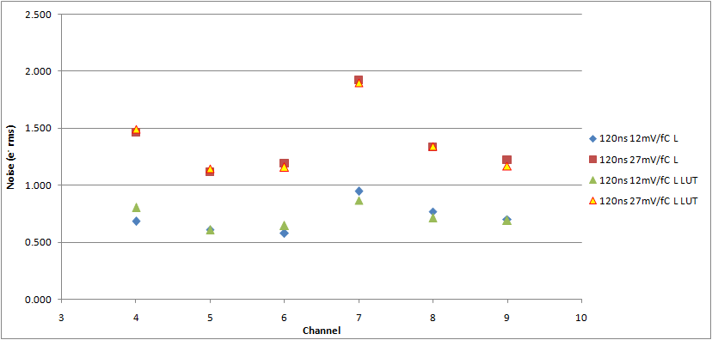
Baseline noise: DSP influence
(PGA4)
Negligible influence of the amount of switching logic on the noise: basic data acquisition and data acquisition with BC1 memory (Look-Up Table) switching.
M. De Gaspari
22nd November 2011
27th March 2012

Slide 9
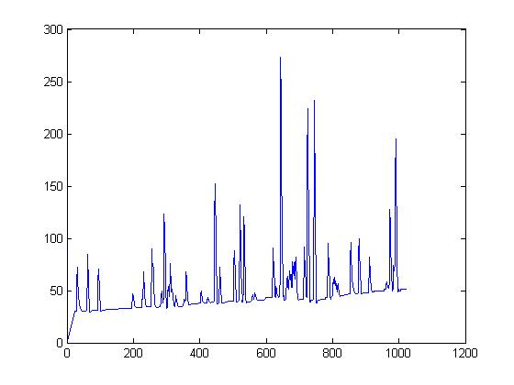
DSP tests 1
Known pattern written in the Pedestal Memory (Baseline Correction 1) and used as test input
Drift of the baseline
Undershoots
Emulates the pattern produced by a real detector
M. De Gaspari
22nd November 2011
27th March 2012

Slide 10
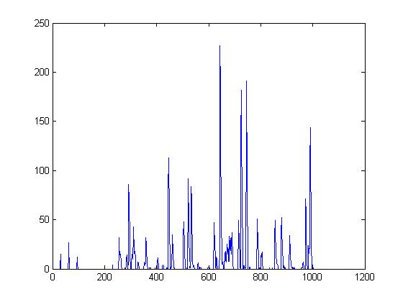
DSP tests 2
The DSP removes offsets, undershoots, baseline drifts
M. De Gaspari
22nd November 2011
27th March 2012

Slide 11
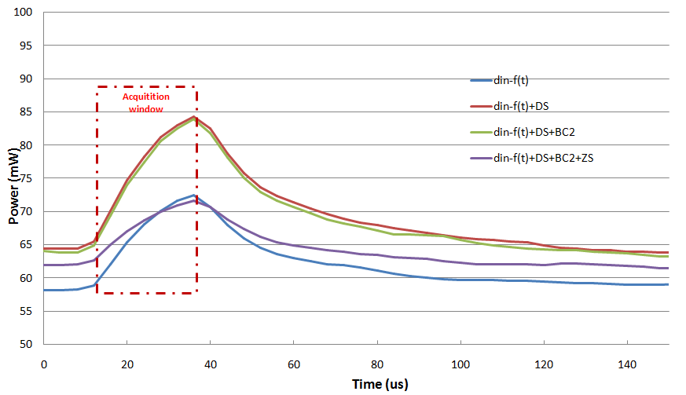
Power consumption: DSP
Power consumption of the DSP when acquiring at 40MHz sampling frequency. Different DSP functionalities included.
M. De Gaspari
22nd November 2011
27th March 2012

Slide 12
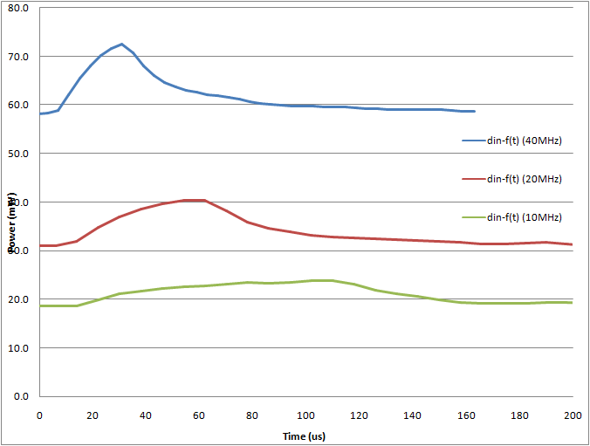
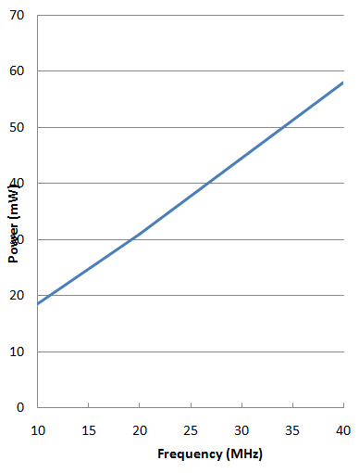
Power consumption: DSP
Power consumption of the DSP for different sampling clock frequencies.
DSP configuration: (Data In) – (Look-Up Table).
M. De Gaspari
22nd November 2011
27th March 2012

Slide 13
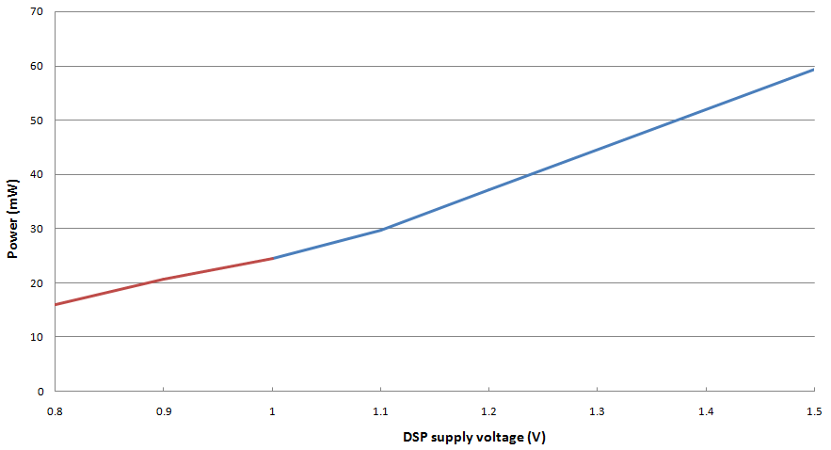
Power consumption: DSP
Power consumption of the DSP at different supply voltages.
Efficient operation down to 1V supply.
M. De Gaspari
22nd November 2011
27th March 2012

Slide 14
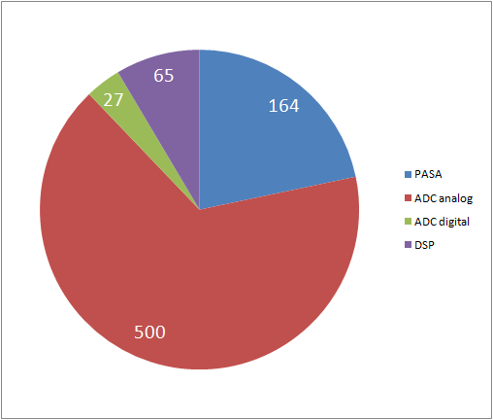
Power consumption
Each block can be switched off independently, and without removing the supply voltage (smart shutdown).
PASA and ADC: remove the bias voltages
DSP: remove the sampling/readout clock
 | 40MHz operation | Smart shutdown
PASA | 10.26mW/ch | 132uW/ch
ADC analog | 31.28mW/ch | 430uW/ch
ADC digital | 1.71mW/ch | ≈0
DSP | 4.04mW/ch | 10uW/ch
Power per block (mW)
Power consumption: 47.3mW/ch, 757mW total @40MHz.
M. De Gaspari
22nd November 2011
27th March 2012

Slide 15
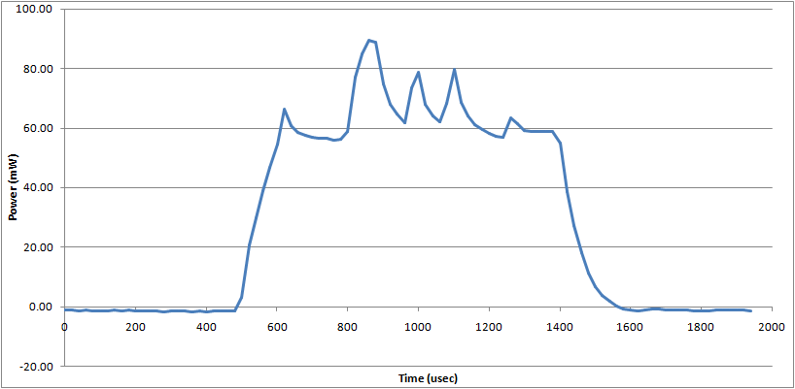
Power pulsing cycle
Acquisition Readout
Power up L1
Trigger
Power consumption of the DSP during a power pulsing cycle.
Minimum delay between power up and L1 trigger has to be measured.
Readout time is determined by the test setup (RCU) ➔ minimum PP cycle ≈1ms.
M. De Gaspari
22nd November 2011
27th March 2012

Slide 16
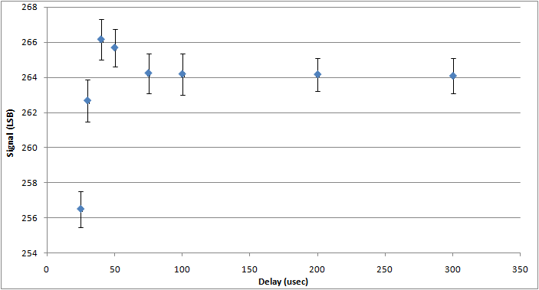
Power pulsing cycle
Good region Continuous mode
A test pulse is injected after power up; the amplitude of the pulse is monitored with different delays between power up and L1.
100usec delay gives good results: difference with continuous mode <1LSB
M. De Gaspari
22nd November 2011
27th March 2012

Slide 17
Power pulsing: results
 | Shutdown (mW) | Power pulsing cycle (uJ)
PASA | 2.12 | 145.2
ADC analog | 6.88 | 421.1
ADC digital | 0.01 | 22.9
DSP | 0.16 | 58.3
Pads | ≈0 | 6.9
Total | 9.2 | 654.3
Power pulsing cycles are repeated at a frequency of 50Hz (Duty≈1/20).
Chip total power=9.2mW+50Hz*654.3uJ=41.9mW
Power reduction by a factor 18.1!
(continuous mode: 757mW)
M. De Gaspari
22nd November 2011
27th March 2012

Slide 18
Conclusions
The 16 channel Super-ALTRO Demonstrator has been designed, prototyped and tested successfully!!
The chip is already usable for the Linear Collider TPC prototype.
The area is 3.07mm²/channel (LCTCP requirement: <4mm²)
Using appropriate design techniques, integration of low-noise analog components and digital functions is possible with little effect on noise performance.
Power pulsing approach has been demonstrated effective in reducing the power consumption, while preserving the performance.
M. De Gaspari
22nd November 2011
27th March 2012

