Slide 1
Micromegas modules
Towards the 7 module test

Slide 2
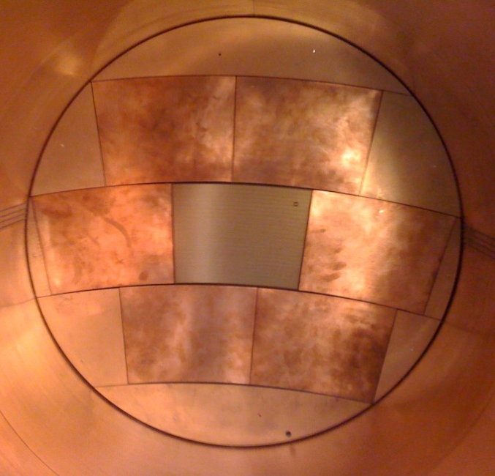
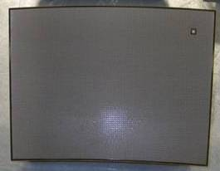
Micromegas panels
Phase I: ‘Large Prototype’ Micromegas modules were built and tested in beam (2008-2011): 7 up to now with various resistive coatings, PCB routings and technology, electronic integration, etc…
Phase II (2011-2012+): build 9 identical modules and address all integration issues, serial production and characterization, multimodule issues (alignment, distortions). Testbench at CERN starting now (⁵⁵Fe source scan) and beam test mid-June at DESY.
Phase III (>2013): build and test one large O(10⁴) channels module possibly with new techniques (Piggyback with resistive ceramics, thin meshes) and smaller O(1 mm) pads for inner wheel.

Slide 3
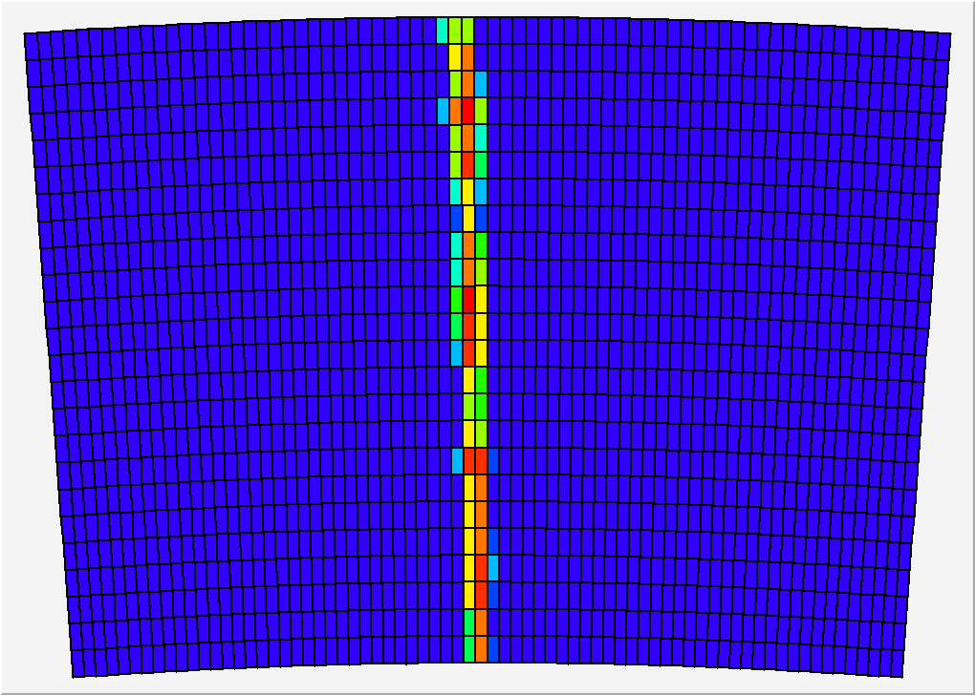
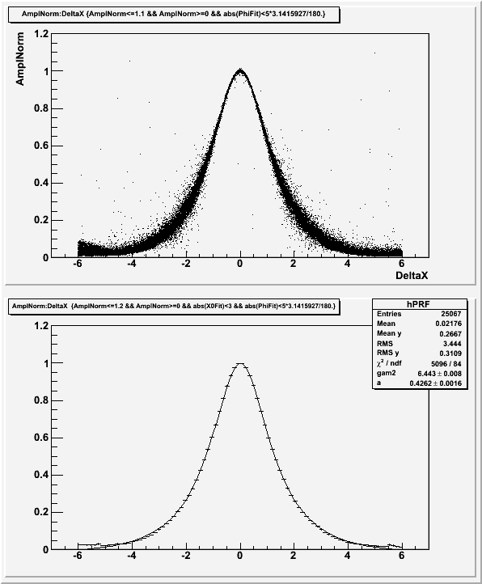
Phase I
Relative fraction of ‘charge’ seen by the pad, vs x(pad)-x(track)
Z=20cm, 200 ns shaping
24 rows x 72 columns of 3 x 6.8 mm² pads
Results: 60 µ resolution at z=0 and homogeneity tested in beam. High-rate operation in a pion beam at CERN.
x(pad) – x(track) (mm)

Slide 4
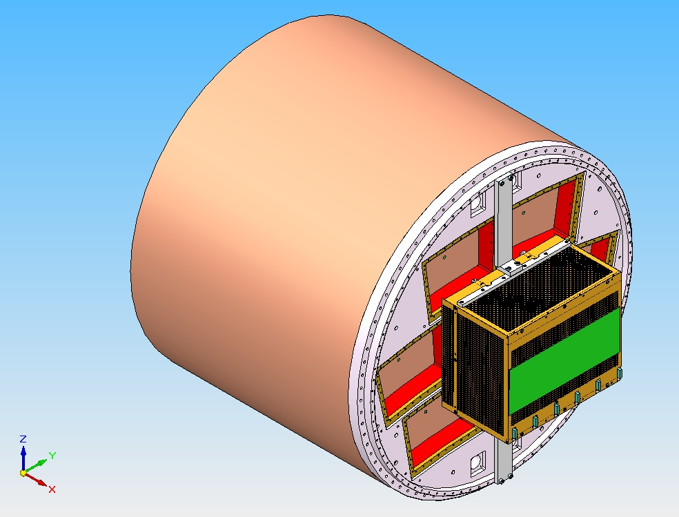
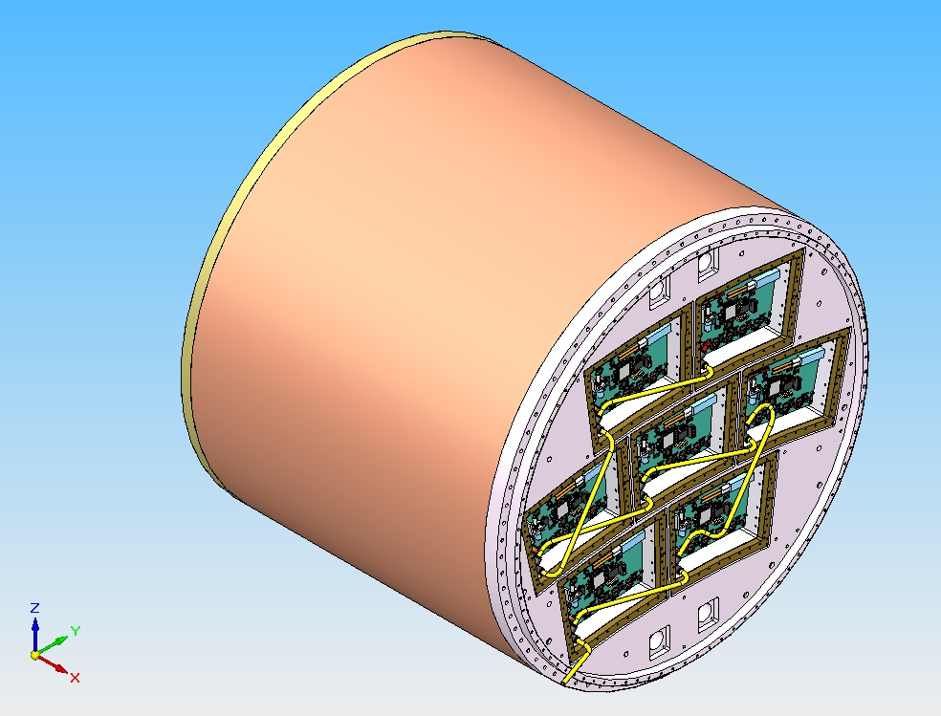
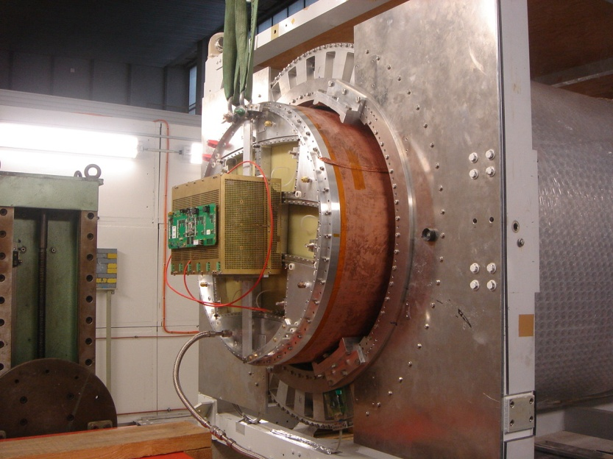
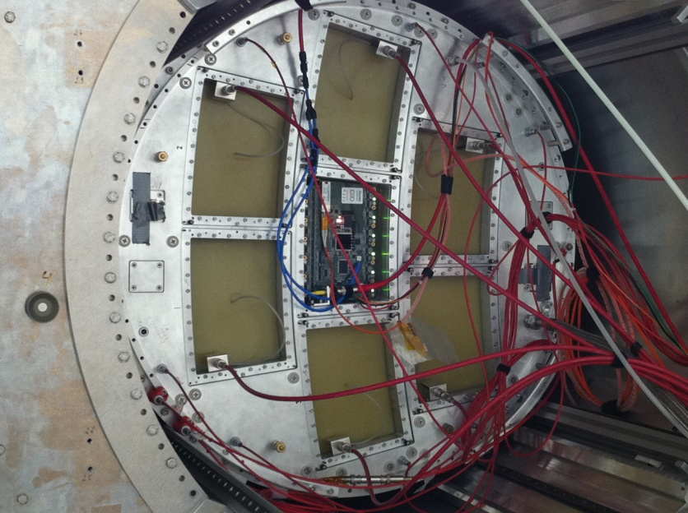
Phase II: 7 module project – electronic integration

Slide 5
May 2011: beam test of a new module with fully integrated electronics
New detector : new routing to adapt to new connectors, lower anode resistivity (3 MΩ/sq), new res. foil grounding on the edge of the PCB.
New 300 points flat connectors
New front end: keep naked AFTER chips and remove double diodes (count on resistive foil to protect against sparks)
New Front End Mezzanine (FEMI)
New backend ready for up to 12 modules
New DAQ, 7-module ready and more compact format
New trigger discriminator and logic (FPGA).

Slide 6
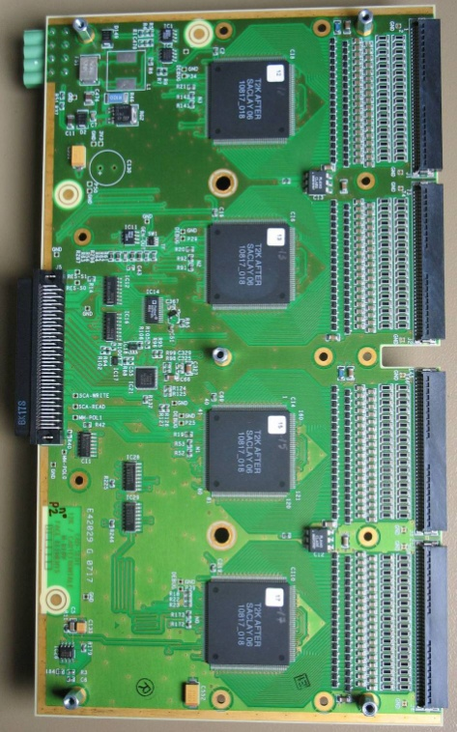
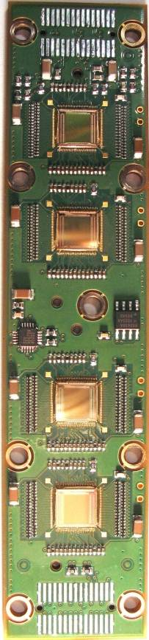
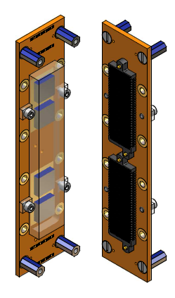
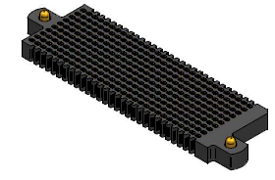
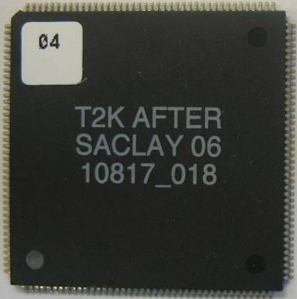
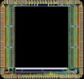
Integrated electronics for 7-module project
Remove packaging and protection diodes
Wire –bond AFTER chips
Use 2 × 300 pins connector
In tests in 2011, it was shown that the resistive foil protects against sparks
FEC
25 cm
4,5 cm
12,5 cm
14 cm
3,5 cm
2,8 cm
3,5 cm
0,78 cm
Chip
0,74 cm
after 2 weeks of operation: no ASIC lost

Slide 7
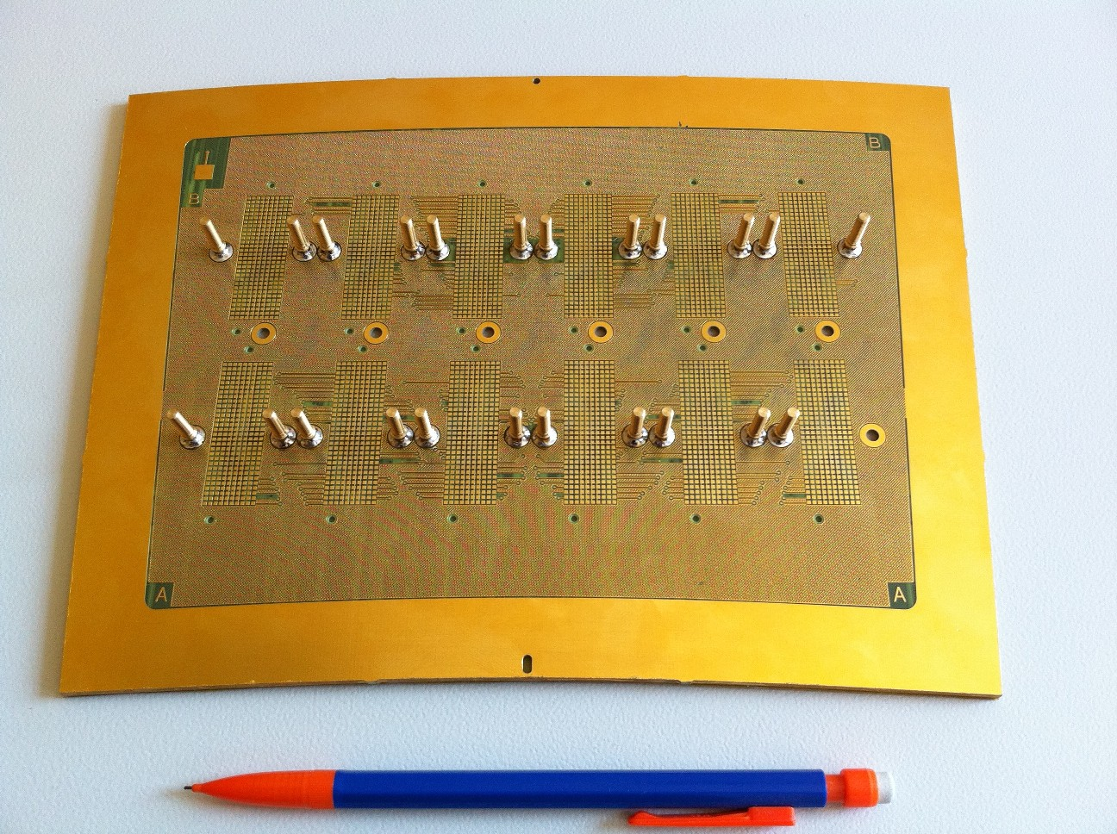
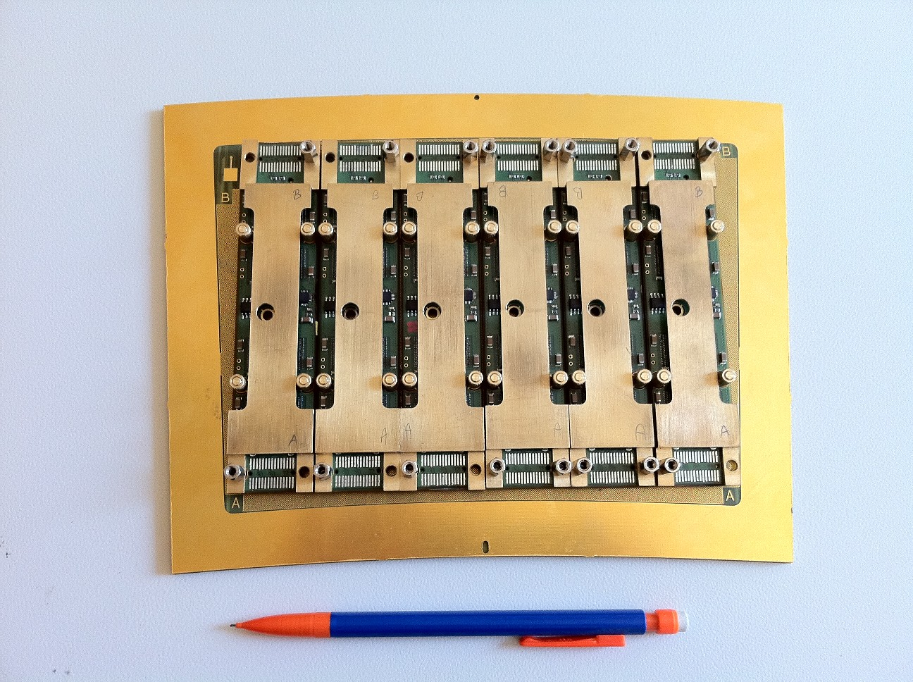
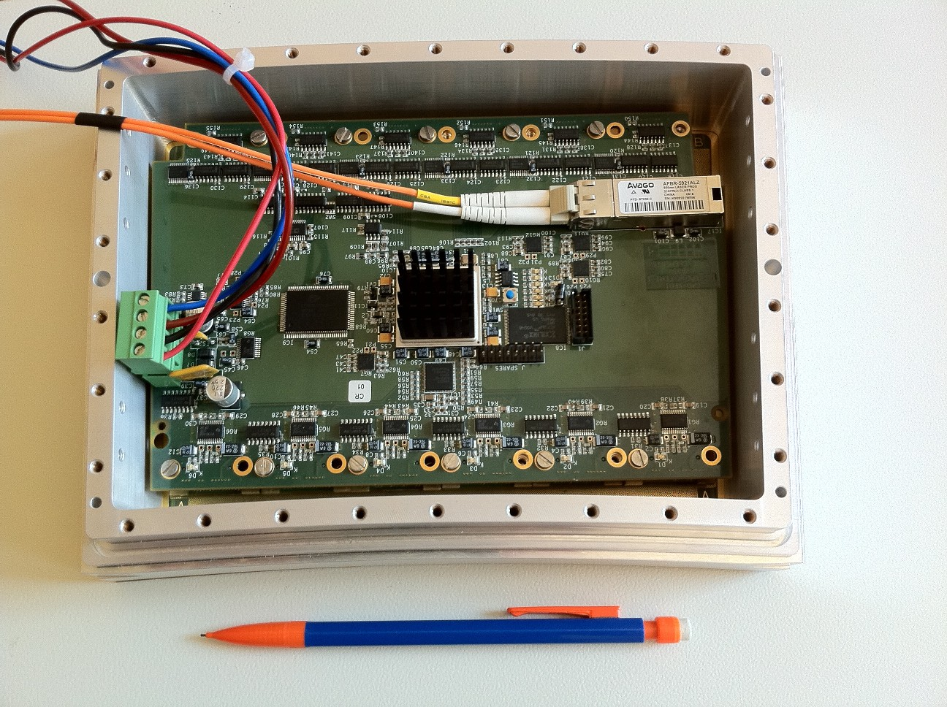
First prototype of the electronics

Slide 8
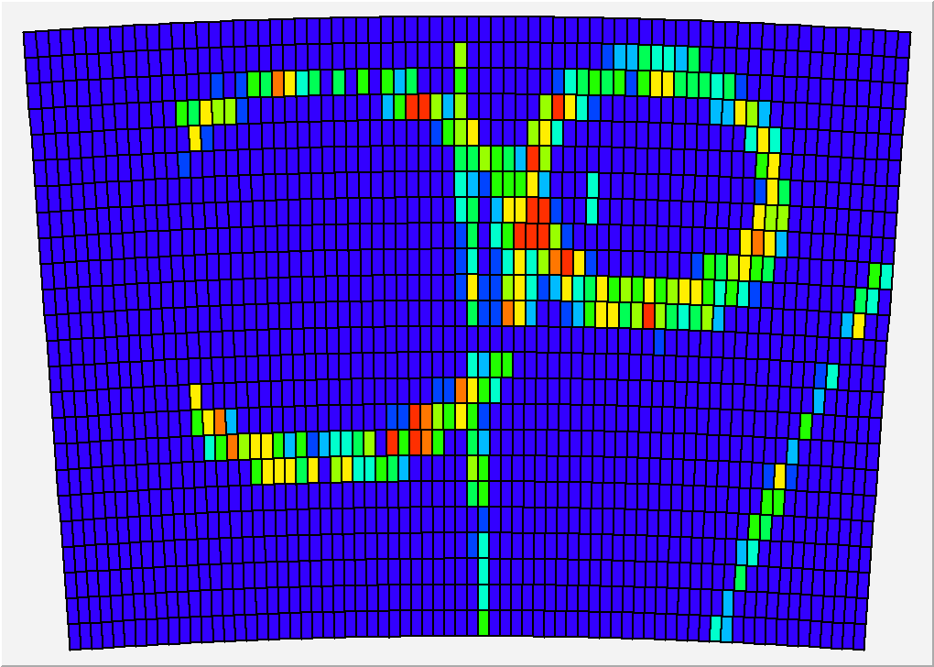

Slide 9
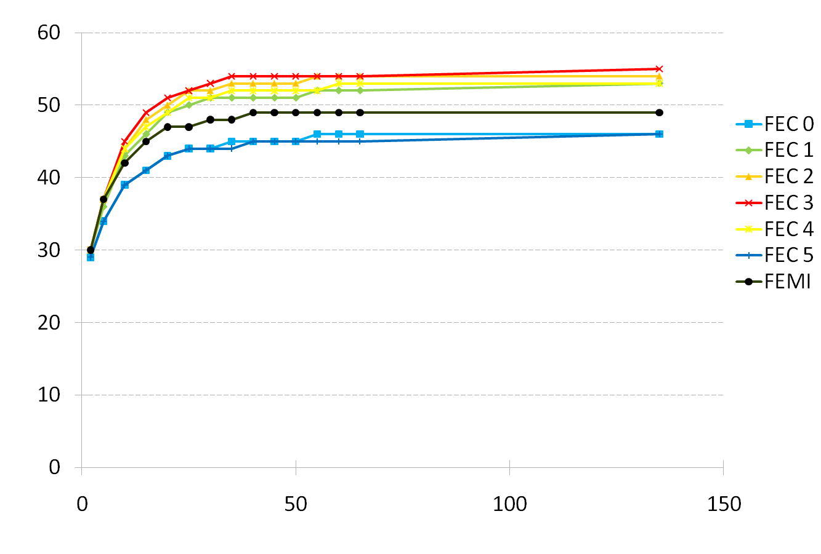
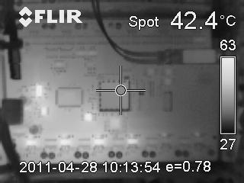
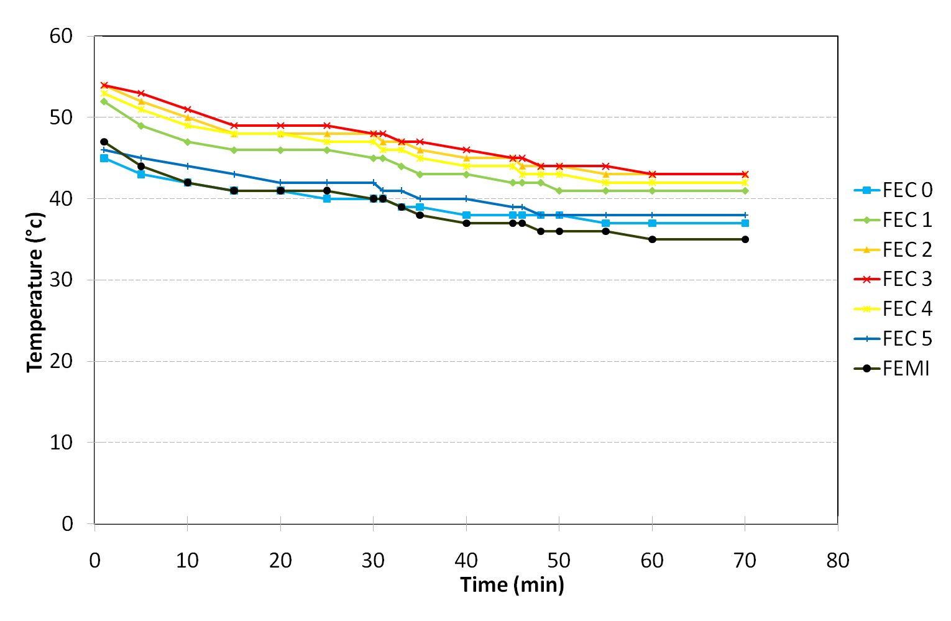
Thermal studies. IR camera shows hot spots (regulators, ADC). T-probes on every component.
2-phase CO2 cooling under study (KEK, Nikhef)
Onset of the electronics
Nitrogen cooling

Slide 10
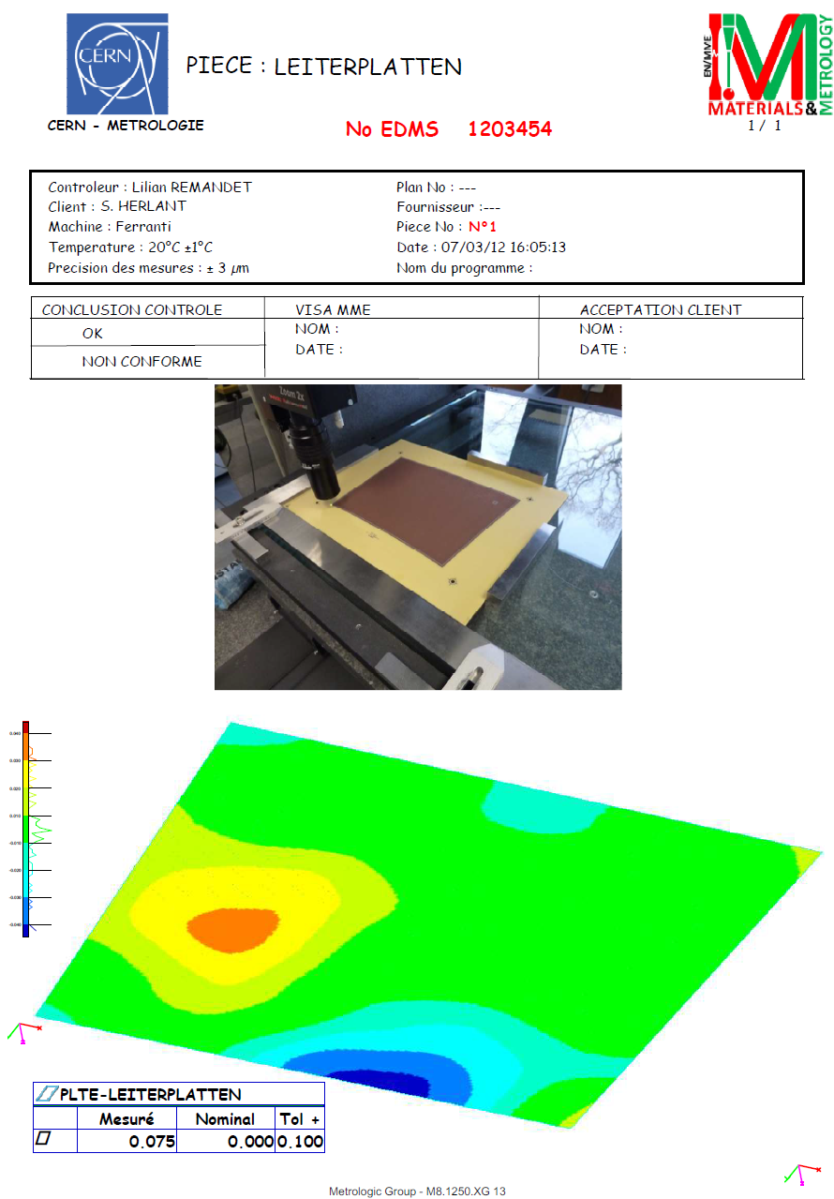
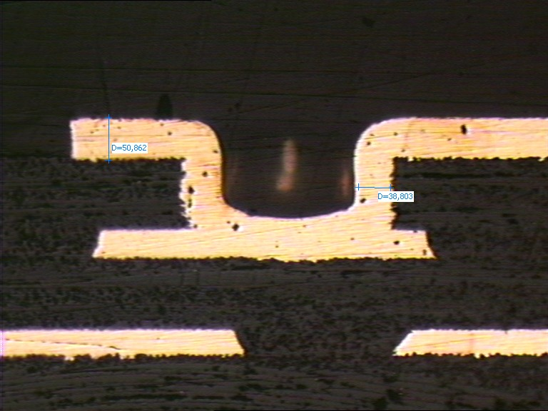
High quality PCB study (by ELTOS with RD51). First 4 new PCBs return from fabrication.
Flatness better than 70 µ !

Slide 11
Present status
Front-End cards : first batch of 12 fully cabled and ready for testing this week.
4 PCB ready and measured. Resistive bulk being applied and gluing on frames this week.
Production of 50 more cards and 5 more modules will start immediately after these tests if everything OK.

Slide 12
Outlook
Building and characterizing detectors with a radioactive source is underway.
Plan to be ready for mounting at DESY in May and start data taking mid-June 2012.

