Slide 1





The PEPPo e⁻ & e⁺ polarization measurements
E. Fanchini
On behalf of the PEPPo collaboration
POSIPOL 2012
Zeuthen 4-6 September

Slide 2

Outline
The PEPPo experiment
Polarization measurements with
electrons and positrons
The Compton transmission polarimeter
PEPPo DAQ & data taking conditions
Electron measurements
Positron measurements
Summary
Creativity103.com

Slide 3
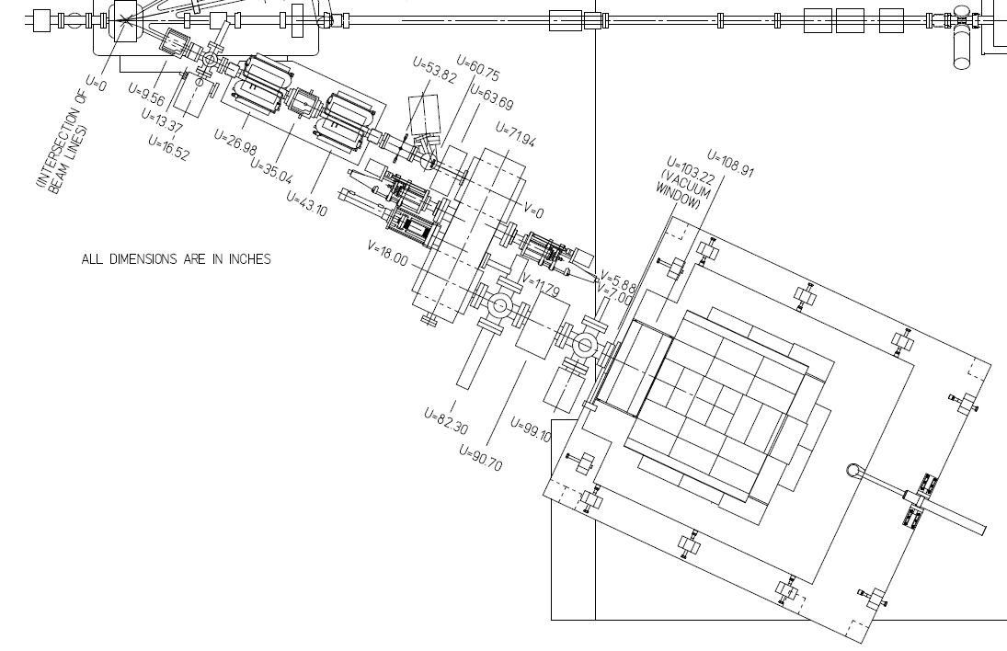
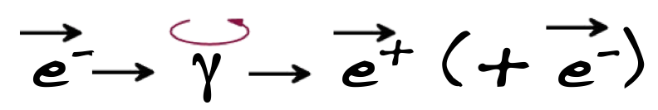
The PEPPo experiment
Polarized Electrons for Polarized Positrons (PEPPo) experiment is placed in the CEBAF injector at the Jefferson Lab. (USA)
Main CEBAF injector beam line
e+ PRODUCTION TARGET
PEPPo Beamline
The aim:
Produce pol. e⁺ from highly polarized e⁻: 85%
e⁻ beam momentum: ~8MeV/c
3-7 MeV/c e⁺ momentum range
Spectrometer for
MOMENTUM SELECTION
Talk: J.Grames - PEPPo Status, preliminary measurements – Tuesday (04/Sept)
Compton transmission POLARIMETER

Slide 4
Compton polarization
Positron polarization is obtained with a 2-step analysis obtained with independent measurements:
Electron and Positron measurements
Physics processes:
Bremsstrahlung: conversion of longitudinally polarized e^{-/+} into polarized photons in the reconversion target
Compton: transmission of polarized photons through a magnetized iron core
Detection: Compton calorimeter
The Compton absorption cross section:
Unpolarized Compton cross section
P_{t} Target polarization
P₃ longitudinally polarization contrib.
A₃ Analyzing power of the Compton scattering

Slide 5
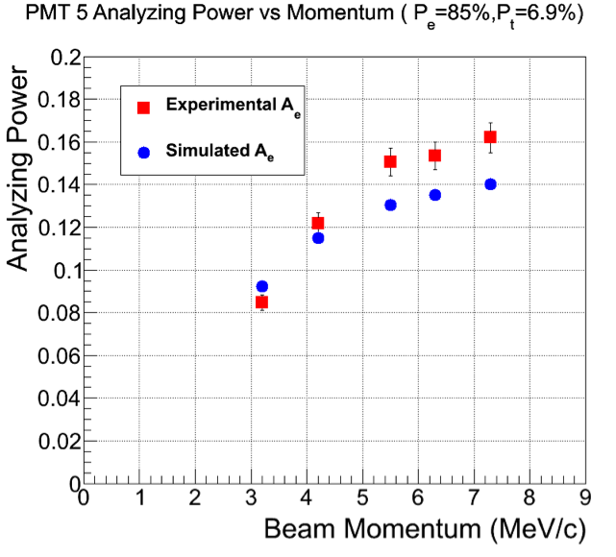
Asymmetry
The Compton absorption is obtained counting the number of transmitted photons for opposite beam helicities (N^{+/-}) or polarized target orientations:
μ1 Compton absorption coefficient
L target length
Experimentally:
P_{e}: polarization of the electron
P_{t}: polarization of the target
A_{e}: analyzing power of the polarimeter
Measurement with an e⁻ beam
P_{e} beam pol. well known
P_{t} of the target known
Validation of the simulation
Extraction of the A_{e} (e⁻ mode)
PEPPo Preliminary
Statistic errors
A.P. used for positron measurements

Slide 6
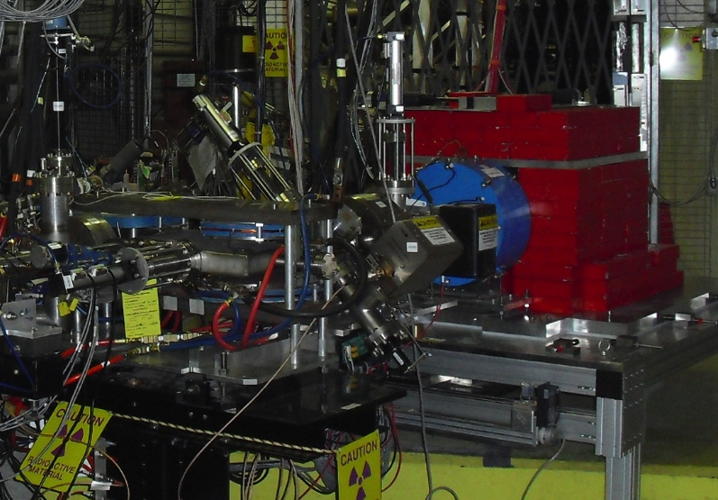
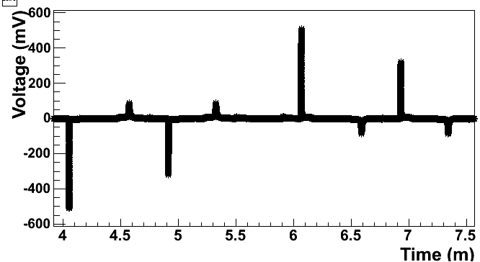
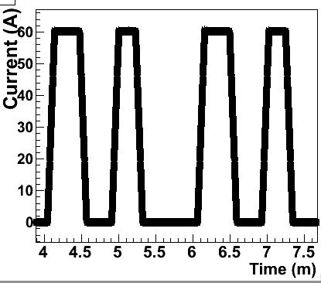
Compton transmission polarimeter
It determines the polarization of the e^{+/-} beam by measuring the asymmetry of polarized photon absorption in a longitudinally polarized target
Polarization measurements obtained by reversing:
Analyzing magnet polarization
Beam polarization
Thanks to E166 collaboration for loaning part of the equipment!
Reconversion target: 2mm tungsten
Analyzing magnet: 7.5cm iron with 7%
polarization, working @+60A (saturation)
Photon detection: 9 CsI crystals (28 cm long and 6 cm square sides) with optimized PMT readout chain
Charge particles selection (TS1): 1 scintillator for e+ measurements
Cycling procedure for systematic study of the magnetization
1
2
3
4
5
6
7
8
9
Beam
direction

Slide 7
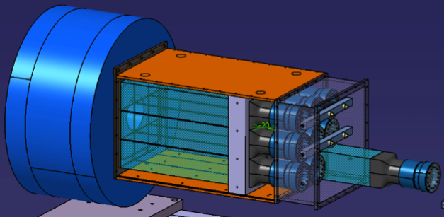
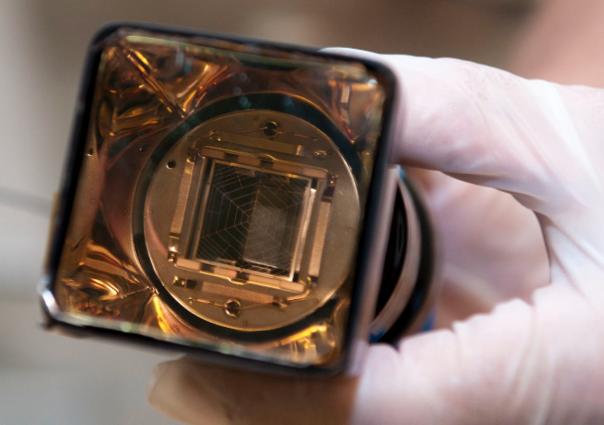
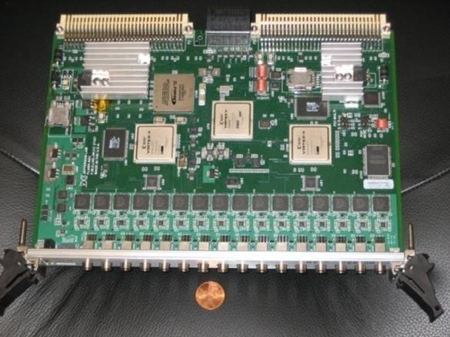
PEPPo DAQ
The signal from the crystal is a long (slightly larger that 2μs) and
optimized pulse to have a maximum amplitude smaller than 2V.
The signal detection was done with a FlashADC board chosen to be compatible with the PMT signals and developed by the JLab electronic group
250 MHz sampling frequency of the detector ADC signals
2μs maximum read-out length
0->-2V maximum signal range
The advantage was the FADC versatility that
allowed the 3 PEPPo data taking configurations :
Sample mode: shape signal reconstruction with
up to 500 samples per event (4ns resolution).
Used for calibration measurements
Semi-Integrated mode (e⁺): 1 integral signal
value per detector triggered event
Integrated mode (e⁻): 1 integral value
per helicity gate

Slide 8
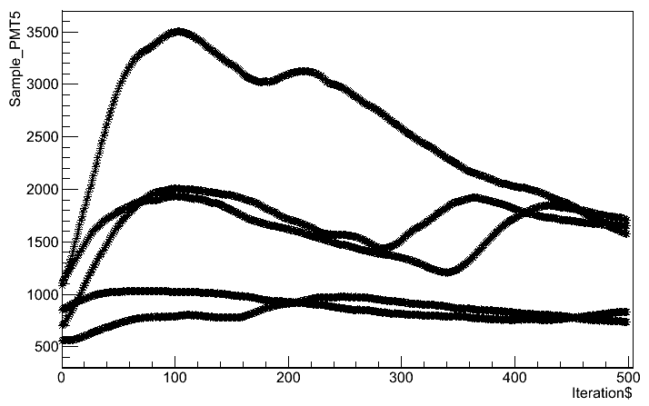
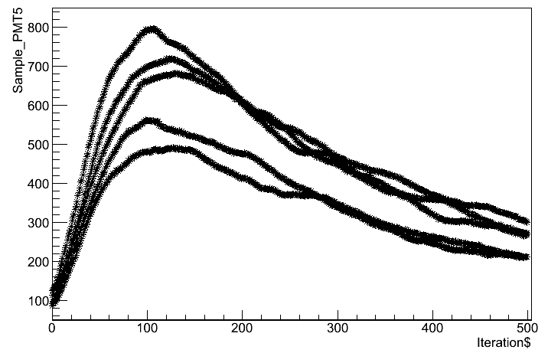
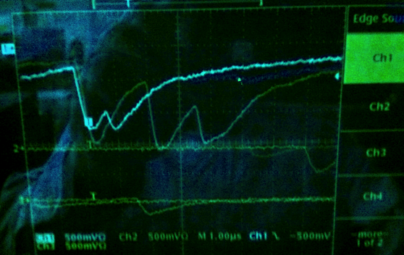
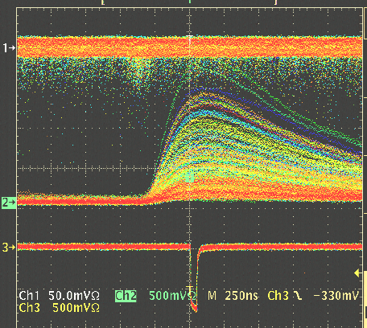
Data taking conditions
Electron measurement
Positron measurement
Mom (MeV/c) | Mode | Set | e⁻ beam current @T1 | Det.Rate(kHz) | Target (mm)
3.2 | e- | 1 | 60pA | 112
4.2 | e- | 1 | 23pA | 184
5.5 | e- | 1 | 25pA | 202
6.3 | e- | 1 | 10pA | 471
7.3 | e- | 1 | 10pA | 164
Mom (MeV/c) | Mode | Set | Ie⁻ beam @T1 | Det.Rate(kHz) | Target (mm)
3.2 | e+ | 1 | 380nA | 9 | 1
4.2 | e+ | 1 | 25nA | 7 | 1
5.5 | e+ | 1 | 95nA | 2 | 1
6.3 | e+ | 1 | 380nA | 8 | 1
3.2 | e+ | 2 | 120nA | 2 | 1
3.2 | e+ | 2 | 380nA | 3 | 0.1
4.2 | e+ | 2 | 130nA | 2 | 1
5.5 | e+ | 2 | 200nA | 3 | 1
6.3 | e+ | 2 | 620nA | 6 | 1
Same conditions
IHWP: IN
AM: -60A
FADC
Sum of few signals
TS1
Oscilloscope
Coincidence trigger
Pile up

Slide 9
e- measurements
High rate measurements (@6.3MeV/c => ~500kHz rate).
Sample and Semi-Integrated mode neglected due to high dead time
Important aspect to consider: asymmetry measurement obtained by counting the number of transmitted photons
E^{+/-} : energy deposited per helicity state
N_{e}^{i}: N. of particles in a given time range
ε_{j}: Probability to produce and detect a photon of energy e_{j}
Integrated method
Detector signal integration during each helicity gate

Slide 10
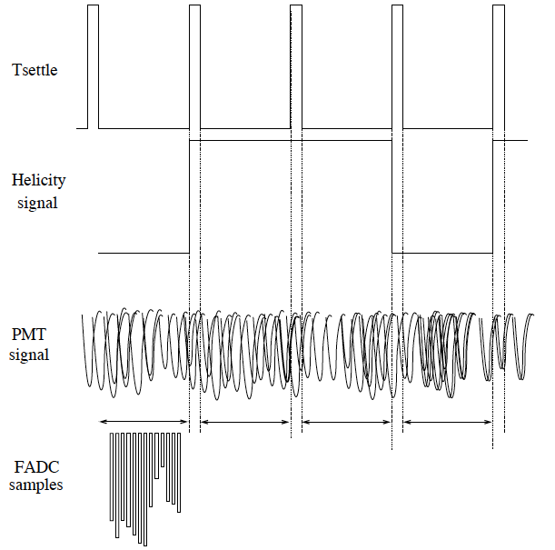
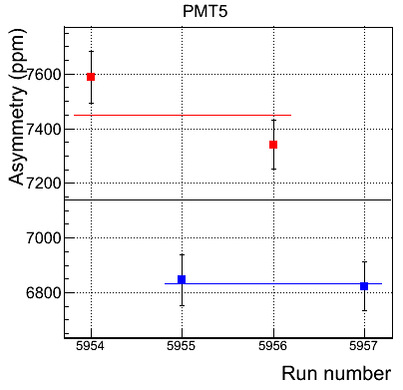
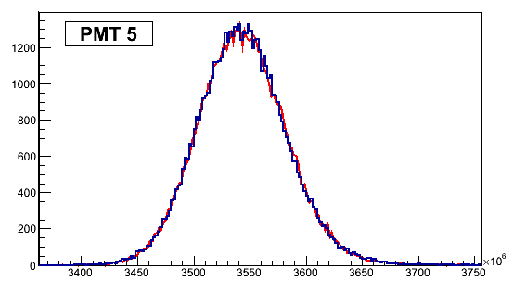
Integrated mode
New FADC firmware developed by JLab for PEPPo
Setting used:
Helicity frequency: 30Hz
Helicity signal delay: 8windows
Helicity pattern: quartet (+--+ or -++-)
h⁻ h⁺ h⁺ h⁻
e⁻ run @4.2MeV/c
E⁻ E⁺ E⁺ E⁻
Abs(A_{T})
A_{T}
Sum over all the samples for ONE helicity gate
RUN | IHWP | AM(A)
5954 | In | +60
5955 | Out | +60
5956 | Out | -60
5957 | In | -60
PEPPo Preliminary
Typical histogram of all E⁺ and E⁻ values along one e⁻ run for the central PMT

Slide 11
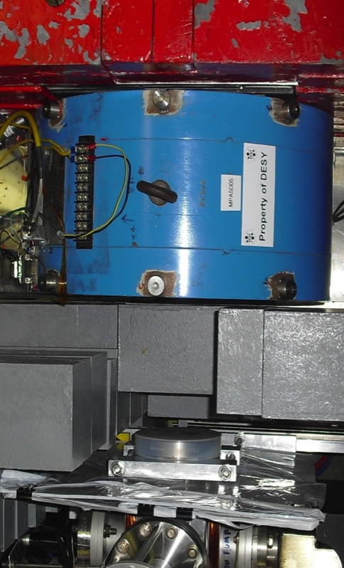
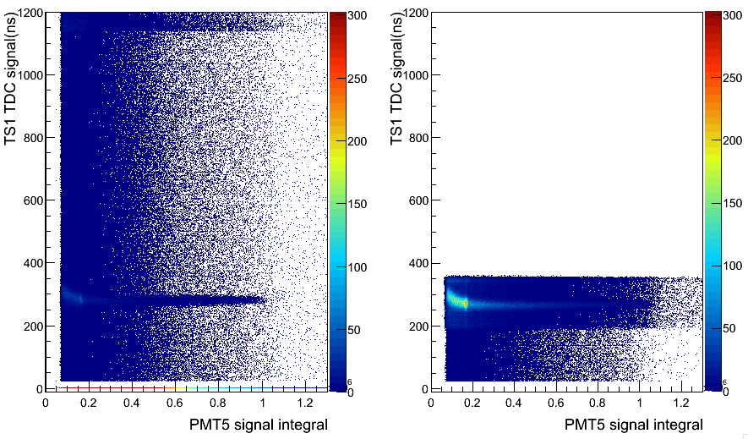

e+ measurements
During the commissioning phase and the first week of data taking
we learned how a better background reduction was important
Data taking configuration obtained with the signal coincidence between a scintillator (TS1) and the signal of the central crystal (PMT5) of the calorimeter
e+ run with NO coincidence trigger
e+ run with TS1/PMT5 coincidence trigger
Beam line Exit window
TS1
Reconversion target + Analyzing magnet
Calorimeter
e+
photon

Slide 12
Semi-Integrated mode
Positrons are secondary particles generated by the main e⁻ beam hitting a tungsten target => Detection Rate drop (e+ rate of the central crystal ~6kHz of
6.3MeV/c)
Semi-Integrated method: integral value of each triggered detector
signal and asymmetry calculation as a function of energy
n⁺_{j} and n⁻_{j}: number of events for the energy bin j for different helicity status (+/-)
Energy distribution deposited for each helicity state and experimental asymmetry is built for each energy bin (A^{j}_{T})
Simulated Energy spectra of a positron beam of 5MeV at the reconversion target, with opposite helicities
(considering P_{T} = P_{e+} =100%)

Slide 13
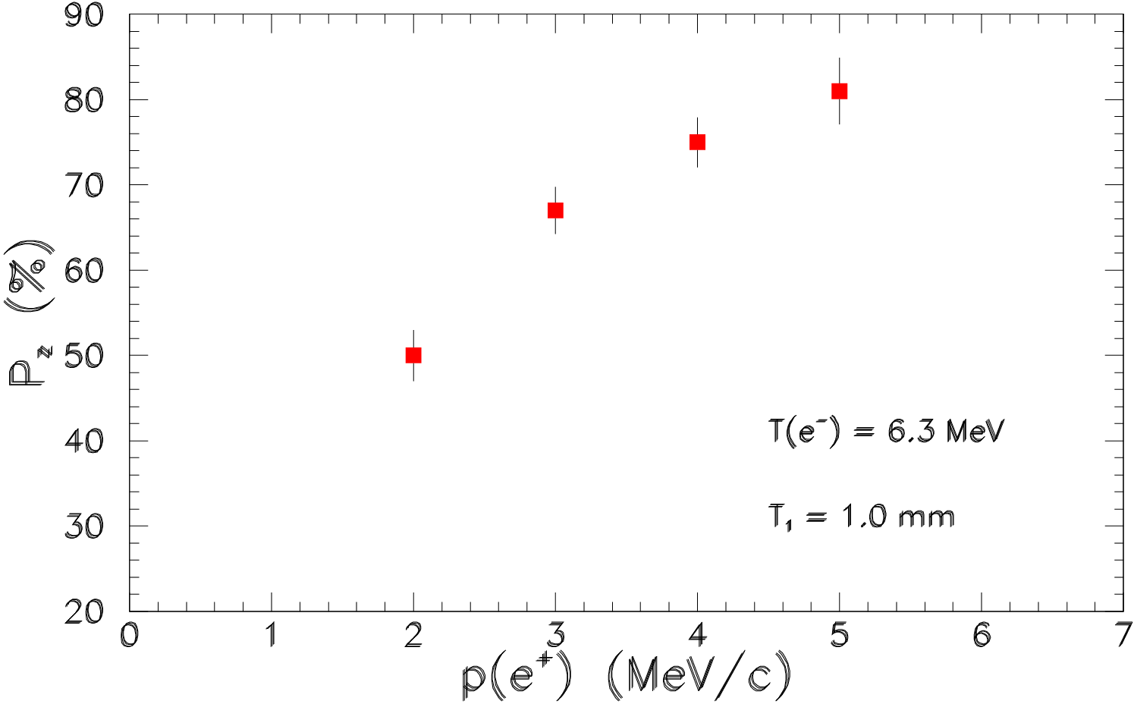
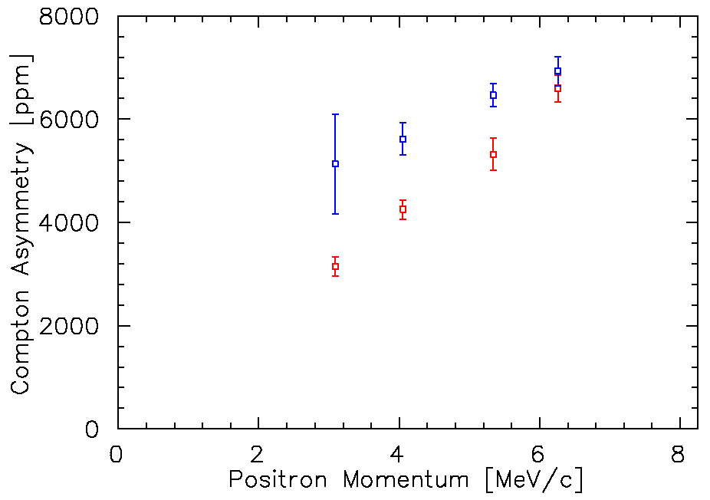
e+ asymmetries
Simulation
From the PEPPo proposal:
4 momenta points for e-
4 momenta points for e+ with 2 target production thickness (1.0 mm & 0.1mm)
e- beam energy = 6.3 MeV/c
e- beam polarization = 85%
Conversion Target = 1 mm W
After 5 weeks of data taking:
5 momenta points for e-
2 set at 4 momenta for e+ with 1.0mm target
1 momentum point for e+ with 0.1mm target
Statistic errors
PEPPo Preliminary
Data Set 1: Preliminary e+ collection momentum scan
Data Set 2
Improved shielding of polarized
background
Improved stability of spectrometer
Improved coincidence timing signal
e- beam energy = 8.25 MeV/c
e- beam polarization = 85%
Conversion Target = 1 mm
Online positron asymmetry calculation similar to the integrated mode

Slide 14
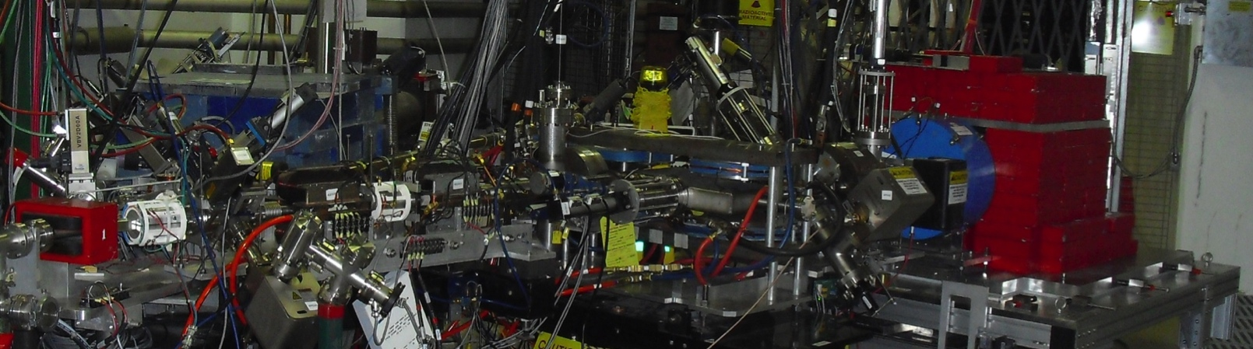
Summary
Large (parts per thousand) asymmetries are observed suggesting the
presence of polarized positrons
Good trend shown as a function of the momentum selection
All the preliminary results come from the online monitoring system and online fast analysis which drove us along all the data taking period
Preliminary results are encouraging
After a good data taking period the full analysis is now ongoing…
And we are finalizing the full GEANT4 simulation

