Slide 1
GRANULAR VS COMPACT POSITRON CONVERTERS:ADVANTAGES & APPLICATIONS TO HYBRID SOURCES
X.Artru (IPNL), R.Chehab (IPNL), M.Chevallier (IPNL), O.Dadoun (LAL), L.Rinolfi (CERN), P.Sievers (CERN), V.M.Strakhovenko (BINP), A.Variola (LAL), C.Xu (IHEP)
With collaboration of T.Takahashi (Hiroshima), T.Omori, T.Suwada, J.Urakawa (KEK)
Presented by P.Sievers

Slide 2
GRANULAR VS COMPACT POSITRON CONVERTERS…
PLAN
* Introduction
* Description of the granular target
* Comparison granular/compact target
* Advantages of the granular targets (thermal dissipation, PEDD,.
* Optimization of the granular target: sphere radius, number w.r.t. beam dimensions, pulse duration, …
* Application for a hybrid e+ source using channeling; cases of ILC &CLIC
* Possible test with a granular target (at KEK); what and how to measure
* summary and discussions.

Slide 3
GRANULAR VS COMPACT POSITRON CONVERTERS…
INTRODUCTION
One of the main problems for the positron converters, dedicated to the future linear colliders, is the high amount of deposited energy due to the high intensities required in the LC. Cooling may be very complicated to evacuate the high amount of heat. Since some years, a particular shape for the targets delivering high beams of pions under proton incidence, has been considered by P.Sievers et al for the neutrino factories. Instead of using compact targets, granular ones made of a large number of small spheres were considered. The idea is based on the high ratio surface/volume of the spheres which makes easier the heat dissipation. Such idea is now investigated for the positron converters and a first application was studied for ILC positron source in the PhD thesis of C.XU (defended in May 2012 at IHEP/Beijing). In this application, the positrons were generated by an intense beam of photons emitted by ultrarelativistic channeled electrons in an axially oriented crystal. We present, here, the main advantages of such converters with a particular emphasis for the ILC case: the conditions for a beam test are also examined.

Slide 4
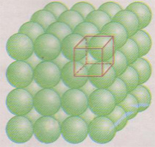
GRANULAR VS COMPACT POSITRON CONVERTERS…
GRANULAR CONVERTERS: A PRESENTATION
The target is made of small spheres
with radii of ~ 1 mm. The spheres are
put in a container with a low Z (Be,
for instance). The best suited cooling
is based on a Helium gas jet circulating
between the spheres and taking off
the heat.

Slide 5
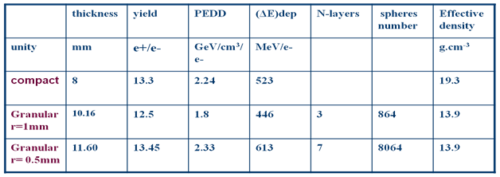
GRANULAR VS COMPACT POSITRON CONVERTERS…
COMPARISON BETWEEN COMPACT AND GRANULAR TARGETS
- Simulation results ( with hybrid source using channeling radiation )
A comparison has been carried out between granular and compact targets: the compact one was chosen as to satisfy the ILC requirements for the positron yield. The granular targets were chosen to be as close as possible to the compact one concerning the yield. A table is summarizing this comparison

Slide 6
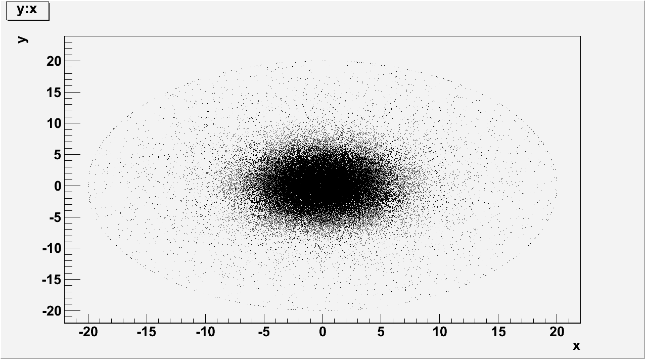
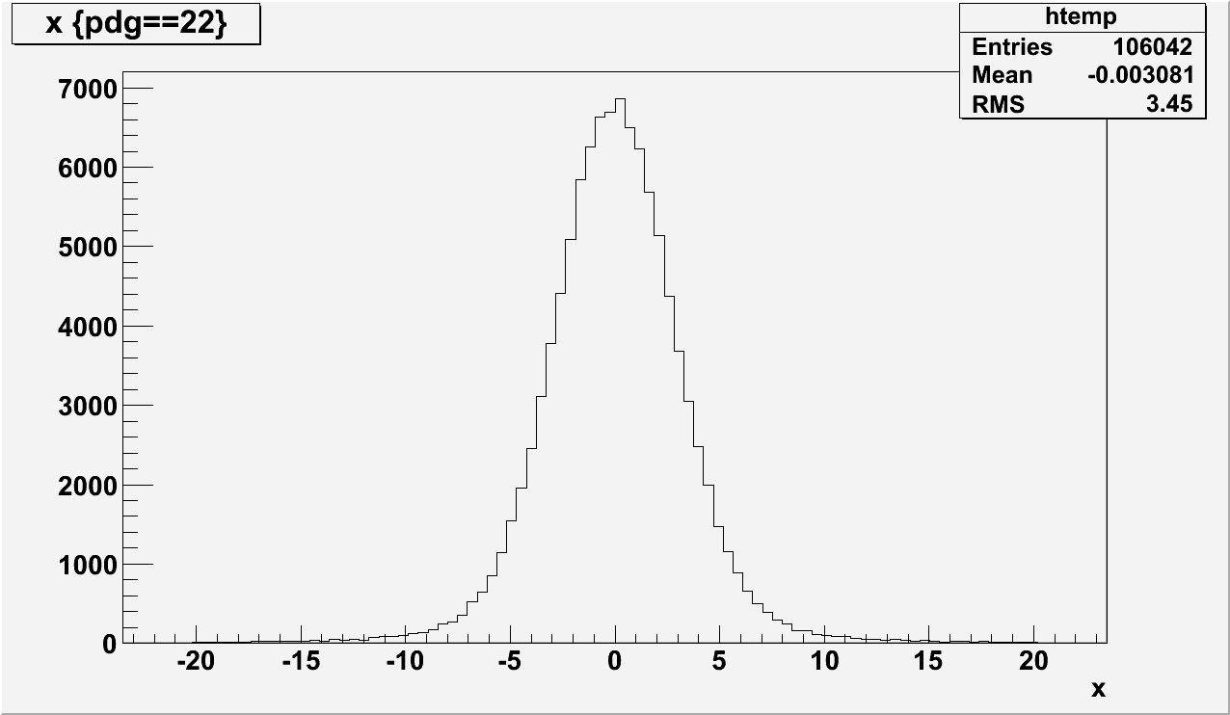
GRANULAR VS COMPACT POSITRON CONVERTERS…
SIMULATIONS WITH A HYBRID SOURCE
The following results are obtained with an hybrid source using a W crystal, 1 mm thick on which a 10 GeV e- beam is impinging; rms transverse radius of e- beam is 2.5 mm. An illustration of the γ beam is given:

Slide 7
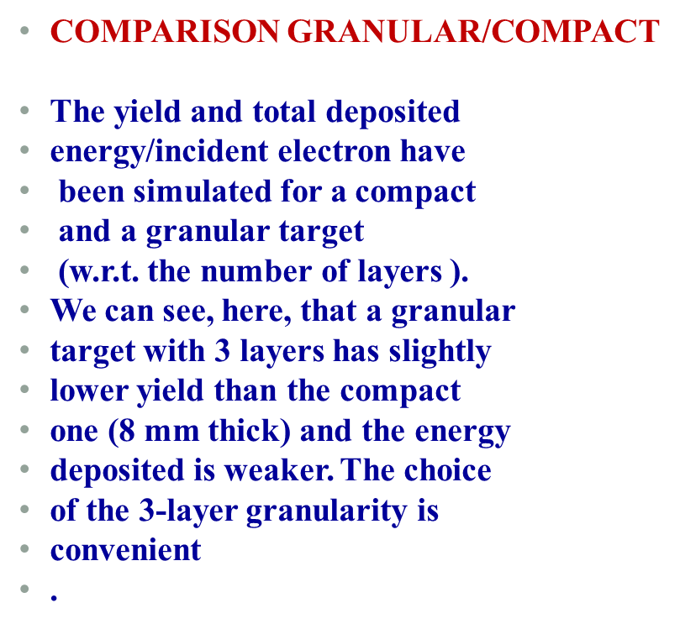
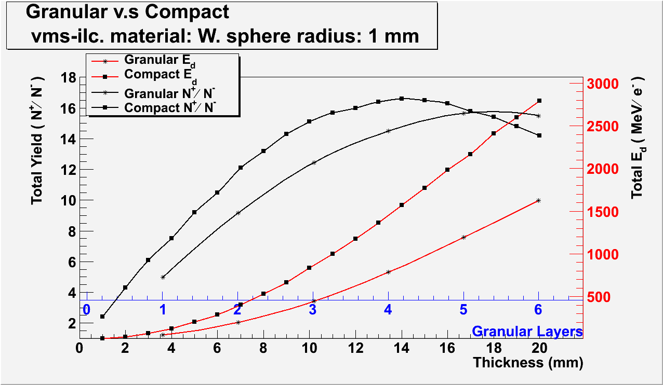
GRANULAR VS COMPACT POSITRON CONVERTERS…

Slide 8
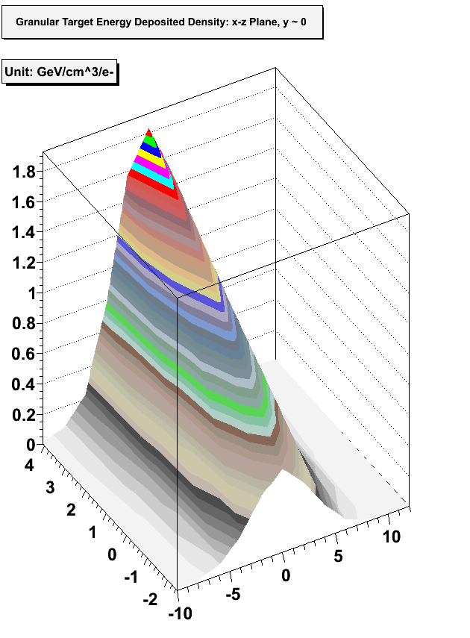
GRANULAR VS COMPACT POSITRON CONVERTERS…
PEDD
The PEDD has been also simulated in the amorphous compact/granular converter. The results of the simulations are given. We can notice the interest of the granular converter w.r.t.
the compact one.
We have chosen to modify the beam
time structure, following the
proposition of Omori et al, to reach
a reasonable amount of energy
deposition density in the converter.
The granular converter is made of 3 layers
=>> Energy deposition: 446 MeV/e-
=>> PEDD; 1.8 GeV/cm3/e-

Slide 9
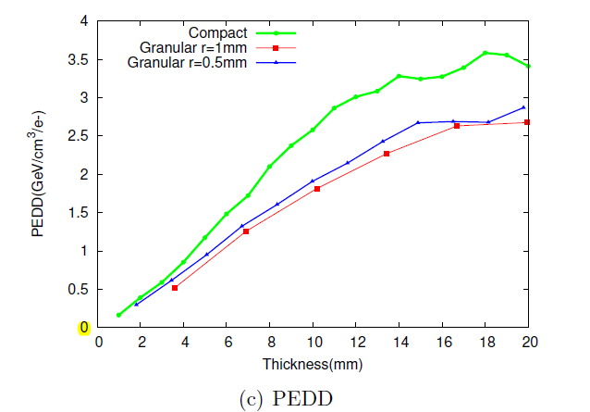
GRANULAR VS COMPACT POSITRON CONVERTERS…
COMPARISON GRANULAR/COMPACT➔PEDD:
The data corresponds to ILC case=>> E-=10 GeV; l(Xtal)= 1 mm

Slide 10
GRANULAR VS COMPACT POSITRON CONVERTERS…
ADVANTAGES OF THE GRANULAR TARGETS
If we consider the convective cooling in a pulsed
temperature regime, the decay time is given by:
τ = C.m/α.F
Where C is the specific heat, m, the sphere mass,
α, the convection cooling coefficient, and F, the
sphere surface. This expression may be written:
τ= C.ρ.R/3.α
With ρ, the density and R the radius of the sphere;
As for a sphere, F/V is 3/R
it shows clearly that a fast cooling requires small R value. So, using small spheres present a real interest to ensure rapid cooling. However, some practical limit to small radii is leading to the choice of R~ 1 mm, at least.
τ
2τ
(The decay is exponential)

Slide 11
GRANULAR VS COMPACT POSITRON CONVERTERS…
OPTIMIZATION OF THE GRANULAR CONVERTER
The parameters to be optimized are: the radius with respect to the beam duration, the beam transverse dimensions…The physical processes taken into account are:
- the energy deposited by pulse in one sphere
- the PEDD in the “hottest” sphere
- the shock waves

Slide 12
GRANULAR VS COMPACT POSITRON CONVERTERS…
APPLICATION TO ILC: THE POSITRON BEAM EXITING THE GRANULAR CONVERTER
GRANULAR
CONVERTER

Slide 13
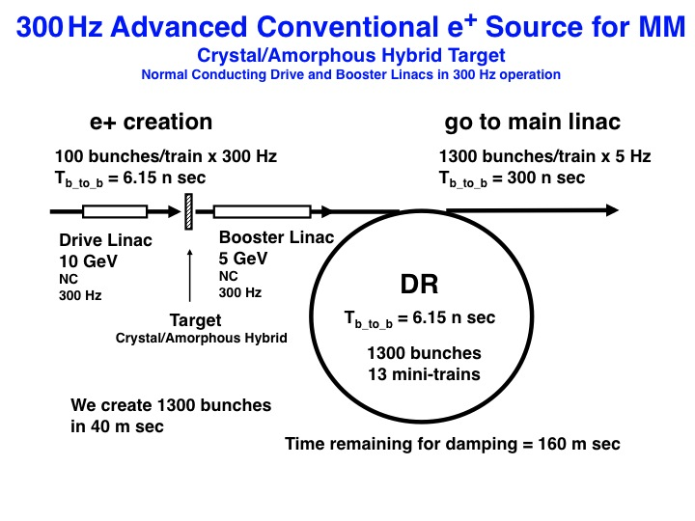
GRANULAR VS COMPACT POSITRON CONVERTERS…
THE SCHEME FOR ILC:
The possibility of using the hybrid source ( or any solid target) for ILC is related to the ability of transforming the long and intense ILC macropulses into many micropulses (or minitrains) allowing to the heat charge to relax between the micropulses (or minitrains). One interesting solution was proposed 3 years ago by T.Omori. The number of bunches is matching with the most recent parameters for ILC.
Number of bunches: 100/minitrains
Number of minitrains: 13/macropulse
Frequency of minitrains: 300 Hz
Time width of macropulse: 40 ms
Simulations on the hybrid e+ source have
been operated with 2 kinds of converters:
- compact converter
- granular converter
(see PhD thesis of C.Xu)

Slide 14
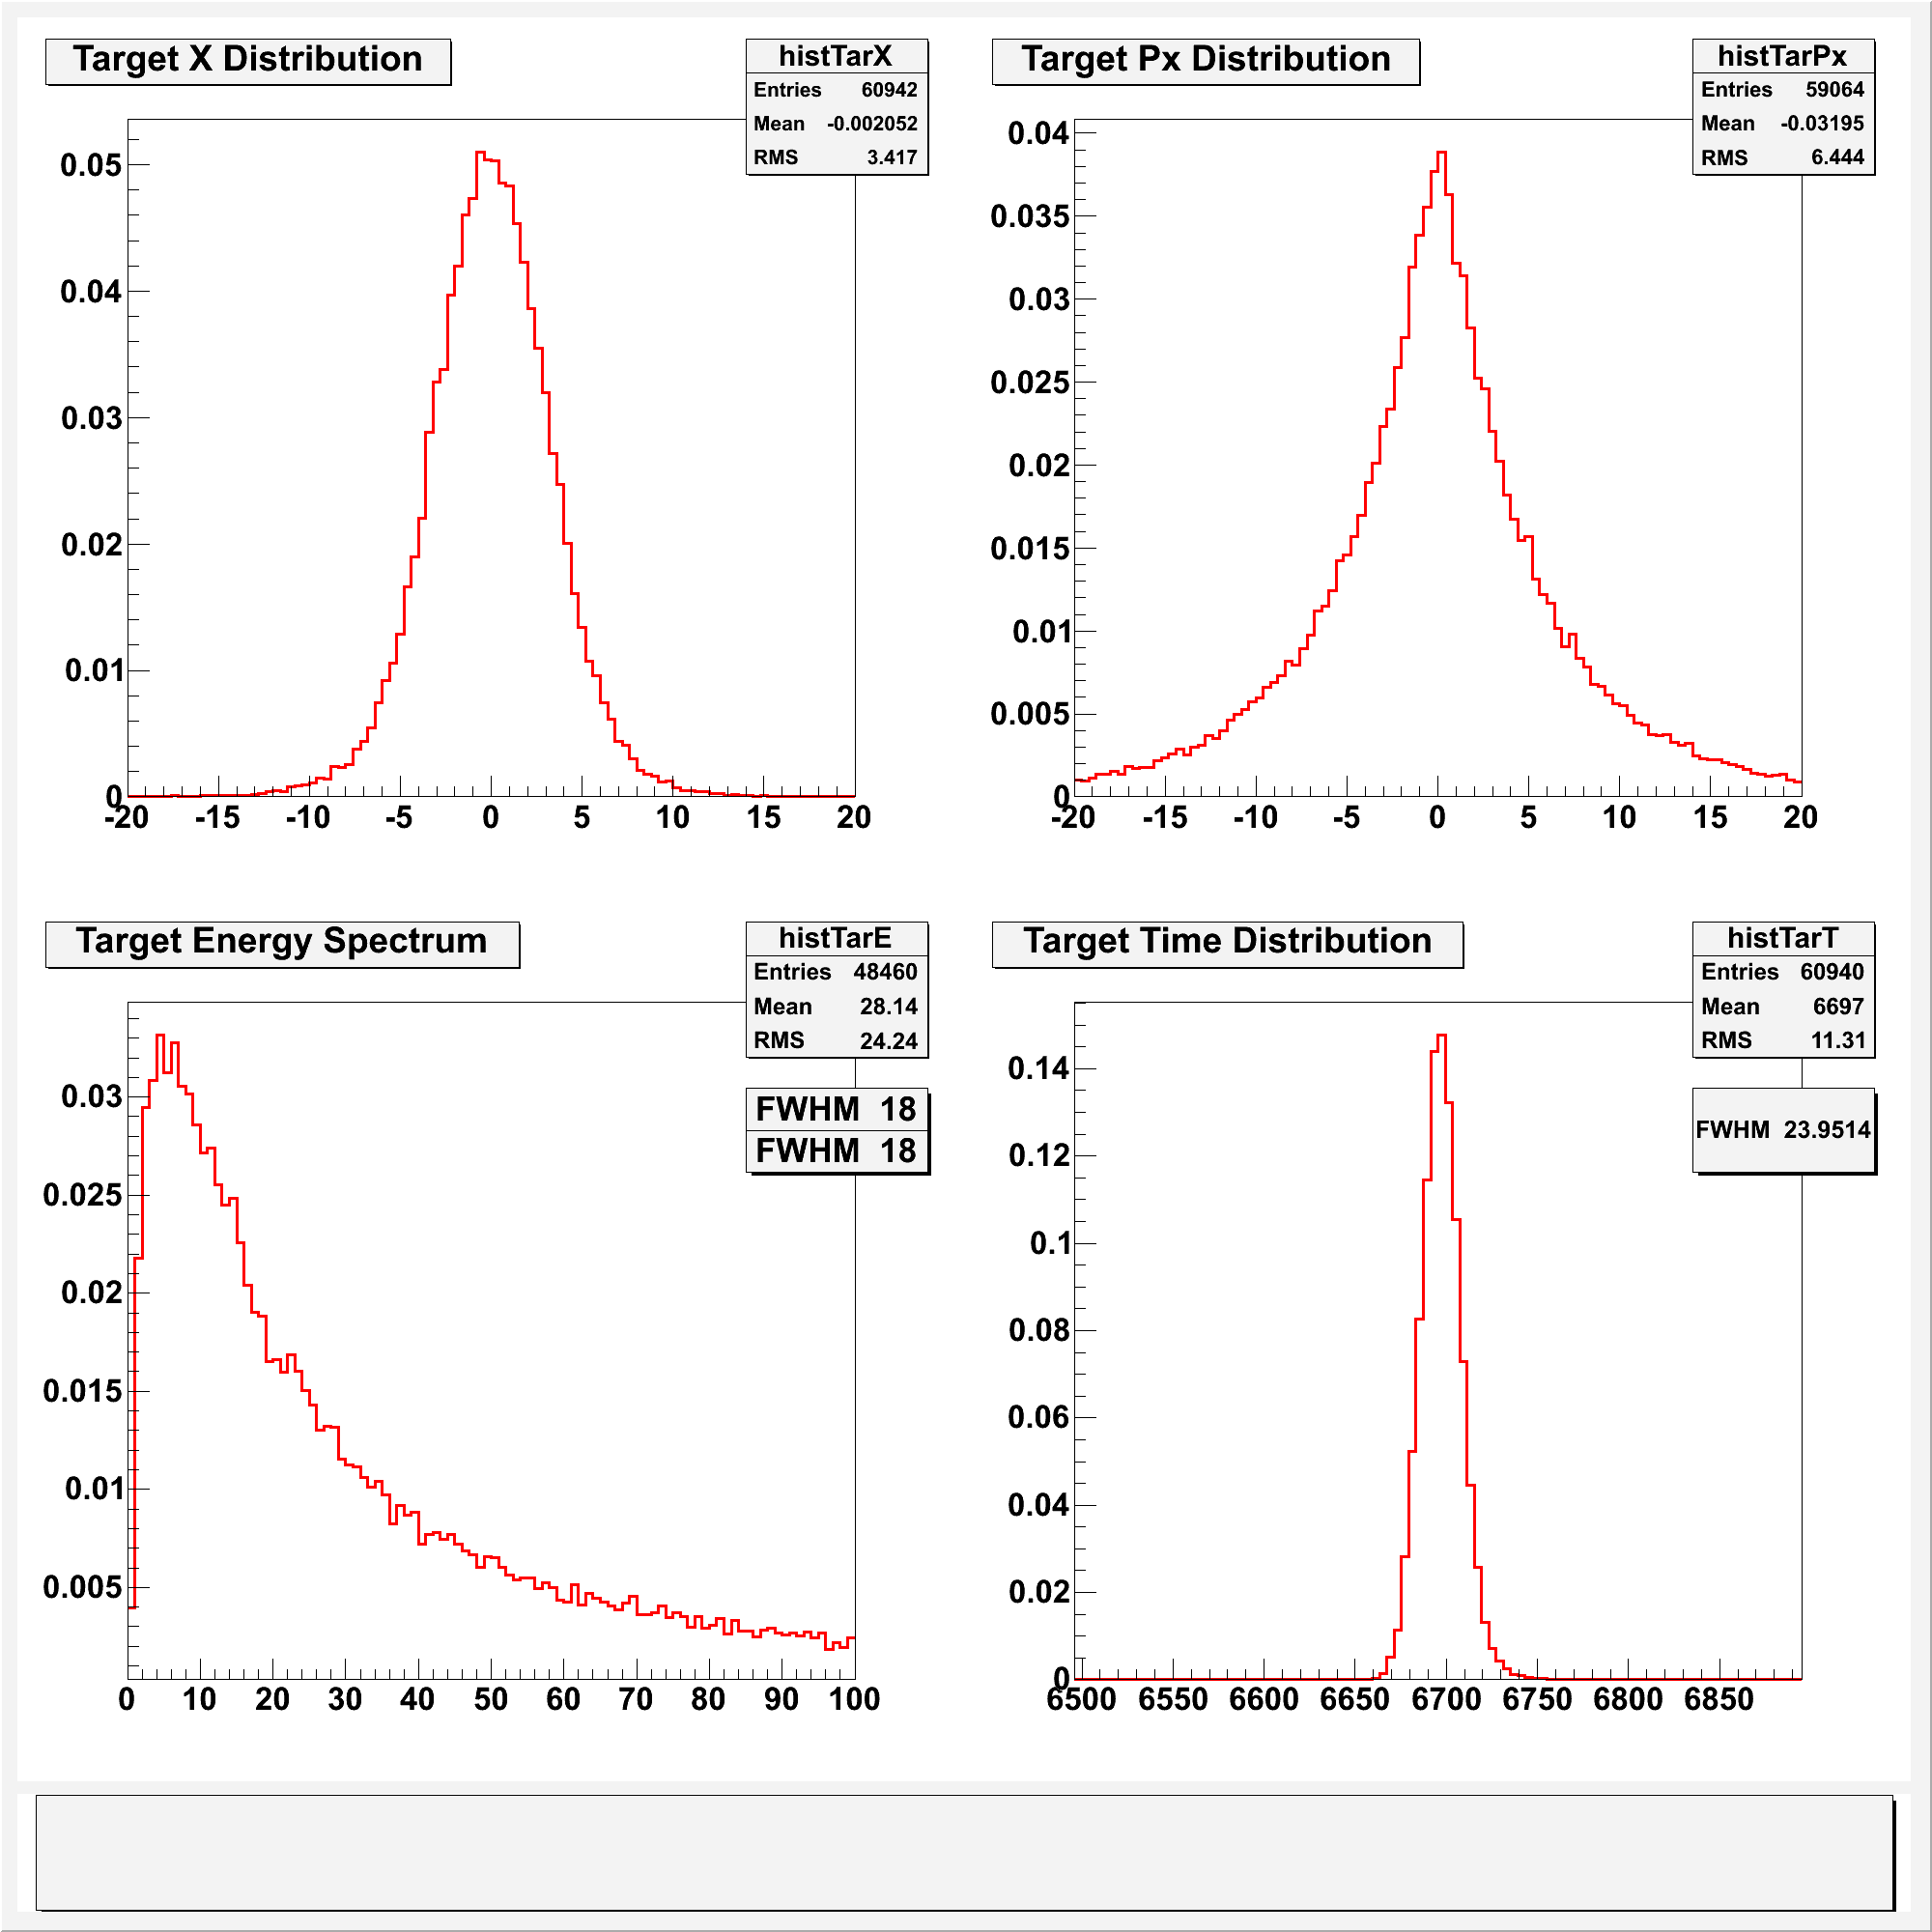
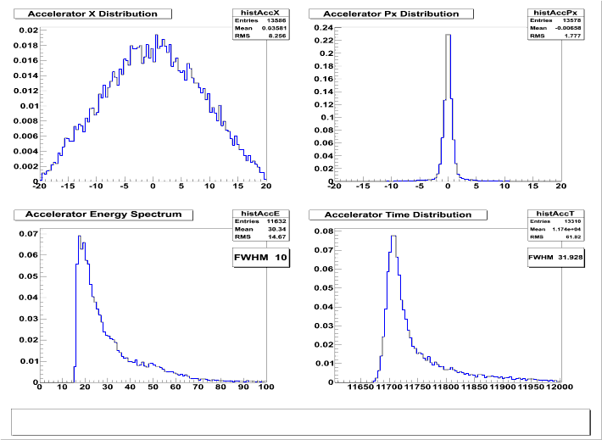
GRANULAR VS COMPACT POSITRON CONVERTERS
- Simulations results on positron beam
The positrons created in the granular target (3 layers) are captured by an AMD.
The AMD has the following characteristics:6T-0.5Tand L=50cm. Energy
spectrum, transverse dimensions and momentum are given.
At target exit
After capture and acceleration

Slide 15
GRANULAR VS COMPACT POSITRON CONVERTERS…
SIMULATIONS RESULTS ON POSITRON BEAM
ANGULAR DISTRIBUTION OF THE POSITRONS AT EXIT OF THE GRANULAR CONVERTER
The parameters are those for ILC
Due to multiple scattering the angular spread is large: θ ~0.32 rad rms , about 20°

Slide 16
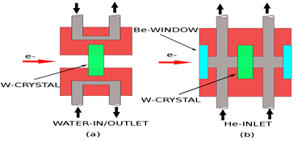
GRANULAR VS COMPACT POSITRON CONVERTERS…
APPLICATION TO ILC: HEATING AND COOLING FOR THE HYBRID SOURCE
THE CRYSTAL;
The crystal must be cooled in order
to preserve its qualities. A stationary
crystal, which receives 5 pulses/second,
leads to important increases
of temperature: 275 °C (water cooled)
and 406 °C, He cooled. So, we consider
an array of 5 crystals with a transverse
displacement of 5 cm/s. In that case,
a crystal is receiving 1 pulse/second and
the temperature rise is of 178 °C (water)
and 365 °C (He).

Slide 17
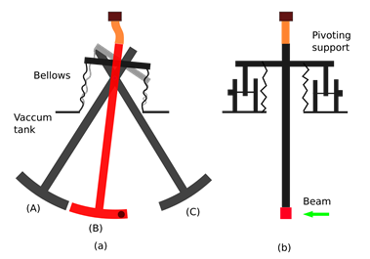
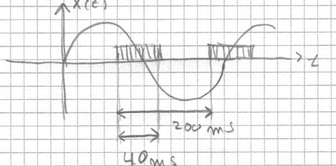
GRANULAR VS COMPACT POSITRON CONVERTERS…
PENDULUM;
For cooling the granular converter, a
stationary target is irrealistic ; a moving
Target is needed. To place the µpulses
Besides each other, the speed is
1cm/3.3 ms =>> 3m/s. The time sharing
between beam on and beam off is:
The arc length is 13 cm and the frequency is 2.5 Hz

Slide 18
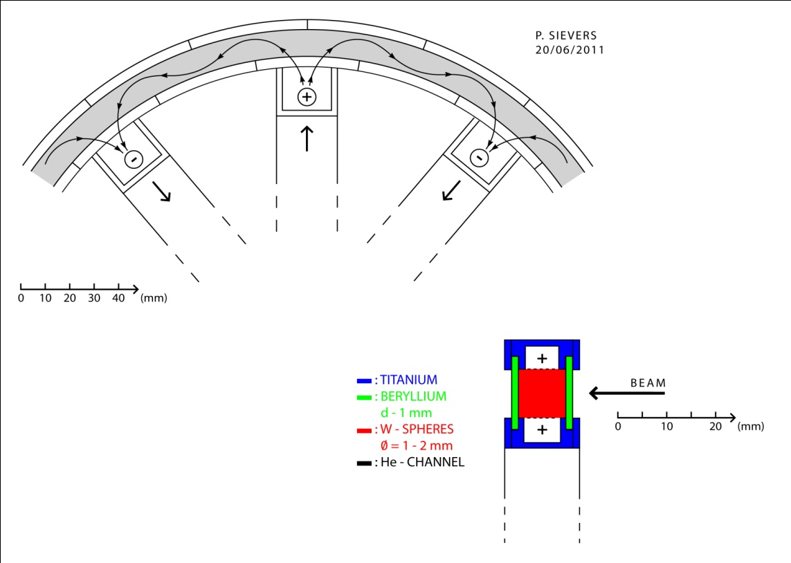
GRANULAR VS COMPACT POSITRON CONVERTER…
THE ROTATING WHEEL:
The wheel diameter is 58 cm ; there are
182 places for the µpulses. The
rotation is: 100 rpm. A He flow is
Circulating to cool the spheres. Be
Windows are at upstream and
downstream faces of the target.

Slide 19
GRANULAR VS COMPACT POSITRON CONVERTERS…
SUMMARY FOR THE TEMPERATURES IN CRYSTAL AND CONVERTER
Single Crystal 5 Crystals Pendulum Rot.Wheel
W W W Be W Be
PEDD 5.83 5.83 31.5 30.6 31.5 30.6
J/g
T/micro 41 41 222 16.3 222 16.3
K
En./microp. 2.6 2.6 146 3.4 146 3.4
J
Av.Power 170 34 730 17 52 0.24
W/Targ.
Max. Temp . 406 365 420 186 242 36
oC,[ He]
Max. Temp . 275 178 250 - -
oC,[Water]
Table 2 Summarizing table Brackets indicate the cooling case

Slide 20
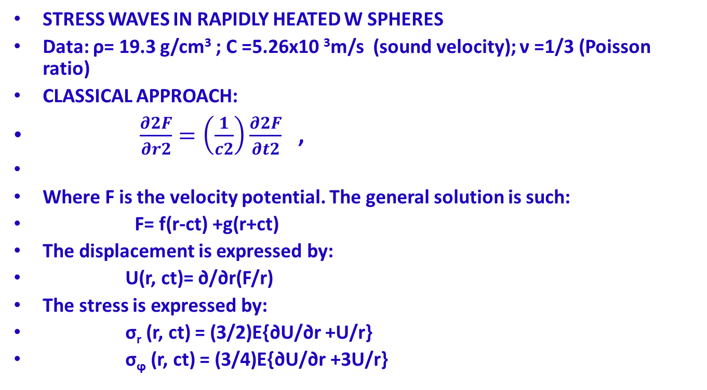
GRANULAR VS COMPACT POSITRON CONVERTERS…
STRESS WAVES IN RAPIDLY HEATED W SPHERES
Data: ρ= 19.3 g/cm³ ; C =5.26x10 ³m/s (sound velocity); ν =1/3 (Poisson ratio)
CLASSICAL APPROACH:
$\frac{∂2F}{∂r2}=\left(\frac{1}{c2}\right)\frac{∂2F}{∂t2}$ ,
Where F is the velocity potential. The general solution is such:
F= f(r-ct) +g(r+ct)
The displacement is expressed by:
U(r, ct)= ∂/∂r(F/r)
The stress is expressed by:
σ_{r} (r, ct) = (3/2)E{∂U/∂r +U/r}
σ_{ϕ} (r, ct) = (3/4)E{∂U/∂r +3U/r}

Slide 21
GRANULAR VS COMPACT POSITRON CONVERTERS…
INITIAL CONDITIONS: ct=0; Instant:ΔT
U(r, ct=0) = αΔTr ; α, being the linear coefficient of thermal
expansion
dU/dt = 0
σ _{r}(r, 0) =σ_{ϕ} (r,0) = 3EσΔT
Boundary conditions :
Free outside the surface; σ_{r} (R, ct) =0
At center: U(0, ct) =0
∂u/∂t (0, ct) =0
The solutions can be written down in closed form:
Consider U(r, ct); σ_{r}(r, ct) ; σ_{ϕ} (r, ct) for 0<ct < R and 0<r<R
Some results for R<ct<3R/2 and 0<r<R/2

Slide 22
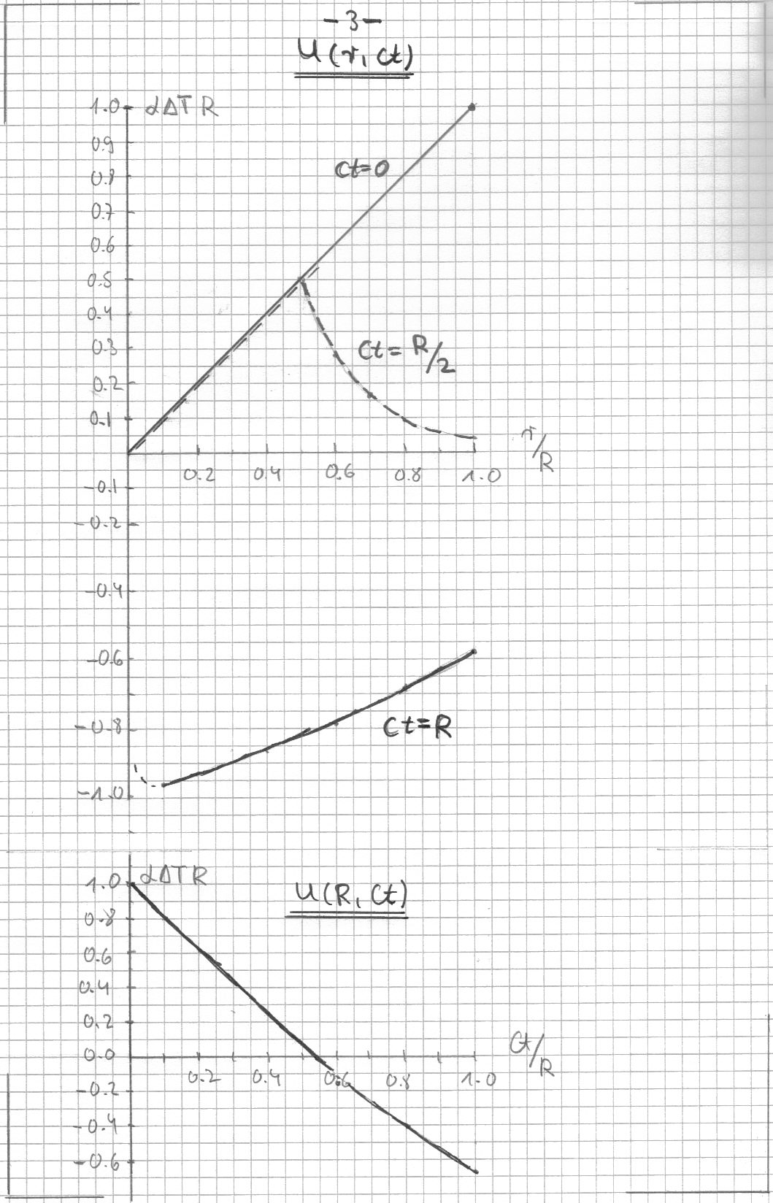
GRANULAR VS COMPACT POSITRON CONVERTERS…
DISPLACEMENT: U

Slide 23
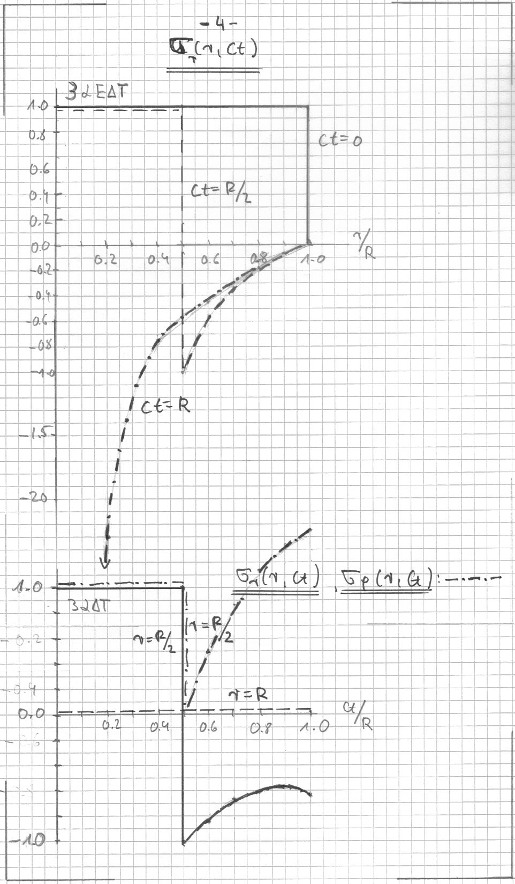
GRANULAR VS COMPACT GRANULAR CONVERTERS…
RADIAL STRESS : σ_{r} (r, ct)
AZIMUTHAL STRESS: σ_{ϕ} (r, ct)

Slide 24
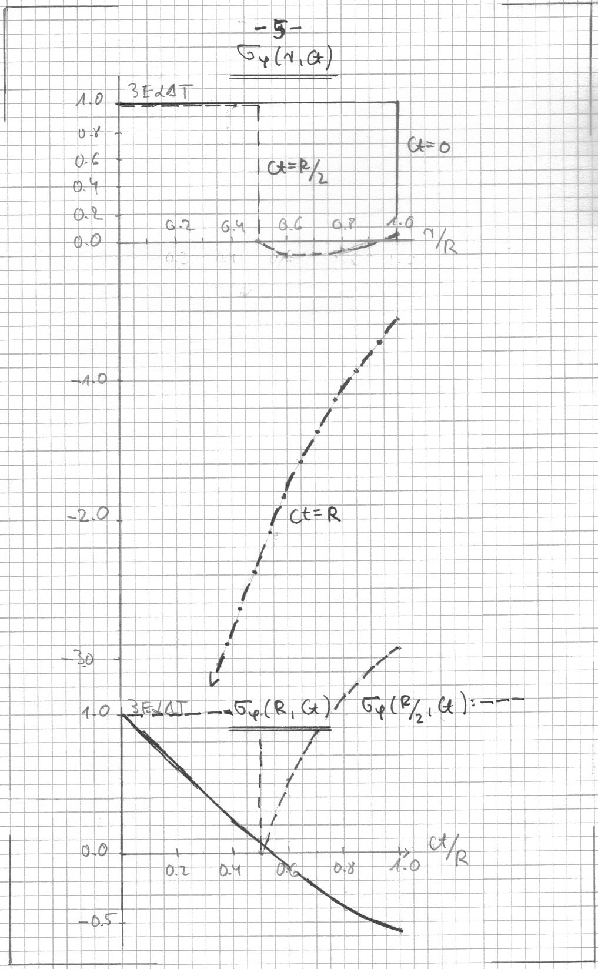
GRANULAR VS COMPACT POSITRON CONVERTERS…
AZIMUTHAL STRESS: σ_{ϕ} (r, ct)

Slide 25
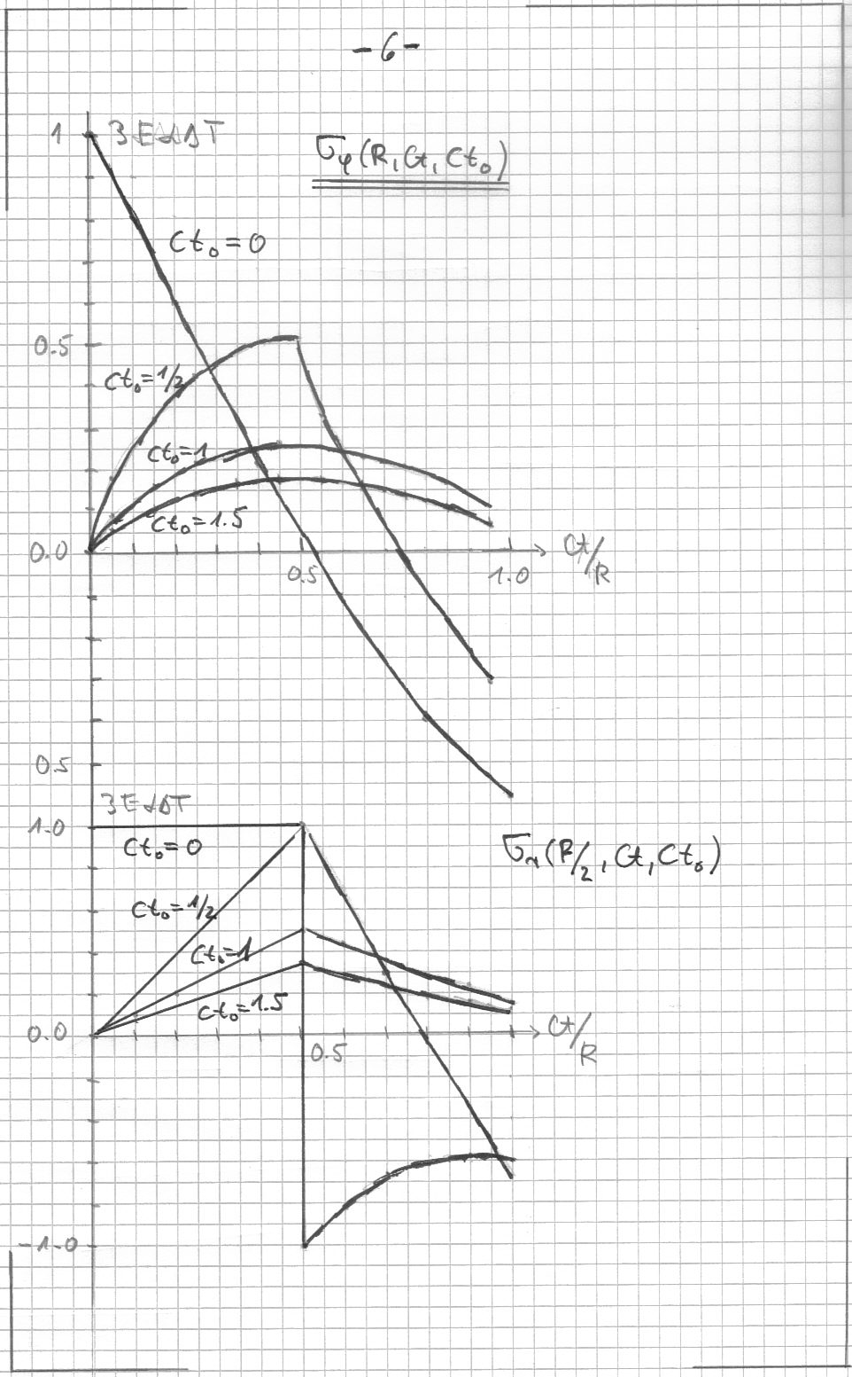
GRANULAR VS COMPACT POSITRON CONVERTERS…
AZIMUTHAL AND RADIAL STRESSES
σ_{ϕ} (R, ct, ct₀ ) and
σ_{r} (R/2, ct, ct₀ )

Slide 26
GRANULAR VS COMPACT POSITRON CONVERTERS…
SUMMARY AND CONCLUSIONS
* THE HYBRID POSITRON SOURCE: Using mainly the photons, emitted by high
energy electrons in an axially oriented crystal, to generate the positrons in a
thick amorphous converter we obtain promising results concerning the positron
yield
* THE GRANULAR CONVERTER: presents promising characteristics for the energy
deposited and the PEDD which are better than for a compact target.
* AN APPLICATION TO ILC: modifying the beam time structure of the ILC beam
following a suggestion by OMORI-san (300 Hz solution) it has been possible to
describe an unpolarized hybrid positron source using a granular converter and
fulfulling the requirements of ILC for the yield, the PEDD and with appropriate
cooling systems involving reasonable speeds for the moving targets.
*

Slide 27
GRANULAR VS COMPACT POSITRON CONVERTERS…
CONCERNING THE STRESSES:
For the Hybrid System the instantaneous temperature rise
in a W-sphere is
ΔT = 232 K.
With a Young’s Modulus of
E = 40 x10⁴ MPa
and a thermal expansion coefficient of
α = 4.5 x 10⁻⁶/°K
the instantaneous thermal stress in a sphere will be
σ = 3 αE ΔT,
σ = 1250 MPa ( 82 % of the elastic limit).
Open questions: Can small W-spheres still be considered as an ideal, amorphous, elastic medium, as assumed in the stress propagation analysis. There may be micro cracks, crystalline micro-structures, ….? What will be the fatigue limit and the life time?

Slide 28
GRANULAR VS COMPACT POSITRON CONVERTERS…
CONCERNING THE STRESSES (continue):
For the ILC the pulse duration is about
τ = 0.6 μs.
The transition time of sound through the 2 mm spheres is
t = 0.2 μs.
We observed stress reductions by a factor 2-3 for pulse durations of
τ = 0.1…..0.3 μs, cto = 0.5…..1.5 mm
at the regions of R/2….R.
Expect further stress reductions with larger pulse durations of τ = 0.6 μs at the outer part as well as at the centre of the spheres. =>> Still to be done!

Slide 29
GRANULAR VS COMPACT POSITRON CONVERTERS…
Experimental verification and benchmarking of the Granular Target are necessary.
The PEDD can be measured by measuring the temperature rise via thermo couples and infrared camera at the rear of the granular target. Can be made at lower than nominal beam intensities. First Results were presented by T. Suwada, T .Takahashi and T. Omori of KEK.
Thermal shock: One would require tests with a nominal gamma-beam and with the proper pulse duration of 0.6 μs.
Tests with equivalent electron or proton beams may also be possible.

