Slide 1
ML & SCRF
Baseline Technical Review
Summary
Akira Yamamoto
Feb. 1, 2012
ILC-GDE ML & SCRF Baseline Technical Review, held at KEK,
Jan. 19-20, 2012

Slide 2
Progress in SB2009 toward TDR, and
Baseline Technical Reviews
 | Technical Area | Place and Dates
SB2009 |  | Proposed Dec. 2009
BAW-1 | 1. Acc. Gradient, 2. Single tunnel, | KEK, Sept. 7-10, 2010
BAW-2 | 3. Reduced RF Power, 4. e+ source location | SLAC, Jan. 17-21, 2011
BTR-1 | DR | INFN, July, 7-8, 2011
BTR-2 | RTML, Sources, BDS/MDI | DESY, Oct. 24-28, 2011
BTR-3 | ML & SCRF | KEK, Jan. 19-20, 2012
BTR-4 | CFS | CERN, March 22-23, 2012

Slide 3
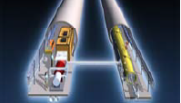
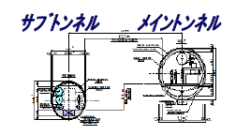
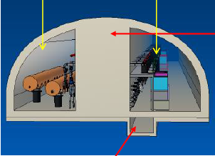
ILC Design: RDR to TDR (SB2009)
Motivation: Cost containment
Single accelerator tunnel
Smaller damping ring
e+ target location at high-energy end,
SCRF: Gradient variation of 31.5 MV/m +/- 20 %,
HLRF: KCS and DRFS with RDR-RF-unit as backup
RDR2007 → SB2009 → TDR w/ mountain site

Slide 4
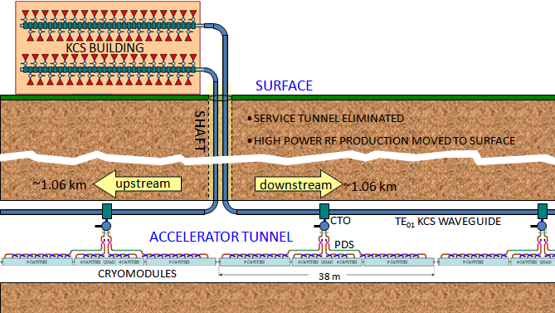
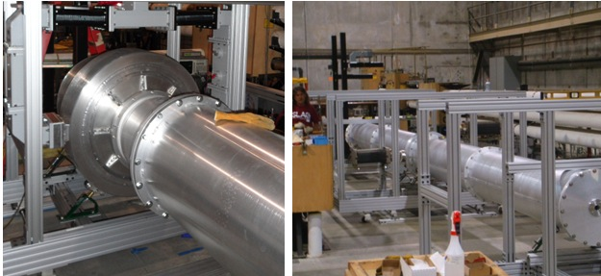
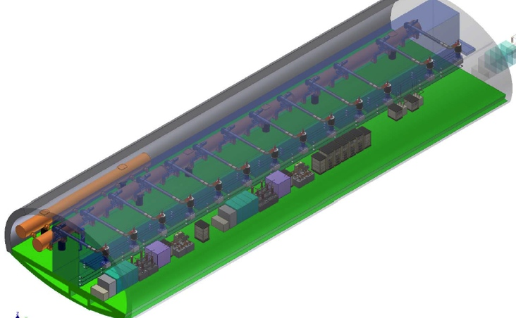
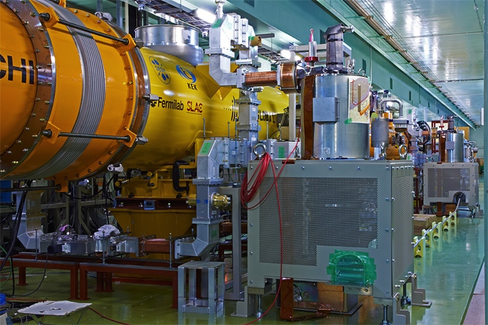
High-Level RF Solutions
Klystron Cluster Scheme, KCS (SLAC)
2×35 10MW MB klystrons
Distributed RF Sources, DRFS (KEK)
~4000×800kW klystrons

Slide 5
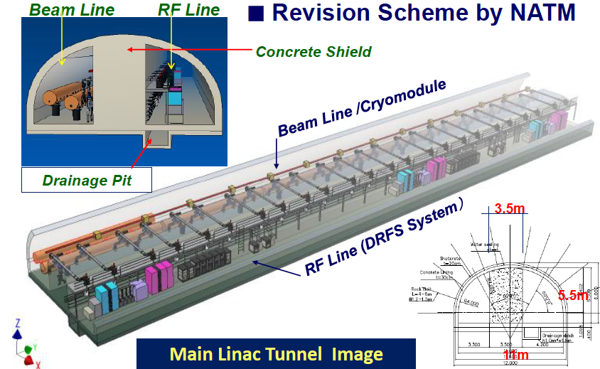
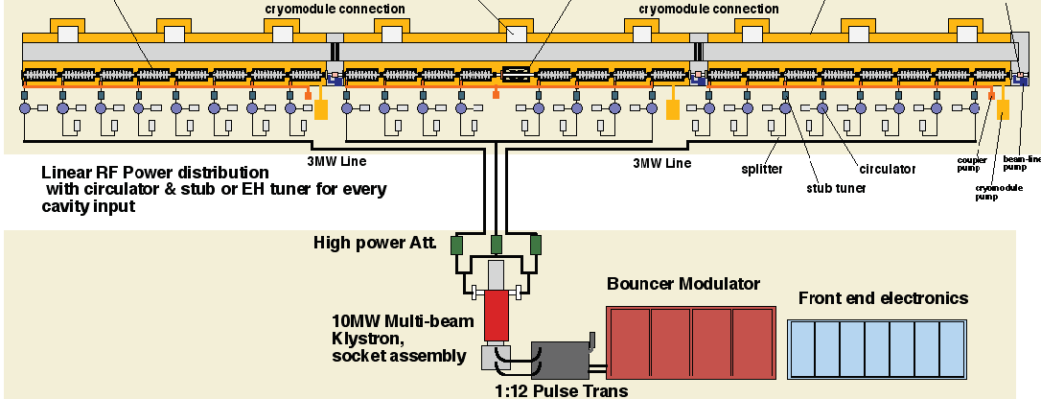
Studies made for 8 cases
DRFS RF unit:
2 cavities operated by 800 kW Klystron
RDR RF unite :
3 Cryomodule (9+8+9 = 26 cavity),
operated by using 10 MW Klystron

Slide 6
A Proposal Revised
9 4 + Q +4 9
8 8 Q 8
8 4 + Q +4 8
Keep the concept of 9+8+9 cavity sting unit

Slide 7
Technical Change Decisions Proposed
Tech. Area | Main Subjects | Description
ML Integration | Parameters and beam dynamics Single tunnel-layout CM and Q periodicity: ML tunnel length Possible tilting of the tunnel | Low-Power design as TDR baseline (SB2009), and alignment tolerance Circular tunnel in flat-land, and Kamaboko tunnel in mountain CM and Q periodicity: >> Stay at 9+4Q4+9 Reserved tunnel-extension of 400 m w/o or w/ utility ? >> More precise discussions for purpose required New request from CFS: possible < 0.5 % tunnel tilting
RF power | HLRF Configuration LLRF operational overhead | KCS in flat-land site RDR-RF unit in mountain site (DRFS to be withdrawn) ≥ 12% RF operational overhead at gradient variation of +/20 % and in RDR-RFunit <33.3 MV/m> in Klystron
Cryomodule | Envelope/interface String Unit 5 K radiation shield | Piping interface with flange?, inter-connect condition, etc, Stay at 9 +4Q4+9 (withdraw 8+4Q4+8) Simplification and accessibility for active components such as tuners
Cryogenics | Unit capacity | Stay at 5 units per linac Limit of tilting angle in ML tunnel
Cavity integration and Cavity/CM test | Envelope, baseline, compatibility Test conditions | Tuner type, coupler warm-flange, beam pipe flange, magnetic shield (inside/outside), LHe tank etc. Test plan and fraction of CM to be tested (how much fraction?)
Cavity performance | Yield Gradient spread Degradation in CM module | New recipe and cost-base scope: 1st pass: 60% and 2nd pass: 70% ? (Assume ~ 1/10 cavities to degrade dG = ~ 20 % or more, and ) >> Adopt a statistical approach to cavity degradation; <> and rms
Cost | Cost containment Exchange rate and conversion | Technical design base on SB2009 (updated) compared with RDR cost

Slide 8
ILC-ML SCRF Cavity Gradient Specifications Update
Cost-relevant design parameters for TDR | ML cavity gradient Specification | R&D Milestone
9-cell Cavity Gradient in vertical test | 35 MV/m, average - Spread: 28 – 42 MV/m (+/- 20 % or less) | 35 MV/m at 90 % yield including 2nd pass, (eq. > 38 MV/m, average)
Cryomodule Operational Gradient | 34 MV/m, average CM Obs. G. Limit = 3 %
Accelerator Operational Gradient | 31.5 MV/m, average Op. G lim = 1.5 MV/m Cntrl margin = 3 %**
Required RF power overhead for control | 10-15%

Slide 9
DESY + S1-G statistics
Mean: -8% ±16% RMS
14 assemblies
108 data points
correlation coeff. -0.27
Note: measurement error? Assume 10% → 13% degradation spread (rms)

Slide 10
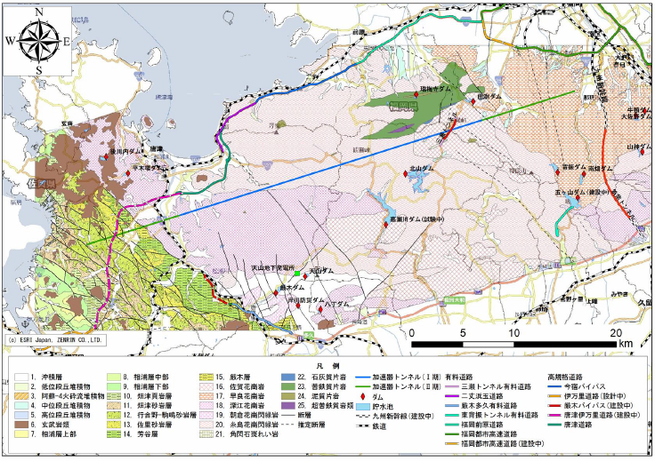
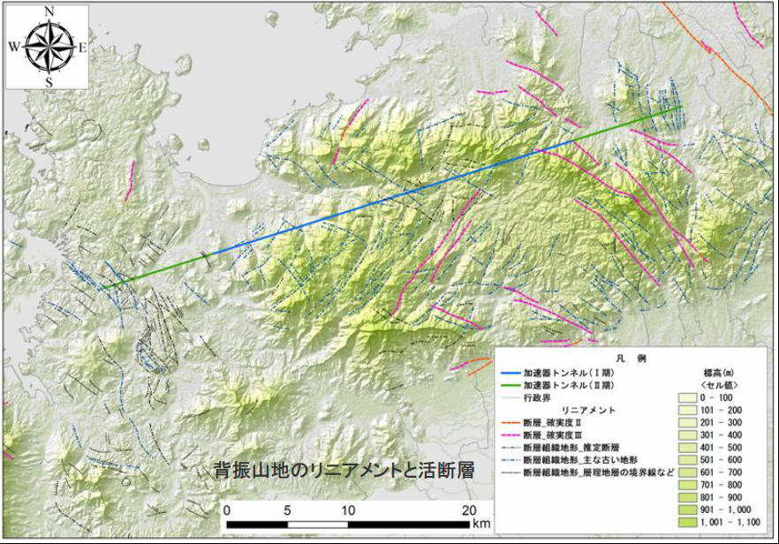
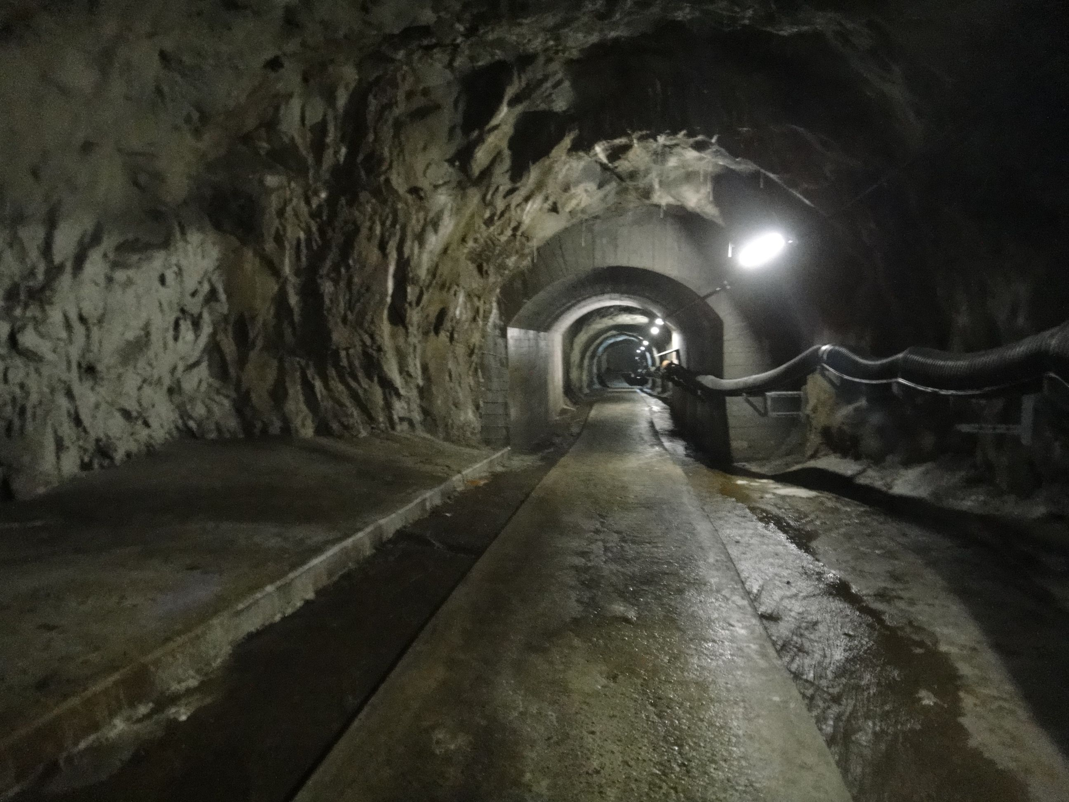
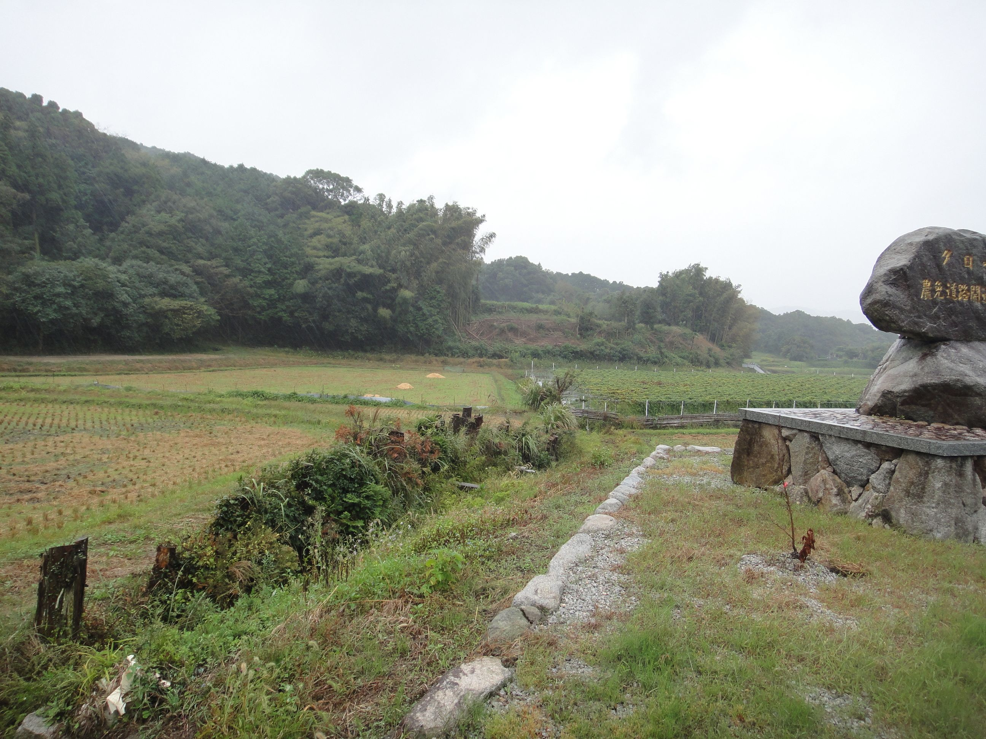
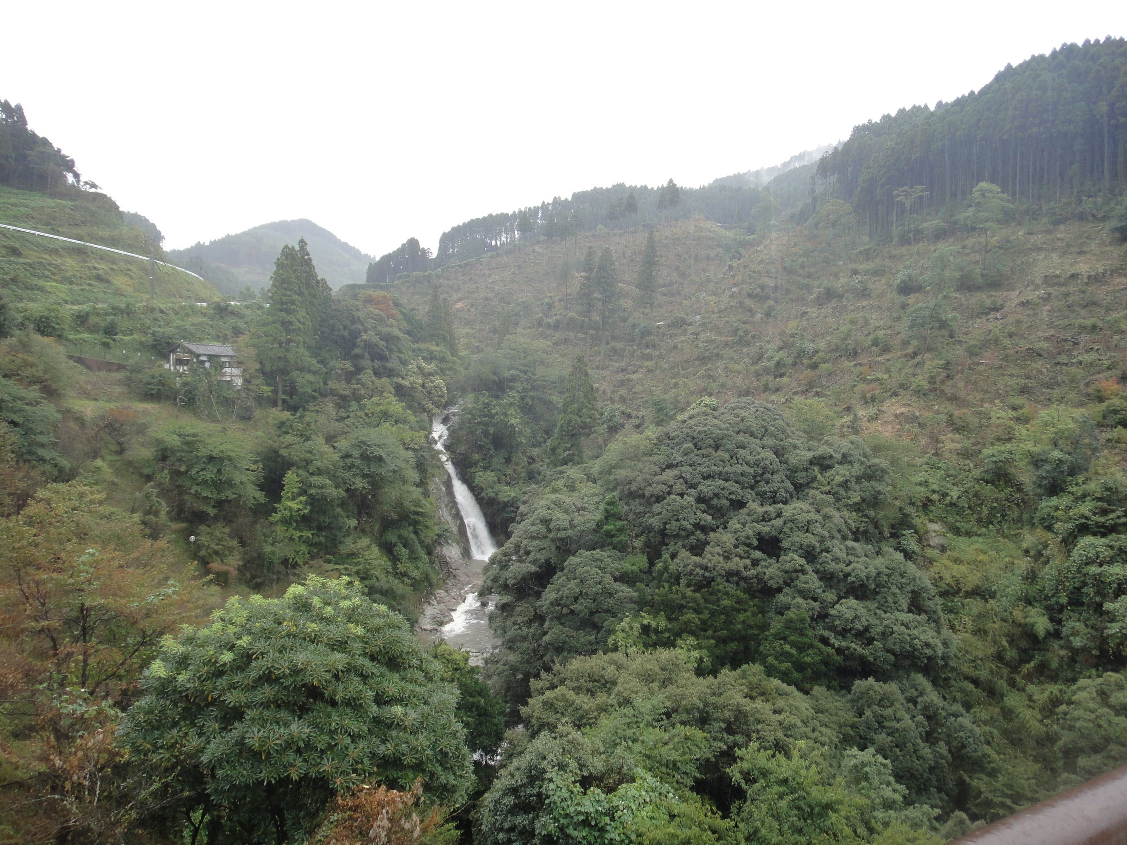
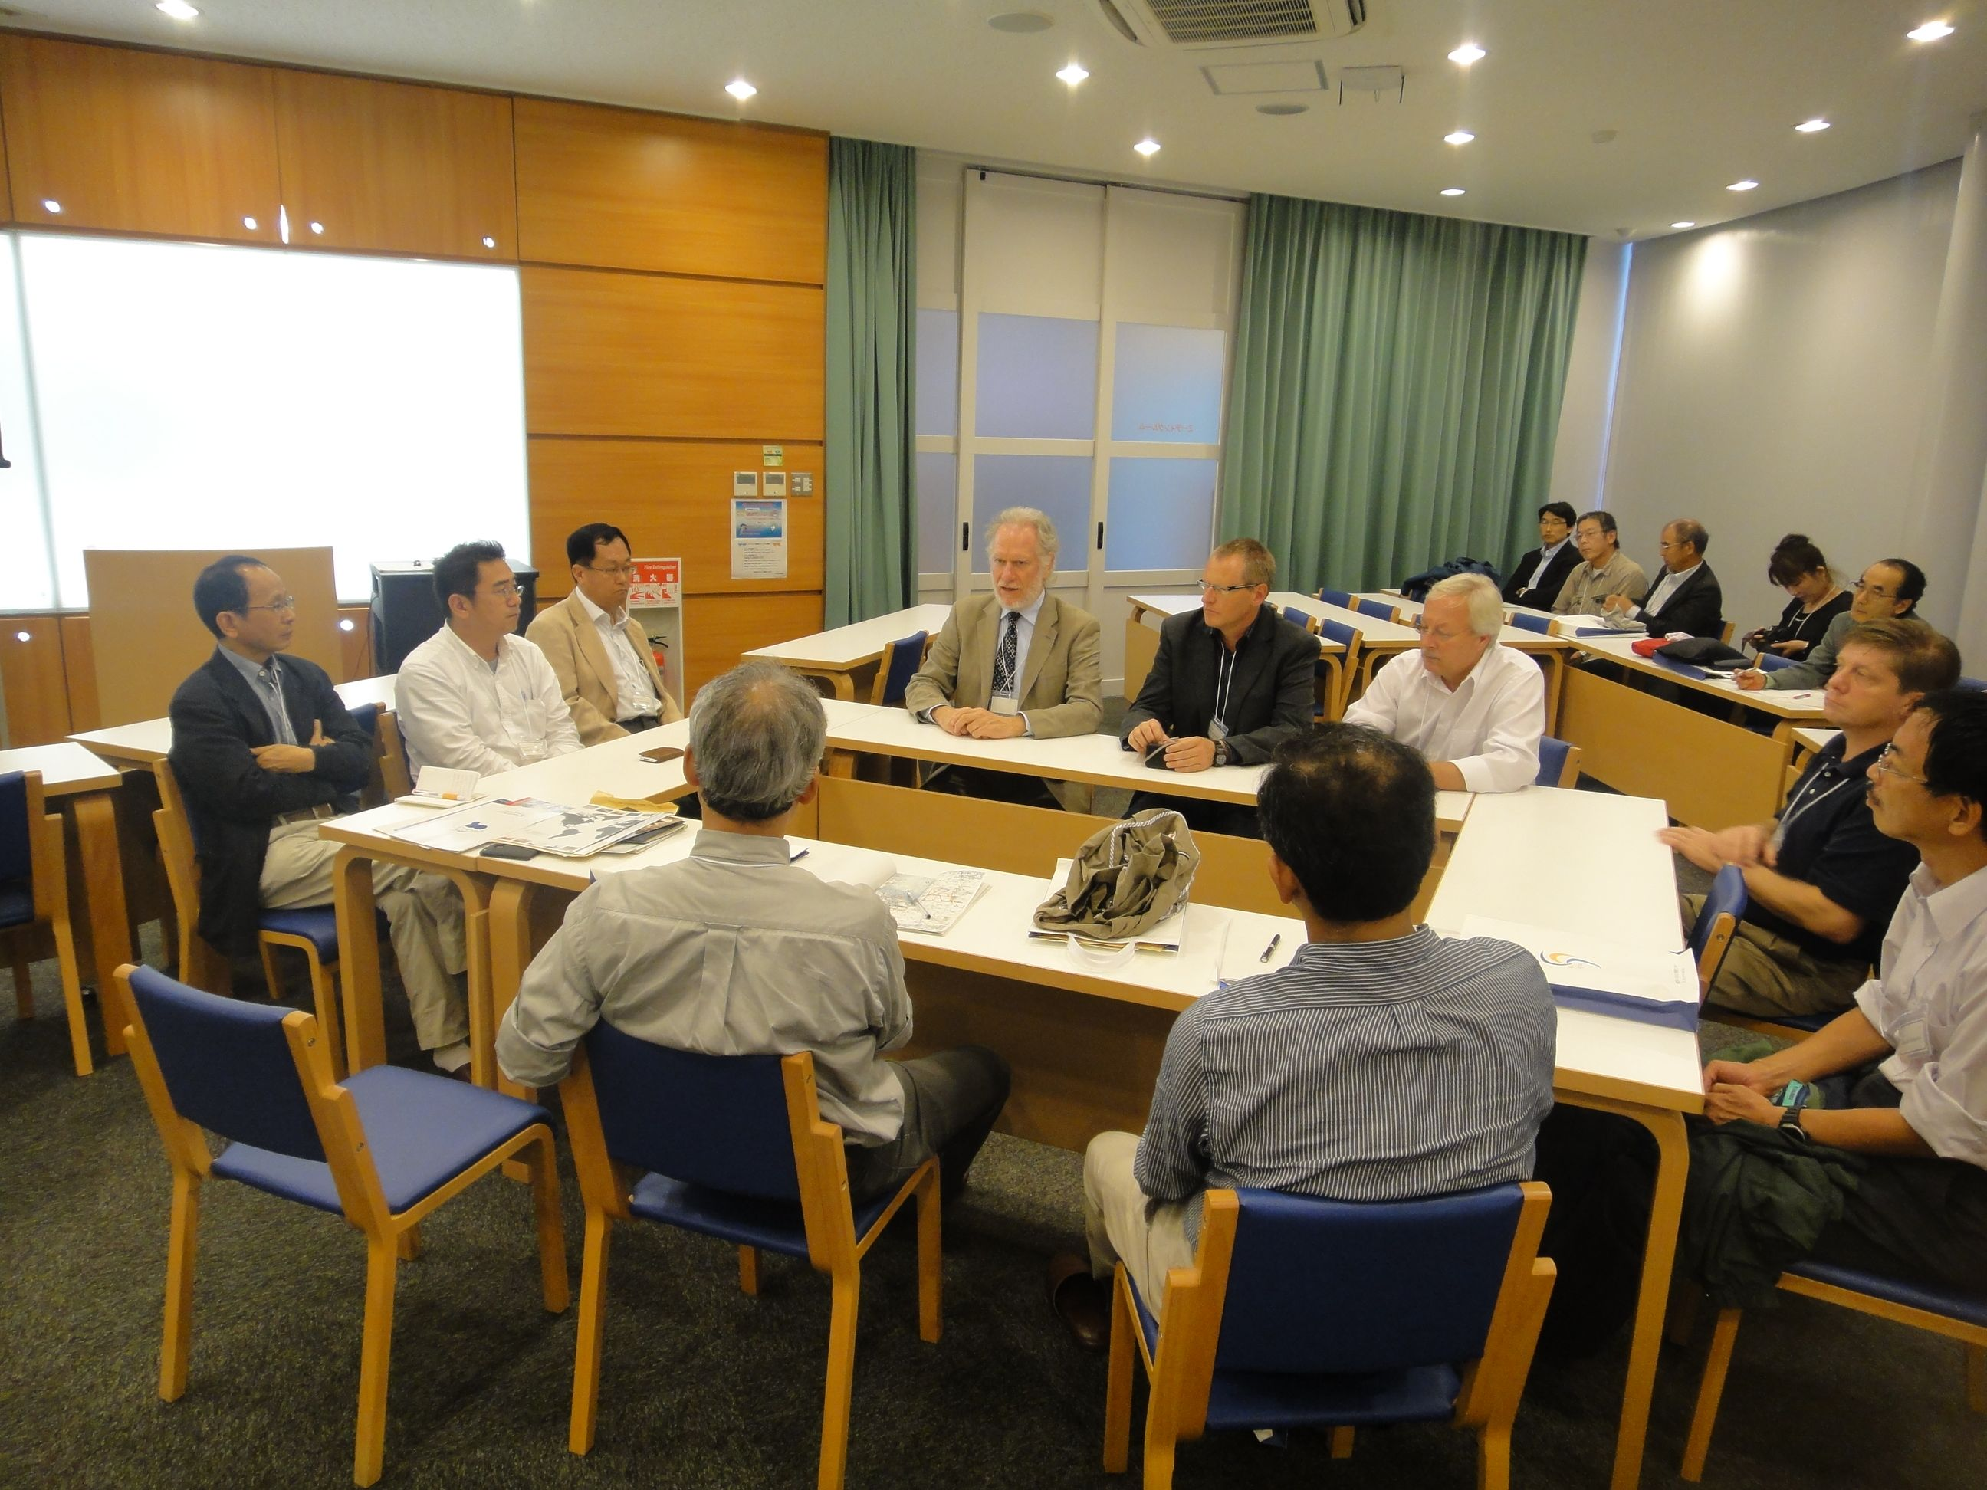
Kyushu/Sefuri area

Slide 11
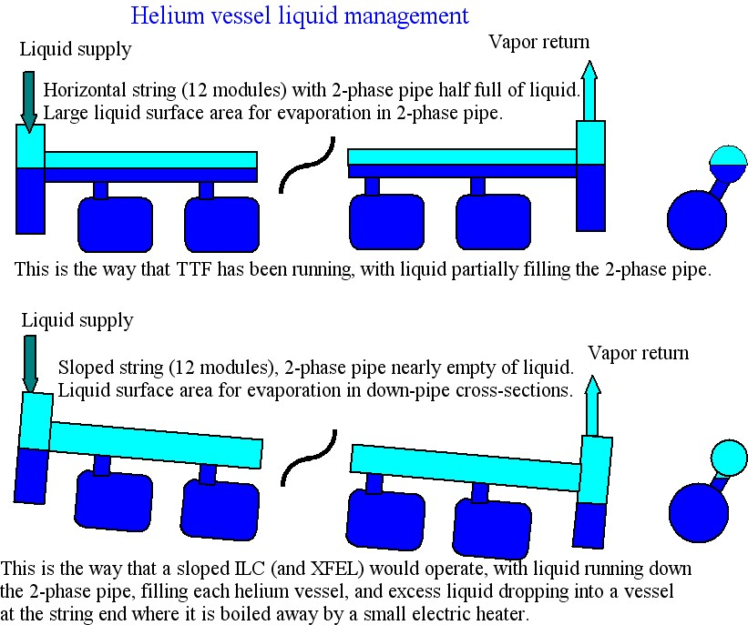

Slide 12
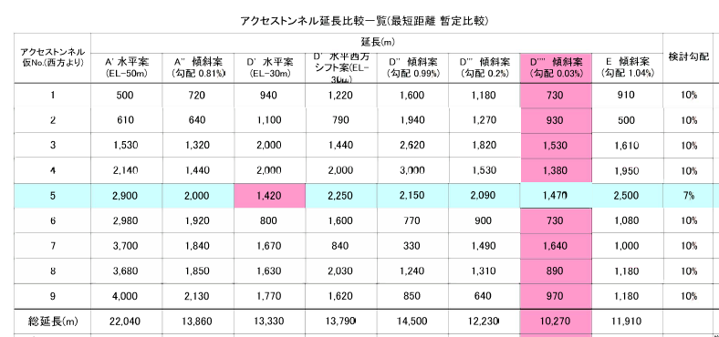
Tunnel Tilting Effect in Sefuri Site
0.8 % tilting enables to save access tunnel length from 22 km to 14 km

Slide 13
Technical-change Decisions Concluded
ML: lattice design based on the cavity-string of {9+4Q4+9} = 26 (in KCS) or 1.5x 26 = 39 in RDR-like RF,
HLRF: KCS w/ flat-land geology, and RDR-like w/ mountain geology
Cryomodule: RDR-like (9+4Q4+9) w/ conduction cooled SCQ at center, and w/ simplification of 5 K shield
Cryogenics: 5 plants / linac allowing a limited tilting w/ reasonable variation (20%) of spacing b/w plants,
Cavity Integration: Cavity; Tesla + Blade tuner, magnetic shield inside,
Cavity gradient: Updated recipes and production yield definition,
Cryomodule tests: in reasonable rate (1/3 ~ ¼) and reasonable cost-balance,
ML-CFS: tunnel-extension to keep energy overhead up to ~ 1.4 % (~150 m) in addition to the current overhead of 3 % (i.e.: assuming 35 to 34 MV/m degradation already in cavity gradient design
  Corresponding 2 x SB2009-RDR-RF units, 2 x 39 cavities per side , (+ 150 m tunnel / linac),
  If tunnel tilting required, additional length of ~ 100 m / 0.5 % required, and the energy overhead not available,
  the ML length to be fixed under constraint of balance of timing issues b/w electron and positron,
  This to be well discussed with detector/physic community and

Slide 14
Home-Works by Korea Meeting
ML Integr. | ML lattice with 9+4Q4+9 cryomodule unit, Energy overhead (1.4%) for operational availability, and add. length Total numbers of CM including ML, RTML, e-source (add. CMs to be fixed) Q magnet + corrector magnet design, and energy dependent design? Strategy for full power upgrade at 500 GeV, and scenario for 1 TeV (Q configuration, FDFD up to 500 GeV, and FFDD at 1 TeV?)
HLRF | Cost saving of PDS, Klystron, Marx Generator and …
CM and Crogenics | CM slot length fixed to be 11,734.5 +850 mm in RDR, or new number 11,830+850 mm from Chicago mtg (2008) Access-ability and maintenance of active components (tuner motors), Cryo-line unit length, additional length of Cold-box for phase-separation, to adapt new RDR-like RF unit and/or tilting tunnel and effect on add. length
Cavity Integr. | Cavity-slot length to be well fixed (to be 1326.7 mm) Reality of magnetic shield inside Lhe tank at central region and outside at inter-connect
Cavity Gradient | Update fabrication process and recipe (such as including tumbling), Re-definition of production yield

Slide 15
backup

Slide 16
Main Linac Layout
Kamaboko RFU: 39 cavities / klystron
  4.5 cryomodules
  Always consider x2 as “atom” → 9 cryomodules
  ΔE ~2x 1.27 = 2.54 GeV (1%)
  235/2.54 = 93: 186 RFU-39 or 837 cryomodules
  0.4% energy margin
  TBR: Add 2 RFU-39 as overhead
  188 RFU-39 → 1.4% energy margin
KCS (RDR – 26 cavities / “klystron”)
  Similar analysis yields 3 CM less per linac
  1.0% energy margin.

Slide 17
Cryo Layout (Kamaboko)
Question for Tom Peterson
RDR (KCS)
  2.5 cold-box every 4 RFU or 12 cryomodules
Kamaboko
  Atomic unit = 9 cryomodules (2x klystrons)
  Need to move cold box to
    every 9 modules (more tunnel length / cold boxes)
    every 18 cryomodules (shorter but problem for cryo?)

Slide 18
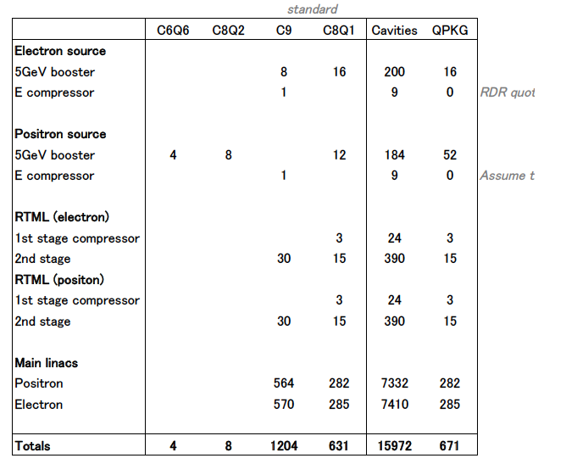
Summary of Numbers of CMs as of Jan. 2012 (by N. Walker)

Slide 19
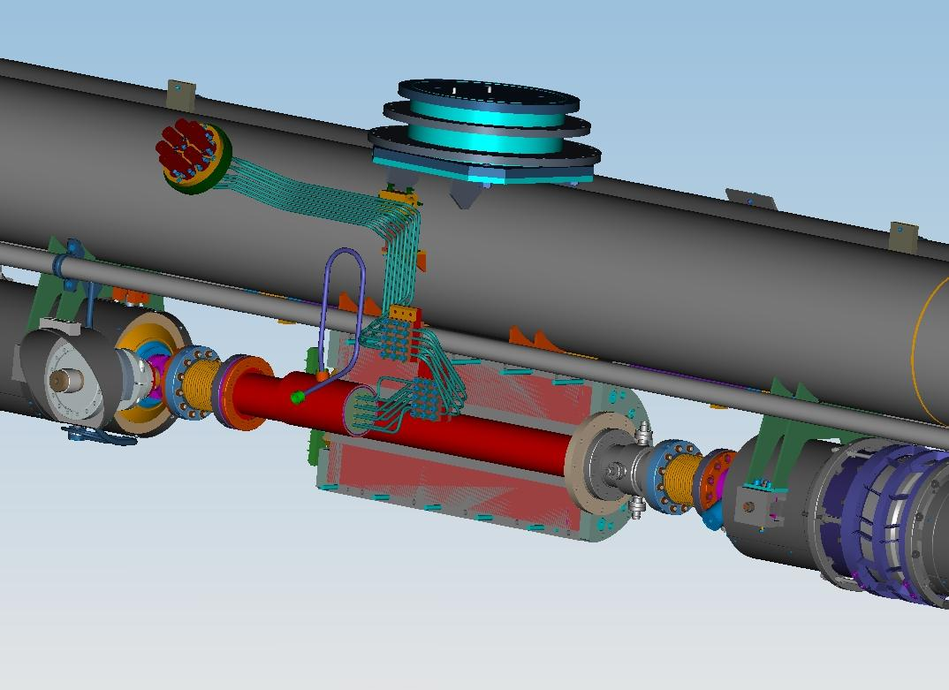
Quadrupole Cross-Section
LHe tank for current leads connections
Beam pipe
Iron yoke
V. Kashikhin, FNAL Review, March 2, 2010

Slide 20
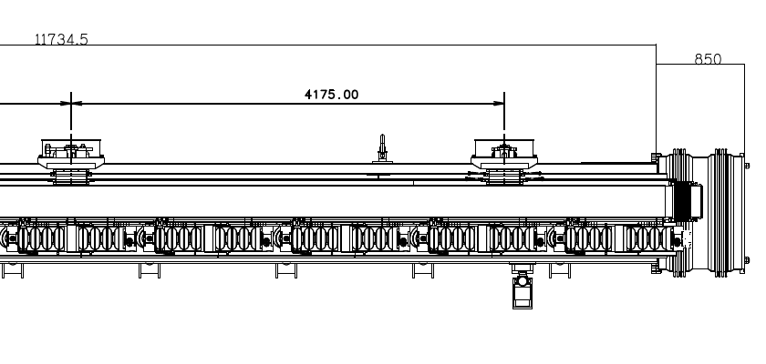
CM4’ Length checked at KEK

Slide 21
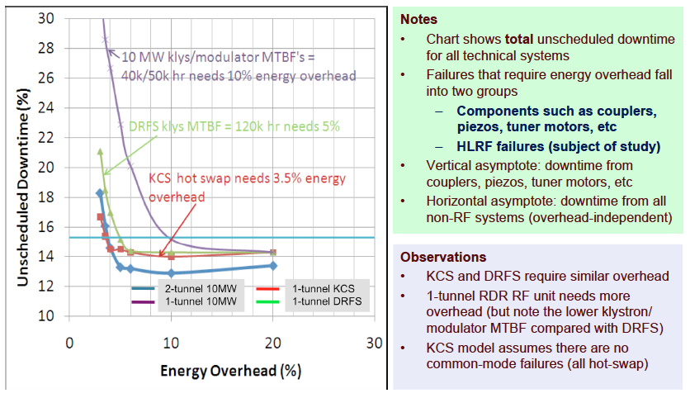
Total Unscheduled downtime vs enrergy Overhead
(slide from E. Elsen, ML/SCRF-BTR)

Slide 22
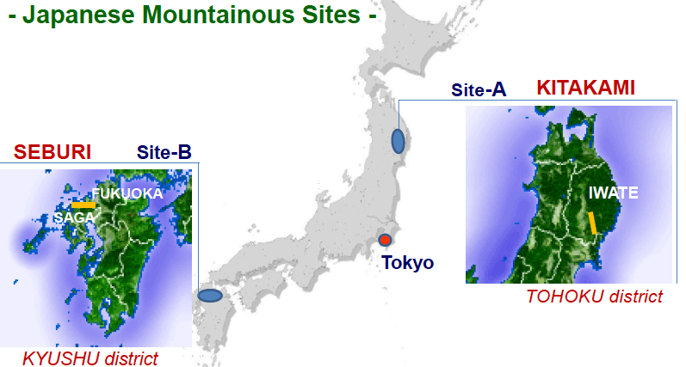
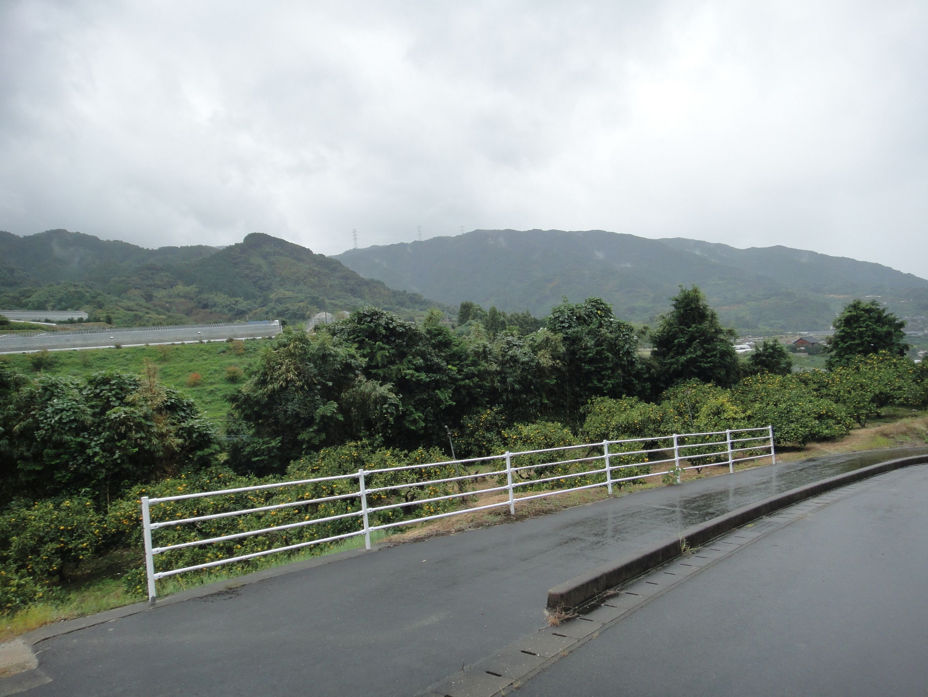
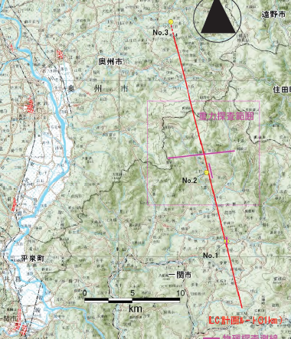
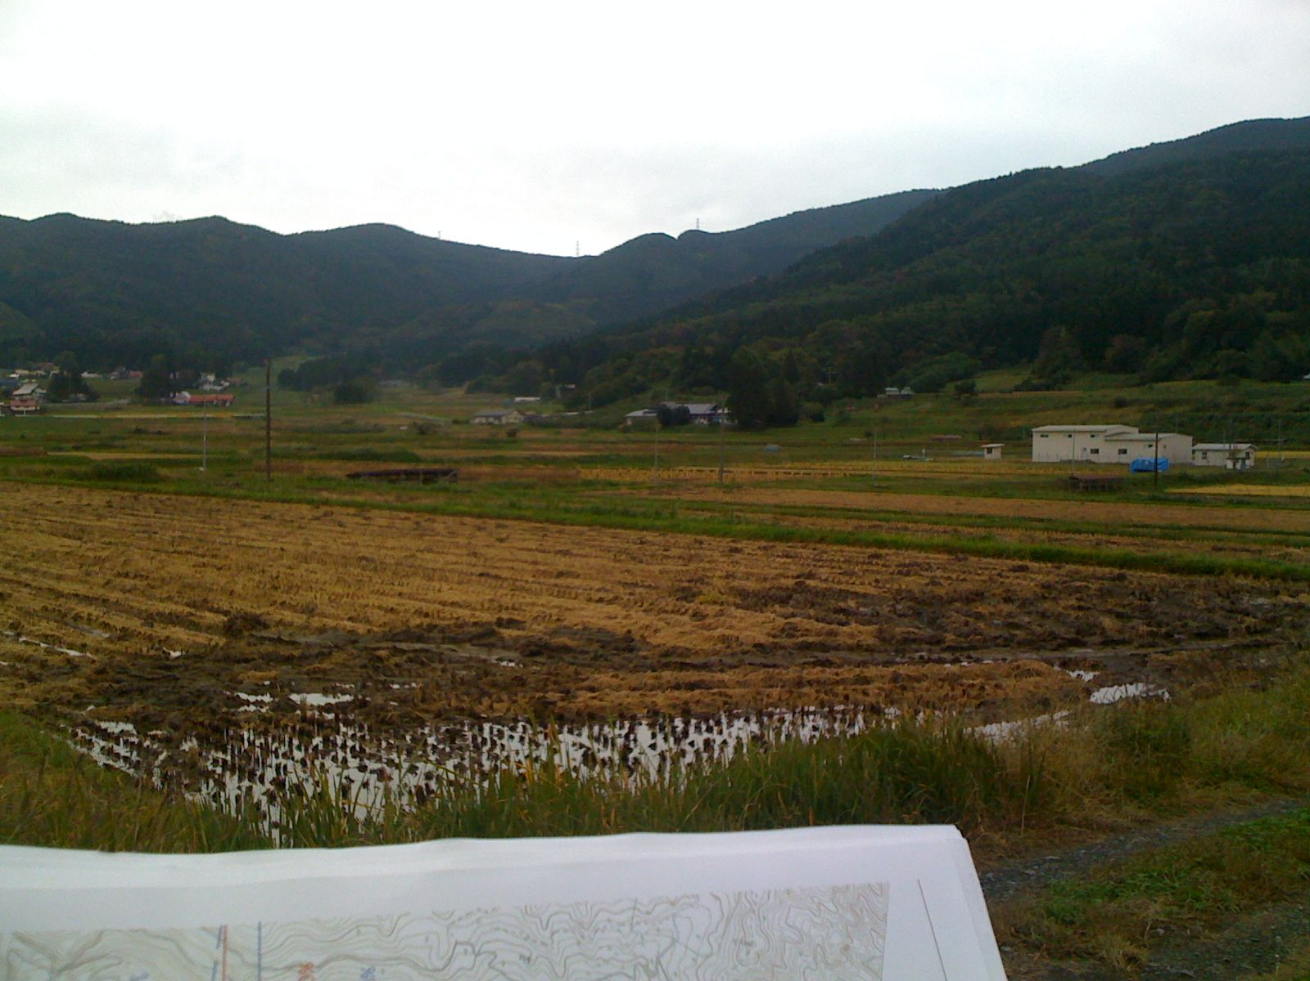
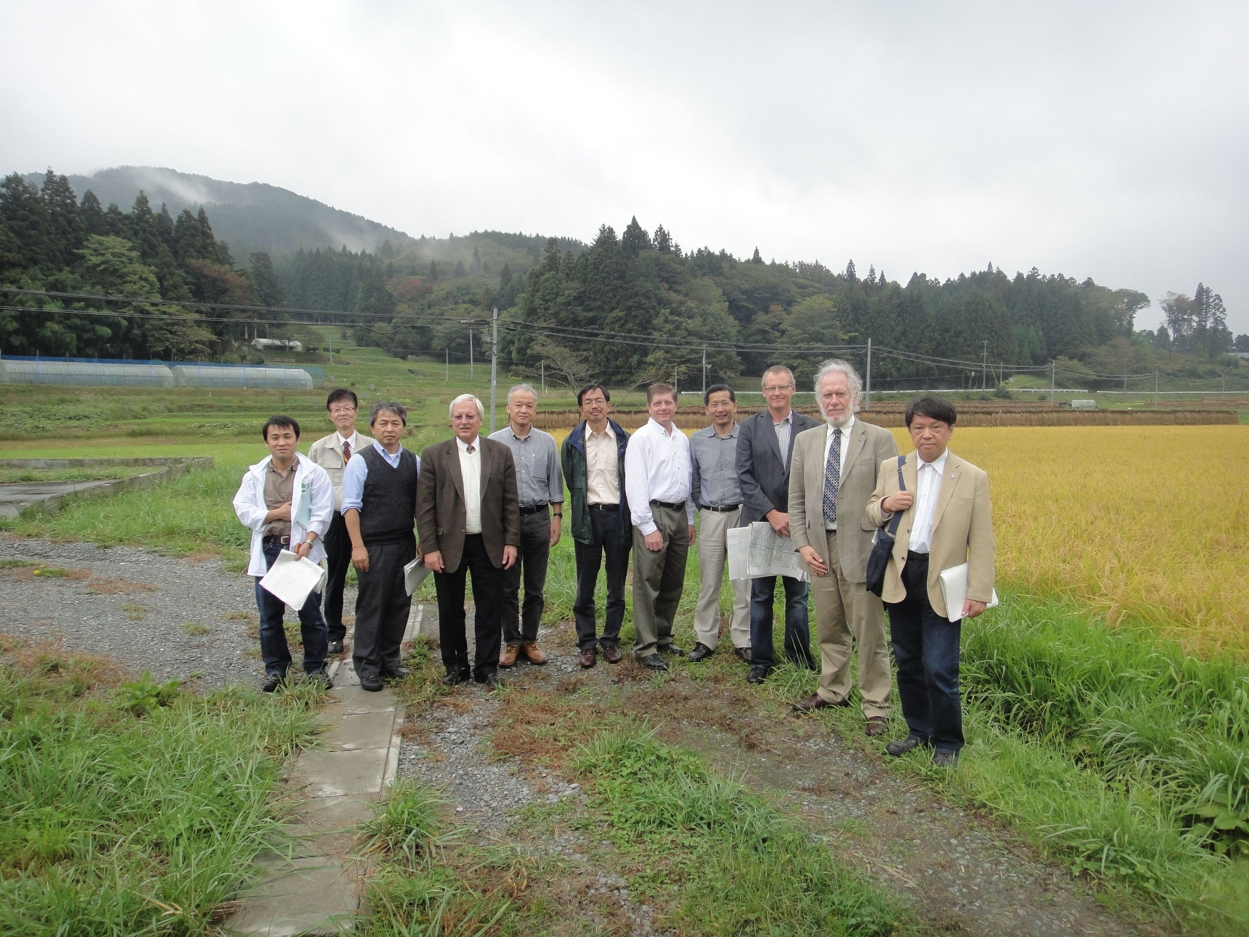
Two Candidate Sites in
Japanese mountainous locations
SEFURI
- GDE-CFS group visited two candidates sites,
Oct. 14 and 15, 2011

