Slide 1
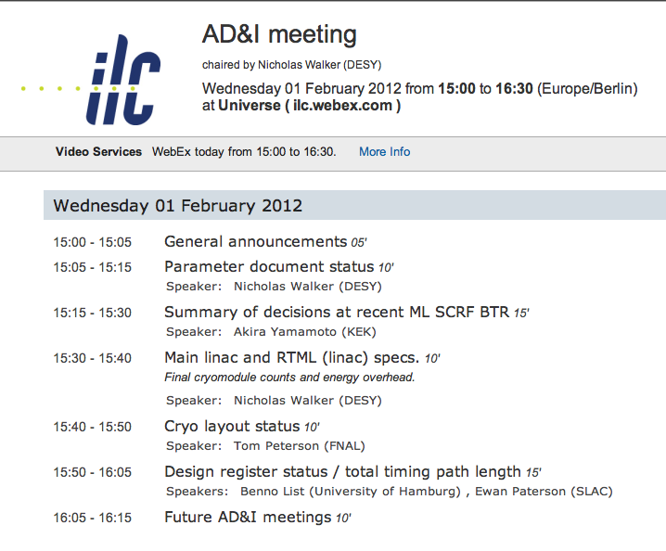

Slide 2
Top-Level Parameters
Consolidated single time-structure
  1312 bunches, 554 ns
Includes parameter sets for upgrades:
  luminosity upgrade (one set)
  TeV upgrade (two sets ,low and high beamstrahlung)
Peak luminosity adjustment: 1.8×10³⁴ cm⁻²s⁻¹ @ 500 GeV
  travelling focus not included
EDMS:
http://ilc-edmsdirect.desy.de/ilc-edmsdirect/document.jsp?edmsid=*925325
TDD: http://www.linearcollider.org/GDE/technical-design-documentation

Slide 3
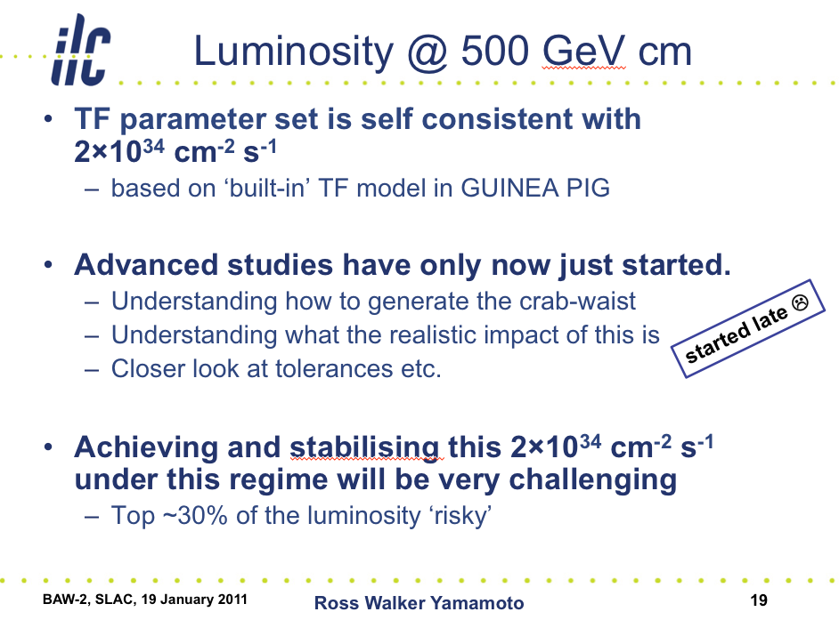
SLAC BAW Jan 2011
PM close-out to low-P discussion

Slide 4
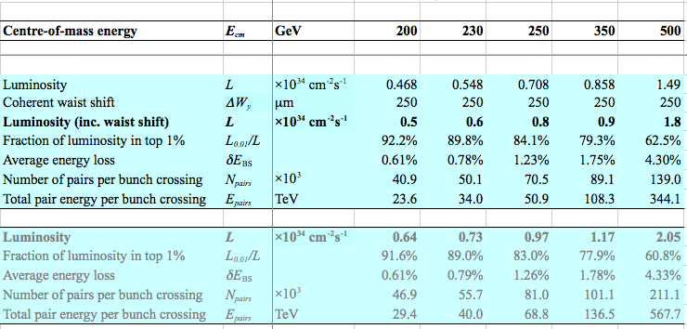
Published Parameters
luminosity now includes enhancement due to coherent vertical waist shift at IP
Trivial to implement (free!)
Travelling focus proving intractable to realise
lower risk

Slide 5
Published Parameters
~20% difference?
to be checked!
luminosity now includes enhancement due to coherent vertical waist shift at IP
Trivial to implement (free!)
Travelling focus proving intractable to realise
lower risk

