Slide 1


LO Phase Study
Mikey Davis
03 February 2012
1/21

Slide 2
LO Phase Study
Analysed all the data sets from all the shifts from the November / December trip
Data arranged in a shift by shift format
Some data sets are dealt with in greater detail
Outliers left in, but explained
All data from P3, y (unless stated)
Mikey Davis
03 February 2012
2/21

Slide 3
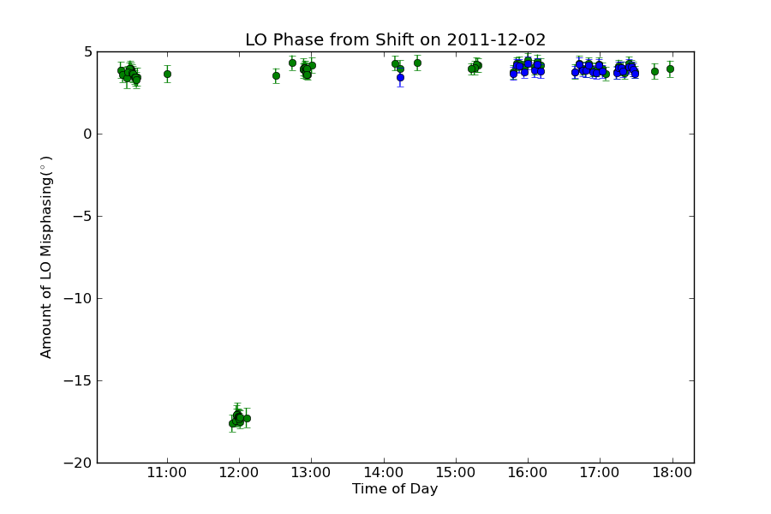
LO Phase Over A Shift
Attenuators added, LO not rephased
Bunch 1
Bunch 2
Mikey Davis
03 February 2012
3/21

Slide 4
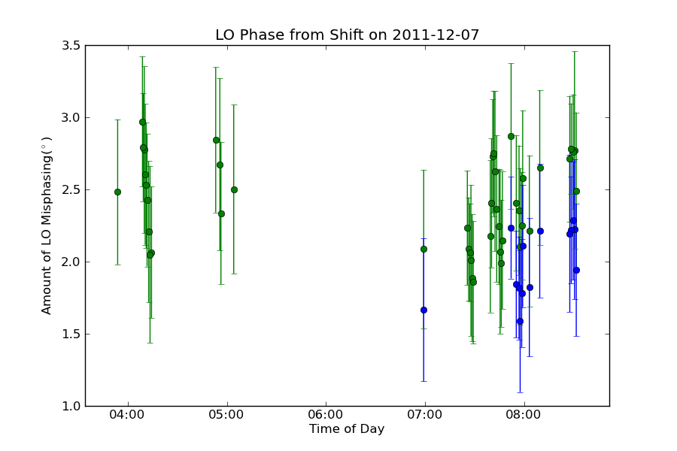
LO Phase Over A Shift
Shift 1
Bunch 1
Bunch 2
Mikey Davis
03 February 2012
4/21

Slide 5
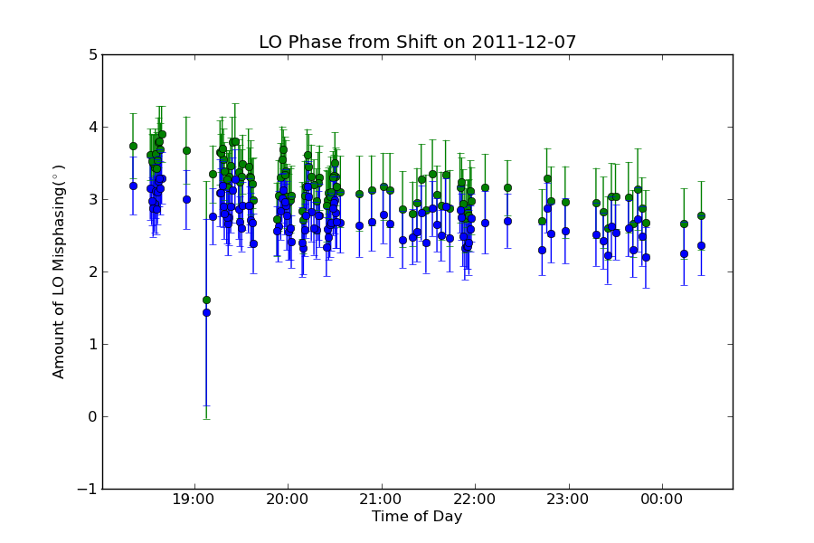
LO Phase Over A Shift
Shift 2
Bunch 1
Bunch 2
DAQ test (basically junk data)
Mikey Davis
03 February 2012
5/21

Slide 6
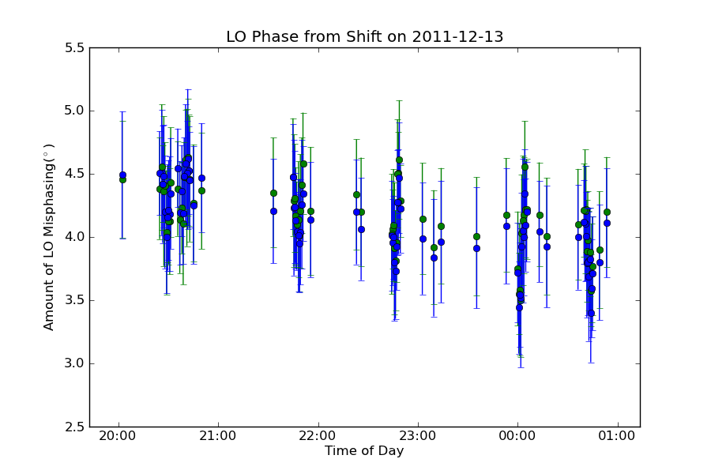
LO Phase Over A Shift
Bunch 1
Bunch 2
Mikey Davis
03 February 2012
6/21

Slide 7
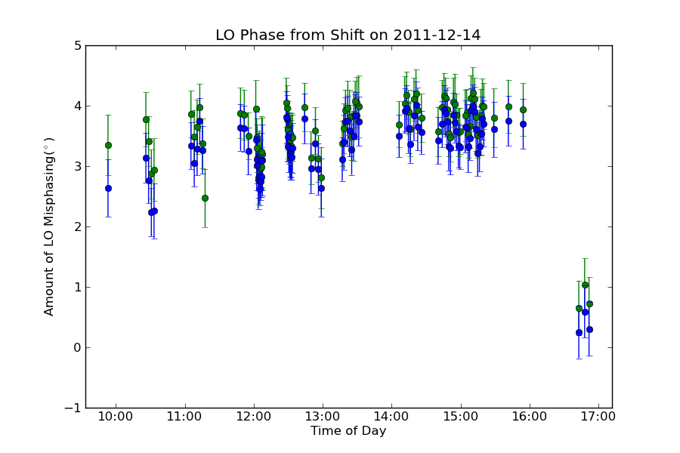
LO Phase Over A Shift
Setup changed, BPMs rephased
Bunch 1
Bunch 2
Mikey Davis
03 February 2012
7/21

Slide 8
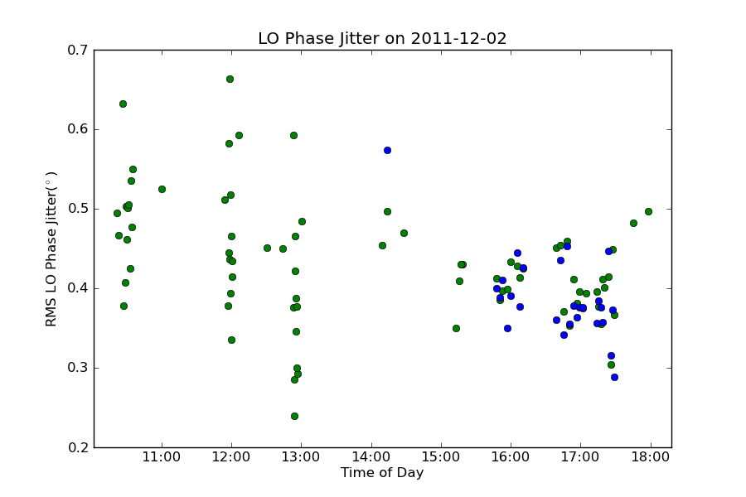
LO Jitter Over A Shift
Bunch 1
Bunch 2
Mikey Davis
03 February 2012
8/21

Slide 9
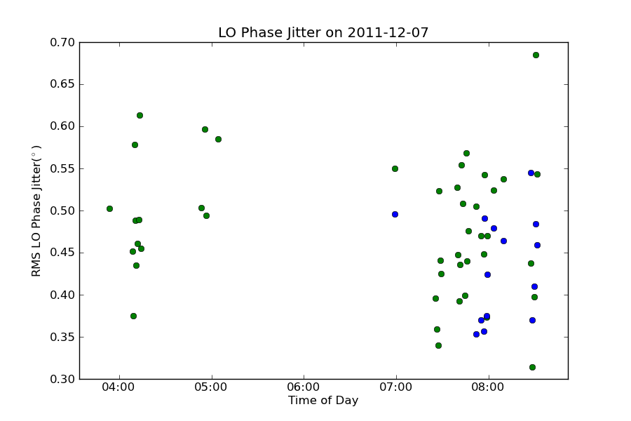
LO Jitter Over A Shift
Shift 1
Bunch 1
Bunch 2
Mikey Davis
03 February 2012
9/21

Slide 10
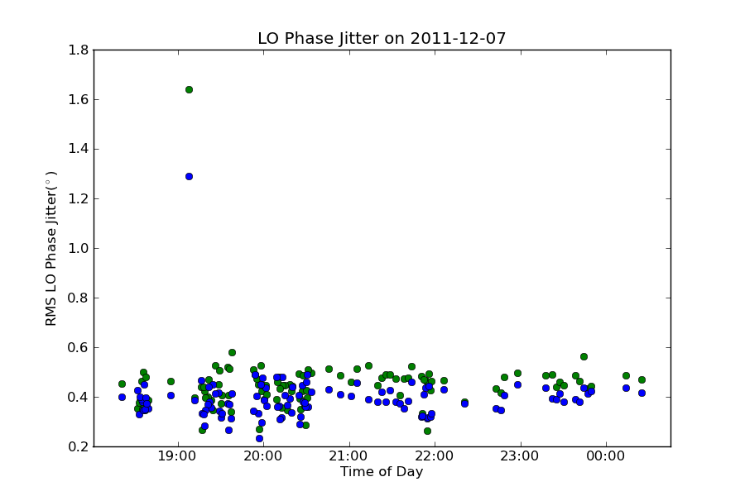
LO Jitter Over A Shift
Shift 2
DAQ test (basically junk data)
Bunch 1
Bunch 2
Mikey Davis
03 February 2012
10/21

Slide 11
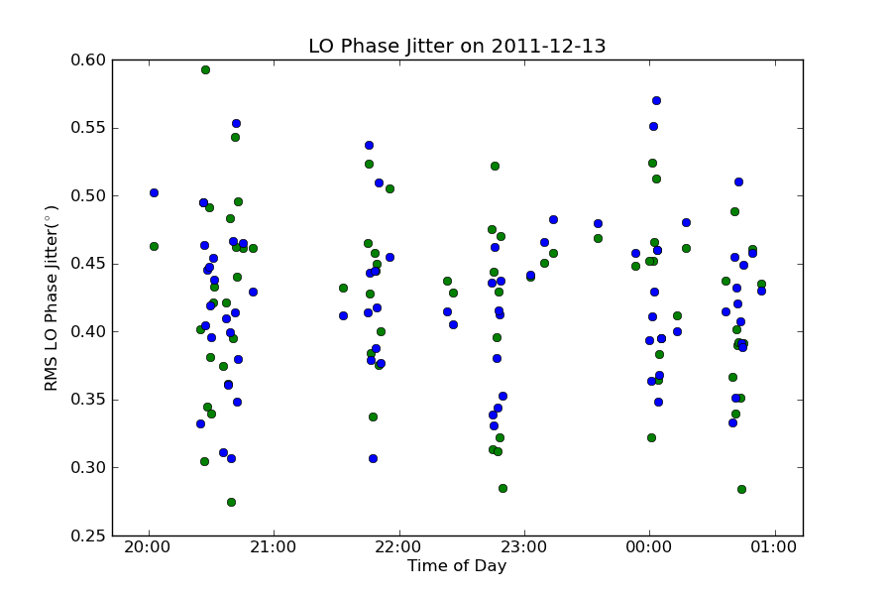
LO Jitter Over A Shift
Bunch 1
Bunch 2
Mikey Davis
03 February 2012
11/21

Slide 12
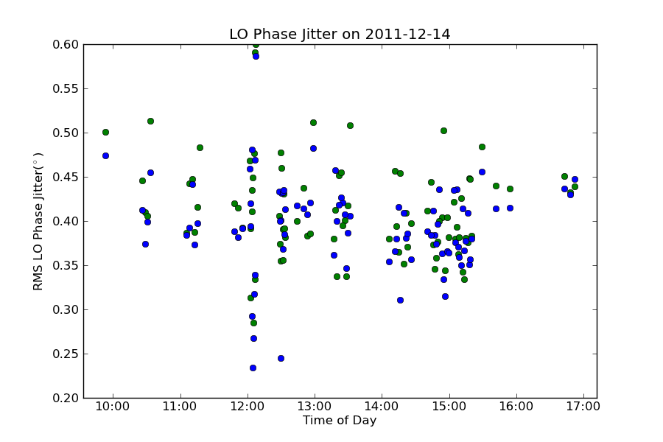
LO Jitter Over A Shift
Bunch 1
Bunch 2
Mikey Davis
03 February 2012
12/21

Slide 13
LO Jitter Examined
Bunch 1
Bunch 2
Mikey Davis
03 February 2012
13/20

Slide 14
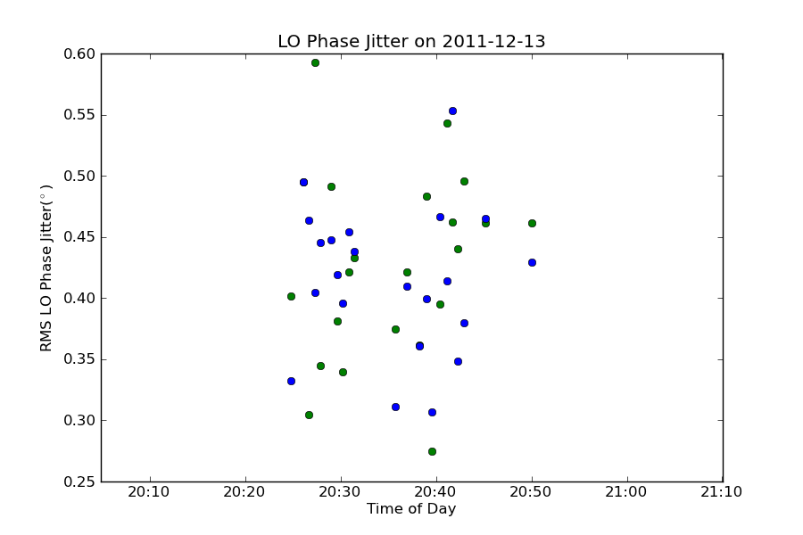
LO Jitter Examined
Bunch 1
Bunch 2
Mikey Davis
03 February 2012
14/21

Slide 15
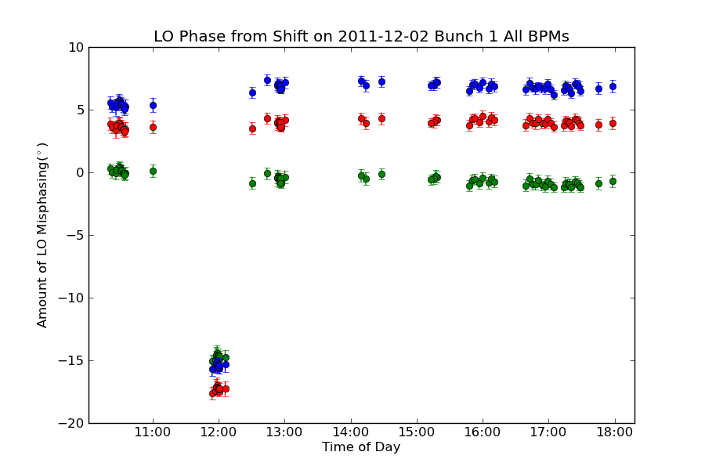
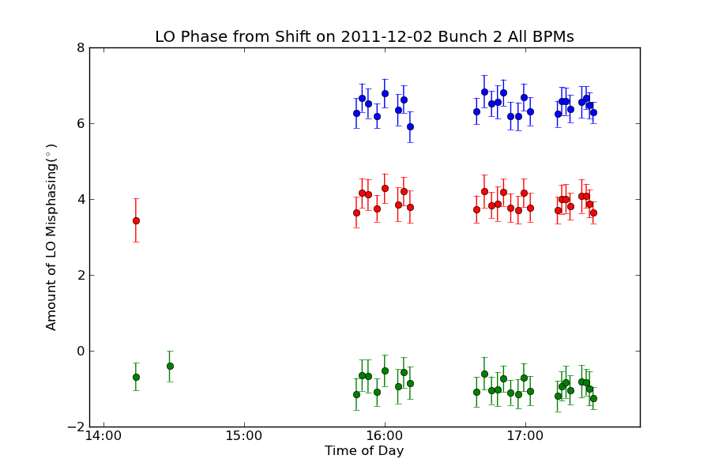
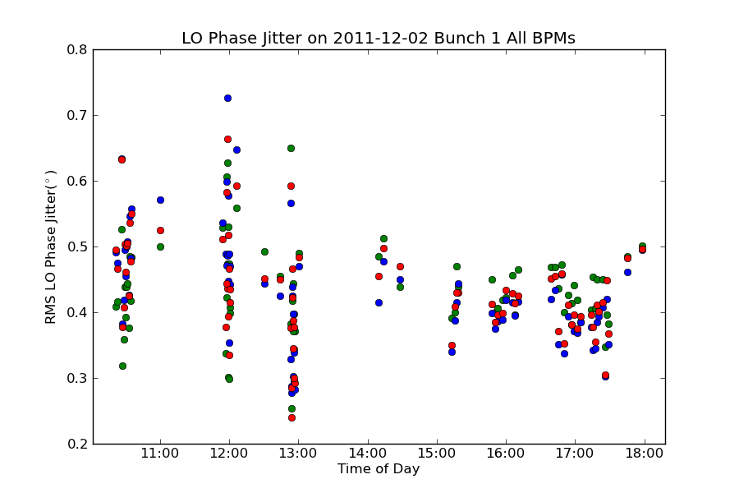
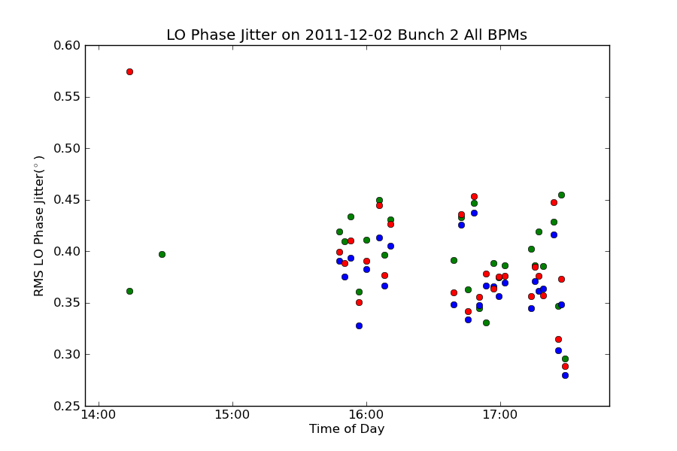
LO Phase Over A Run
Bunch 1
Bunch 2
Bunch 3
Mikey Davis
03 February 2012
15/21

Slide 16
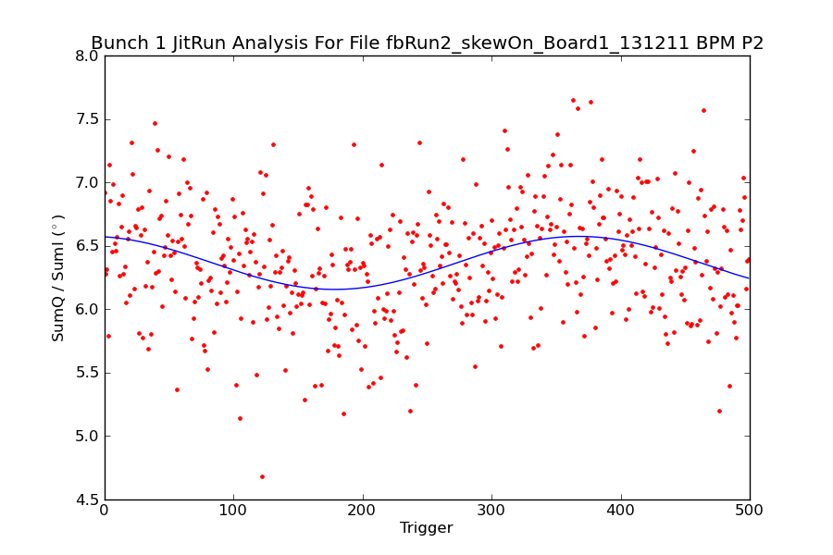
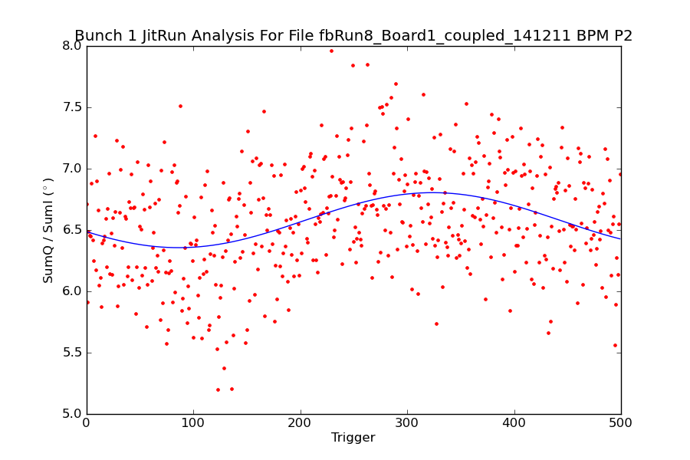
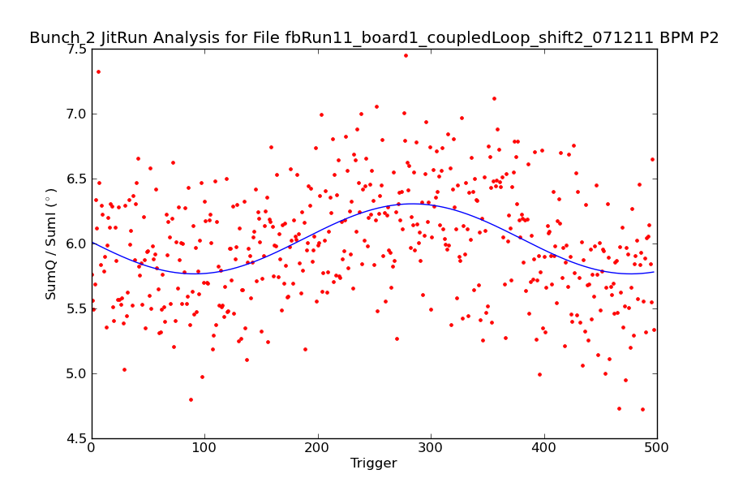
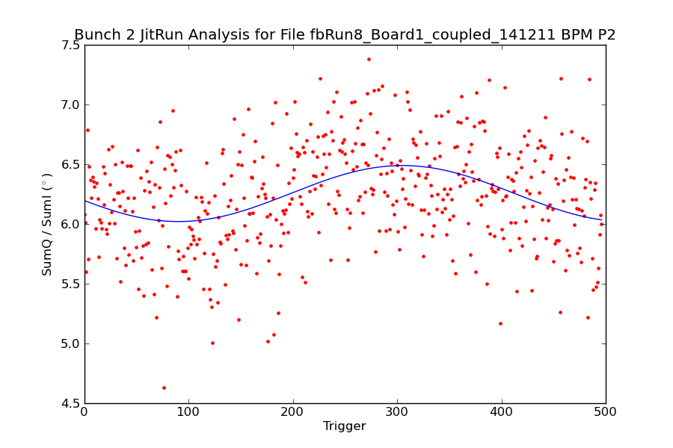
LO Phase Over A Run
Mikey Davis
03 February 2012
16/21

Slide 17
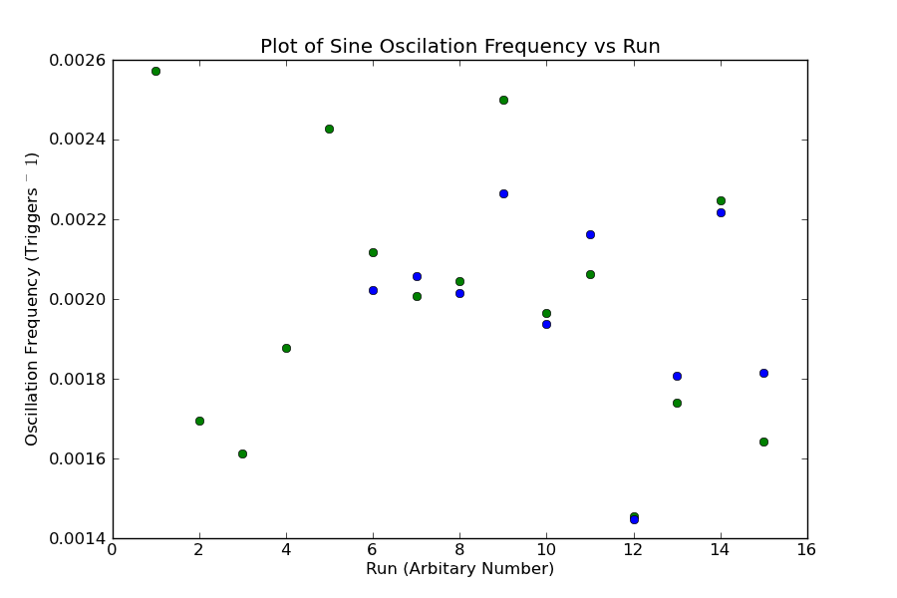
LO Phase Over A Run
Bunch 1
Bunch 2
Mikey Davis
03 February 2012
17/21

Slide 18
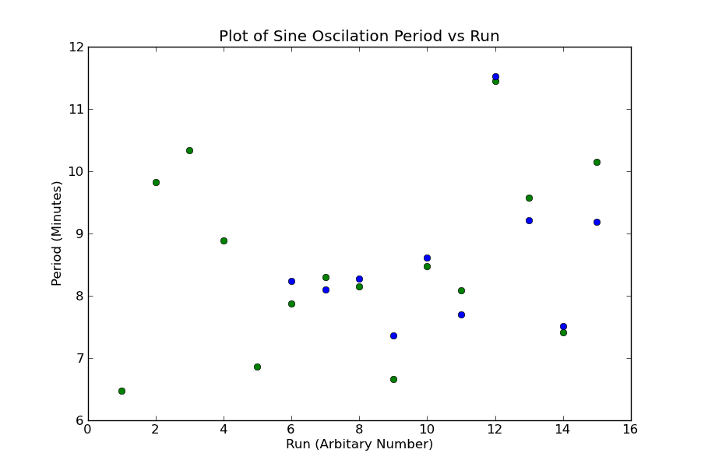
LO Phase Over A Run
Bunch 1
Bunch 2
Mikey Davis
03 February 2012
18/21

Slide 19
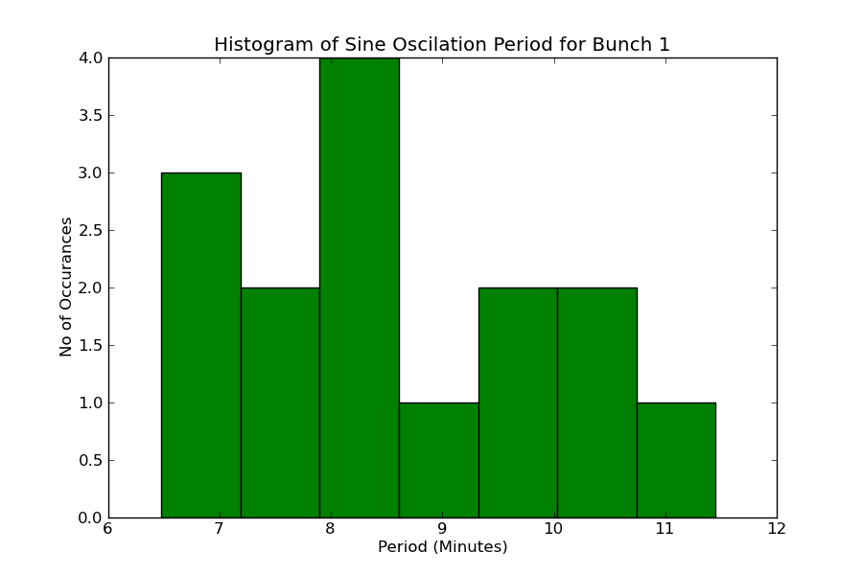
LO Phase Over A Run
Bunch 1
Mikey Davis
03 February 2012
19/21

Slide 20
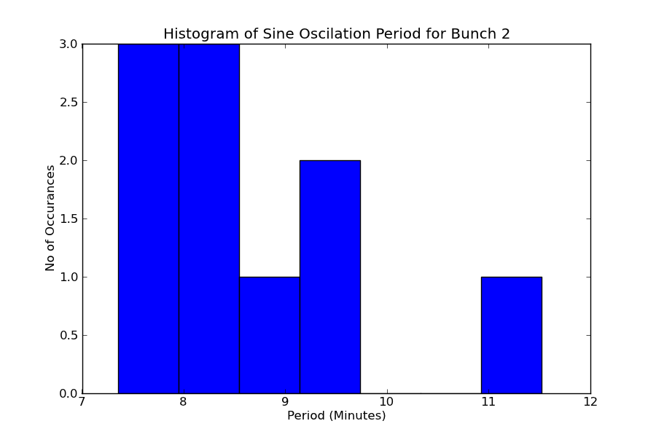
LO Phase Over A Run
Bunch 2
Mikey Davis
03 February 2012
20/21

Slide 21
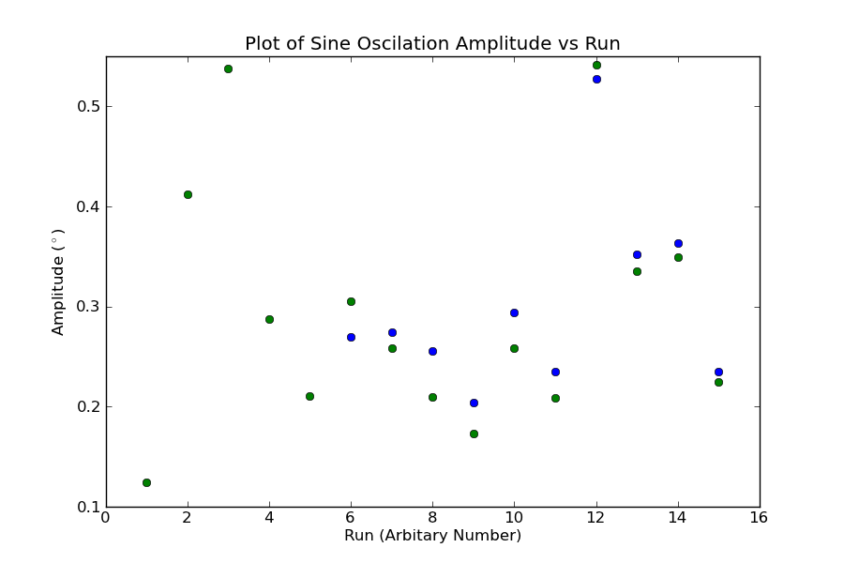
LO Phase Over A Run
Bunch 2
Mikey Davis
03 February 2012
21/21

