Slide 1


Further Investigations into the LO
Mikey Davis
10 February 2012
1/7

Slide 2
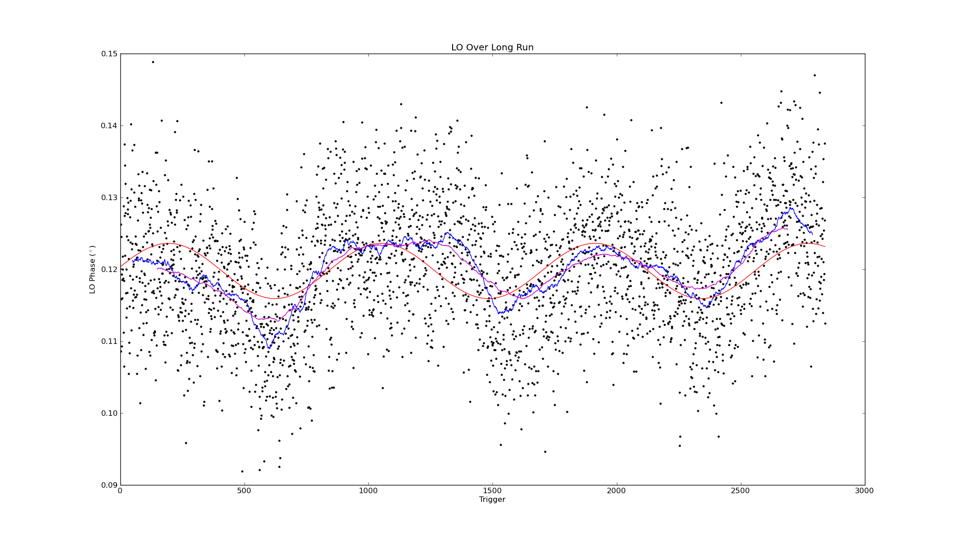
Lo Over a Long Run
Red Fitted Sine Wave
Blue 100 point Moving Average
Magenta 300 Point Moving Average
Mikey Davis
10 February 2012
2/7

Slide 3
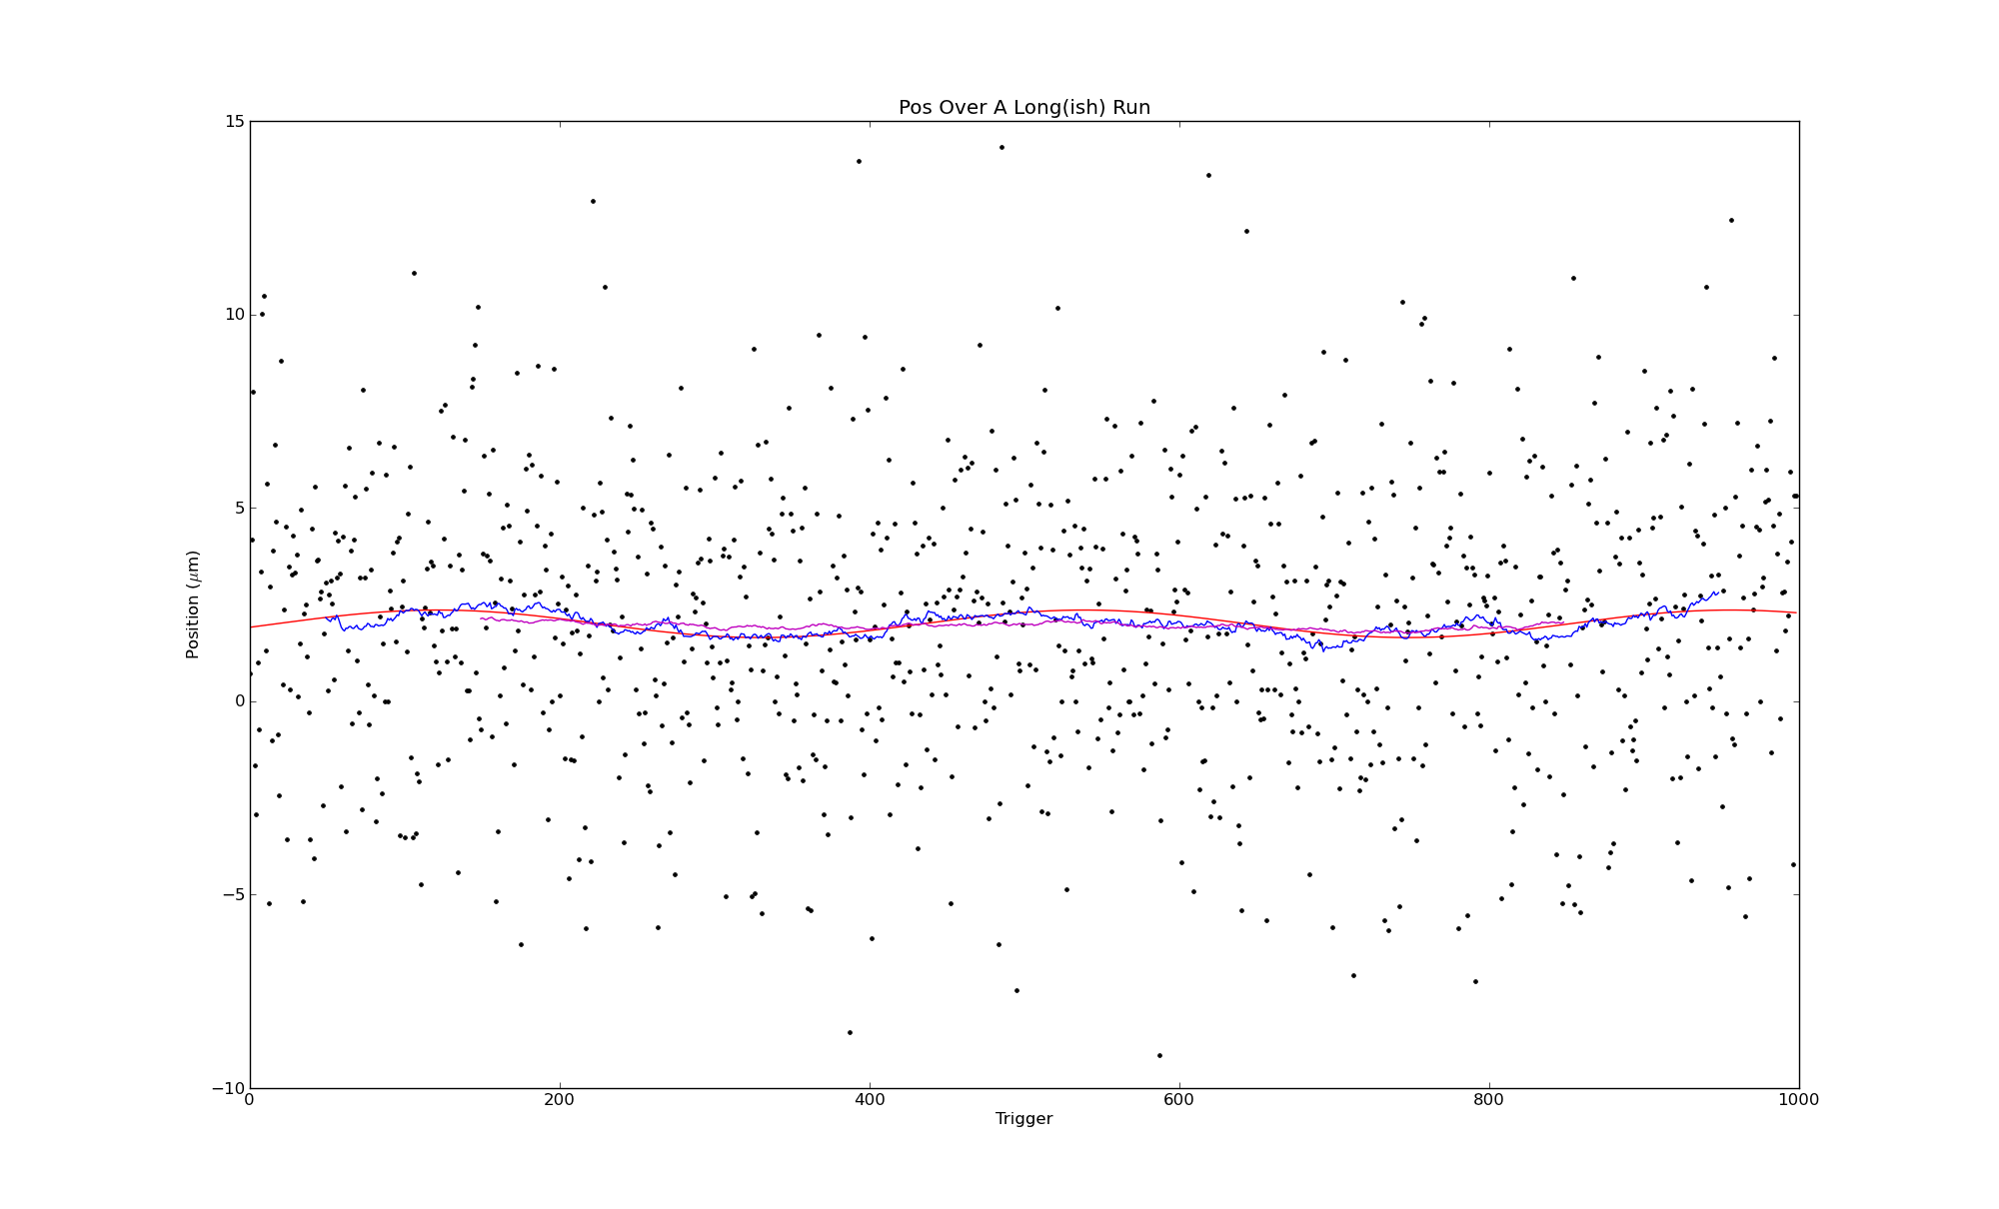
Lo Over a Long Run
Red Fitted Sine Wave
Blue 100 point Moving Average
Magenta 300 Point Moving Average
Mikey Davis
10 February 2012
2/7

Slide 4
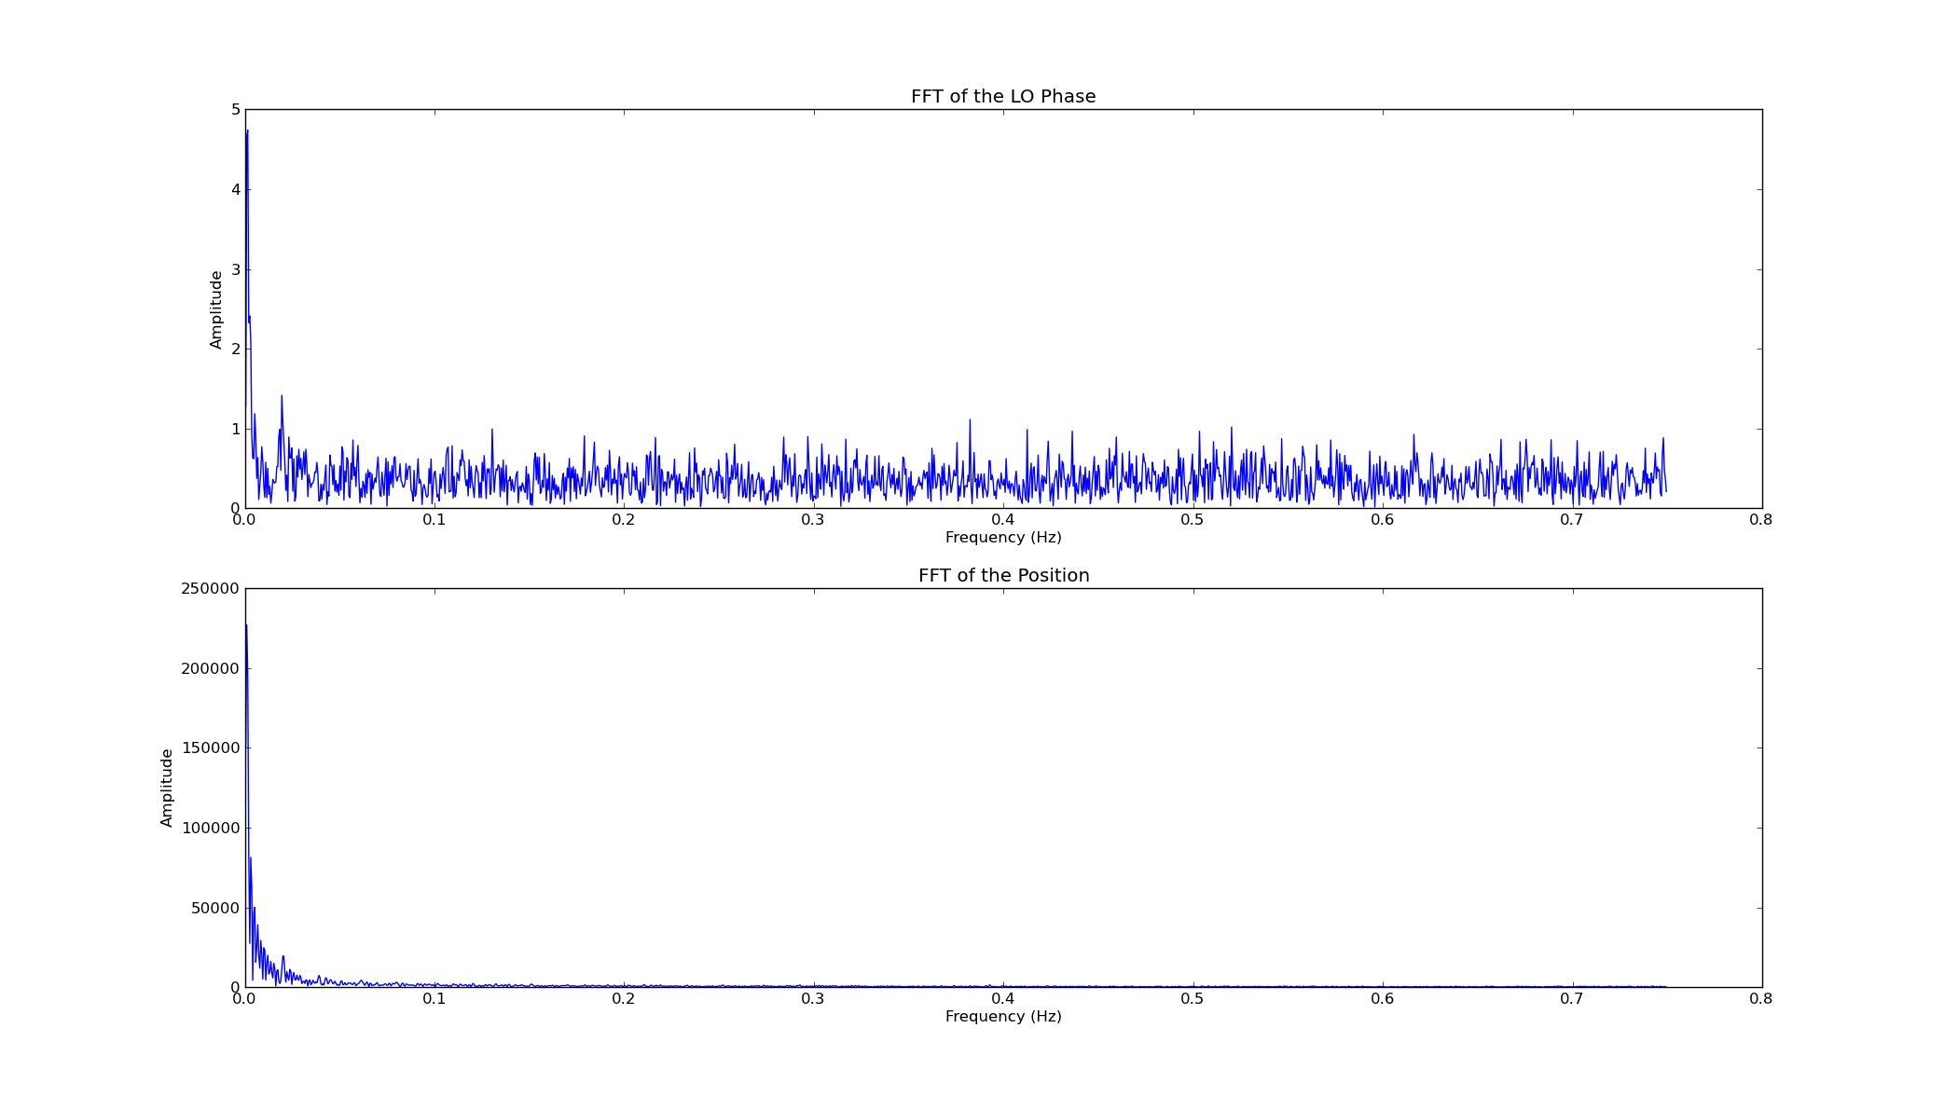
FFT of the Signals
Mikey Davis
10 February 2012
3/7

Slide 5
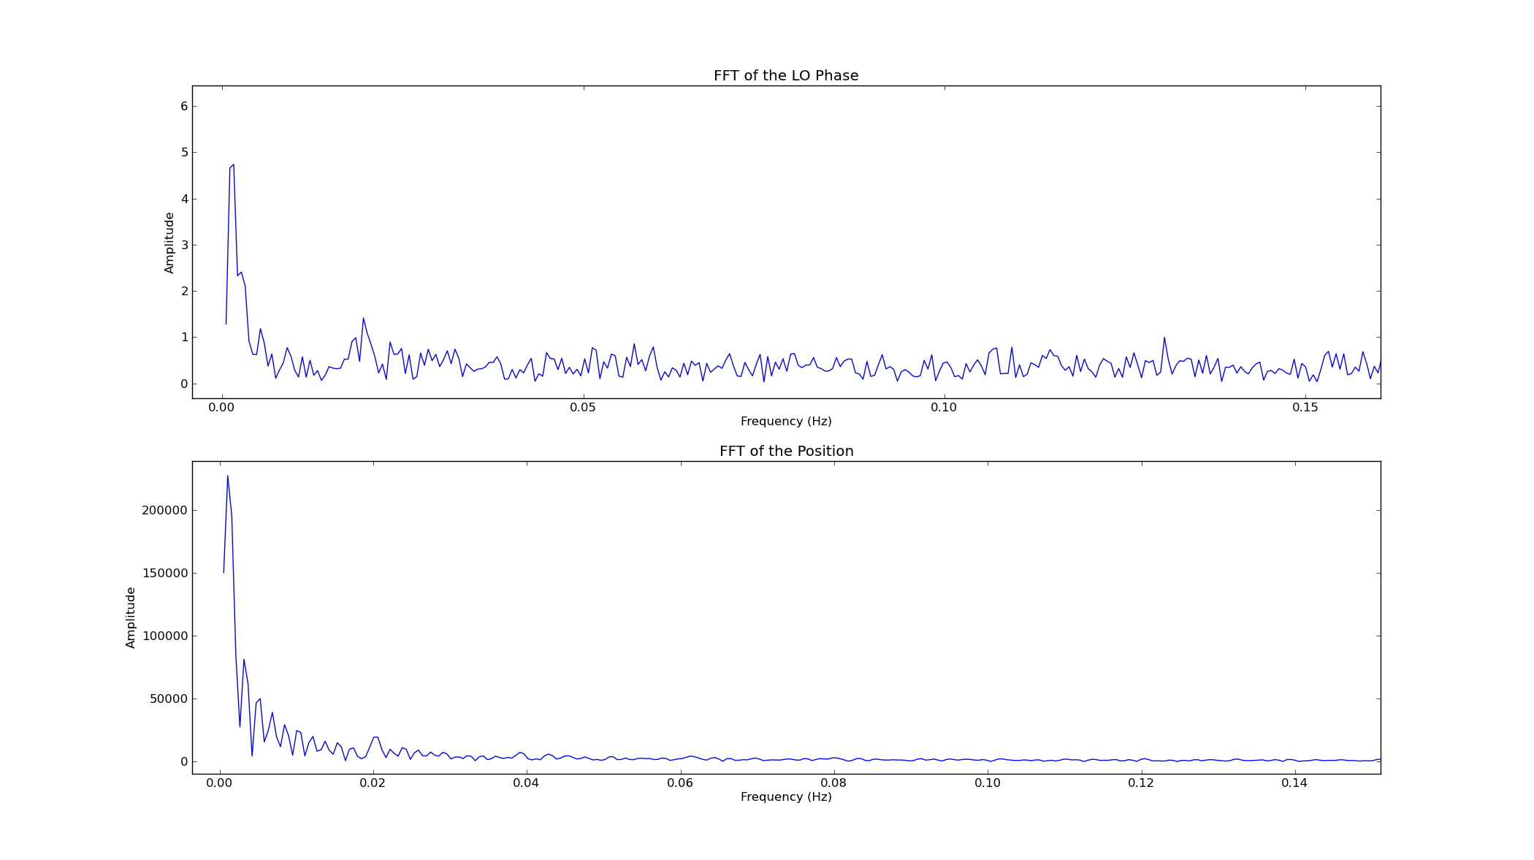
FFT of the Signals
Mikey Davis
10 February 2012
4/7

Slide 6
FFT of the Signals
Period of Approx. 12 Mins
Period of Approx. 50 Seconds
Mikey Davis
10 February 2012
5/7

Slide 7
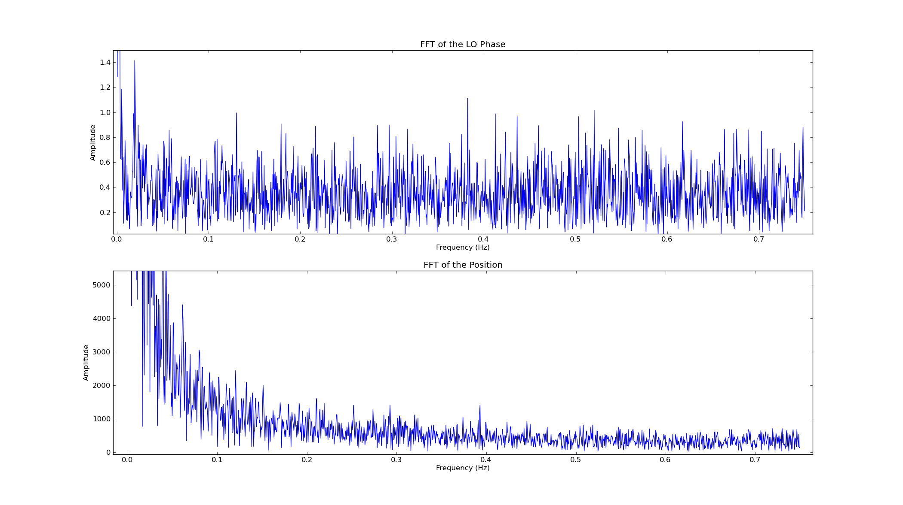
FFT of the Signals
Mikey Davis
10 February 2012
6/7

Slide 8
FFT of the Signals
Period of Approx. 2.5 Seconds
Mikey Davis
10 February 2012
7/7

