Slide 1
AD&I MEETING
CFS REQUIREMENTS STATUS
CONVENTIONAL FACILITIES
AND SITING
V. Kuchler
Notes:
:

Slide 2
Overview
  CFS AD&I Action Items
  Requirements Status by Area System
  Status of Laser Room and Dump Requirements
  Central Region Beam and Service Tunnel Status
  CFS Documentation in EDMS

Slide 3
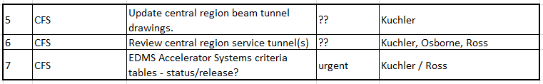
CFS AD&I Action Items
Each of these Items will be Addressed in this Presentation
However there is Overlap for the Input to Each of these Items
Area Systems will be Addressed Individually to Contribute to the Status of Each of the CFS Action Items

Slide 4
  Requirements Status by Area System
  e- Source
    Current Criteria Tables are Based on the Original RDR e- Source Design
    No Updated Lattice Information is Currently Available
    No Specific Location of the e- Source has been Established (see latest Central Region Documentation from B. List 12-21-11)
  e+ Source
    Current Criteria Tables have been Updated – No further Updates are Expected at this Time
    No Updated Lattice Information is Currently Available
  Damping Ring
    Current Criteria Tables will be Updated When New Magnet and Power Supply Information is Available (Meeting with M. Palmer is set for 02-21-12)
    No Updated Lattice Information is Currently Available

Slide 5
  Requirements Status by Area System cont.
  RTML
    Current Criteria Tables and Lattice Information are Based on 16 (1+15) RF Units
    Updated Information (Both Criteria and Lattice) Based on 17 (1+16) RF Units Should be Available by 02-17-12
  Main Linac
    New Main Linac Configurations are being Developed which Consist of a 1.5% (3 RF Units) Length Increase for Undulator Loss and General Operational Overhead
    KCS Layout for the Americas and European Regions is being Finalized by C. Nantista and T. Peterson
    RDR-Like Layout for the Asian Region is being Finalized Through A. Enomoto
    No Updated Lattice Information is Currently Available

Slide 6
  Requirements Status by Area System cont.
  Beam Delivery System
    Current Criteria Tables have been Updated – No further Updates are Expected at this Time
    Lattice Information is Currently Complete
  Interaction Region
    Current Criteria Tables are Under Development, However the Impact on Required CFS Services is Unlikely to Change Significantly
    Lattice Information is Not Required
  General
    Lattice Information is Required to Complete the CFS Drawings in Accordance with PM Guidance
    Lattice Information is not Specifically Required to Begin Work on Cost Estimation
    How Much “Lattice Tweaking” is Permitted Before Overall Machine Timing Becomes and Issue ?

Slide 7
Status of Laser Room and Dump Criteria
  Draft Criteria Documents have been Developed for both Laser Rooms and Dumps
  Number of Laser Rooms has been Established but a Generic Layout Still Needs to be Developed for Service Tunnel Configuration
  Full BDS Service Tunnel Equipment Layout is Still Needed
  Mid-Power and High-Power Dump Locations and Layouts are Well Understood
  Low-Power Dump Locations are Located in General and Layouts are not Considered to have a Large Impact on CFS Tunnel Requirements

Slide 8
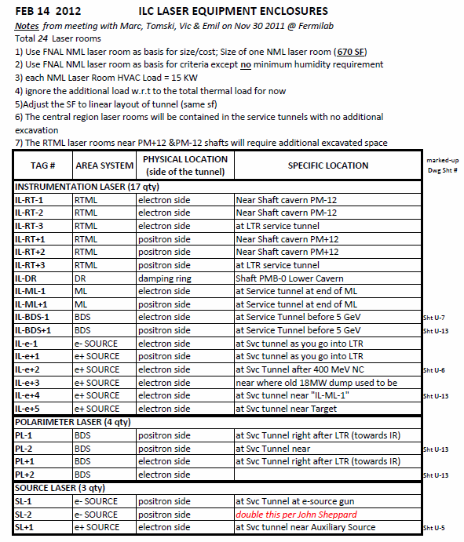
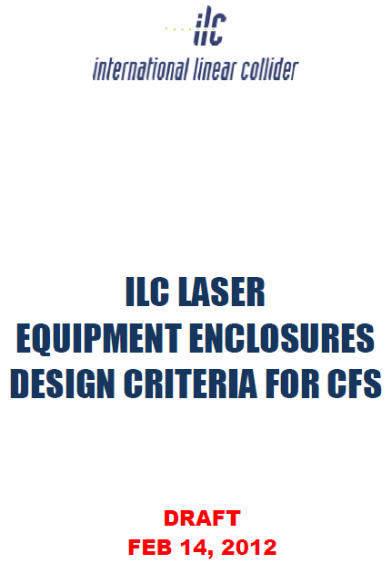

Slide 9
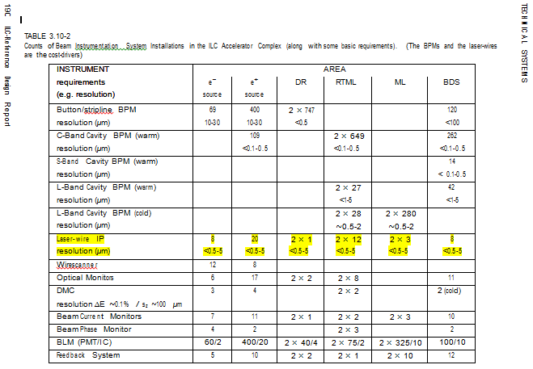

Slide 10
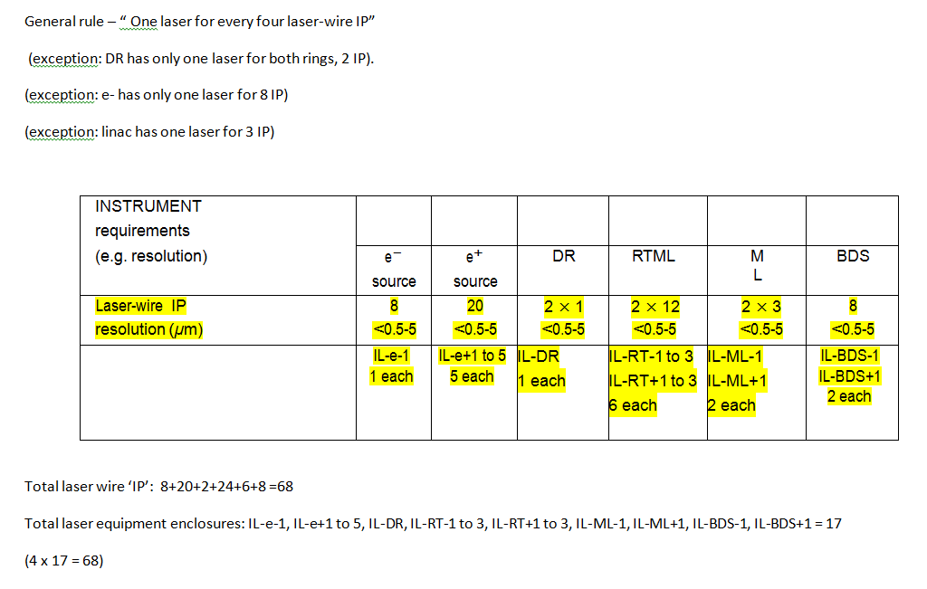

Slide 11
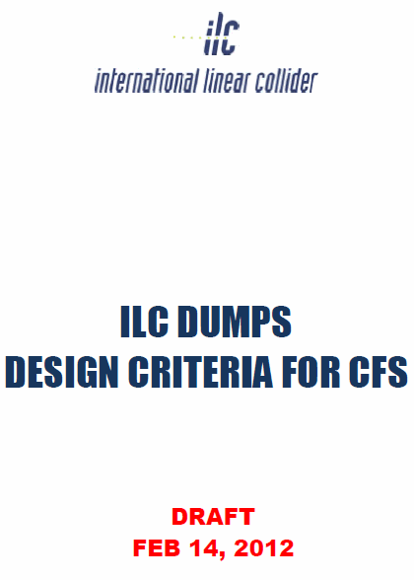
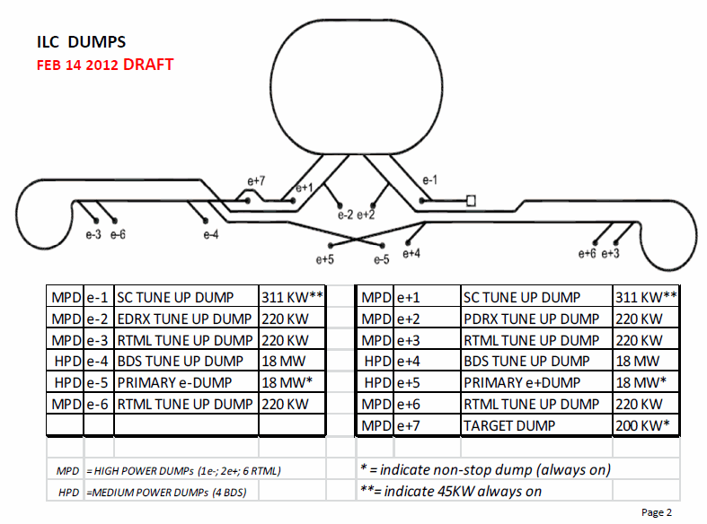

Slide 12
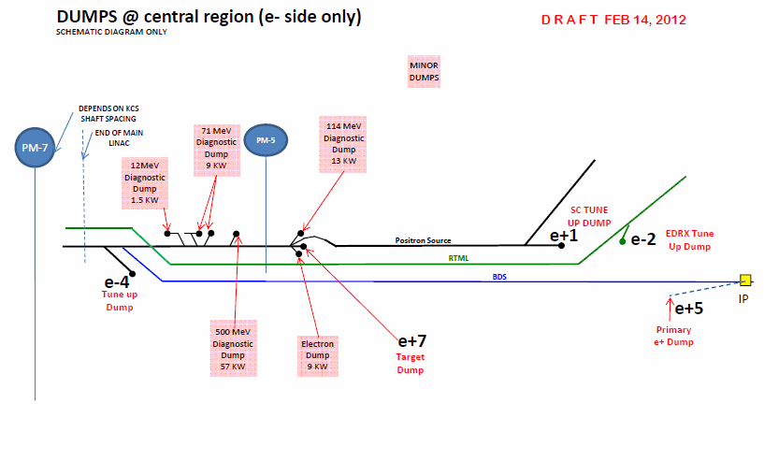

Slide 13
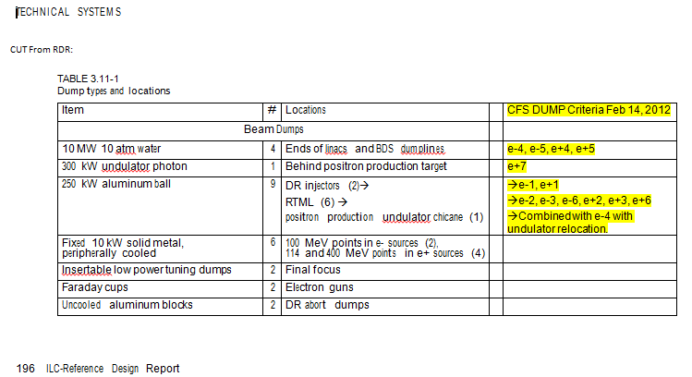

Slide 14
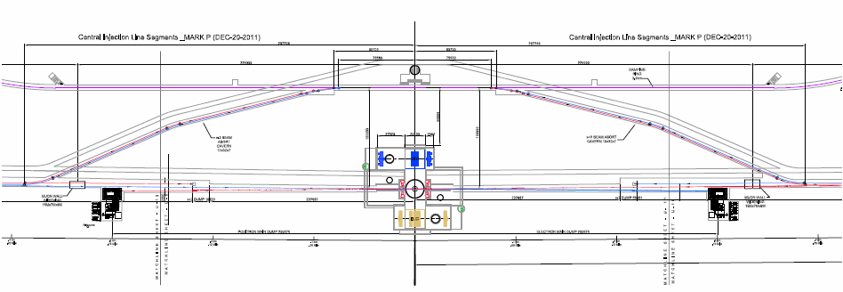
Current Central Region Layout
  Reflects the Current Geometric Data Contained in Central Region Documentation Dated 12-21-11
  Further Work on the Service Tunnel Equipment Layout is Still Needed

Slide 15
CFS Documentation in EDMS
  Area System and Technical Equipment Criteria that has been Made Available to B. List Through the CFS FTP Web Site for Uploading into the EDMS System
    e- Source (incorrectly posted) Still Needs Additional Criteria
    e+ Source – Needs Updating
    Damping Ring – Needs Updating
    RTML – Needs Updating
    Main Linac – Needs Updating
    Beam Delivery System - Current
    Total Cooling and Electrical Power Loads – Needs Updating
    Some Cryo Information – Needs Updating
  Information that Still Needs Work and Posting
    Interaction Region
    Laser Rooms
    Dumps
    TDR Baseline Drawings
  Final TDR Criteria Posting Should Reflect a Common Date

Slide 16
Summary
  Progress Continues to Finalize CFS TDR Criteria
  Area System Representatives have been Very Cooperative to Help Develop Needed Criteria
  Our Goal is Still to Begin the CFS BTR at CERN with No Outstanding Criteria Issues Remaining
  Two Outstanding General TRD Issues Do Remain
    How will Installation Issues be Addressed in the Technical Design Report
    How will We Address the Issue of the Overall and Comprehensive Project Schedule in the Technical Design Report

