Slide 1
SC Quadrupole Magnets in
ILC Cryomodules
Reported by Akira Yamamoto
CM Meeting, Feb. 28, 2012

Slide 2
Concerns and Actions
Beam handling capacity after energy upgrade
  Change beam dynamics
Field instability in lowest energy (< 10 %) operation
  Provide a shorter magnet design with separation of dipole from quadrupole,
Stability of axis and Ramping property
  To be confirmd by condcution cooling test

Slide 3
Requirements to SC Quad. And Dipole
Provided by K. Yokoya and K. Kubo
 | Nominal length | Nominal field (G.) | Static Field in max. | Ramping
Quad | ~ 0.6 m | 50 T/m | 30 T/m*m | 0.01 T/m*m/sec (0.03% /sec)
Dipole | ~ 0.6 m | 0.1 T | 0.05 T*m | 3E-4 Tm/sec (0.6 % /sec)
Model Magnet Design: 120 % to nominal design

Slide 4

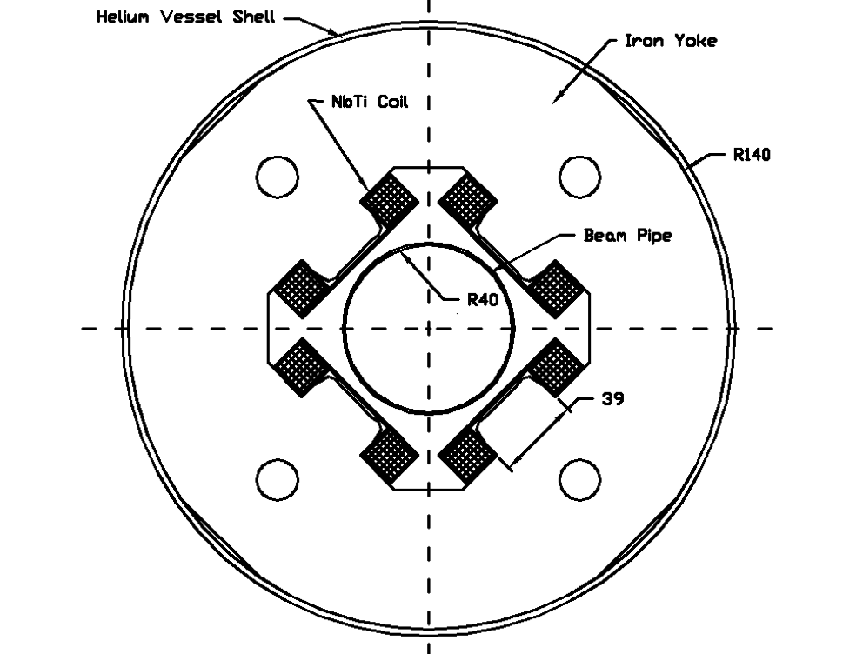
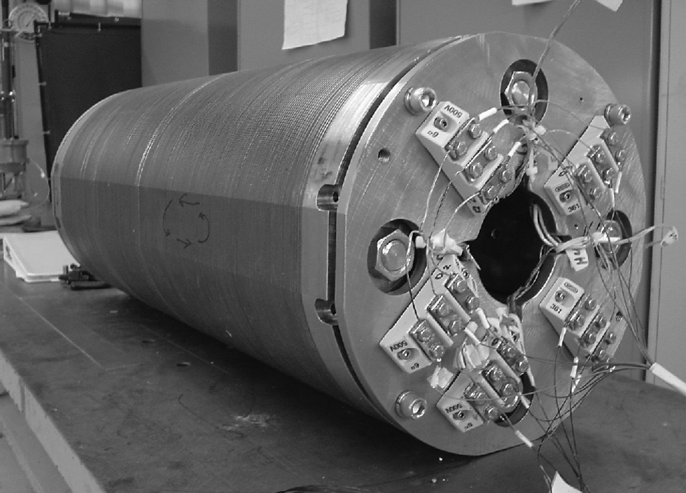
Quadrupole Specification & Superconductor
Integrated gradient, T | 36
Aperture, mm | 78
Effective length, mm | 666
Peak gradient, T/m | 54
Peak current, A | 100
Field non-linearity at 5 mm radius, % | 0.05
Quadrupole strength adjustment for BBA, % | -20
Magnetic center stability at BBA, um | 5
Liquid Helium temperature, K | 2
Quantity required | 560
NbTi wire diameter, mm | 0.5
Number of filaments | 7242
Filament diameter, um | 3.7
Copper : Superconductor | 1.5
Insulated wire diameter, mm | 0.54
Insulation | Formvar
Twist pitch, mm | 25
RRR of copper matrix | 100
Critical current Ic @ 4.2K, at 5T | 204 A

Slide 5
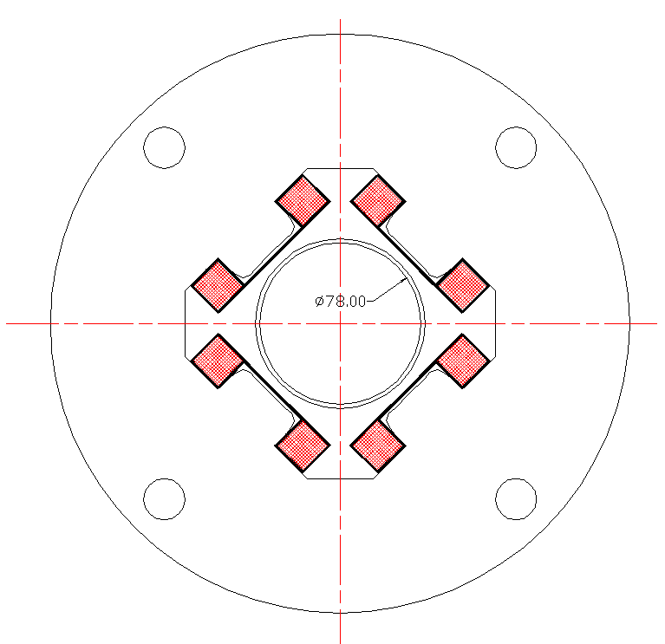
A possibility: Combined Function
Main Quadrupole
  Positive: 1, 3,
  Negative: 2, 4,
Corrector Dipole
  Positive: 1, 4
  Negative: 2, 3

Slide 6
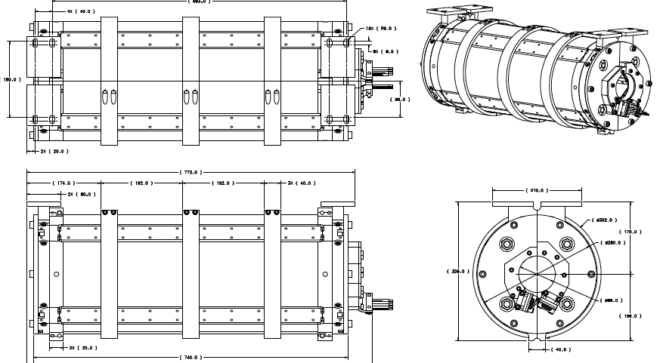
Fermilab Model Magnet

Slide 7
SC Quadrupole Design in TDR, Proposed
The SC quadrupole magnet design needs to satisfy very wide range of beam energy (i.e. magnetic field strength) including energy upgrade to 1 TeV
A standard magnet design:
  optimized to cover the energy range of approximately 10 to 100 % of 250 GeV operation, based on the requirements of a FoDo like lattice. The same magnets can be used to accommodate beam energies of 260-500 GeV for the TeV upgrade, using a FoFoDoDo lattice.
An additional magnet design:
  specifically in the lower energy operation below 10 % of the full magnetic field (< 25 GeV beam operation). The magnet field strength may be stronger and the length can be shorter, in order to minimize the associated field instability.
  It is prudent to separate the quadrupole magnet from dipole corrector magnet, placing them adjacent along the beam-line axis. The exact design and configuration of the SCRF magnets remains an important action item.
It is assumed, however, that
  all magnet package solutions will fit the single defined interface conditions in the cryomodule, thus avoiding the need for more than one cold-mass variant.

Slide 8
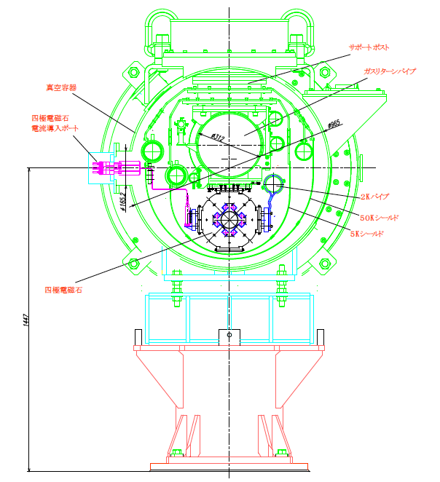
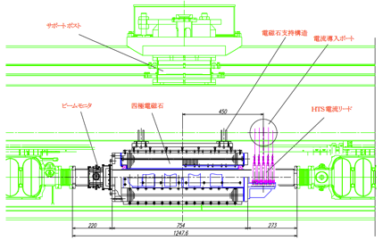
SC Quadrupole in Cryomodule
Suspended by GRP

Slide 9
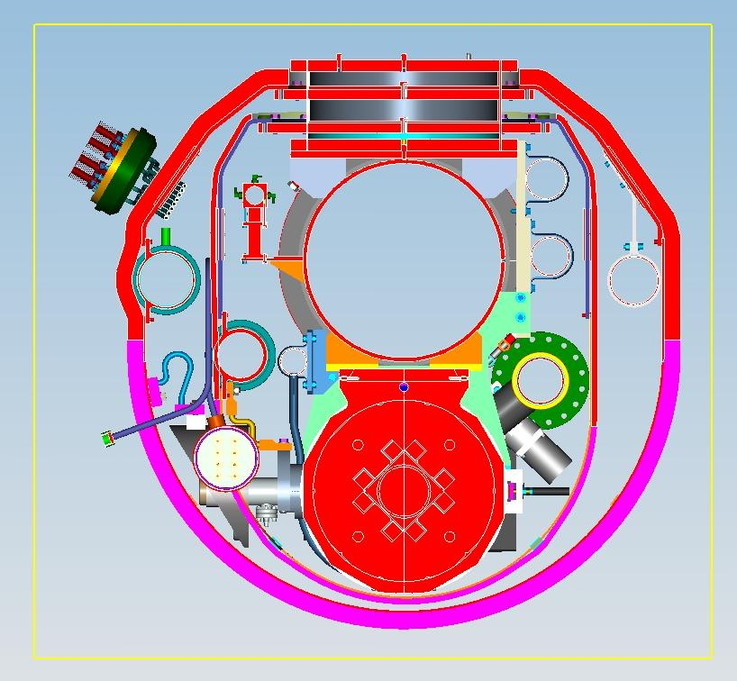
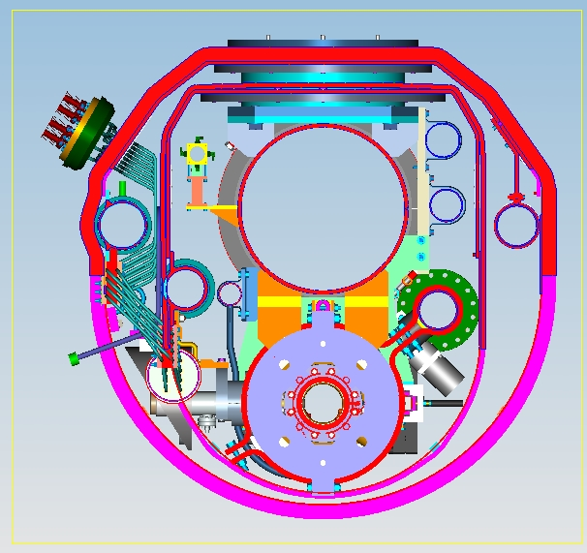
Cryomodule Cross-Section
LHe supply pipe
Quadrupole cold mass
Thermal leads to LHe supply pipe
V. Kashikhin, FNAL Review, March 2, 2010

Slide 10
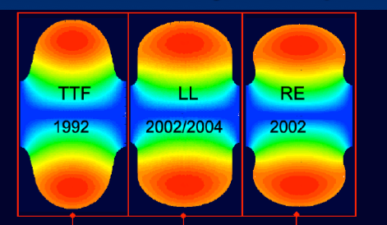
From 500 to 1000 GeV
<26 km ?
(site length <52 km ?)
1.1 km
<10.8 km ?
10.8 km
1.3 km
2.2 km
Main Linac
BDS
Quad: FD-FD
Quad: FF-DD
e+ src
IP
bunch comp.
ultra-high gradient R&D
>2012
Main Linac
<G_{cavity}> = 31.5 MV/m
G_{eff} ≈ 22.7 MV/m
(fill fact. = 0.72)
central region
Snowmass 2005 baseline recommendation for TeV upgrade:
G_{cavity} = 36 MV/m ⇒ 9.6 km
(VT ≥ 40 MV/m)
Based on use of low-loss or re-entrant cavity shapes
N. Walker

Slide 11
Quad Strength
Quad strength is defined by quad spacing, required phase advance (μ) and beam energy.
For flexibility quad should provide optics with phase advance μ=90° up to final energy E=250 GeV (~20%)
Extra strength will need for matching.
Lattice with quad spacing s = 38 m (9+8+9 cavities in RF unit)
L_{quad} (effective) = 0.626 m (in TESLA design)
or
Final choice for gradient:
Allow to tune up to μ=90° phase advance @ 250 GeV
Additional ~ 20% overhead for lattice matching

Slide 12
Corrector strength
Maximum required strength of corrector is defined from the following assumptions:
Energy = 250 GeV; μ= 90º; (RDR: μ_{x} /μ_{y} = 75º/60º)
Quad offset: rms σ= 0.3 mm; (3σ ≈ 0.9 mm)
Max beam offset ±3 mm at energy 250 GeV
(<10% of strength needs to deflect beam along the Earth curvature)
Max current: (at 250 GeV) = 40A
Stability: same as for quads.
Field change: by a few percent in 0.2 s, every 0.2 s
Change step: (equivalent ~1μm of quad center motion)
  2.e-6 T*m at 15 GeV; 3.e-5 T*m at 250 GeV

Slide 13
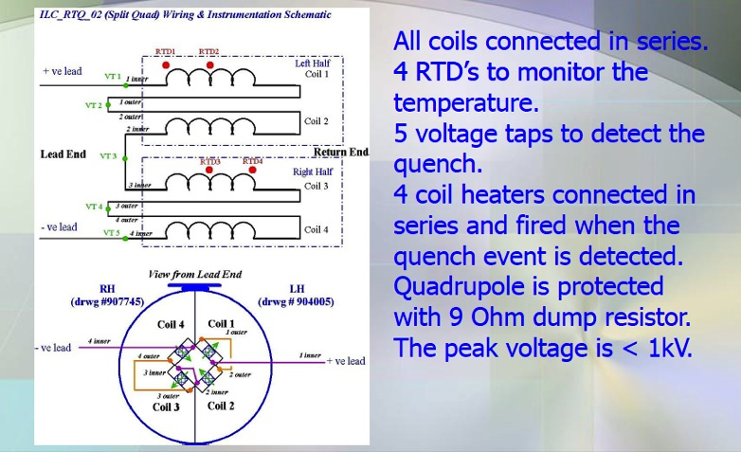
Test Circuit

Slide 14
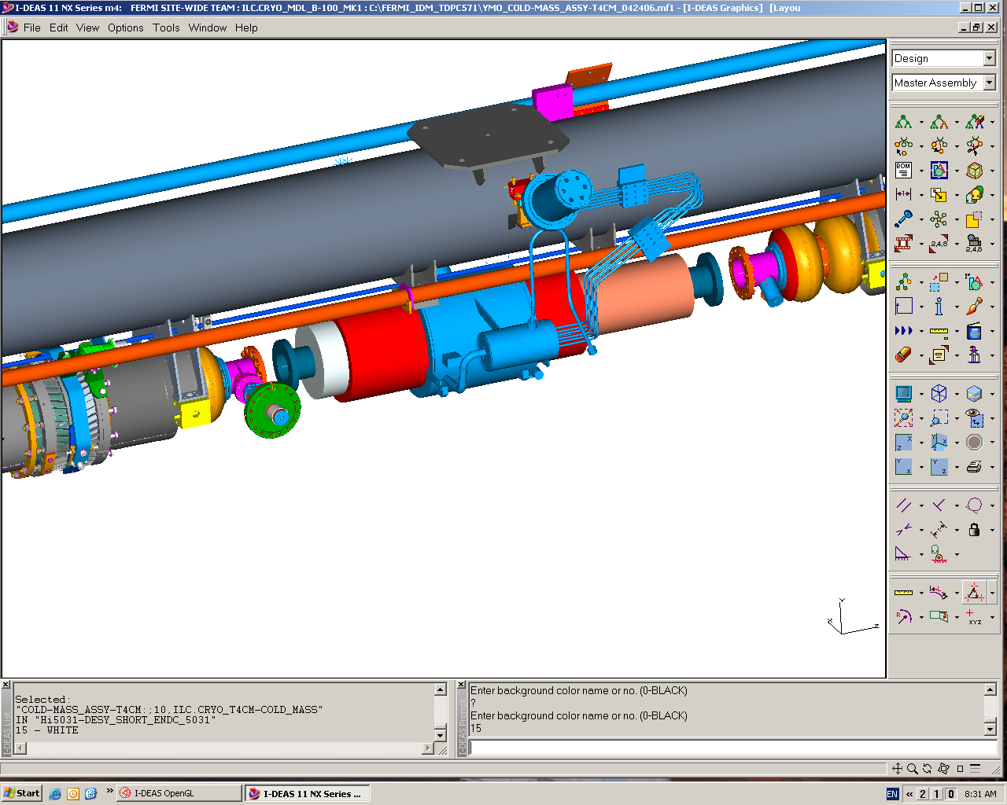
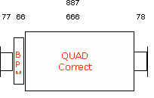
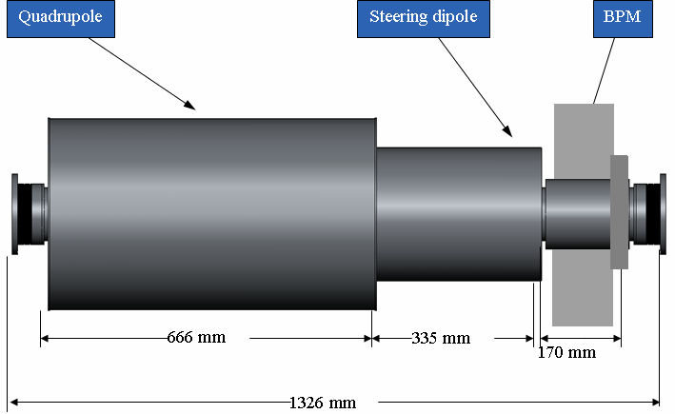
Main Linac Type-4 Cryomodule
Central support
300 mm pipe
SCRF
BPM
Quad and Correctors
SCRF
Space available for Quad
Total package: ~1.3m, incl.
  BPM: ~170 mm
  Quad: ~ 660 mm
  correctors: 335 mm
ILC
TESLA TDR
Combined or stand alone correctors (Quad center stability issues) ?

Slide 15
Number of SC quads (RDR and SB2009)
RTML(5-15 GeV) | # CM | # Quad
e⁻/e⁺ Bunch compressor | 45 / 45 | 17/17
Total | 90 | 34
Main linac (15-250 GeV) | # CM | # Quad
Electron Linac* | 846 | 282
Positron Linac | 834 | 278
Overhead (3.5%) | 30+30 | 10+10
Total | 1680+60 | 560+20
* Incl. 12 CMs to recover 3.23 GeV energy losses in undulator
Note: each quad is combined with vertical corrector, every second quad has also horizontal corrector
Proposed changes in SB2009 lattice:
  Single stage compressor: 6 CM’s (quad in each)
  Post-acceleration 5 ➔ 15 GeV is part of ML
  Total number of CM’s is reduced by 3, but # quads increases +1

Slide 16
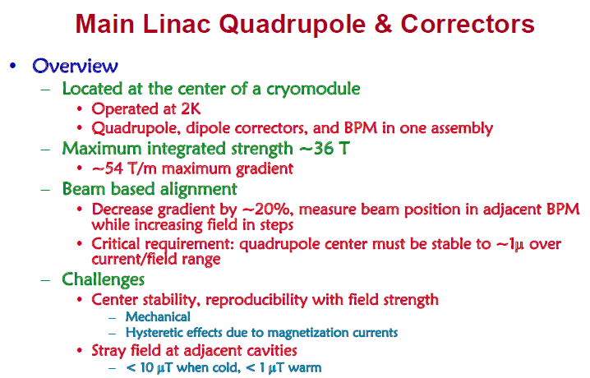
J.Tompkins, PAC’07

Slide 17
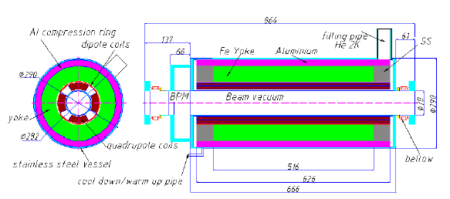
Quadrupole R&D Work at
Fermilab
Fermilab: V. Kashikhin et al.,
  Test results of superconducting quadrupole model for linear colliders
  This conference, 4LPA01,
SLAC/CIEMAT: C. Adolphsen et al

Slide 18
Quadrupole R&D Work at
Fermilab
Fermilab: V. Kashikhin et al.,
  Test results of superconducting quadrupole model for linear colliders
  This conference, 4LPA01,

