Slide 1
TDR L parameters update
N. Walker (for the PMs / EC)
AD&I WebEx meeting
29.02.2011

Slide 2
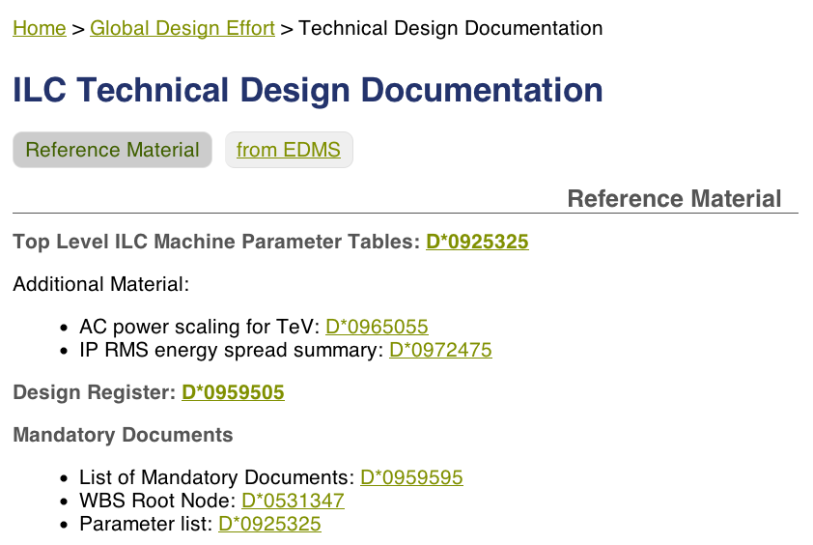
Formal Parameters: EDMS
D*0925325
  Available directly from
  http://www.linearcollider.org/GDE/technical-design-documentation
Thanks to Tony Hartin for doing the GUINEA PIG runs
EDMS ID D*0973835

Slide 3
Proposal / Rationale
Adopt uniformly high D_{y} for all E_{cm} (~25)
Include 10-15% (20%!?) gain from coherent vertical waist shift at IP (~0.8σ_{z})
Assume a 30% increase in collimation depth for
E_{cm} ≤ 250 GeV
  split FD approach
  factor 1.7 reduction in β∗_{x} (over ~1/γ scaling)
Assume intra-train fast feedback at linac exit will constrain vertical beam jitter ≤ 1.5 μm RMS at SP2/SP4
  ~0.2 σ_{y} at 250 GeV beam energy
Keep “effective” IP γε_{y} ~ 35 nm
  average emittance from LET emittance tuning simulations +10%
Drop TF because
  Difficultly in implementing the crabbed waist
  Very high disruption parameter too challenging (incl. collimator wakes)

Slide 4
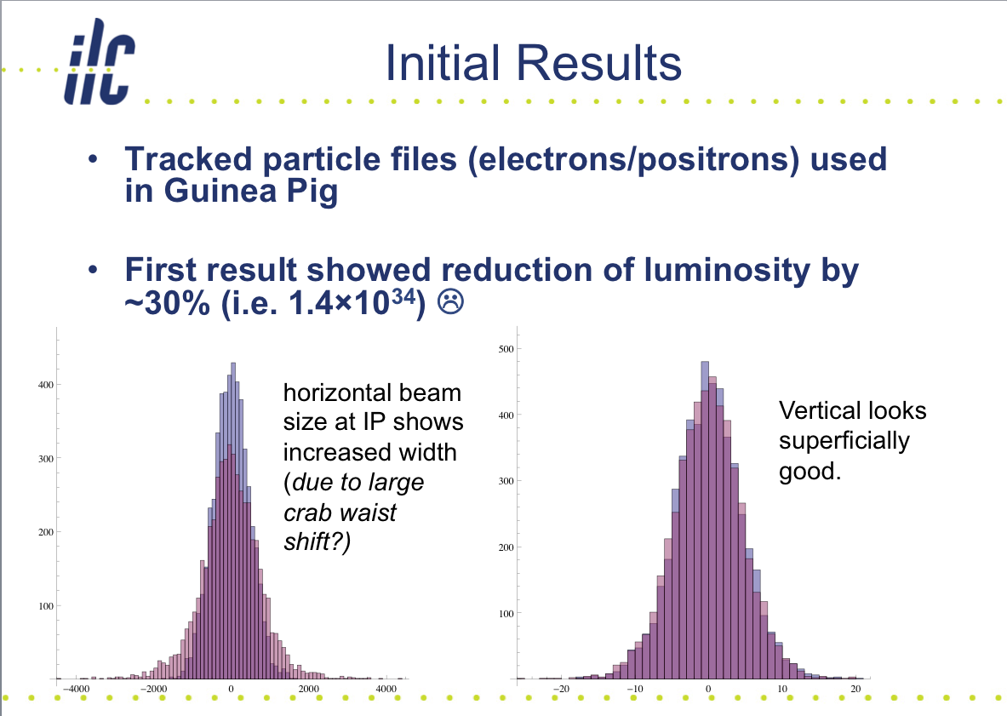
Crab Waist Simulations (Tracking)
SLAC BAW
Jan. 2011
Practical implementation appears difficult to achieve

Slide 5
Collimator Wakefields
very high disruption parameters required by TF
140% @ 0.5σ_{y}
Assume 0.2σ_{y} @ 250GeV
⇒ 0.13σ_{y} @ 100 GeV
⇒ ~10% emittance growth
jitter = σ_{y}/2
But does the collimator gap change?
(β*_{y} is changing)
T. Tauchi

Slide 6
Comparison to TF numbers
luminosity x10³⁴ cm⁻²s⁻¹

Slide 7
Fractional L in top 1% E_{cm}

Slide 8
Issues
Optics solution still needs verification
  smaller (in general) β functions
  short (split) FD solutions for low E_{cm}
  Including re-evaluation of collimator depth
Luminosity stability (high D_{y})
  impact on integrated luminosity
Fast trajectory correction implementation
  should be feasible, but clearly needs a realistic design concept
    location of BPMs, kickers, performance analysis etc.
Optics solutions will be looked at by R. Tomas starting April.
  Solutions probably May/June
  Plan for success in the meantime.
Complicated problem which really requires “start-to-end” like simulations
  including fast feedback correction etc.
  legacy simulations exist but for for different lattice (RDR), but results were very positive
Need to look at lattice and see how this might fit
  Should not be a real problem
  Performance evaluation requires more design work
  May need adjustment of early BDS lattice to accommodate hardware

