Slide 1
FLASH 9mA studies:
21-26 Feb 2012
John Carwardine

Slide 2
Machine conditions
  800us bunch-trains (2400 bunches)
  Average current over 800us: ~4.5mA (1.5nC/3MHz)
  Beam energy: 1GeV
  Average gradients (ACC67): 26.7MV/m avg (13 cavities)
  Max operating gradients (ACC7): 4 cavities above 31MV/m

Slide 3
Studies highlights
  Operated full beam current within ~7% of klystron saturation
  Flattened individual gradients to <<1% peak-peak and 4.5mA/800us operation within 5% of quench
  ‘Crash test’: 800us/4.5mA -> beam off -> 800us/4.5mA
  Ramped up current from ~zero to 4.5mA with ACC67 gradients approaching quench
  ‘Cavity gradient limiter’ for dynamically preventing quench
  Operated machine into quench with 800us / 4.5mA

Slide 4
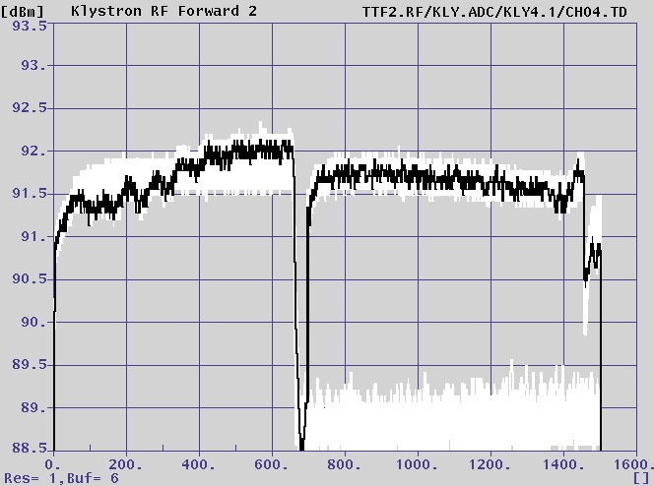
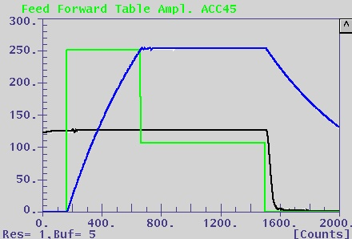
Klystron saturation studies
RF fwd power during fill and flat-top with beam loading and longer fill time
Reference waveforms with zero beam loading: gradient (blue) and Klystron fwd power (green)

Slide 5
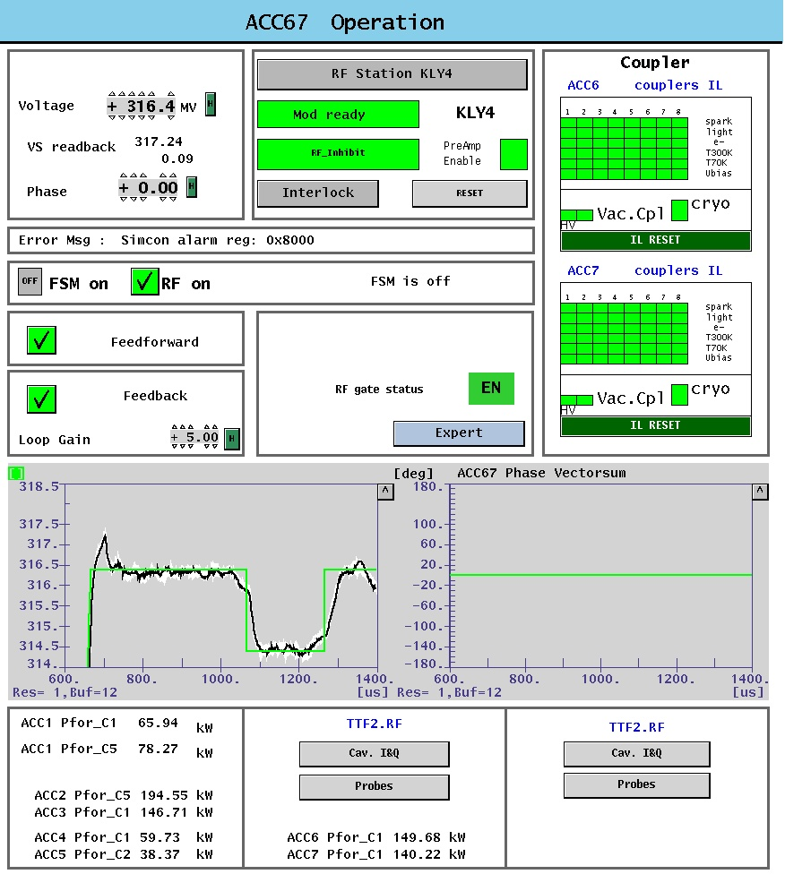
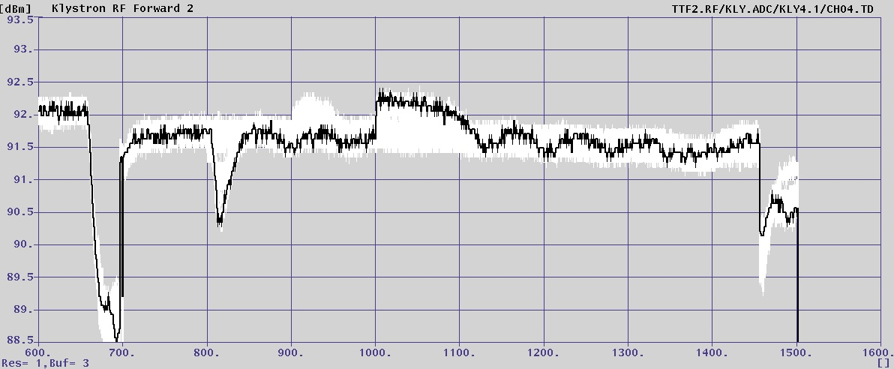
Disturbance test
Notch applied to Vector Sum setpoint
Forward power shows slower response on step up due to lower klystron gain in saturation

Slide 6
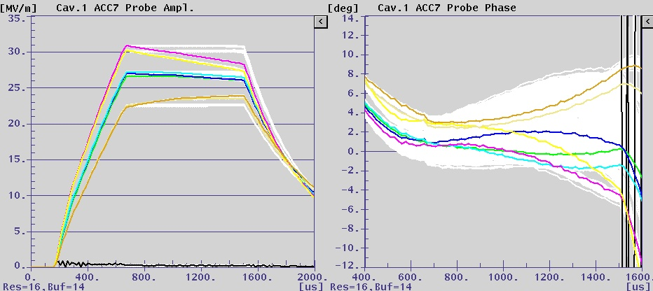
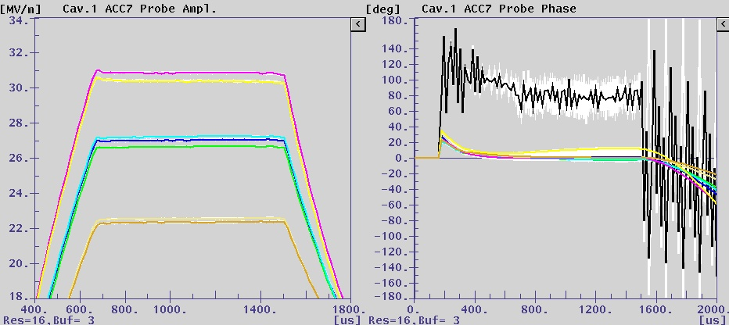
Cavity gradient flattening
Optimized for 4.5mA, beam off (tilts)
Optimized for 4.5mA with 4.5mA/800us (no tilts)

Slide 7
Iterative flattening of cavity gradients
(~+/-8% to ~+/-0.3%)
Iterative algorithm flattens cavity gradients by adjusting individual Loaded-Qs
Gradient tilts by cavity (%)
Gradient tilts by cavity (%)
Gradient flat-tops for each cavity
Gradient flat-tops for each cavity
Before running algorithm
Before running algorithm

Slide 8
Automated ramp-up to full current by extending length of bunch-train
Gradient flat-tops for each cavity
Start with maximum current but short bunch train
Gradient limiter dynamically ramps down klystron output if gradient threshold is exceeded – prevents quenching
Iterative algorithm maintains flat gradients for ‘beam on period’
Progressively increase length of bunch train
400us
500us
700us

Slide 9
‘Mombo’ quench on ACC7:
Cascade of quenches resulting from VS regulation
Gradient (MV/m)
Sequence of rf pulses on ACC7 cavities during ramp-up to quench

Slide 10
Studies were very successful
  Achieved most of the main objectives with bunch trains of 800us / 4.5mA
  We have become accustomed to the FLASH accelerator running very well
Next 9mA study period at FLASH: Sept 2012

