Slide 1
Main Linac
Technical Design Documentation
Benno List
DESY –IPP-
AD&I Webex meeting 29.2.2012

Slide 2
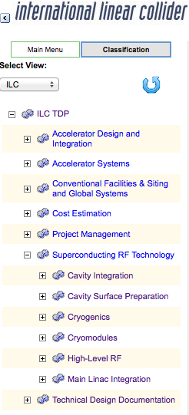
Work Breakdown Structure
Currently: Below “Superconducting RF Technology” 5 items: TAGs
Need to define
  Responsibilities
  Deliverables
  WBS for each TAG (1 addt’l level)
WBS helps to identify missing information

Slide 3
Parameter Lists
Cavity parameters: Only template (by B.L.) exists: D*0973245
Cryomodule parameters: 1st version released by Paolo Pierini 23.2.12: D*0973345
  Documents slot lengths used in lattices (12652mm for C9, C8Q mods)
  More information is being prepared by Paolo
  Will contain numbers for cryo loads, needed for cryo plant dimensioning
Main Linac Parameters: Only draft (by N.W.) exists: D*0975625
Cryogenics parameters: Draft by T. Peterson exists: D*0975575
  awaiting decision
  → needed urgently to fix ML length → RTML lattice → CFS!
  Should contain parameters for cryo plants (size, power consumption, conventional cooling requirements…)
HLRF: No EDMS documentation (except documents collected by CFS), several versions of overview slide for KCS circulating by email, causing confusion → needs work
LLRF/Controls: Nothing in EDMS

Slide 4
Components
Design documentation is needed for
  Input couplers
  Tuners
  Instrumentation
  Quad/corrector/BPM packages
  Cryoboxes
  …
Needs to be incorporated into WBS (who delivers doc’s?)
For each component:
  Parameters / Specifications
  Engineering design (drawings, 3D CAD model)
Document also alternative designs?

Slide 5
Plug Compatibility
Currently placeholder sheet in cryomodule parameter document
Maybe separate document(s)?
  Written description: which parts are to be plug-compatible
  Specifications: mechanical dimensions, electrical, connectors
  Drawings / 3D models

Slide 6
Processing, Assembly & Testing
Stages:
  Niobium sheets
  Single cells / dump bells
  Cavities
  Cavity strings
  Cryomodules
Each stage has costly and manpower-intensive manufacturing
→ needs documentation!
  Manufacturing steps, estimated manpower
  Testing procedures
  Necessary assembly facilities and production equipment

Slide 7
CFS
Available documents:
  KCS CFS Design Criteria: D*0970355
  DRFS CFS Design Criteria: D*0970415
  More documents (water, electricity): see web page
Unavailability of EDMS documentation has forced CFS group to collect specifications in their “CFS Design Criteria” documents
Documents that fall under the responsibility of the TAGs should be
  taken out of the CFS criteria documents
  Put into separate EDMS documents
  Linked with “depends on” relationship from CFS criteria
TAG leaders need to check CFS documents in EDMS (see http://www.linearcollider.org/GDE/technical-design-documentation/conventional-facilities-and-siting for overview) and alert CFS group if input has changed

Slide 8
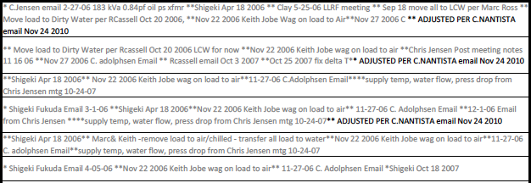
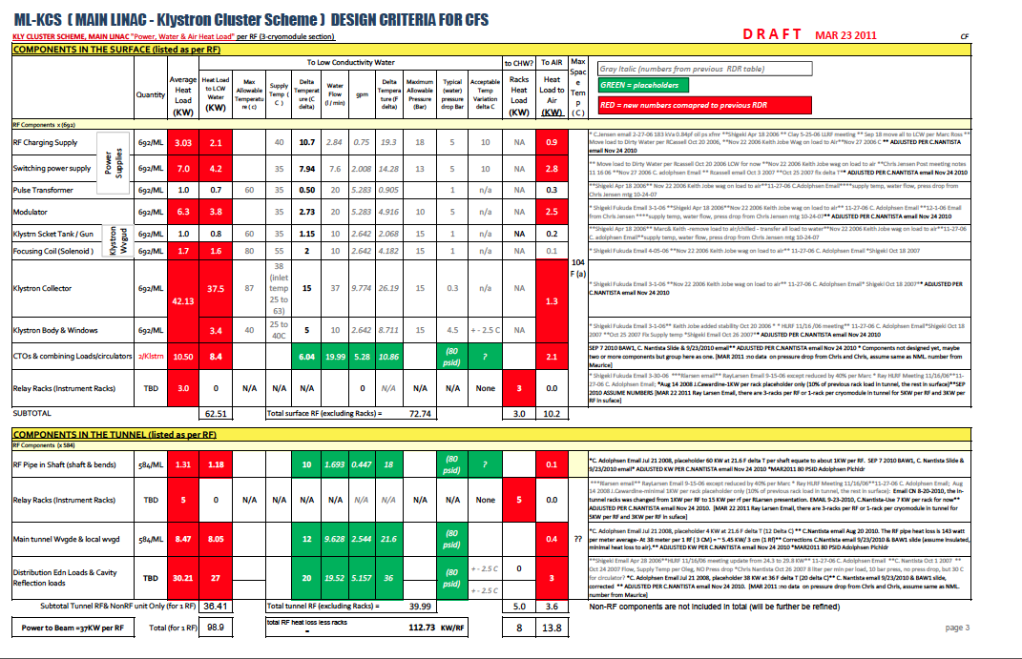
CFS, cont’d
All this data was collected by the CFS group from the TAGs.
Ideally, this should be collected in an specification document under the responsibility of the TAGs!
From EMDS D*970355

Slide 9
Summary
Proposal to extend WBS 1 level below TAG level
Define scope of TAGs: responsibilities, deliverables
Candidates for mandatory documents:
  Parameter lists
  Component specifications
  Assembly & Testing: procedures & facilities
  Lattice description (hierarchical: cavity, quad pack, cryomodule, RF units, cryo units)
  Specifications for CFS
  Cost information (not covered here)

