Slide 1
AA->HH Study Current Status
Shin-ichi Kawada
AdSM, Hiroshima University

Slide 2
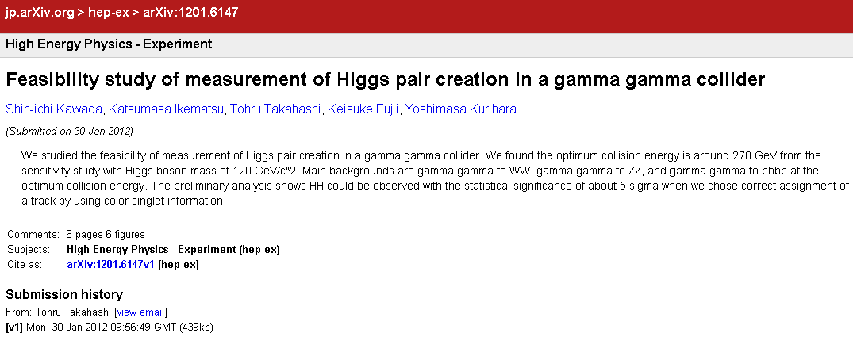
Proceedings of LCWS11
arXiv:1201.6147
submitted 2012/1/31
(I forgot to inform...)

Slide 3
Current Status
preparing the paper
Now updating Ver.1 -> Ver.2...

