Slide 1
DR Magnets & Power Supply System
ILC-ADI Meeting
March 14, 2012
Mark Palmer
Cornell/Fermilab

Slide 2
Updates for DTC04 Lattice
Design Team
  P. Bellomo (SLAC – distributed PS System)
  C. Spencer (SLAC – magnets)
  J. Conway (Cornell – mechanical layouts and supports)
  J. Crittenden (Cornell – wiggler field model)
  M. Billing (Cornell – system integration)
DTC Lattice – version 4
  D. Rubin (Cornell)

Slide 3
Bus-Based PS System Motivations
Need individually controlled quads, sextupoles and correctors for low emittance tuning
  Centrally-located power supplies would require extensive cable runs
  Major tunnel infrastructure impact
  Cooling challenges
Distributed PS system with
  Bulk power supplies power DC bus
  <50V bus for personnel safety and water-cooled for thermal control
  Local DC-DC converters in water-cooled racks
provides individual control and minimal heat load to air (eg, local cables typ. <10m between converters and magnets) a heat load to air < 30W/m/ring

Slide 4
RDR Cost Impact
RDR Power System
Cable costs greatly reduced!
35% cost savings relative to RDR
Controls-related hardware becomes dominant cost
Distributed Power System
2007 Exercise

Slide 5
DTC04 Magnet Counts
DTC04 Magnet Summary (single ring) from D. Rubin
Element | Length[m] | Strength | Number
Arc Dipoles | 3 | 2.28 kG | 150
Circumference changing chicane dipoles | 1 | 2.68 kG | 28
Other dipoles | 2 | < 2.28 kG | 4
Arc Quadrupoles | Various | < 0.6 m⁻² | 450
Quadrupoles in dispersion suppressor and straights | Various | < 0.55 m⁻² | 213
Sextupoles | 0.3 | < 4.34 m⁻³ | 600
Wigglers | 1.92 | 1.6-2.2 T | 54-60

Slide 6
Physical Magnet Count
Comparison with RDR
In general
  Similar number of cells with stronger focusing to achieve ultra low emittance
  More tightly packed a allows groups of magnets to mount on rails (better alignment & optimized cost)
  But magnet costs do not scale with ring circumference
Similar
Counts
Costing of magnets/supports
now in progress
Quantities under
review

Slide 7
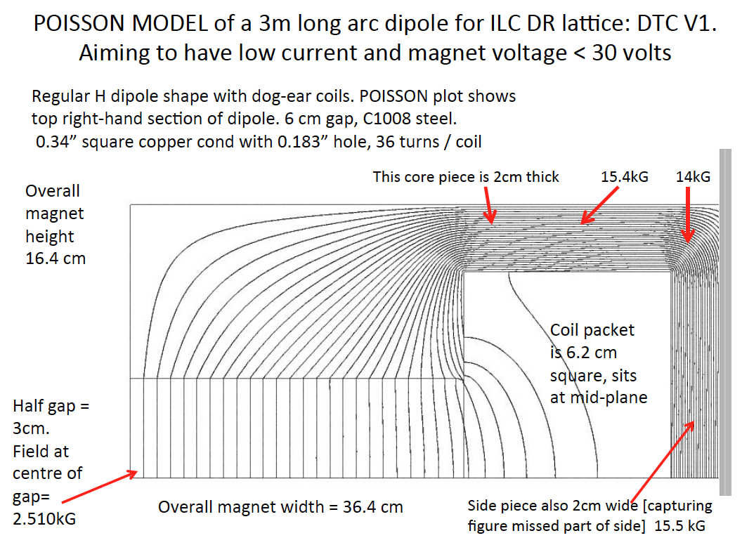
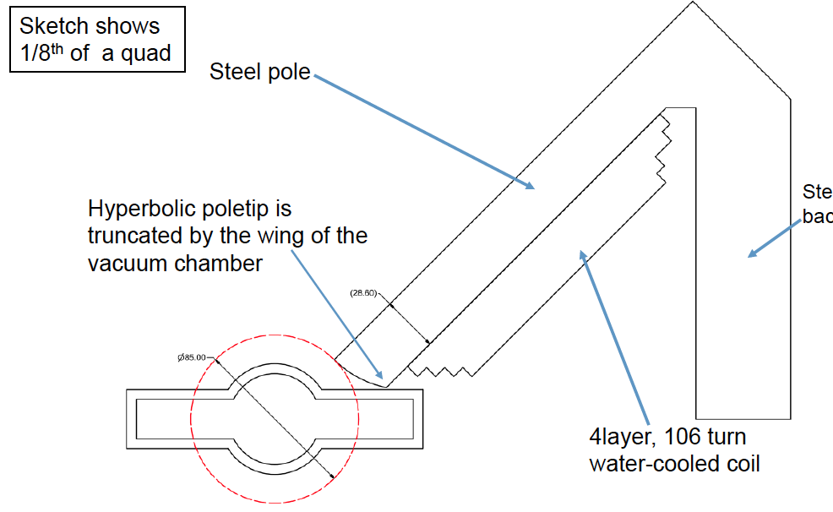
New Magnet Families Now Ready
Magnet designs must be optimized to meet current and voltage constraints of bus
Have also had to adjust designs to allow for EC mitigations in wiggler region (large antechamber impacts magnet bore)
New dipole designs

Slide 8
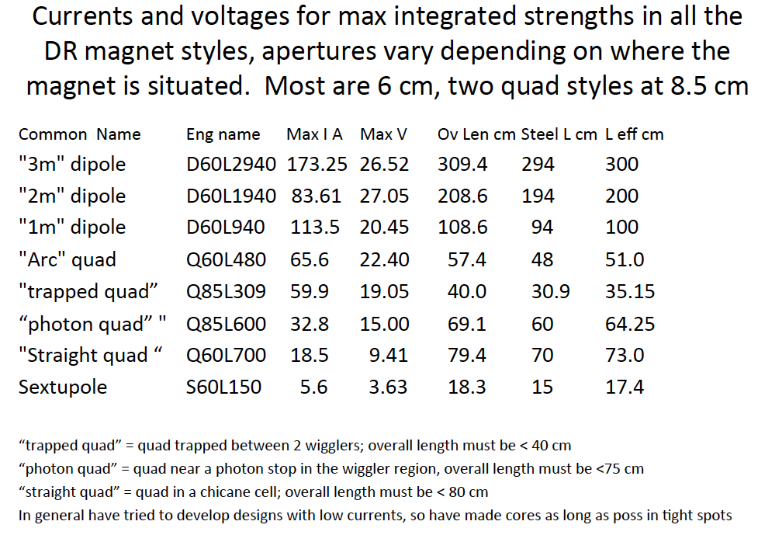
New Magnet Styles (C. Spencer)

Slide 9
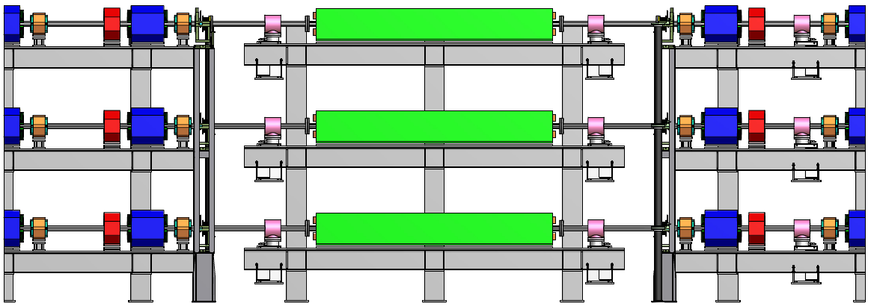
Arc Cell Support Structure (J. Conway)
Incorporates new vacuum system design
Utilizes single rail system for quads/sextupoles/correctors

Slide 10
Wigglers
Wigglers: DTC parameters are (intentionally) closely matched to the ILC “Optimized” Wiggler design.
Optimized wiggler expected to cost ~75% of the design costed for the RDR
a Wiggler cost ratio per ring: ~0.75×54/80 = 51%
ILC Optimized Wiggler
  12 poles
  Period = 32 cm
  Length = 1.68 m
  B_{y,peak} = 1.95 T
  Gap = 86 mm
  Width = 238 mm
  I = 141 A
2011 TBR
Preliminary Estimate

Slide 11
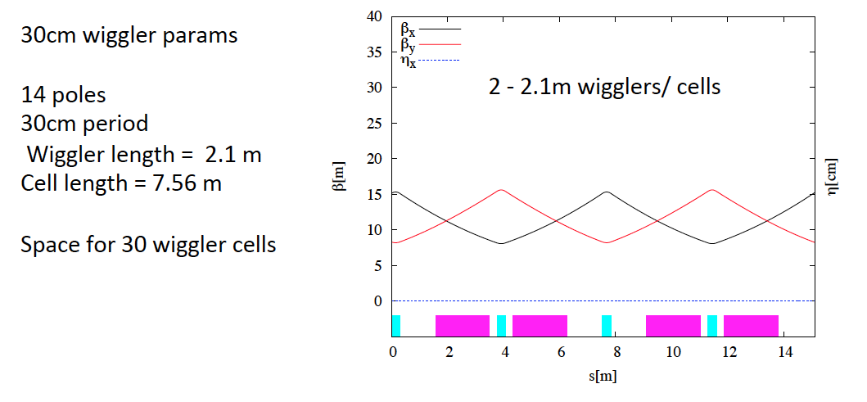
Updated Wiggler Parameters
New wiggler parameters required for full range of potential ring operation (ie, 10 Hz):
Updated cost estimate
in preparation

Slide 12
2007 RDR Distributed Power Supply Concept (P. Bellomo)
4 bulk supplies
  2 in each major alcove
  Feed 8 buses (4 per ring)
  Individual DC-to-DC converters for each magnet
    Water-cooled racks distributed around the ring
    Magnets
      Quadrupoles
      Sextupoles
      Correctors (dipole, skew quad, other)
  Distribute AC to local wiggler power supplies
  Reduce heat load around tunnel due to cable losses to air to <50W/m
Main dipoles powered in 6 strings per ring
  6 dipole supplies per alcove
Injection/Extraction lines
  Same as for RDR
Quadrupole, Sextupole & Corrector Bus
2007 Exercise

Slide 13
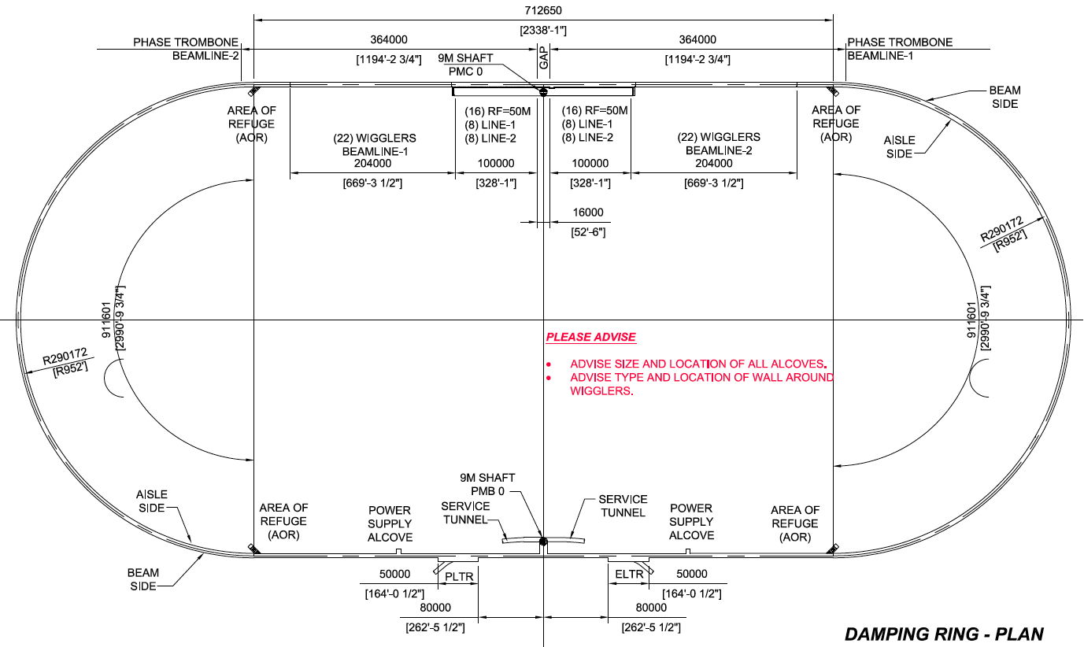
DTC04 PS Locations
Dipole Bulk
Distributed Bulk
Pulsed

Slide 14
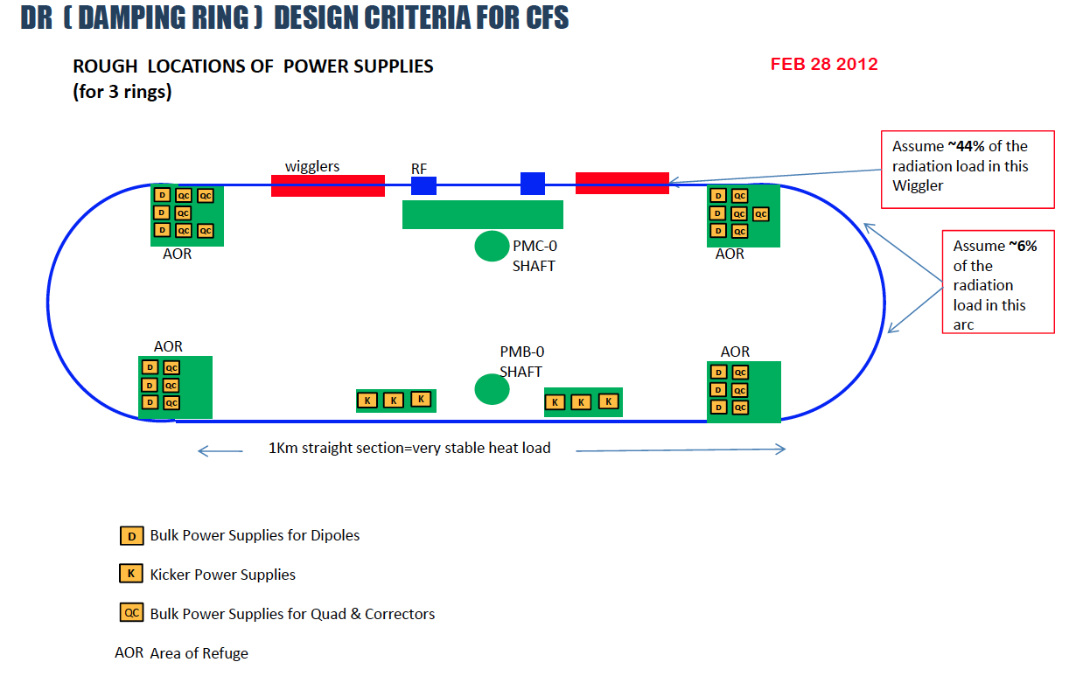
CF&S Layout

Slide 15
Very Rough DC PS System Estimate
Assume similar bulk/dipole PS specifications (needs validation)
Assume similar bus specifications (typical magnet spec has changed so this needs validation)
NOTE: RDR ring cost would have been $34M
2011 TBR
Preliminary Estimate

Slide 16
DTC04 PS System Cost Breakdown
(2012 – P. Bellomo)
For 1 e+ and 1 e- ring
2007 a 2012
Cost escalation negligible due to change in commodities costs
(principally Al cost for bus)

Slide 17
Conclusion
Magnets and distributed power supply conceptual design are complete
  Heat load to air appears acceptable
  (<30 W/m/ring)
Updated wiggler model complete
Updated support structure concept complete
CF&S update has been provided
Costing and documentation exercise is in progress
  Targeting a full cost update to G. Dugan by month’s end

