Slide 1
ILC Utilities – Electrical / Mechanical
ILC has six regions:
  1/2. Sources (electron / positron)
  Damping Rings
  Ring to Linac
  SC Linac → Power critical
  Beam Delivery
But… Superconductivity means “low resistance”…

Slide 2
Power Loads:
(Reference Design – 2006)
Beam Power (500 GeV): 22 MW

Slide 3
Heat Loads:

Slide 5
Superconducting resonators
Typical resonator intrinsic Q
Loaded Q – from coupler
losses
V_{C}
Equilibrium ‘matched’ condition ideal
V_{g}
P_{g}
Cancel
V_{CW}
V_{b}
T_{b}
0
T_{e}

Slide 6
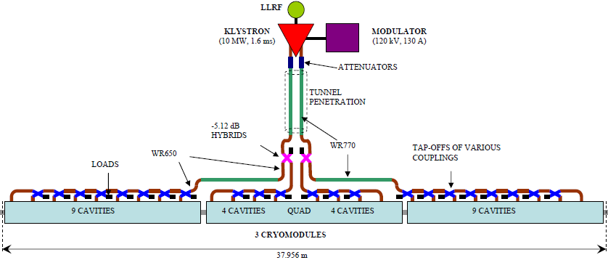
Old RDR Power Distribution System

Slide 7
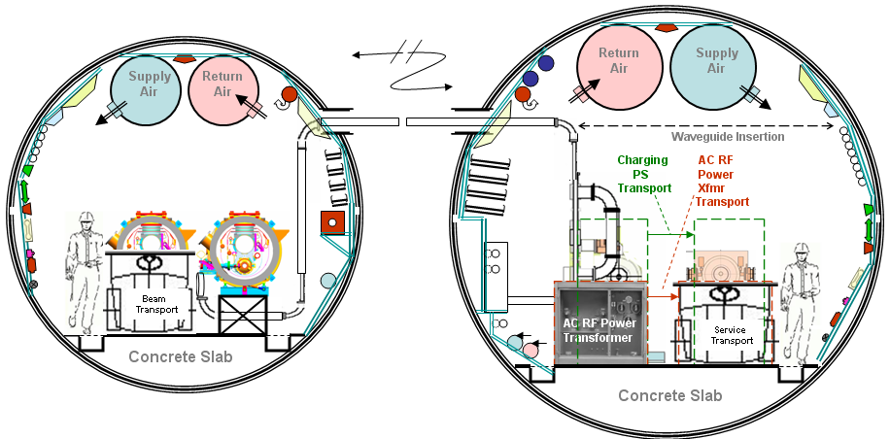
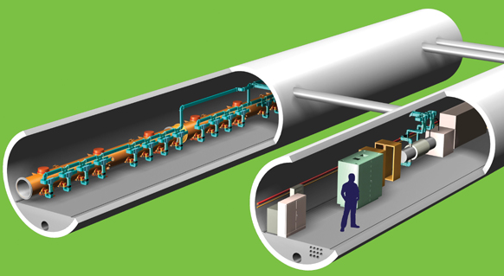
Baseline Tunnel Layout
Two 4-5 m diameter tunnels spaced by ~7 m.
Accelerator Tunnel
Waveguides Cryomodules
Penetrations
(every ~12 m)
Service Tunnel
Modulators Klystrons Electrical Dist Cooling System

Slide 9
Klystron Modulator:
150 KW (10/.6=17 MW peak) (XFEL 410KW)
Few % losses

Slide 11
Installing an 8-cavity cryomodule:
~15 each made and tested DESY, Fermilab, KEK
(125 more now under construction)

Slide 12
SC Linac power feed

Slide 15
Top 3 load types:
Klystron/modulator localized 60%
Waveguide distributed 15% ←to be regulated
Cryomodule distributed 25%
Most of the heat load to water does not require tight temperature regulation

Slide 16
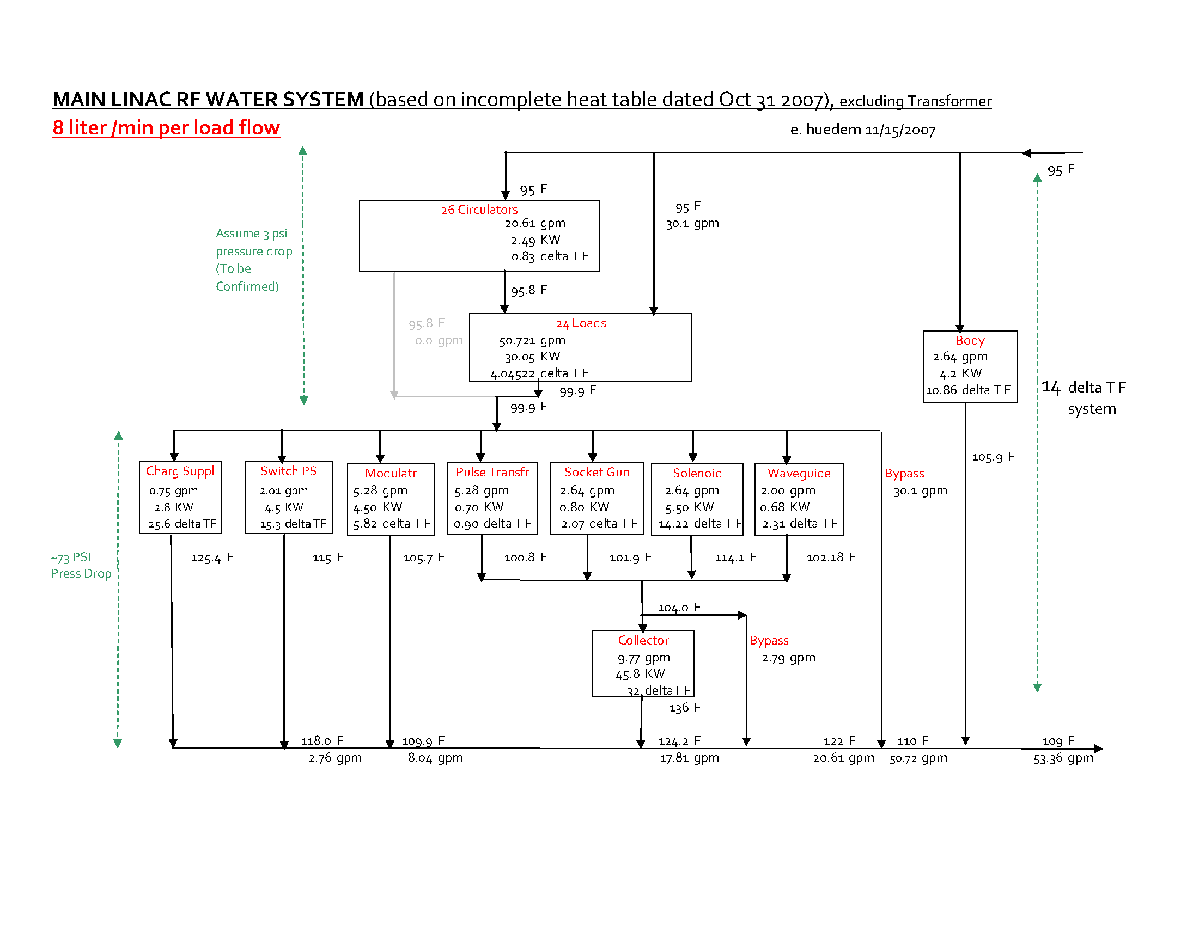
Stacking of Loads / High Delta T
1 RF

Slide 17
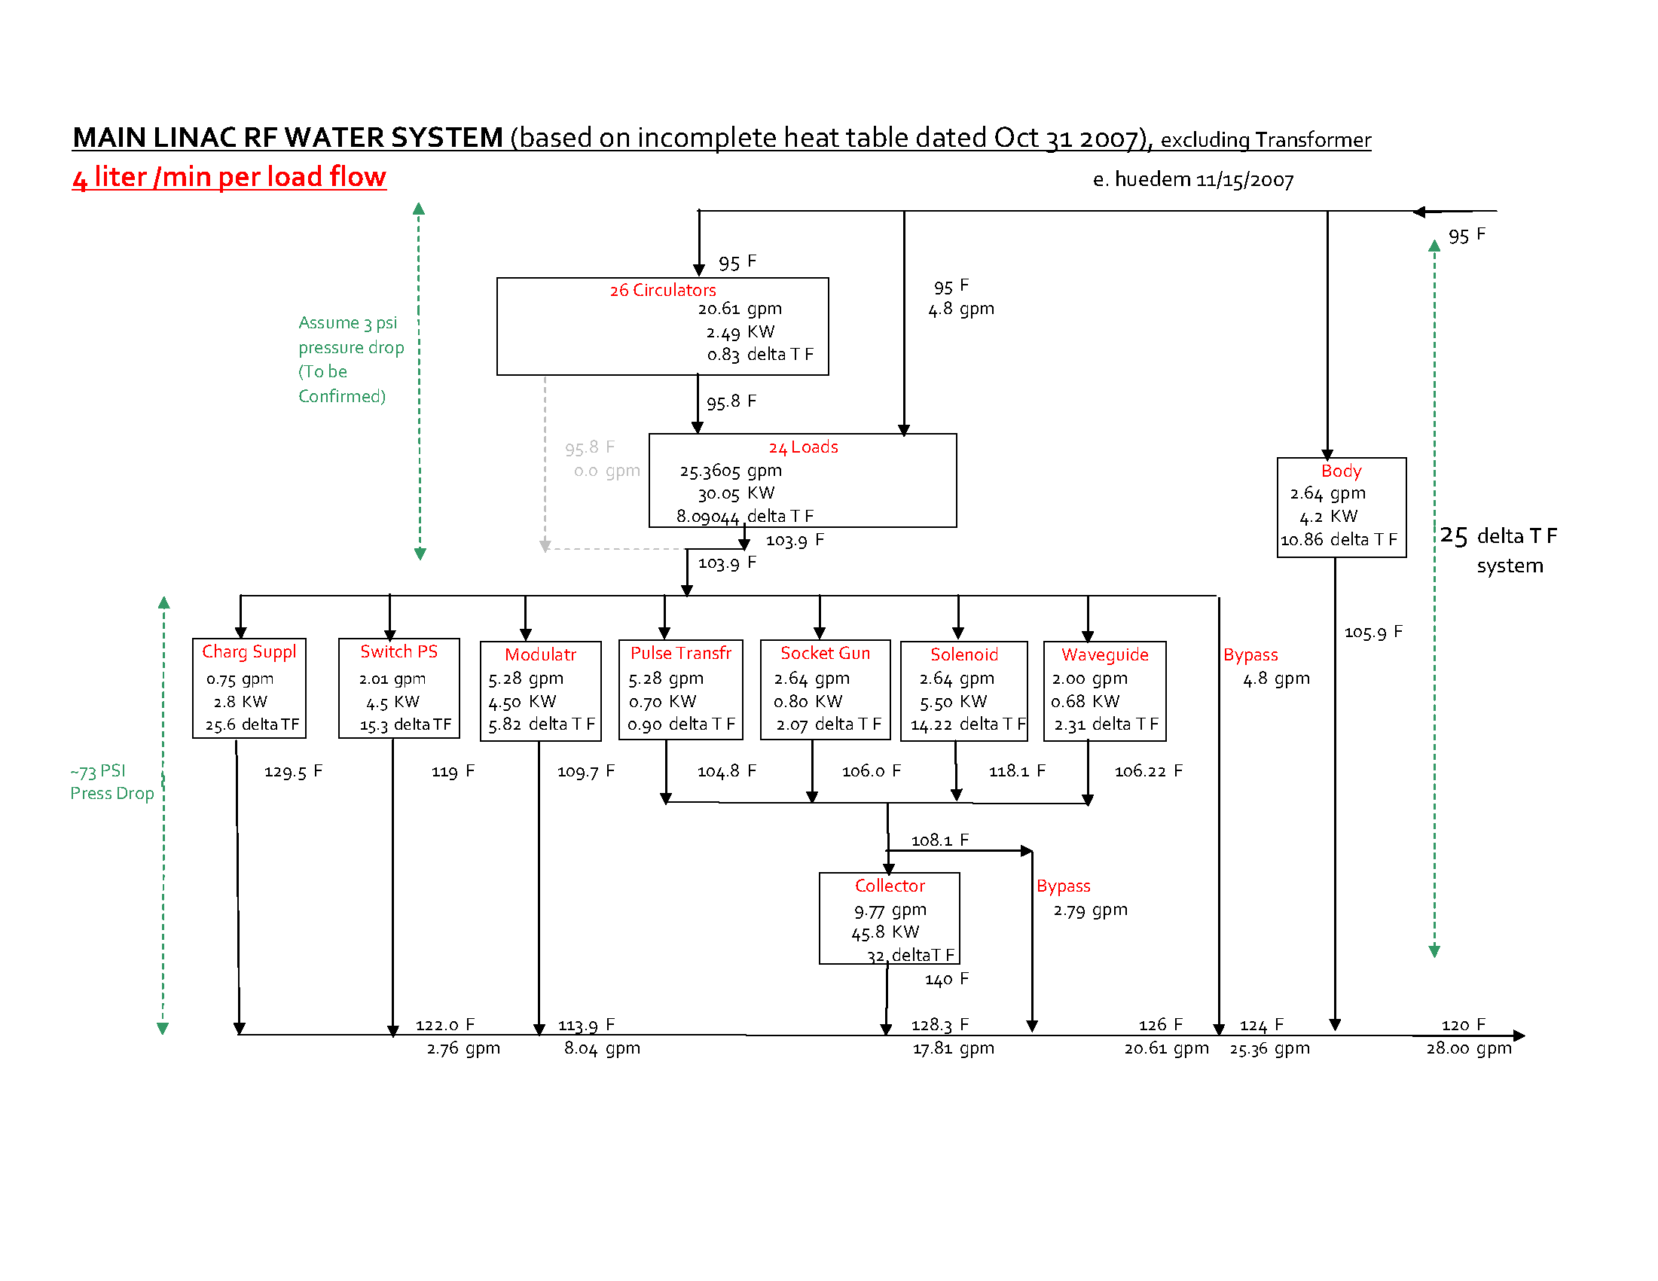
Stacking of Loads / High Delta T
1 RF

Slide 18
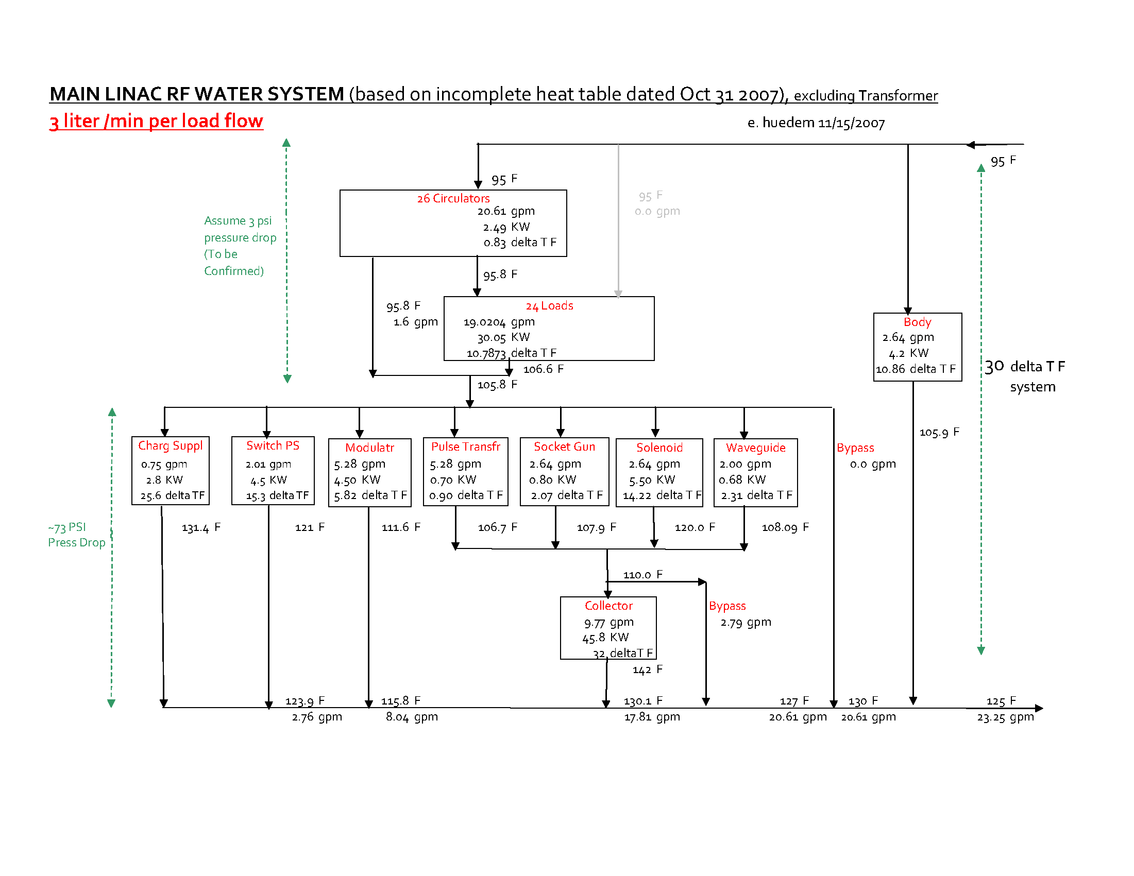
Stacking of Loads / High Delta T
1 RF

Slide 19
Waveguide Heat of ONE RF UNIT (Oct 4 2007)
At Service Tunnel (to air -load to fancoil) = 1.17KW
LLRF
KLYSTRON
MODULATOR
Assume issue with mixing air between tunnel, watercooled waveguide in the penetration by???
Sealed
ATTENUATORS
At Penetration (water) = 0.676KW?
TUNNEL PENETRATION
Sealed
At Beam Tunnel (to air )= 5.9KW*
*if the straight run of waveguide in beam tunnel are watercooled, the remaining load to air becomes 5.4KW
Heat Loss from Cryo ~5w/m (T.Peterson) ~(-0.18KW)
Heat Loss from RockWall ignored
Heat Loss (Air ) ~38 w/m ~(-1.3 KW) *15F delta T air at 2.5Km
Heat Gain (Waveguide) = 5.9 KW ~ +5.9 KW
--------------------------------------------- ----------------
NET LOAD to AIR (beam tunnel) + 4.42 KW
See HVAC slides
later, for option of
aircooled wavgd
at penetration &
about rock contrbtion
cn eh Oct 4 2007

Slide 20
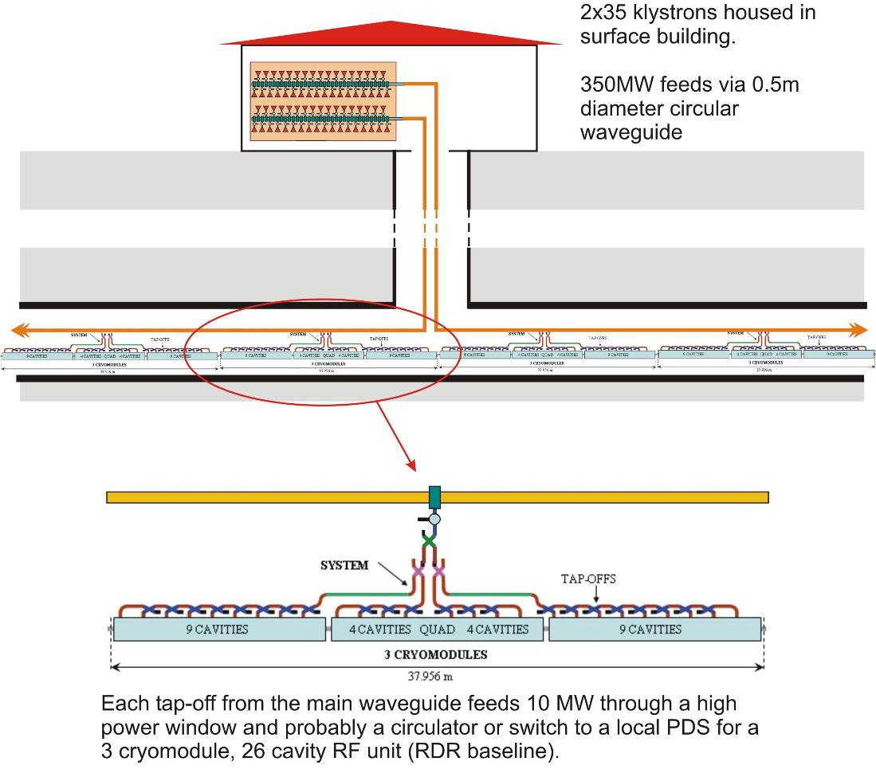
Klystron Cluster Concept
RF power “piped” into accelerator tunnel every 2.5 km
Service tunnel eliminated
Electrical and cooling systems simplified
Concerns: power handling, LLRF control coarseness
~10 MW
Same as baseline

Slide 21
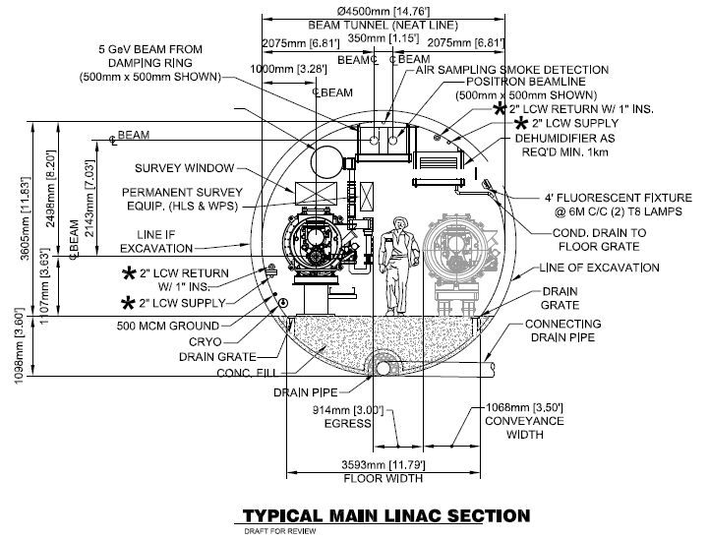
First Pass at New Tunnel Layout
RF Waveguide

