Slide 1
Update of experimental hall in Japanese mountain site
Y. Sugimoto
2012.4.12

Slide 2
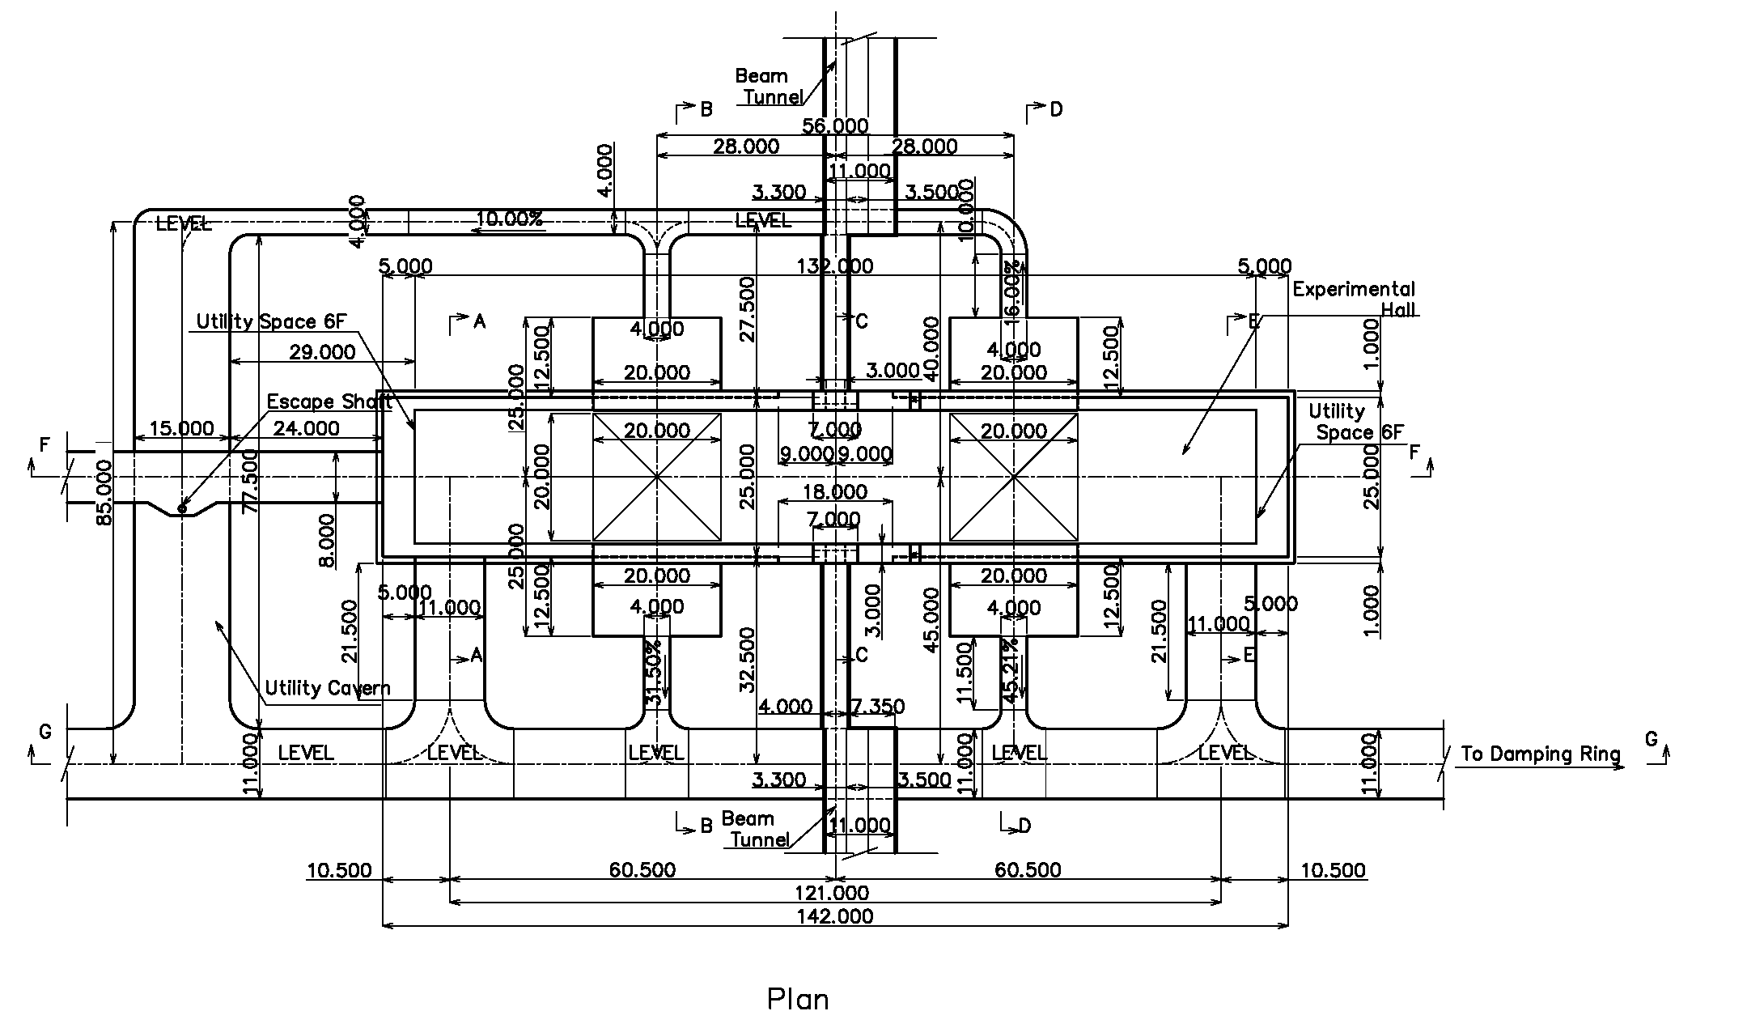
Design shown at CFS BTR

Slide 3
Alternative design
142m → 120m

Slide 4
Today’s talk
At CFS BTR, someone said 142m is too large (to keep cost containment), and another one said 142m is too small (for detector assembly)
I will show a possible detector installation plan based on the 142m option, and discuss about a possibility of 120m option

Slide 5
Assembly area
Area 1: Platform
  YB0 assembly
  Barrel detectors installation/cabling
  Endcap HCAL installation
Area 2/3: Alcoves
  Endcap HCAL cabling
  Endcap ECAL install/cabling
  QD0 support tube assembly
  FCAL install/cabling
Area 4: Tentative platform on beam line side
  YE, YB+, YB- (iron yoke and muon detector) assembly/install/cabling
Area 5: Loading area side
  HCAL rings assembly
  Tooling assembly
  Storage area

Slide 6
Boundary conditions
Cranes
  250 ton crane on beam line side
  30 ton crane on loading area side
  2.8 ton cranes in alcoves
    In order to minimize the size of alcoves, the crane rails should be supported from the arch part → Only small cranes can be used (can be 5 ton, depending on the max weight of endcap ECAL modules)
Work conflicts
  In order to avoid conflicts of parallel works, first few hours of each working day should be dedicated to transportation to each assembly area

Slide 7
Step 1
Tentative platform is assembled in Area4 using a crawler crane
Central barrel yoke YB0 is assembled on the platform using 250 ton crane
HCAL modules are assembled to a ½-z ring in Area5 using 30 ton crane
Cradle for coil installation is assembled in Area5 using a crawler crane

Slide 8
Step 2
Solenoid coil is moved on the platform using two sets (one from SiD) of 250 ton crane

Slide 9
Step 3
Endcap iron yoke (YE+) is assembled in Area 4
Solenoid coil installation to the YB0 in Area 1

Slide 10
Step 4
Muon detector installation to YB0

Slide 11
Step 5
YE+ is moved to platform using air-pads after muon detector installation
HCAL barrel ½-z ring is assembled in Area 5

Slide 12
Step 6
Endcap yoke YE- is assembled in Area4
Muon detector of YB0 cabling
HCAL barrel ring assembly in Area5

Slide 13
Step 7
YB0 shifted in z direction
Endcap HCAL installation in Area 1
Scaffold for endcap cabling is assembled in Area 5

Slide 14
Step 8
YE- is moved to platform
½ of barrel HCAL is moved to platform using two 250 ton cranes, and installed
Endcap yoke (+) is pushed into Area 2
Endcap HCAL cabling in Area 2
Scaffold for barrel cabling is assembled in Area 5

Slide 15
Step 9
Another barrel ring yoke YB+ is assembled in Area 4
Central barrel YB0 is shifted in z direction
Barrel HCAL (+) cabling in Area 1
Endcap HCAL (-) installation in Area 1

Slide 16
Step 10
Endcap yoke (-) is pushed to Area 3
½ of barrel HCAL is moved to platform using two 250 ton cranes, and installed

Slide 17
Step 11
YB+ muon detector installation and cabling in Area 4
Endcap ECAL (+) installation using 2.8 ton crane in Area 2
Barrel HCAL (-) cabling in Area 1
Endcap HCAL (-) cabling in Area 3

Slide 18
Step 12
YB+ is moved to Area 1
Another barrel yoke ring YB- is assembled in Area 4
Endcap ECAL (+) cabling in Area 2
Endcap ECAL (-) is installed using 2.8 ton crane in Area 3
Barrel ECAL is installed in Area 1

Slide 19
Step 13
YB- muon detector installation/cabling in Area 4
Barrel ECAL cabling in Area 1
Endcap ECAL (-) cabling in Area 3

Slide 20
Step 14
Detector is closed and field mapping is performed
QD0 support tubes assembly in Area 2/3
QD0 and BCAL installation/cabling in Area 2/3
After removing the tentative platform in Area 4, beam line shield is constructed

Slide 21
Step 15
Detector is opened again
TPC installation in Area 1
Lumical installation in Area 2/3

Slide 22
Step 16
Si inner trackers are installed in Area 1

Slide 23
Step 17
Detector is closed again and ready for detector pre-commissioning

Slide 24
Timeline
Assumptions
  YB rings: 50d each
  YE: 100d each including muon detector installation/cabling
  Muon detector: 20d+20d for each barrel ring
  Liquid He becomes available 8 months after the cavern is get ready
  Field mapping will be done after ECAL installation and cabling: 20d for cool down, 60d for mapping, 20d for warm up
  Others: Same as the detailed Gantt chart given by Karsten

Slide 25
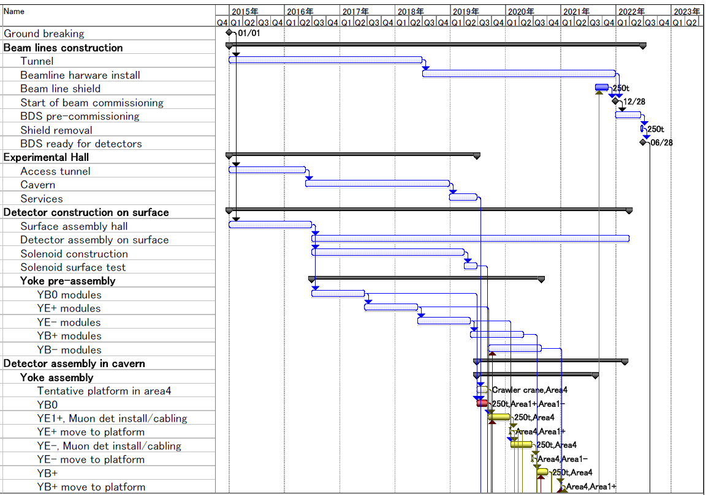
Timeline

Slide 26
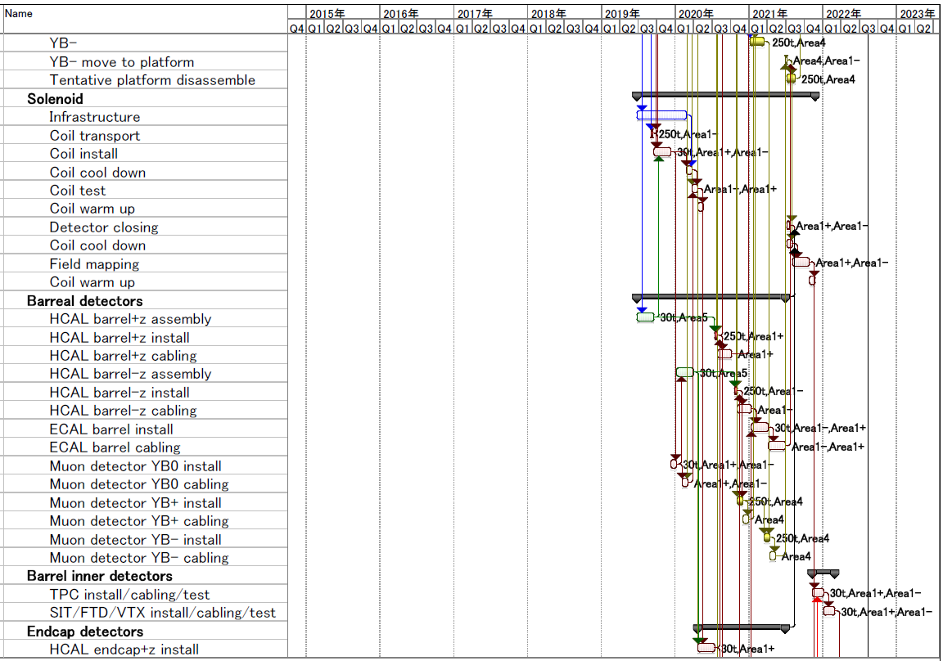
Timeline

Slide 27
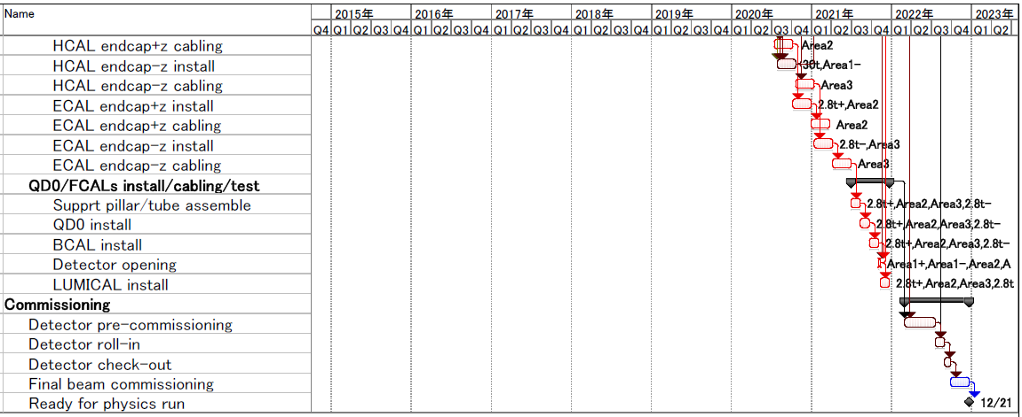
Timeline

Slide 28
Summary
The 142m option of the cavern looks OK for detector installation of ILD without extending the original schedule (8 years from ground breaking to physics run)
If HCAL barrel rings are assembled on surface, 120m option may be OK
The depth of the alcoves (12.5m) may be somewhat tight. 15m is OK?
Crane capacity in alcoves has to be decided

