Slide 1
1 TeV pair backgrounds with ILD_O1_v02
Akiya Miyamoto
KEK
18-April-2012
ILD Software/Analysis WG meeting

Slide 2
Simulation conditions
GuineaPig files : produced by Hartin. Taken from /afs/desy.de/group/flc/pool/analysis/public/pairs/hartin/[1000,500]GeV - Waisty_opt_Jan2012_1000GeV_B1b_runX_waisty_190 20BX - Waisty_opt_Jan2012_500GeV_run9_waisty_250 7BX
Mokka: ilcsoft-v01-13-04, Mokka-07-07
ILD_O1_v02. ILD_00fwp01 (500GeV) for comparison with LOI
Setting for Anti-DID and pair simulation in mokka.steer /Mokka/init/EditGeometry/rmSubDetector SField01
/Mokka/init/EditGeometry/addSubDetector fieldX03 1000 /Mokka/init/lcioDetailedTRKHitMode SITCollection
/Mokka/init/lcioDetailedTRKHitMode VXDCollection
/Mokka/init/lcioDetailedTRKHitMode FTDCollection
/Mokka/init/lcioDetailedTRKHitMode TPCCollection
/Mokka/init/lcioDetailedTRKHitMode TPCSpacePointCollection
/Mokka/init/TPCLowPtStepLimit true
/Mokka/init/pairParticlesPerEvent 100
/Mokka/init/TPCCut 0 keV

Slide 3
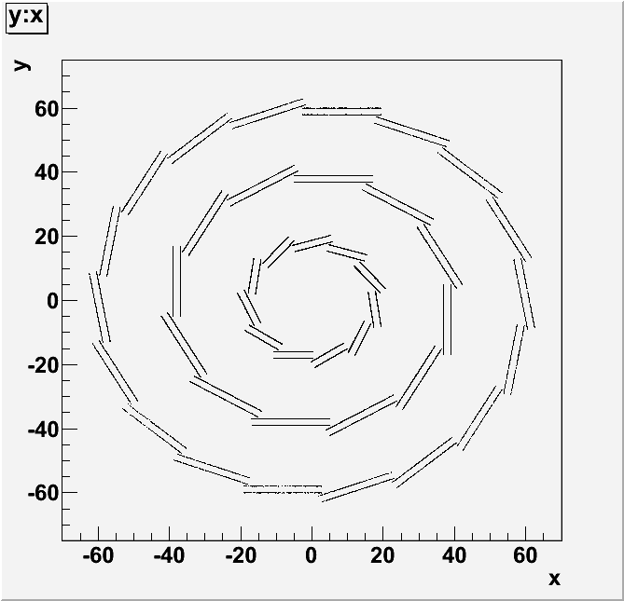
VTX hits in XY plane
Distribution of SimTrackerHits were studied
6
5
4
7
3
8
2
1
Number shown is ladder number
9
0
10
0
0

Slide 4
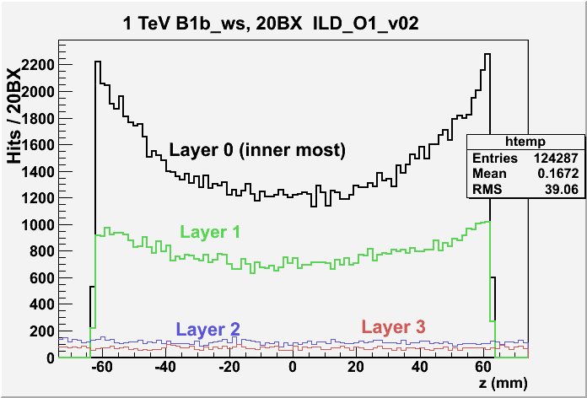
Z distribution

Slide 5
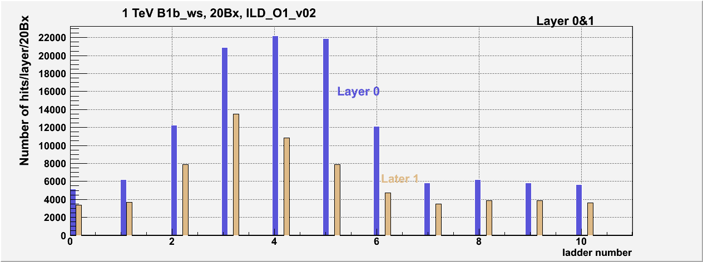
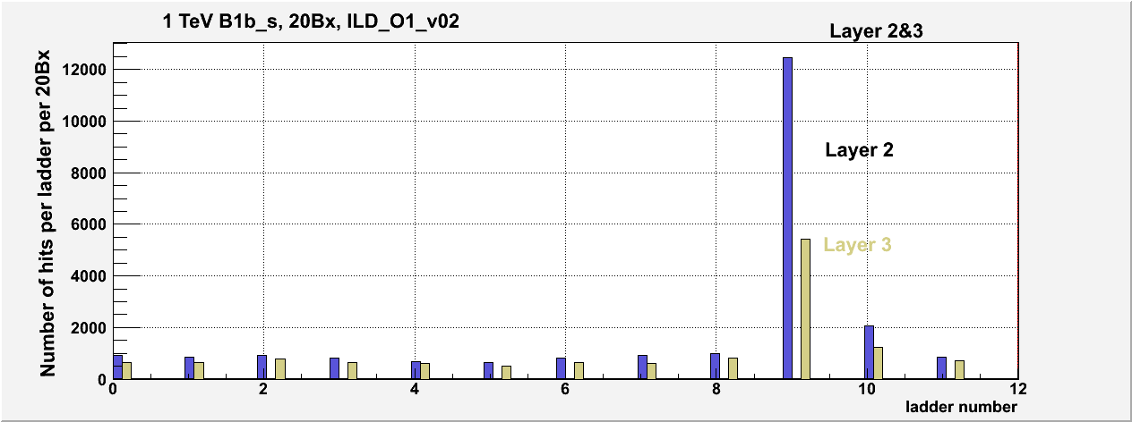
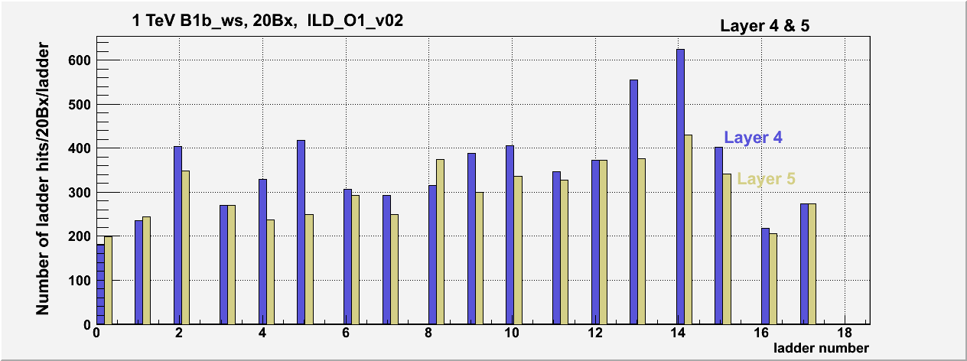
Phi dependance of VTX hits

Slide 6
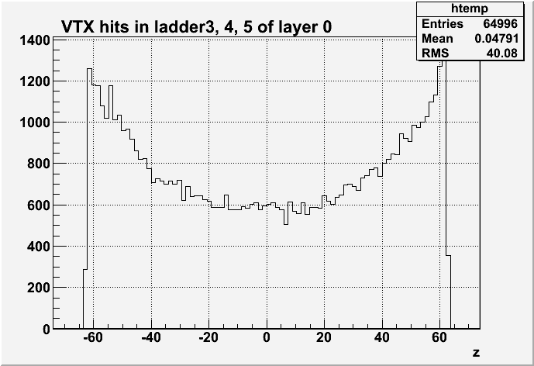
VTX hits in ladder 3 and 4 and 5
About half of hits in the inner most layer is in ladder 3, 4, and 5

Slide 7
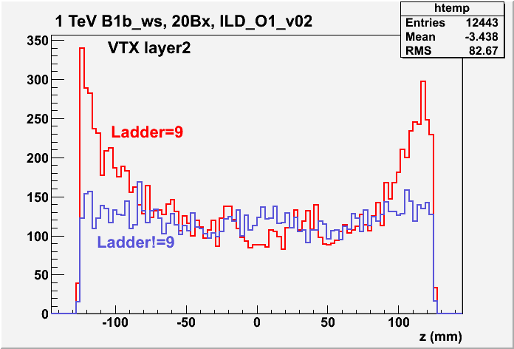
Layer 2 ladder 9:
Z distribution of ladder 9 is similar to layer0 ladders. Many hits due to back scattering ?

Slide 8
VTX geometry to calculate hit occupancy
Hit occupancy is calculated assuming 1 SimTrackerHit create 4 pixel hits
4 * ( # of simtracker hits /BX ) * (# of BXs/Read out )
Occupancy =
total number of pixels
Ladder | width |  |  | 11 | mm
 | Half length
 |  | Layer 0&1 |  | 62.5 | mm
Readout time
 | CMOS layer0&1 |  |  | 46 | usec
 |  | layer2,3,4,5 |  | 184 | usec
 | FPCCD |  |  | inter-pulse
1 TeV | Number of bunches |  |  | 2450
 | bunch separation |  |  | 366 | nsec
 |  |  |  | CMOS like |  |  | FPCCD like |  |  | FPCCD/CMOS
Layer | Width (mm) | HalfL (mm) | #Ladder | #BX/RO | Pixel size (um^2) | #Pixels (M) | #BX/RO | Pixel size (um^2) | #Pixels (M) | #RO/#Pixel ratio
0&1 | 11 | 62.5 | 11 | 125 | 25^2 | 24.2 | 2450 | 5^2 | 605 | 0.784
2&3 | 22 | 125 | 12 | 504 | 25^2 | 105.6 | 2450 | 5^2 | 2640 | 0.194
4&5 | 22 | 125 | 18 | 504 | 25^2 | 158.4 | 2450 | 5^2 | 3960 | 0.194
500 GeV | number of bunches |  |  | 1312
 | bunch separation |  |  | 554 | nsec
 |  |  |  | CMOS like |  |  | FPCCD like |  |  | FPCCD/CMOS
Layer | Width (mm) | HalfL (mm) | #Ladder | #BX/RO | Pixel size (um^2) | #Pixels (M) | #BX/RO | Pixel size (um^2) | #Pixels (M) | #RO/#Pixel ratio
0&1 | 11 | 62.5 | 11 | 83 | 25^2 | 24.2 | 1312 | 5^2 | 605 | 0.632
2&3 | 22 | 125 | 12 | 333 | 25^2 | 105.6 | 1312 | 5^2 | 2640 | 0.158
4&5 | 22 | 125 | 18 | 333 | 25^2 | 158.4 | 1312 | 5^2 | 3960 | 0.158
x25
1/20

Slide 9
VTX bkg hit occupancy ( w. “CMOS” )
Beam para. | 1000GeV-B1b_ws |  |  |  | 500 GeV_ws |  |  |  | LOI
DID | w. AntiDID |  | no. DID |  | w. AntiDID |  | w. AntiDID
Detector | ILD_O1_v02 |  | ILD_O1_v02 |  | ILD_O1_v02 |  | ILD_00fwp01
Sim. Stat. | 20Bx |  | 20Bx |  | 7Bx |  | 7Bx
Layer | Hits/BX | Hit occ.(%) | Hits/BX | Hit occ.(%) | Hits/BX | Hit occ.(%) | Hits/BX | Hit occ.(%) | Hit occ.(%)
0 | 6214.4 | 12.84 | 25821.0 | 53.35 | 2132.3 | 2.93 | 2678.6 | 3.67 | 3.33
1 | 3333.6 | 6.89 | 14599.4 | 30.16 | 1102.4 | 1.51 | 1674.4 | 2.30 | 1.90
2 | 1143.1 | 2.18 | 788.5 | 1.51 | 349.1 | 0.44 | 335.3 | 0.42 | 0.40
3 | 663.3 | 1.27 | 567.3 | 1.08 | 223.3 | 0.28 | 287.1 | 0.36 | 0.33
4 | 317.0 | 0.40 | 341.6 | 0.43 | 91.0 | 0.08 | 69.4 | 0.06 | 0.08
5 | 271.7 | 0.35 | 333.0 | 0.42 | 90.3 | 0.08 | 62.1 | 0.05 | 0.06
Hit occupancies are estimated at 1 TeV and 500 GeV, with different det. config.
1 tracker hit = 4 pixel hits accumed.
500 GeV case, ILD_00fwp01 results consistent with LOI values ILD_O1_v02 is about 20~30% less than ILD_00fwp01 in L0&1.
1000 GeV : w. AntiDID is about x4 of 500 GeV no DID/w.DID x4 more hits in 1st layer. Note: # Pairs = 430k/BX(1TeV), 169k/BX(500GeV) ➔ x 2.5
Considering phi dep. Layer 0, ladder 3~5 have ~1/2 hits of 11 ladders.
➔ Occupancy would be ~ 3 larger in these ladders

Slide 10
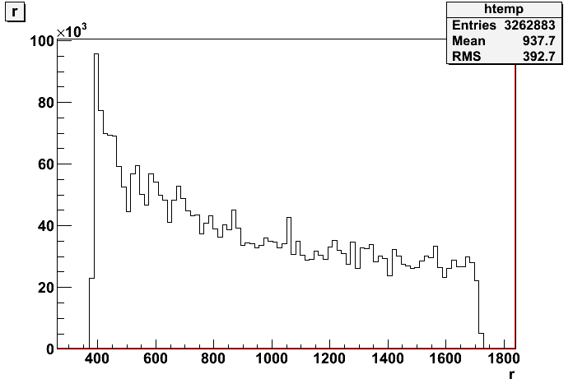
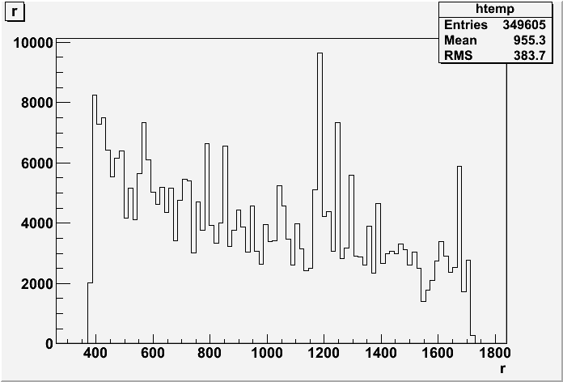
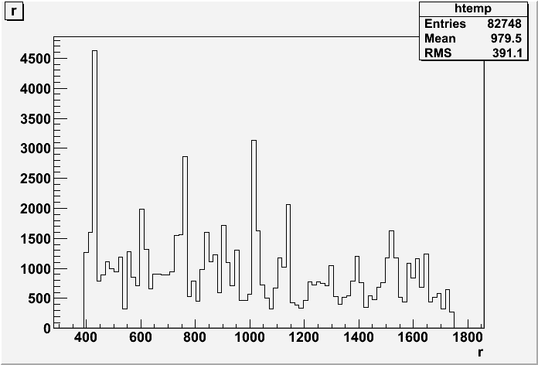
TPC hits
1 TeV: 163khits/BX (ILD_O1_V02)
500 GeV: 50khits/BX (ILD_O1_V02)
12k hits/BX (ILD_00fwp01)
1 TeV ~ 3 x 500 GeV hits
ILD_O1_V02 ~ 4xILD_00fwp01

Slide 11
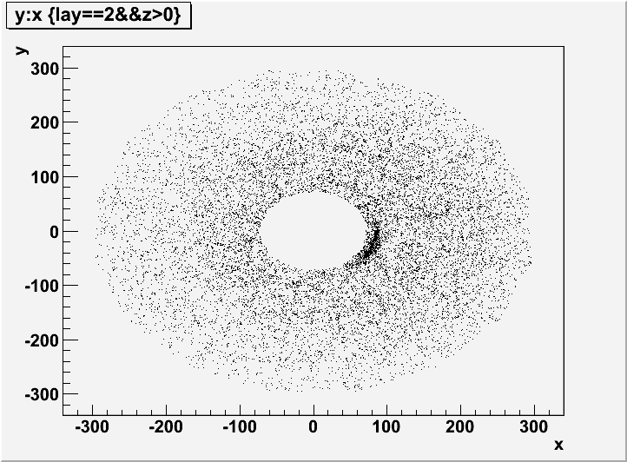
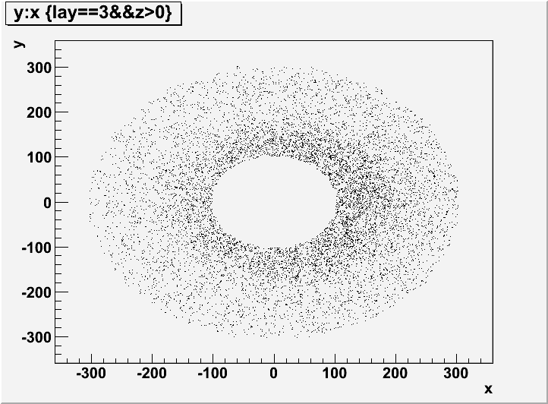
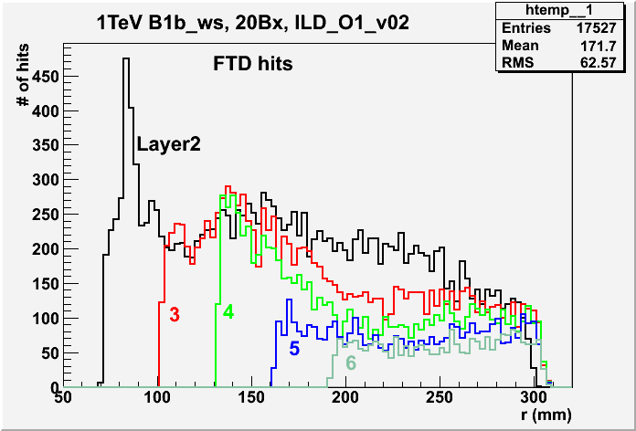
FTD Hits 1 TeV
(ILD_O1_V02)
 | #Hits/BX |  | Ratio
Layer | 1TeV | 0.5TeV | 1/0.5
0 | 0 | 0
1 | 0 | 0
2 | 876 | 270 | 3.24
3 | 619 | 191 | 3.24
4 | 407 | 123 | 3.31
5 | 202 | 56 | 3.59
6 | 126 | 37 | 3.37

Slide 12
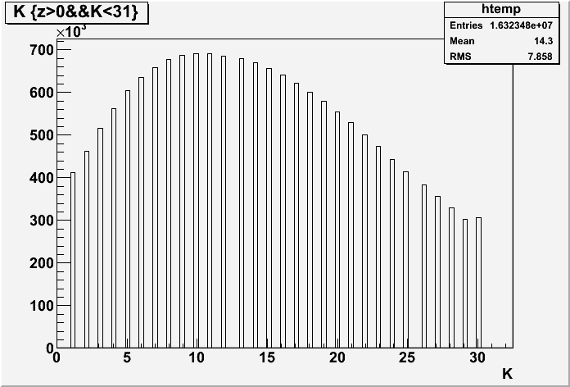
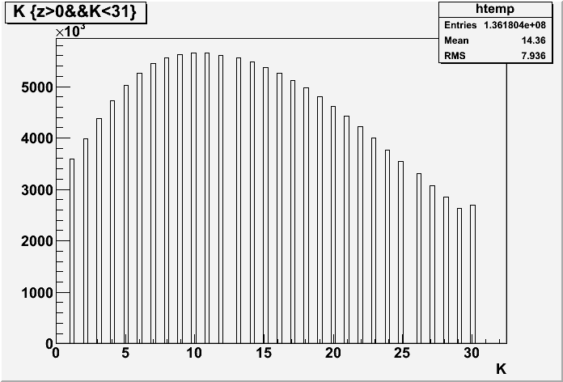
BCAL
(ILD_O0_V02)
# Hits
∑E/BX=3.33E7
500GeV
Z distribution
∑E/BX=9.78E7
1TeV
~2.9 x 500GeV
Z distribution

Slide 13
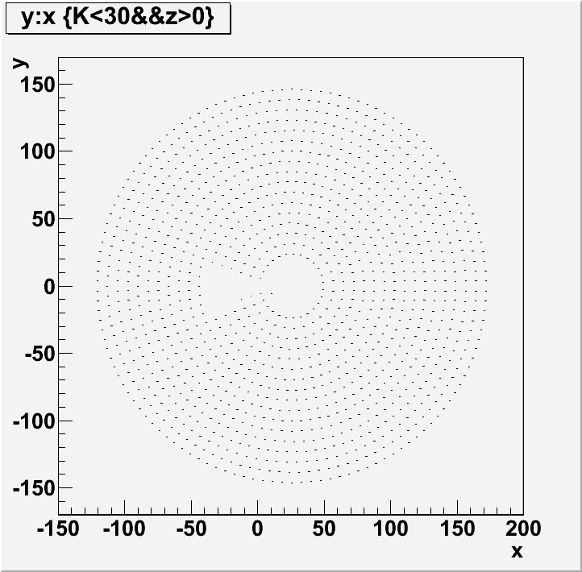
BCAL : “Radial” ∑E/Bx distribution
0
16
1TeV is 3.3~3.8 times more
∑E/Bx than 500 GeV

Slide 14
Summary
Background hit occupancies were studied
with the latest GDE beam parameters for 1 TeV and 500 GeV
ILD_O1_v02, Mokka-07-07-p06
VTX
500 GeV result is consistent with LOI result with a factor of two.
Assuming a detector with 25umx25um pizels, 46/184 usec readout,
Hit occupancy of SImTrackerHit at 1 TeV was about x4 of 500 GeV
Taking into account phi-dependence of hit distribution, the occupancy could be x3 larger
Faster readout is required.
FPCCD like detector ( smaller pixels, inter-pulse readout ),
Occupancies at the inner layers would be higher.
TPC, FTD, BCAL : 3~4 times more hits at 1 TeV
Need to Identify the source of the background hits
500 GeV ILD_O1_V02 : ~x3 more TPC hits than ILD_00fwp01

Slide 15
Backup
Slides

Slide 16
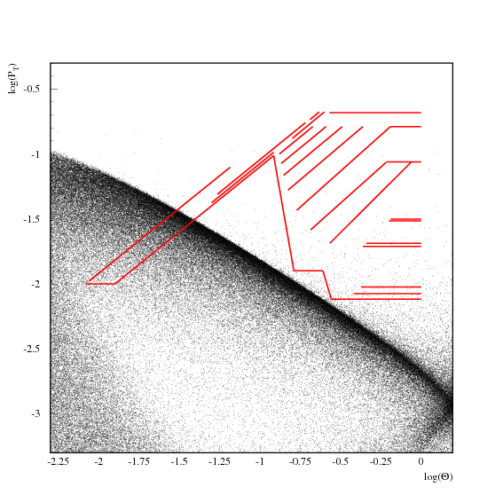
1 TeV B1b_ws
By Mikael Berggren

