Slide 1
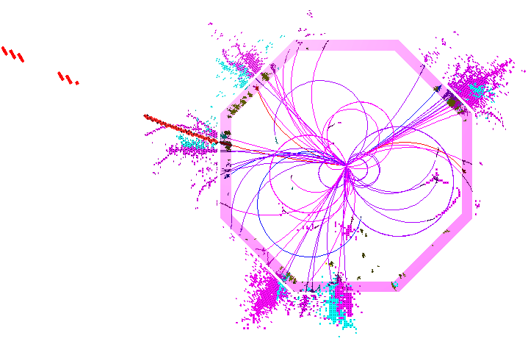
PandoraPFA: Status for ILD
ILD Analysis/Software Meeting, 18/04/2012
J.S. Marshall, University of Cambridge

Slide 2
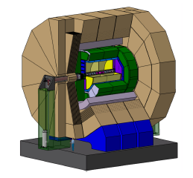
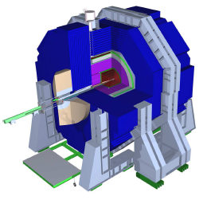
Overview
Recent IlcSoft changes are likely to have an impact on the particle flow reconstruction.
Pandora algorithms are isolated from these changes by the MarlinPandora client application.
MarlinPandora is responsible for performing the following software/detector-specific tasks:
Providing calibrated energy values for each calorimeter cell,
Making quality cuts for all input inner-detector tracks and calorimeter cells,
Specifying information about inner-detector tracks and their relationships (kinks, prongs, etc.).
Now need to review these operations...
Isolate specific detector and software details, creating self-describing hits, tracks, etc.
Run registered algorithms/tools and perform book-keeping
Pandora Framework
Pandora Client Application
Algorithm Manager
CaloHit Manager
API
Cluster Manager, etc.
ILD/Marlin
SiD/org.lcsim

Slide 3
Calibration
With any important change to simulation or reconstruction, need to perform calibration.
PandoraAnalysis package contains Marlin processors and simple binaries to ease this process.
Ensure that Mokka hits are calibrated, using following MC samples:
10,000 10GeV photons at cos(θ) = 0.02, with random φ values,
5,000 10GeV K_{L} at cos(θ) = 0.02, with random φ values,
5,000 10GeV muons at cos(θ) = 0.02, with random φ values.
Determine PandoraPFA MIP calibration constants, using the muon sample.
Identify the PandoraPFA constants (below). We might expect these to just be 1.0, but need to account for mip cuts applied in MarlinPandora and also for PandoraPFA isolation cuts.
ECAL_To_EM_GeV
ECAL_To_HAD_GeV
HCAL_To_EM_GeV
HCAL_To_HAD_GeV
MUON_To_GeV
Aim to optimise jet energy reconstruction: quantify using Z→uds events, RMS₉₀(E)/Mean₉₀(E).

Slide 4
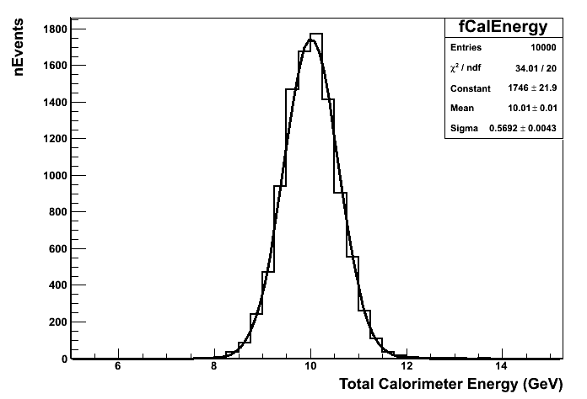
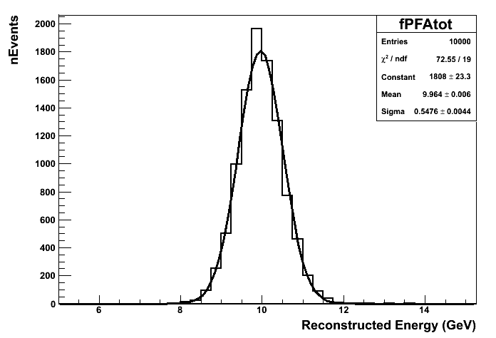
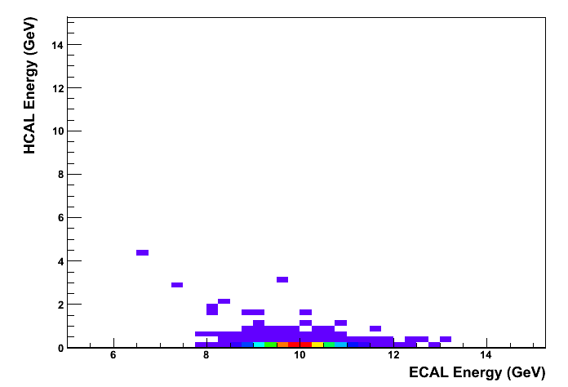
ECAL Calibration
ECAL calibration rather straightforward.
Change CalibrECAL from 40.91, 81.81 to 42.91, 85.82
Pandora constants: ECAL_To_EM_GeV=1.00
HCAL_To_EM_GeV=1.00
HCAL To EM constant not too important

Slide 5
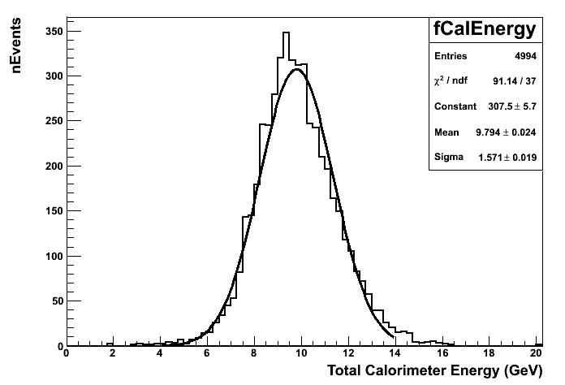
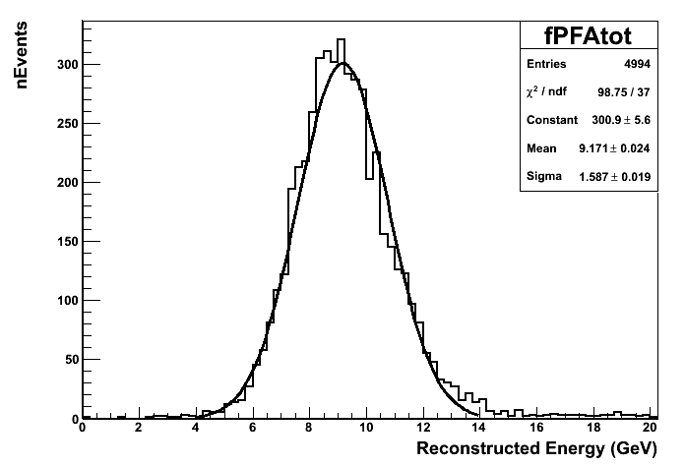
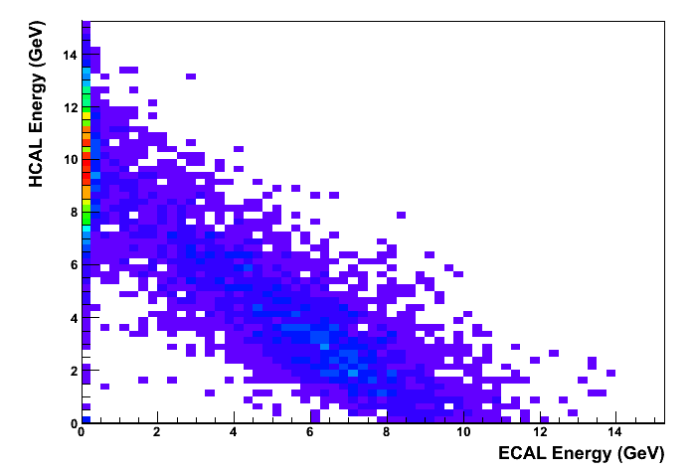
HCAL Calibration
HCAL calibration difficult: non-Gaussian, energy corrections, K_{L} energy divided between ECAL/HCAL
Use MINUIT to optimise for jet energy reconstruction: change CalibrHCAL from 34.80 to 58.60
Pandora constants: ECAL_To_HAD_GeV=1.05
HCAL_To_HAD_GeV=1.00
Further increases distort distribution

Slide 6
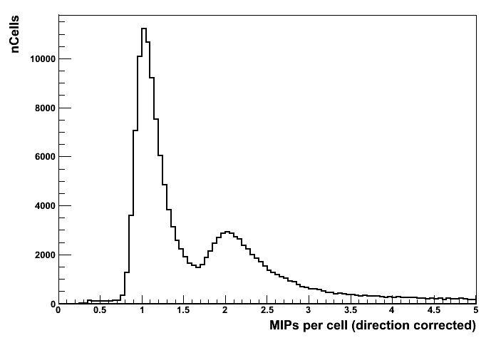
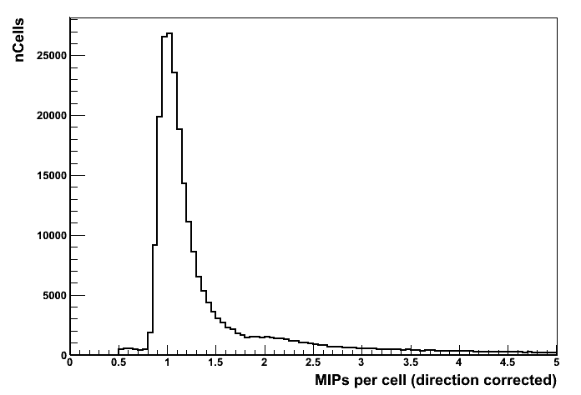
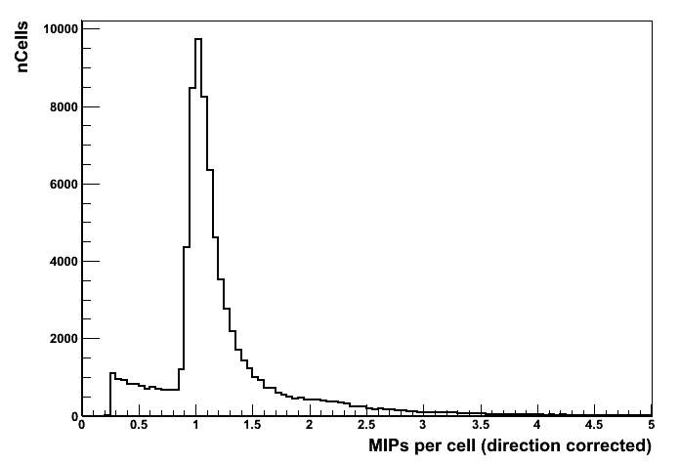
MIP Calibration
ECAL
HCAL
MIP constants: ECAL_To_MIP=160.0 HCAL_To_MIP=34.8 MUON_To_MIP=10.0
Need to change product of CalibrMUON and MUON_To_MIP from 100,000 to 465.
Choose to keep MUON_To_MIP unchanged (for now), intermediate MUON_To_GeV untested.
MUON

Slide 7
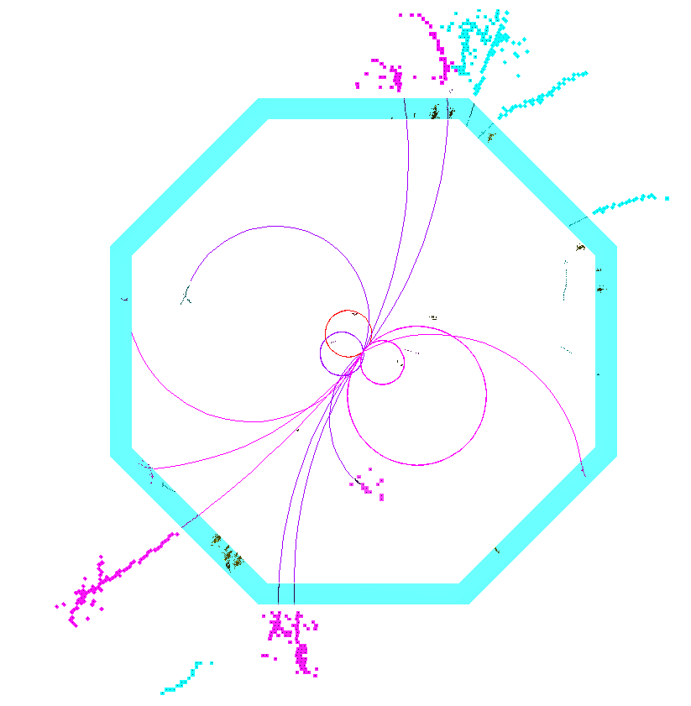
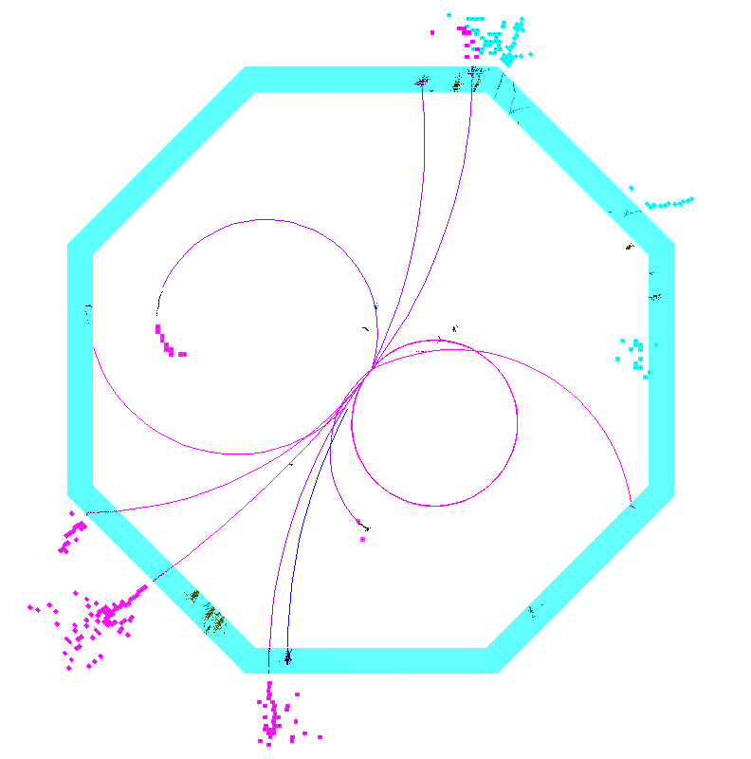
Z→uds Simulation
Assess performance using Zs at different energies decaying at rest into light quarks, producing two back-to-back jets. Backgrounds not included and no jet finding performed.
For most interesting comparison, use IlcSoft v01-13-05 version of Mokka to process same stdhep files for both ILD_00 and ILD_O1_v02. Same physics lists, etc. Change only detector model.
Reconstruct events with IlcSoft v01-13-05, using old tracking/calibration (previously validated steering file) and new tracking/calibration (new steering file from ILDConfig repository).
Event 1
Same 91GeV Z→uds stdhep file
Same physics list and Mokka version
IlcSoft v01-13-05
Same PandoraPFA
ILD_00
Old Tracking/Calibration
ILD_O1_v02 New Tracking/Calibration

Slide 8
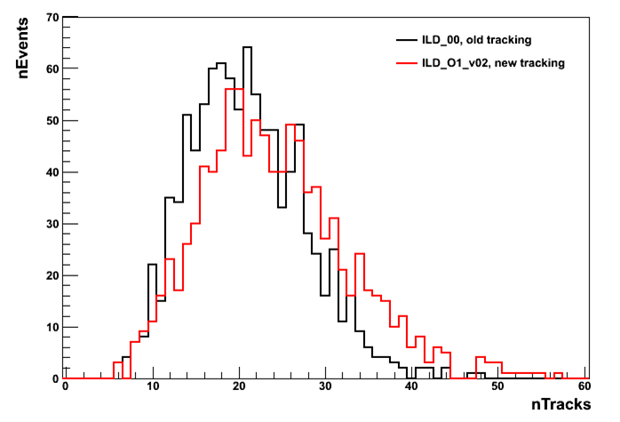
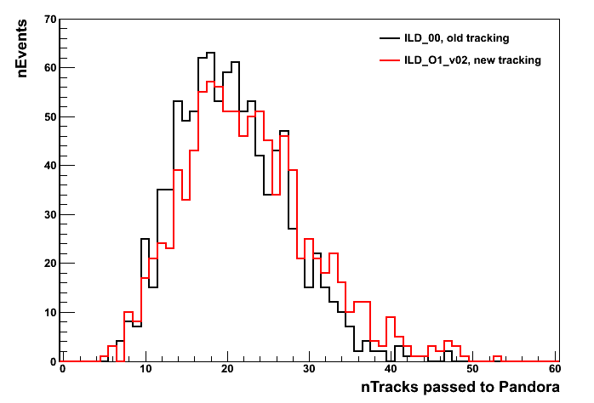
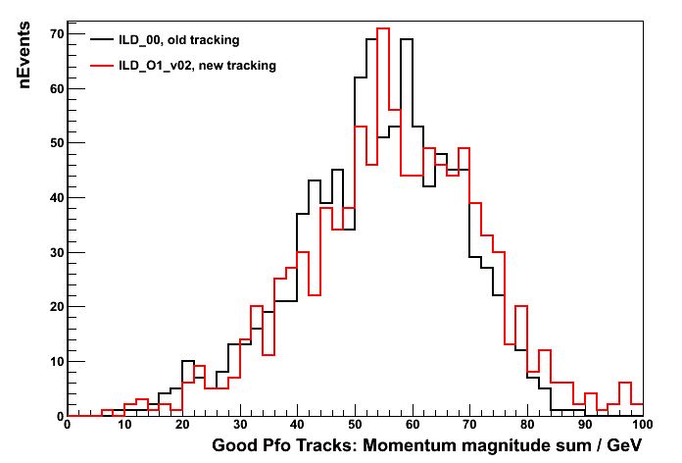
Tracking Changes
Tracking reconstruction has changed significantly. Can no longer assume that the many track quality checks in MarlinPandora are appropriate.
For first tests, continue to apply “sensible” track quality cuts, but nothing directed at specific pathologies in either the old or the new tracking software.
Cannot assume that track-relationship information, provided by KinkFinder and V0Finder processors, can be used safely.
For first tests, do not feed track-relationship information to Pandora algorithms.
Preliminary plots, with rather low stats: 1,000 91GeV Z→uds events

Slide 9
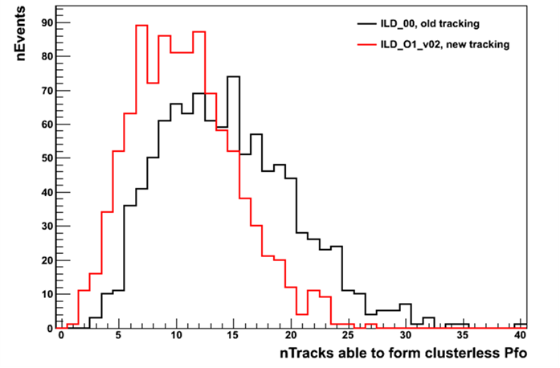
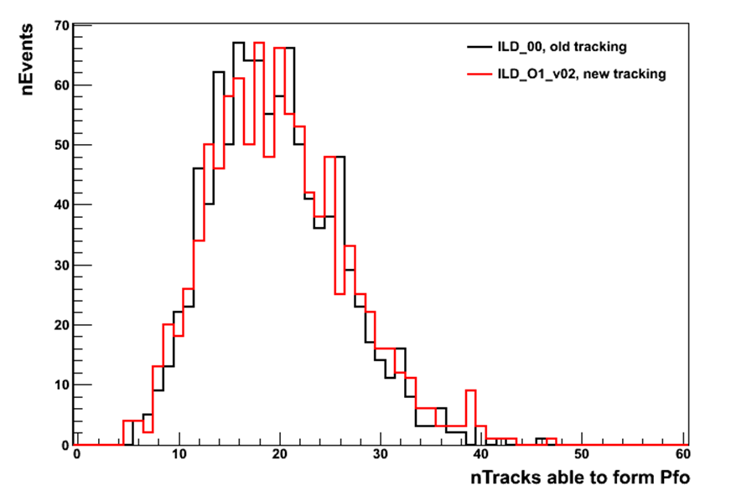
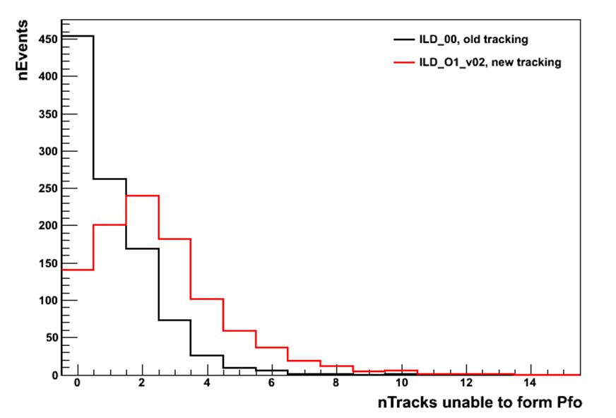
Tracking Changes
MarlinPandora chooses not to pass tracks to Pandora if have only a small number of tracker hits (accounts for different tracking detectors in decision).
However, this is not full story. MarlinPandora also specifies a number of important properties, which tell Pandora algorithms how to use tracks they receive:
CanFormPfo flag
CanFormClusterlessPfo flag

Slide 10
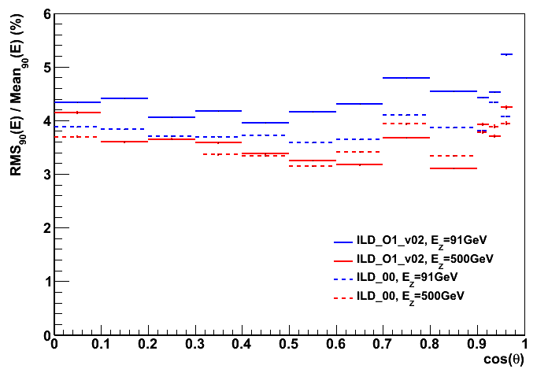
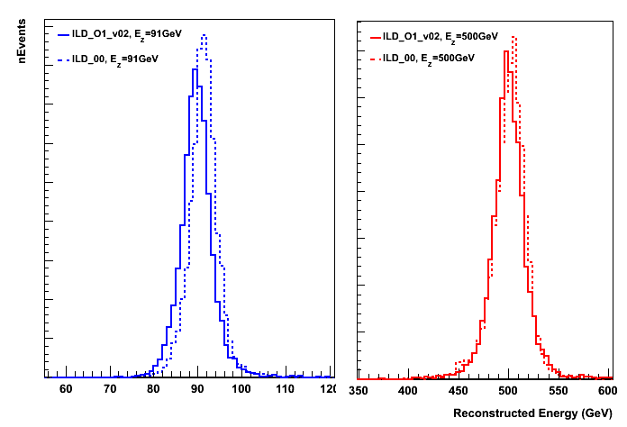
Z→uds Results
Jet energy reconstruction results indicate problems. Sizeable at E_{Z}=91GeV, decrease at E_{Z}=500GeV.
E_{z} (= 2 * E_{j}) | 91GeV | 500GeV
ILD_00, RMS₉₀(E_{j})/mean₉₀(E_{j}) [%] | 3.69 ± 0.05 | 3.40 ± 0.05
ILD_O1_v02, RMS₉₀(E_{j})/mean₉₀(E_{j}) [%] | 4.15 ± 0.05 | 3.48 ± 0.05

Slide 11
Next Steps...
Have reported first quick studies of performance with new detector model and reconstruction. Now need to understand the observed degradation in jet energy resolution:
New track reconstruction?
Calibration problems?
Simulation issues?
If calibration is a problem, not as simple to solve as might first think: MINUIT-controlled variation of calibration parameters cannot improve present jet energy resolution results.
Have so far examined ILD_00 with old tracking reconstruction, plus ILD_O1_v02 with new tracking. Would be helpful to test old detector model with new reconstruction software.
A “TruthTracker” that is fully functional for Z→uds events would also help to narrow search.
Suggestions very welcome!
Must distinguish between these
 | ILD_00 | ILD_O1_v02
Old Tracking | ✓ | ?
New Tracking | ? | ✗

