Slide 1
Discussions on the Approach to Technical Systems for the TDR
N. Walker
AD&I meeting 11.04.2012

Slide 2
RDR “Matrix”

Slide 3
RDR “Matrix”
RDR Chapter 2 Accelerator Description

Slide 4
RDR “Matrix”
RDR Chapter 3 Technical Systems

Slide 5
TDR Approach
TDR Chapter 3 - 8
SCRF
SCRF

Slide 6
TDR Approach
TDR Chapter 3 - 8
warm RF
LLRF

Slide 7
“Exceptions” to the Rule(s)
Cryogenics
  Main linac dominates
  Sources, RTML, BDS requirements documented in respective chapters, but
  Tech. solutions referenced to ML chapter
SCRF Tech
  For source and RTML – same as above.
Remain issues
  Hopefully few
  Dealt with at editing phase

Slide 8
TDR and remaining Tech/Global systems
How to deal with these in the TDR?
General approach
Deal with them in AS chapters 3-8 as appropriate
Assume unchanged from RDR (copy & paste)
Review requirements! (I.e. read RDR)
Likely to be exceptions to these “rules”

Slide 9
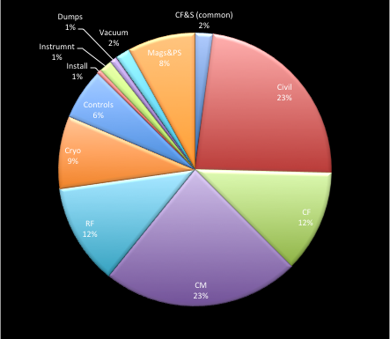
Cost Guidance!
Magnet/PS (8%)
Vacuum (2%)
Dumps (<1%)
Instrum. (2%)
Controls (6%)
Total ~20% TPC

Slide 10
Magnets and Power Supplies (1)
Chapter 3.1
  magnet design, PS, supports
  7 pages
  Relative generic text – no ‘solutions’ (EDMS!)
Requirements (from AS)
  Field strength & quality, aperture etc. , stability →EDMS
  Summary table(s) in TDR chapters
Special magnets should be described in TDR chapters
  e.g. BDS final doublet
The need for a stand-alone section?
  Global summary table (RDR Table 3.1-1)
  Description of considerations for design work (mostly in support of cost estimate)

Slide 11
Magnets and Power Supplies (2)
Sources
  No change to tech. requirements
  Component counts need to be adjusted for TDR baseline
    Mostly e+ source
  Central region integration: influence on PSS?
    few resources!
Damping Ring
  Complete overhaul of lattice
  Magnet designs (assume unchanged?)
  PSS – complete overhaul
Covered in detail in DR chapter

Slide 12
Magnets and Power Supplies (3)
RTML
  No change to tech. requirements
  Component counts need to be adjusted for TDR baseline
  Central region integration: influence on PSS?
BDS/MDI
  No change to tech. requirements
  Component counts need to be adjusted for TDR baseline
  Central region integration: influence on PSS?

Slide 13
Vacuum Systems
RDR chapter 3.2
  Dominated by SCRF linac vacuum → TDR SCRF
  Relatively thin elsewhere (comprehensive)
Requirements
  vacuum specs. in TDR AS chapters
  solutions also

Slide 14
Instrumentation
RDR section 3.10
  Comprehensive overview of systems/types/general requirements
  Includes beam-based feedback systems
  Summary of device counts and requirements
Summary information / requirements and counts → relevant TDR chapters
  Review specifications (resolutions etc).
  Include more detail on ‘special devices’ as required.

Slide 15
Instrumentation
Sources
  No change from RDR specs
  Component count updates
DR
  No change from RDR specs ??
  Component count updates
RTML
  No change from RDR specs
  Component count updates
BDS/MDI
  No change from RDR specs
  Component count updates

Slide 16
Collimator and Dumps
RDR section 3.11
  Covered everything that got in the way of the beam
  Superficial – no real design work
  exception: 18MW dumps (focus → BDS)
  Generic solutions proposed for dump ratings
Requirements etc. to be dealt with in TDR AS chapters
  specific details as required
  Type of dump (e.g. water called Al balls) should be mentioned.

Slide 17
Dumps and collimators
Sources
  No change from RDR specs
    e+ photon dump (and pol. collimator) should be specially mentioned.
  Component count updates
DR
  No change from RDR specs
  Component count updates
RTML
  No change from RDR specs
  Component count updates
BDS
  Expect more detail on main dumps
  Collimator systems unchanged
  Component count updates (unchanged?)
Dump requirements intended for review by operations task force

Slide 18
Control System
RDR section 3.12
  Quite detailed!
Requirements ‘self generated’
  From AS its basically
    numbers of channels
    operation modes
    …
Special case – should be captured in an independent TDR section
  similar to RDR.

Slide 19
In Summary
RDR TS sections where comprehensive but quite superficial
  no real design work
  most of the costing detail in spread sheets and other documents (cf magnets and power supplies)
RDR text (for most part) still valid: may consider including for completeness
  general approach and design philosophy
  basis of cost estimate
  …
Most requirements, components counts can easily be accommodated in TDR AS chapters
TDR chapter authors need to review their requirements / counts / special cases
  for inclusion into their respective chapters.

