Slide 1
STF Quantum-Beam Accelerator commissioning status
H. Hayano, KEK, 04172012

Slide 2
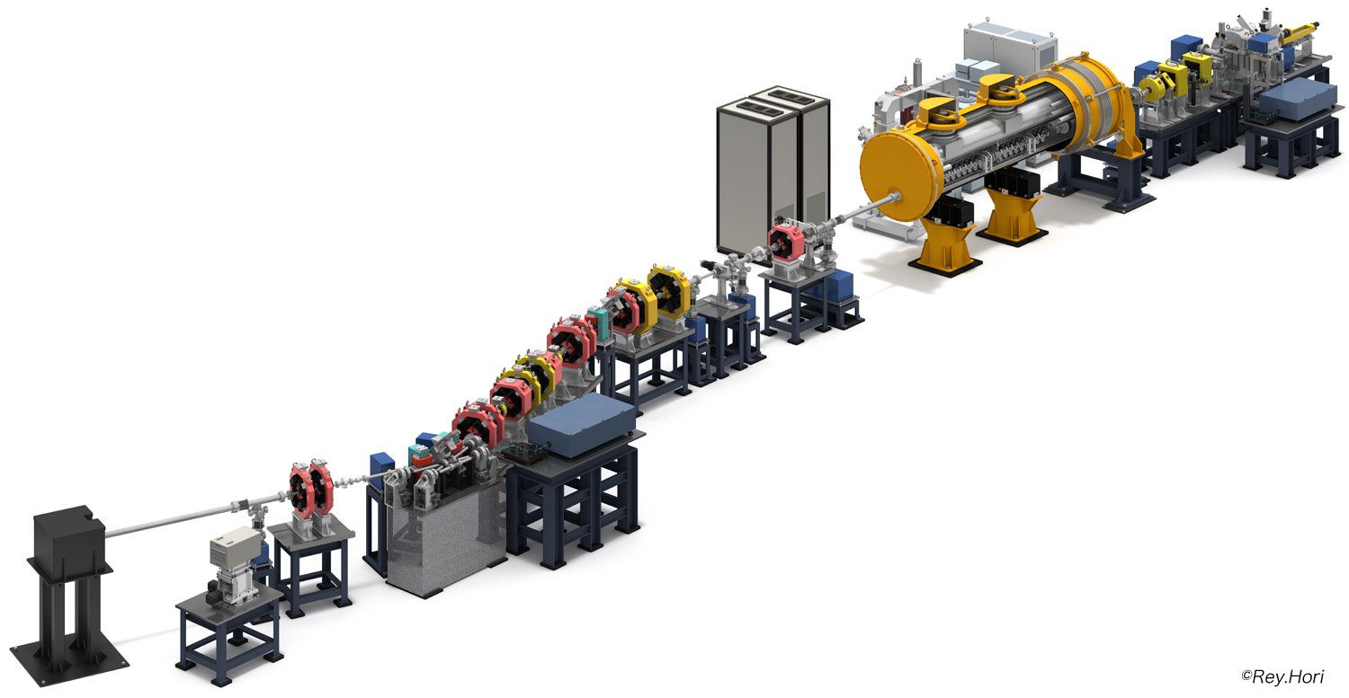
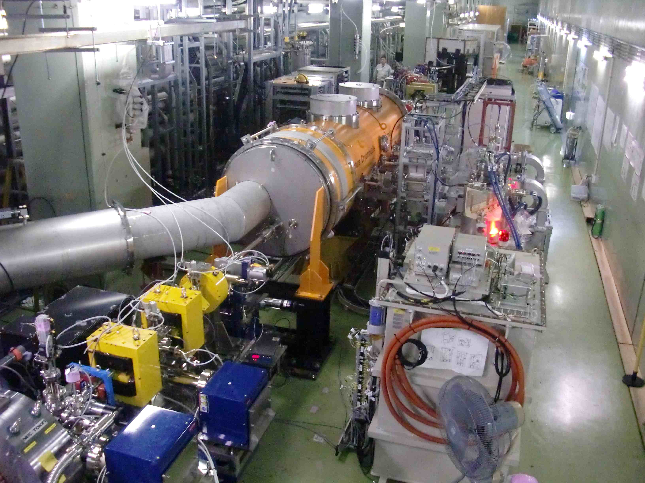
STF Quantum-Beam experiment
KEK-STF
Quantum-Beam Accelerator
High-flux X-ray by Inverse-Compton scattering
10mA electron beam （40MeV, １ｍｓ, ５Ｈｚ）
4-mirror laser resonator cavity
head-on collision with beam
photocathode RFgun
Capture cryomodule ( 2 SC cavities )
collision point
(Laser, electron beam)
Target: 1.3 x 10¹⁰ photons/sec 1%bandwidth
2012. Feb : cool-down started,
April : beam acceleration

Slide 3
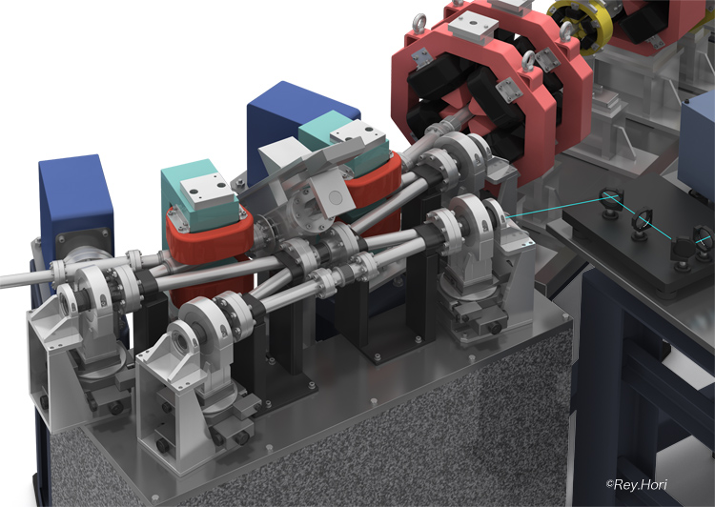
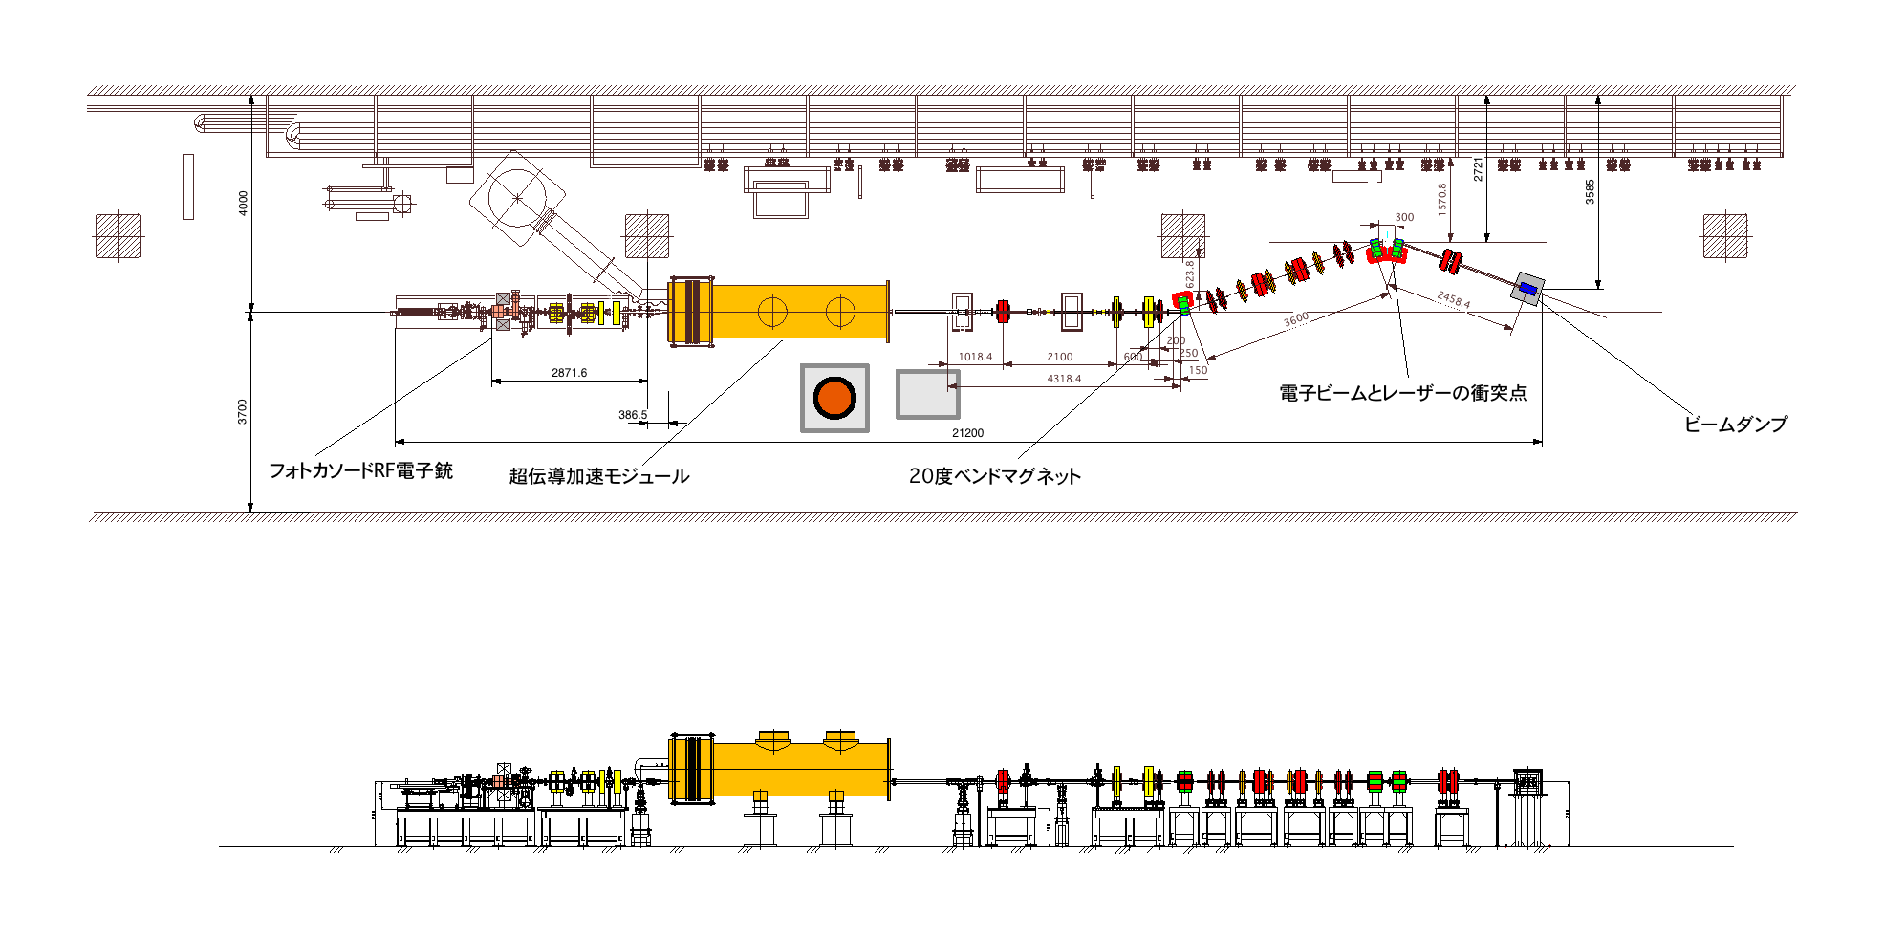
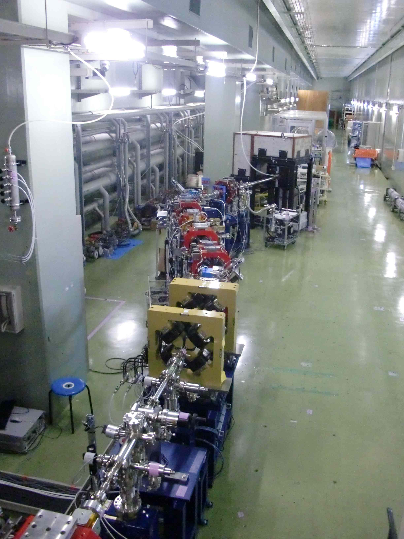
STF Quantum-Beam experiment
High-flux X-ray by Inverse-Compton scattering
10mA electron beam （40MeV, １ｍｓ, ５Ｈｚ）
4-mirror laser resonator cavity
head-on collision with beam
Target: 1.3 x 10¹⁰ photons/sec 1%bandwidth
~30keV X-ray
collision point
(Laser, electron beam)
photocathode RFgun
Capture cryomodule ( 2 SC cavities )

Slide 4
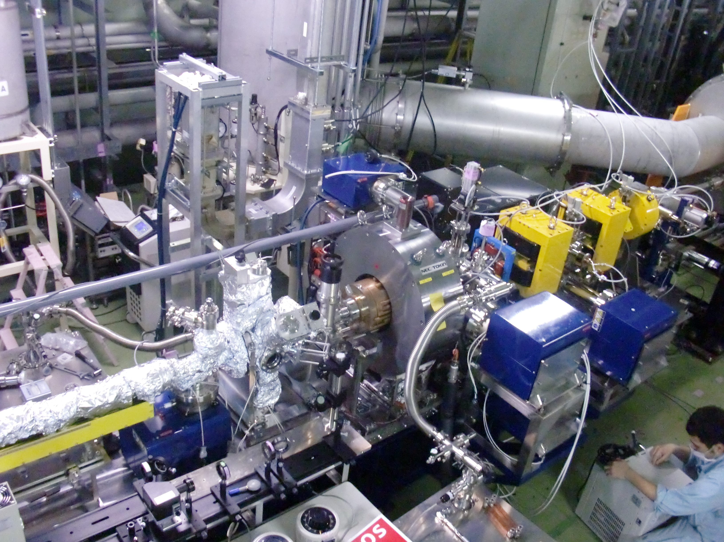
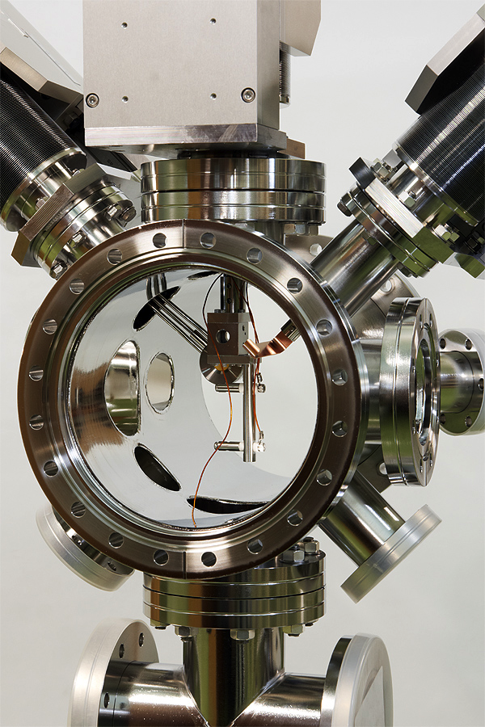
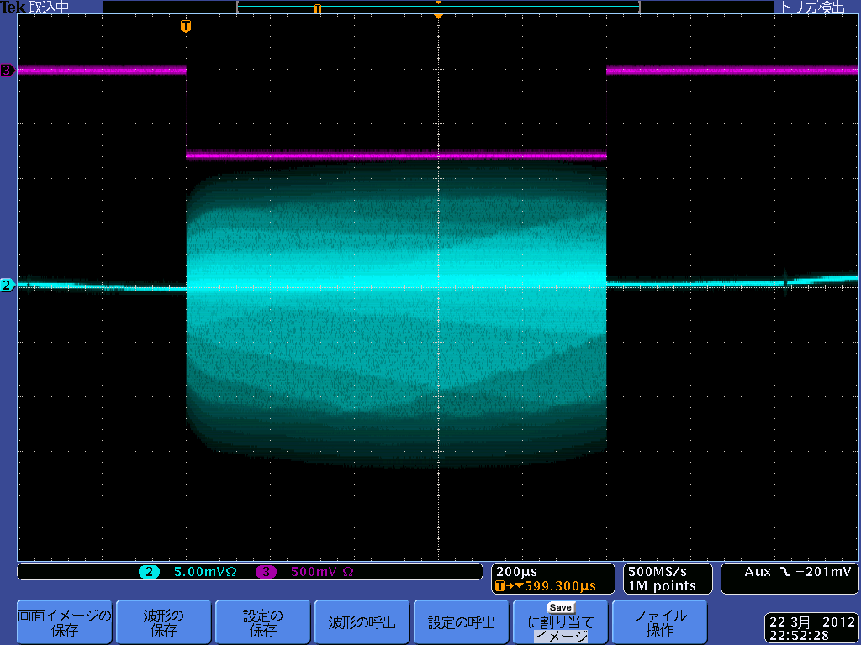
STF Photo-cathode RF-gun
Cs2Te
Photocathode
Preparation
Chamber
Cs2Te photocathode
Preparation chamber
RFgun cavity
1ms beam was extracted
Molybdenum cathode-block

Slide 5
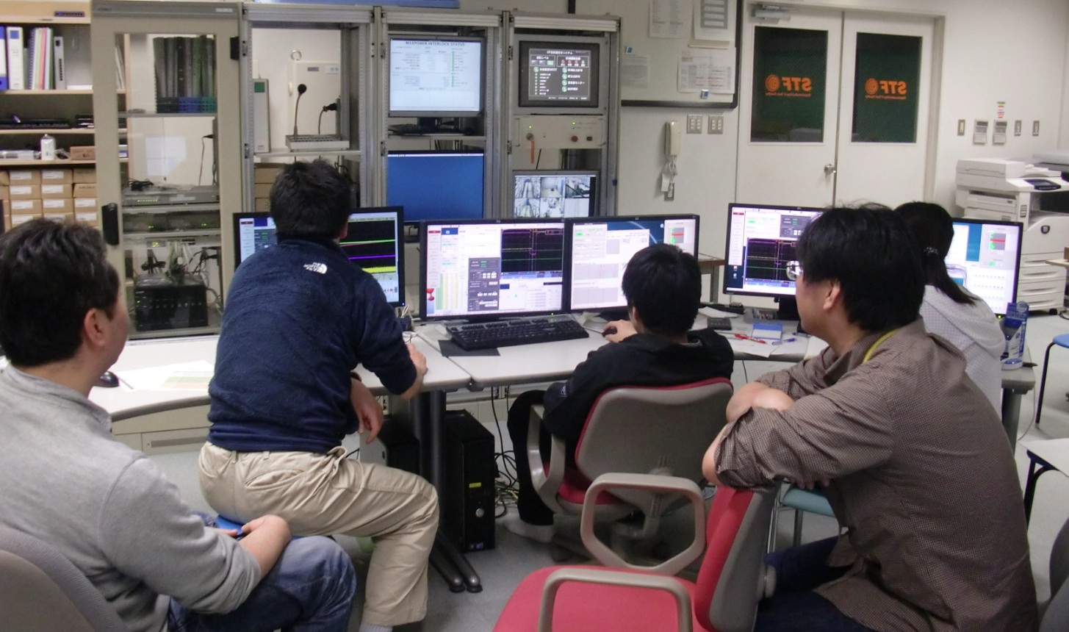
STF control room
K. Watanabe,
M. Fukuda,
K. Sakaue,
H. Shimizu,
Kuramoto,
T. Matsumoto,
M. Omet
After tuning and measurement of SC cavity,
Beam commissioning was started from April 12,2012 with very small charge.
Acceleration confirmation was quickly done, however,
beam was spread-out at downstream.
On April 13,2012, we could make good transmission to beam-dump
with the tuning of RF-gun solenoid very carefully.

Slide 6
Accelerated beam (April 13,2012)
Energy：40MeV、
Beam charge：41pC/bunch、28bunches
repition：5Hz
RFgun cavity power：2.2MW
(34.6MV/m cathode field）
Beam energy from RFgun：3.3MeV/c
SC cavity voltage；
MHI-012:20.15MV/m
MHI-013:21.5 MV/m
Accelerated Beam bunch
Blue：BPM signal exit of Rfgun
Purple：WCM signal downstream of cryomodule
green：beam-loss-monitor signal
Yellow：beam gate timing
Beam profile at collision point：
1mm(FWHM)
Accelerated Beam profile
X orbit
Y orbit
Beam orbit

Slide 7
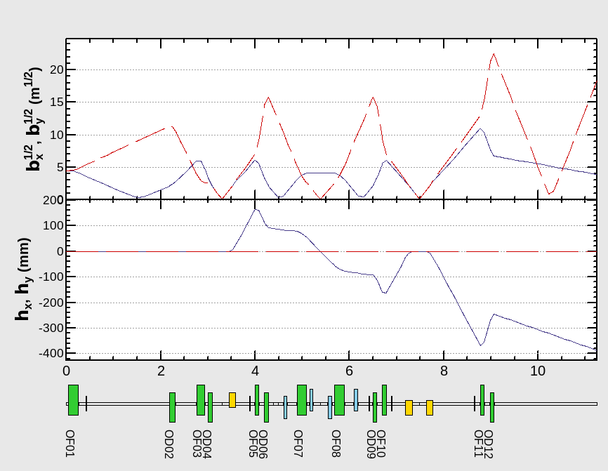
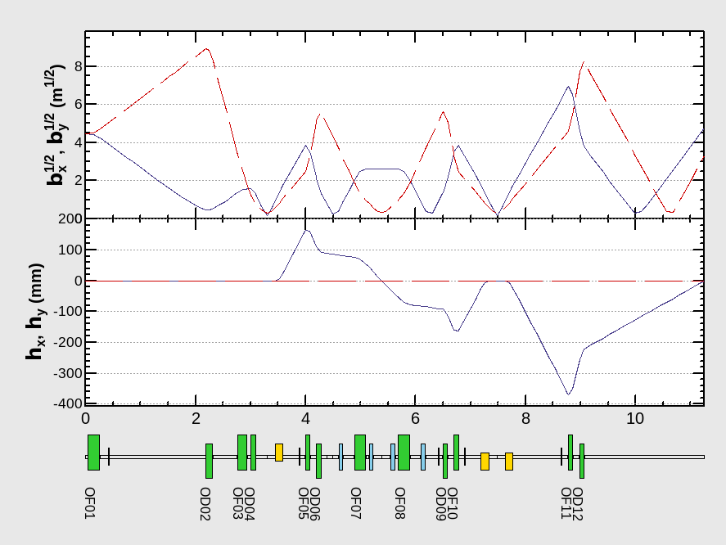
Focusing optics downstream of cryomodule
Now we used this;
Design Optics
Commissioning Optics
Collision point
cryomodule
Beam dump
Optics aiming 10µm beam focusing
at beam and laser collision point
assuming 1mm.mrad emittance from gun.
Reducing beta function for more
easy beam transportation.
T. Okugi

Slide 8
Schedule
April 2012
Sun
Mon
Tue
Wed
Thu
Fri
Sat
cool-down
GV open
cool-down
beam to dump
cool-down
beam to dump, beam monitor tuning
KILC12
cool-down
20% beam power trial
G.W. shutdown
20% beam power operation is required for the examination of radiation safety to prove
the radiation leakage enough small.

Slide 9
Beam tuning procedure on April-run
RFgun : 2MW, 50μs-RF pulse width, set # of bunch 40 and 30pC/bunch, comissioning optics
4/12 (Thu) : SC-cavity tuning for 19MV/m both, set bend 40MeV, GV-open,
35bunch operation, SC-cavity phase scan, beam steer by looking screen monitor
4/13 (Fri) : same beam parameter with 4/12, orbit tuning to dump, profile tuning at screen
by looking beam-loss monitor
4/17 (Tue) : same beam parameter with 4/12, orbit tuning to dump by looking BPM
minimize beam-loss monitor signal by orbit and by beam-size
4/18 (Wed) : orbit tuning to dump by looking BPM
wire scanner monitor start-up
4/19 (Thu) : orbit tuning to dump by looking BPM
wire scanner monitor start-up
4/20 (Fri) : orbit tuning to dump, prepair for 1ms beam train operation
LLRF tuning for FB operation
4/24 (Tue) : same beam parameter with 4/12, orbit tuning to dump by looking BPM
RF pulse and beam pulse extension to 1ms, LLRF feedback ON
4/25 (Wed) : 1ms beam parameter, 20pC/bunch
orbit and profile tuning by looking beam-loss monitor
4/26 (Thu) : 1ms 20pC/bunch beam, orbit and profile tuning
beam loss survey, lead-block shielding
4/27 (Fri) : 1ms 20pC/bunch beam, orbit and profile tuning
beam loss survey, lead-block shielding

Slide 10
May 2012
Sun
Mon
Tue
Wed
Thu
Fri
Sat
4 mirror
Laser
Accumulation
cavity
Lead block
shield
RFgun
Cooling
System
improvement
cryomodule cool-down
cryomodule cool-down
cool-down
20% beam power operation
Beam Operation
The examination of radiation safety will be scheduled in a week of June 4.

