Slide 1
R&D Section Outline (DR- Related)

Slide 2
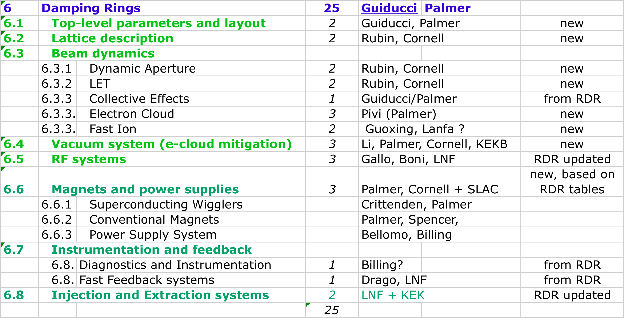
Damping Rings Outline

