Slide 1
SiD detector performance

Slide 2
Procedure
ZZ events at 250, 500, 1000, 2000 GeV
One Z decays invisibly, one to jets
Detector simulation in SLIC v2r11p2
Tracking in lcsim 1.21-SNAPSHOT
(using clic cdr tracking strategies)
sidloi3_trackstates tried and found worse
Reco in slicPandora “V6” (The version Jeremy uploaded)
Jet finding: kt, R=1.5
RMS90_{E,M}.C

Slide 3
sidloi3
LOI version of the detector as described in the engineering report
RPC digital HCAL
20+10 SiW ECAL
5 silicon tracking layers
5 pixel layers

Slide 4
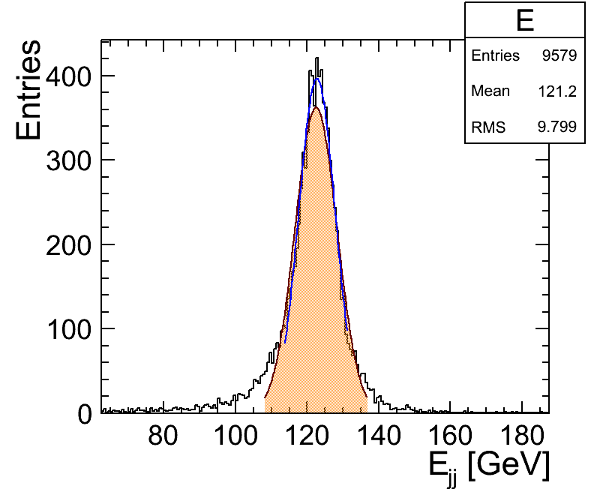

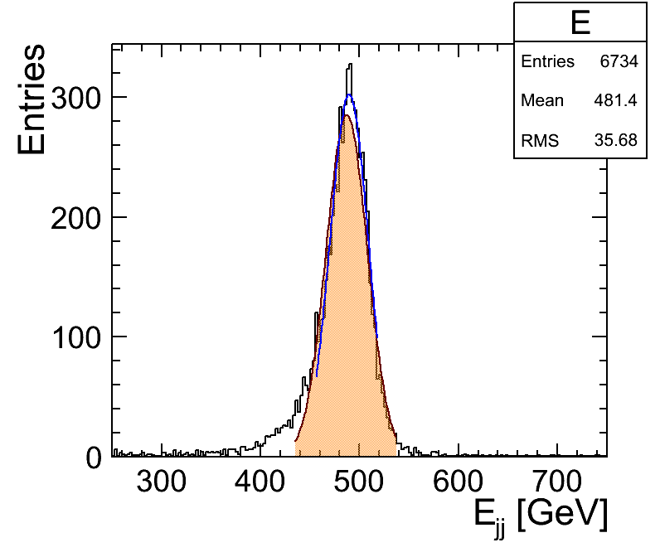
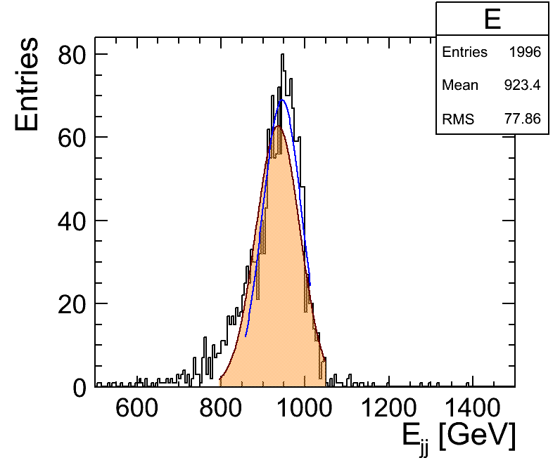
250 GeV
500 GeV
Sidloi3
1000 GeV
2000 GeV

Slide 5
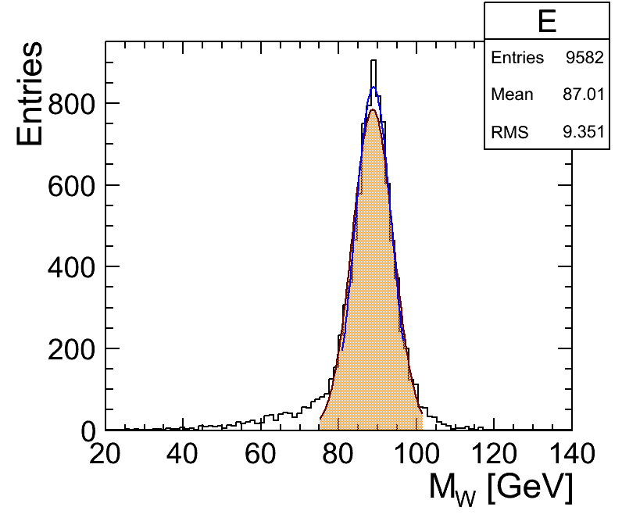

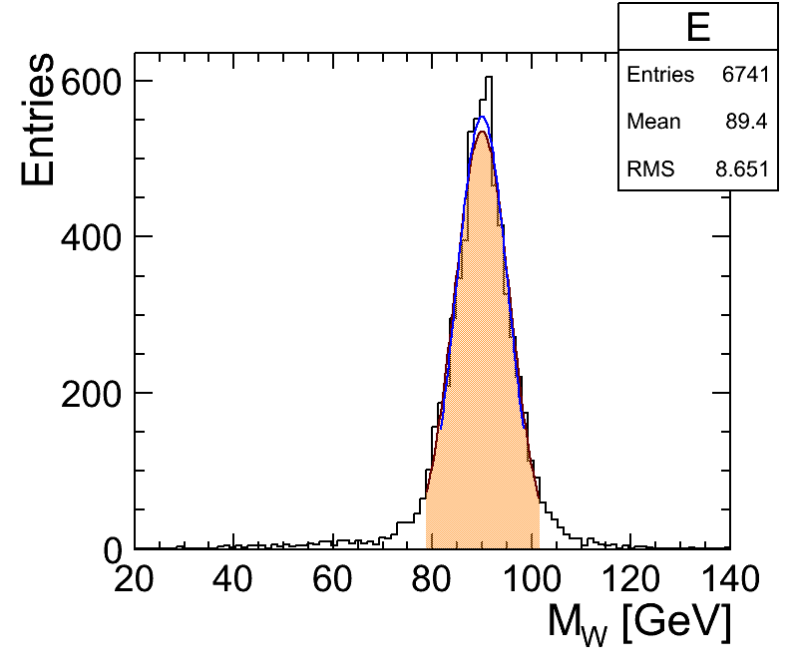
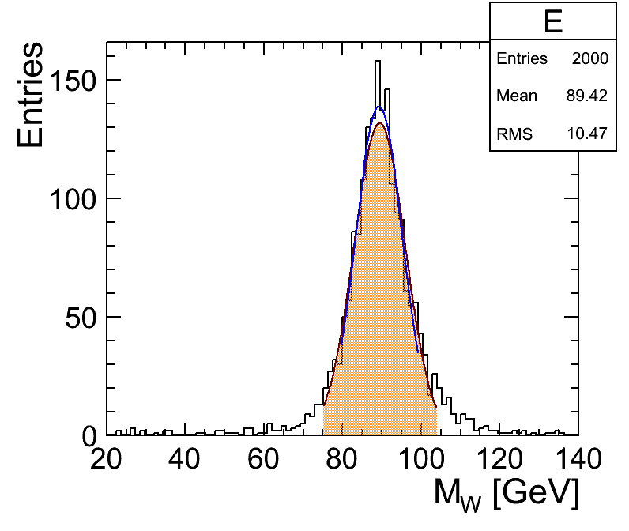
250 GeV
500 GeV
Sidloi3
1000 GeV
2000 GeV

Slide 6
sidloi3_scint
Like sidloi3
Change active hcal material to scintillator
Run lcsim-cal-calib instructions on Confluence

Slide 7
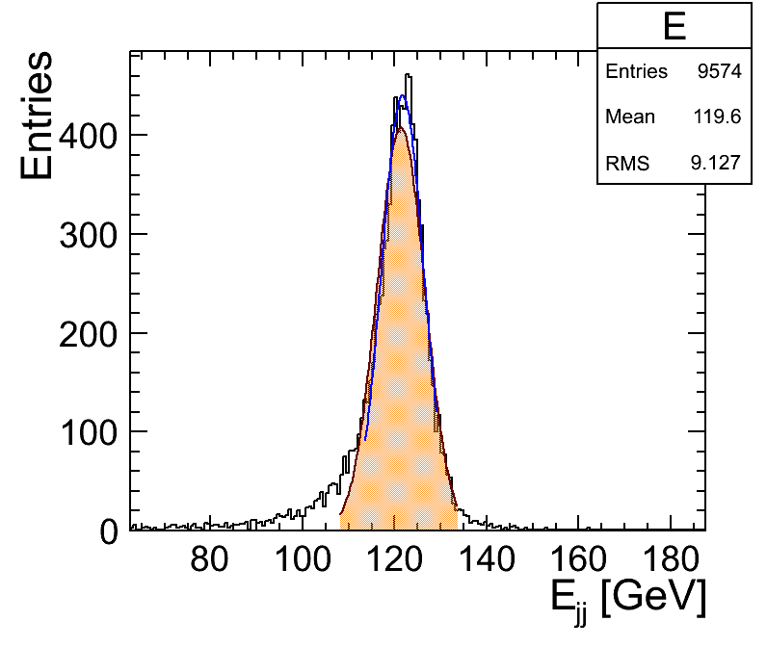

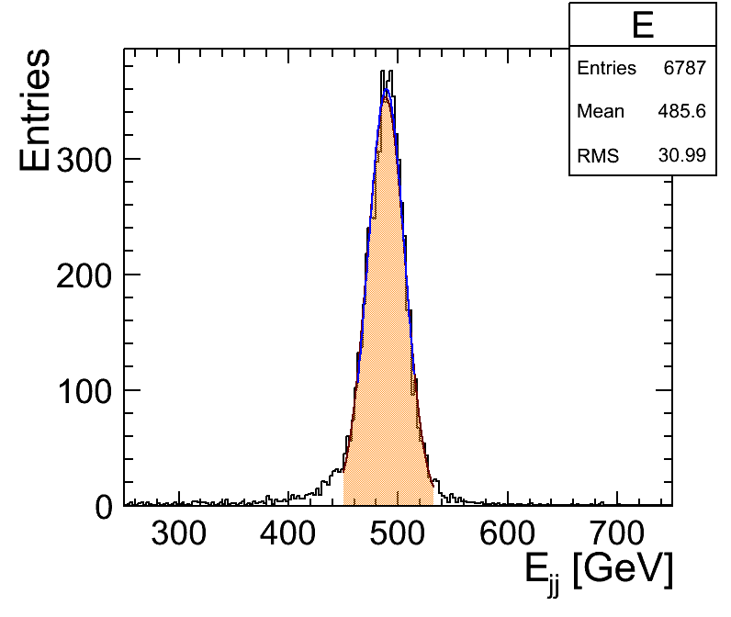
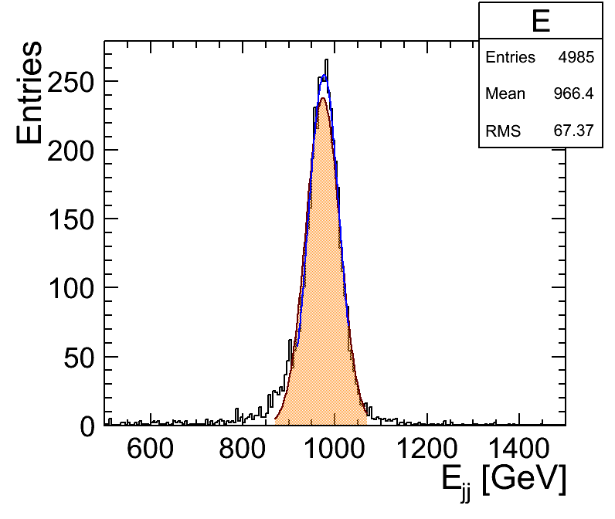
250 GeV
500 GeV
Sidloi3_scint
1000 GeV
2000 GeV

Slide 8
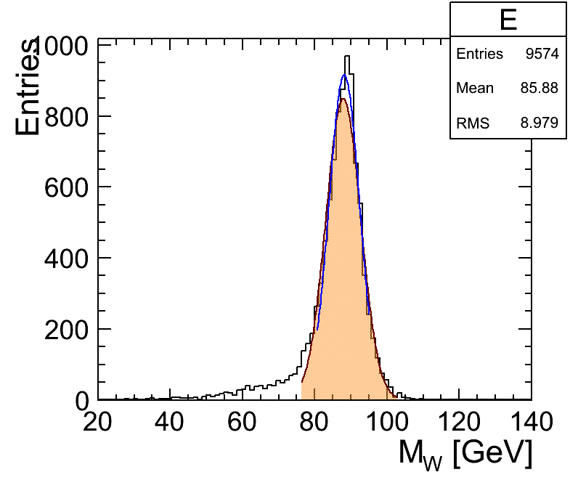
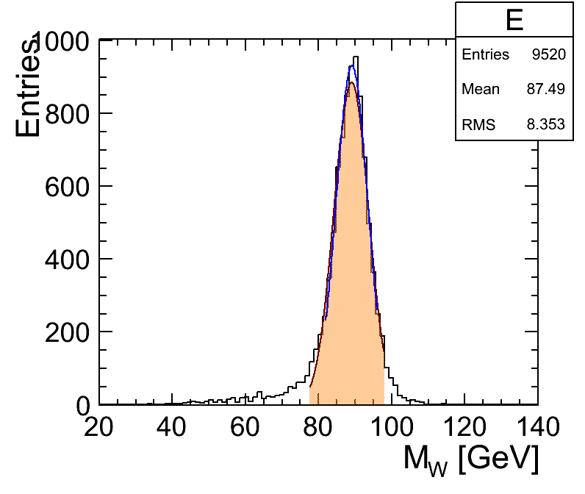
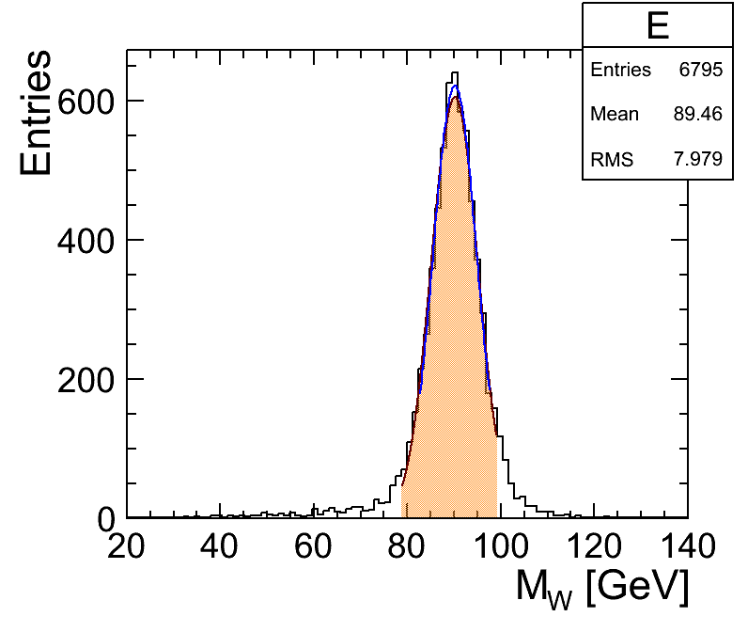
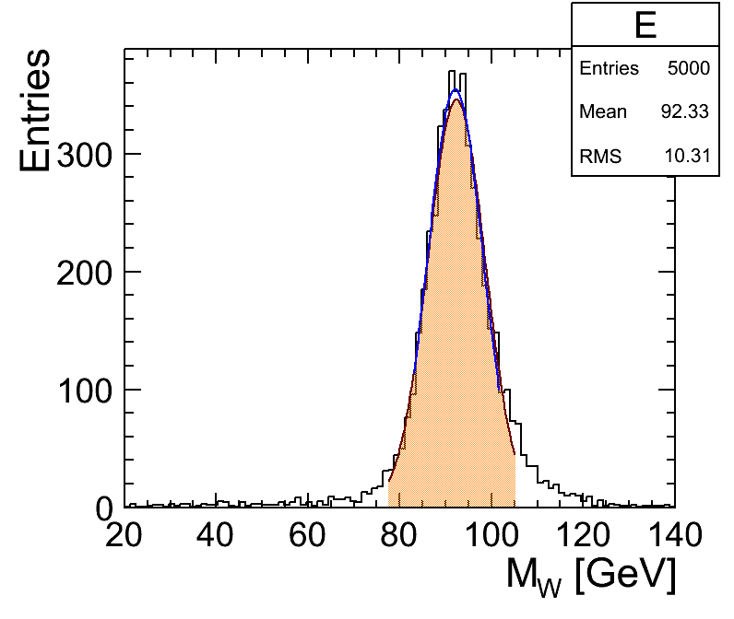
250 GeV
500 GeV
Sidloi3_scint
1000 GeV
2000 GeV

Slide 9
sidloi3_scint3x3
Like sidloi3
Change active hcal material to scintillator
Change segmentation from 1x1 to 3x3
Run lcsim-cal-calib instructions

Slide 10
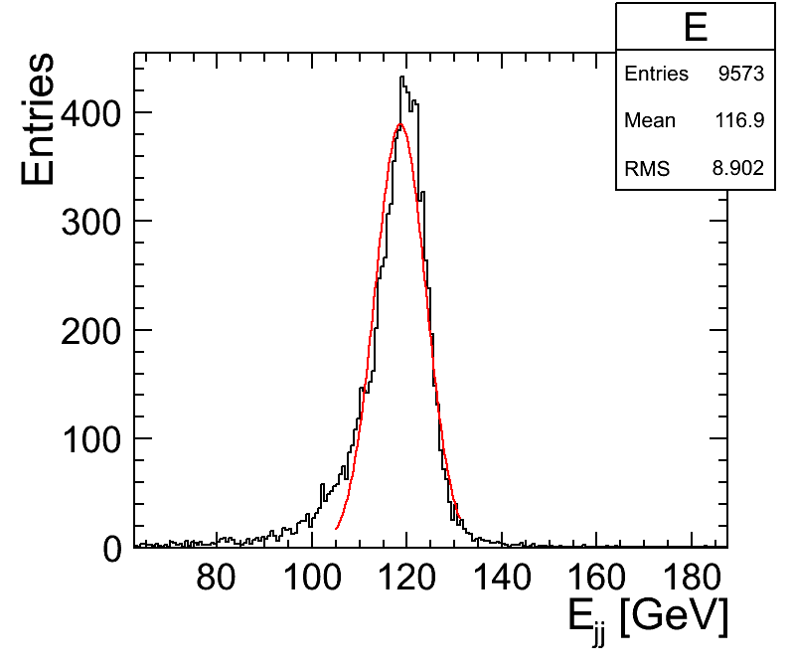
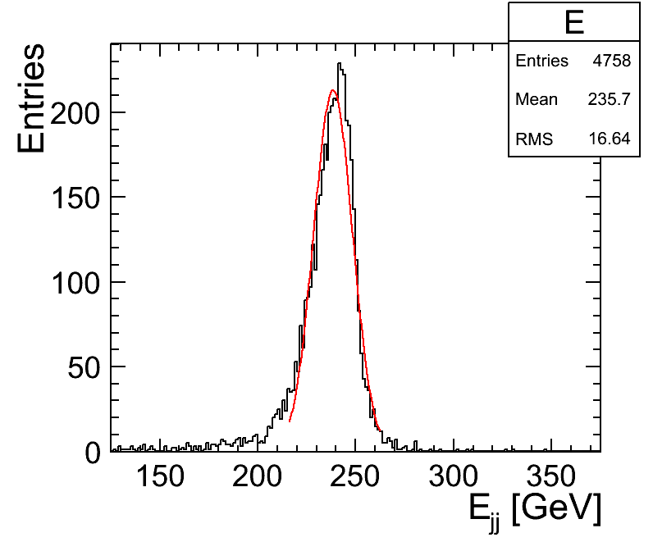
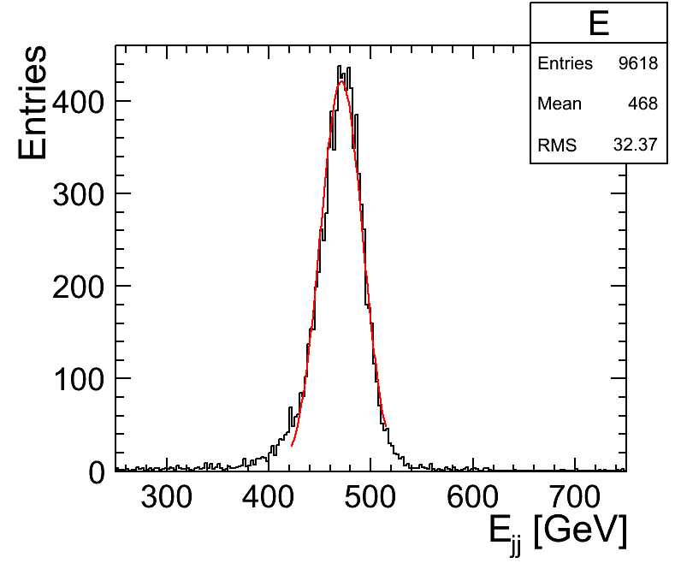
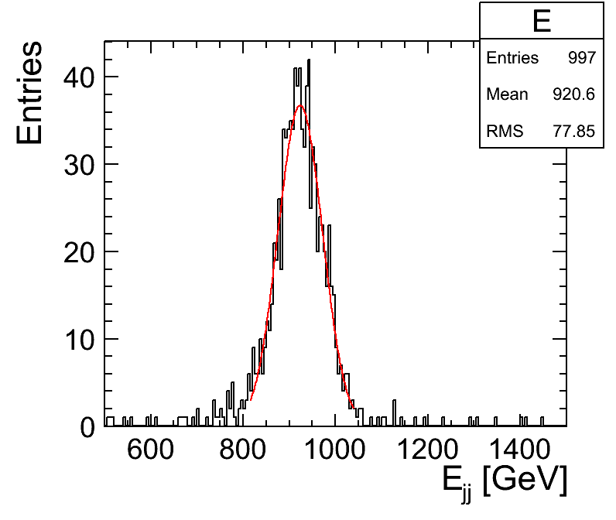
250 GeV
500 GeV
Sidloi3_scint3x3
1000 GeV
2000 GeV

Slide 11
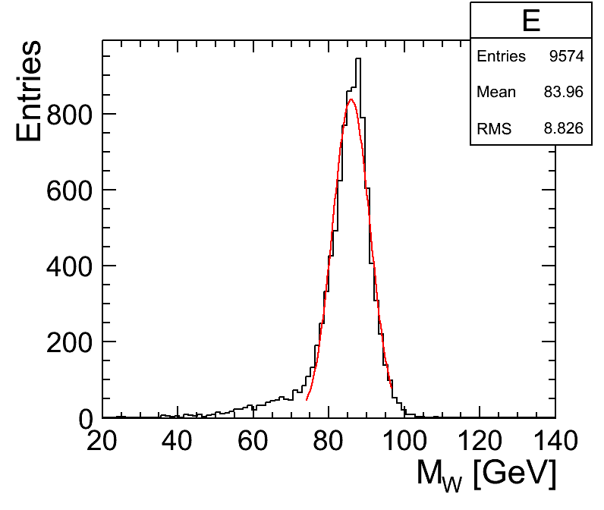
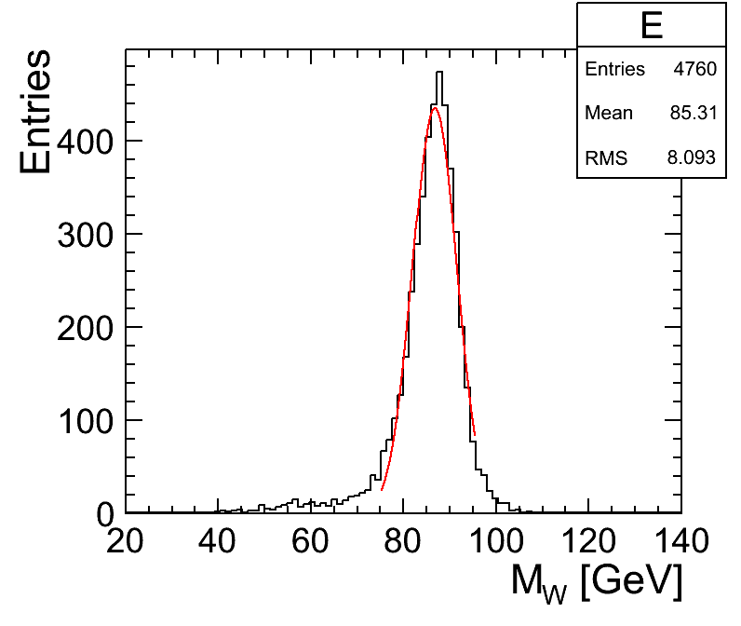
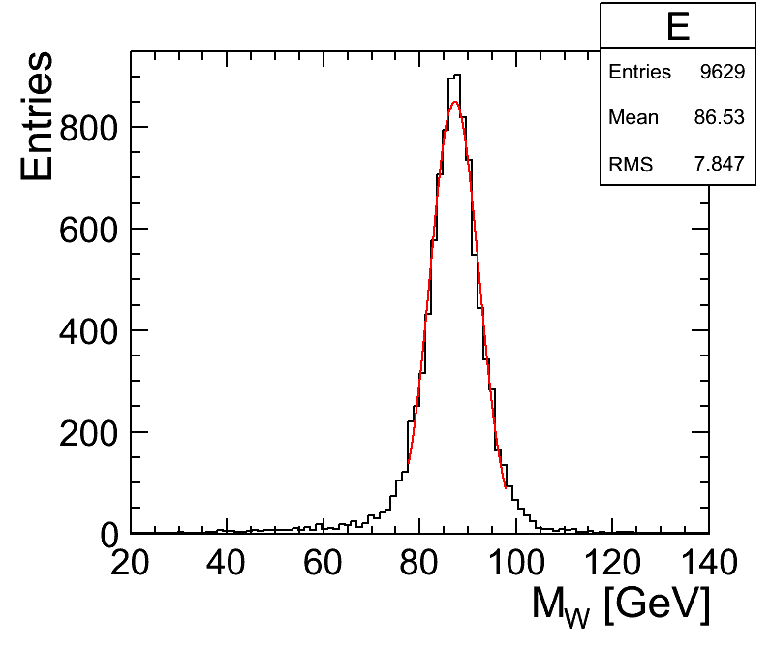
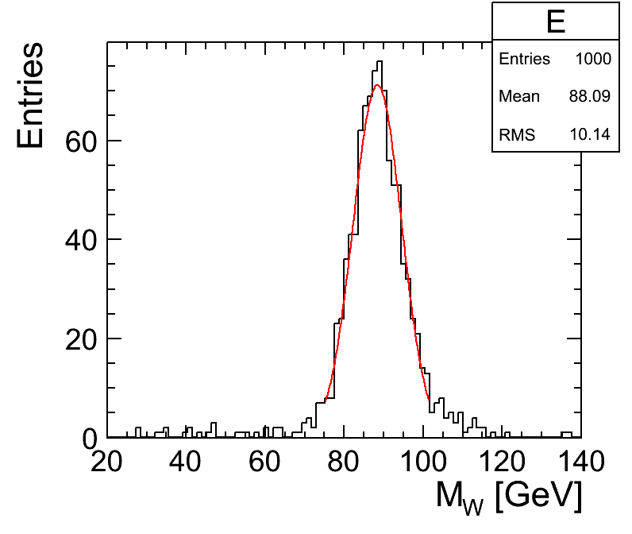
250 GeV
500 GeV
Sidloi3_scint3x3
1000 GeV
2000 GeV

Slide 12
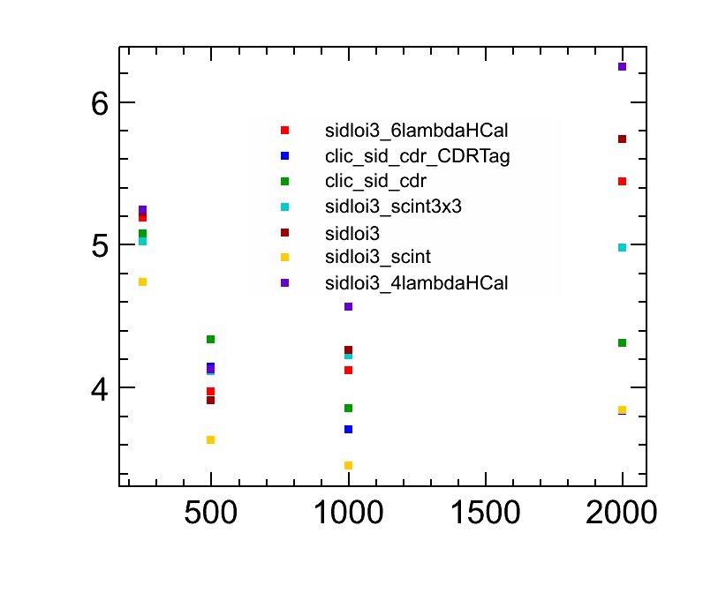
Dijet Energy resolution (%)
√s

Slide 13
Summary
Digital reconstruction in PandoraPFA is OK (sidloi3 vs. sidloi3_scint3x3)
We see the effect of leakage at sqrts = 1 TeV, E_jet = 250 GeV (sidloi3 vs. sidloi3_6lambdaHCal) and / or confusion (sidloi3_scint3x3 (Fe) vs. clic_sid_cdr (W))
Improvement in 1x1 cm^2 analog readout is bigger than deterioration through leakage
None of the detectors seems particularly good at low energy, but it looks like sidloi3 is good enough for tth

Slide 14
Workplan
Somebody should reproduce the resolution plot
We should verify the calibration for some of the detectors to understand the bias.
There’s a lot of knobs to turn. It’s late in the game. It looks like sidloi3 is good enough. The effect of design on the reconstruction is not exactly understood, so should focus on understanding reco rather than changing detector design for mass production.
Go with sidloi3, possibly try to optimize calibration
Simulation has to start sooner than reco.
If we identify shortcomings in the analysis, should understand those and study possible mitigation in the context of the analysis.
These are detector benchmarks after all

Slide 15
Other detectors

Slide 16
sidloi3_{4,6}lambdaHCal
Like sidloi3
4lambdaHCal
sidloi3 – 8 layers HCal (Steel + RPC)
Move solenoid inwards
6lambdaHCal
sidloi3 + 8 layers HCal (Steel + RPC)
Move solenoid outwards

Slide 17

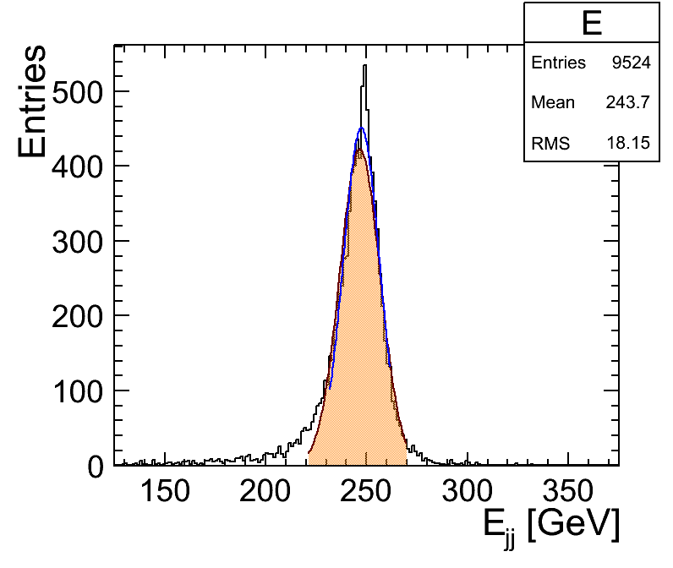
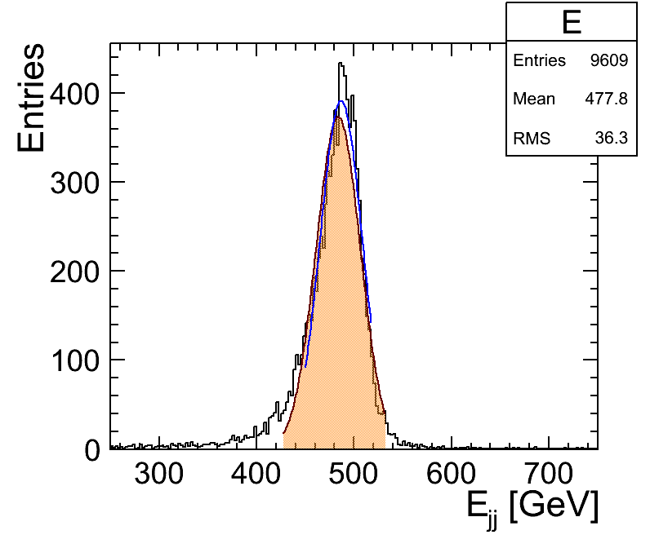
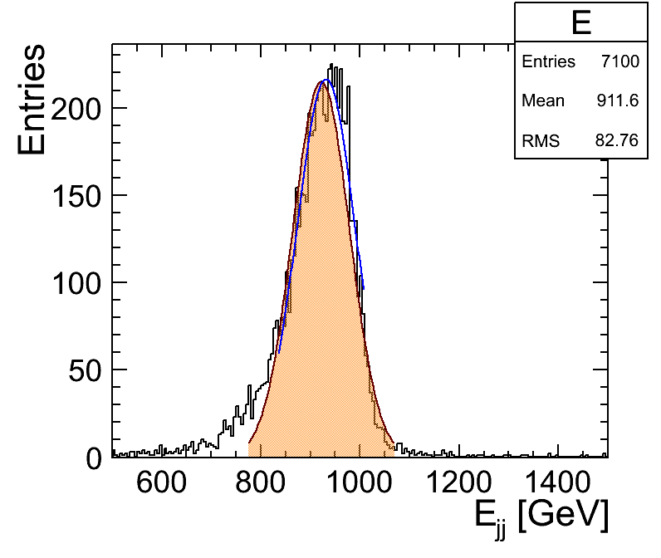
250 GeV
500 GeV
Sidloi3_4lambdaHCal
1000 GeV
2000 GeV

Slide 18
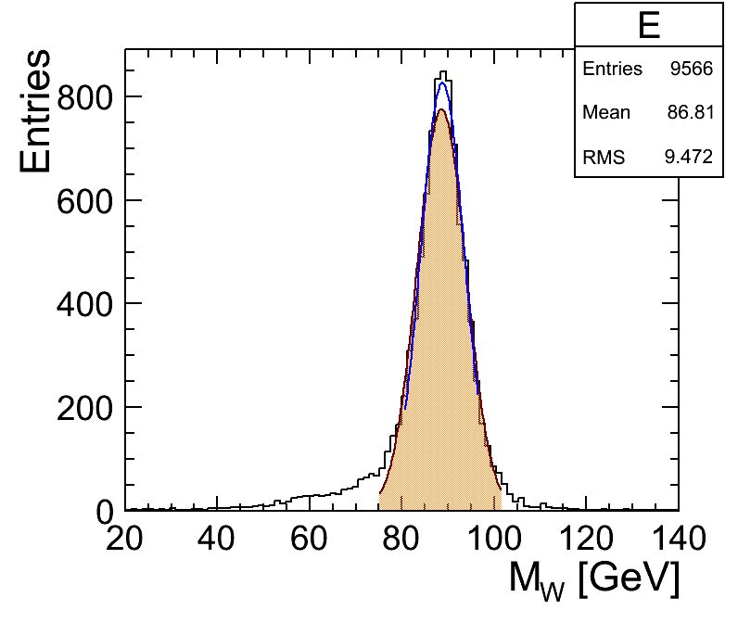
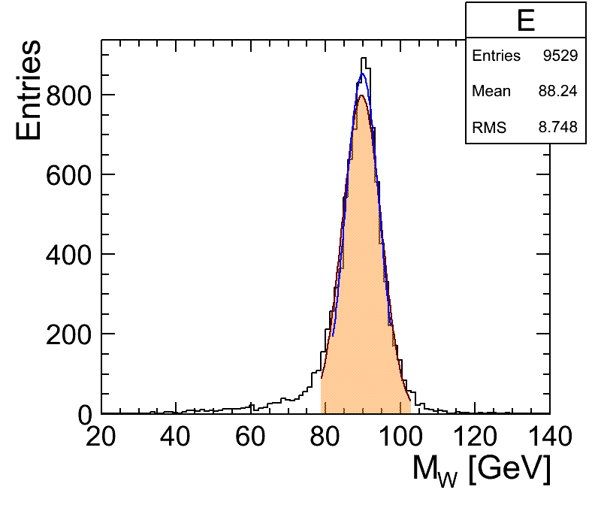

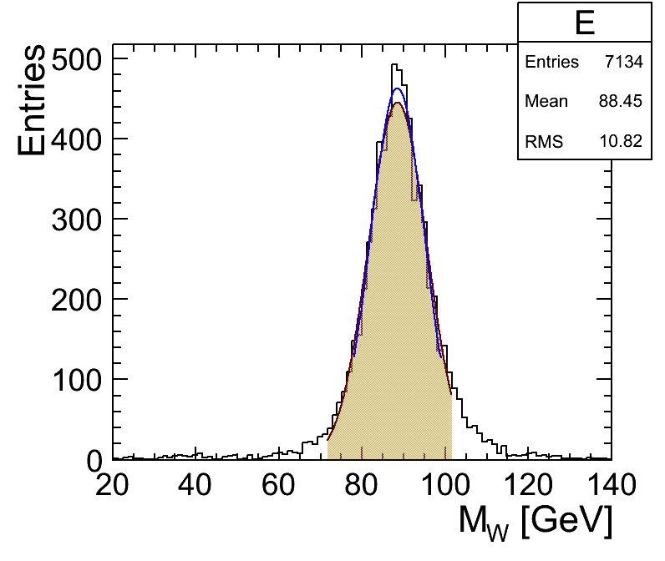
250 GeV
500 GeV
Sidloi3_4lambdaHCal
1000 GeV
2000 GeV

Slide 19

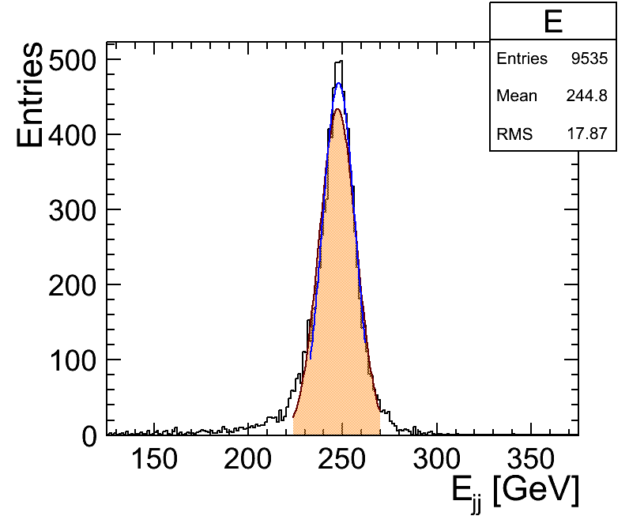

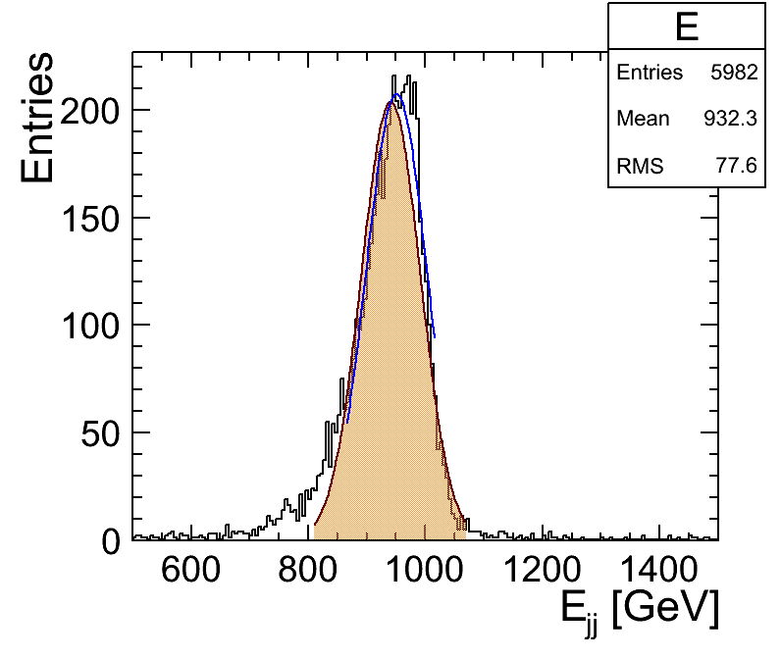
250 GeV
500 GeV
Sidloi3_6lambdaHCal
1000 GeV
2000 GeV

Slide 20



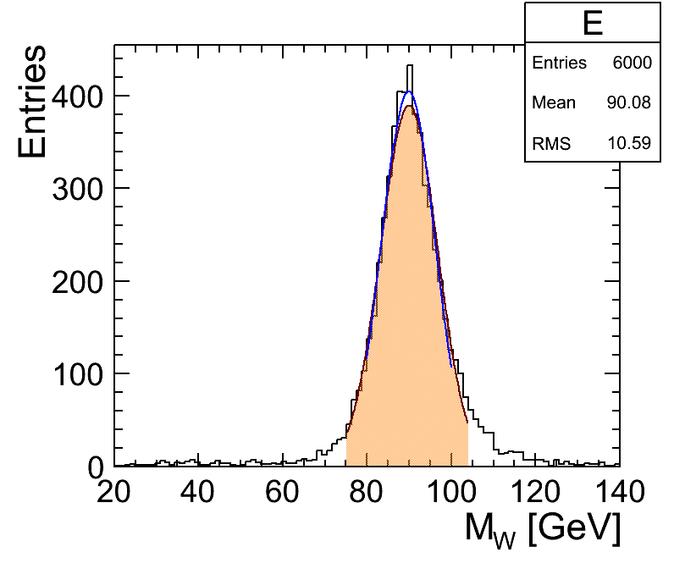
250 GeV
500 GeV
Sidloi3_6lambdaHCal
1000 GeV
2000 GeV

Slide 21
clic_sid_cdr
Start with sidloi3
Move pixel layers out (and tracker layers accordingly)
ECal basically the same
HCal: Tungsten + scintillator (3x3 cm^2)
Coil inner diameter slightly bigger (technical maximum possible)

Slide 22
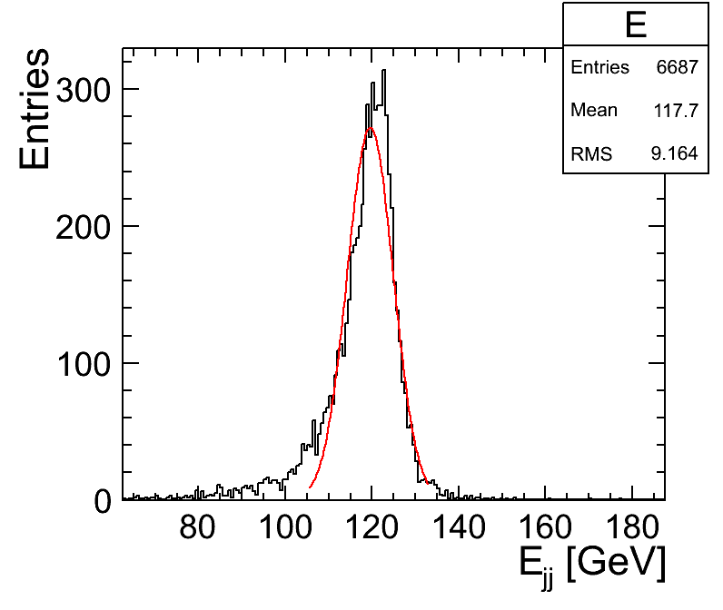
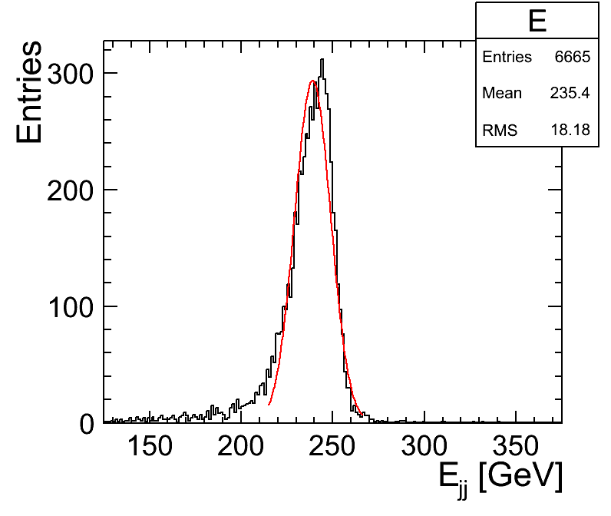
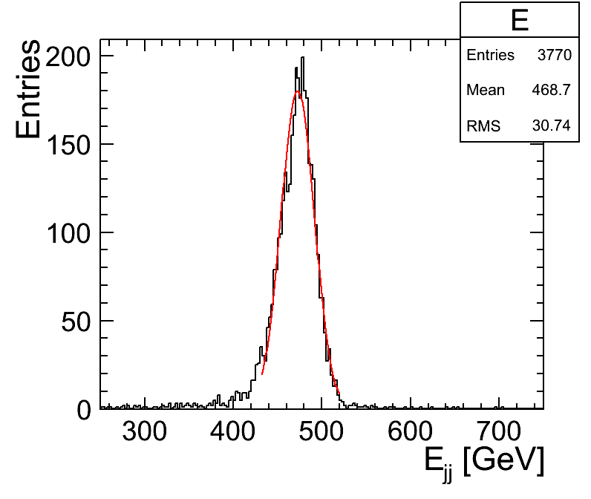
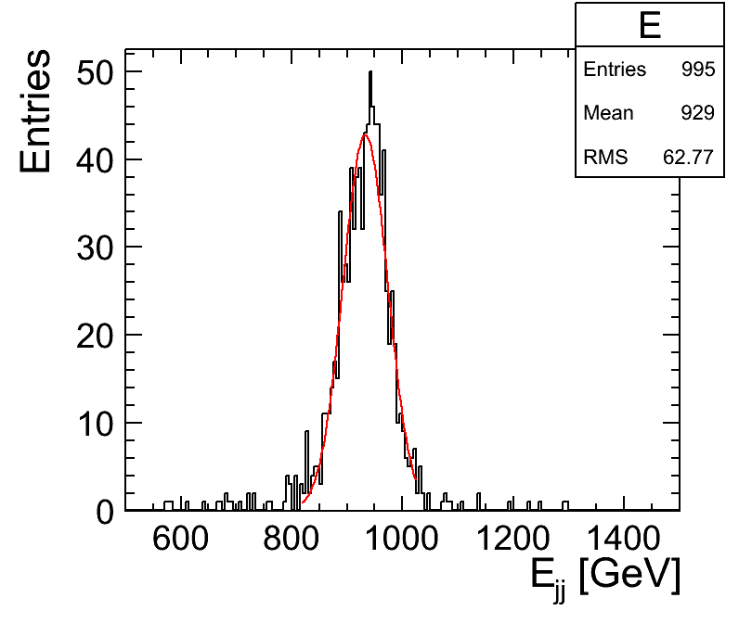
250 GeV
500 GeV
clic_sid_cdr
1000 GeV
2000 GeV

Slide 23
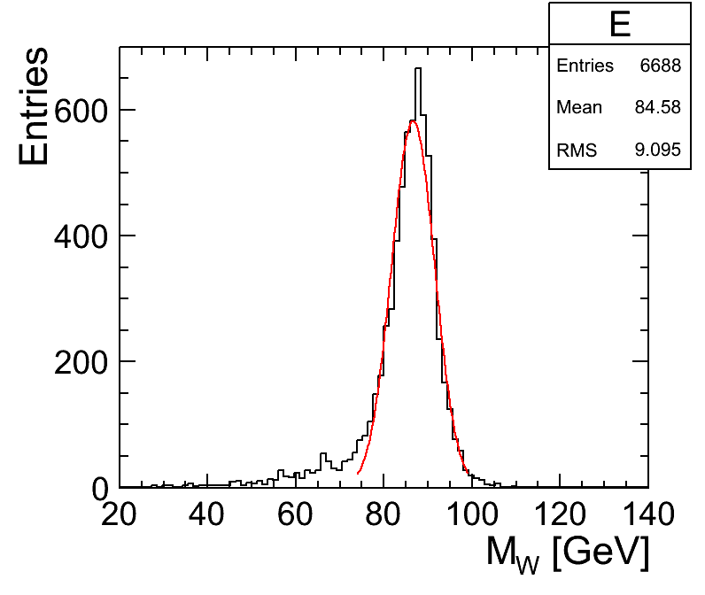
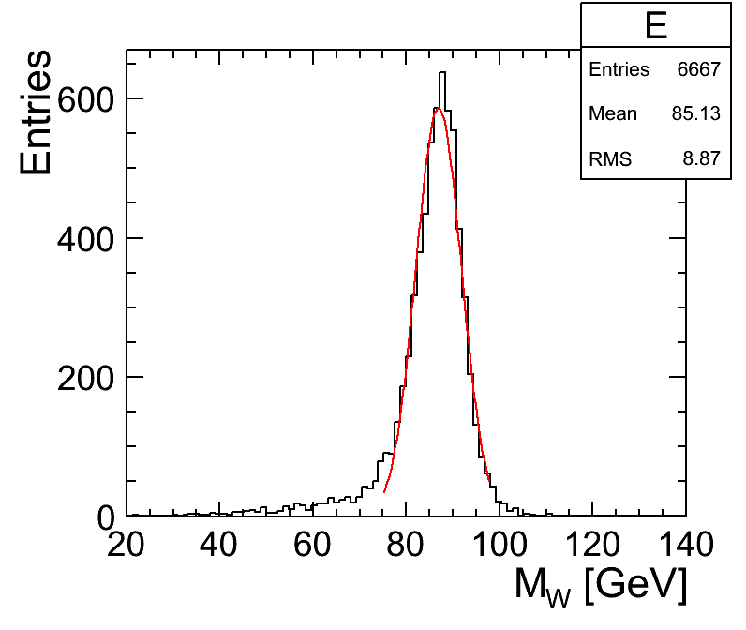
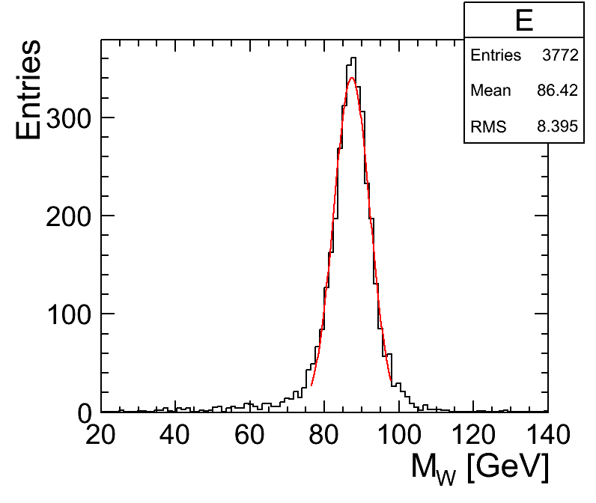
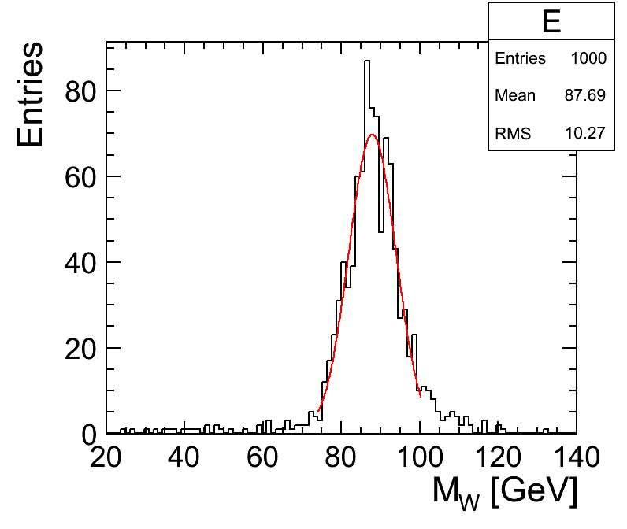
250 GeV
500 GeV
clic_sid_cdr
1000 GeV
2000 GeV

