Slide 1
2012.05.08: Hayano
Cavity status; recent KEK activities
(1) STF CM-1 cavities are;
MHI-014: 3-rd VT:36MV/m (finished)
MHI-015: 3-rd VT: 33.5 -> 18.4MV/m F.E. turn ON
MHI-016: 2-nd VT:34MV/m (finished)
MHI-017: 1-st VT: 38MV/m (finished)
MHI-018: 1-st VT: 31MV/m
MHI-019: 1-st VT: 26MV/m
MHI-020: 1-st VT: 9MV/m heavy field-emission
MHI-021: 1-st VT: 38.9MV/m (finished) MHI-022: waiting for 1-st VT in this week
(2) New bender/KEK cavities;
TOS-02(w/o HOM): 1-st VT: 31.2MV/m
HIT-02(with HOM): 1-st VT: 35.2MV/m
KEK-00(w/o HOM): 1-st VT: 26MV/m, 2-nd VT:29MV/m
KEK-01(with HOM): under fabrication
(3) other project cavities;
ERL-2cell cavity #2: 5-th VT: 50.4MV/m

Slide 2
March 6
ERL 2-cell cavity #2 5-th VT
Detail report in the end of slides

Slide 3
March 15
MHI-020 1-st VT
heavy field emission → input RF cable break happened!

Slide 4
March 29
KEK-00(w/o HOM) 1-st VT
limited by input RF cable break-down
(at N-type J-J juction)

Slide 5
April 5
KEK-00(w/o HOM) 2-nd VT
limited by cell#2 defects, other cells were over 40MV/m

Slide 6
April 12
MHI-021 1-st VT

Slide 7
April 26
HIT-02(with HOM) 1-st VT
It has many defects on several Iris and beam pipe, however, it went up 35MV/m.

Slide 8
History and Recent result of cERL 2-cell cavity #2
K. Watanabe (KEK)
May/2012

Slide 9
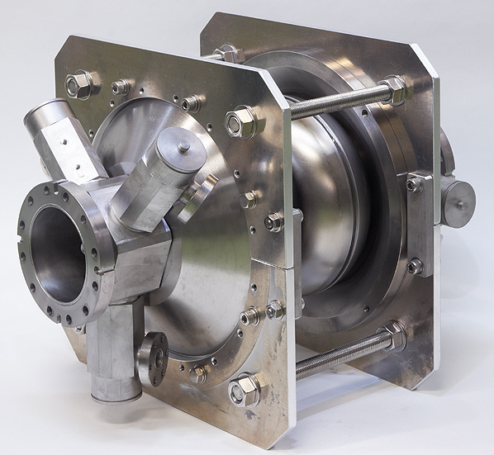
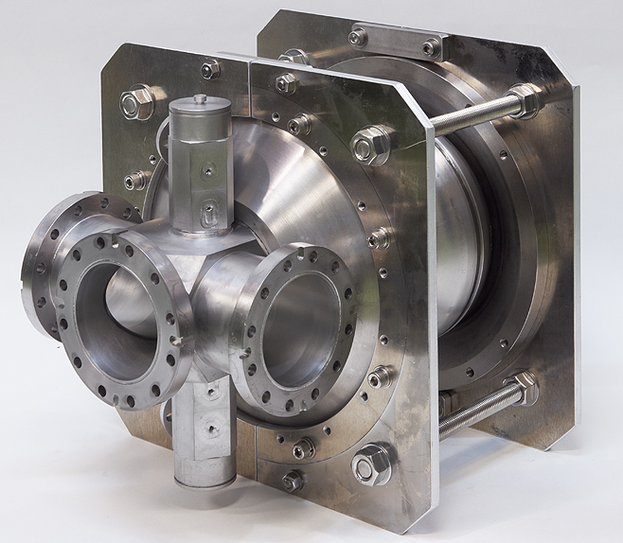
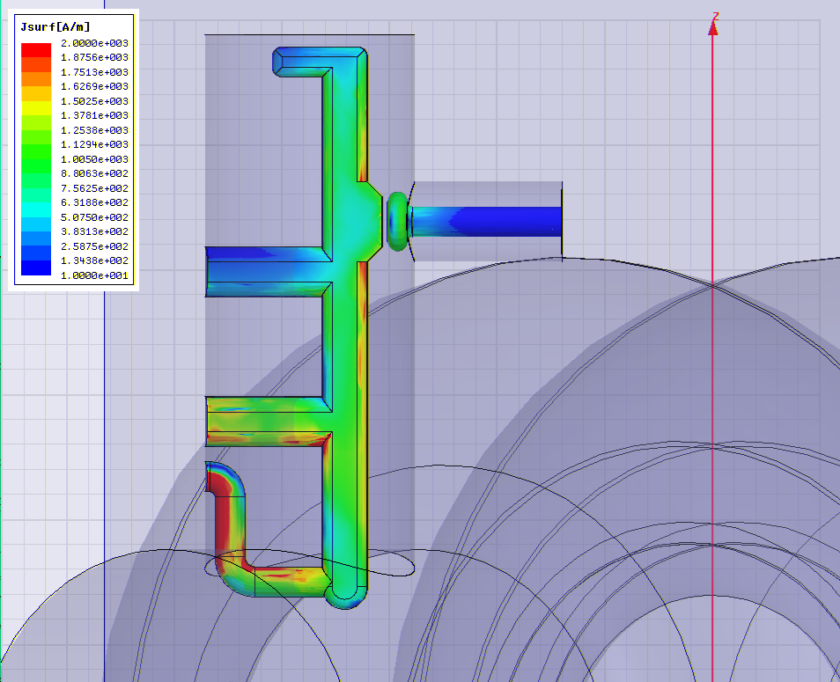
Log
Mar/2009: Fabrication cavity by MHI
July/2009: Bulk EP (5 + 100 um) and Annealing
Feb/2010: Light EP (20 um) and 1st VT
April/2010: Light EP (20 um)
and 2nd VT with HOM pick-up (Type 0 Normal)
July/2010: Light EP (20 um)
Aug/2010: 3rd VT with HOM pick-up (Type 0 Normal)
Sep/2010: Light EP (20 um)
Oct/2010: 4th VT with HOM pick-up (Type 0 Normal)
Feb/2012: Light EP (5um)
Mar/2012: 5th VT with HOM pick-up (Type 2)
1st VT: to check the cavity performance (quality check).
2nd ~ 5th VT: to study a performance of HOM coupler
and HOM pick-ups.
Measurement of sustainable field without
quench at HOM coupler at CW
The field was raised to a rf power limit
or heating limit of HOM pick-ups.
cERL injector 2-cell cavity #2 (Proto-type model)
(With two input coupler port and five loop-type HOM couplers)
Target Gradient is 15 MV/m at CW in Cryomodule.
* Cavity design by E. Kako
* HOM coupler and feed-through design by K. Watanabe
* Optical Inspection was done after each treatment.
Few defects found at Outside weld area.
These defects created by press work.
On the weld area, there are no welding defect.
* The LLRF measurement, HOM study, RF tuning, optical inspection, preparation part, assembly work and VT were done by K. Watanabe with few Technicians.
total EP removal =190µm

Slide 10
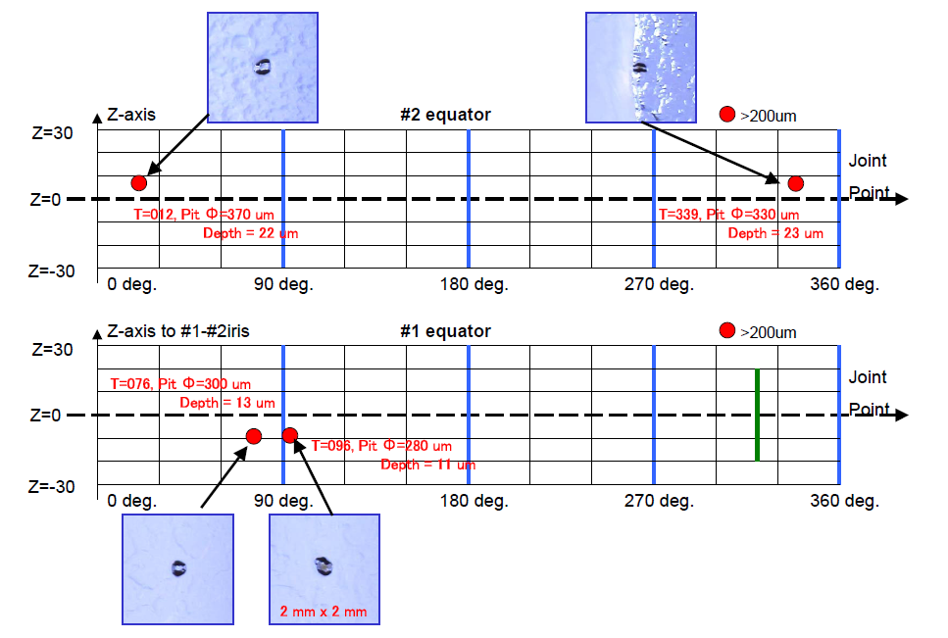
Example: Optical Inspection result (After 1st VT)
Four pit type defect found at Outside weld area.
(defects created by press work)
On the EBW seam, there were no welding defect.

Slide 11
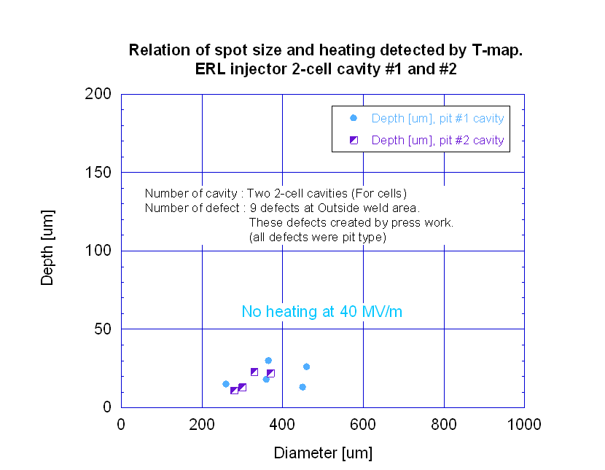
Relation of defect size and heating detected by thermo-sensors
No heating at 50 MV/m

Slide 12
Recent result of Vertical tests of #2 cavity: Qo-Eacc

Slide 13
Cavity Parameters of 2-cell injector and 9-cell cavity
 | cERL 2-cell (KEK) | 9-cell TESLA-like
Frequency | 1300 MHz | 1300 MHz
R/Q | 204.0 | 1016
G | 287.8 | 277
Esp/Eacc | 2.25 | 2.17
Hsp/Eacc [Oe/MV/m] | 42.2 | 41.0
K (coupling) | 1.94 | 2.0
L (effec.) | 0.23 m/cavity | ---
Iris diameter. BP diameter. | 70 mm 88 mm | 70 mm 80 mm
Other | Hsp on Equator 50 MV/m→2110 Oe | Hsp on Equator 45 MV/m→1845 Oe
Calculated by E. Kako (by Superfish)

Slide 14
Result of Vertical tests of #2 cavity: History and Summary
 | Max Eacc and Cause of limitation | Other
1st VT Mar/2010 | 40.9 MV/m without Quench. The test was stopped because a field exceeded 40MV/m. | Removed material = 125 um
2nd VT April/2010 | Vacuum leak happened during 2K high field measurement, then the test was stopped. No quench at 14 MV/m in Liq He………. Leak location was one ICT 70 flange (Low temperature side). | Removed material = 145 um With HOM pick-up (Type 0 Normal, gap = 0.5 mm)
3rd VT Aug/2010 | 38.6 MV/m with Quench at HOM pick-up. Sustainable field：12 MV/m outside liq. He 17.4 MV/m in liq. He Cause of limitation was a heating of HOM pick-up. | Removed material = 165 um With HOM pick-up (Type 0 Normal, gap = 0.5 mm)
4th VT Oct/2010 | 42.6 MV/m with Quench at HOM pick-up. Sustainable field：13 MV/m outside liq. He 18.4 MV/m in liq. He Cause of limitation was a heating of HOM pick-up. | Removed material = 185 um With HOM pick-up (Type 0 Normal, gap = 2.0 mm)
5th VT Mar/2012 | 50.4 MV/m without Quench and Field Emission (in lig. He). The test was stopped because a field exceeded 50MV/m. (RF power limit) Hsp on Equator is 2127 Oe. | Removed material = 190 um With HOM pick-up (Type 2, gap = 2.0 mm)

Slide 15
Surface treatment
No. | Amount EP [um] Current density | 1st water rinsing | rinse | HPR [hour] | Other
Bulk EP | 5 + 100 | Idle: 5 min Case 1 | none | 2 | ---
Light EP 1st | 20 26-30 mA/cm2 | Idle: 20 min Case 2 | FM-20 and HOT Bath with Ultra-sonic (1 hour + 1 hour) | 2.5 + 2.5 (with Flange) | In coated Helicoflex 100 C Baking
Light EP 2nd | 20 24-30 mA/cm2 | Idle: 20 min Case 2 | FM-20 and HOT Bath with Ultra-sonic (1 hour + 1 hour) | 2.5 + 2.5 (with Flange) | In coated Helicoflex 100 C Baking
Light EP 3rd | 20 30-40 mA/cm2 | Idle: 20 min Case 2 | FM-20 with Ultra-sonic (2 hours) | 2.5 + 2.5 (with Flange) | In coated Helicoflex 100 C Baking
Light EP 4th | 20 30-40 mA/cm2 | Idle: 20 min Case 2 | FM-20 with Ultra-sonic (2 hours) | 2.5 + 2.5 (with Flange) | In coated Helicoflex 100 C Baking
Light EP 5th | 5 37-38 mA/cm2 | Idle: 30 min Case 3 | End Group cleaning by Brush. FM-20 with Ultra-sonic (30 min) End Group cleaning again by Brush. | 4 + 2 (with Flange) | Sn coated Helicoflex 120 C Baking
Process of 1st water rinsing
* Case 1: Water supply flow (4 min) -> Pump off (2 min) : Repeat this cycle (total 40 min)
* Case 2: Water supply flow (3 min) -> Pump off (1 min) : Repeat this cycle (total 90 min)
* Case 3: water fill-and-close (40 min), water supply flow 20min, and with cavity rotation 40min : total 100min

Slide 16
Preparation of HOM pick-up (1): Surface Treatment and Cleaning Method
No. | Type | Treatment | Cleaning Method after CP
1st VT | Without
2nd VT | Type 0 | Feedthrough: only FM-20 with Ultra-sonic Niobium antenna: Chemical polishing (without mechanical polish) | FM-20 with Ultra-sonic ~ 10 min.
3rd VT | Type 0 | Feedthrough: only FM-20 with Ultra-sonic Niobium antenna: Chemical polishing (without mechanical polish) | FM-20 with Ultra-sonic ~ 10 min.
4th VT | Type 0 | Feedthrough: only FM-20 with Ultra-sonic Niobium antenna: Chemical polishing (without mechanical polish) | FM-20 with Ultra-sonic ~ 10 min.
5th VT | Type 2 | Remove a brazing material near Joint point between inner conductor and niobium antenna. Mechanical polishing on niobium antenna after fabrication (mirror finish). Chemical polishing on niobium part (Total: 5 min). | After CP, FM-20 with Ultra-sonic ~ 20 min. Washing by sponge with FM-20. Dry at Class 10.

Slide 17
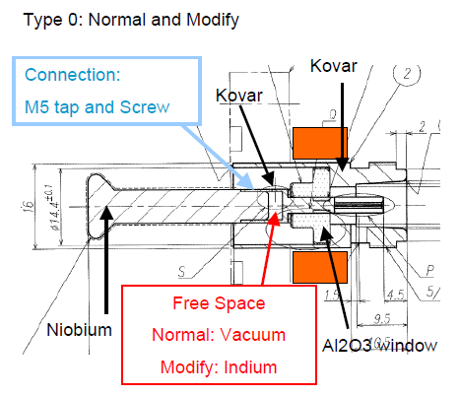
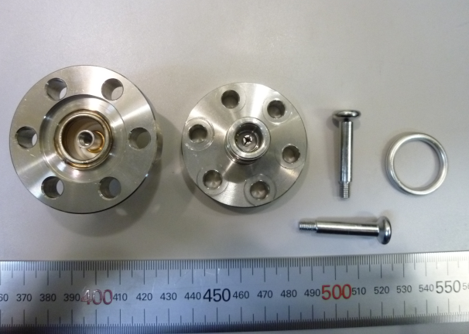
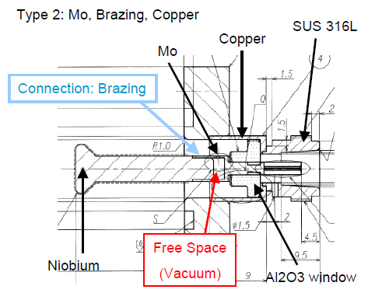
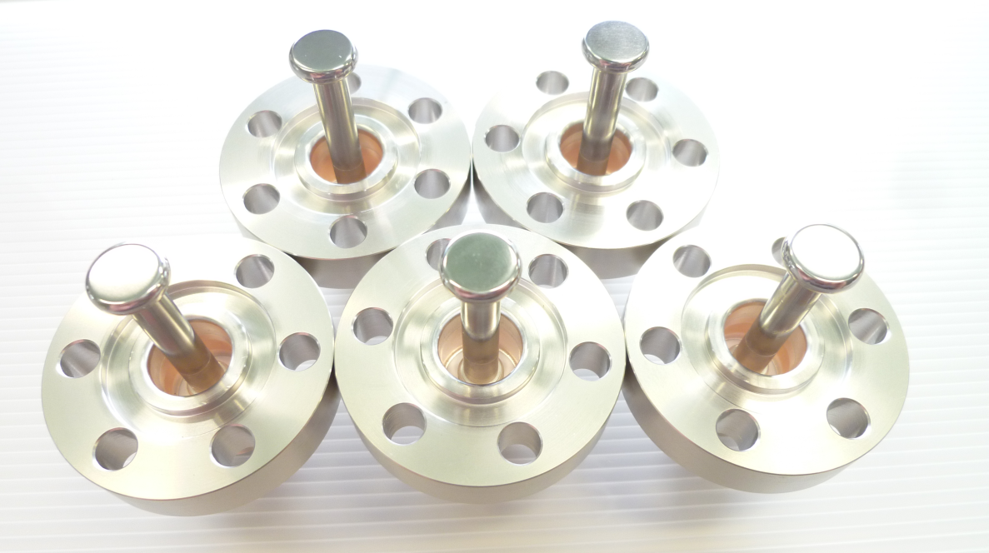
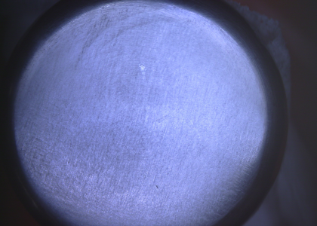
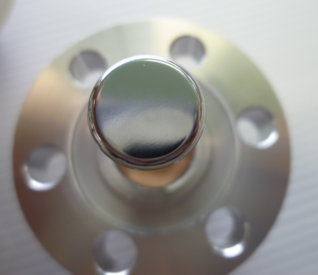
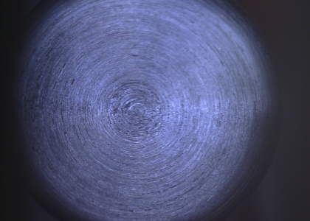
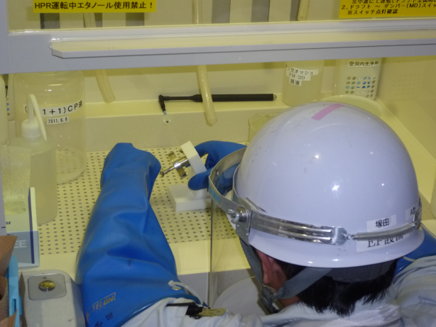
Preparation of HOM pick-up (2): Structure of HOM pick-ups
Type 0
Type 2: Improvement of cooling performance and surface conditions
Feedthrough
Nb antenna
Male pin
Seal
Images: After Mechanical Polish
Go to CP process
In case of “Turn off -> Mechanical Polish -> CP”
Get Smooth surface on antenna tip
Surface on Nb antenna Tip
“Turn off -> CP”
Not Smooth at antenna tip

Slide 18
About 5th VT of #2 cavity

Slide 19
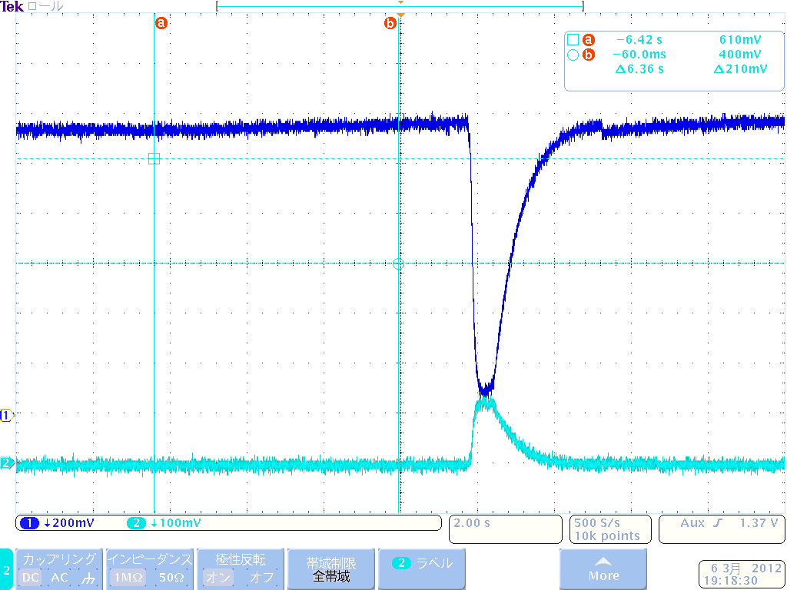
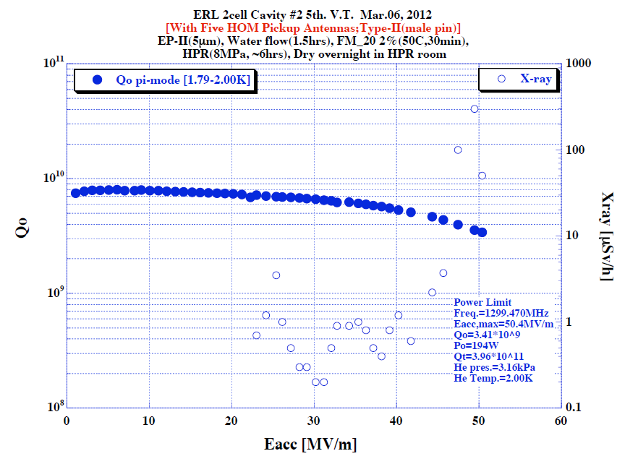
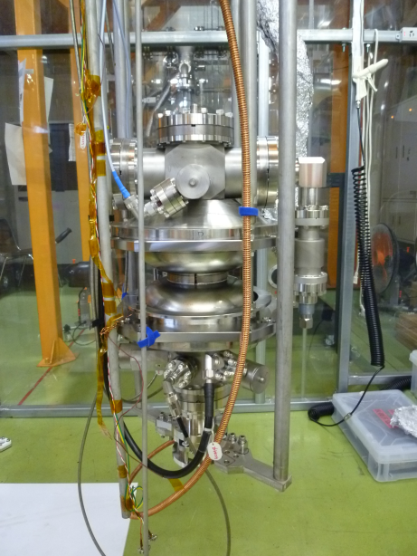
Process level during 2K high field measurement (5th VT)
Pt (field)
Pref

Slide 20
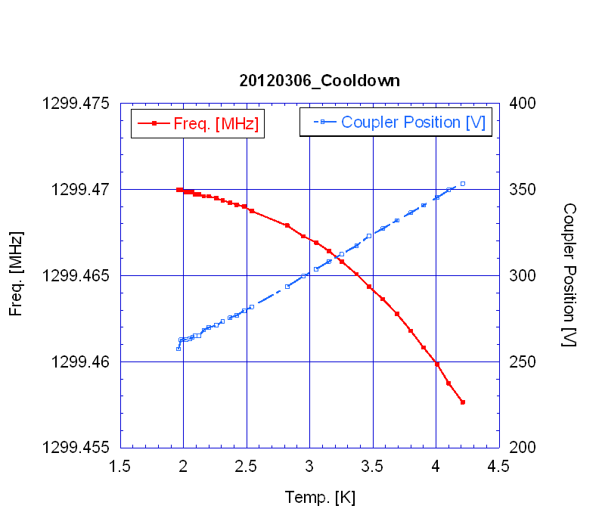
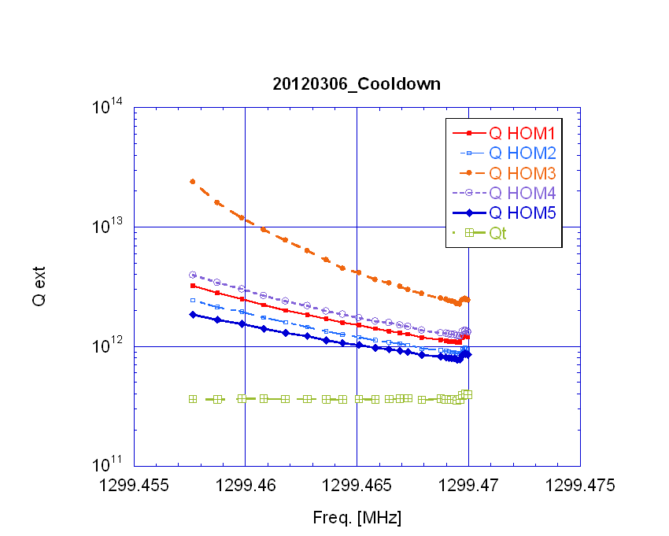
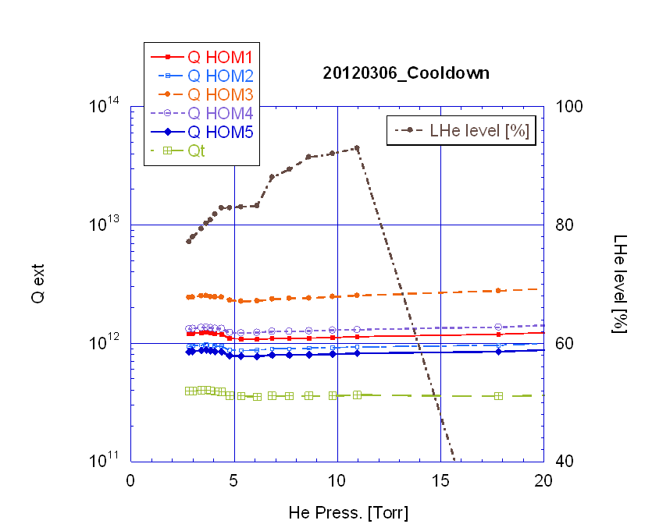
Frequency and Qext change during cooldown (5th VT)
Tuning of HOM couplers for accelerating mode was very well.
Resonant Frequency at Room temp (vacuum). is 1297.685 MHz.

Slide 21
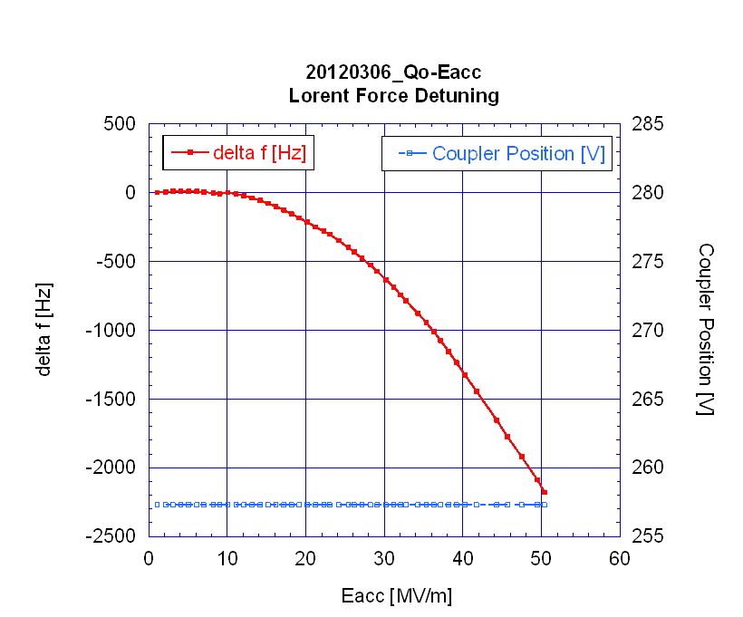
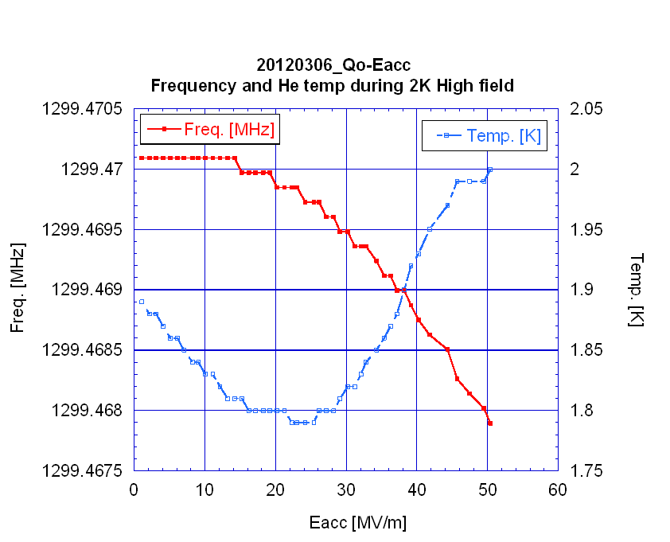
Lorentz force detuning (5th VT)

Slide 22
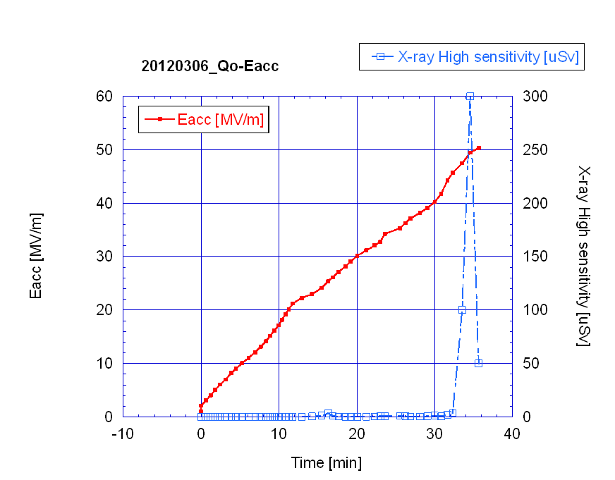
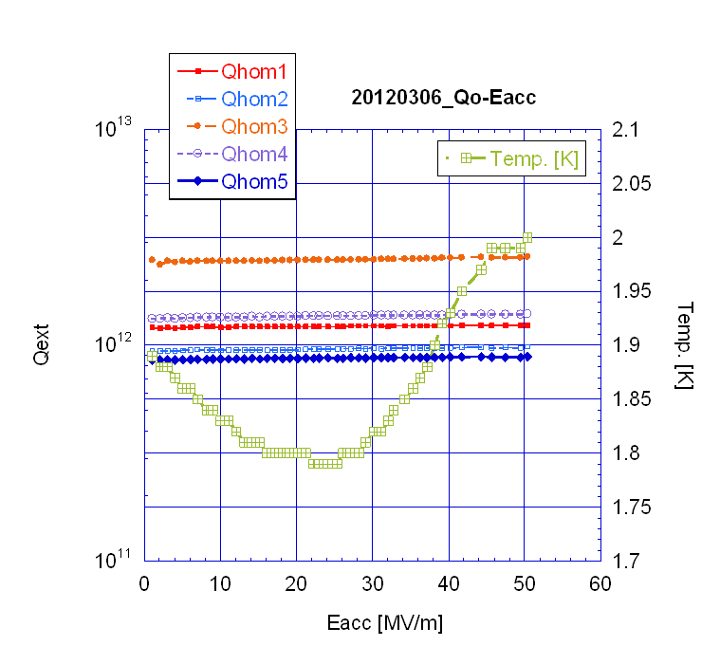
Trend during 2K high field (5th VT)
A process happened at 50 MV/m, then X-ray level was degrease. (Final: 50 uSv/h at 50.4 MV/m)
During 2K High field test, the RF power was supplied always on.
Qext of HOM couplers were not changed (no quench observed at HOM pickups).

Slide 23
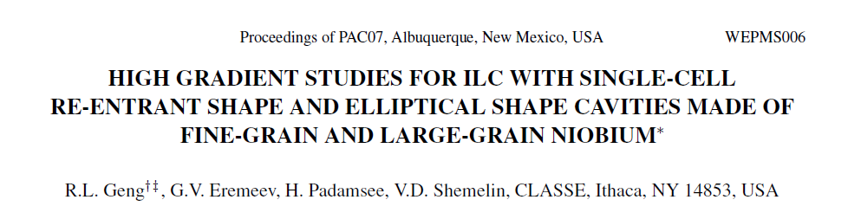
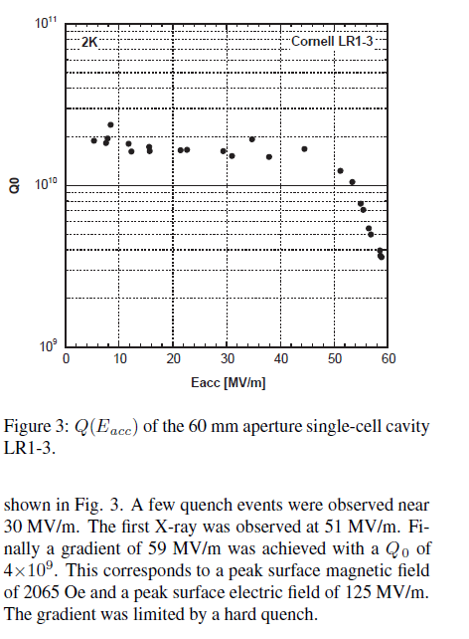
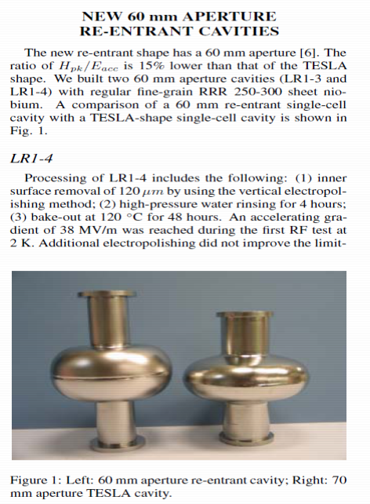
Reference of world record of Hsp on Equator

