Slide 1
Cornell Updates
A9 processed by VEP + bake achieved
@2K, Eacc =39.5MV/m, Qo =6.71e9, Rad =32R/hrs
Limited by RF power, no quench.
@1.8K, Eacc =35.8MV/m, Qo=1.2e10, Rad=10R/hrs
Limited by liq. He level, no quench.
A9 was surveyed after VT and found no activation.
A9 was re-HPRed, and will be tested this week.
A10, AES5 will be processed and tested w/ same procedures.

Slide 2
A9,VT result

Slide 3
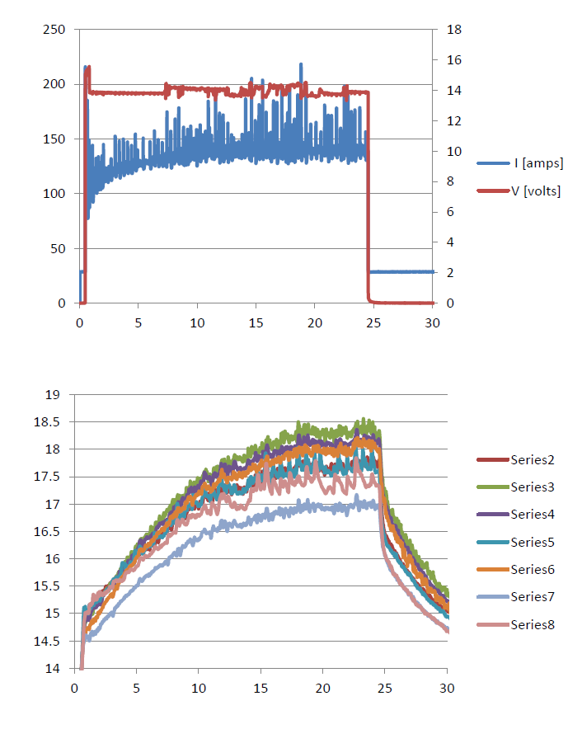
A9 processes
(1) USC
(2) VEP 5um.
14V, ~140A, 25min., 17.5+-0.5C
(3) Methanol rinse.
(4) HOM brushing. (5) USC (6) HPR (total 18hrs).
(7) 120C*48hrs bake.
Voltage [V]
Current [A]
Time [min.]
Temp. [C]
VEP monitoring
Time [min.]

Slide 4
9-cell history
VT | Cavity | VT Date | Process | Eacc max | Qo at Eacc max
1 | A9 | 15-Aug-07 | VEP(160um)+ degas + VEP(30+40um) +USC+HPR+Bake | 26.6 | 7.64E+09
2 | A9 | 15-Sep-07 | VEP(30um) +USC+HPR+Bake | 26.3 | 8.82E+09
3 | A9 | 4-Feb-09 | VEP (??) +USC+HPR+Bake | 25.3 | 3.53E+09
4 | A9 | 13-Mar-09 | re-HPR | 25.7 | 6.53E+09
5 | A9 | 8-Mar-11 | Tumbling (cell#1) + VEP(120um) + degas + Oxypolish +USC+HPR+Bake | 36.2 | 4.29E+09
6 | A9 | 14-Apr-11 | VEP(30um) +USC+HPR+Bake | 25.6 | 1.09E+10
7 | A9 | 5-Apr-12 | VEP(5um)+USC+HPR+Bake | 39.5 | 6.71E+09
VT | Cavity | VT Date | Process | Eacc max | Qo at Eacc max
1 | A10 | 10-Jan-10 | VEP(200um)+ degas + VEP(25um) +USC+HPR+Bake | 28 | 6.00E+09
2 | A10 | 22-Nov-10 | Tumbling(all cell) + VEP(120um) + degas + VEP(30um) +USC+HPR+Bake | 24 | 1.66E+10
VT | Cavity | VT Date | Process | Eacc max | Qo at Eacc max
1 | AES5 | 30-Mar-09 (at Jlab) | HEP(120um) + degas + HEP(25um) +USC+HPR+Bake | 20.5 | 1.2e10
2 | AES5 | 14-Sept-10 (at Jlab) | Tumbling(cell#3 at CU) + VEP(120um at CU) +degas +USC+HPR+Bake | 31 | 6.5e9
3 | AES5 | 14-Oct-10 (at Jlab) | re-HPR | 27 | ???
4 | AES5 | 20-Jan-11 | VEP(140um) + degas + VEP(30um) +USC+HPR+Bake | 24.6 | 7.2e9
5 | AES5 | 1-Feb-11 | Re-test w/ OST | 23.8 | 6.9e9

Slide 5
JLab Update
Rongli Geng, Aril Palczewski, Yongming Li
May 8, 2012
40th ILC Cavity Group Meeting

Slide 6
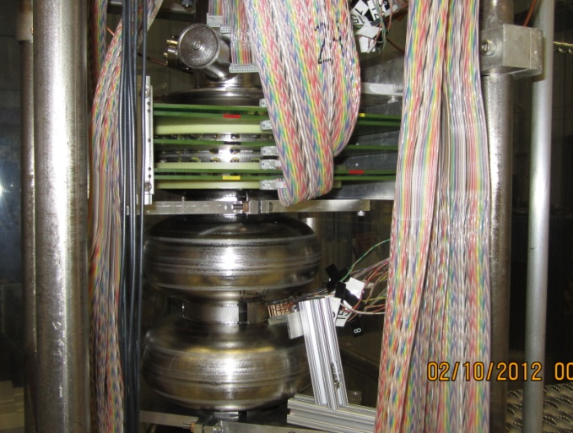
JLab Status: 9-cell Cavities
Seamless 9-cell cavity processing and instrumented testing
Z163 last test at DESY
33.1 MV/m, Q0 1.8E10 at 2K, no FE
A region near stiffening ring in cell#8 responsible for quench
Z163 1st test at JLab after light EP 30 um + standard procedure
34.4 MV/m, Q0 1.4E10 at 2K, little FE
Cell#1/9 responsible for quench
Z163 re-test at JLab with instrumentation for quench studies
Local resistor array (4x4) at cell#8 quench region predicted by DESY
JLab 2-of-9 fixed thermometry boards at Cell#1 & #9
Cornell OST’s (6 each attached to test stand)

Slide 7
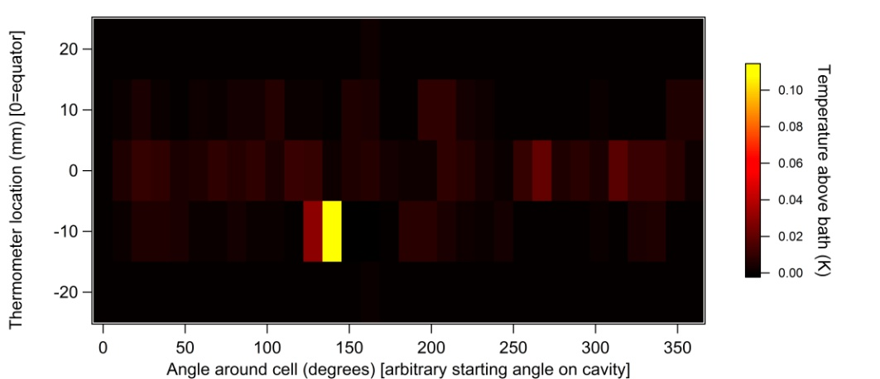
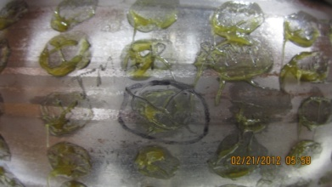
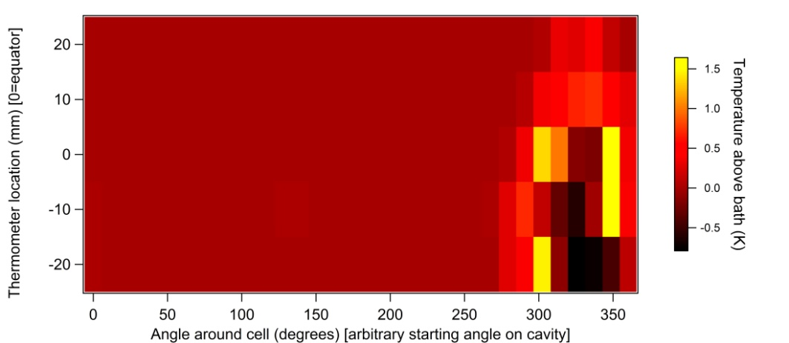
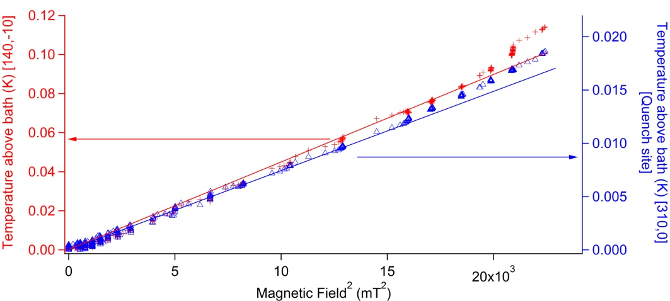
9-Cell Seamless Cavity Z163 Cell#9
Before quench
Quench source within 10 mm distance from equator
In quench
Strongest preheating site did not quench, but the deviation from quadratic heating seem to turn on sooner at the quench.

Slide 8
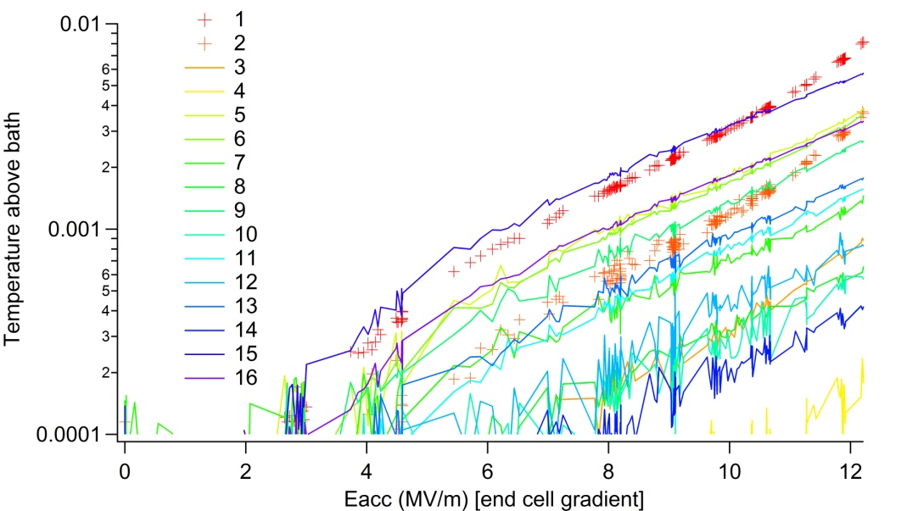
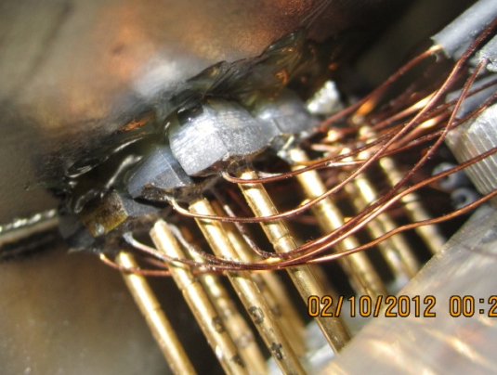
9-Cell Seamless Cavity Z163 Cell#8
Hs/Eacc = 3.30 mT/(MV/m) at stiffening radius, R=55 mm
For reference, Hpk/Eacc = 4.26 mT/(MV/m) for TTF shape
Trend deviating (Quenching ) thermometers closest to stiffing ring weld - #1/#2
This result is in agreement and hence confirms the earlier result obtained at DESY by using the rotating thermometry system

Slide 9
Z163 Quench Study Summary
Cell Pair | Limiting cell | Limiting cell gradient (Pi-mode equivalent) | Information Source of Limitation | Pass-band mode triggering quench
1/9 | 9 | 35.5 MV/m | JLab 2of9 thermometry boards | 8 Pi/9
2/8 | 8 | 30.5 MV/m | AP’s local array (4x4 Allan Bradley) | 2 Pi/9
3/7 | - | - | - | -
4/6 | 6 | 29.0-30.0 MV/m | OST | 6 Pi/9, 4 Pi/9
5 | 5 | 23.7-29.7 MV/m | OST | Pi, 7 Pi/9, 5 pi/9, 3 Pi/9

Slide 10
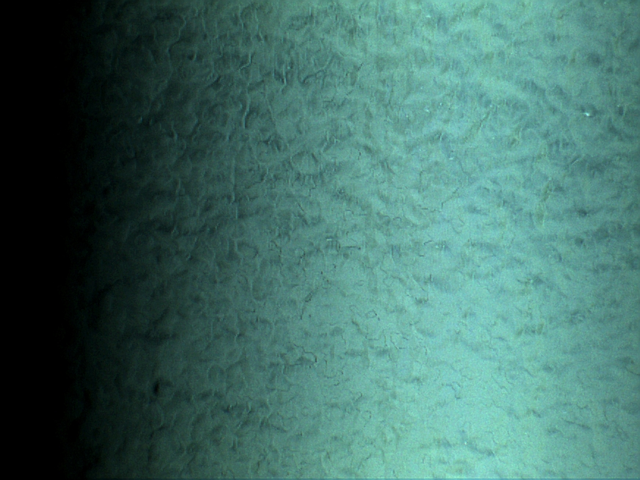
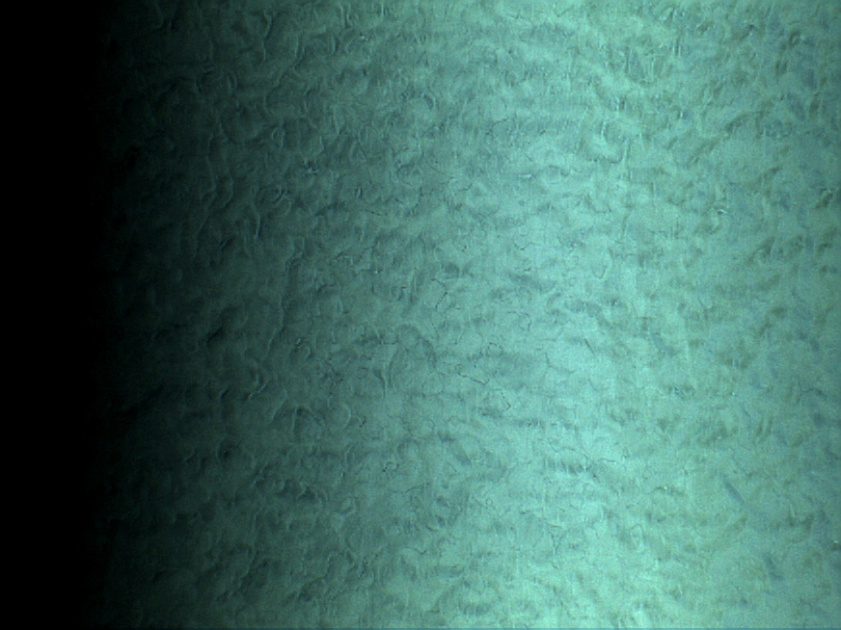
Z163 Cell#9 Quench Region Optical Inspection
No outstanding feature observable on RF surface at quench location
Quench Location
A random remote Location

Slide 11
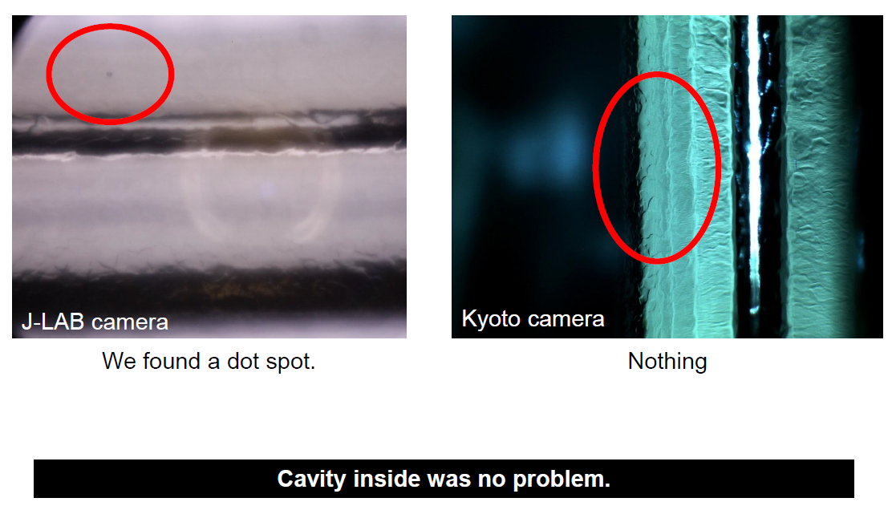
KEK 9-cell Cavity ICHIRO8
Gradient limited to 25-30 MV/m due to strong field emission
Field emission turn on in pass-band measurements
Suspected emitter location: iris #4, #5, #6
Post-test optical inspection was performed using KEK’s Kyoto camera and JLab’s LDM-based inspection machine
Cavity return to KEK

Slide 12
New 9-cell LSF Shape Cavity
LSF shape is a SLAC design (Z.H. Li, C. Adolphsen)
Hpk/Eacc = 3.7 mT/(MV/m), Epk/Eacc = 2.0
12% lowering of peak surface magnetic field ratio without raising peak surface electric field ratio
First 9-cell prototype cavity under fabrication at JLab
No HOM coupler
JLab TEDF civil construction affected in-house press machine and EBW machine
Aim for original goal of completing fabrication by end of FY12
Processing and testing is uncertain due to zeroing out of ILC R&D budget in FY13

Slide 13
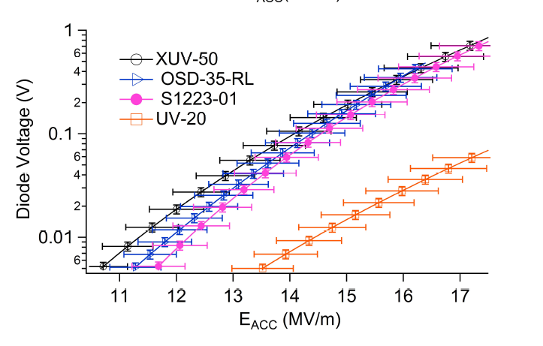
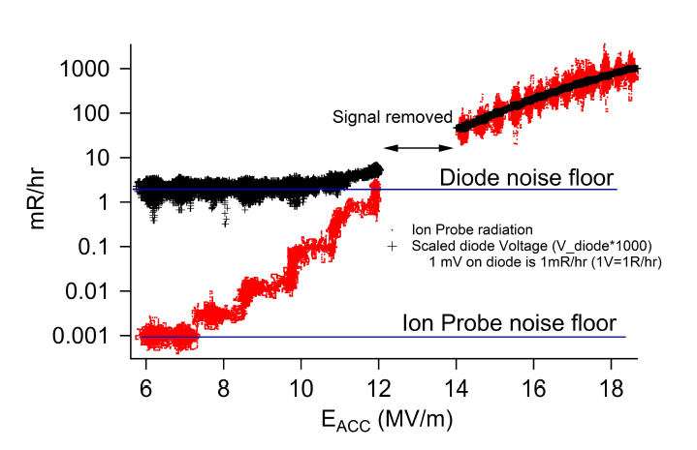
Cryogenic Field Emission Instrumentation (I)
Diode sensor selection completed for cryogenic detection of field emission induced X-ray.
Established scaling of diode sensitivity against standard dosimetry (ion probe placed above Dewar top plate within radiation shielding block)
Will contribute a poster to IPAC12 (A.D. Palczewski, R.L. Geng)

Slide 14
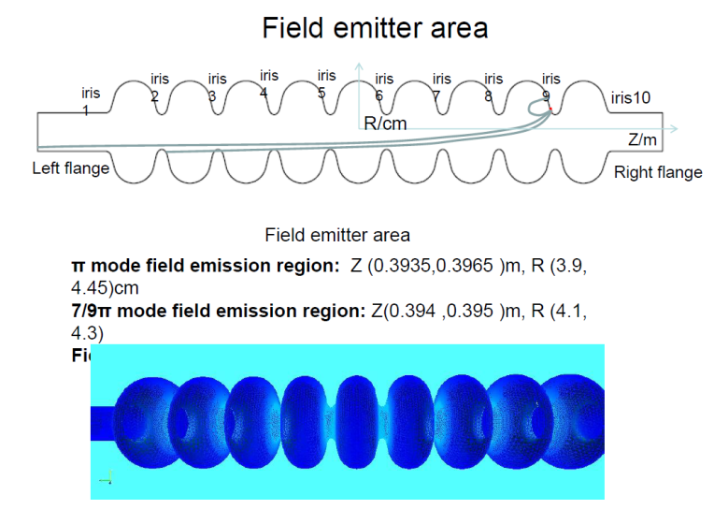
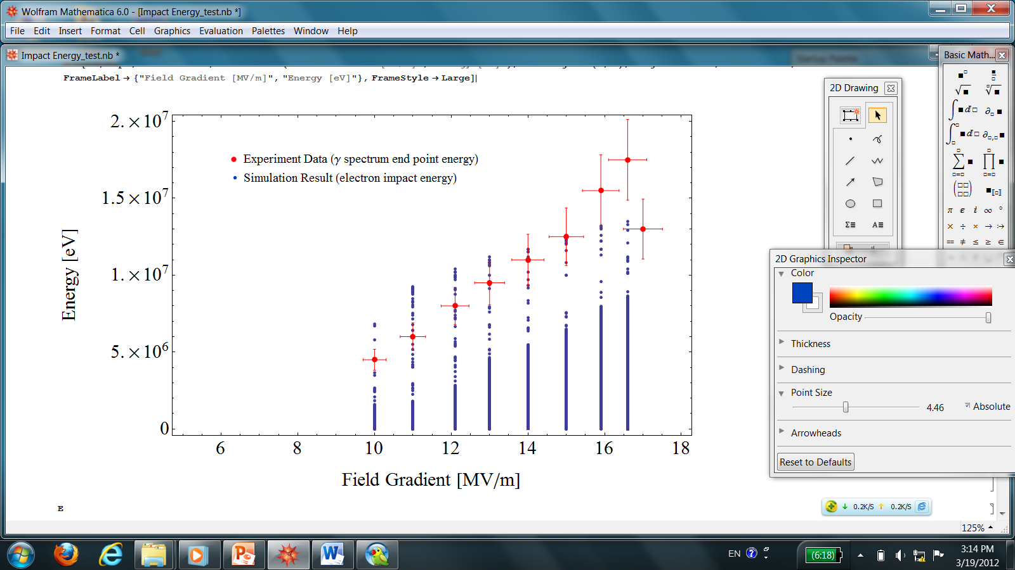
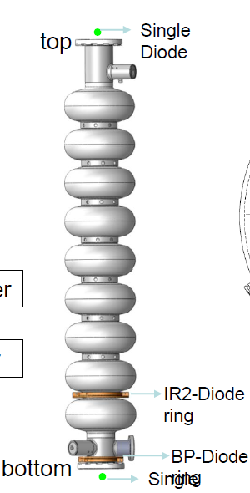
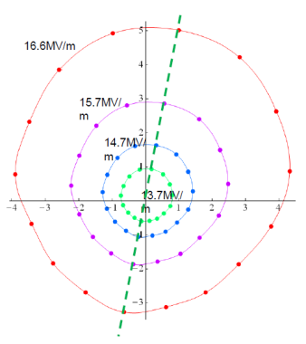
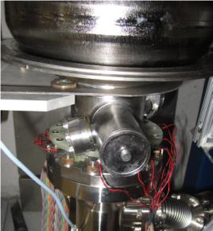
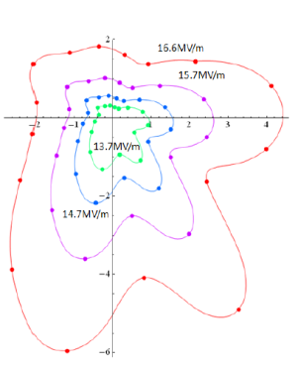
Cryogenic Field Emission Instrumentation (II)
detector saturated
First success in predicting location of active field emitter in a 9-cell cavity (RI23) at JLab
Cryogenic X-ray detection + RT NaI(Tl) crystal for X-ray end-point-energy + SLAC ACE3P modeling
Y.M. Li, A.D. Palczewski, R.L. Geng, to be published

Slide 15
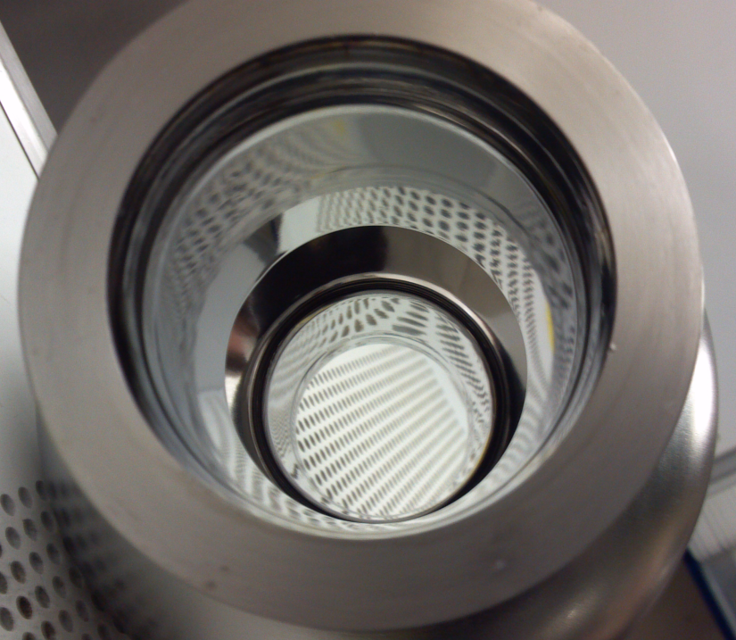
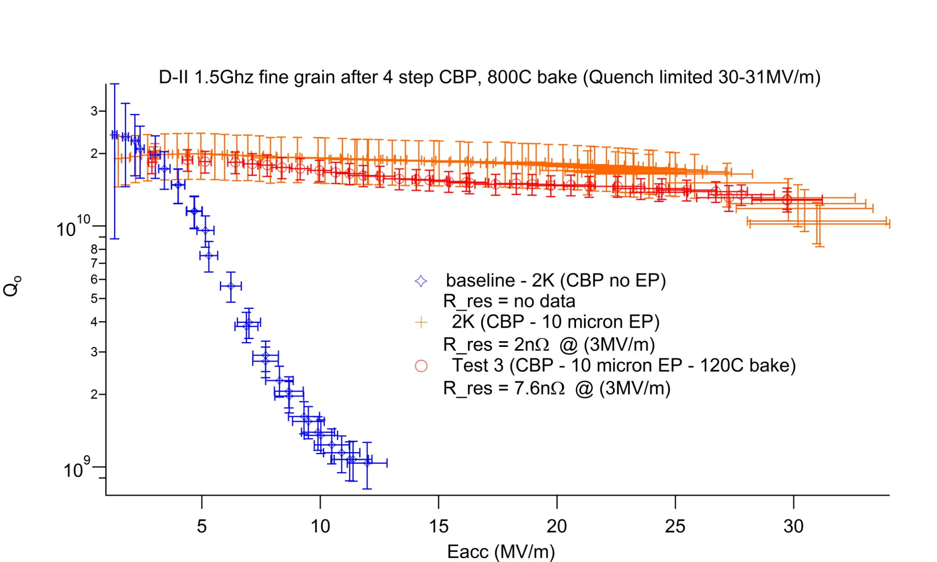
Optimizing Mechanical Polishing
Four-step CBP (based on 5-step recipe of C. Cooper, FNAL)
800Cx2hr
Light EP 10 um removal
First trial 1-cell 1.5GHz cavity (photo and graph on right)
In-house CBP
Light EP at ANL/FNAL facility using standard procedure
Second trial 1-cell 1.3 GHz cavity
In-house CBP
Light EP in-house VEP
Will contribute a poster to IPAC12 (A.D. Palczewski, H. Tian, R.L Geng)

Slide 16
Fermilab S0 News
FNAL/ANL joint facility water accident
Downtime ~6 weeks
FNAL/IB4 R&D facility and ANL G150 partially available
AC114 tumble polished, tested 6.Mar.
TB9NR004 tested March 13.Mar
Significant emphasis on process/test of SSR1 and 650 MHz cavities in the near future
First 10 AES cavities (of 20) currently due end May
IHEP low-loss large-grain cavity arrives at FNAL for process/test around August

Slide 17
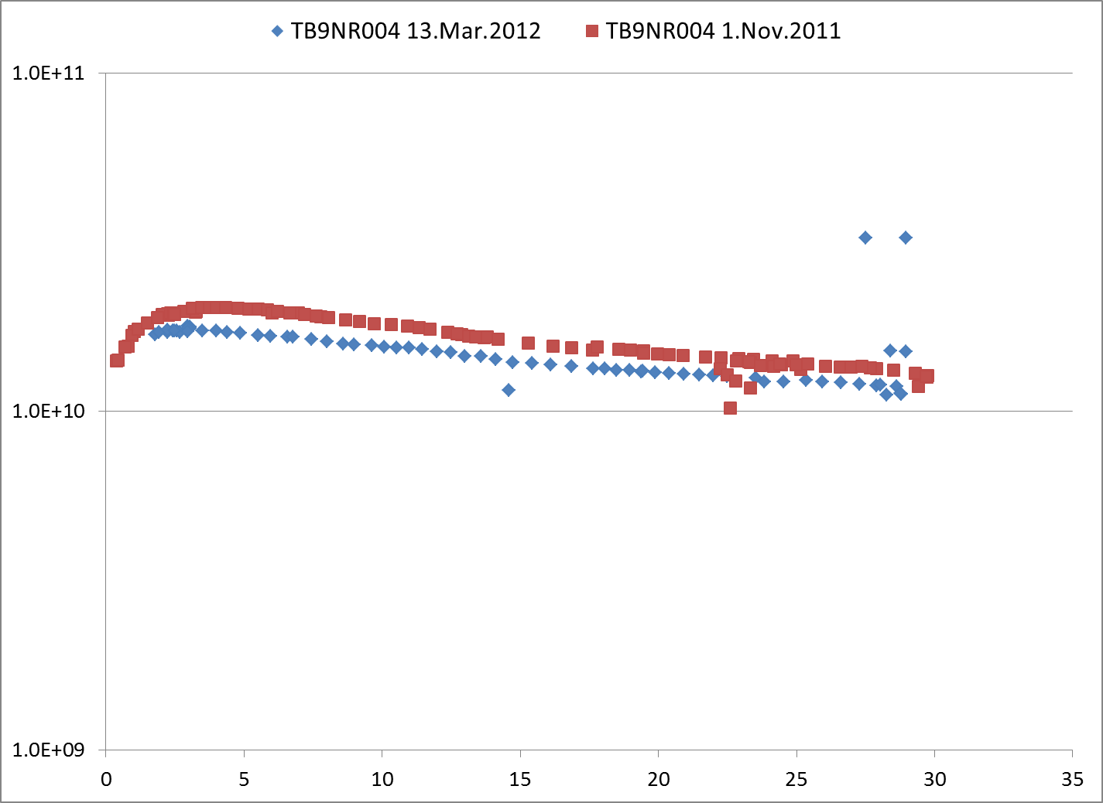
TB9NR004 Test
1st pass (EP) 29.7 MV/m
2nd pass (EP) 29.0 MV/m

Slide 18
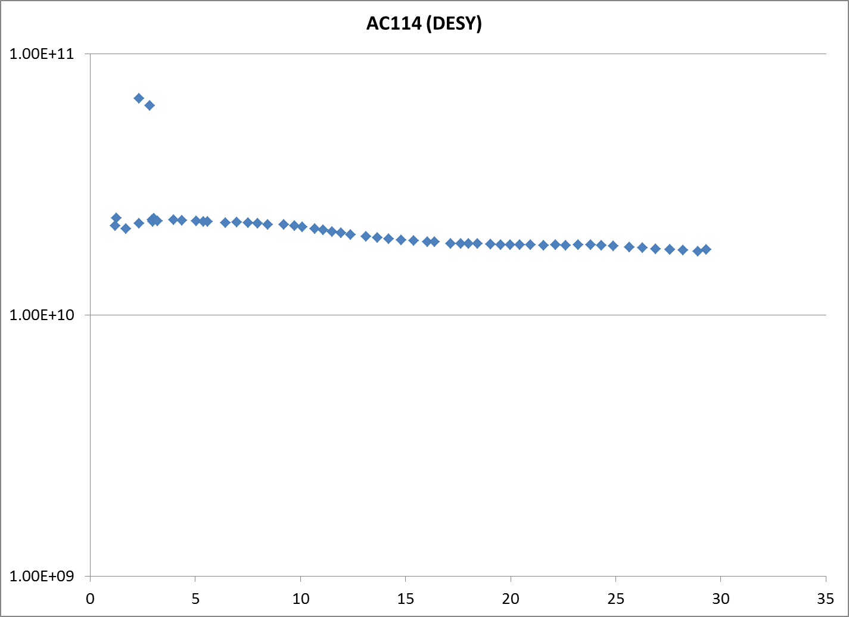
One of the DESY large grain cavities that did so well (except this one)
At DESY: Eacc(max) after BCP 28.7 MV/m, after EP ~14 MV/m
After FNAL tumbling (Charlie) 29 MV/m. Deemed good enough.

Slide 19
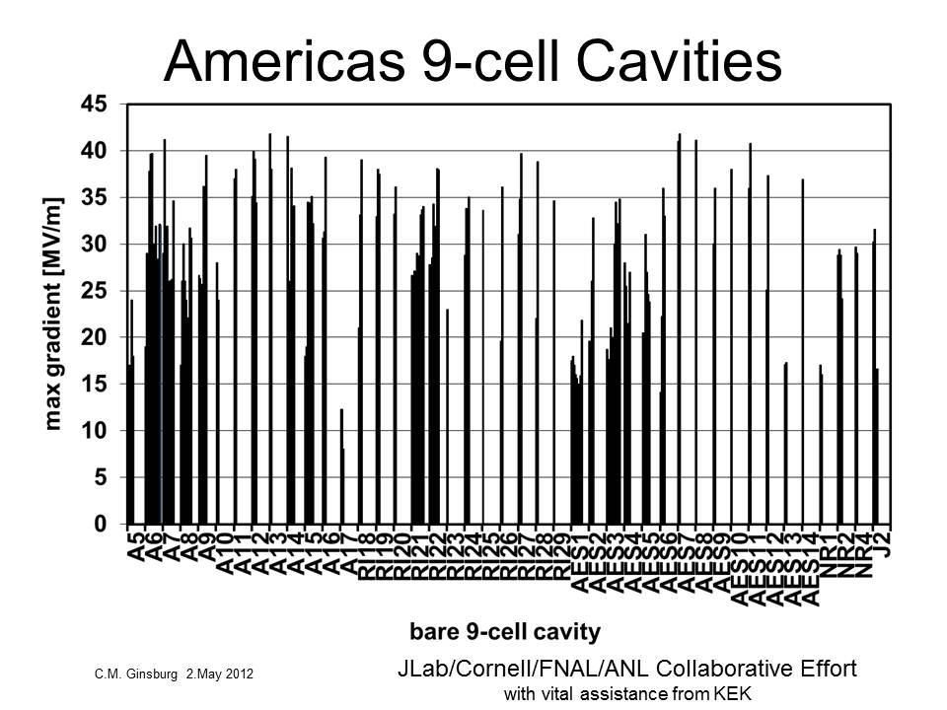

Slide 20
