Slide 1
Status of Event Mixing and Other Issues
Tim Barklow (SLAC)
May 10, 2012

Slide 2
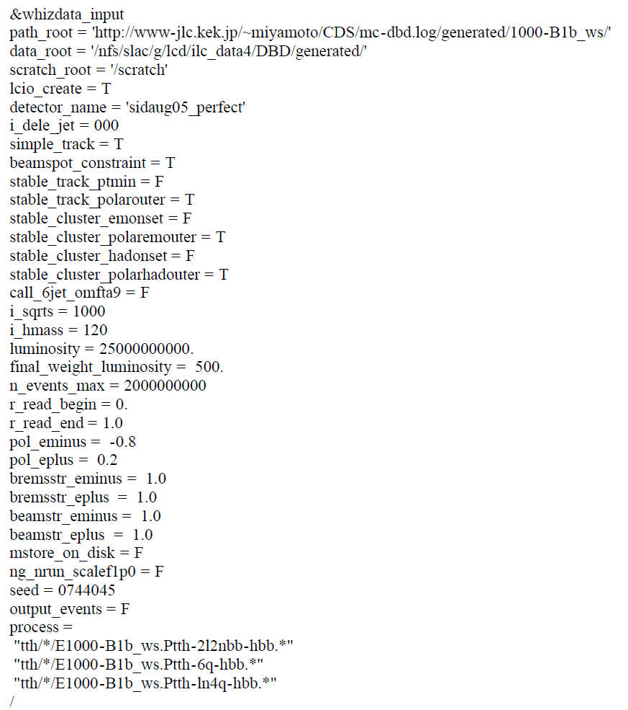

Slide 3
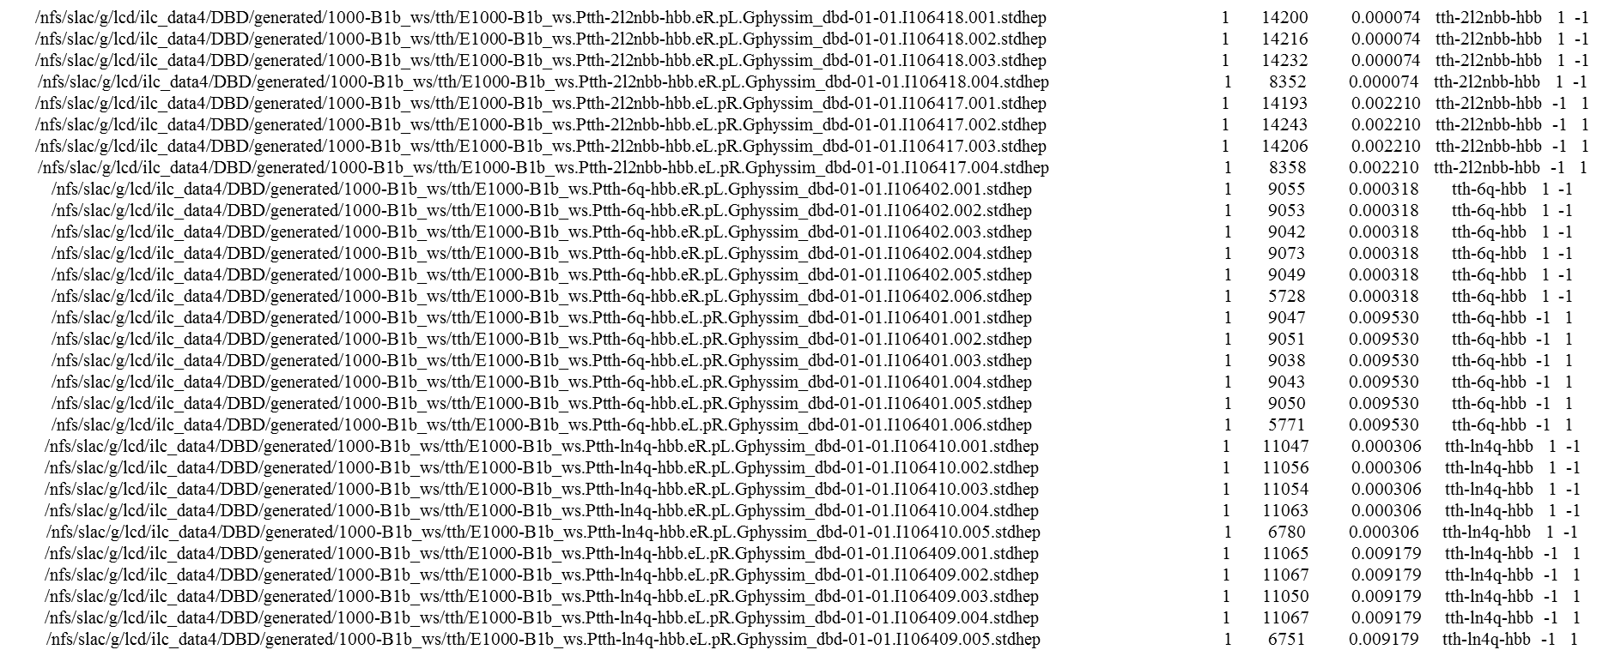

Slide 4
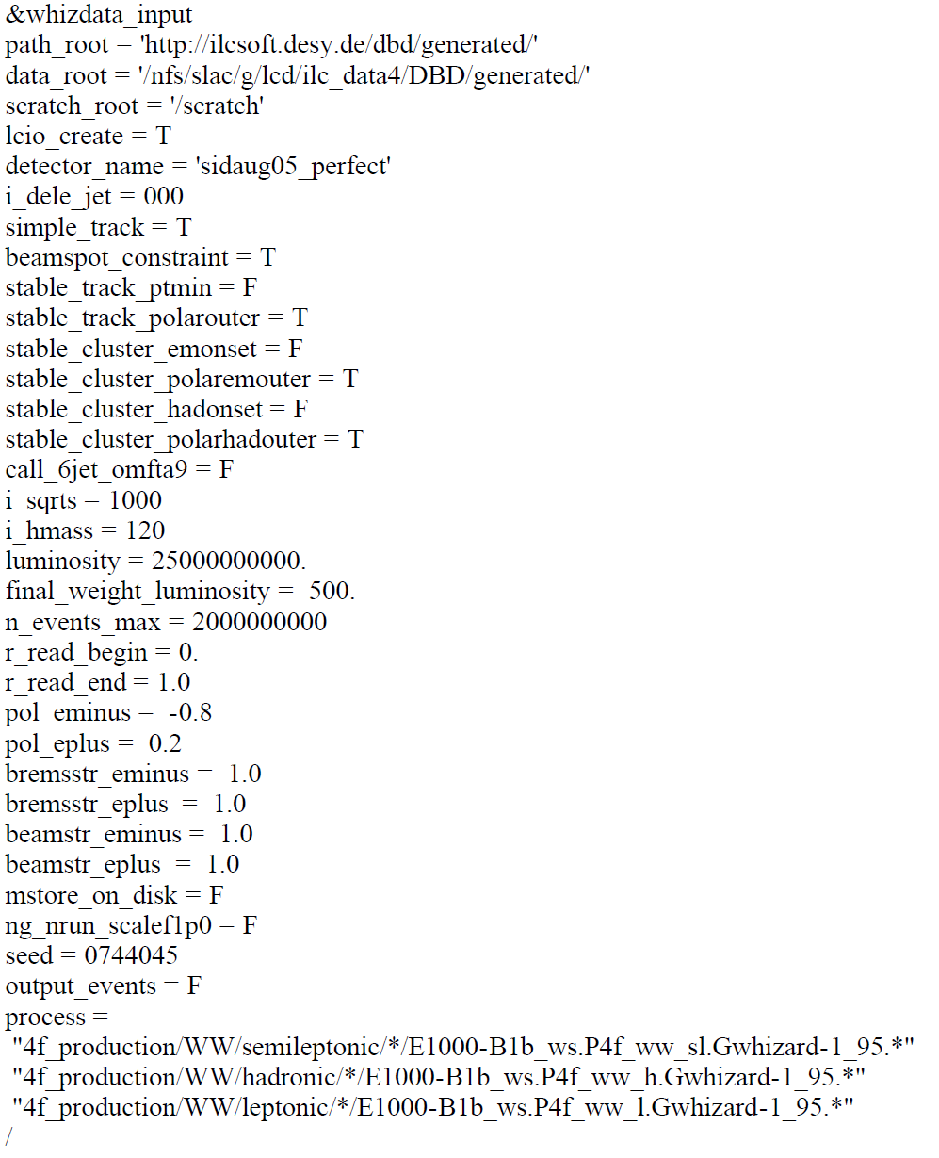

Slide 5
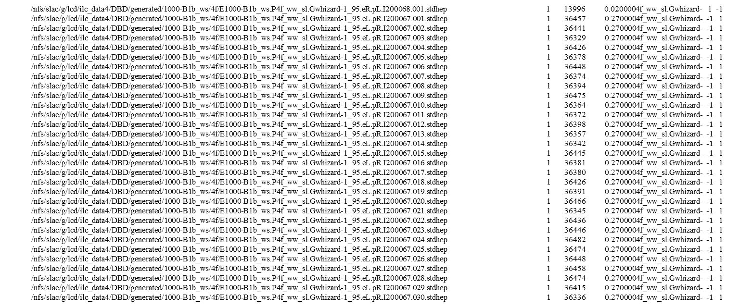

Slide 6
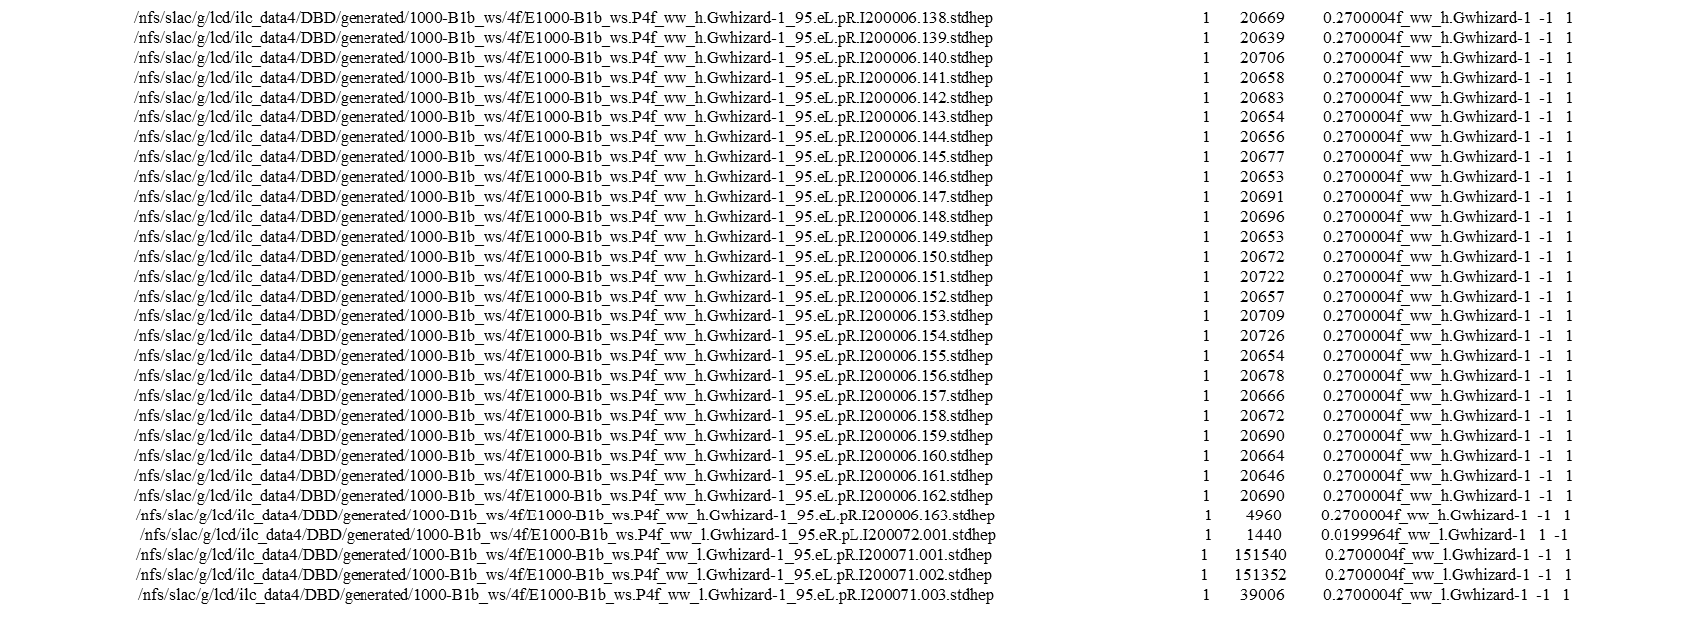
.
.
.

Slide 7
Exception in thread "main" java.io.IOException: Invalid file name: /nfs/slac/g/lcd/ilc_data4/DBD/generated/1000-B1b_ws/tth/E1000-B1b_ws.Ptth-2l2nbb-hbb.eR.pL.Gphyssim_dbd-01-01.I106418.001.stdhep
at org.lcsim.io.whizdata.WhizDataFileList.<init>(WhizDataFileList.java:63)
at org.lcsim.io.whizdata.Main.main(Main.java:26)
public class WhizDataFileList
{
private static int MAX_OPEN_FILES = 500;
private Pattern pattern = Pattern.compile(".*w(\\d+)_.*");
private List<WhizDataFile> files = new ArrayList<WhizDataFile>();
private long[] chooser;
private Random random;
Matcher matcher = pattern.matcher(fileName);
if (!matcher.matches())
{
throw new IOException("Invalid file name: " + fileName);
}

Slide 8
Minijet generation
PARP(2) changed from 10.00000 to 100.00000
PARP(81) changed from 1.90000 to 0.40000
PARP(104) changed from 0.80000 to 0.80000
PARP(111) changed from 2.00000 to 0.50000
CKIN(3) changed from 0.00000 to 20.00000
use pythia cross, whizard_integral,<aa cross-sec>(mb),total cross-section(mb)=
0.321980610022527 1.604174762343909E-007 5.165131685622336E-008
(5.165E+4 fb)
1 VMD/hadron * VMD 0.000D+00
2 VMD/hadron * direct 8.590D-09
3 VMD/hadron * anomalous 1.728D-08
4 direct * direct 5.668D-08
5 direct * anomalous 2.784D-08
6 anomalous * anomalous 5.003D-08

