Slide 1

A TPC for the Linear Collider
P. Colas
on behalf of LCTPC

Slide 2
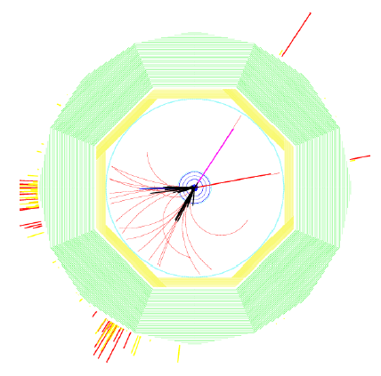
2 detector concepts : ILD and SiD
Both based on the ‘particle flow’ paradigm
SiD: all-silicon
ILD: TPC for the central tracking
Benchmark process: e+e- -> HZ, Z->µµ
Requirements:
Momentum resolution
δ(1/p_{T}) <2.10⁻⁵ GeV/c with vertex constraint
δ(1/p_{T}) <9.10⁻⁵ GeV/c TPC only
(200 points with 100 µ resolution in Rφ)
2-track separation: 2 mm in Rφ and 6 mm in z in a high density background
Material budget: <5% X° in the barrel region, <25% X° in the endcap region
B=3.5 T

Slide 3
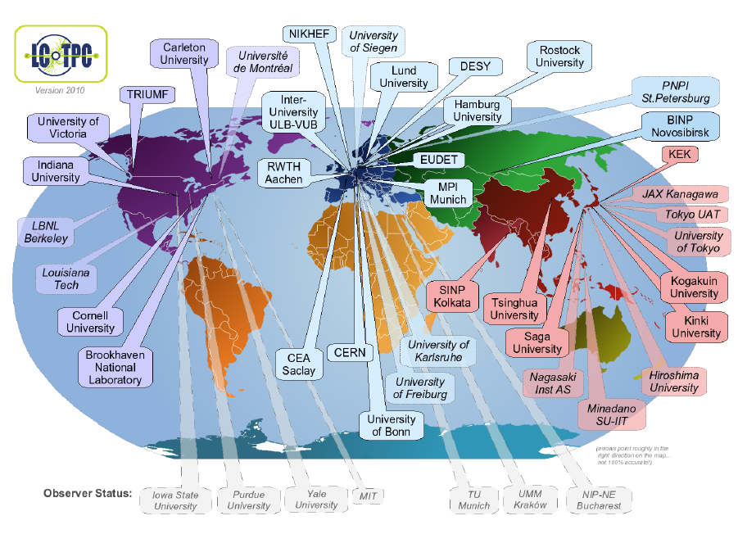
All the R&D is gathered in LCTPC
38(*) member + 7 observer institutes from 12 countries
(*) 25 signed the MOA

Slide 4
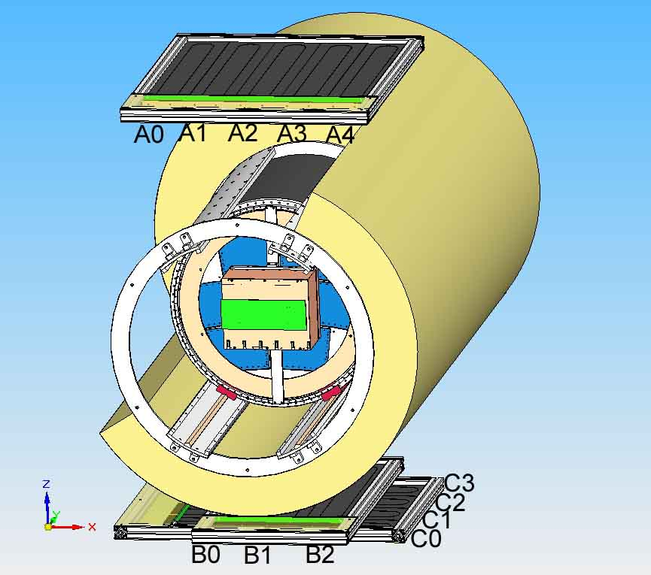
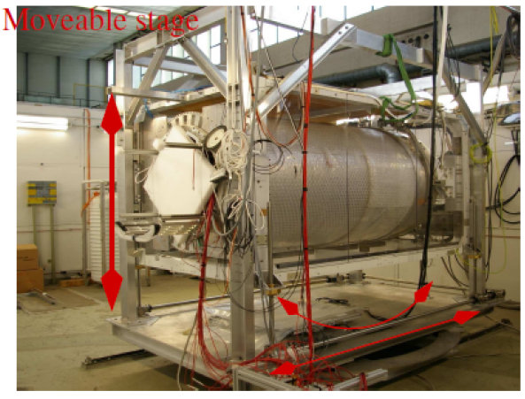
The EUDET test setup at DESY
The EUDET (FP6) setup at DESY is operational since 2008
Being upgraded within AIDA (FP7): autonomous magnet with internal He compressors
SiPM trigger
Field cage

Slide 5
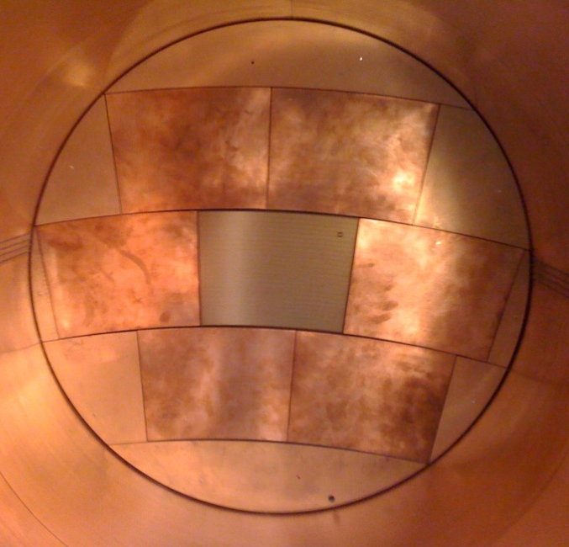
Beam tests at DESY : 5 technologies
Laser-etched Double GEMs 100 µ thick (‘asian GEMs’)
Micromegas with charge disper-sion by resistive anode
GEM + pixel readout
InGrid (integrated Micromegas grid with pixel readout)
Wet-etched triple GEMs (‘European GEMs’)

Slide 6
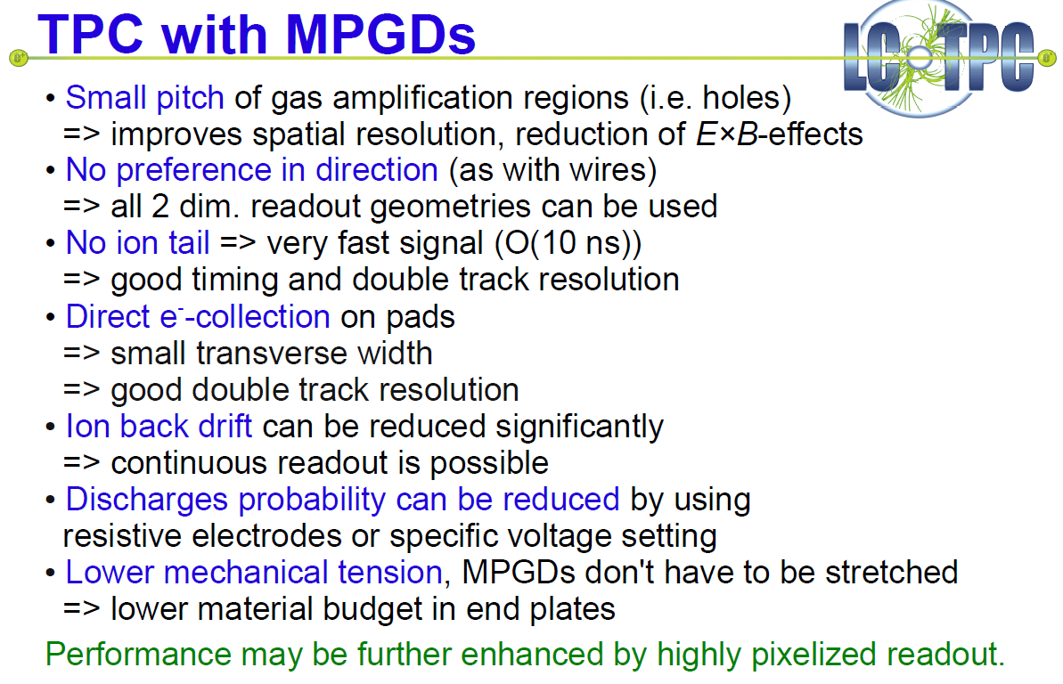
Advantages of MPGDs

Slide 7
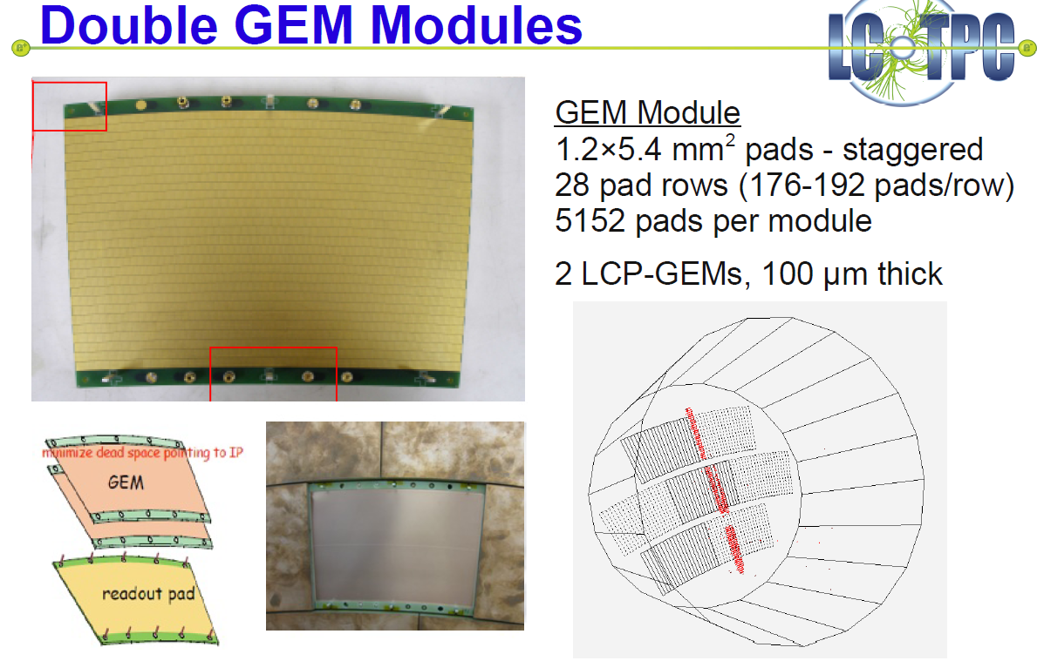

Slide 8
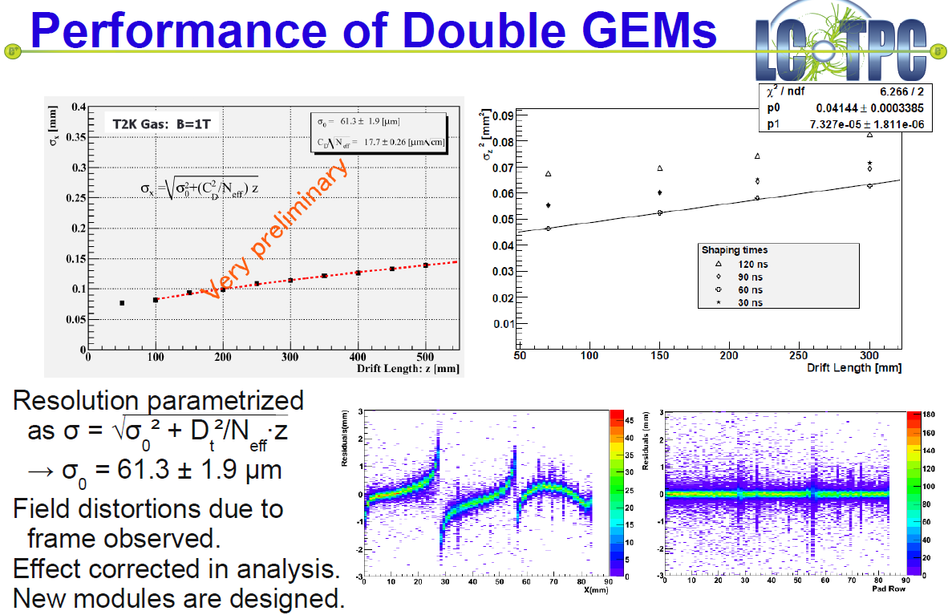

Slide 9
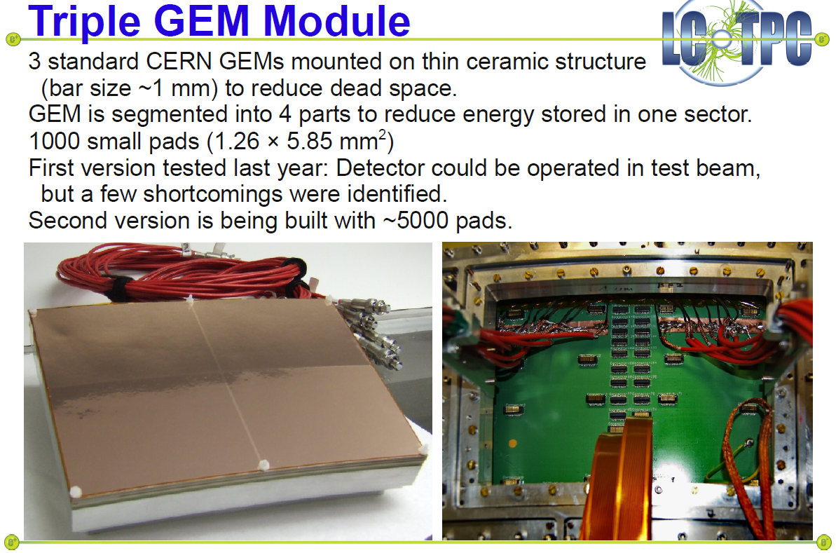

Slide 10
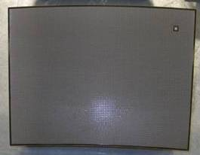
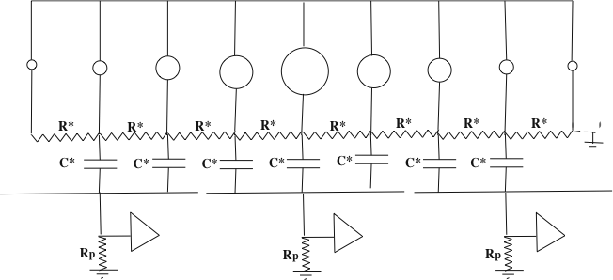
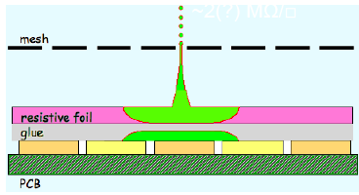
Charge spreading by resistive foil
Resistive coating on top of an insulator: Continuous RC network which spreads the charge: improves position sensitivity
M. Dixit, A. Rankin, NIM A 566 (2006) 28
Various resistive coatings have been tried: Carbon-loaded Kapton (CLK),
3 and 5 Mohm/square, resistive ink.

Slide 11
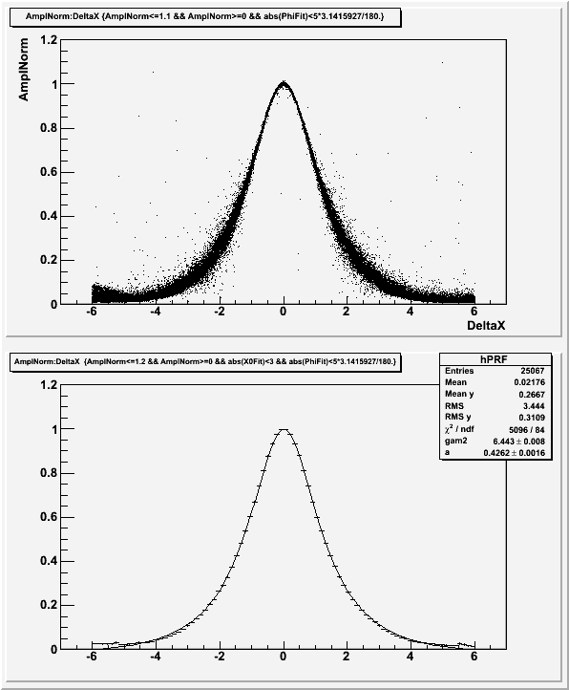
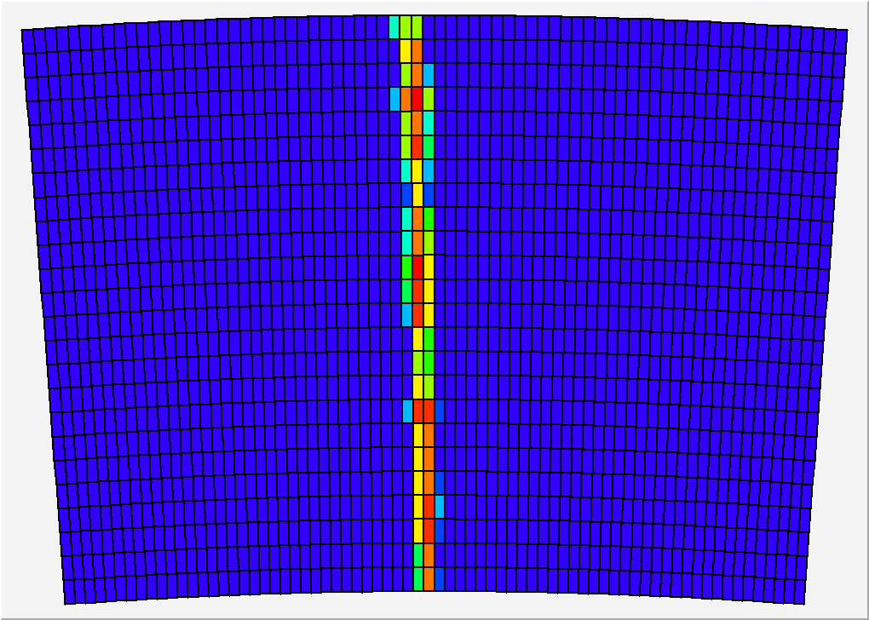
Pad response
Relative fraction of ‘charge’ seen by the pad, vs x(pad)-x(track)
Z=20cm, 200 ns shaping
24 rows x 72 columns of 3 x 6.8 mm² pads
x(pad) – x(track) (mm)

Slide 12
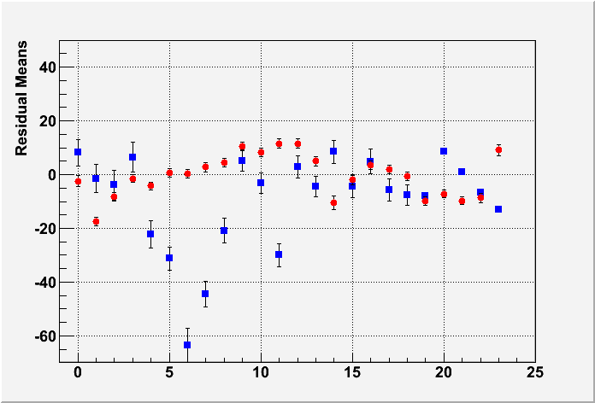
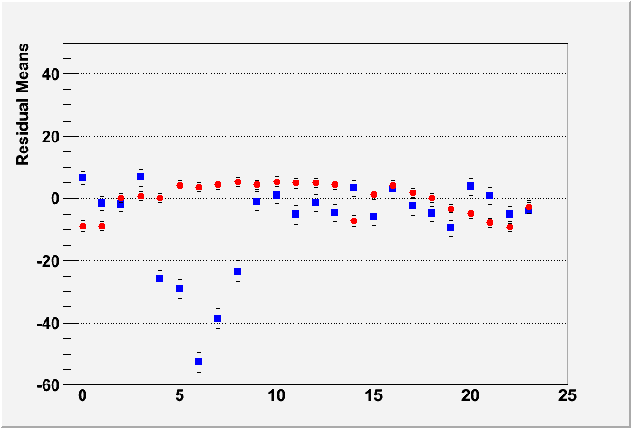
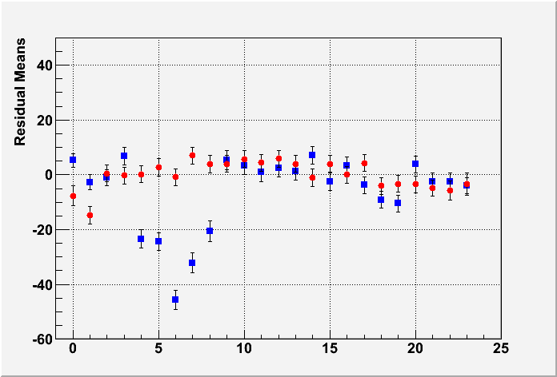
Uniformity (B=1T data)
MEAN RESIDUAL vs ROW number
Z-independent distortions
Distortions up to 50 microns for resistive ink (blue points)
Rms 7 microns for CLK film (red points)
-> select CLK
Z=5cm
Z=35cm
Z=50cm
Row number

Slide 13
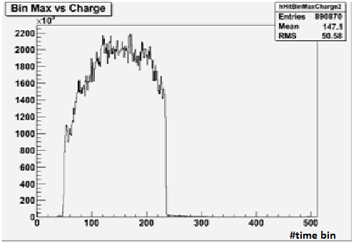
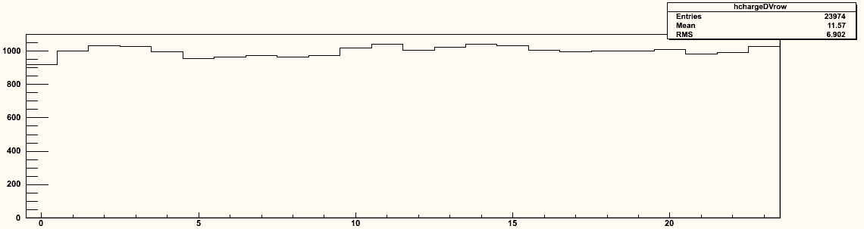
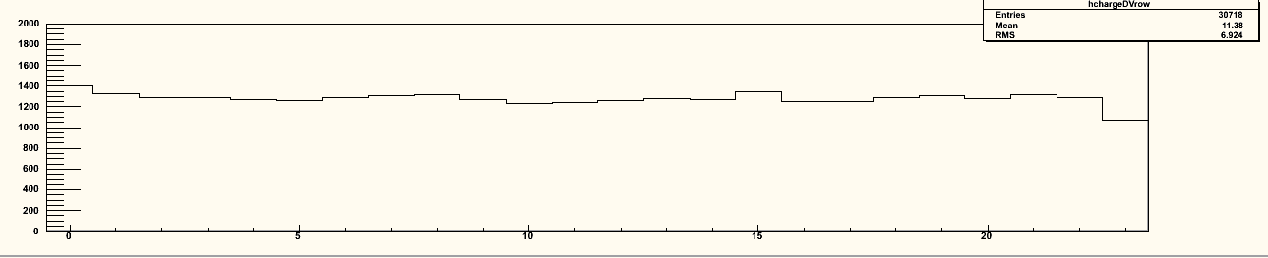
Uniformity
z distribution
Average charge by row
Average charge by row
Using cosmic-ray events
B=OT
Using 5 GeV e-
B=1T
0 5 10 15 20
0 5 10 15 20
Excellent uniformity up to the edge of the module, thanks to the ‘bulk’ technology.

Slide 14
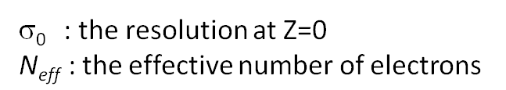
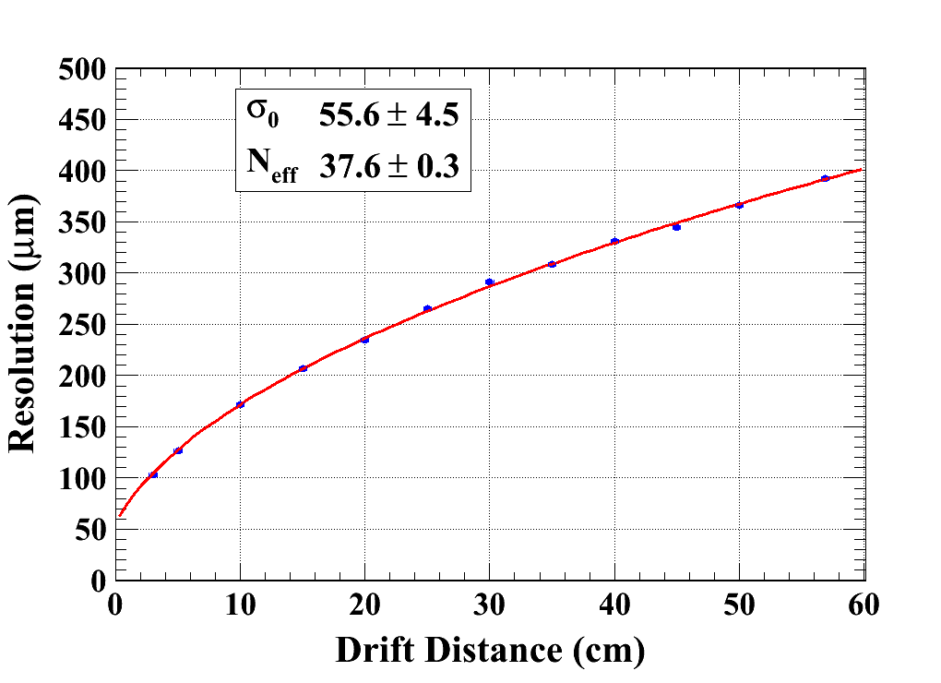
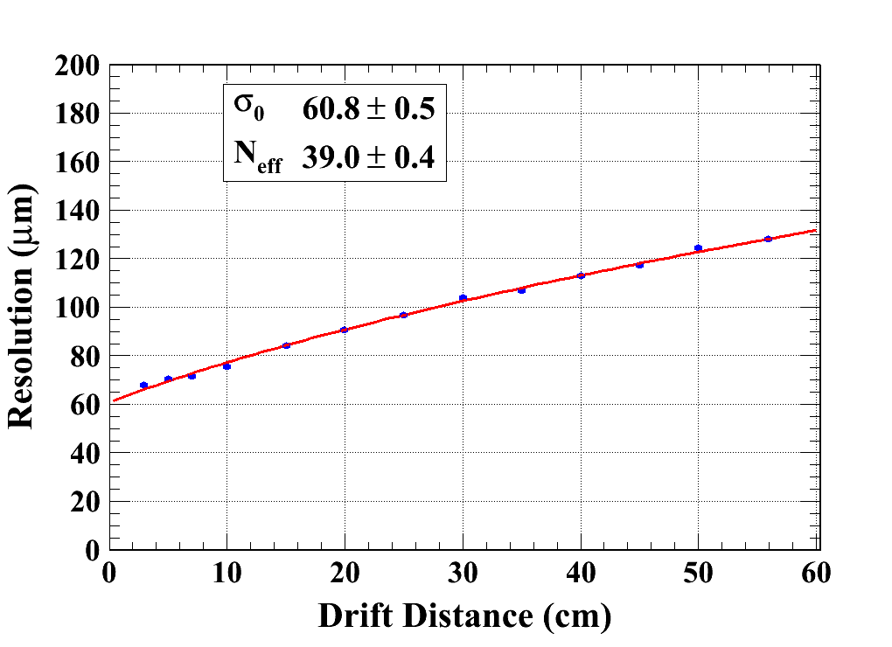
Data analysis results (B = 0T & 1T)
Carbon-loaded kapton resistive foil
Gas: Ar/CF4/Iso 95/3/2
C_{d} : diffusion constant
B=0 T C_{d} = 315.1 µm/√cm (Magboltz)
B=1 T C_{d} = 94.2 µm/√cm (Magboltz)
Module 4
χ² : 10.6
Ndf: 10
Module 3
χ² : 29.1
Ndf: 11

Slide 15
N_{eff} measurement with Micromegas
Averaging B=0T and B=1T data, modules 4, 5 and 3 (excluding ink module):
  N_{eff} = 38.0±0.2(stat) (systematics difficult to assess)
  σ₀= 59 ± 3 µm
  Note that 1/<1/N> = 47.1 from Heed for 5 Gev electrons on 6.84mm long pads.
  Thus N_{eff} has to be between 23.5 (for exponential gain fluctuations) and 47.1 if there are no gain fluctuations.
  1/<1/N> = 34.9 for 5.4 mm pads (GEM case).
D. Arogancia et al., NIM A 602 (2009) 403

Slide 16
Dependence of resolution with peaking time
Z=5cm
CLK 5 MΩ/sq
Optimum resolution for 500 ns peaking time -> try to lower resistivity to lower this peaking time (faster charge spreading)

Slide 17
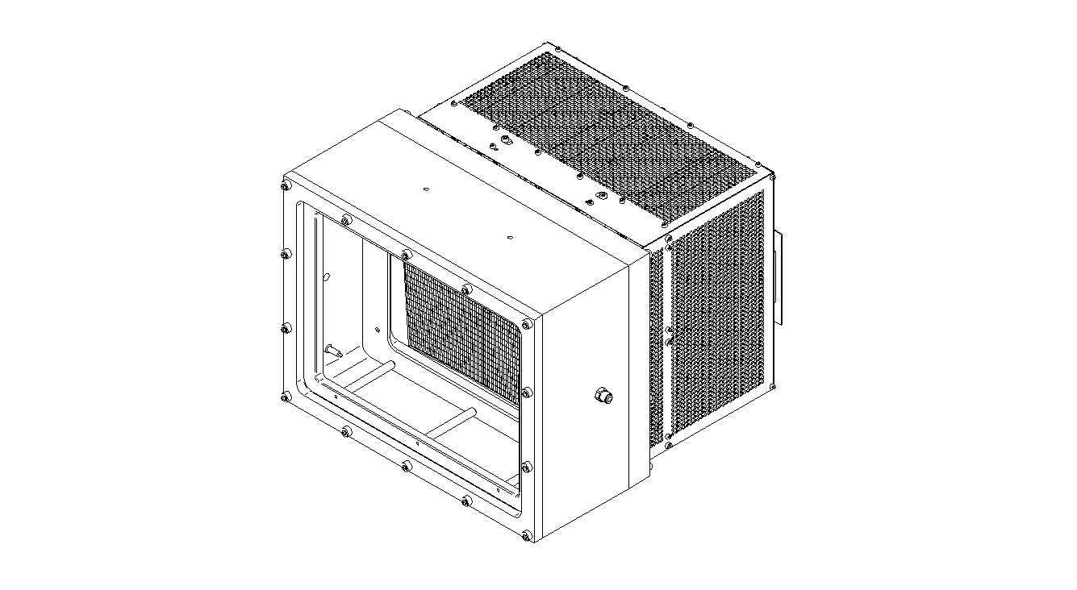
Test in a high intensity π beam
Top
40 cm
B field
11 cm
27 cm
35cm
Bottom

Slide 18
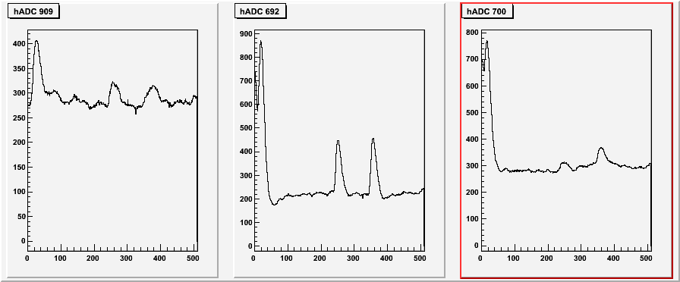
Test at CERN (July 2010) at 180 kHz (5 x 2 cm² beam) showed no charging up and stable operation
Peaking time of 200 ns is enough to obtain the best resolution -> 300 ns suffice to distinguish 2 tracks on the same pad
4µs
Time (in 40 ns bins)

Slide 19
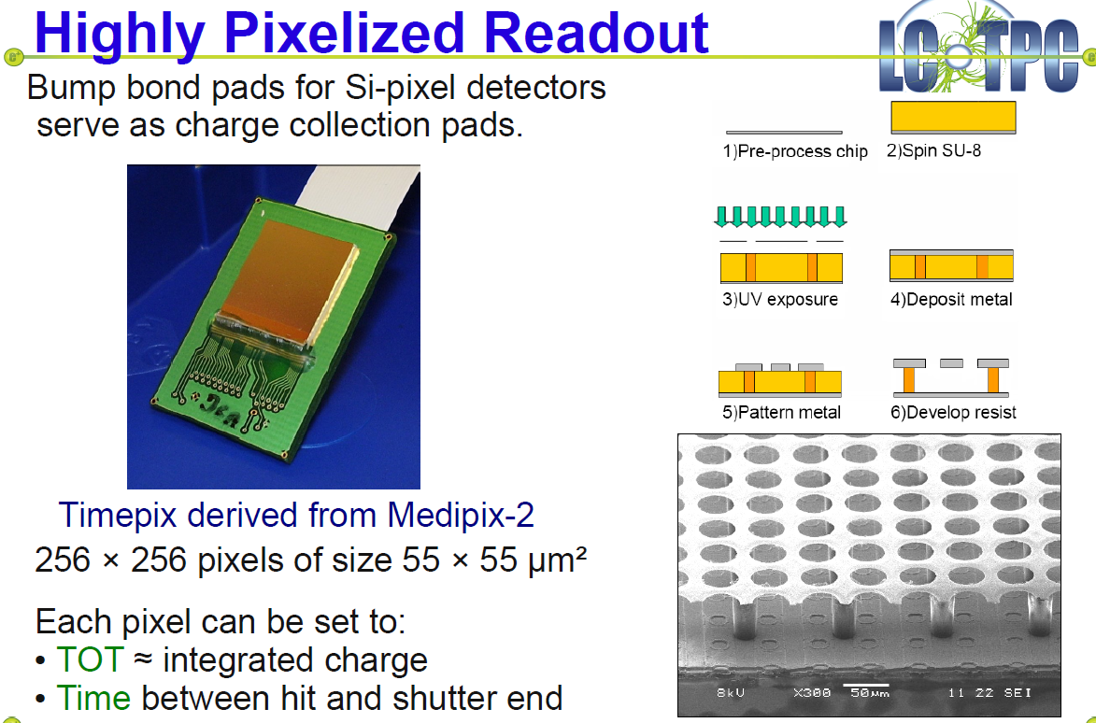

Slide 20
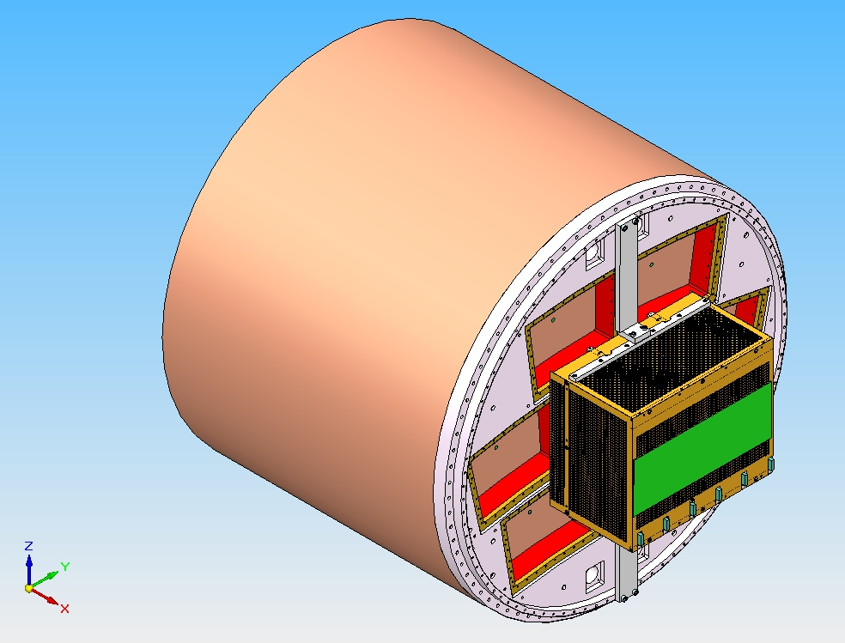
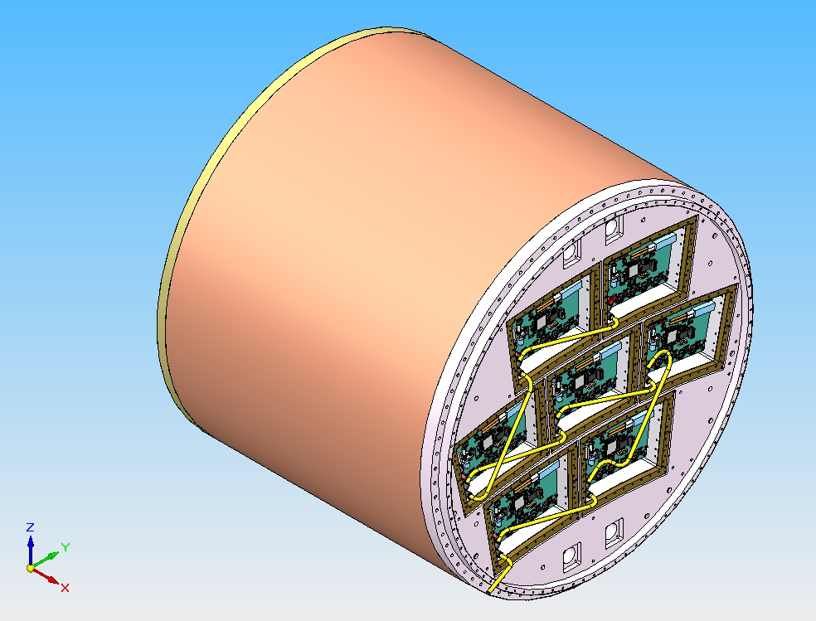
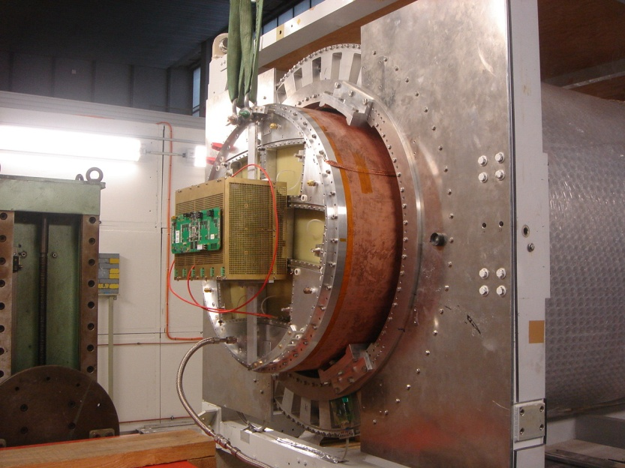
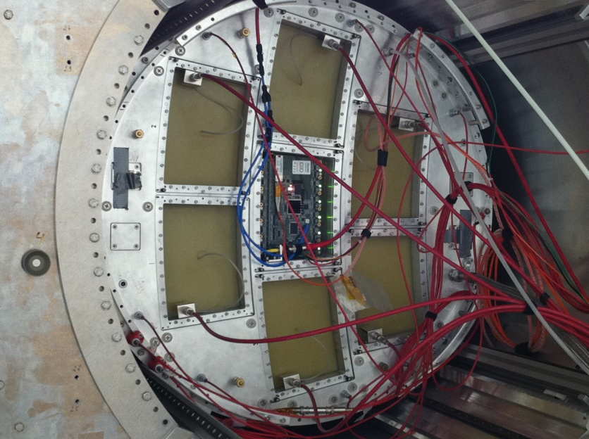
7 module project – Micromegas electronic integration

Slide 21
Integration and cooling
New detector : new routing to adapt to new connectors, lower anode resistivity (3 MΩ/sq), new res. foil grounding on the edge of the PCB.
New 300 points flat connectors
New front end: keep naked AFTER chips and remove double diodes (count on resistive foil to protect against sparks)
New Front End Mezzanine (FEMI)
New backend ready for up to 12 modules
New DAQ, 7-module ready and more compact format
New trigger discriminator and logic (FPGA).

Slide 22
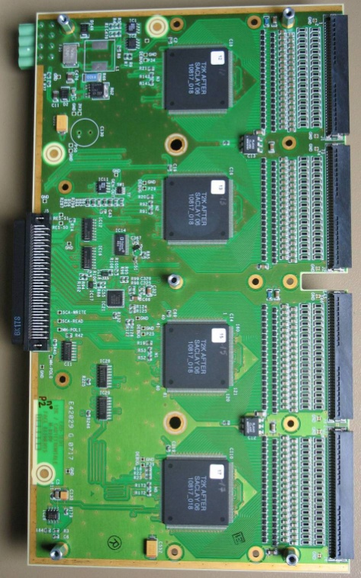
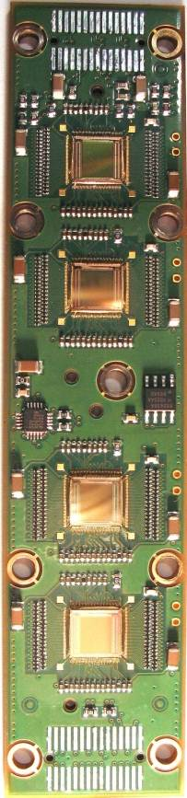
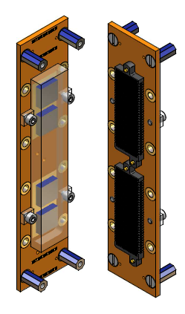
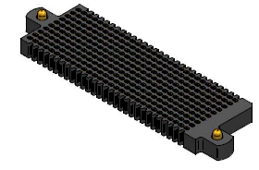
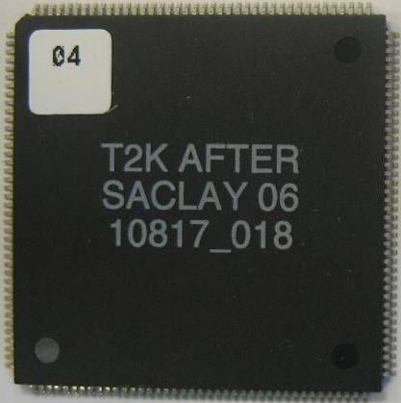
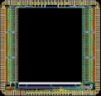
Integrated electronics for 7-module project
Remove packaging and protection diodes
Wire –bond AFTER chips
Use 2 × 300 pins connector
Use tiniest resistors (1 mm × 0.5 mm) from O to 10Ω
FEC
25 cm
4,5 cm
12,5 cm
14 cm
3,5 cm
2,8 cm
3,5 cm
0,78 cm
Chip
0,74 cm
after 2 weeks of operation: no ASIC lost:
  The resistive foil protects against sparks

Slide 23
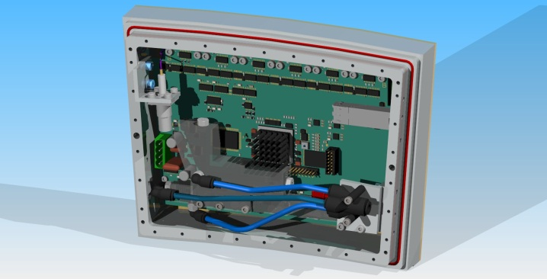
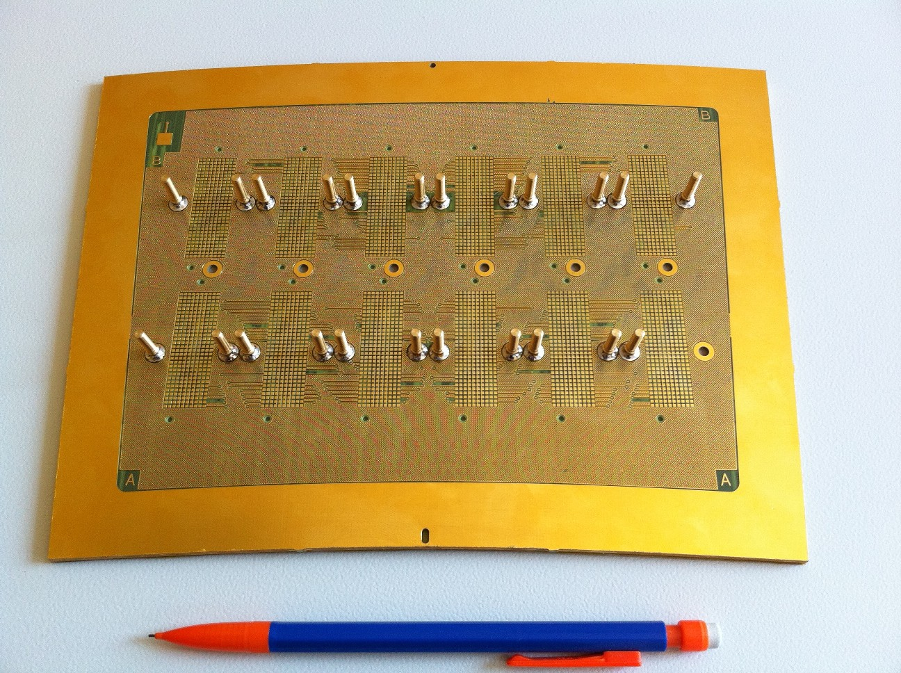
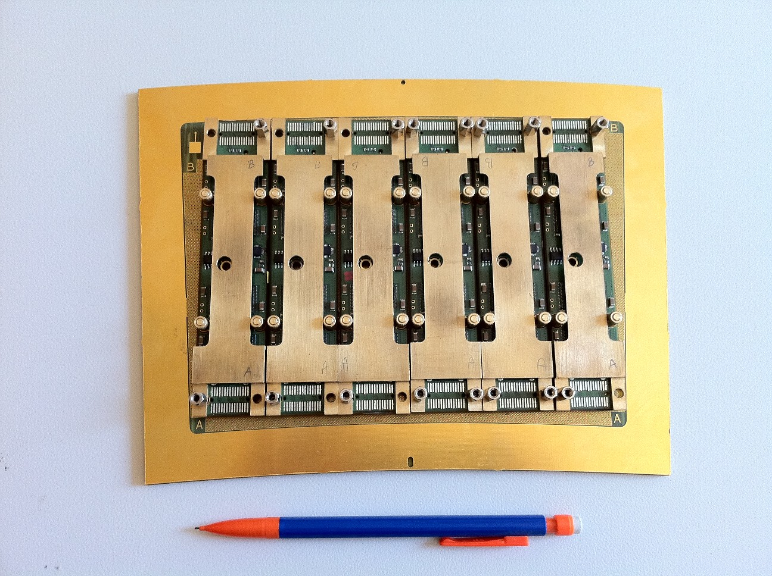
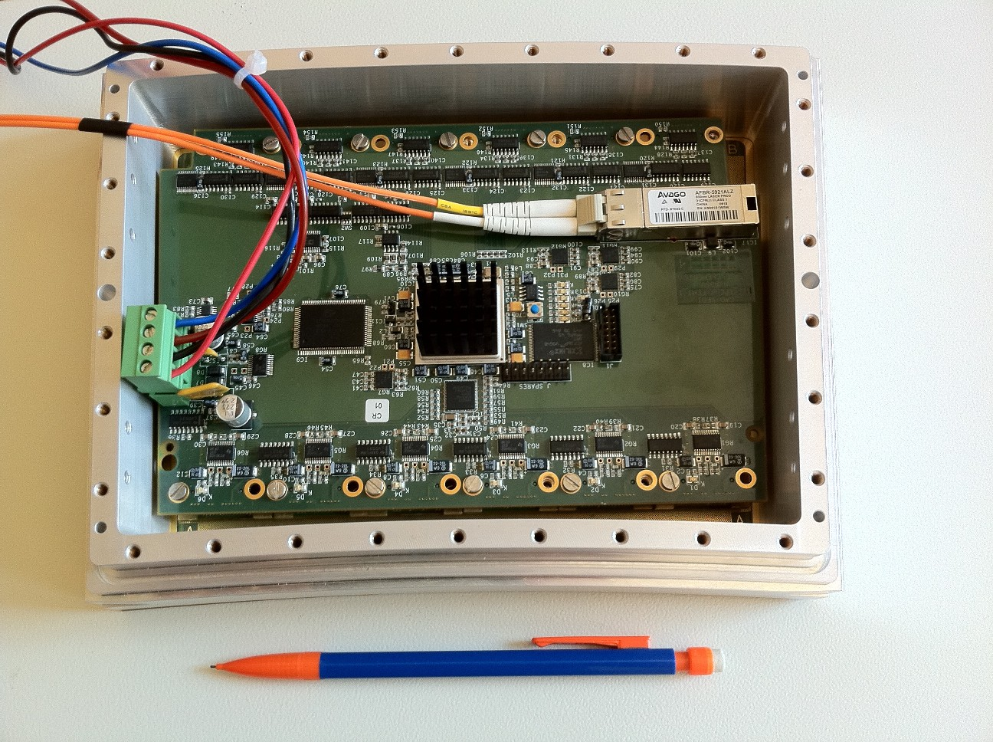
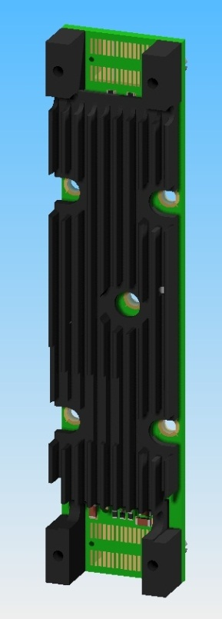
First prototype of the electronics

Slide 24
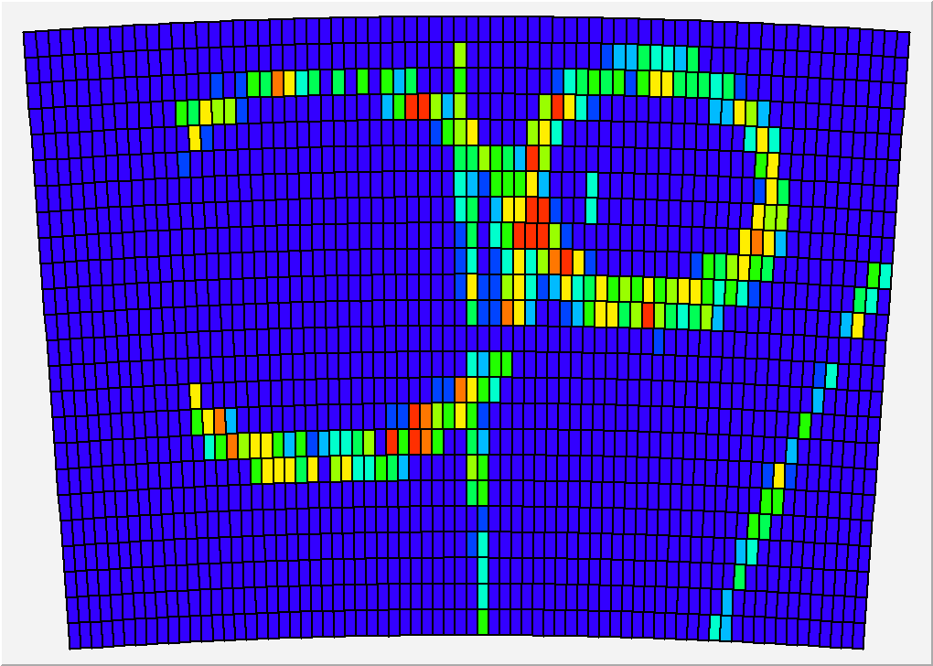

Slide 25
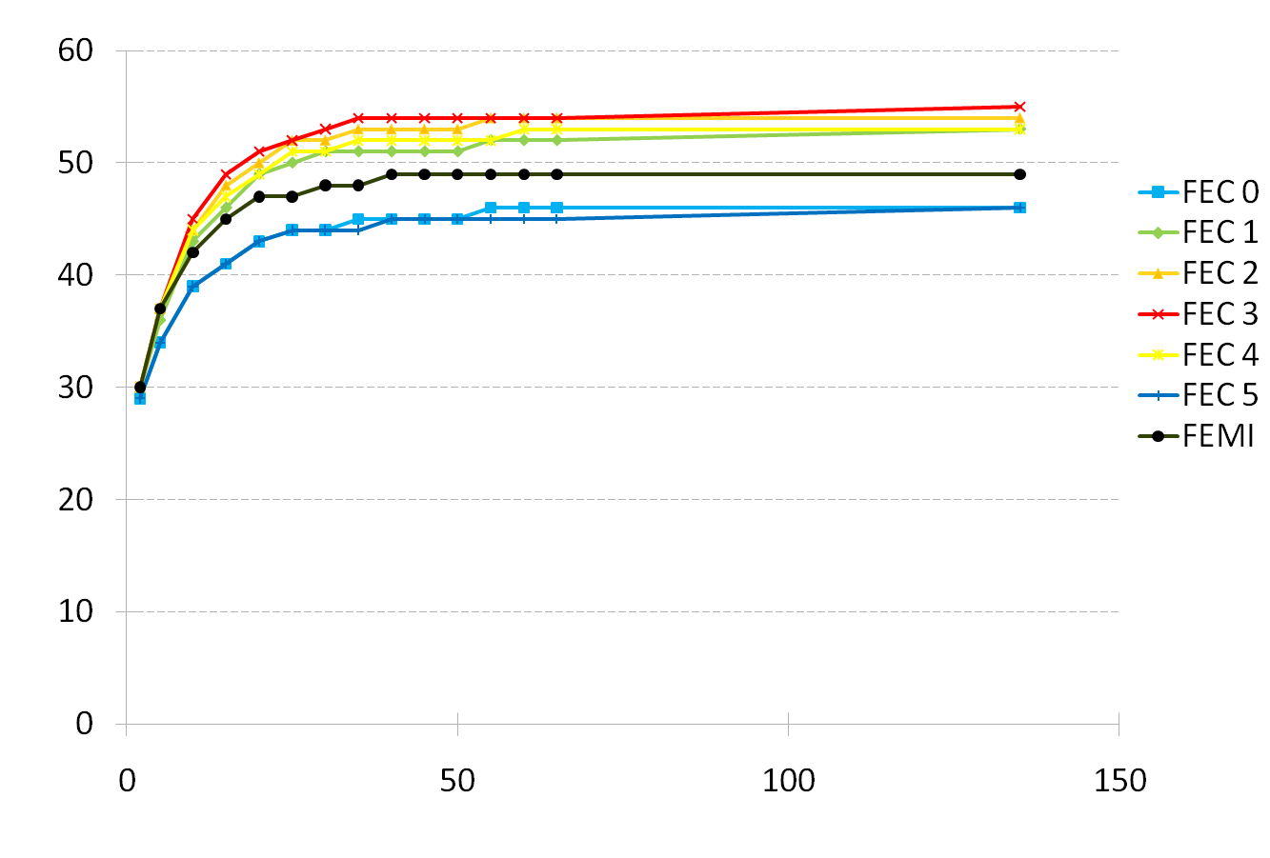
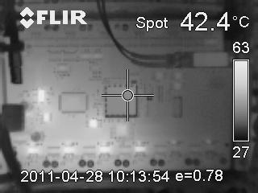
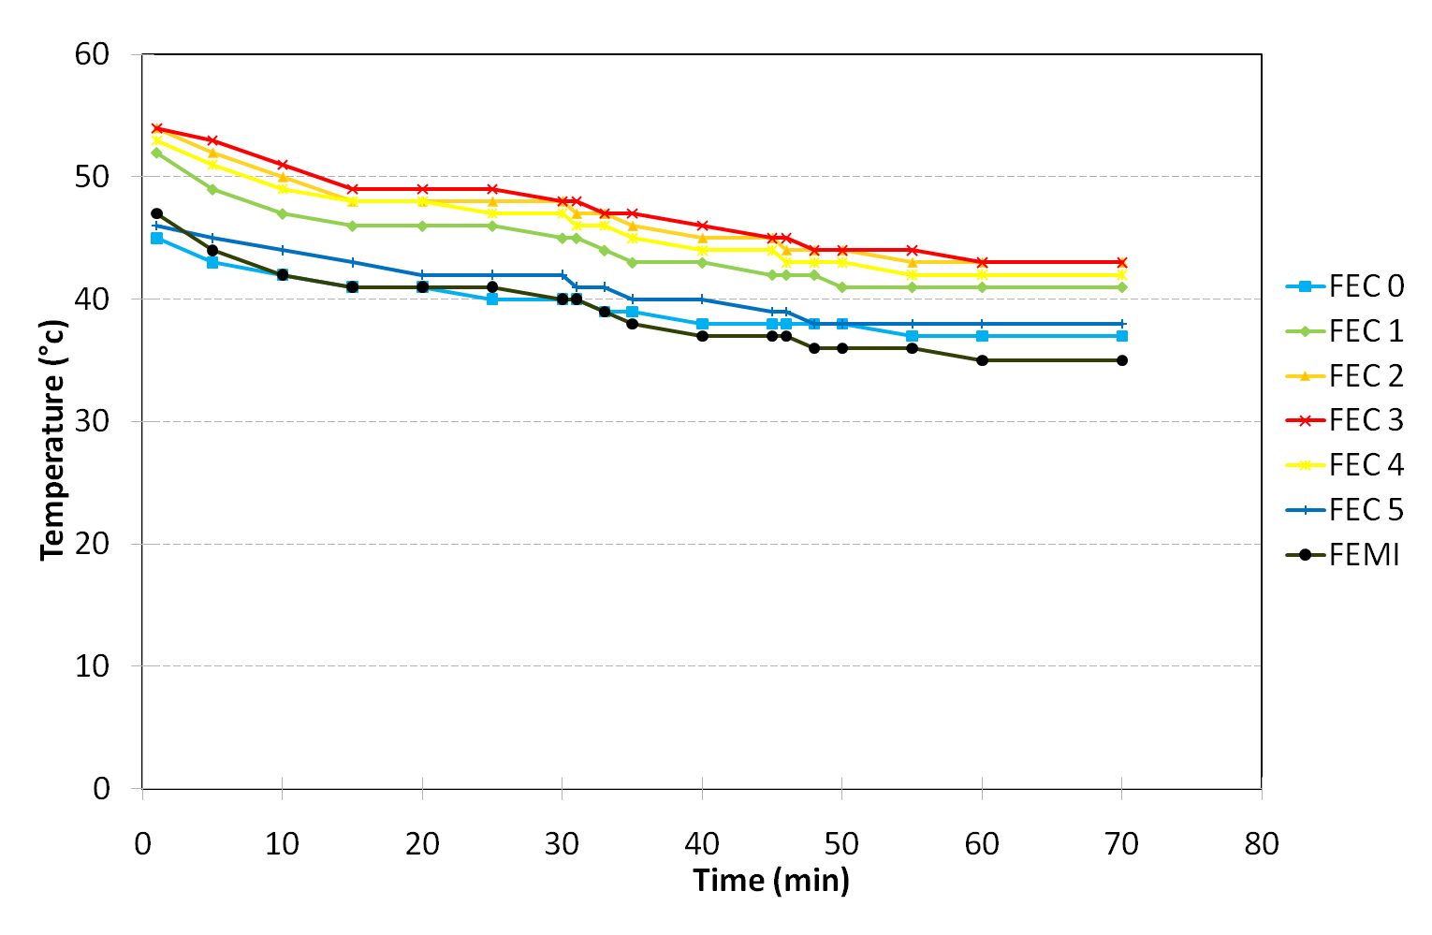
Thermal studies. IR camera shows hot spots (regulators, ADC). T-probes on every component.
2-phase CO2 cooling under study (KEK, Nikhef)
Onset of the electronics
Nitrogen cooling

Slide 26
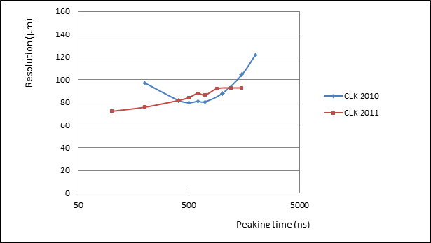
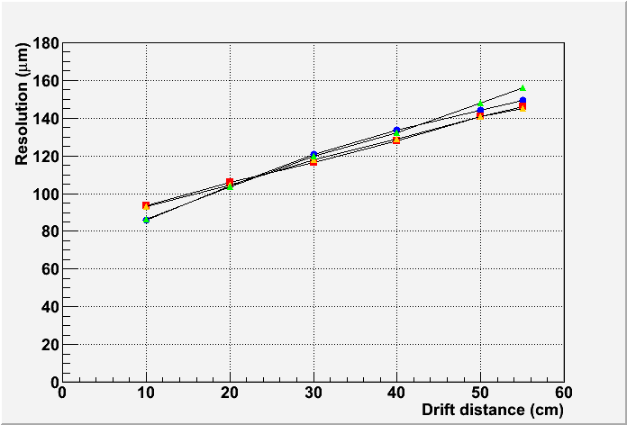
Preliminary results : resolution (B=1T data)
Tends to confirm previous measurements
(excluding lines with ASICs in bad contact).
Optimum resolution now obtained for peaking time below 200 ns
Resolution vs z for various peaking times.

Slide 27
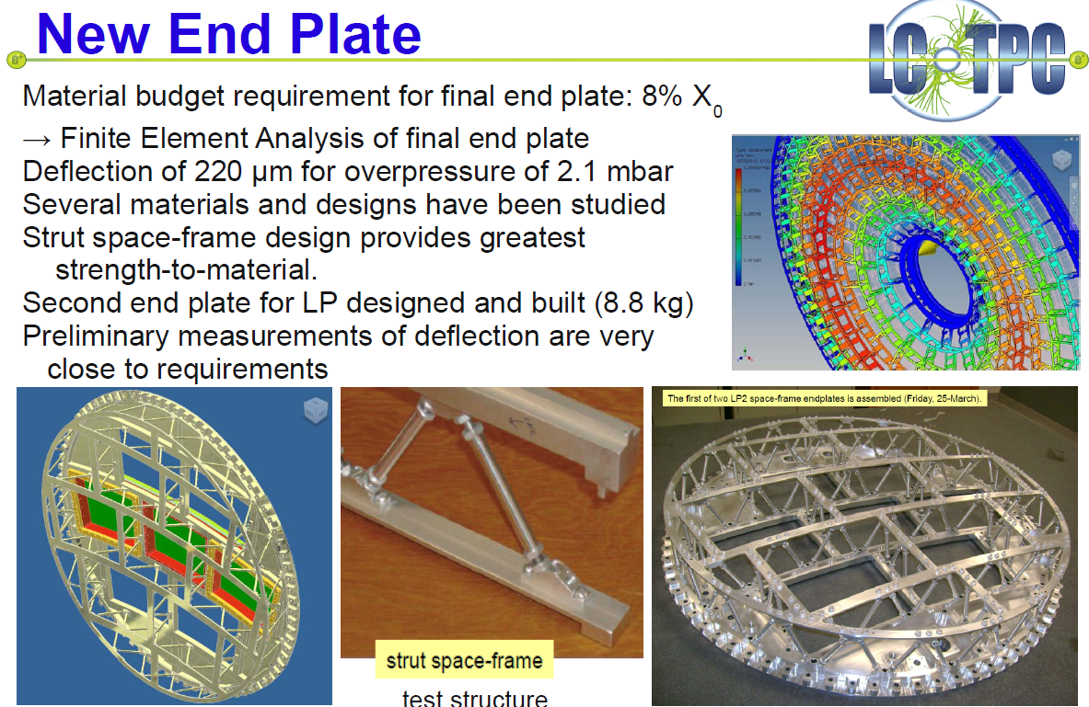

Slide 28
Ion disk and gating

Slide 29
Preparation for future electronics
Design and optimization work in progress for a new chip GdSP, evolution from SALTRO16:
  64 or 128 channels
  130 nm technology
  Very low noise
  Integrated ADC
  6 different power regions for power cycling
  High level filtering (baseline subtraction, spike removal)

Slide 30
CONCLUSIONS
MPGDs have been shown to fulfill the requirements for the readout of a TPC for the LC.
Integration work (electronics and cooling) is going on, and practical production issues are addressed for the pad readout.
Pixel readout needs more development to gain in reliability and operability in large surfaces.

