Slide 1
Proposed TDR baseline LLRF design
J. Carwardine, 22 May 2012

Slide 2
LLRF system layout per the RDR

Slide 3
LLRF for TDR: KCS vs DKS
DKS
  Essentially the RDR layout revised for Low Power config
  RDR: RF Unit had one klystron feeding 3 CMs (26 cavities)
  TDR: still uses groups of 3 CMs, but for Low Power config, each klystron feeds 1½ groups of 3 CMs (39 cavities)
  Vector Sum control of 39 cavities, remote adjustment of Pk, QL, and phase for each cavity, mechanical tuners, piezo tuners,
KCS
  Each group of 3 CMs is fed from a coaxial tap-off from a single 300MW rf feed
  Low Power config removes klystrons from each cluster but doesn’t change the Local PDS
  Length of KCS section in ML: 26 groups of 3 CMs = 1.25km
  Vector Sum control of 26 groups of 3 CMs (676 cavities)
  Long loop delays due to transit times

Slide 4
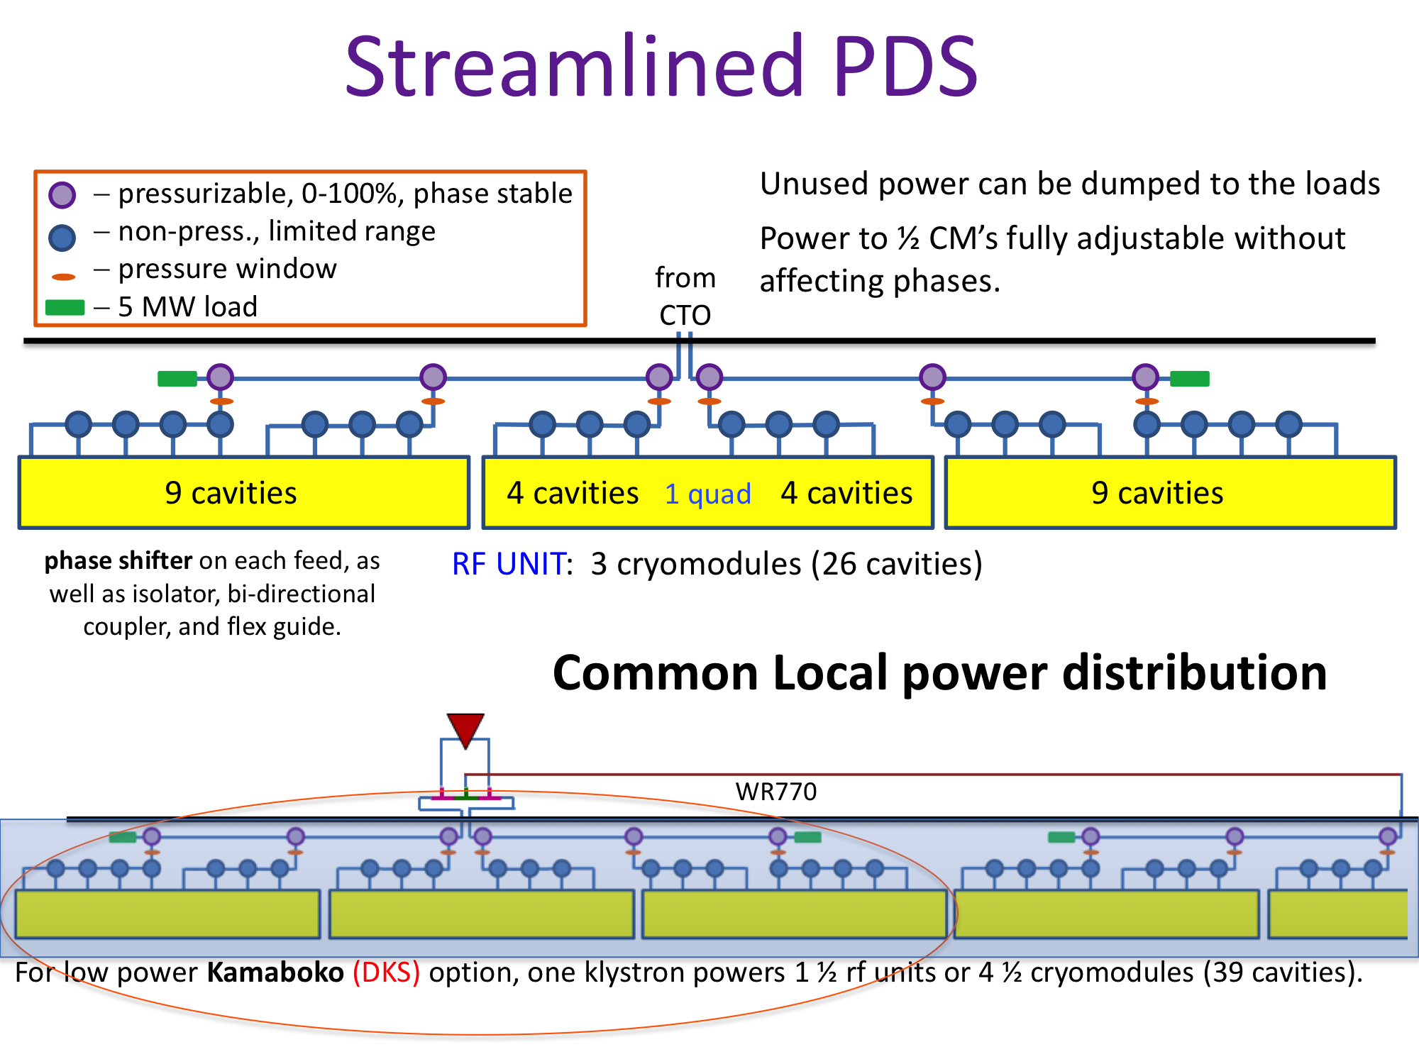
A. Yamomoto

Slide 5
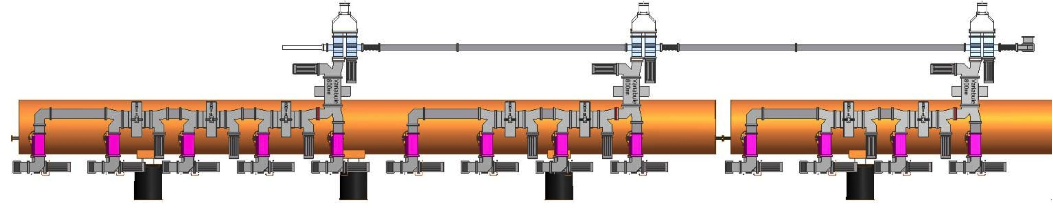
TDR Local Power Distribution System for ‘Low Power’ configuration
(Showing half of an RF-Unit for KCS)
Motorized double
U-bend power tap-offs
RF in
5MW load
Motorized variable hybrids
Motorized phase shifters
(one per cavity)
KCS (RF source: one CTO per 3 cryomodules)
(Still uses 3 CM group as in RDR)
½ RF-unit for KCS (shown above) comprises:
Cryomodules: 1 + ½ = 1 ½
Cavities: 5+4 + 4 = 13
Motorized double U-bends (2 per CM): 3
Motorized variable hybrids: 4+3 + 3 = 10
Motorized phase shifters: 5+4 + 4 = 13
Motorized input couplers: 5+4 + 4 = 13
Total knobs for each ½ RF Unit for KCS = 39
DKS (RF source: 2 klystrons per 3 groups of 3 cryomodules)
(RDR configuration but with every third klystrons removed)
½ RF-unit for DKS comprises:
Cryomodules: 1+ ½ + ½ + 1 + 1 + ½ = 4 ½
Cavities: 5+4 + 4 + 4 + 4+5 + 5+4 + 4 = 39
Motorized double U-bends (2 per CM): 9
Motorized variable hybrids: 4+3 + 3+3 + 3+4 + 4+3 + 3 = 30
Motorized phase shifters: 5+4 + 4+4 + 4+5 + 5+4 + 4 = 39
Motorized input couplers: 5+4 + 4+4 + 4+5 + 5+4 + 4 = 39
Total knobs for each ½ RF Unit for DKS = 117
S. Fukuda / C. Nantista

Slide 6
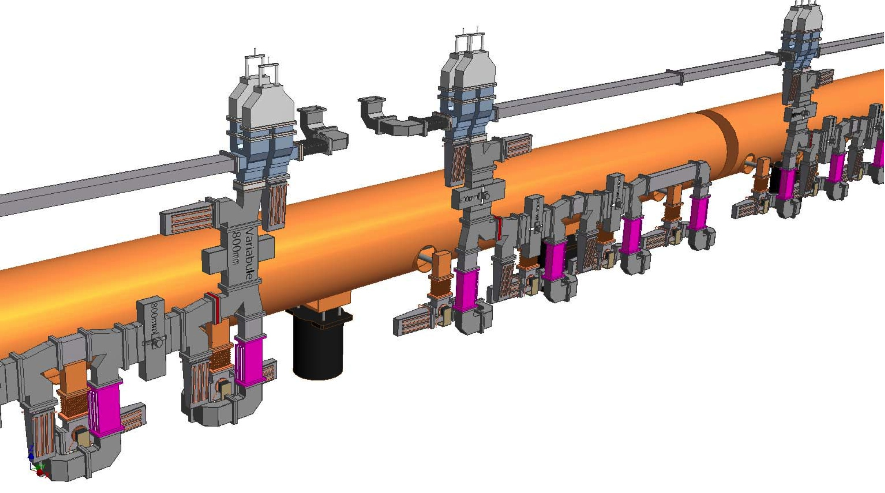
New TDR Baseline Local Power Distribution System
Variable double U-bend power tap-offs
RF power
Variable hybrids
Variable phase shifters
S. Fukuda / C. Nantista

Slide 7
KCS – global view
Cluster LLRF controller

Slide 8
KCS LLRF concept – local at RF unit
(local equipment, functionality is identical to RDR-like
Difference between KCS and DKS is the power delivery method
Local processing equipment

Slide 9
Technical Design Report outline
 | Part II: The ILC Baseline Reference | Page counts |  | Author
1 | Introduction and overview | 5
2 | General parameters and layout | 15
3 | SCRF Linac Technology | 39
 | Main linac top-level parameters and general layout |  | 2 | Adolphsen
 | Cavity performance and production specifications |  | 10 | Yamamoto
 | Cavity integration (couplers, tuners etc.) |  | 10 | Hayano
 | Cryomodule design including quadrupole and cryogenic systems |  | 10 | Perini
 | RF power source |  | 3 | Fukuda
 | Low-level RF control concept |  | 2 | Carwardine/Michizono
 | Cavity and cryomodule testing |  | 2 | Hayano
4 | Main linac layout for a flat topography | 7
 | Layout |  | 2 | Adolphsen
 | Klystron cluster scheme RF power distribution system |  | 4 | Nantista?
 | LLRF control for Klystron Cluster Scheme |  | 1 | Carwardine/Michizono
5 | Main linac layout for a mountain topography | 7
 | Layout |  | 2 | Adolphsen?
 | Distributed Klystron scheme power distribution system |  | 4 | Fukuda
 | LLRF control for Distributed Klystron Scheme (‘RDR-like’) |  | 1 | Carwardine/Michizono

Slide 10
Scope of LLRF sections
In Main Linac Technology (2 pages)
  LLRF system hardware functional description (1 page + diagram)
  LLRF system applications / functionality (1 page + diagram)
In ML for flat topography (1 page)
  LLRF system layout diagram
  Achieved LLRF performance
In ML for mountain topography (1 page)
  LLRF system layout diagram
  LLRF performance limitations due to large VS and long transport delays
  Global control at cluster level vs fast local processing at the CM
Only 4 pages allocated in total, so will need to be able to cite other papers, documents, etc for details
  What do we have that can be referenced?

Slide 11
List of functions / applications (from Julien Branlard)
Global (klystron-level applications)
  MIMO: second order dynamical regulator
  LFF: modifies FF to minimize repetitive controller error
  BLC: modifies FF to compensate beam loading
  BBF: modifies setpoints to minimize beam energy error
Local (cryomodule-level applications)
  Gradient limiter: truncate RF/acts on SP to lower cav. Grad.
  Quench detect: RF off at next pulse
  Auto Loaded-Q: set and monitor cav. QL
  Auto Pk/Ql control to flatten gradients
  Auto piezo setup: Lorentz force detuning compensation
  Energy optimizer: distribute energy losses to other stations
Operations: startup, shutdown, exception management,…

