Slide 1
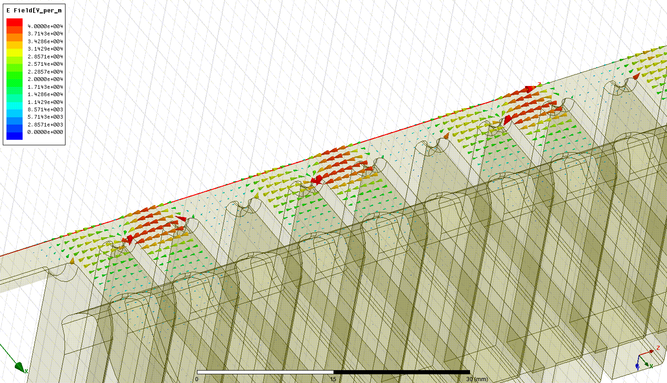
Acceleration!
Beam direction
By Alexej Grudiev

