Slide 1
Course B: rf technology
Normal conducting rf
Part 4a: Introduction to Wakefields
Walter Wuensch, CERN
Seventh International Accelerator School for Linear Colliders
1 to 4 December 2012

Slide 2
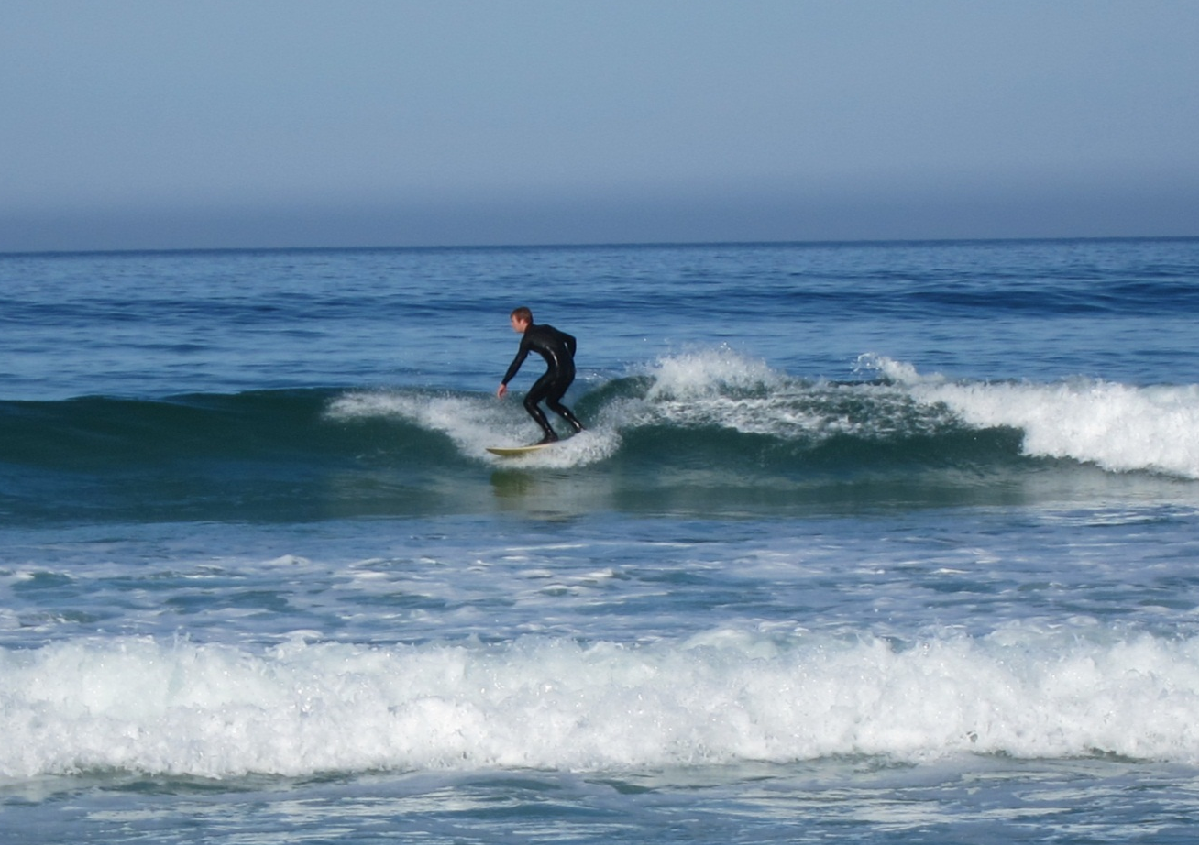

Wakefields
We will now discuss how charges, which travel through rf structures (and beam pipes with features) , leave behind fields and how these fields act on following charges.
In the previous section we restricted ourselves only to the interaction between a current and a single (the main one) mode of an rf structure. We focused on acceleration.
Now we will consider the interaction with many modes, in particular on transverse ones. We address for the purposes of studying beam stability. A beam picks up energy spread and transverse kicks from wakefields.

Slide 3
Basic assumptions
In this section we are going to consider only highly relativistic driving and following bunches:
using the (really good) approximation that v=c
that the beam trajectories through the structures we study are not affected by the fields, i.e. they follow straight unbendable lines
we will calculate the momentum “kicks” the particles are subject to and pass them on to the beam dynamics gang. They will deal with the trajectories on bigger scales through particle tracking.
This is a very special case of moving charges, radiated fields along with conductors – luckily for us the charge movement is fixed before hand and we only need to understand the fields.
This is for example not the case in the injector where the beam is not relativistic yet. There you need to solve field and particle trajectories self consistently using PIC (Particle In Cell) codes.

Slide 4
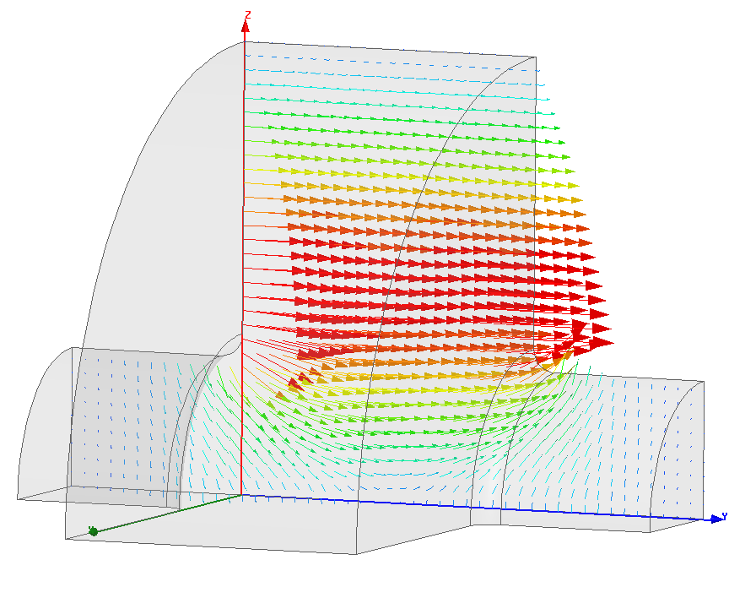
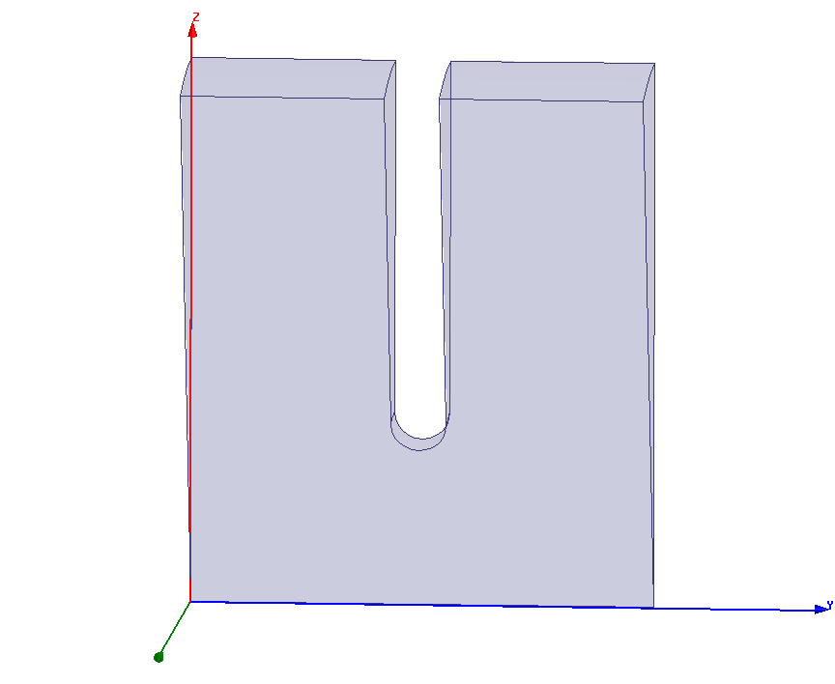
Two kinds of wakefields
We consider a train of bunches. Here a bunch acts on following bunches. We call this effect the long-range wakefield.
We often analyze this case by considering the series of modes the driving beam excites in the cavity or DLWG.
We consider a single bunch, and all real bunches have finite length. Here the head of the bunch acts on the tail of the bunch. We call this effect the short-range wakefield.
This one we analyze by considering the diffraction of the fields of the bunch from the discontinuities in the walls of our cavity or DLWG.

Slide 5
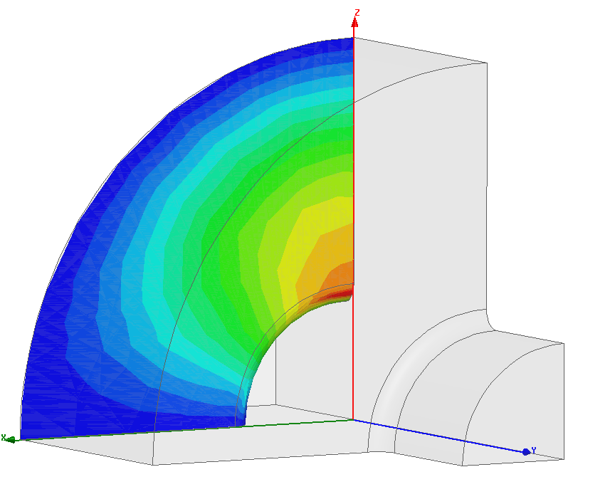
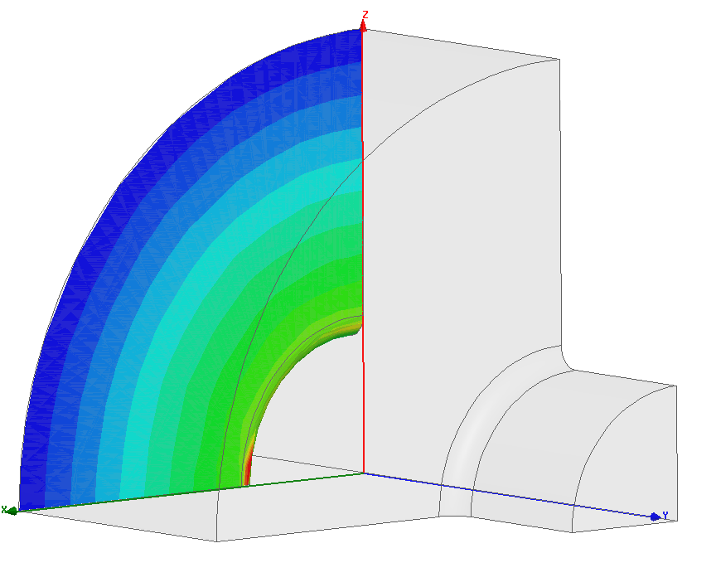
Another distinction among wakefields
Transverse wakefields – a radially offset bunch (head) excites azimuthally varying modes which gives a transverse momentum to following bunches (tail).
The induced kick is represented by the red arrow.
Longitudinal wakefields – a bunch (head) excites m=0 modes which gives an acceleration/deceleration momentum to following bunches (tail). We’ve already started working on this type of wakefield in section 2.

Slide 6
Actually solving something
These days there are a number of programs - GdfidL, Microwave Studio, ACE3P, HFSS - to get spectacularly accurate solutions for the wake potentials.
They operate mainly in time-domain, calculating fields step by step as the particle flies through the structure and doing for you the necessary integrals.
You can also use frequency domain codes to get detailed understanding of what’s happening to individual modes and do design work. There is also a rich history of semi-analytic methods like circuit models and mode matching techniques.
Still it is important to be familiar with the underlying theory in order to understand the results and what the origin of different features are.
I won’t be fully rigorous, there isn’t nearly enough time, but I’ll try to pick out the highlights of derivations and the characteristics for solutions for special cases.
In the next section we will study how to design a cavity to reduce wakefield effects.

Slide 7
We will now look at the ‘frequency spectrum’ of a finite length bunch.
Bunches in linear colliders are short – with a σ≅50 μm for CLIC
Radiation from bunches starts to be suppressed at frequencies where, roughly, the half wavelength is less than the bunch length.
This point is important since it puts an upper limit on the frequencies that we need to consider.
Let’s look at this question in a bit more detail.

Slide 8
The “pancake” field pattern of a relativistic point charge
Example: 1 TeV charge at 3 mm radius has field region only 6 nm to be compared to CLIC bunch length of roughly 100 μm.

Slide 9
Points to emphasize
No fields before or after charge - we do not need to consider direct charge-to-charge forces.
We need our conducting boundaries to communicate to following charges.
And of course it’s impossible to communicate forward, you’d have to go faster than the speed of light.
Because the ‘opening angle’ of the field of a relativistic beam is so narrow, our field pattern in free space exactly matches our bunch charge pattern for real linear collider type bunches.
Before we look at the excitations of modes, which have specific frequencies, let’s get a feeling for the frequencies a typical linear collider bunch contains.

Slide 10
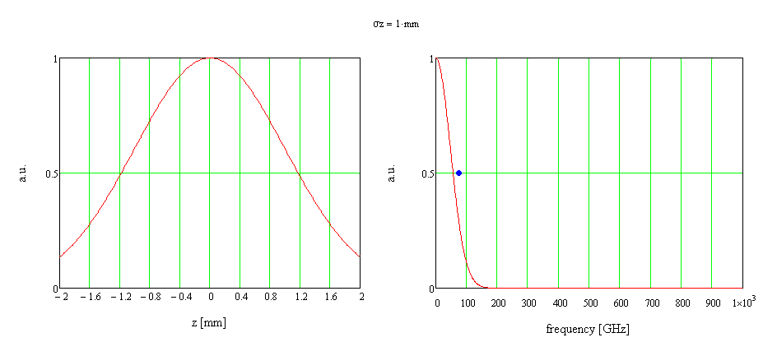
Frequency content of a Gaussian bunch
speed of light
Fourier transform
Blue dot is
Charge distribution
frequency distribution

Slide 11
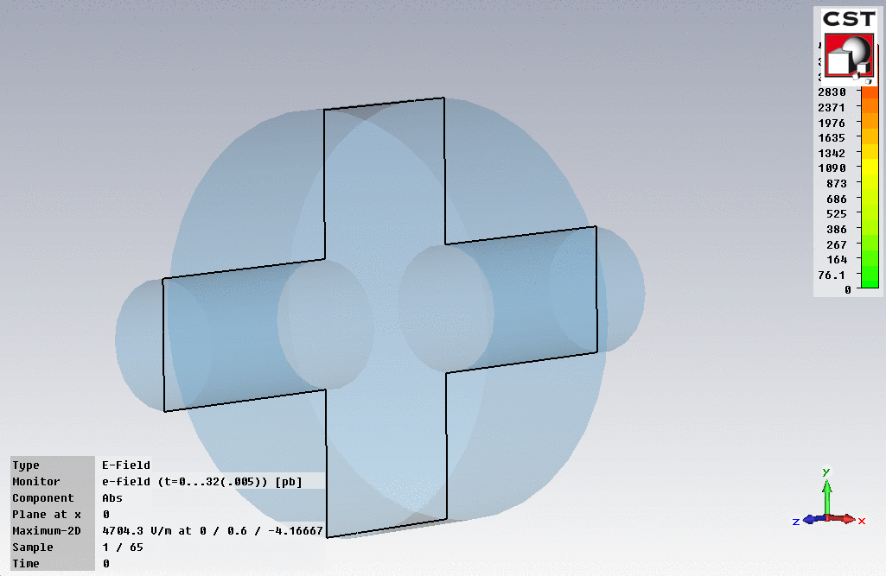
The fields left behind a finite length bunch

Slide 12
We are now going to introduce the idea of a wake potential.
This is the potential, measured in volts, a driving bunch leaves behind it, which is experienced by a witness charge.
In the standard formalism the bunches both travel at the speed of light, along straight lines parallel to the structure axis.
This is the information needed for beam dynamics simulations which calculate instabilities caused by charges acting on following charges.
The wake potential can be given for the whole of a finite length structure or per unit length for a infinitely long periodic structure.

Slide 13
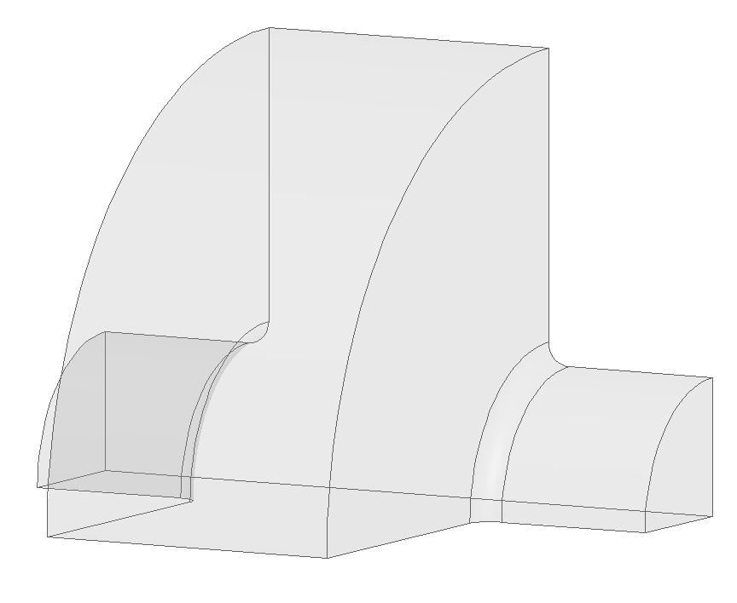
Our coordinate system
L
driving bunch
s
r
z
following bunch

Slide 14
The longitudinal wake potential
This the total voltage that is lost (or gained) by a test charge following a driving charge q at distance s.
It induces an energy spread in the beam which causes emittance growth through effects like chromaticity.
The wake potential is given by the integral of the fields that are left behind by a very short driving bunch,
distance
time

Slide 15
As we have seen, high frequency part of the wake will depend on how long the bunch is. It is cut-off at half-wavelengths which correspond to the bunch length.
This comes out rigorously because the delta wake-potential on the previous slide can then be used as a Green’s function to get the voltage loss/gain from a bunch of arbitrary shape by convoluting with the shape of the current,
Now we will look at how you would approach calculating the longitudinal wake for a resonant cavity which has lots of modes, and then look at a numerical example.

Slide 16
Longitudinal wake by expanding the normal modes in a cavity
Reminder from section 2, the loss factor from a mode λ is,
The total acceleration left behind in the mode is (the bunch sees half its own field),
To get the total wake potential we sum over all the modes (that is really about all there is to it),
The terms of the longitudinal wake are cosine-like, which is reasonable, because the driving bunch itself loses energy.

Slide 17
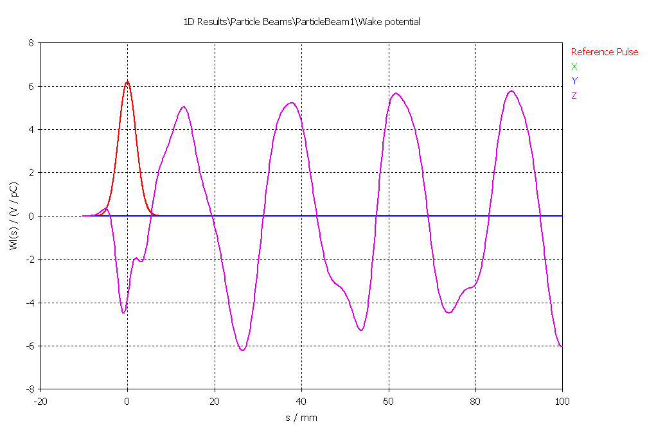
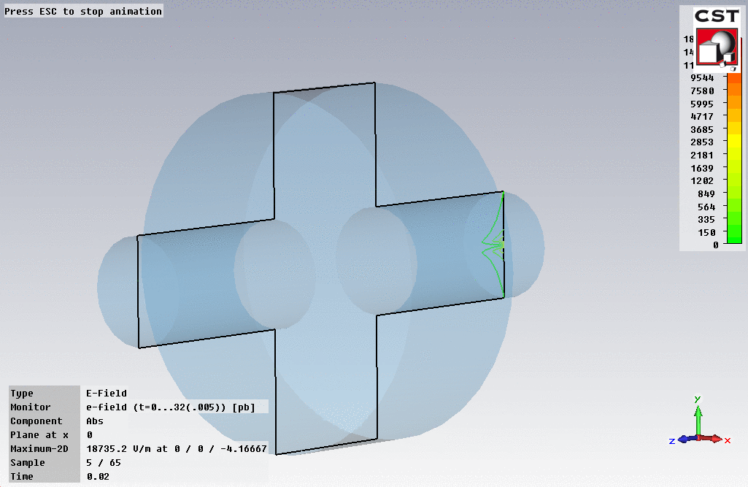
Longitudinal wake potential from in a pillbox cavity
σ=2 mm bunch
Philosophy: Here we see better where the fundamental theorem of beam loading is coming from

Slide 18
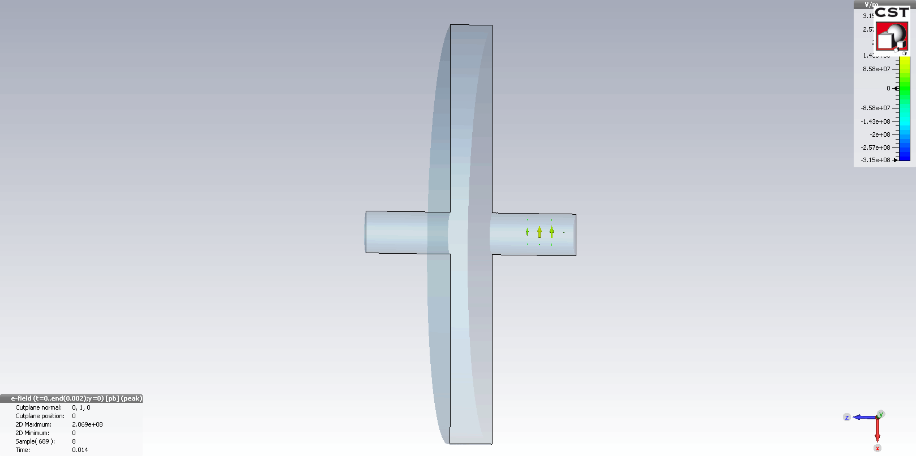
Longitudinal wake
Cavity:
r=10 mm radius
d=2 mm thick
Beam pipe:
1 mm radius
Beam:
σ = 0.5 mm

Slide 19
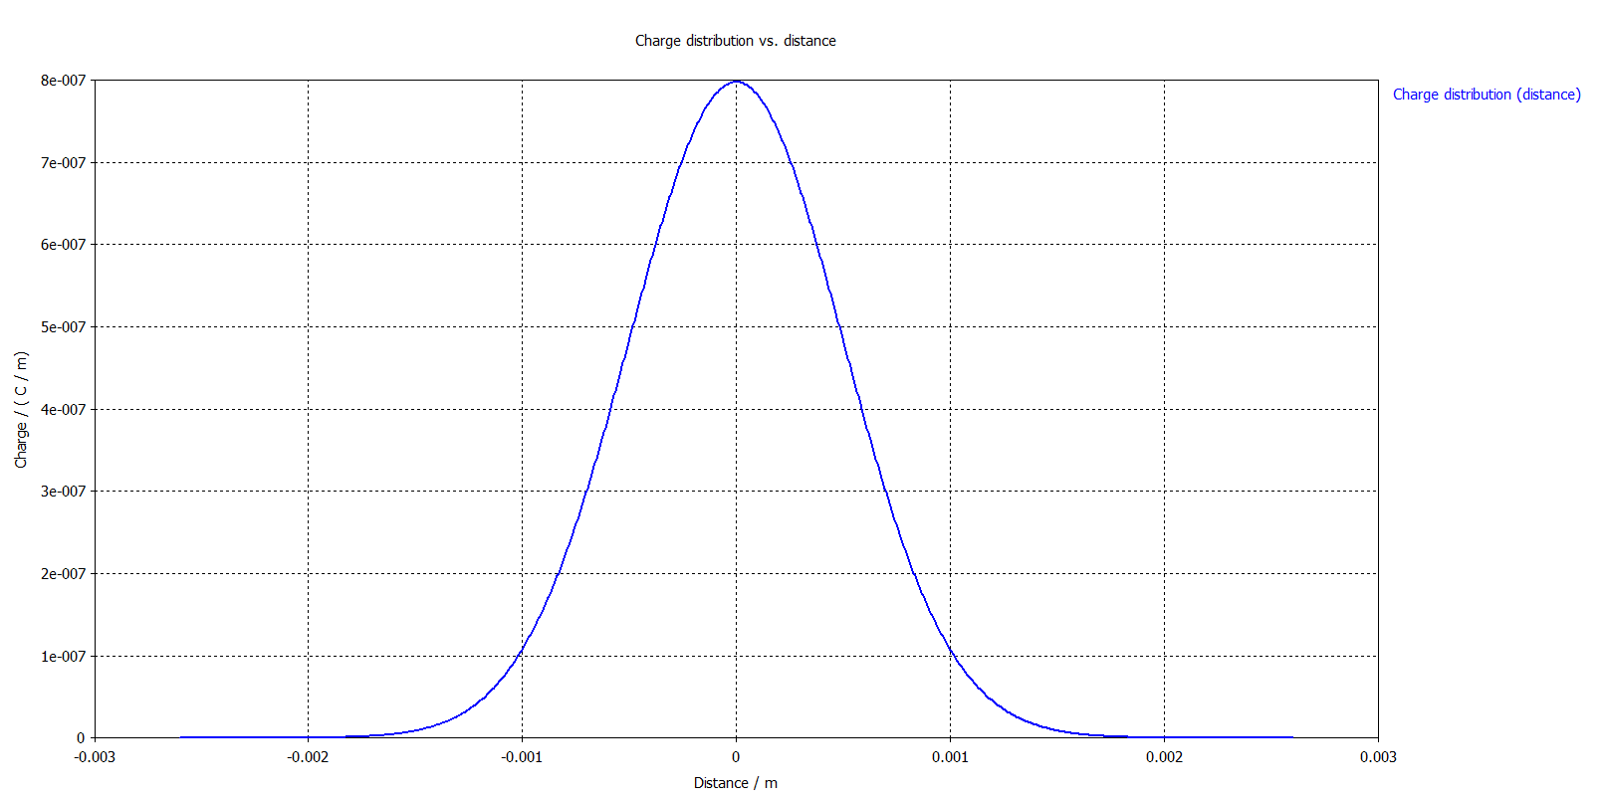
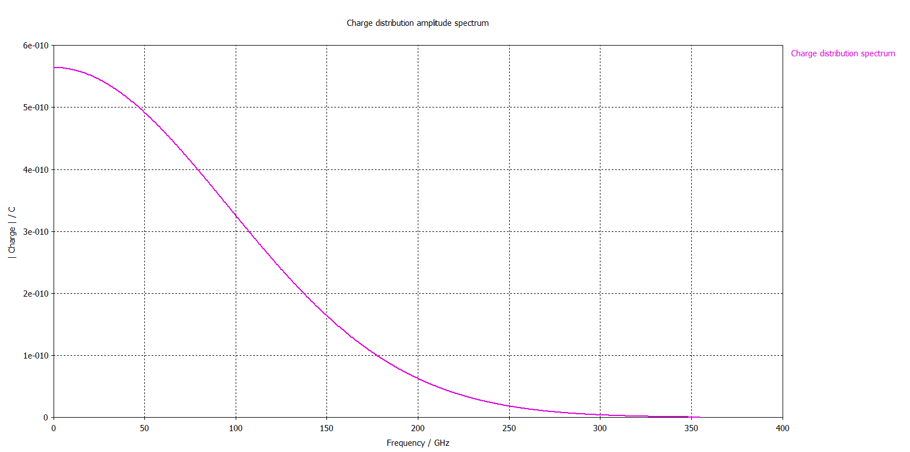

$$σ=0.5 mm$$

Slide 20
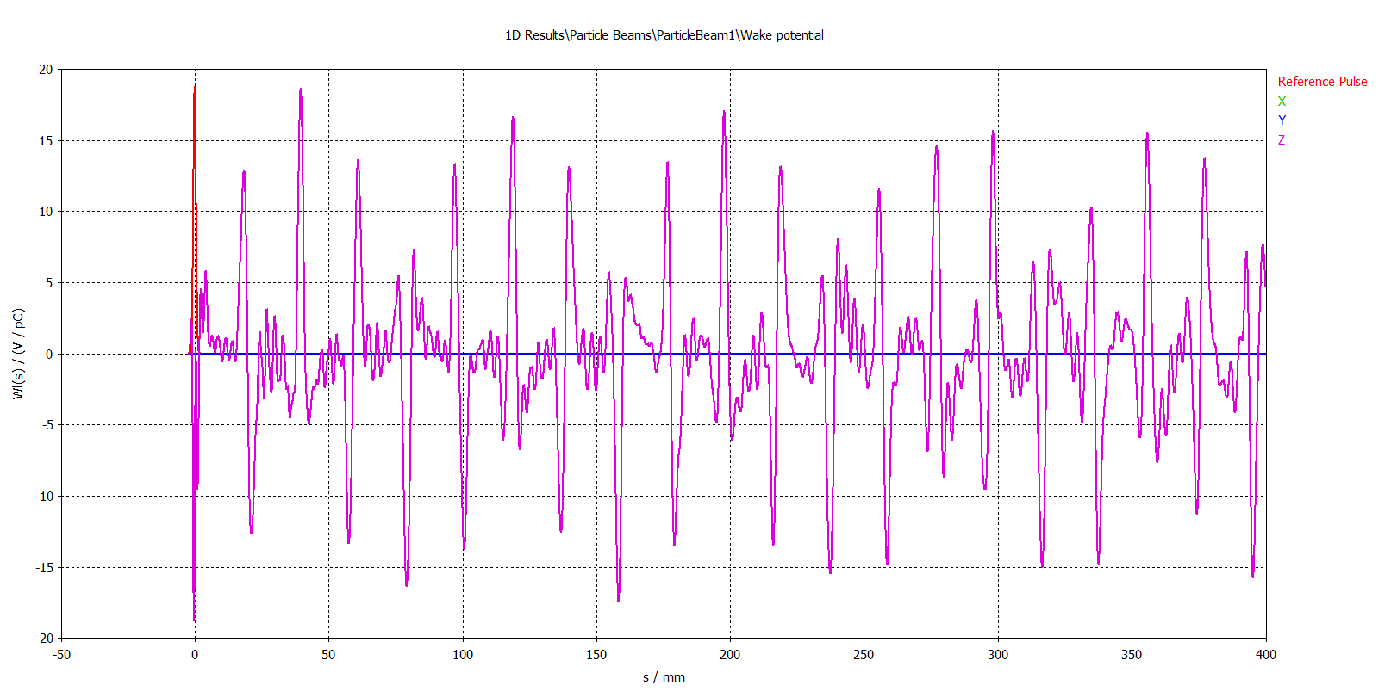
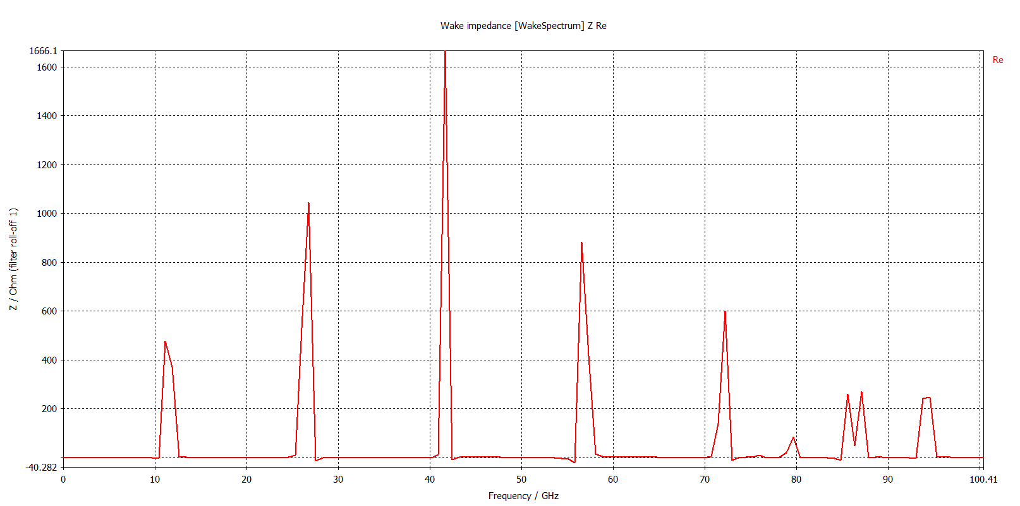

Slide 21
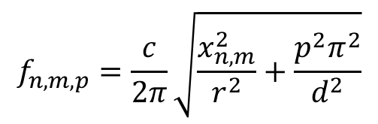
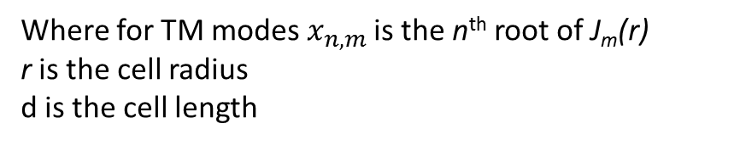
TM_{0,1,0}
TM_{0,2,0}
TM_{0,3,0}
TM_{0,4,0}
TM_{0,5,0}
TM_{0,6,0}
TM_{0,4,1}
TM_{0,1,1}
TM_{0,3,1}
Pillbox cavity
TM_{0,2,1}
$$f_{n,m,p}=\frac{c}{2π}\sqrt{\frac{x_{n,m}^{2}}{r^{2}}+\frac{p^{2}π^{2}}{d^{2}}}$$
Where for TM modes$x_{n,m}$ is the n^{th} root of J_{m}(r)
r is the cell radius
d is the cell length

Slide 22
Now the transverse wake potential
It tells us how a transversely offset bunches gives a transverse kick to following charges.
BUT this one is significantly trickier. We have seen how fields are excited as a function of offset and now we need to understand how they kick following bunches.
We already have all the formalism to deal with the excitation of the bunch, the loss factor k:
We just need to do the integral along a path with the correct transverse offset. k goes to being k(r,θ) .

Slide 23
The physics of how rf fields kick a particle is of course all completely contained in the Lorenz force,
But there is a simpler way of looking at the kick from rf cavities.
You can put in some properties which come from E and B being related through Maxwell’s equations,
and that we are considering the special case that v=c,
and derive something called the Panofsky-Wenzel theorem.

Slide 24
The Panofsky-Wenzel Theorem
We don’t have time to do the derivation, I will just state the result, and then we will look at the consequences of it in a couple of special cases.
The Panofsky-Wenzel theorem says that you can get the total transverse kick of an rf cavity by integrating the radial variation of the longitudinal acceleration,
The Panofsky-Wenzel theorem relates the transverse wake to changes in the longitudinal one.
It also tends to be computationally simpler than calculating the forces directly and can be very, very useful in quickly settling arguments with your colleagues. You can easily see what the fields will do.
Let’s look at some special cases to get a feeling for this equation.

Slide 25
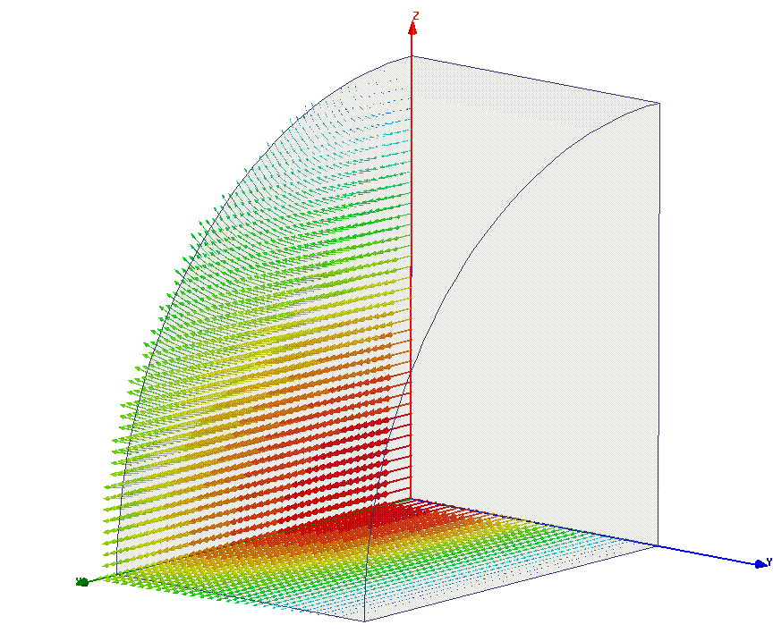
A surprise - the TE_{1,1,1} mode cannot kick the beam!
E fields on magnetic symmetry plane
H fields on electric symmetry plane
Because it has no longitudinal electric field so Panofsky-Wenzel says it won’t!
But certainly the transverse electric field must kick the beam?
You can look at the problem more closely and in this specific case convince yourself the magnetic field magnetic field cancels the kick from the electric field.
But it’s easier just to use the Panofsky-Wenzel theorem, no E_{z} so no variation in E_{z} so no kick!
E fields on magnetic symmetry plane

Slide 26
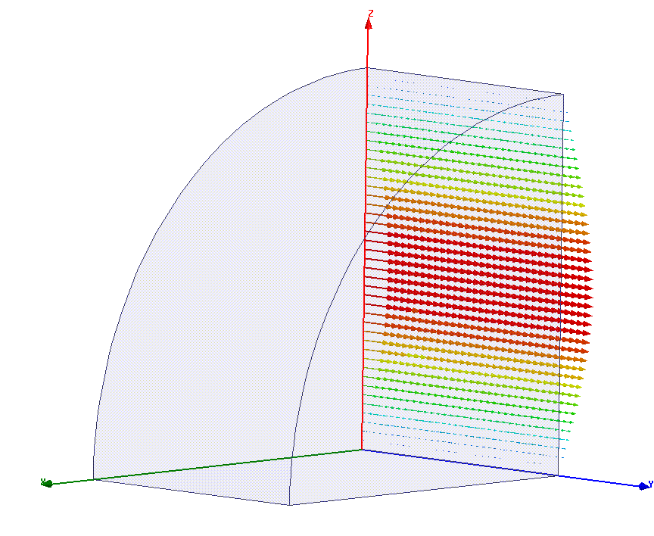
But the TM_{1,1,0} mode does deflect
H fields on conducting end wall
E fields on magnetic symmetry plane
There’s both E_{z} and a transverse gradient of it – hence the mode kicks the beam.
The excitation by the beam is proportional to E so increases ‘linearly’ with transverse offset.
This is the “cavity BPM” and “rf kicker” mode.

Slide 27
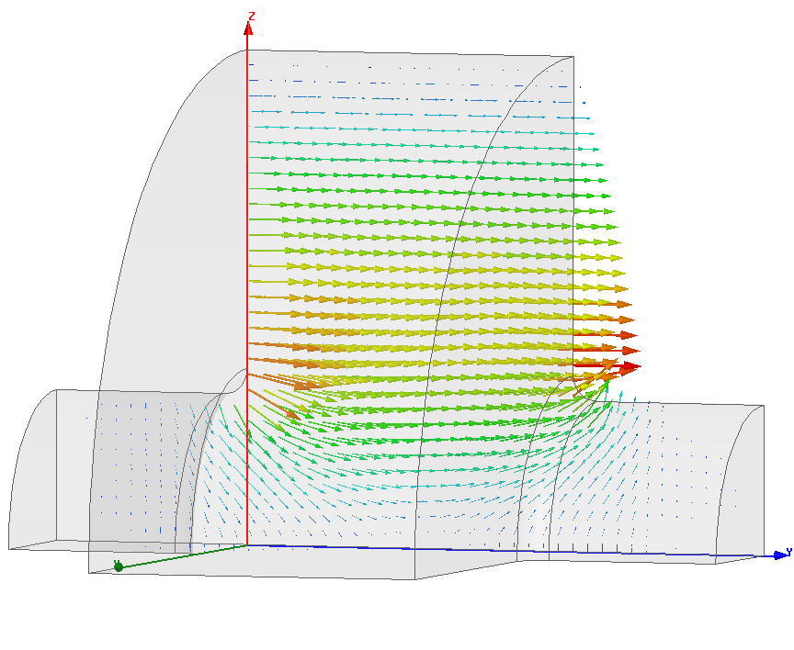
Now there’s an amazing thing about beam apertures.
It’s one of the rare occasions where a necessary, practical, feature (you’ve got to get the beam through the cavity) gives you a simplified behavior.

Slide 28
What do I mean by this?
Consider the acceleration by the TM_{0,1,0} mode in a pillbox cavity.
The field pattern is J₀, a Bessel function. Consequently you have a radial dependence of the integral and you expect to have rf (de)focusing.
BUT
over a circular beam aperture there is no variation of the integral of E_{z} so no focusing!
Why? I would need to study this proof more to be in a position to teach it… But the essential element is that with a beam pipe, the bunch does not cross any conducting charges. This means that there are conservation of flux integrals over volumes inside the beam aperture.
For the TM_{0,1,0} mode the flux lines in the center of the cavity only end on the cavity beam pipe, so you get the same projected and integrated E_{z} at all radii inside the beam pipe.

Slide 29
The consequence of this is that, for a circular geometry, with a circular beam pipe, you can expand the E_{z} integral as,
And the consequence of being able to expand the fields in such a way is that for modes with
m=0: The E_{z} integral is constant so no kick.
m=1: The E_{z} integral varies strictly linearly across the beam aperture
m=2: etc.
On the other hand if the beam aperture, or the cavity, is not circular then you cannot expand the fields like shown above and you get variation in r and θ. You can make a rf quadrupole from oval cells or apertures.

Slide 30
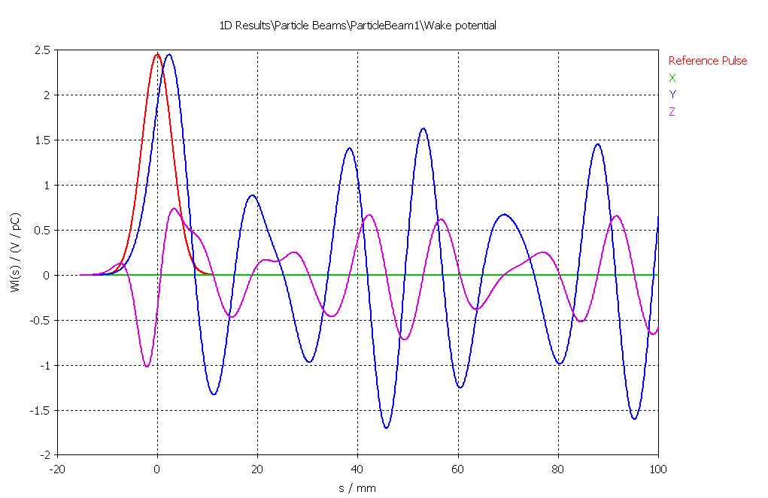
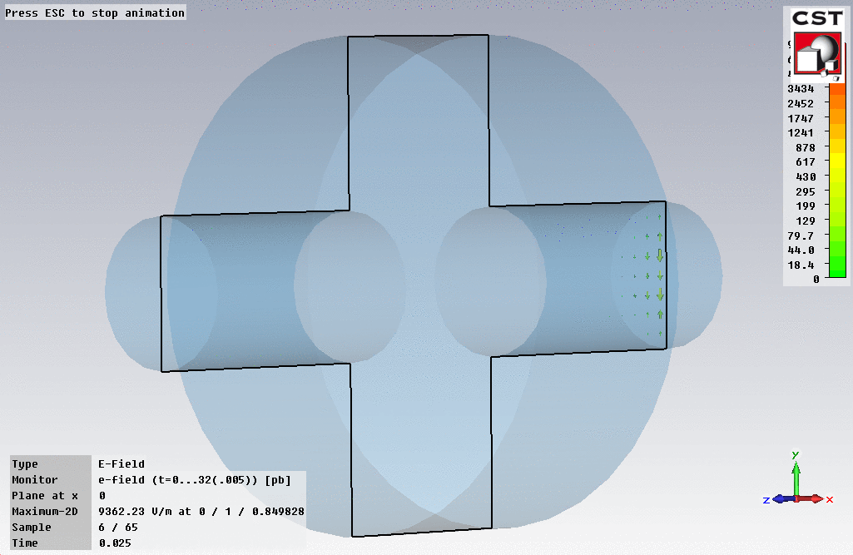
Transverse wake potential in pillbox cavity.
3 mm σ beam, 1 mm off-set

Slide 31
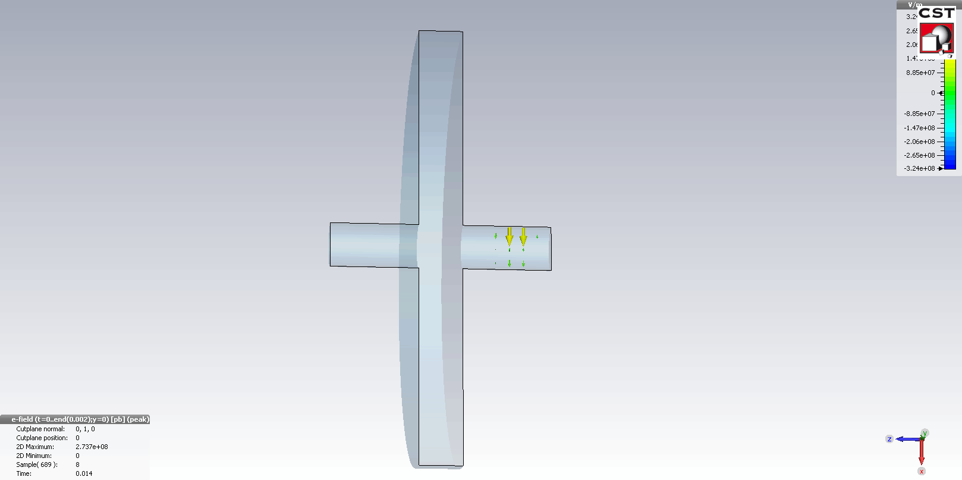
Transverse wake
Cavity:
10 mm radius
2 mm thick
Beam pipe:
1 mm radius
Beam:
σ = 0.5 mm
Offset 0.5 mm

Slide 32
$$σ=0.5 mm$$

Slide 33
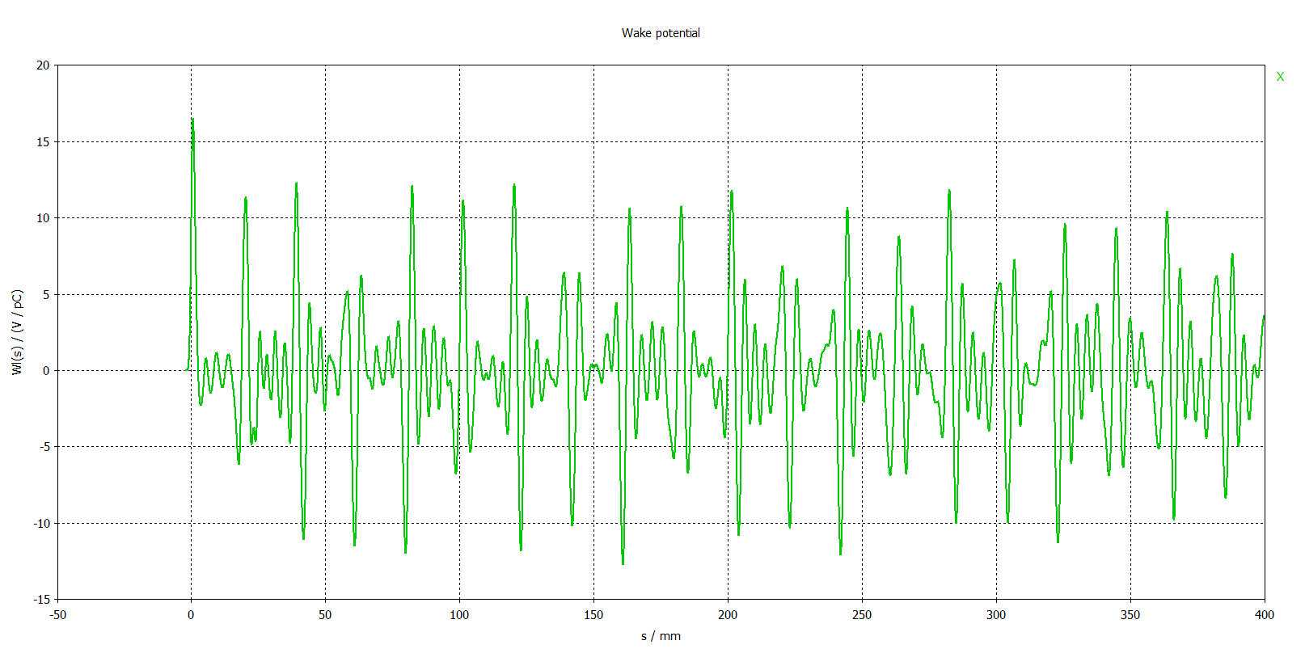
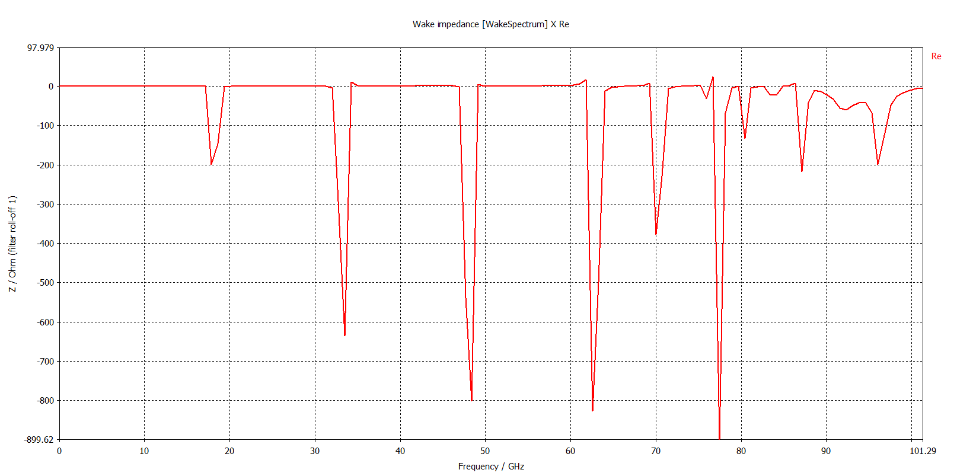

Slide 34
TM_{1,1,0}
TM_{1,2,0}
TM_{1,3,0}
TM_{1,4,0}
etc. – pillbox does not include beam pipe.
Pillbox cavity
$$f_{n,m,p}=\frac{c}{2π}\sqrt{\frac{x_{n,m}^{2}}{r^{2}}+\frac{p^{2}π^{2}}{d^{2}}}$$
Where for TM modes$x_{n,m}$ is the n^{th} root of J_{m}(r)
r is the cell radius
d is the cell length

Slide 35
The most important special case
Circularly symmetric structure.
Small offsets so the transverse wake potential is dominated by dipole, m=1, modes.
We can write the transverse wake potential as
a is beam pipe diameter
r is particle path
One radial variation due to longitudinal wake.

Slide 36
And of course wake for a finite length bunch is the convolution with the delta function wake:

Slide 37
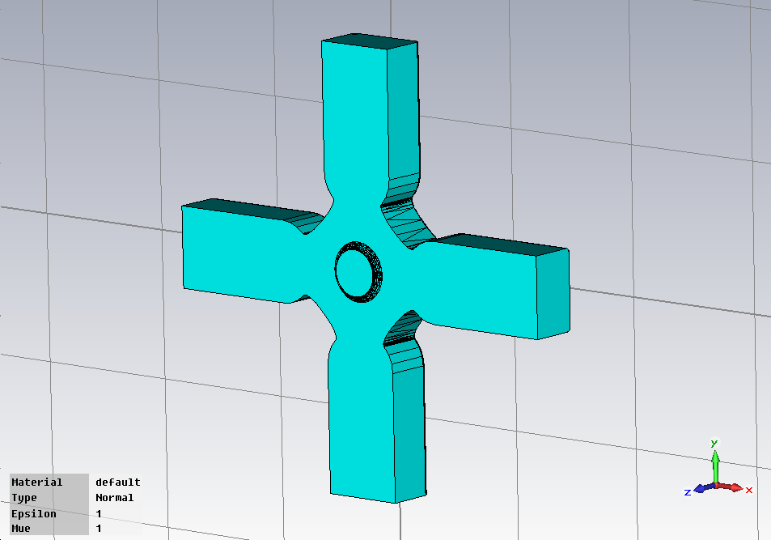
In the next section we will discuss higher-order-mode suppression and one of the techniques is to lower the Q of dipole modes. The geometry looks typically like this:
The figures in the next three slides are from Giovanni De Michele.

Slide 38
The wakefield from such a structure looks like calculated in the time domain:
Exponential decay of wake

Slide 39
In such a case it becomes important to describe the wake as an impedance spectrum, not just as a sum of modes.
real
imaginary

