Slide 1
Damping Rings and Ring Colliders
Introduction to Damping Rings
S. Guiducci, INFN-LNF
Seventh International Accelerator School for Linear Colliders
Hosted by Raja Ramanna Centre for Advanced Technology
4 December 2012

Slide 2
Outline
A3.1 - DR Basics: Introduction to Damping Rings
  Role of the damping rings in the ILC accelerator complex
  Review parameters and constraints of CLIC and ILC damping rings
  Identify key challenges
A3.2 - DR Basics: General Linear Beam Dynamics
  Review the basic physics of storage rings including the linear beam dynamics
A3.3 - LER Design: Radiation Damping and Equilibrium Emittance
  Radiation Damping and Synchrotron Motion
  Quantum Excitation and Equilibrium Emittance
  Summary of Beam Parameters and Radiation Integrals
A3.4 - LER Design: Damping Ring Lattices
  ILC Damping Ring Design Optimization
  The ILC DR Lattice, Parameters and Design Choices
  CLIC Damping Ring Design Optimization
  The CLIC DR Lattice, Parameters and Design Choices
These slides have been presented at the 2010 LC school by Mark Palmer with a few additions and updates by myself

Slide 3
Outline (contd)
A3.5 – DR Technical systems
  Review technical challenges of ILC and CLIC DR
  Vacuum system and e-cloud mitigations
  Damping wigglers
  Injection/extraction kickers
A3.6 – Beam Dynamics
  Overview of Impedance and Instability Issues
  Review of Selected Collective Effects
A3.7 – R&D Challenges and Test Facilities
  CESR-TA
  ATF
A3.8 – Circular Colliders
  Basics of circular colliders
  Luminosity and tune shifts
  Beam lifetimes
  Challenges of future colliders

Slide 4
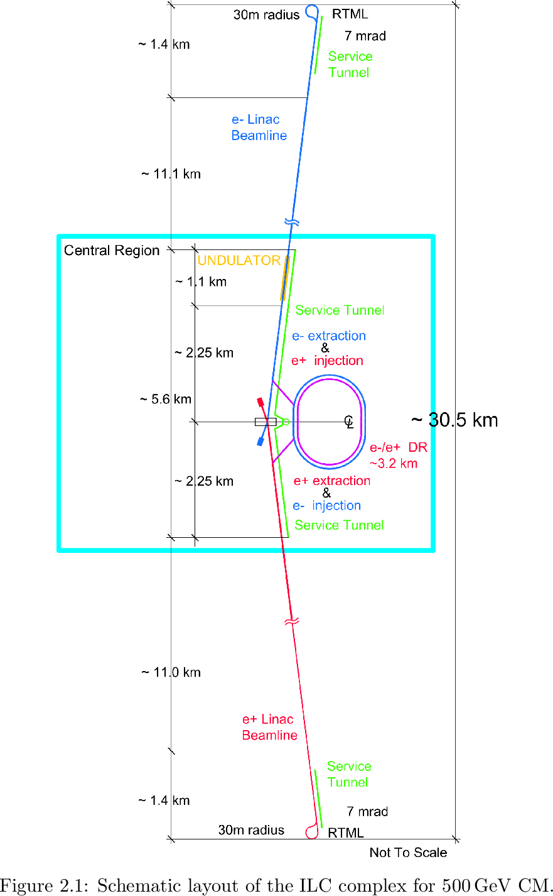
Role of the Damping Rings
The damping rings
  Accept e⁺ and e⁻ beams with large transverse and longitudinal emittance and produce the ultra-low emittance beams necessary for high luminosity collisions at the IP
  Damp longitudinal and transverse jitter in the incoming beams to provide very stable beams for delivery to the IP
  Delay bunches from the source to allow feed-forward systems to compensate for pulse-to-pulse variations
ILC RDR Layout a

Slide 5
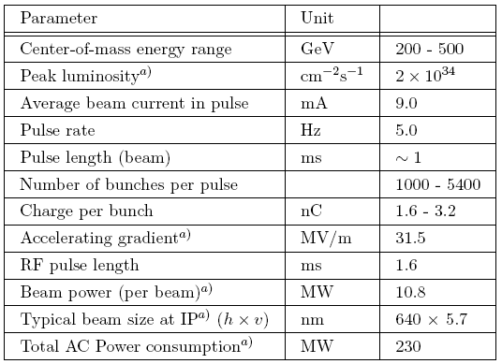
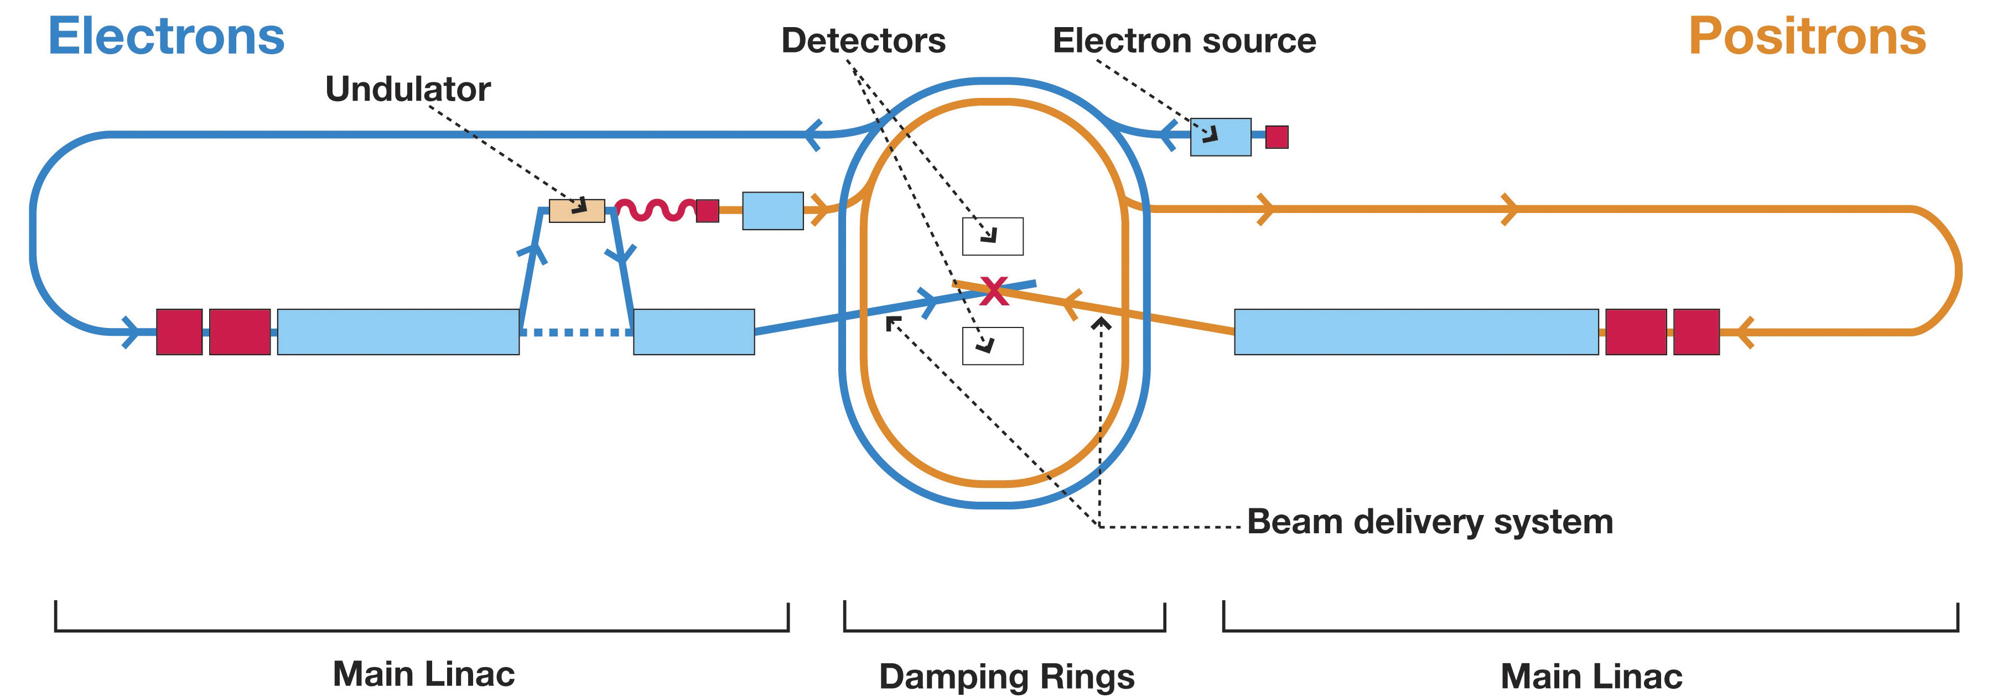
The ILC Reference Design
Machine Configuration
  Helical Undulator polarized e⁺ source
  Two ~6.5 km damping rings in a central complex
  RTML running length of linac
  2 ×11.2 km Main Linac
  Single Beam Delivery System
  2 Detectors in Push-Pull Configuration
~8K cavities/linac operating @ 2°K
Bunch Compressors
~31 km

Slide 6
DR Reference Design Parameters
By the end of the first 2 days of lectures, the goal is for each of you to be able to explain the reasons that the parameters in this table have the values that are specified.
Caveat: Some parameters have
already been changed
By the end of the DR lectures, you should be able to identify and explain why several of these parameters are (or already have been) candidates for further optimization.
So, let’s begin our tour of ring dynamics and what these parameters mean…
Parameter | Units | Value
Energy | GeV | 5.0
Circumference | km | 6.695
Nominal # of bunches & particles/bunch |  | 2625@2.0×10¹⁰
Maximum # of bunches & particles/bunch |  | 5534@1.0×10¹⁰
Average current | A | 0.4
Energy loss per turn | MeV | 8.7
Beam power | MW | 3.5
Nominal bunch current | mA | 0.14
RF Frequency | MHz | 650
Total RF voltage | MV | 24
RF bucket height | % | 1.5
Injected betatron amplitude, A_{x}+ A_{y} | m·rad | 0.09
Equilibrium normalized emittance, γε_{x} | μm·rad | 5.0
Chromaticity, χ_{x}/χ_{y} |  | -63/-62
Partition numbers, J_{x} J_{y} J_{z} |  | 0.9998 1.0000 2.0002
Harmonic number, h |  | 14,516
Synchrotron tune, ν_{s} |  | 0.067
Synchrotron frequency, f_{s} | kHz | 3.0
Momentum compaction, α_{c} |  | 4.2 × 10⁻⁴
Horizontal/vertical betatron tunes, ν_{x}/ ν_{y} |  | 52.40/49.31
Bunch length, σ_{z} | mm | 9.0
Momentum spread, σ_{p}/p |  | 1.28 × 10⁻³
Horizontal damping time, τ_{x} | ms | 25.7
Longitudinal damping time, τ_{z} | ms | 12.9

Slide 7
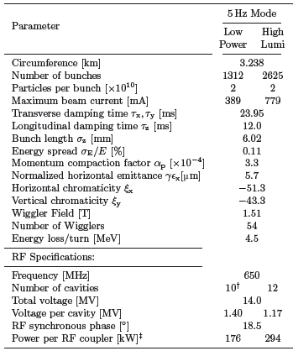
DR Reference Design Parameters
By the end of the first 2 days of lectures, the goal is for each of you to be able to explain the reasons that the parameters in this table have the values that are specified.
Caveat: Some parameters have
already been changed
By the end of the DR lectures, you should be able to identify and explain why several of these parameters are (or already have been) candidates for further optimization.
So, let’s begin our tour of ring dynamics and what these parameters mean…
UPDATED
TDR Parameters - 2012

Slide 8
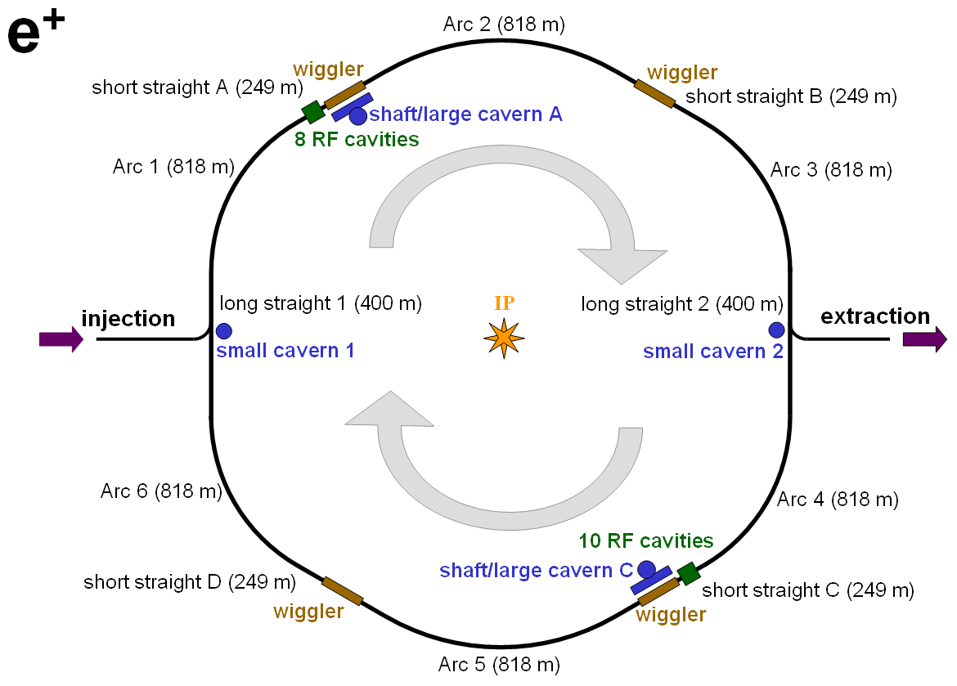
The RDR Damping Ring Layout
OCS6 TME-style Lattice

Slide 9
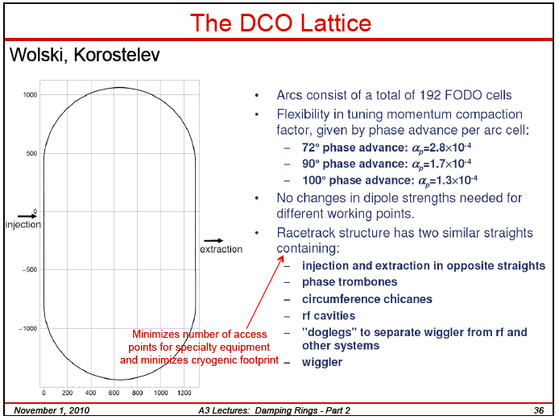
2008 Baseline Lattice - 6.5 km

Slide 10
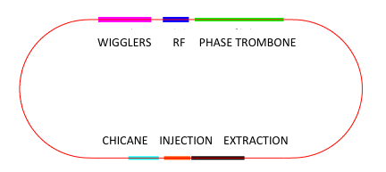
The TDR Damping Ring Layout
DTC4 – TME style lattice
Circumference 3.2 km
Same layout as DCO lattice
700 m

Slide 11
ILC Damping Ring Design Inputs
A number of parameters in the previous table are (essentially) design inputs for the damping rings (or can be directly inferred from such inputs). The table below summarizes these critical interface issues. (aUpdated TDR values)
We will examine these requirements from the perspective of the collision point first and then look at requirements coming from other sub-systems downstream and upstream of the DRs.
Don’t forget, however, that these parameters are the result of a great deal of back-and-forth negotiation between sub-systems and between accelerator and HEP physicists. Thus they represent a mix of technological limits and physics desires…
Particles per bunch | 1×10¹⁰ - 2×10¹⁰ | Upper limit set by disruption at IP.
Max. Avg. current in main linac | ~9 mA | Upper limit set by RF technology.
Machine repetition rate | 5 Hz | Set by cryogenic cooling capacity. Partially determines required damping time.
Max. Linac RF pulse length | ~1 ms | Upper limit set by RF technology.
Min. Particles per machine pulse | ~5.6×10¹³ | Lower limit set by luminosity goal.
Injected normalized emittance | 0.01 m-rad (a0.008 m-rad ) | Set by positron source. Partially determines required damping time.
Injected energy spread | ±0.5% rad (a±0.75% rad ) | Set by positron source.
Injected betatron amplitude (A_{x}+A_{y}) | 0.09 m-rad (a0.07 m-rad ) | Set by positron source.
Extracted normalized emittances | 8 μm horizontally 20 nm vertically | Set by luminosity goal.
Max. Extracted bunch length | 9 mm (a6 mm) | Upper limit set by bunch compressors.
Max. Extracted energy spread | 0.15% | Upper limit set by bunch compressors.

Slide 12
Downstream Requirements
The principle parameter driver is the production of luminosity at the collision point
where
N is the number of particles per bunch (assumed equal for all bunches)
f_{coll} is the overall collision rate at the interaction point (IP)
σ_{x} and σ_{y} are the horizontal and vertical beam sizes (assumed equal for
all bunches)
H_{D} is the luminosity enhancement factor
Ideally we want:
  High intensity bunches
  High repetition rate
  Small transverse beam sizes
Notes:
Disruption enhancement factor has a value around 1.5 for the ILC

Slide 13
Parameters at the Interaction Point
The parameters at the interaction point have been chosen to provide a nominal luminosity of 2×10³⁴ cm⁻²s⁻¹. With
  N = 2×10¹⁰ particles/bunch
  σ_{x} ~ 640 nm ⇔ β_{x}* = 20 mm, ε_{x} = 20 pm-rad
  σ_{y} ~ 5.7 nm ⇔ β_{y}* = 0.4 mm, ε_{y} = 0.08 pm-rad
  H_{D}~ 1.7
In order to achieve the desired luminosity, an average collision rate of ~14kHz➔9kHz is required (we will return to this parameter shortly). The beam sizes at the IP are determined by the strength of the final focus magnets and the emittance, phase space volume, of the incoming bunches.
A number of issues impact the choice of the final focus parameters. For example, the beam-beam interaction as two bunches pass through each other can enhance the luminosity, however, it also disrupts the bunches. If the beams are too badly disrupted, safely transporting them out of the detector to the beam dumps becomes quite difficult. Another effect is that of beamstrahlung which leads to significant energy losses by the particles in the bunches and can lead to unacceptable detector backgrounds. Thus the above parameter choices represent a complicated optimization.
  TDR UPDATE
  σ_{x} ~ 474 nm ⇔ β_{x}* = 11 mm, ε_{x} = 20 pm-rad
  σ_{y} ~ 5.9 nm ⇔ β_{y}* = 0.48 mm, ε_{y} = 0.07 pm-rad
  H_{D}~ 2

Slide 14
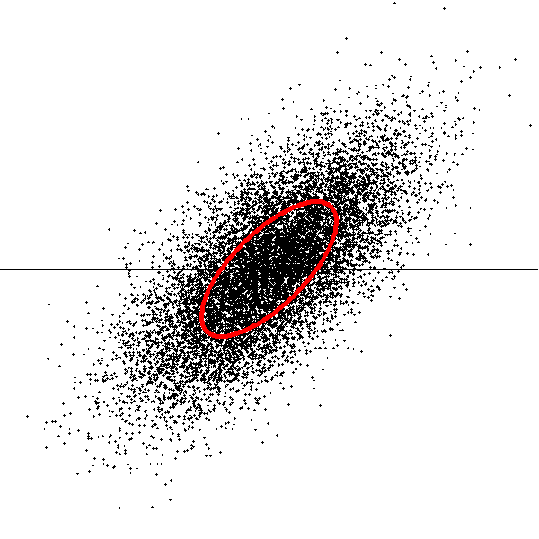
Emittance Transport from the DR to the IP
The geometric emittances required at the IP are:
  ε_{x} = 20 pm-rad
  ε_{y} = 0.08 pm-rad
We need to use the relativistic invariant quantity, the normalized emittance, in order to project this to the requirements for the damping ring.
  Note: We will take a more detailed look at emittance in the DR in tomorrow’s lecture
Twiss parameter
x
Normalized Emittance:
Use of the conjugate phase-space coordinates (x,p_{x}) from the Hamiltonian instead of (x,x′) gives:
  p_{x} = px′ = mcβγx′
Thus we define the normalized emittance as
  ε_{n} = βγε_{geo} ≈ γε_{geo} for a relativistic electron
longitudinal
acceleration

Slide 15
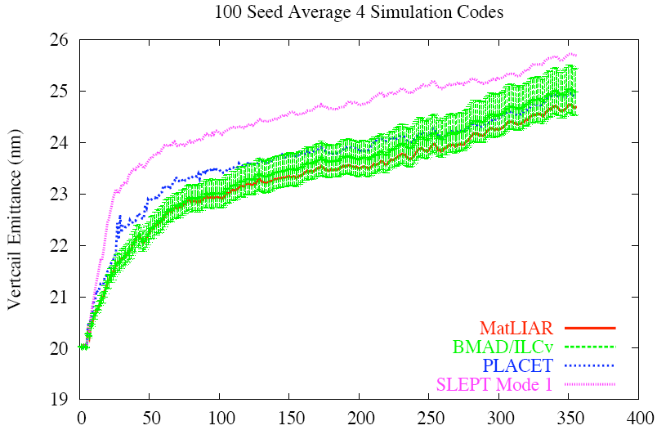
Emittance Transport from the DR to the IP
We can now infer the requirements for the equilibrium emittance requirements for the ILC DRs
DR extracted emittances must
allow for downstream
emittance growth during
transport as well as for the
finite damping time during the
machine pulse cycle
 | ε_{geo} @ IP (250 GeV) | ε_{n} @ IP | Equilibrium ε_{n} @ DR | Equilibrium ε_{geo} @ DR (5 GeV)
x | 20 pm-rad | 10 μm-rad | ½ × (10 μm-rad) | 0.5 nm
y | 0.08 pm-rad | 40 nm-rad | ½ × (40 nm-rad) | 2 pm
Allow for 100% vertical emittance growth downstream of DRs
LET Benchmarking (J. Smith)
BMAD/ILCv curve shows error bars

Slide 16
ILC Main Linac (ML) Parameters
The bunch-train structure is largely determined by the design of the superconducting RF system of the main linac (ML)
  1 ms (a0.7 ms) RF pulse
  9 mA (a5.8 mA) average current in each pulse
  5 Hz repetition rate
This leads to the nominal bunch train parameters:
  n_{b} = 2625 (a1312) bunches per pulse
  Δt_{b} ~ 380 ns (a554 ns) for uniform loading through pulse
The resulting collision rate at the IP is then
  f_{coll} = 13.1 kHz (a7 kHz)
consistent with the target luminosity. The 5 Hz repetition rate places the primary constraint on the DR damping times. In order for the bunches in each pulse to experience 8 full damping cycles, a transverse damping time of ≤25 ms is required.
Primary Limitation
RF power system
Cryogenic load

Slide 17
Baseline Bunch Train
From the discussion on the preceding page, we can now see
the basic bunch train structure
  1 msec pulse
  ~3000 uniformly spaced bunches (a1312)
  ~350 ns between bunches (a554 ns) (TDR a 220 km)
a
Thus, the damping rings must act as a reservoir to store the full train. Because we cannot afford to build a 300+ km ring, we must fold the long bunch train into a much shorter ring a key trade-offs between bunch spacing and ring circumference.
Note that (for the RDR baseline) there will be significant overlap between the injection and extraction cycles:
  Structure of machine
  Maintain relatively constant beam loading
Injection Systems
DR
Extraction to RTML

Slide 18
Bunch Compressors
Shortly after extraction from the damping ring, the bunches will traverse the bunch compressors. These devices take the relatively long bunches of the damping rings (σ_{z} ∼ fraction of a centimeter) and manipulate the longitudinal phase space to provide bunches that are compatible with the very small focal point at the IP (σ_{z} ∼ 200-500 microns). Technical and cost limitations place serious constraints on how long the bunch from the DR can be and the maximum energy spread.
  RDR DR Bunch length: 9 mm a 2-stage bunch compressor
  Extracted energy spread within the bunch compressor acceptance
  From the downstream point of view, lowering the bunch length to
  6mm would allow the cheaper and simpler solution of using a single stage
  bunch compressor. From the DR point of view, shorter bunches require
  smaller values of the ring momentum compaction (impacts sensitivity to
  collective effects) or higher RF voltage (more RF units, hence greater cost).

Slide 19
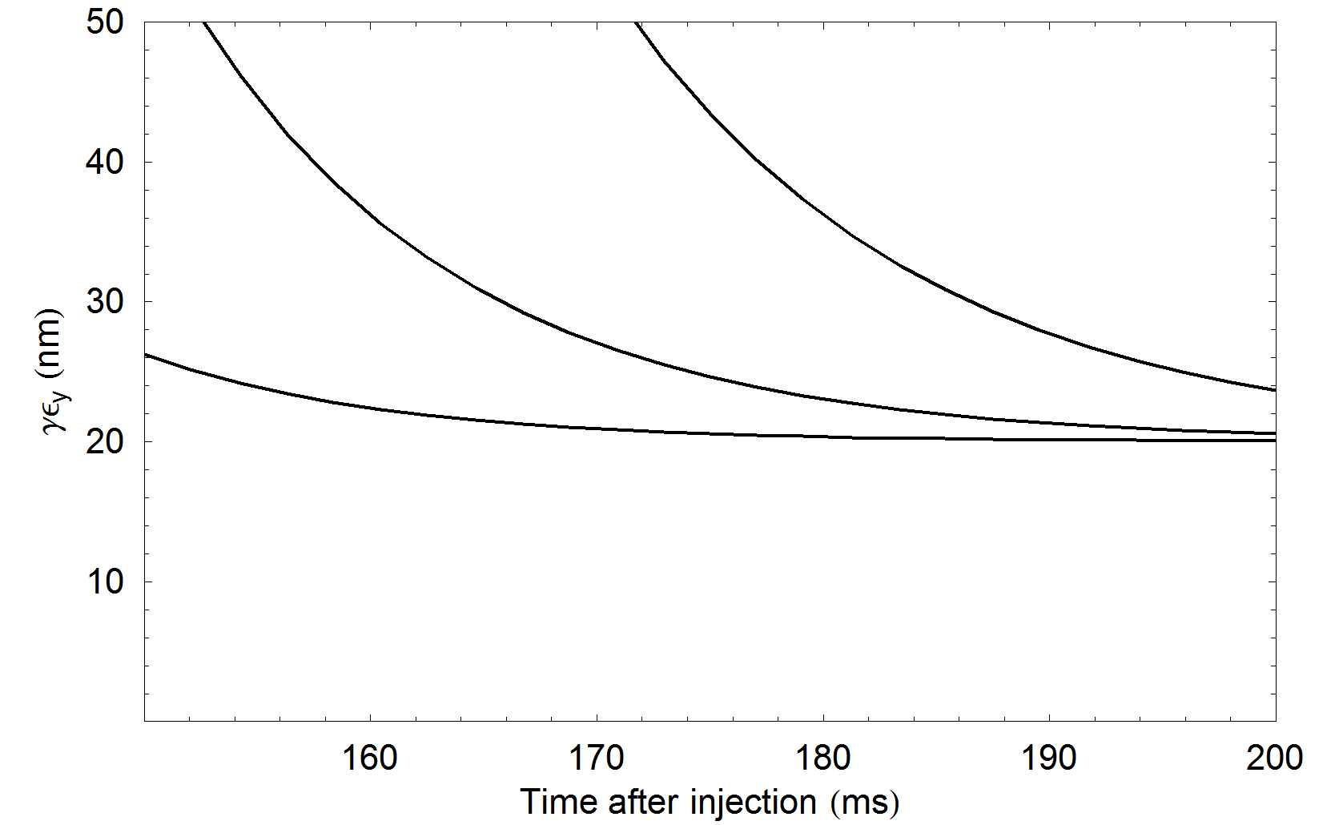
Upstream Requirements
The key upstream requirement is the emittance of the beams produced by the injectors. Positron production via a heavy metal target results in much larger emittances due to scattering in the target for positrons than for electrons whose emittance can be controlled by the design of the injector gun and its cathode. The approach to the target extraction emittance is shown for various DR damping times assuming the target e⁺ injected emittance (ε_{n} = 0.01 m-rad).
t/τ
200/27 = 7.4
200/24 = 8.3
200/21 = 9.5
27 ms
24 ms
τ = 21 ms

Slide 20
Upstream Requirements
In addition to the need to damp the large emittance beams that are injected from the positron source, the injected beams are expected to have potentially large betatron amplitudes and energy errors. This requires that the acceptance of the damping ring to be sufficiently large to accommodate these oscillations immediately after injection. It places important constraints on the minimum aperture of the vacuum system and the minimum good field regions of all of the magnets (including the damping wigglers).
From DR Baseline Configuration Study
Particle capture rates assuming that the limiting physical aperture in the damping rings is due to the vacuum chambers in the wiggler regions. The choice of a superferric wiggler design, with large physical aperture, allows for a DR design with full acceptance.

Slide 21
Arriving at a design
We have now looked at several interface issues between the damping rings and the rest of the accelerator complex
  Train structure
  Equilibrium emittance requirements
  Bunch length requirements
  Acceptance of ring
  Timing structure
There are various choices that can be made to design a ring at this point
  The choices typically have a myriad of trade-offs
  Will look at a few examples to understand the design evaluations that are required
  Design choices must be carefully matched to likely paths of evolution of the overall machine design

Slide 22
Optimization Issues - I
Optimization is complicated. Many decisions are tightly coupled and many trade-offs are required.
Example 1: Ring Circumference
  Large circumference a space charge effects are more severe
  If space charge effects are significant a a higher energy is desirable
  Higher energy a larger equilibrium emittance
  Control of equilibrium emittance a significant impacts on ring design
  Small circumference a fewer components and smaller tunnel so cheaper and potentially better net hardware reliability
  Small circumference a folding of linac bunch train into ring requires more closely spaced bunches
  Closely spaced bunches a more challenging bunch-by-bunch injection and extraction
  Closely spaced bunches a electron cloud and fast ion effects more severe
Notes:
Will come back to these issues tomorrow…

Slide 23
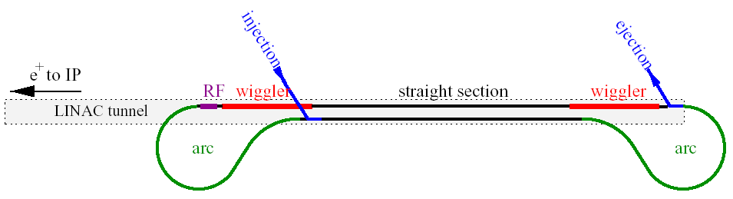
Lattice evolution
2005 TESLA dogbone
17 km
2007 RDR OCS6
6.5 km
2011 DTC04
3.2 km

Slide 24
Optimization Issues - II
Example 2: Beam Energy
  Higher energy a sensitivity to collective effects is lessened (beam instabilities, intrabeam scattering, space charge, etc)
  Higher energy a damping rates increase from the increased synchrotron radiation
  Higher energy a for a given normalized emittance from the sources, the beam is smaller due to adiabatic damping from the initial beam acceleration and the ring acceptance issues are eased
  Lower energy a in the limit of small enough bunch charge, this provides a smaller equilibrium emttance
  Lower energy a weaker magnets and lower field RF cavities to focus the beam, hence cheaper (and often more reliable) hardware
Notes:
Will come back to these issues tomorrow…

Slide 25
Optimization Issues - III
Example 3: Technical Contraints: High Voltage Kickers
  Wide kicker pulse a typically more stable, hence better for uniform injection/extraction
  Wide kicker pulse a requires a large ring circumference to allow bunch-by-bunch injection and extraction (bunch spacing)
  Wide kicker pulse a relatively fewer kicker structures (matched to pulse width) will be required in the ring (minimize impedance issues, improve reliability, minimize cost)
  Wide kicker pulse a works well in a scenario with full train injection/extraction
  Narrow kicker pulse a higher bandwidth requires careful impedance matching with kicker structure
  Narrow kicker pulse a many short kicker structures required (reliability and cost concerns)
  Narrow kicker pulse a high voltage pulses beyond state-of-the-art when the ILC RDR was published
Notes:
Will come back to these issues tomorrow…

Slide 26
Optimization Issues - IV
Example 4: Technical Constraints: Damping Wigglers
  Competing technologies:
    Permanent magnet
    Normal conducting electromagnet
    Superconducting electromagnet
  Performance issues:
    Aperture
    Allowable field strength
    Field quality
    Sensitivity to radiation damage
    Operating cost
  ILC design choice:
  Employ only a damping ring with no pre-damping ring
    Places significant weight on aperture and field quality issues in order to handle the large input beams from the positron source
Notes:
Will come back to these issues tomorrow…

Slide 27
Optimization Issues - V
Example 5: Physics Requests
  Provide wider energy range for producing luminosity a for the ILC, this affects the positron production mode
  Positron production at fixed energy point in main linac a if want to explore a lower energy, need to produce positrons on one pulse and then change the acceleration in the ML for collisions on a separate pulse
  Two pulse configurations a positron damping ring only filled 50% of time
  50% duty cycle a new RF system design
  50% duty cycle a increase damping rate so that 5Hz pulses for collision can be maintained
  Lower positron production energy a poorer production and inability to achieve desired standard operating parameters
  Lower positron production energy a potentially unacceptable impact on the positron target design
Notes:
Will come back to these issues tomorrow…

Slide 28
ILC DR Design
The ILC DR baseline configuration is able to meet the key design parameters required for the baseline design
  Validation of the various design choices continues
  Major limiting areas of operational concern identified for further R&D included
    Achievement of 2pm vertical emittance
    Electron Cloud effects
    Fast Ion effects
    Ability to stably inject and extract closely spaced bunches
  An aggressive R&D program has been underway for the past 2 years to try to address these issues
  The design continues to evolve as we iterate the overall ILC machine design to achieve maximum value…
Before going any further, however, let’s look at the CLIC damping ring design…

Slide 29
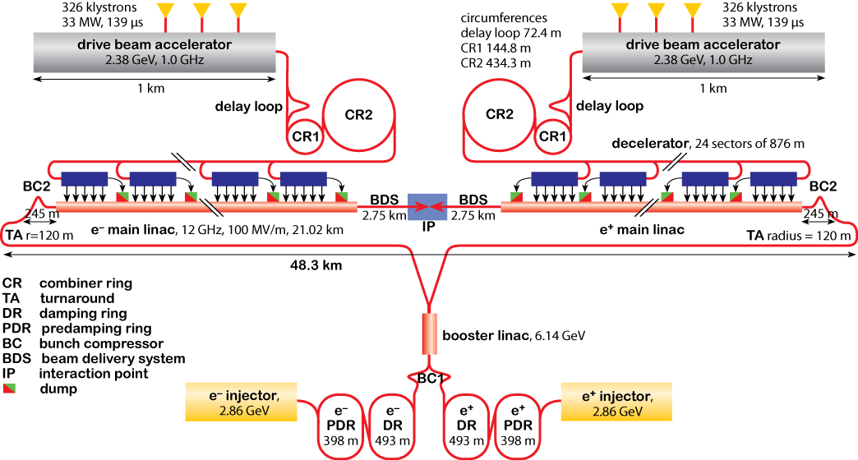
General CLIC Layout for 3 TeV
Drive Beam Generation
L. Rinolfi
Main Beam Generation

Slide 30
CLIC versus ILC parameters driving damping ring design
Parameters | Units | ILC | CLIC
Number of particles/bunch | 10⁹ | 20 | 4.1
Linac bunch spacing | ns | 554 | 0.5
Number of bunches /train |  | 1312 | 312
Repetition rate | Hz | 5 | 50
Horizontal normalized emittance | nm | 5500 | 500
Vertical normalized emittance |  | 20 | 5
Longitudinal normalized emittance | keV m | 33 | 6

Slide 31
Some ILC-CLIC Comparisons
Parameter | Units | ILC DR (RDR) | CLIC DR
Energy | GeV | 5.0 | 2.86
Circumference | km | 6.695 | 0.42056
Nominal # of bunches & particles/bunch |  | 2625@2.0×10¹⁰ | 312@0.41×10¹⁰
Macropulse Repetition Rate | Hz | 5 | 50
Average current | A | 0.4 | 0.15
Energy loss per turn | MeV | 8.7 | 4.2
RF Frequency | MHz | 650 | 2000
Total RF voltage | MV | 24 | 4.9
Equilibrium normalized emittance, γε_{x} | μm·rad | 5.0 | 0.4
Natural Chromaticity, χ_{x}/χ_{y} |  | -63/-62 | -168/-60
Momentum compaction, α_{c} |  | 4.2 × 10⁻⁴ | 8 × 10⁻⁵
Bunch length, σ_{z} | mm | 9.0 | 1.6
Momentum spread, σ_{p}/p |  | 1.3 × 10⁻³ | 1.4 × 10⁻³
Horizontal damping time, τ_{x} | ms | 25.7 | 1.9
Longitudinal damping time, τ_{z} | ms | 12.9 | 0.96

Slide 32
Some ILC-CLIC Comparisons
Parameter | Units | ILC DR (TDR) | CLIC DR (CDR)
Energy | GeV | 5.0 | 2.86
Circumference | km | 3.238 | 0.428
Nominal # of bunches & particles/bunch |  | 1312@2.0×10¹⁰ | 312@0.41×10¹⁰
Macropulse Repetition Rate | Hz | 5 | 50
Average current | A | 0.4 | 0.15
Energy loss per turn | MeV | 4.5 | 4.0
RF Frequency | MHz | 650 | 2000 (1000)
Total RF voltage | MV | 14 | 10
Equilibrium normalized emittance, γε_{x} | μm·rad | 5.7 | 0.46
Natural Chromaticity, χ_{x}/χ_{y} |  | -51/-43 | -115/-85
Momentum compaction, α_{c} |  | 3.3 × 10⁻⁴ | 1.3 × 10⁻⁴
Bunch length, σ_{z} | mm | 6.0 | 1.6 (1.8)
Momentum spread, σ_{p}/p |  | 1.1 × 10⁻³ | 1.0 × 10⁻³
Horizontal damping time, τ_{x} | ms | 24.0 | 2.0
Longitudinal damping time, τ_{z} | ms | 12.0 | 1.0
Updated to 2012

Slide 33
CLIC DR Complex
Normal conducting RF design in ML allows train-level injection/extraction instead of bunch-by-bunch
The use of pre-damping rings relaxes the dynamic aperture and energy acceptance requirements in the damping rings
e⁻ linac to PDR transfer line
e⁻ Pre-damping Ring
X-ray dump
X-ray dump
X-ray dump
e⁻ Damping Ring
e⁻ PDR to DR transfer line
X-ray dump
Delay loop
e⁻ DR to Booster linac transfer line
e⁺ DR to Booster linac transfer line
e⁺ Damping Ring
X-ray dump
e⁺ PDR to DR transfer line
X-ray dump
X-ray dump
e⁺ Pre-damping Ring
X-ray dump
e⁺ linac to PDR transfer line

Slide 34
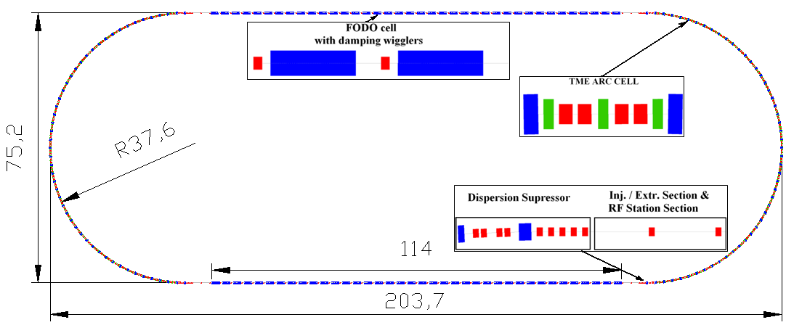
CLIC DR Layout
S. Sinyatkin, et al., LER 2010
167.3
Racetrack shape with
  96 TME arc cells (4 half cells for dispersion suppression)
  26 Damping wiggler FODO cells in the long straight sections (LSS)
  Space reserved upstream in the LSS for injection/extraction elements and RF cavities

Slide 35
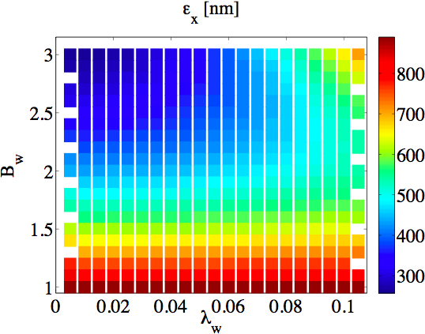
CLIC Damping Ring Challenges I
In the presence of the pre-damping rings, the major challenges for dynamic aperture and energy acceptance move upstream of the damping rings
Major issues for damping rings include:
  The repetition rate (50 Hz) requires very short damping times
  High charge density in each bunch means Intrabeam Scattering has a significant impact on the equilibirum emittance
  a Both of these issues drive the
  damping wiggler specifications
  to a very high field design
  which can only be achieved
  with superconducting
  technology
Nb₃Sn SC
wiggler
NbTi SC
wiggler
BINP PM
Wiggler

Slide 36
CLIC Damping Ring Challenges II
Achieving the necessary equilibrium emittance requires careful lattice design
  Target Emittance sensitive to:
    IBS, which must be directly taken into account – it’s not a small perturbation which is unlike any other rings of this type
    E_{ring}
    Achievable wiggler parameters
  A very strongly focusing lattice requires particular care with:
    Magnet strengths
    Alignment tolerances
Collective Instabilities
  Electron Cloud in the positron ring
  Fast Ion Instability in the electron ring
  Space charge plays a major role in the energy and circumference choice

Slide 37
CLIC Damping Ring Challenges III
Repetition rate and bunch structure
  0.5 ns bunch spacing to match main linac structure
  2 GHz RF System – Examples of other rings:
    SLAC-PEPII LER – 476 MHz
    LBNL-ALS – 500 MHz
    KEKB – 500 MHz SC
    CESR – 500 MHz SC
    KEK-ATF – 714 MHz
    ILC DR – 650 MHz SC
    CLIC DR – 2000 MHz
  Requires
    New power source design
    Demonstrated capability to handle high peak and average currents
CDR: 1 GHz RF option
DR bunch spacing 1 ns
To get 0.5 bunch spacing the trains have to be recombined in a delay loop downstream of the DRs with an RF deflector.

Slide 38
CLIC Damping Ring Challenges IV
With the extremely small beam sizes at the IP, exquisite pulse stability, O(10⁻⁴) is required
  Similar to ILC DR
  However the pulser requirements, which must inject/extract the whole train in each pulse, is conceptually simpler
    ILC DR pulse width ~6ns
    CLIC DR pulse width ~160ns
So, while the design challenges involve many of the same issues for the ILC DR and the CLIC DR, the actual operating parameters give rise to distinctly different designs with different issues being the dominant ones.

Slide 39
In Summary
Requirements
Design Choices
Number of bunches
Number of particles/bunch
Emittances ε_{x}, ε_{y}
Damping times τ_{x,y}
Bunch length σ_{l}
Energy spread σ_{p}
Large acceptance for the injected positron beam
Energy
Circumference
Momentum compaction
Lattice
Technical systems

Slide 40
Summary
At this point we have completed an overview of some of the key design issues for the CLIC and ILC damping rings
These rings offer a range of challenges both to the lattice designers as well as the technical designers who must come up with reliable implementations of hardware that meet the design specifications
I hope that you walk away from this portion of the lecture with an appreciation for how complicated trade-offs are required to meet aggressive physics specifications
In the next part of this lecture we will spend some time looking at the basic physics of storage rings in order to provide further insight into the details of such decisions

Slide 41
Bibliography
The ILC Collaboration, International Linear Collider Reference Design Report 2007, ILC-REPORT-2007-001, http://ilcdoc.linearcollider.org/record/6321/files/ILC_RDR-August2007.pdf.
S. Y. Lee, Accelerator Physics, 2nd Ed., (World Scientific, 2004).
J. R. Rees, Symplecticity in Beam Dynamics: An Introduction, SLAC-PUB-9939, 2003.
K. Wille, The Physics of Particle Accelerators – an introduction, translated by J. McFall, (Oxford University Press, 2000).
S. Guiducci & A. Wolski, Lectures from 1st International Accelerator School for Linear Colliders, Sokendai, Hayama, Japan, May 2006.
A. Wolski, Lectures from 2nd International Accelerator School for Linear Colliders, Erice, Sicily, October 2007.
A. Wolski, Lectures from 4th International Accelerator School for Linear Colliders,
Beijing, China, October 2009.
A. Wolski, J. Gao, S. Guiducci, ed., Configuration Studies and Recommendations for the ILC Damping Rings, LBNL-59449 (2006). Available online at: https://wiki.lepp.cornell.edu/ilc/pub/Public/DampingRings/ConfigStudy/DRConfigRecommend.pdf
Various recent meetings of the ILC and CLIC damping ring design teams.

Slide 42
Bibliography (contd)
Recommended Accelerator Physics Texts:
  H. Wiedemann, Particle Accelerator Physics, 3rd Edition. (Springer, 2007)
  CAS CERN Accelerator School, 5th General Accelerator Physics Course, CERN 94-01, 1994 http://cdsweb.cern.ch/record/235242/files/full_document_V1.pdf
Basic Documentation
  Handbook of Accelerator Physics and Engineering, A. W. Chao, M. Tigner, (World Scientific, 1999).
  ILC A Technical Progress Reporthttp://ilcdoc.linearcollider.org/record/32863/files/ilc_interim_report_2011-lores.pdf
  A Multi-TeV linear collider based on CLIC technology: CLIC Conceptual Design Report, CERN-2012-007 http://project-clic-cdr.web.cern.ch/project-CLIC-CDR/CDR_Volume1.pdf
  International Linear Collider Technical Design Report, To be published

