Slide 1
DAC outputs on 18/05/2012
Neven Blaskovic & Mikey Davis
FONT meetings

Slide 2
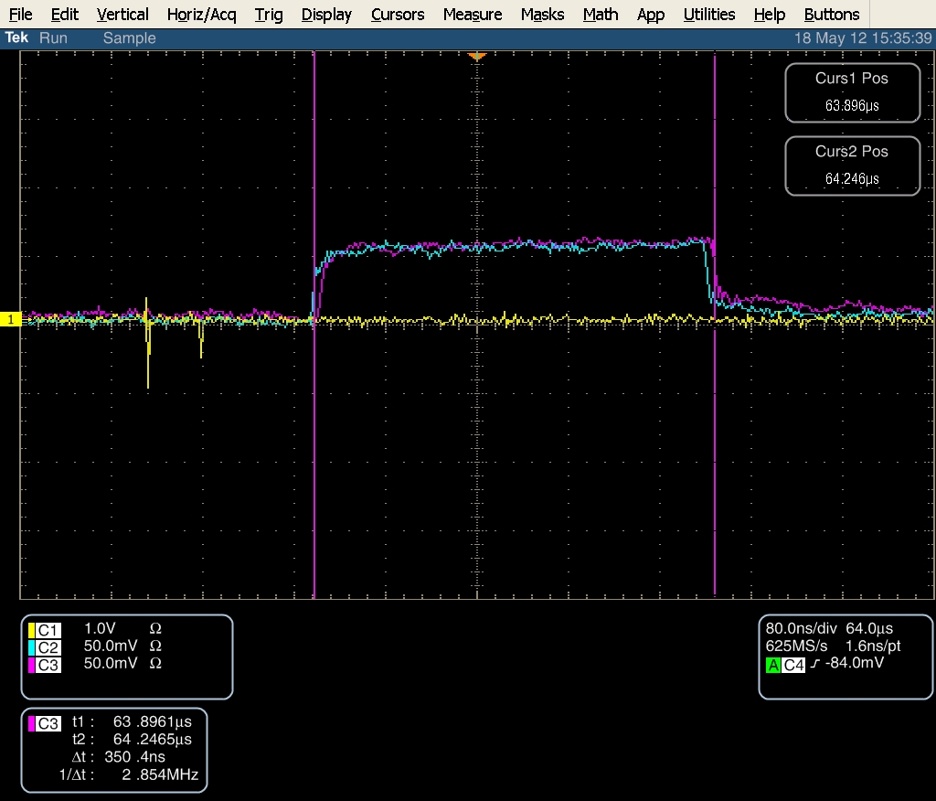
Constant DAC
K1 Constant DAC = 500; K2 Constant DAC = 500
Yellow: P2x, Blue: K1, Purple: K2

Slide 3
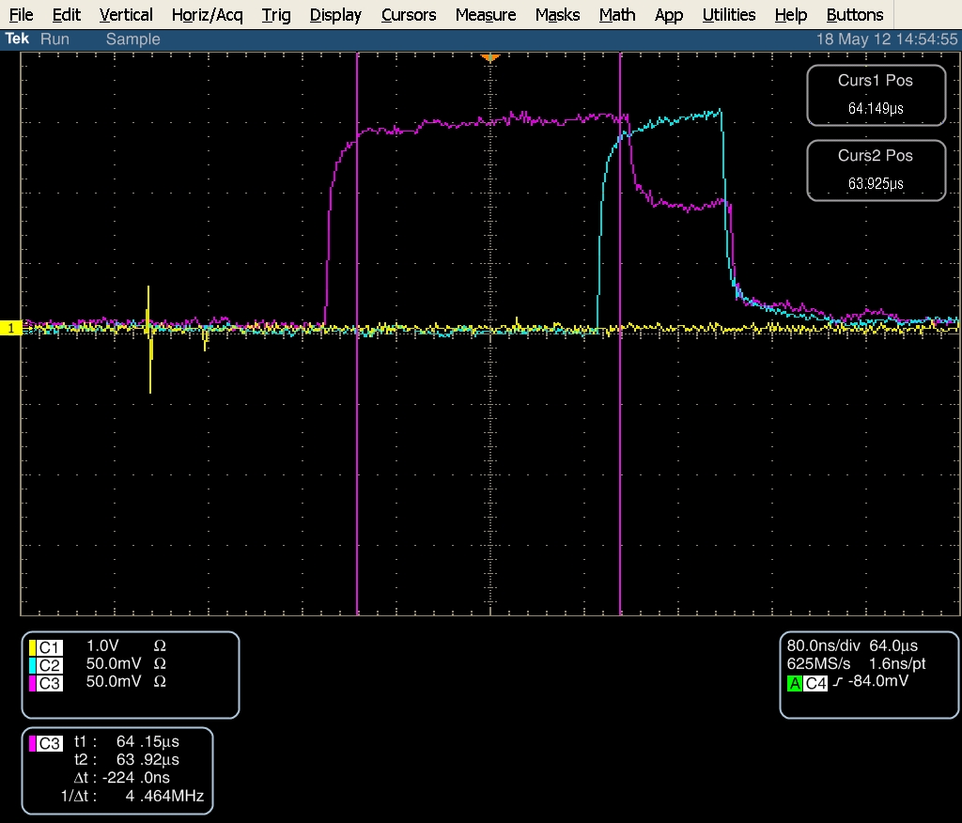
Uncoupled Feedback
K1P2 Gain = 5000; K2P3 Gain = 5000; uncoupled
Yellow: P2x, Blue: K1, Purple: K2

Slide 4
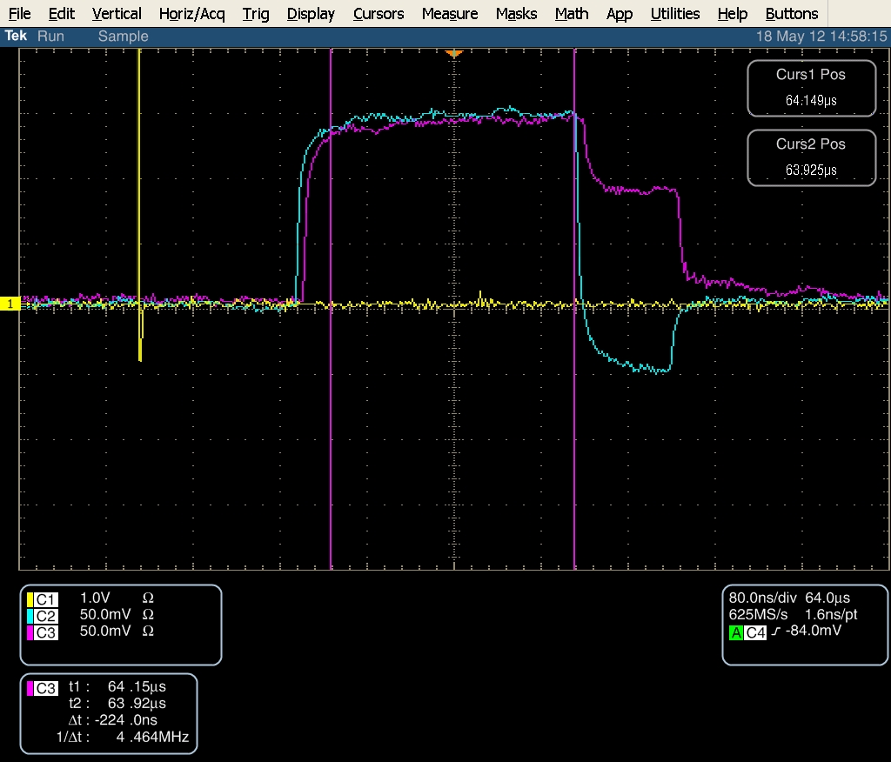
Coupled Feedback
K1P2 Gain = 5000; K2P3 Gain = 5000; coupled
Yellow: P2x, Blue: K1, Purple: K2

Slide 5
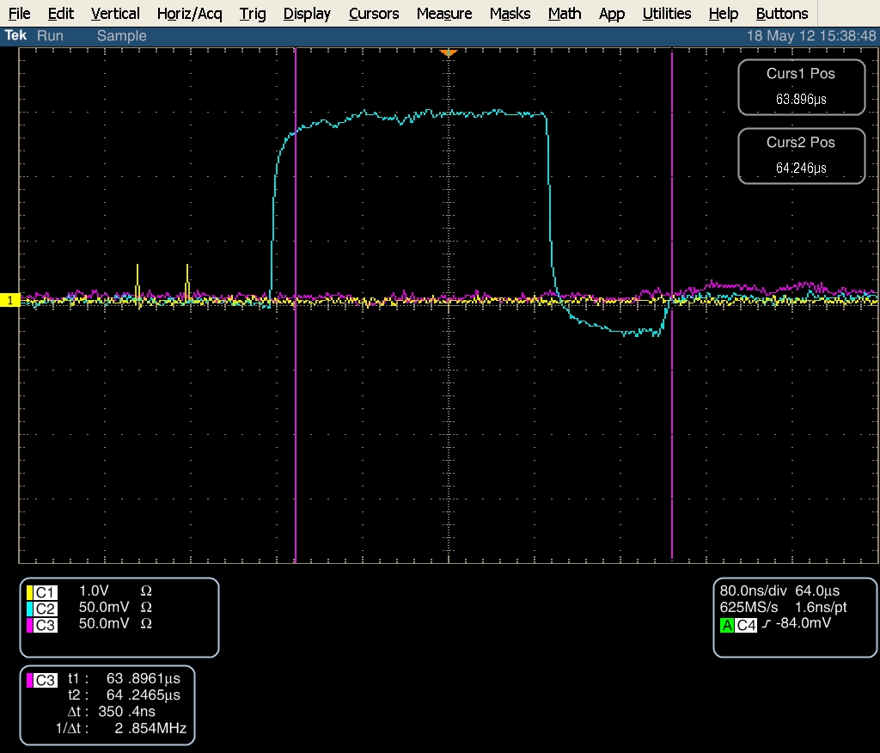
Uncoupled Feedback K1P3
K1P3 Gain = 5000; coupled
Yellow: P2x, Blue: K1, Purple: K2

