Slide 1
CM-1 & RFCA002 (CM-2)
Status
ILC Cryomodule meeting
29 May 2012
E. Harms & ?/FNAL

Slide 2
CM-1 Disassembly Plans
CM-1 is transported back to Industrial Center Building for checkout and disassembly
  Inspect input couplers for any damage
  Check thermal intercepts, especially on HOM cans for good contact
  As found alignment of cavity string once removed from vacuum vessel
  Investigate tuners and motors, especially ones that stopped functioning (#8) or would stick (#2)
  Separate cavities in MP-9 clean room, prepare, and re-test low performing ones in HTS
CM-1 will be re-installed in ASTA as the 2nd operating cryomodule
  What to do with underperforming cavities: re-process or replace, etc. will be determined after testing
Input from Tug Arkan et al

Slide 3
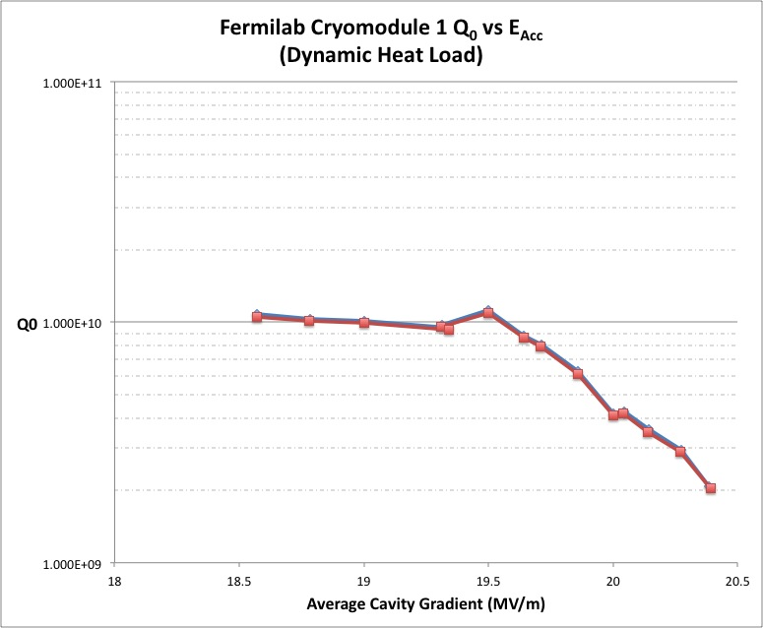
Module Dynamic Heat Load Measurement
Static Heat Load
  Total ~37 Watts
  CC-2 ~15 Watts
  CM-1 ~24 Watts

Slide 4
RFCA002 Installation
To avoid confusion between location in accelerator and component, we will refer to CM-2 by its component name: RFCA002.
Cryomodule is installed in ASTA on 18 May; checkout and connection has begun
  Vacuum work
  Cryogenic piping preparation
  Electrical checkout and cable hookup
  RF measurements
  Alignment

Slide 5
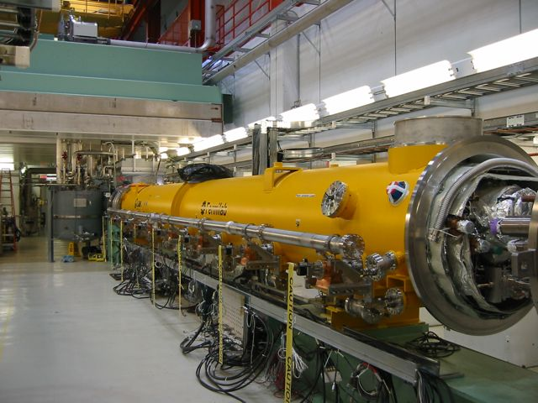
RFCA002 Installation
Courtesy of Jerry Leibfritz

Slide 6
RFCA002 Short-term Schedule
Already Completed
  Alignment
  Electrical checkout
28 May – 1 June
  Complete cabling
4 - 8 June
  Preparation for Warm coupler conditioning
  RF system/klystron re-calibration
  Couplers and Cavities under active pumping
12 - 16 June
  Initiate warm coupler conditioning (one cavity at a time)
Remainder of June
  Finish Coupler Conditioning
  Complete installation
  Cryogenics interconnects
  Leak checks, pressure tests, safety approval
~28 June
  Initiate Cooldown

Slide 7
RFCA002 Cavity Performance
Cavity | Last Vertical Test | Last Horizontal Test*
TB9AES008 | 41 MV/m | >35 MV/m
TB9RI018 | 39 MV/m | >35 MV/m
TB9AES010 | 38 MV/m | >35 MV/m
TB9RI019 | 38 MV/m | >35 MV/m
TB9ACC016 | 37 MV/m | 19 MV/m
TB9AES009 | 36 MV/m | 35 MV/m
TB9RI027 | 40 MV/m | >35 MV/m
TB9RI028 | 39 MV/m | 33 MV/m
*Administrative Limit of 35 MV/m for Peak Gradient at HTS
Courtesy of Andy Hocker
For cold operation (at least until all cavities are characterized and initial cryomodule operation completed) we will not exceed 31.5 MV/m.

Slide 8
Thank you for your attention

