Slide 1
STF Quantum-Beam Accelerator commissioning status
H. Hayano, KEK, 05292012

Slide 2
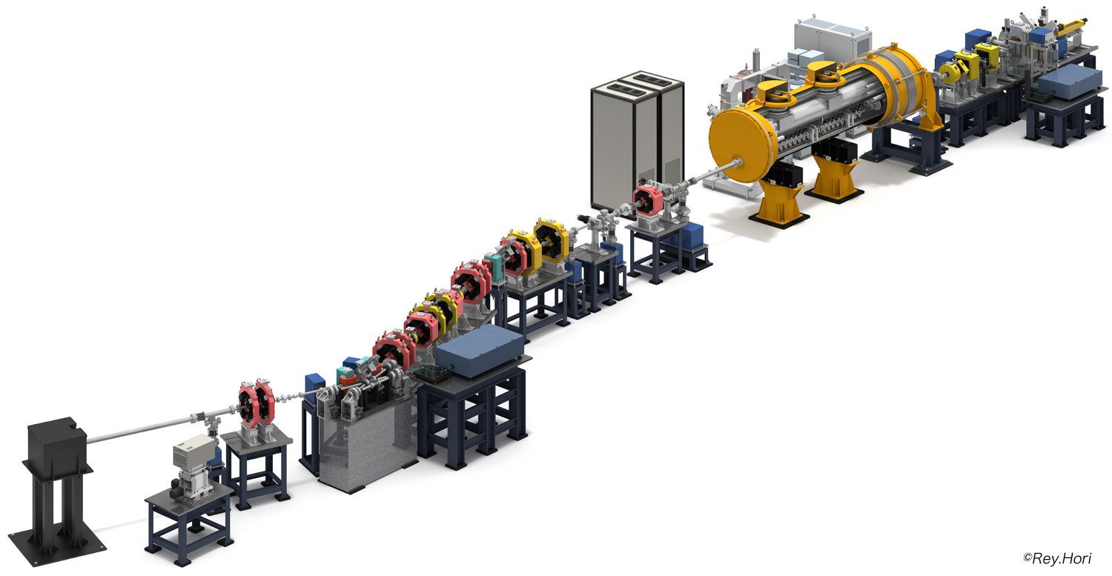
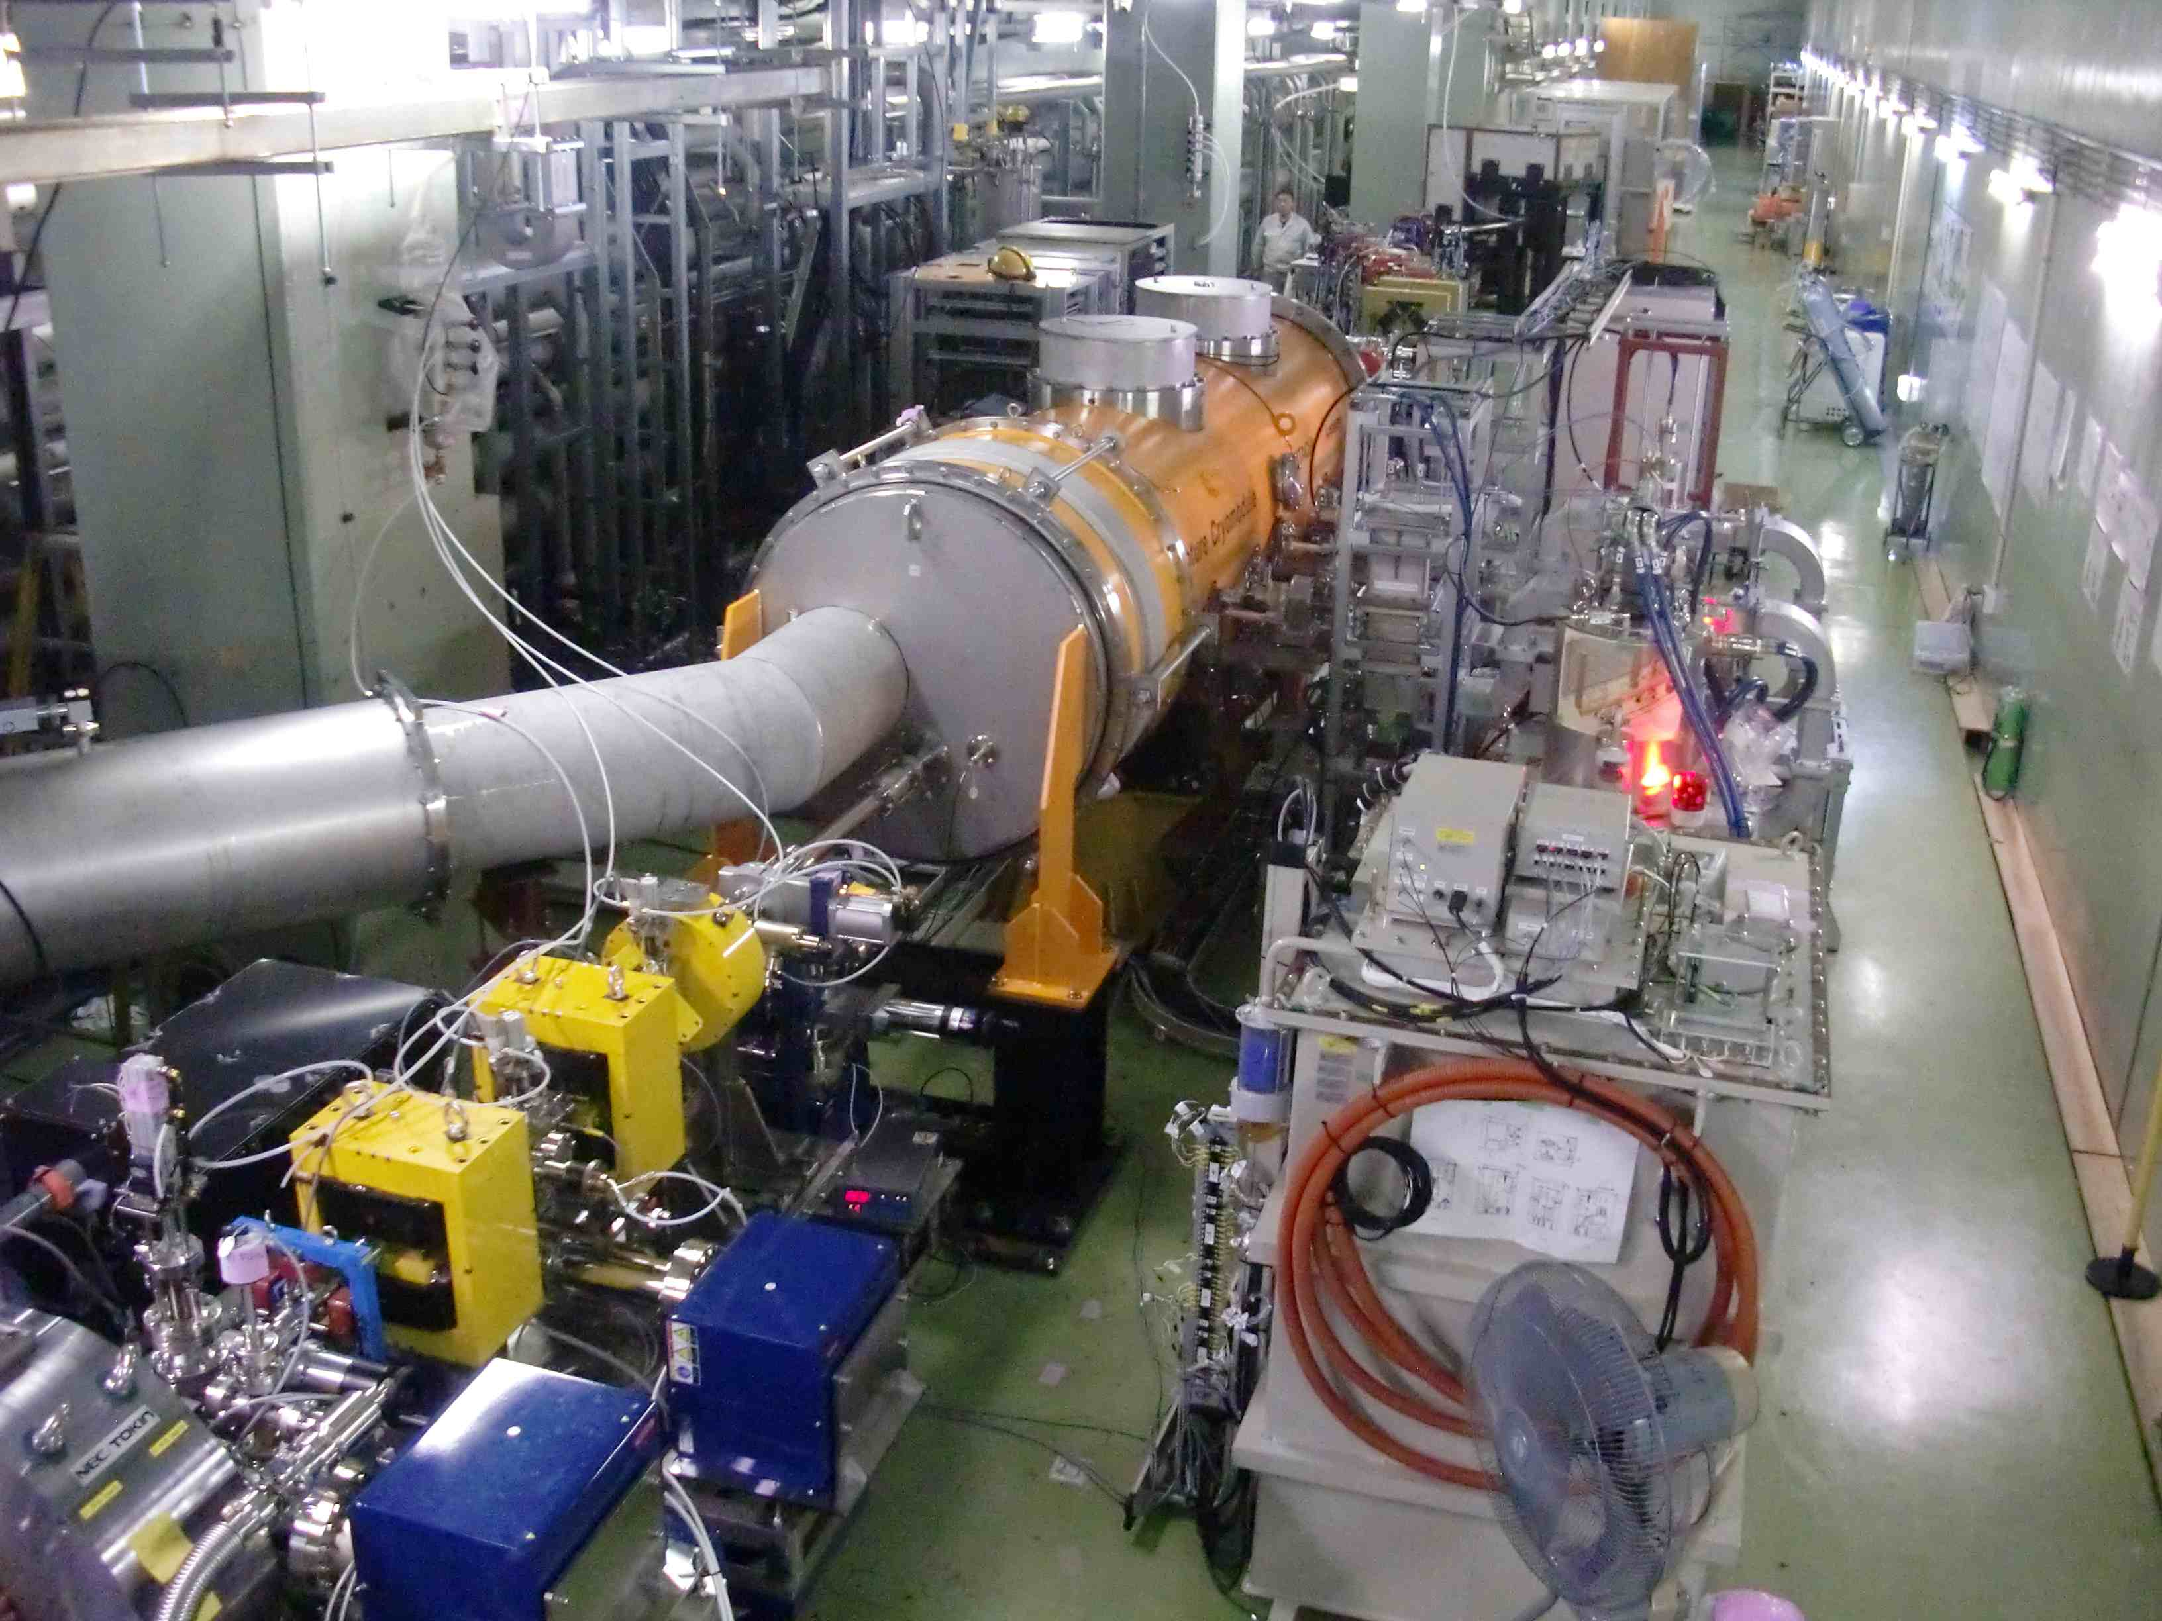
STF Quantum-Beam experiment
KEK-STF
Quantum-Beam Accelerator
High-flux X-ray by Inverse-Compton scattering
10mA electron beam （40MeV, 1ms, 5Hz)
4-mirror laser resonator cavity
head-on collision with beam
photocathode RFgun
Capture cryomodule ( 2 SC cavities )
collision point
(Laser, electron beam)
Target: 1.3 x 10¹⁰ photons/sec 1%bandwidth
30KeV X-ray
2012. Feb : cool-down started,
April : beam acceleration
experiment: June run,
October run

Slide 3
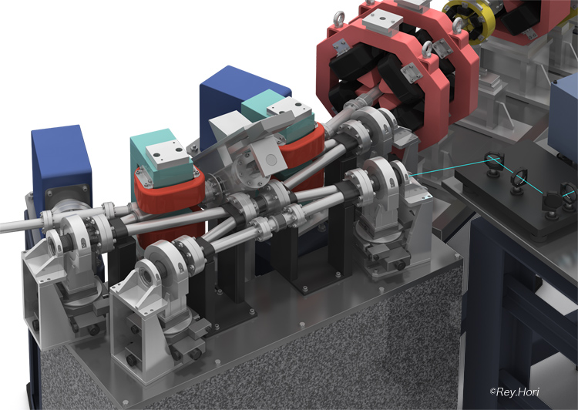
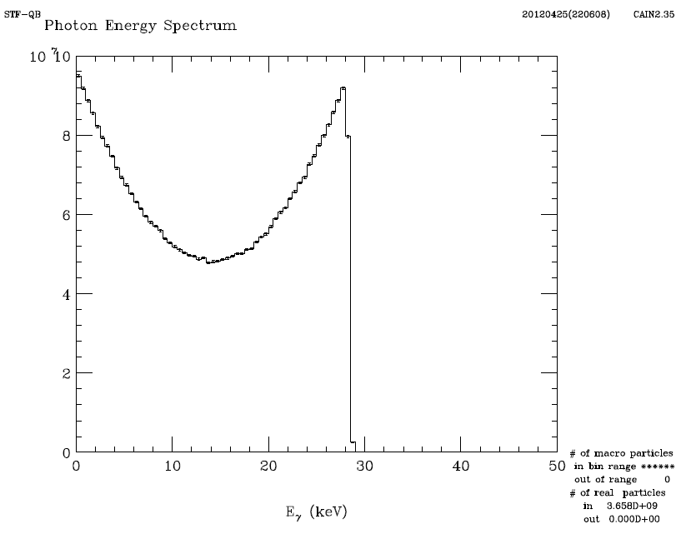
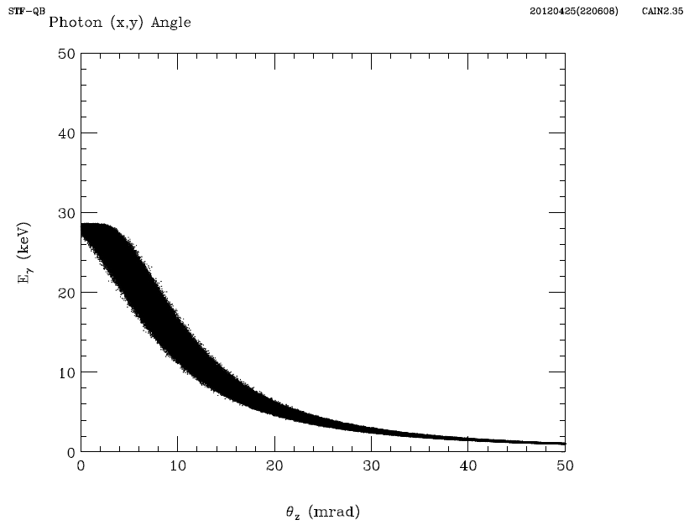
Plan of X-ray generation by Inverse-compton scattering
4-mirror laser accumulation, head-on with e-beam
40MeV, head-on collision
max. 28 keV X-ray
X-ray
X-ray Energy
 | Electron | Laser
Energy | 40MeV | 1.17eV (λ=1064nm)
Energy spread | 0.1% (rms)
Beam size(rms) | 10μm | 10μm
Pulse width(FWHM) | 12ps | 12ps
Intensity | 61.5 pC/bunch | 50mJ/pulse
Number of bunches | 162500 | ----
Emittance | 0.5π mm mrad
Collision angle | 0deg (Head on)
Rep. Rate | 5Hz
X-ray Energy
X-ray angle
target: 1.3x10¹⁰ photons/sec/1%bw

Slide 4
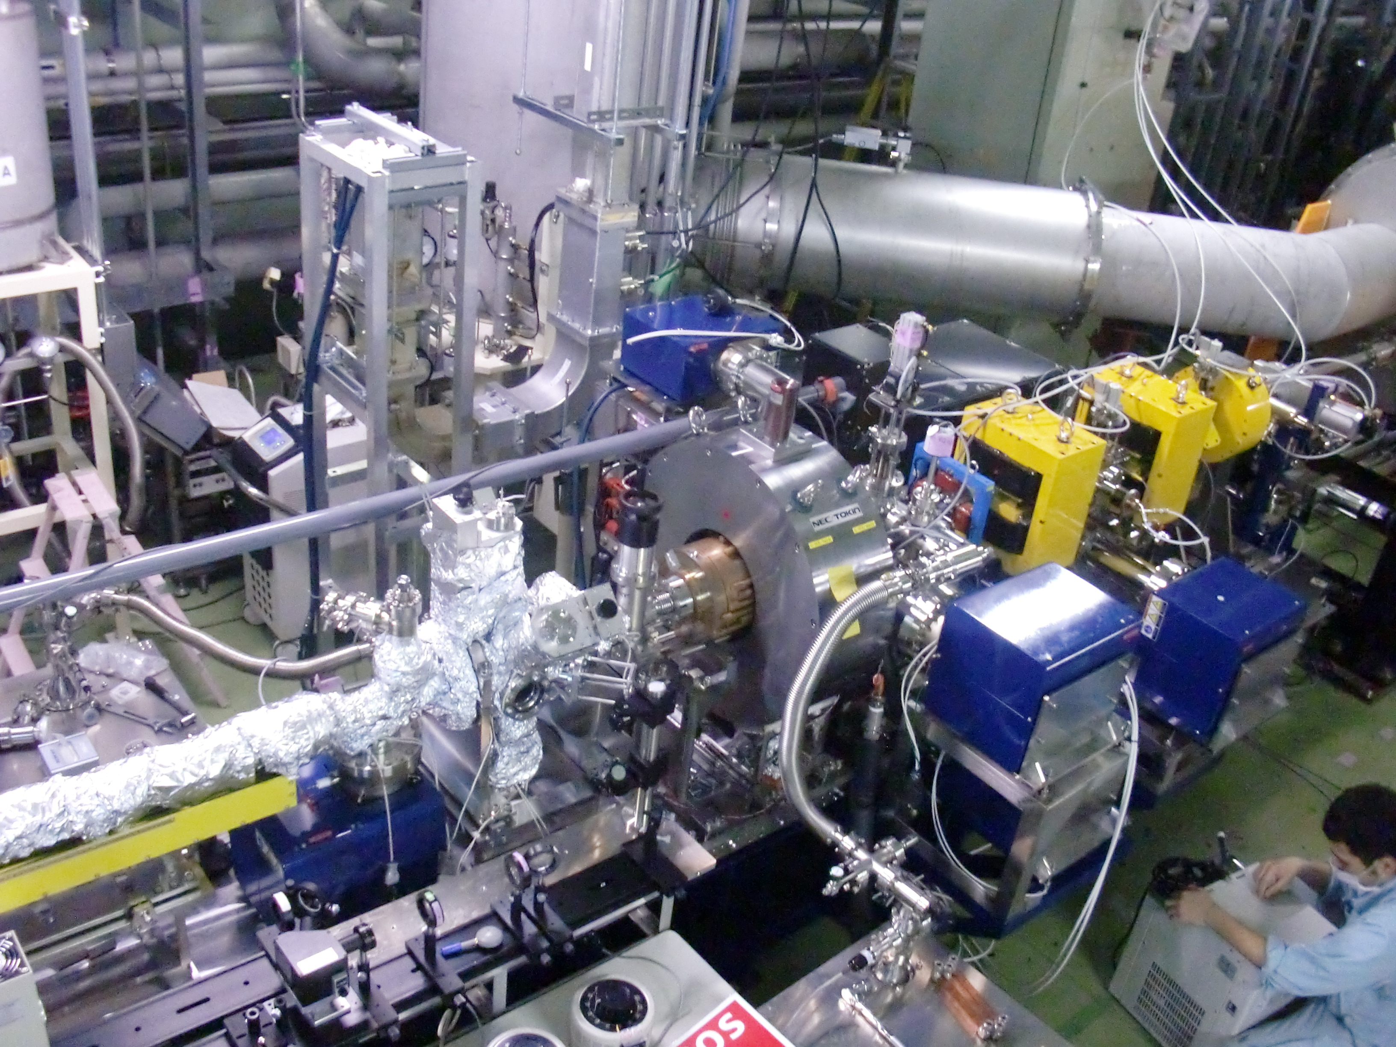
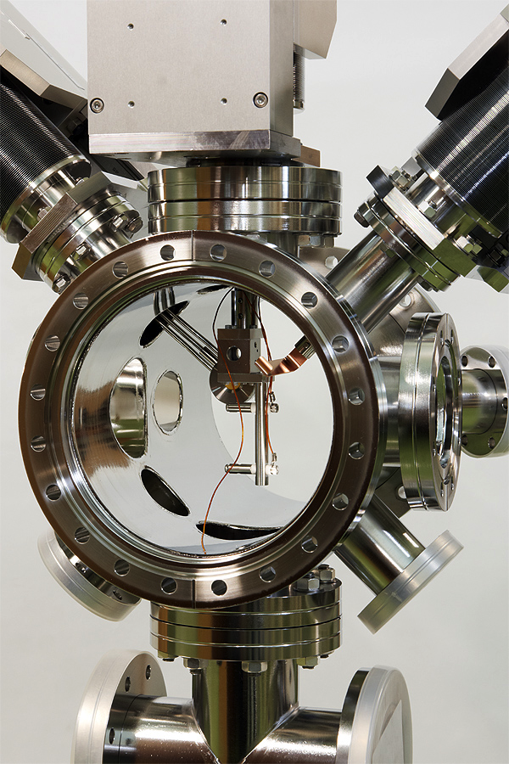
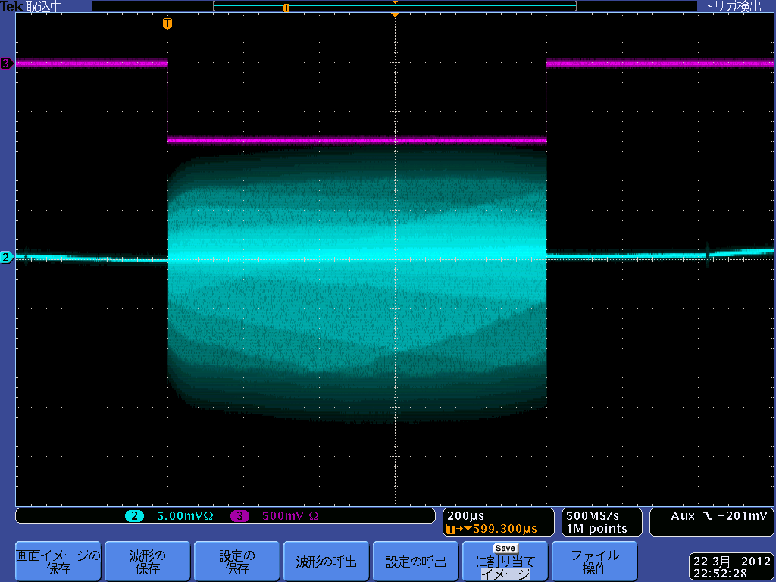
STF Photo-cathode RF-gun
Cs₂Te
Photocathode
Preparation
Chamber
Molybdenum cathode-block
Cs₂Te photocathode
Preparation chamber
RFgun cavity
Quantum efficiency of photo-cathode
0.5 – 1.5%
dark-current (peak)
~300µA
emittance:
reliable measurement was not yet done
1ms beam was extracted
from Gun

Slide 5
Accelerated beam (April 13,2012)
Energy：40MeV、
Beam charge：41pC/bunch、28bunches
repition：5Hz
RFgun cavity power：2.2MW
(34.6MV/m cathode field）
Beam energy from RFgun：3.3MeV/c
SC cavity voltage；
MHI-012:20.15MV/m (40MV/m in VT)
MHI-013:21.5 MV/m (33MV/m in VT)
Accelerated Beam bunch
Blue：BPM signal: exit of Rfgun
Purple：WCM signal: downstream of cryomodule
green：beam-loss-monitor signal
Yellow：beam gate timing
Beam profile at collision point：
1mm(FWHM)
Accelerated Beam profile
X orbit
Y orbit
Beam orbit

Slide 6
162.5MHz 10,000 bunches (61.5µsec) acceleration
61.5µsec beam
4% of Design maximum Beam Power

Slide 7
STF Building cross-section
Radiaiton leakage to STF surface buliding (4% of design beam power)
EP room
non-control area
(<0.2µSv/h)
Klystron gallery
control area
(<20µSv/h)
Waveguide hole
scale to
Tunnel
underground
(control area)
(non-control area)
Need to reduce 1/14 for controlled-area
1/28 for non-controlled area,
by putting more lead-shield, concrete,...
beam dump
concrete shield

Slide 8
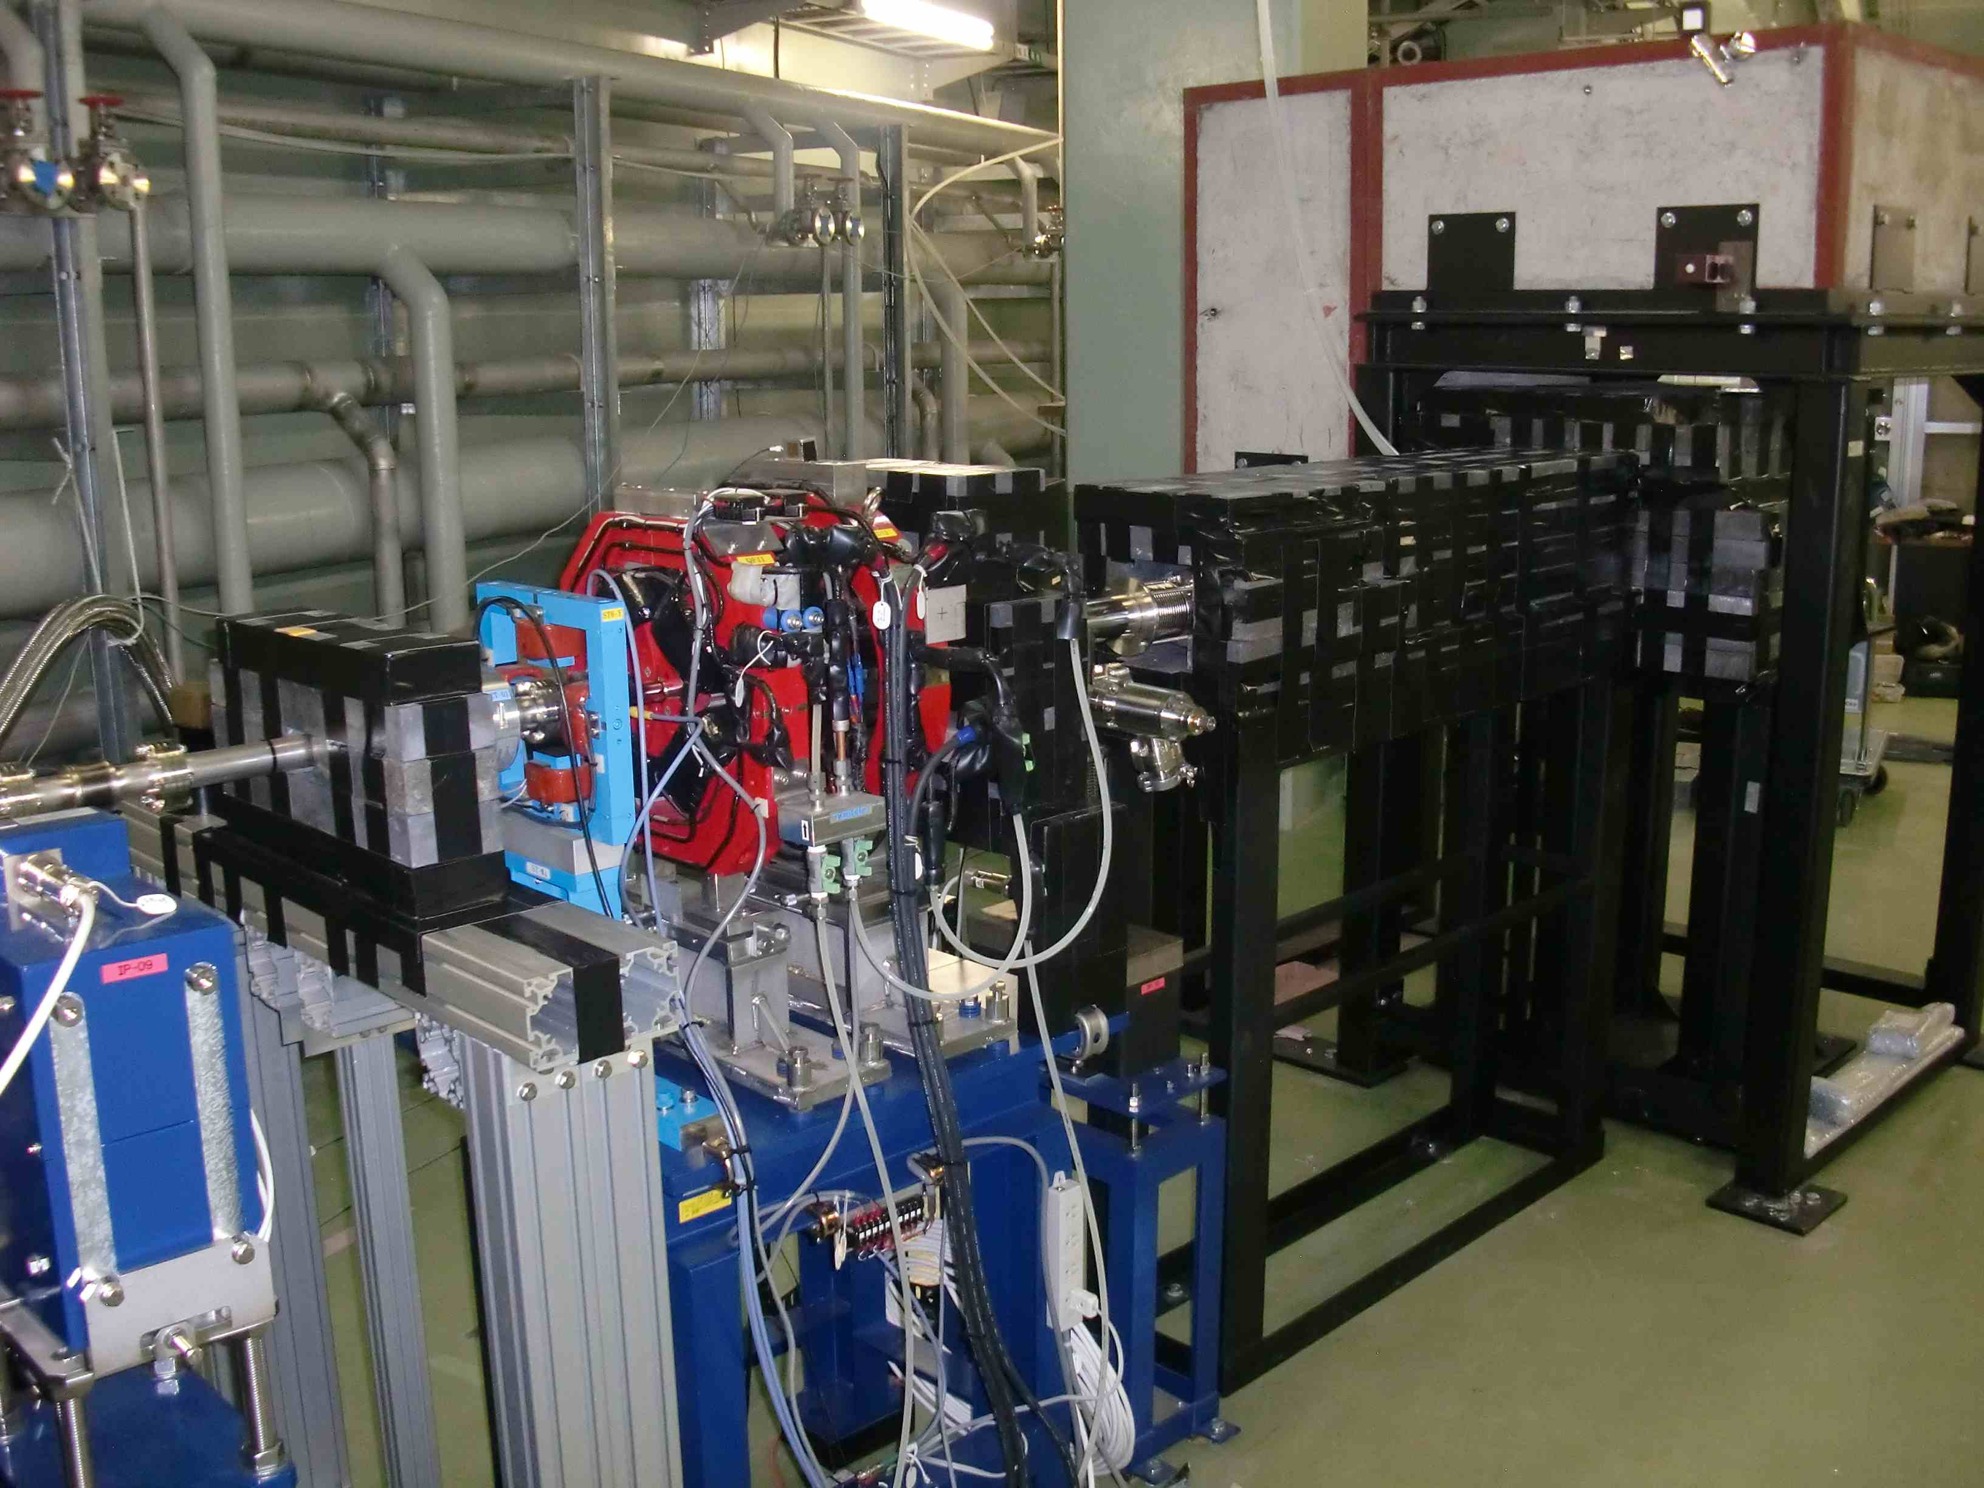
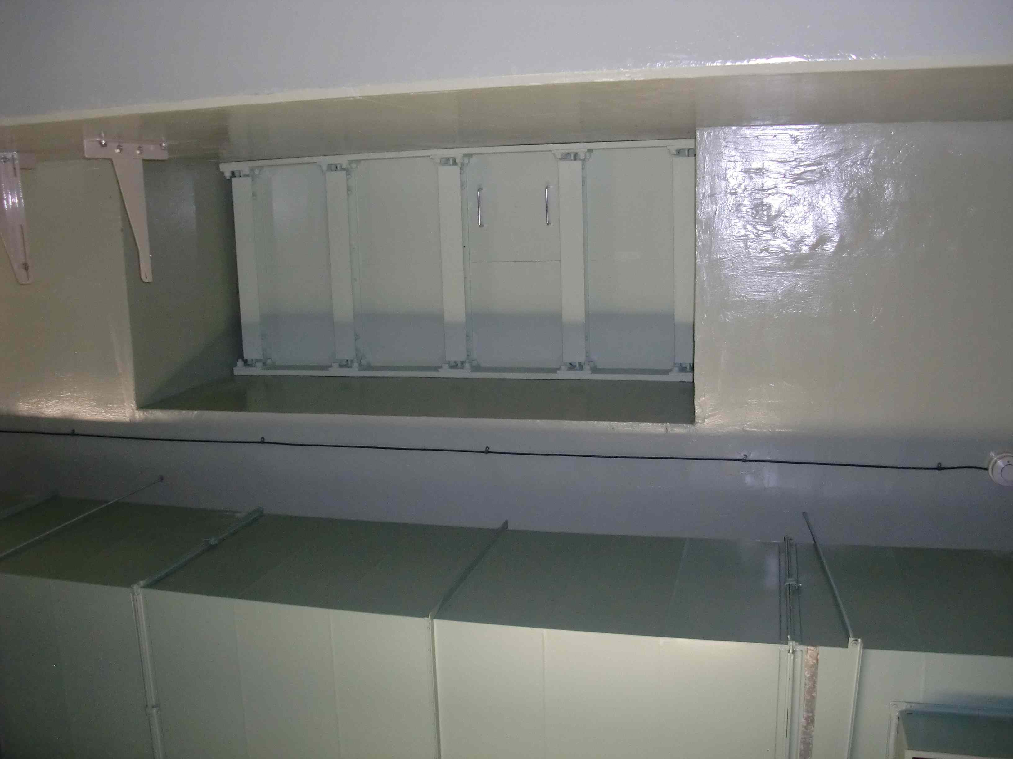
More shield were installed
lead-block were placed in front of dump
lead-shield were installed in the WG-hole
STF accelerator beam dump.
Beam goes from left to right.
Waveguide access hole between tunnel
and Klystron gallery.
(looking up from tunnel)

Slide 9
April 2012
Sun
Mon
Tue
Wed
Thu
Fri
Sat
cool-down
GV open
cool-down
beam commissioning start
cool-down
beam to dump, beam monitor tuning
KILC12
cool-down
radiation survey by 4% beam power
G.W. shutdown

Slide 10
Schedule
May 2012
Sun
Mon
Tue
Wed
Thu
Fri
Sat
4 mirror
Laser
Accumulation
cavity
Lead block
shield
RFgun
Cooling
System
improvement
cryomodule cool-down
SC-cavity process
cryomodule cool-down
SC-cavity
process
cool-down
radiation survey by 4% beam power
Beam Operation re-start

Slide 11
June 2012
Sun
Mon
Tue
Wed
Thu
Fri
Sat
cool-down
beam focus operation
cool-down
beam focus operation
cool-down
beam focus / BG reduction
cool-down
beam focus / BG reduction
Operation target: Reduce beam emittance, then focus the beam down to 10µm size.

Slide 12
July 2012
Sun
Mon
Tue
Wed
Thu
Fri
Sat
cool-down
Beam-laser collision trial
cool-down
radiation shield examination
Summer shutdown
Operation target: Try to collide electron beam with Laser beam.

