Slide 1
ML-SCRF: Monthly WebEx Meeting
May 30, 2012
Reports from PMs
  GDE activity and meeting plan
  KILC-12 Summary: (A. Yamamoto)
    ILC-PAC and recommendations (M. Ross)
Reports from TA Group Leaders (if any? )
  Cavity, Cavity Integration, Cryomodule, Cryogenics, HLRF, ML
Special Discussions on
  Re-naming to identify better Flat-land or Mountainous conditions/parameters (N. Walker / A. Yamamoto)
  Progress in TDR Drafting (J. Cawardine / N. Walker)

Slide 2
ML & SCRF Action/Meeting Plan (2012)
Month | Day | Place | Meeting
April | 4 23-26 | WebEx Korea | ML-SCRF Monthly meeting (Check homework) ACFA-LCWG : KILC-12 S1-Global report (draft) TDR drafts and cost-study reports, required
May | 15-16 21-25 30 | Fermilab New Orleans | ILC-PAC IPAC ML-SCRF Monthly meeting
Sept. | 10-14 | Telaviv | Linac-2012
Oct. | 22-26 29-30 | Texas Annaheim | LCWS IEEE-NS (LC event)
Nov. | 5-6 15 | JLab | TTC Final Draft of TDR
Dec. | 13-14 | KEK | ILC-PAC

Slide 3

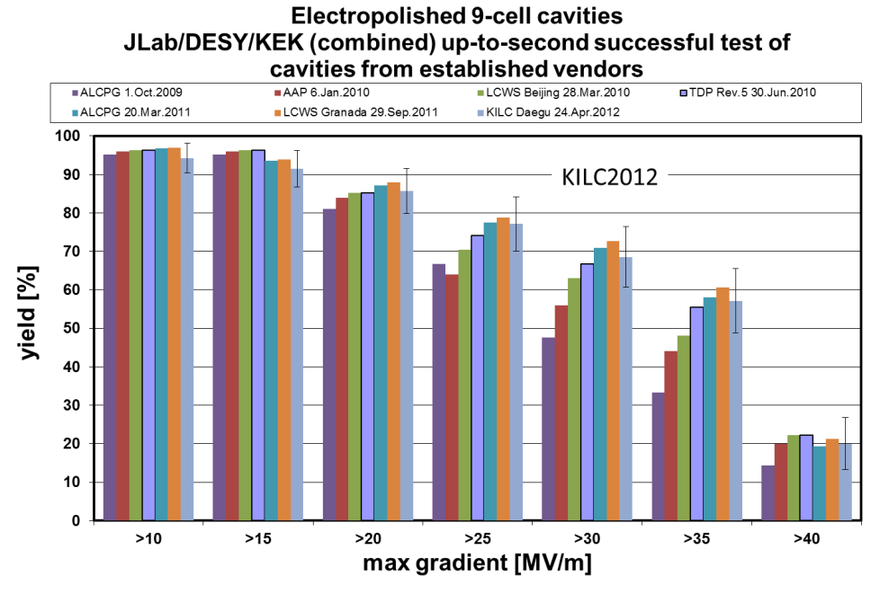
Progress Integrated in Cavity Gradient Yield Updated, April., 24, 2012
Plot courtesy
Camille Ginsburg of FNAL
TDP-2 Goal
35 MV/m usable
Being
saturated

Slide 4
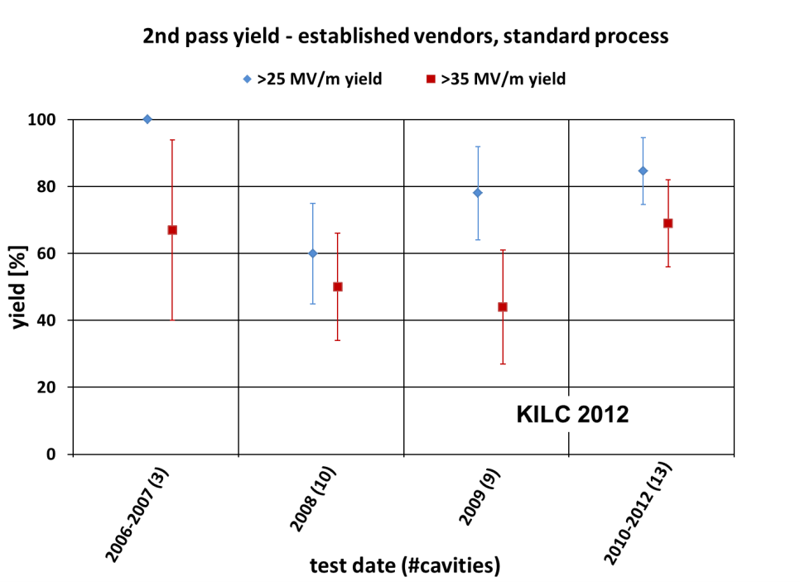
Yearly Progress in Cavity Gradient Yield as of April 24, 2012
Yield ’10 ~ ’12:
~ 85% @ 25 MV/m
~ 80% @ 28 MV/m
~ 70% @ 35 MV/m
Yield in ’08 ~ ’09:
~ 70% @ 25 MV/m
~ 46% @ 35 MV/m

Slide 5
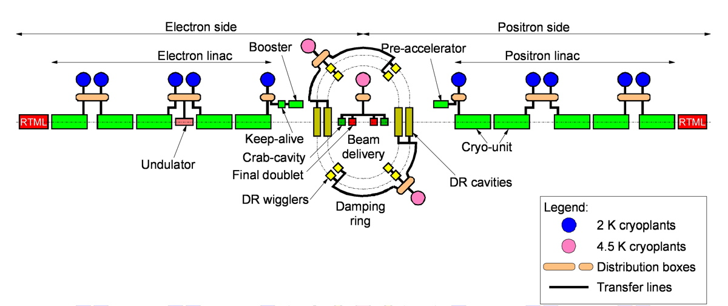
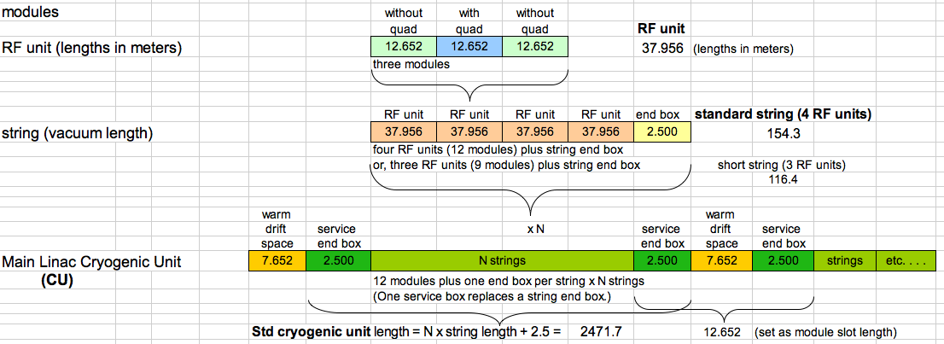
RDR cryogenic layout, for reference

Slide 6
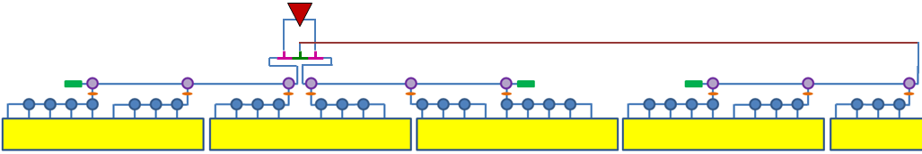
Streamlined PDS
pressurizable, 0-100%, phase stable
non-press., limited range
pressure window
5 MW load
Unused power can be dumped to the loads
Power to ½ CM’s fully adjustable without affecting phases.
from CTO
9 cavities
4 cavities 1 quad 4 cavities
9 cavities
phase shifter on each feed, as well as isolator, bi-directional coupler, and flex guide.
RF UNIT: 3 cryomodules (26 cavities)
Common Local power distribution
WR770
For low power Kamaboko (DKS) option, one klystron powers 1 ½ rf units or 4 ½ cryomodules (39 cavities).

Slide 7
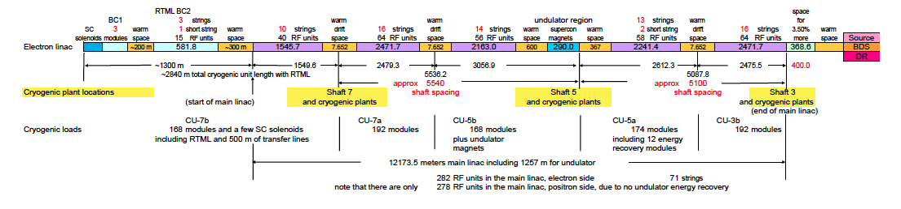
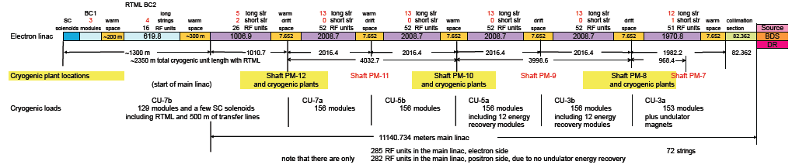
Cryogenics Unit Difference between RDR (~ DKS) and KCS
RDR
KCS
Shifted)

Slide 8
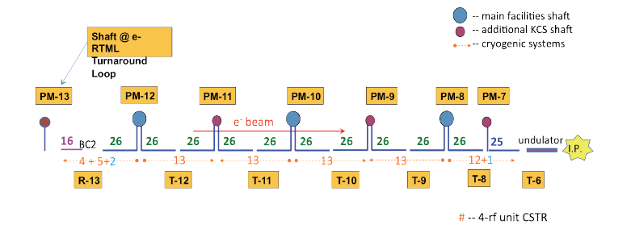
Cryogenics Unit Difference between RDR (~ DKS) and KCS
RDR
KCS
Shifted)

Slide 9
Cryogenics Unit Difference between RDR (~ DKS) and KCS
RDR
KCS
Shifted)
Moving
Shaft?

Slide 10
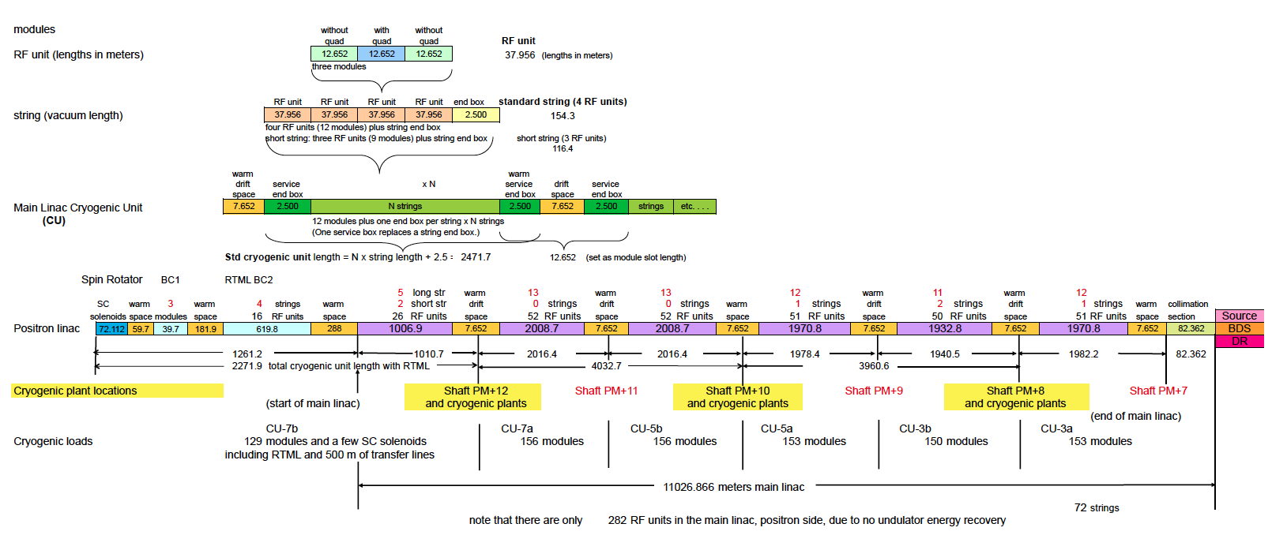
KCS-ML Cryogenics Unit Layout

Slide 11
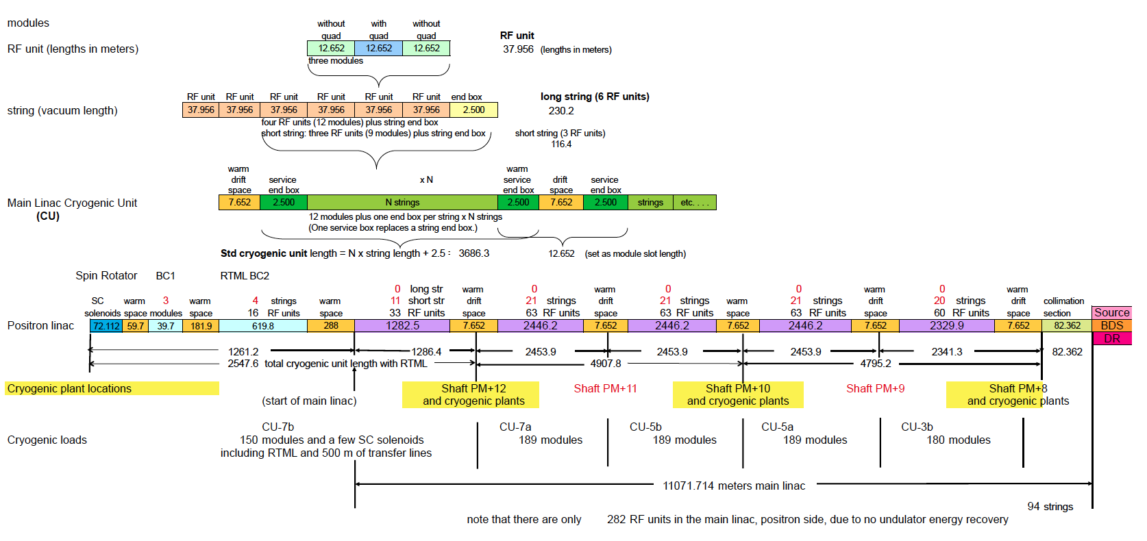
DKS-ML Cryogenics Unit Layout

Slide 12
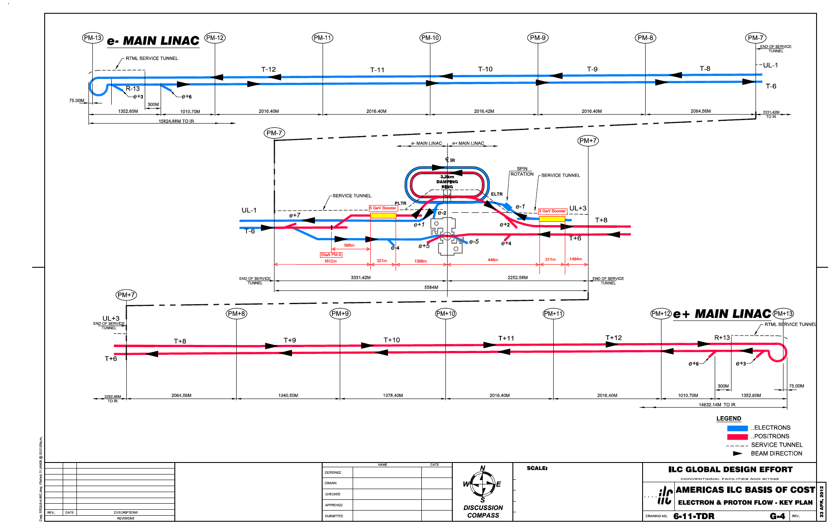
Central Region Layout

Slide 13
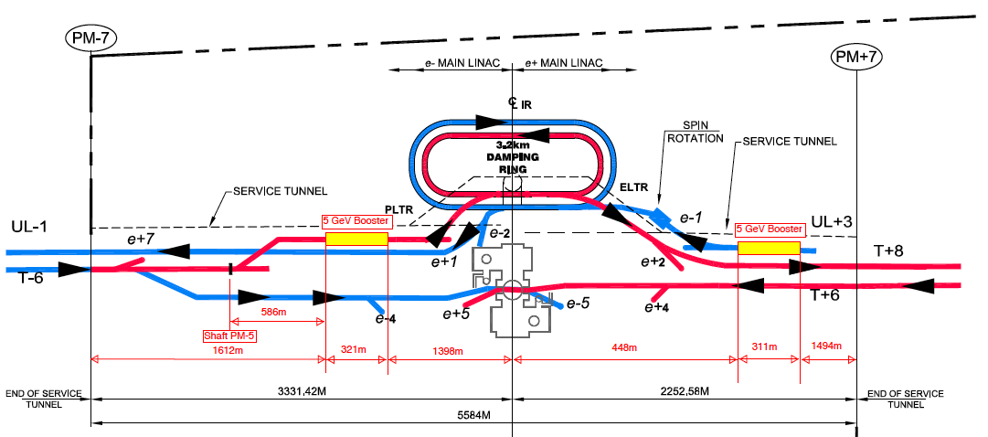
Central Region Layout-2

Slide 14
Cryogenics Dedicated Meeting
Central region cryogenics layout and configuration to be discussed in a webex meeting
To be held
  18:00, May 31 at Fermilab
  8:00, June 1, KEK
Topic: ILC Central Region Cryogenics Date: Friday, June 1, 2012 Time: 8:00 am, Japan Time (Tokyo, GMT+09:00) Meeting Number: 752 751 028 Meeting Password: crcryo Host Key: 903881 (use this to reclaim host privileges) ------------------------------------------------------- To join the online meeting (Now from mobile devices!) ------------------------------------------------------- 1. Go to https://ilc.webex.com/ilc/j.php?ED=165488187&UID=0&PW=NMTU1YmU2MGU2&RT=MiM0OQ%3D%3D 2. If requested, enter your name and email address. 3. If a password is required, enter the meeting password: crcryo 4. Click "Join".

Slide 15
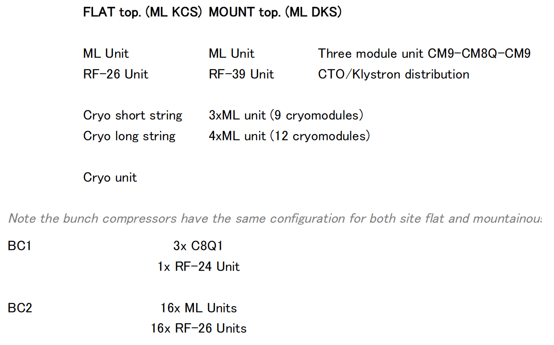
Re-naming requested in TDR advised by N.W

Slide 16
Summary
ILC accelerator technology
  SCRF cavity gradient progressing toward 35 MV/m,
  Beam test facility functioning to demonstrate the ILC accelerator requirements,
Technical Design Report (TDR)
  Contents being settled w/ flat and mountainous cases,
  Draft being submitted by each author,
  Final draft due LCWS-12, Oct., 2012
Further work beyond TDR
  Advanced R&D for 1 TeV upgrade capability,
  Further study to be readh for various energy operation
Many thanks for the KILC12 organizer

Slide 17
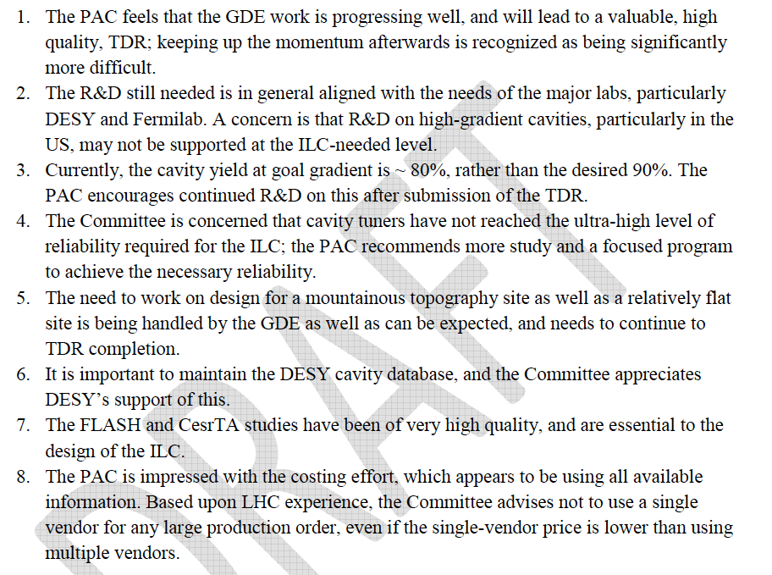
PAC
Summary and Recommendations

Slide 18
Publication and Review
First-draft sections | * 23 April *
Complete edited draft | 22 October (ILCWS 12)
Final draft (for PAC) | 15 November
PAC review | 15-16 December
Expect international reviews:
Both technical and cost
(Q1-22 2013)
Formal publication at Lepton Photon Conf.
(SF, June 2013)

Slide 19
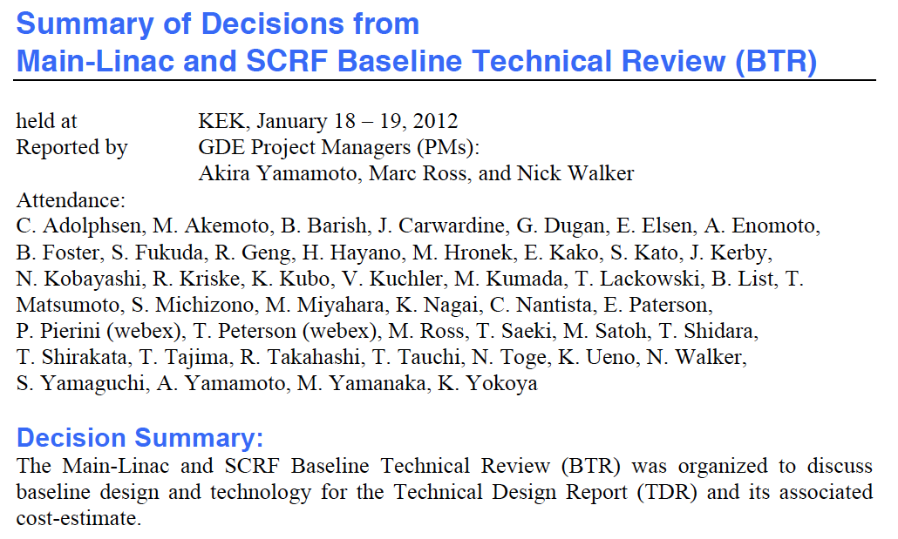
Summary of ML and SCRF BTR
(being uploaded to SCRF meeting Indico Agenda)

Slide 20
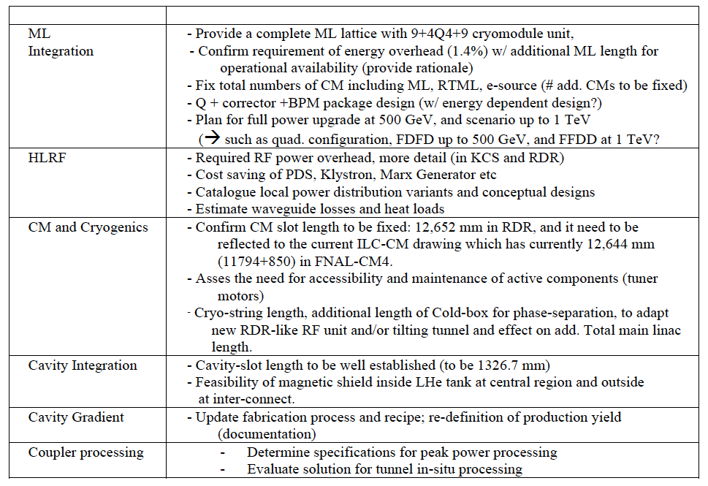
Homework by KILC

Slide 21

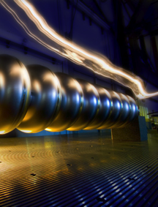
TDR Technical Volumes
2007
2011
2013*
TDR Part I:
R&D
~250 pages
Deliverable 2
ILC Technical Progress Report
(“interim report”)
AD&I
TDR Part II:
Baseline
Reference
Report
~300 pages
Deliverables 1,3 and 4
Technical Design Report
Reference Design Report
More discussed by J. Carwardine
On Jan. 20, tomorrow
* end of 2012 – formal publication early 2013

Slide 22
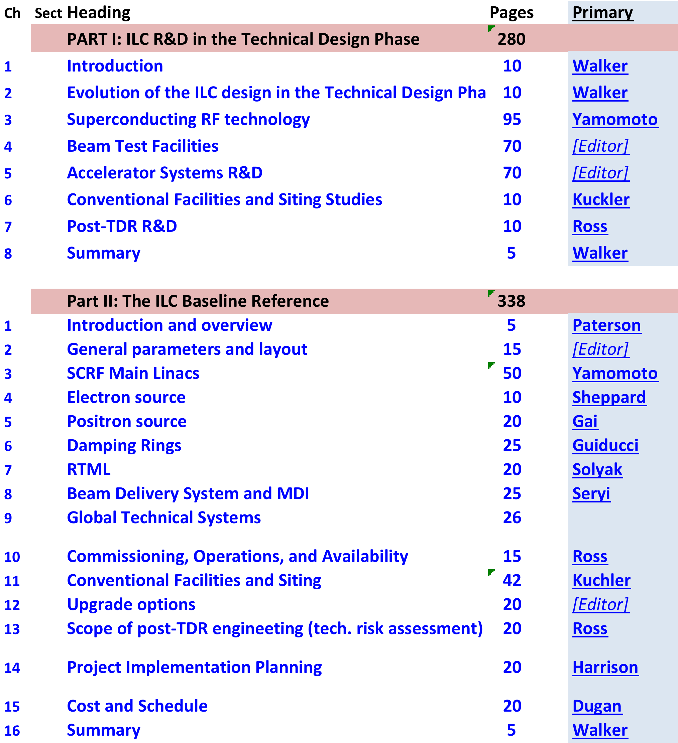
Logistics
There are too many chapters to spend 3hrs on each, so we will need to prioritize
Which authors are going to the meeting?

Slide 23
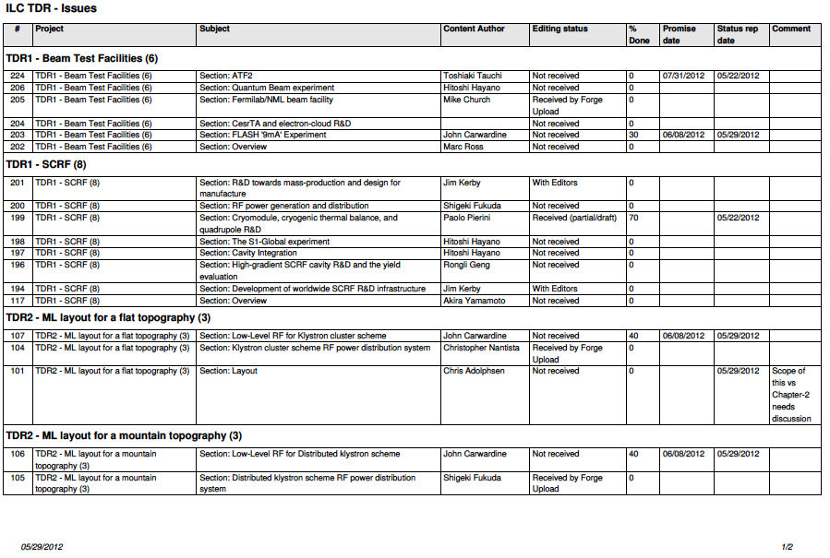
TDR Writing Status reported by J. K

