Slide 1
Update (29/05/2012)
MAD-X for Windows XP in Oxford – can run it now ( some editing of files was required
MAD-X via SSH in DESY/CERN is running but..
I can use converted BDS lattice to first step matching
Take 250 GeV CoM settings the task is to:
match to the new β_{x} =13mm and β_{y} =0.41mm
and remove dispersion which is non=zero in the present lattice –should vary quadrupoles downstream
KQF3 := 0.011524797231; kqf3 = 0.01147786643 ;
KQD0 := -0.15229179766; kqd0 = -0.1522525301 ;
KQF1 := 0.07234909233; kqf1 = 0.07254916217 ;
KQF5 := 0.011062408721; kqf5 = 0.01097346172 ;
KQD4 := -0.858256166518E-2; kqd4 = -0.008605842666 ;
β_{x} = 0.01299999482 ; β_{y} = 0.0004105255407 ; α_{x} =3.852111358e-010; α_{y} = 3.623848278e-010 ; Dx=-1.285273381e-010

Slide 2
Update(cont.)
When I use the full matching program ( with call to Python)from Rogelio, some error message appears:
file "getSigmasMixed25.py", line 10, in ?
from mapclassGaussianDelta25 import *
File "/afs/desy.de/user/m/malyshev/private/ILC_BDS/RepILCcopy/mapclassGaussianDelta25.py", line 4, in ? from numpy import *
ImportError: No module named numpy
Nevertheless
./getSigmasMixed25.py is running
and I got a list of sigma values. Thus some mistake in redirection to CERN afs happens somewhere.

Slide 3
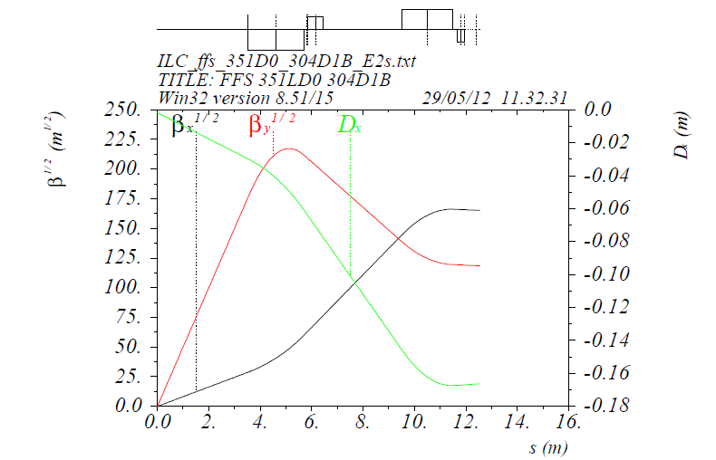
500 GeV CoM final doublet

Slide 4
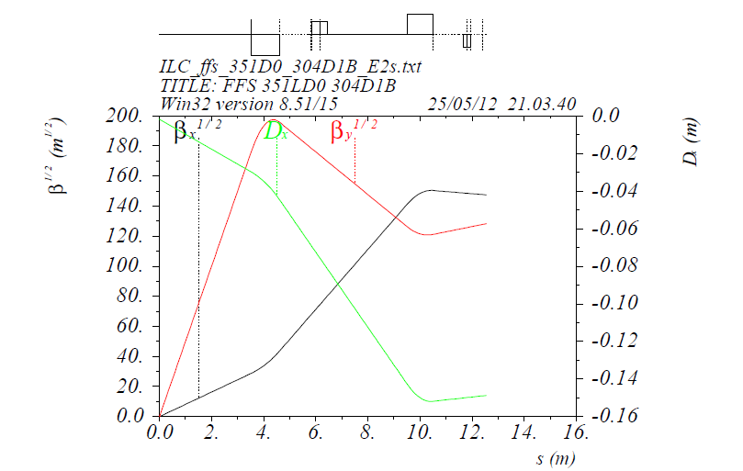
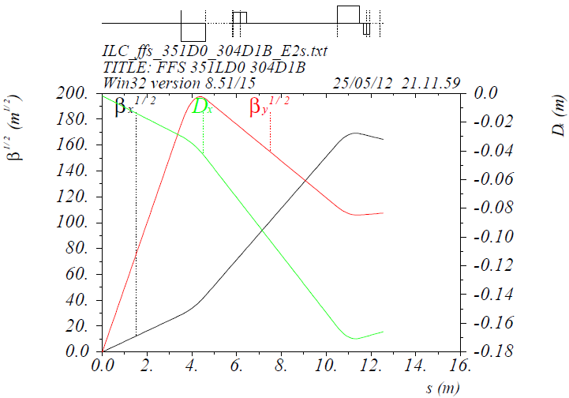
250 Gev CoM (unmatched)
IP
IP

Slide 5
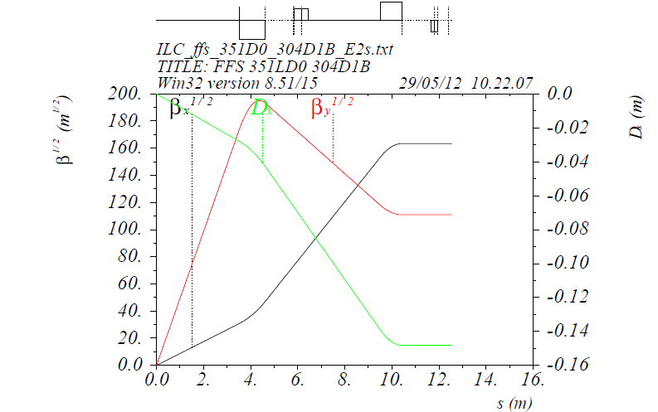
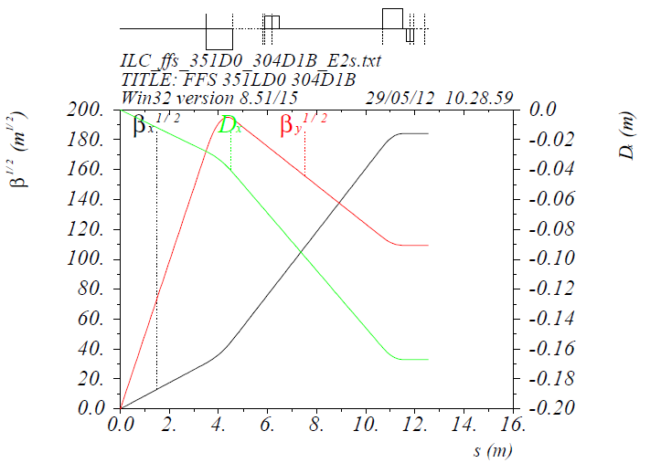
250 GeV CoM
IP
L_{QF1}= L_{D0}=1/2of original-0.06135
L_{D0}=1/2of original+ 0.0235
IP
L_{D0}=1/2of original-0.19
L_{QF1}=1/2of original-0.0784

Slide 6
Plans
Get MAD-X matching program running ( update Python in DESY or/and short visit to CERN?)
250 Gev CoM lattice optimisation over range of parameters

