Slide 1


Analysis of the Cavity BPM Data
Mikey Davis
1st June 2012
1/16

Slide 2
Introduction
I did several different experiments over the trip
I shall present these along with some analysis of the data
Mikey Davis
1st June 2012
2/16

Slide 3
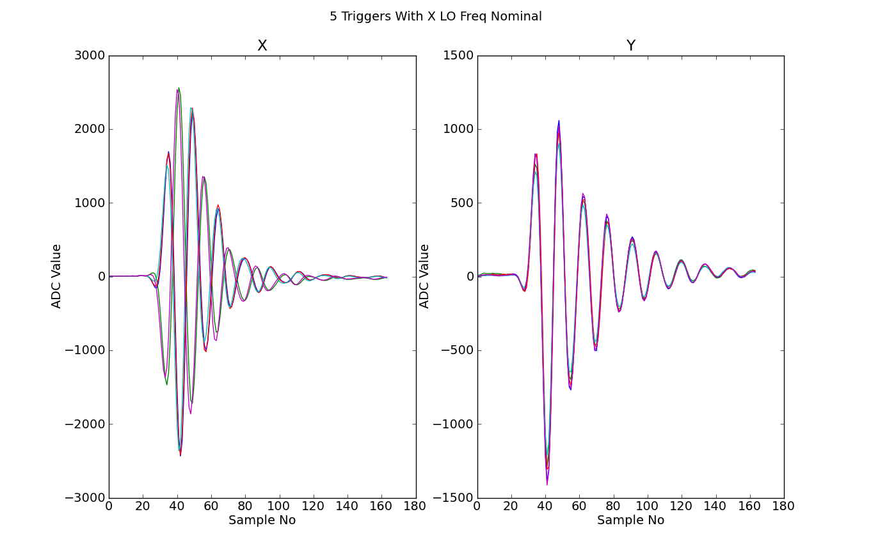
Standard Signals
Mikey Davis
1st June 2012
3/16

Slide 4
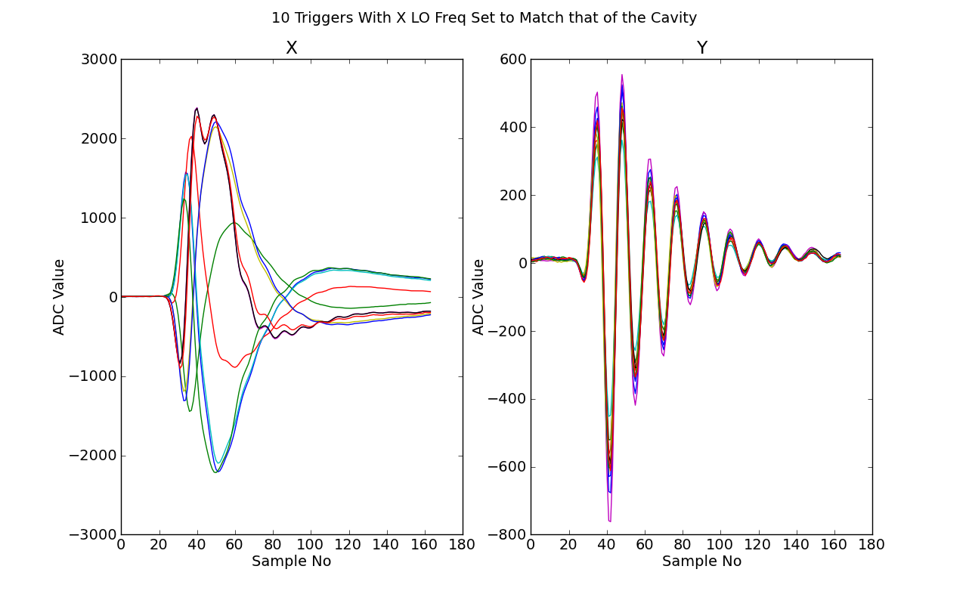
Signal With X Lo Matched
Mikey Davis
1st June 2012
4/16

Slide 5
Phase Locking the X Signal
It should be possible to lock the phase of the x LO signal to the beam arrival like the y LO.
If we then adjust the frequency to get a homodyne signal we should get a signal we can use
I tried to do this…
Mikey Davis
1st June 2012
5/16

Slide 6
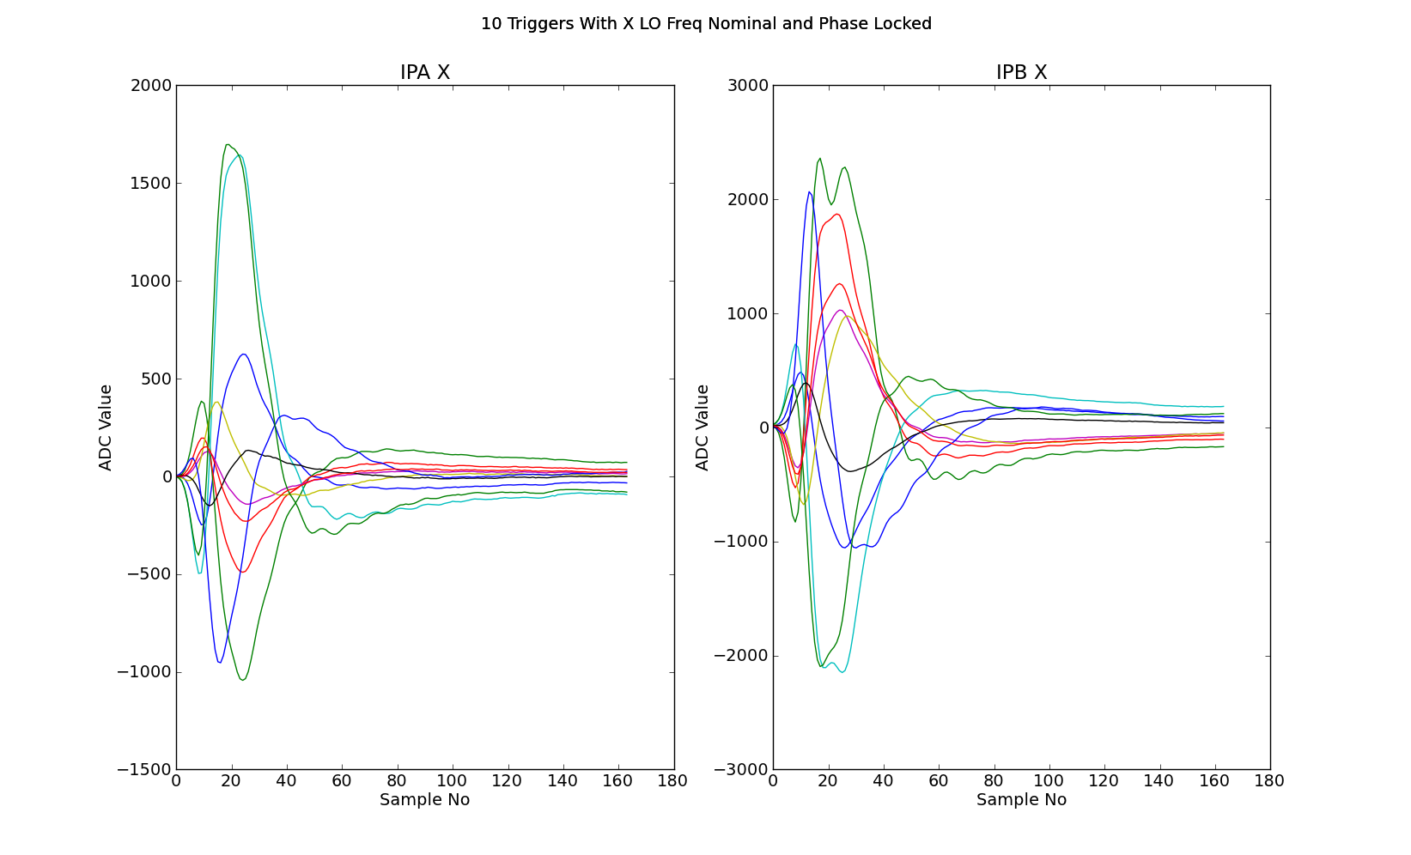
Signal With X Lo Phase Locked
Mikey Davis
1st June 2012
6/16

Slide 7
Phase Locked Lo Continued
This has clearly not worked
Glenn has pointed out that I would need to adjust the frequency of the X Lo to be some multiple of the master oscillator frequency
Mikey Davis
1st June 2012
7/16

Slide 8
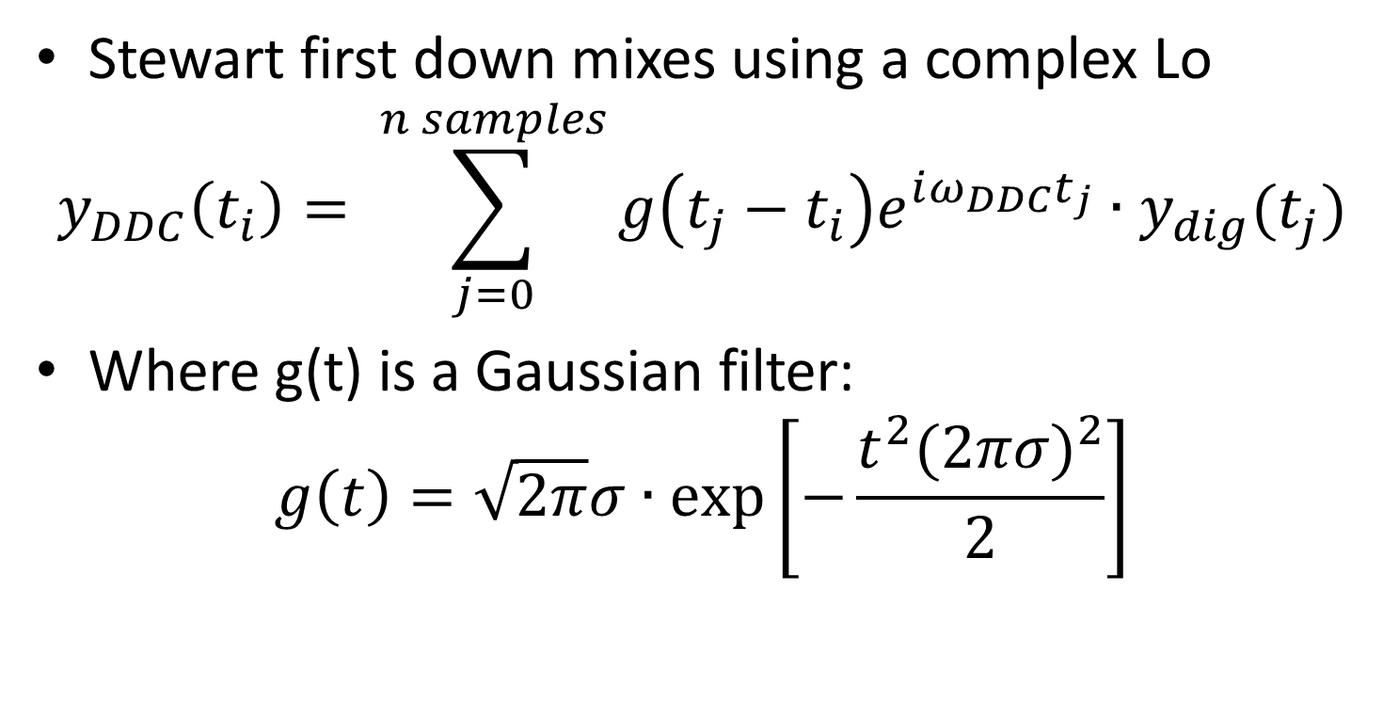
Stewarts Procedure
Stewart first down mixes using a complex Lo
$$y_{DDC}\left(t_{i}\right)= \sum_{j=0}^{n samples}{g\left(t_{j}−t_{i}\right)e^{iω_{DDC}t_{j}}∙y_{dig}(t_{j})}$$
Where g(t) is a Gaussian filter:
$$g\left(t\right)=\sqrt{2π}σ∙exp⁡\left[−\frac{t^{2}(2πσ)^{2}}{2}\right]$$
Mikey Davis
1st June 2012
8/16

Slide 9
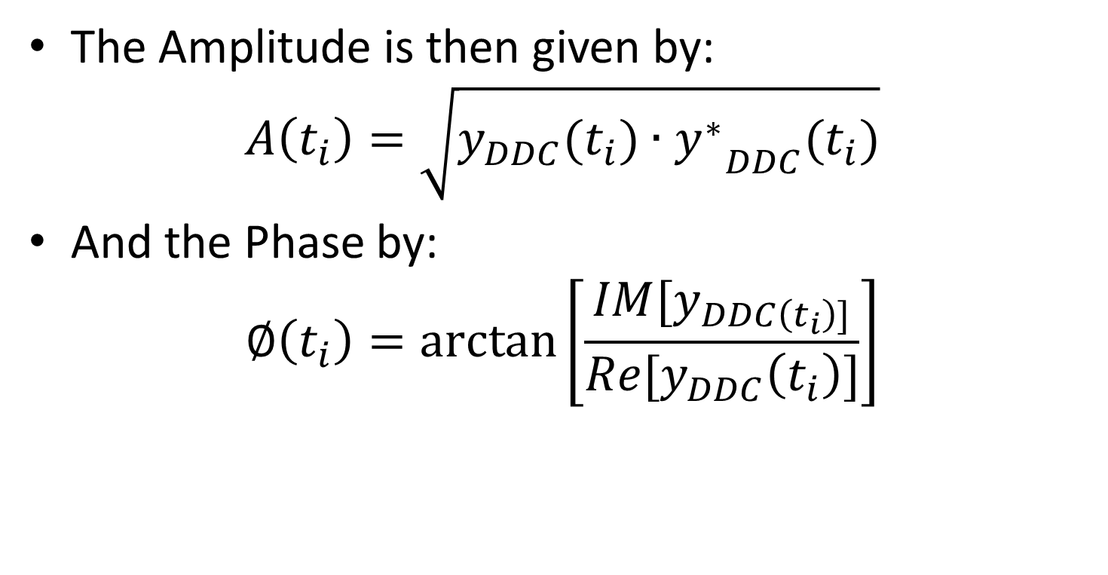
Amplitude and Phase
The Amplitude is then given by:
$$A\left(t_{i}\right)=\sqrt{y_{DDC}(t_{i})∙{y_{}^{∗}}_{DDC}(t_{i})}$$
And the Phase by:
$$∅\left(t_{i}\right)=arctan\left[\frac{IM[y_{DDC\left(t_{i}\right)]}}{Re[y_{DDC}\left(t_{i}\right)]}\right]$$
Mikey Davis
1st June 2012
9/16

Slide 10
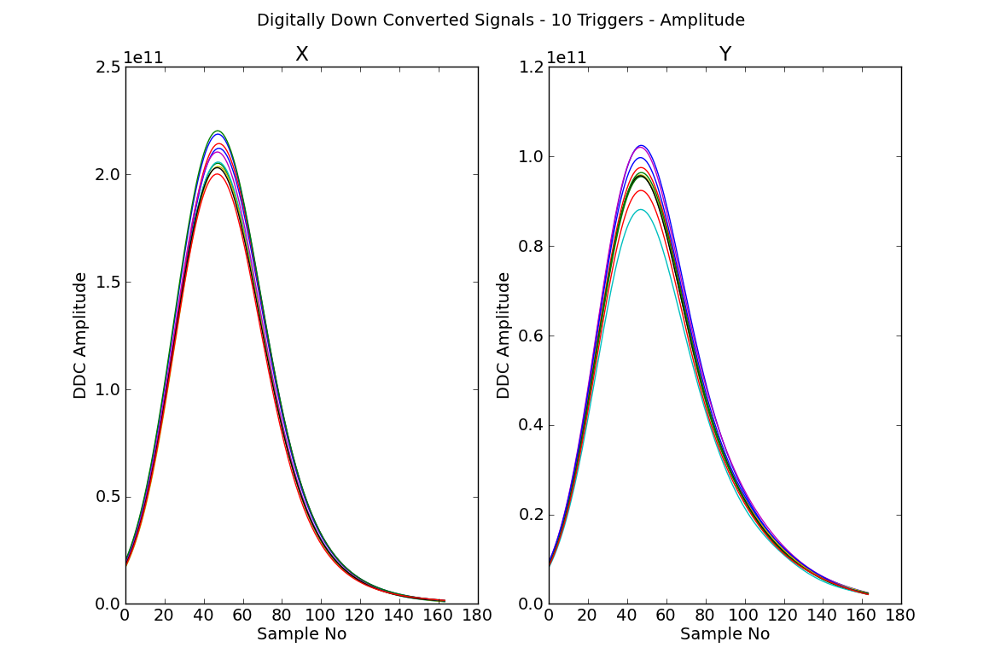
Down Mixed Signal(Amplitude)
Mikey Davis
1st June 2012
10/16

Slide 11
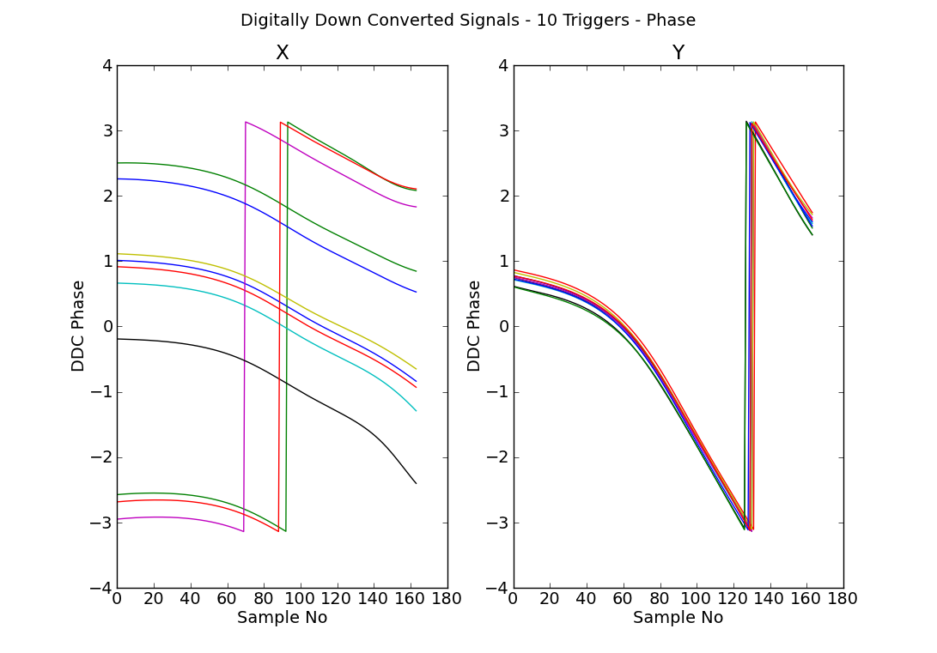
Down Mixed Signal(Phase)
Mikey Davis
1st June 2012
11/16

Slide 12
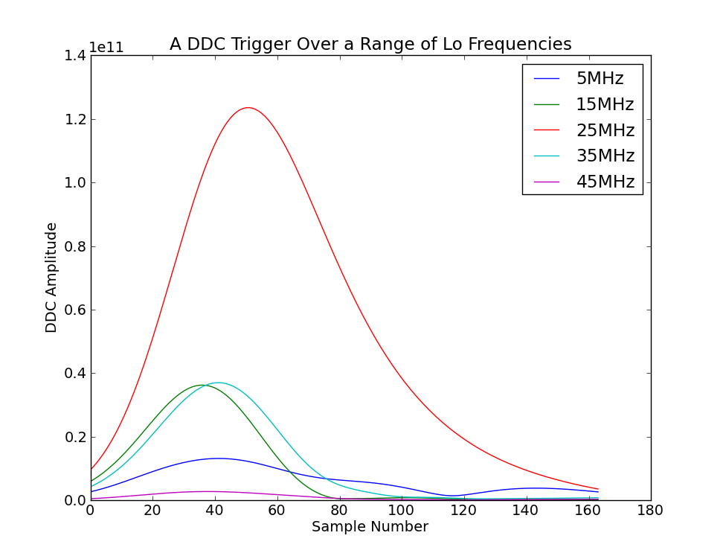
Lo Frequency
Mikey Davis
1st June 2012
12/16

Slide 13
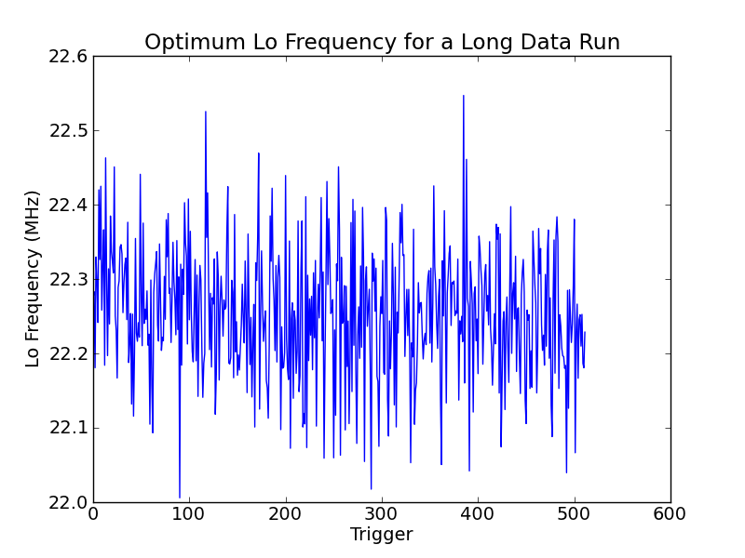
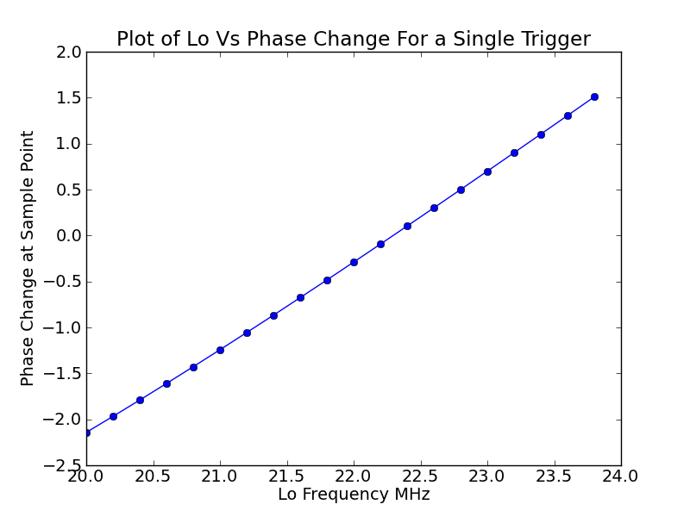
Optimum Lo Frequency
Mikey Davis
1st June 2012
13/16

Slide 14
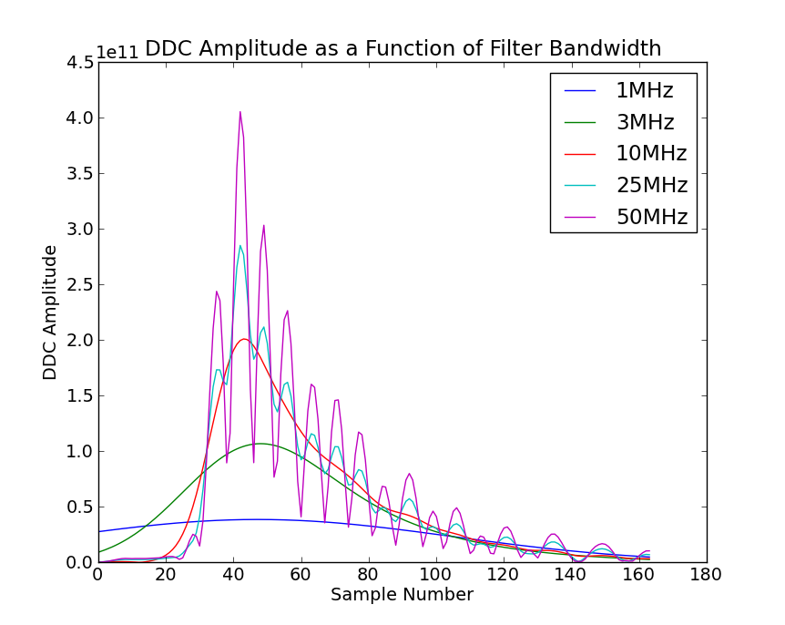
Filter Bandwidth
Mikey Davis
1st June 2012
14/16

Slide 15
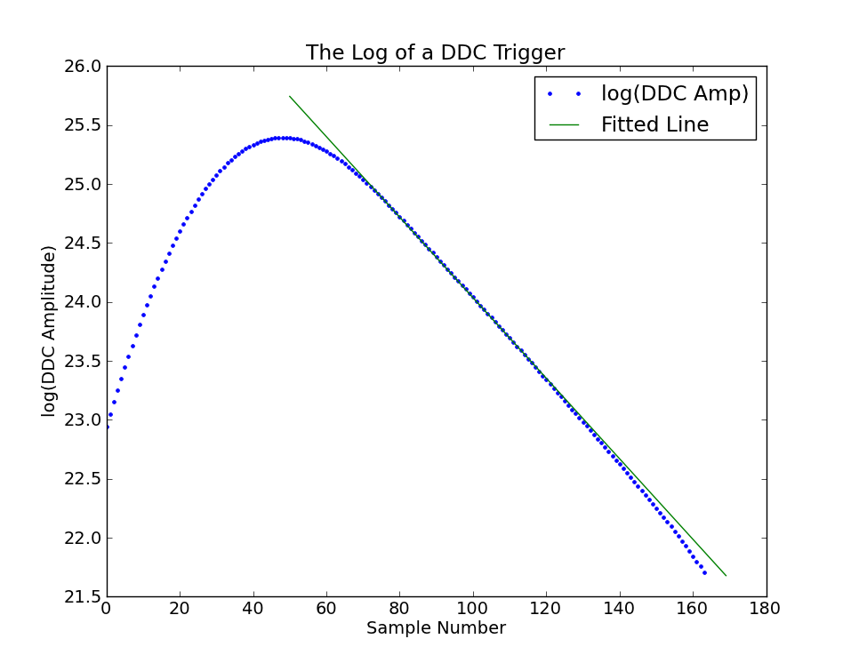
Ln Amplitude
Mikey Davis
1st June 2012
15/16

Slide 16
Conclusions
We can rather unsurprisingly use the FONT V board to record Data from the cavity electronics
If we want to go down the DDC route I would think we’d need a simpler method
If not we could still try Honda’s electronics or a correctly phase locked Lo.
Mikey Davis
1st June 2012
16/16

