Slide 1

Mechanical studies for a TPC at the ILC
I-DEAS for the ILD-TPC
Ties Behnke, Volker Prahl
DESY Hamburg

Slide 2
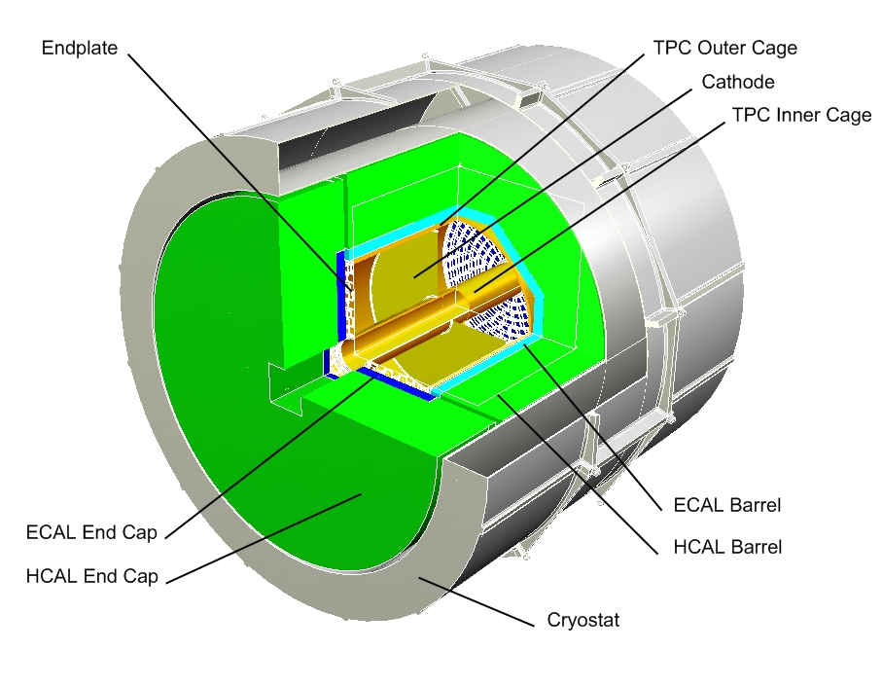
The mechanical model
Detector components
inside the magnet
  VTX
  Silicon
  TPC
  Calorimeters
Current model:
TPC supported from Coil
Inner detectors supported from TPC

Slide 3
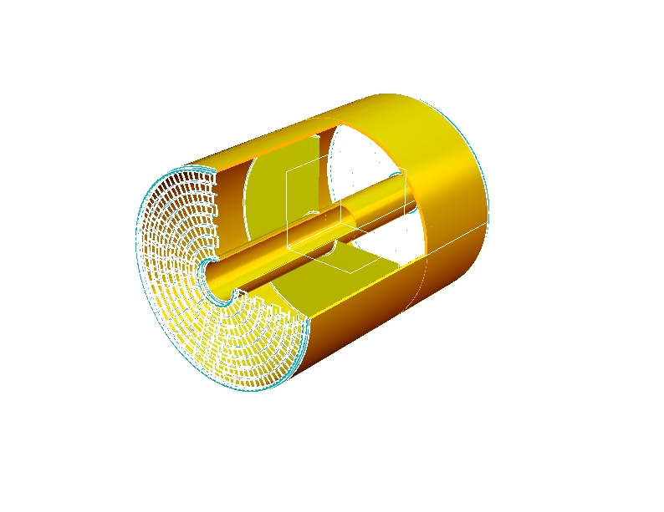
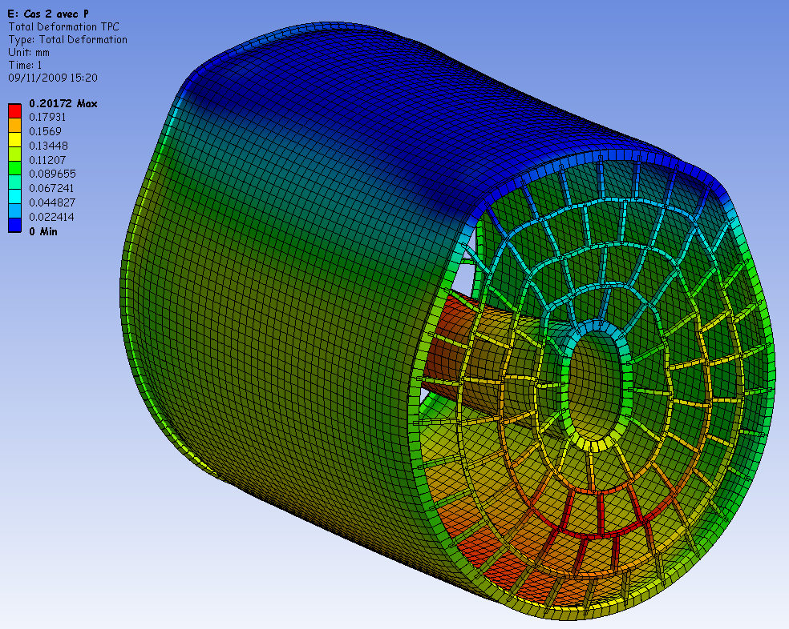
Design studies: mechanical properties
Light weight Endplate
by D.Peterson
FEM Calculations by CEA Saclay:
Deflection O(150 µm) @ 3 mbar
We still do not have a very good
understanding of the beviour of
the system.
PRC report 2010

Slide 4
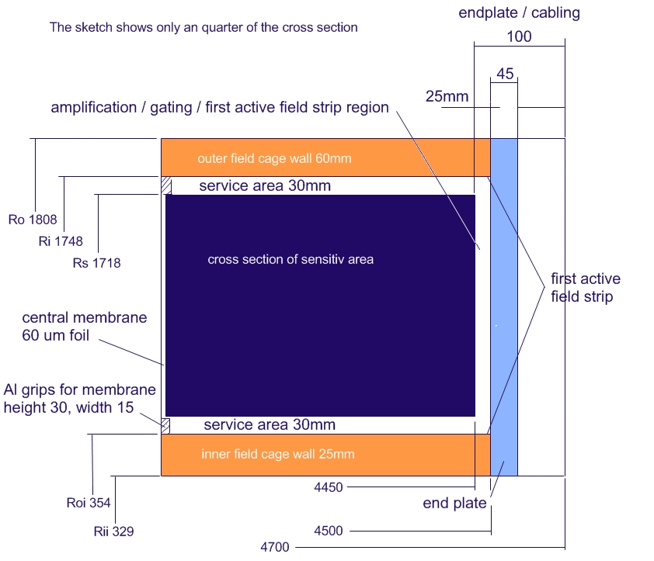
Details of TPC design
Infrastructure ( Cables, Gaslines, Cooling, Alignment ) C.Clerc
Boudaries for a design have been
defined

Slide 5
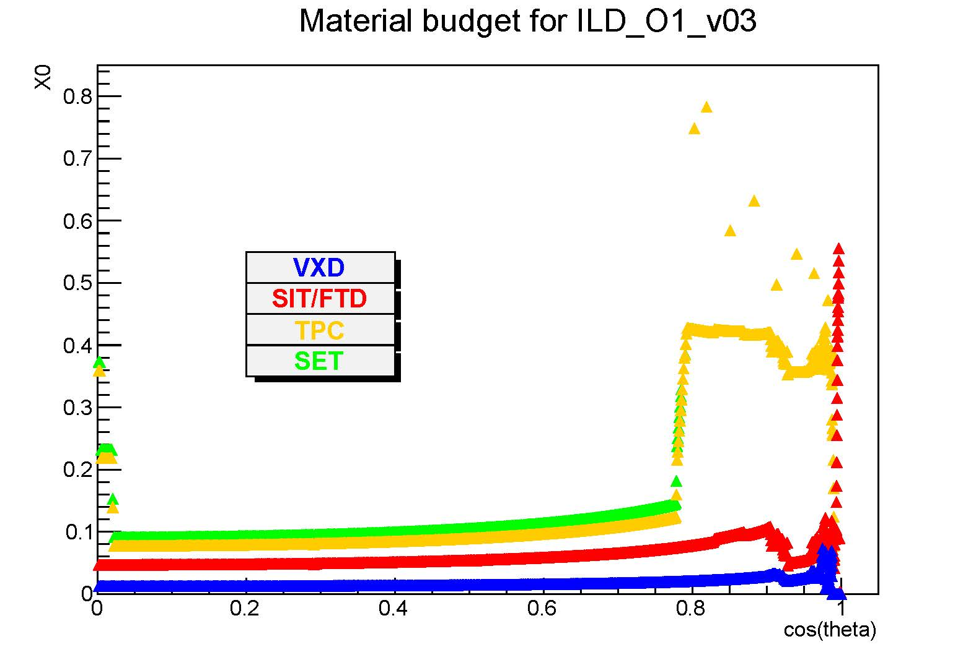
Material distribution
40%X0 spike in the
middle of the detector:
Caused by the cathode
support

Slide 6
Support Rings
Current model:
Massive Carbon-fiber support ring
Proposed alternative model
Support ring from composite materials:
1mm Carbon (0.35%)
28mm Carbon Foam (0.5%)
1 mm Carbon (0.35%)
About 2% X0 (instead of 40%)
for two rings
Support rings
carbon – foam - carbon
Cathode foil

Slide 7
Cathode design and support
Typical cathode design:
Tensioned foil (mylar, CFC, …)
supported by inner and outer ring
Design goals and problems:
Light weight, thin
Mechanically stable and robust
(inaccessible)
Supply of HV non trivial
Studies in laboratory support
this design: load is about 2kg/10cm outer radius
HV supply through special
HV cable, OF about 14mm for
100 kV
STAR TPC

Slide 8
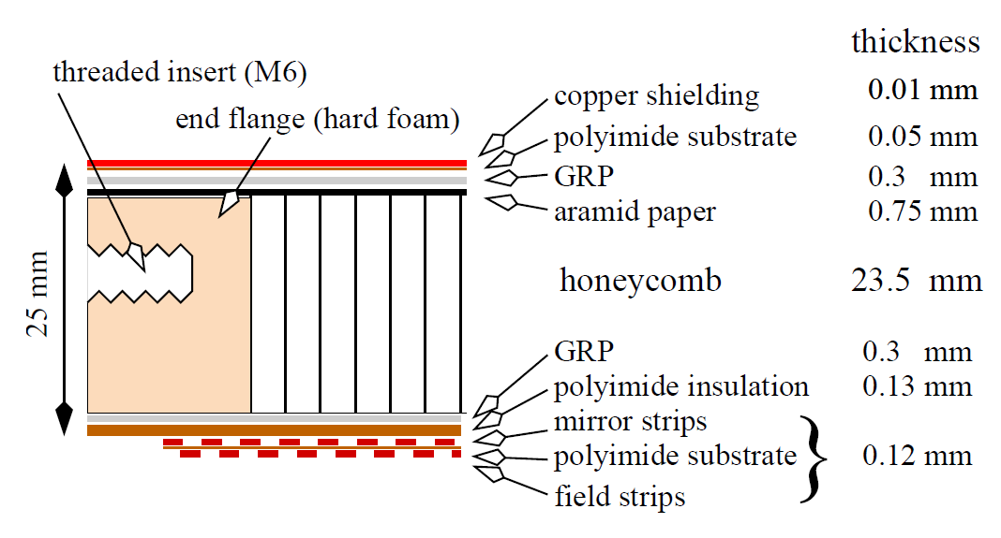
Field Cage Design
Wallstructure Large Prototype TPC: HV stable up to 30 kV
→ extrapolate to ILD-TPC (O(100 kV))
Estimate: Outer field cage 60mm, inner field cage 30mm

