Slide 1
ILC Central Region Cryogenics for
DR, BDS/MDI, and Detectors
Akira Yamamoto (GDE-PM)
in cooperation with
SCRF, BDS, DR, Detector groups, and PMs
GDE-ADI meeting, June 20, 2012

Slide 2
This is outcome from Intensive Meetings, since early 2012
February GDE, ADI and cryogenics meetings
March: GDE Cryogenics Meeting
April: KILC12, Central Region Session
May : GDE/Detector Cryogenics Meeting
May: GDE ADI meeting
June: MDI/Detector Cryogenics Meetings (2~3)
Today: GDE ADI meeting
We would thank everyone’s much effort and contribution for better understanding and discussions.

Slide 3
Cryogenic Systems Layout Status
Tom Peterson,
with some contribution by Akira Yamamoto
ILC cryogenics meeting via Webex
31 May 2012, added June 20, 2012

Slide 4
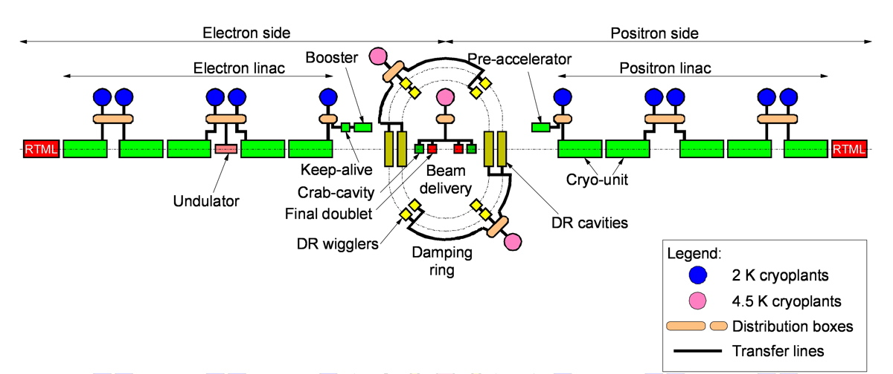
RDR cryogenics layout, for reference

Slide 5
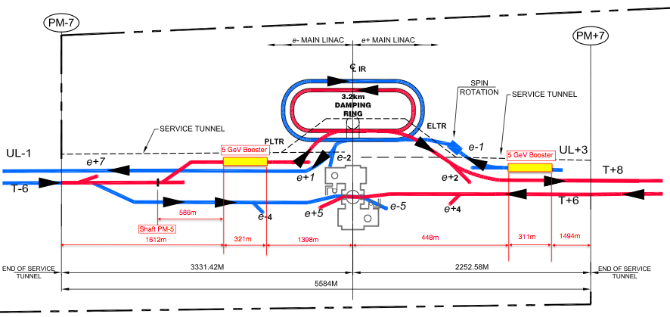
5 GeV booster linac locations
ILC GDE Cryo, Tom Peterson 31 May 2012

Slide 6
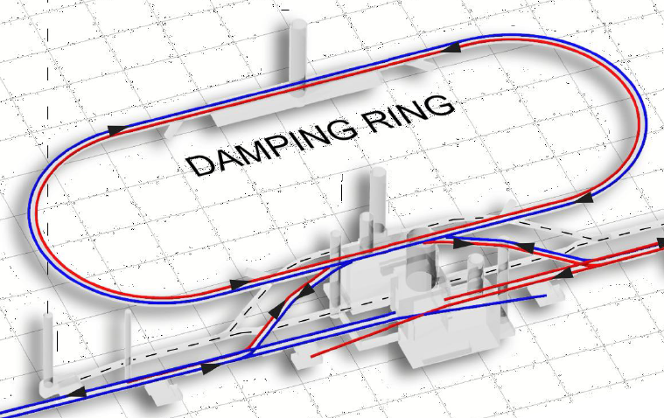
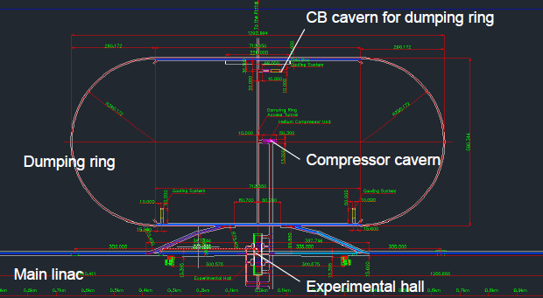
Cryogenics Location in Central Region
Flat Topography
Cryogenics at Central Region
Damping Ring
e- source: Booster Linac
e+source: Booster Linac
Focusing (QF0) + Crab Cavity
Focusing (QD0) + Comp. Sol. + SiD Solenoid
Focusing (QD0) + Comp. Sol. + ILD Solenoid
An important Concept suggested:
Distributed Refrigerators (Cold-Boxes)
  Best efficiency in themodynamics
Centralized Main-compressor station
  Well isolated from detector hall
    Major vibration source distanced
  CFS interface to be unified
    electricity and water-cooling
Main Compressors
on surface
Mountainous Topography
Damping Ring
Main Compressors,
underground

Slide 7
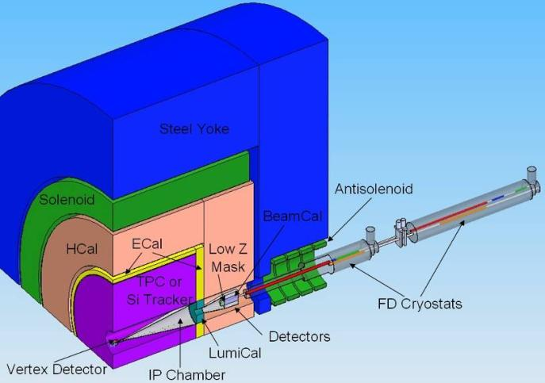
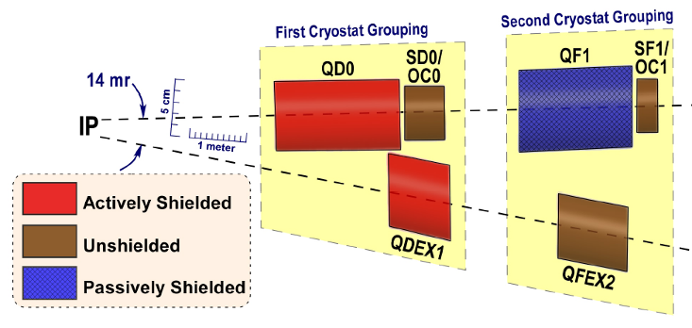
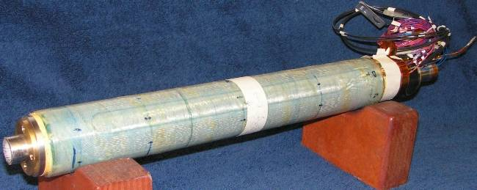
IR Region and Final Doublet
FD arrangement for push pull
  different L*
  ILD 4.5m, SiD 3.5m
Short FD for low E_{cm}
  Reduced β_{x}*
    increased collimation depth
  “universal” FD
    avoid the need to exchange FD
    conceptual - requires study
Many integration issues remain
  requires engineering studies beyond TDR
  No apparent show stoppers
BNL prototype of self shielded quad
Notes:
Short FD effectively increases collimation depth (SR fan from FD). Universal FD (to prevent having to exchange cryostats) still requires proof of principle design.
Still many integration issues for IR/MDI. Requires engineering studies (beyond TDR).

Slide 8
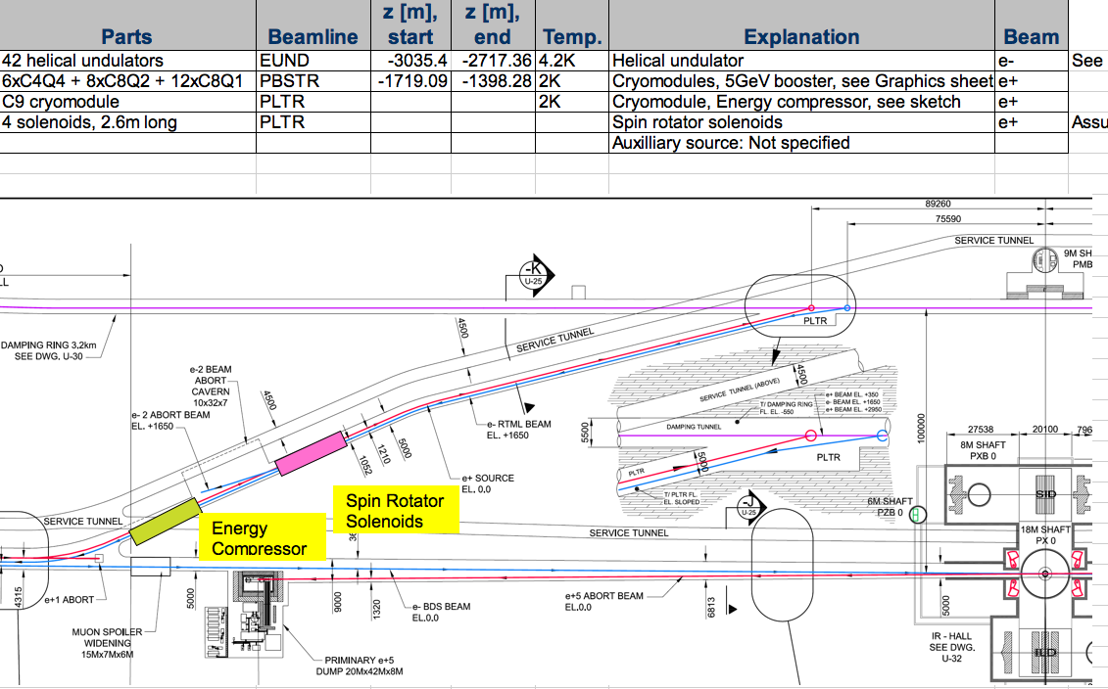
A few other cryogenic devices
ILC GDE Cryo, Tom Peterson 31 May 2012

Slide 9
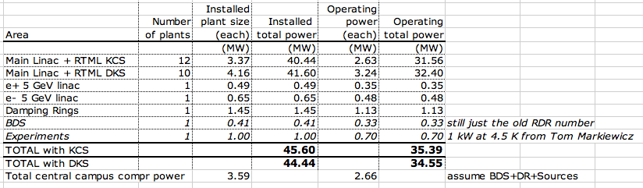
Installed cryogenic plant power
KCS and DKS have essentially the same total cryogenic plant power
  DKS slightly higher due to shorter cryogenic strings, more end boxes. Difference insignificant.
Undulators and some other odd devices not in this yet
ILC GDE Cryo, Tom Peterson 31 May 2012

Slide 10
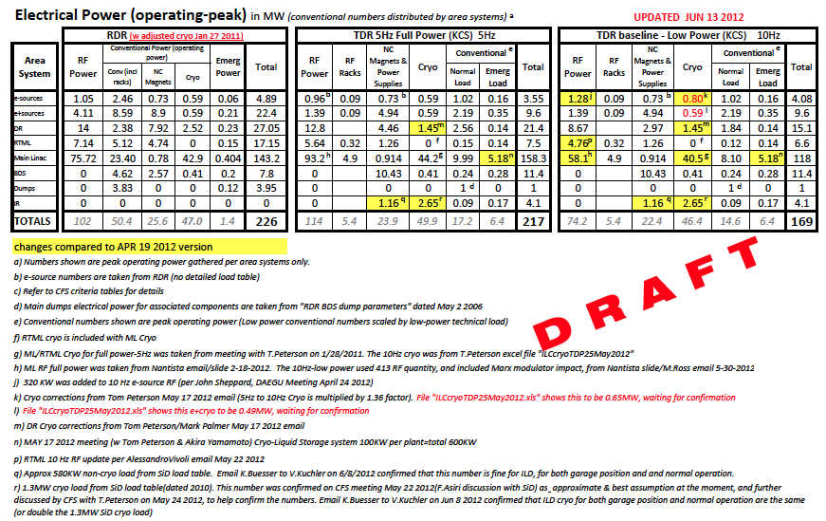
ILC-TDR: CFS Electric Power Balance

Slide 11
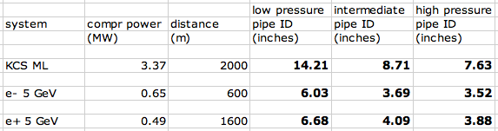
Helium pipe sizes for remote compressor locations
Piping from the central campus to relatively small cryogenic plants such as boosters is not a problem
  3 1/2 inch (100 mm) pipe installed cost est in 2006 is $148/meter
  6 inch (150 mm) pipe installed cost in 2006 is $275/meter
  12 inch (300 mm) pipe installed cost est in 2006 is $716/meter
Main Linac compressors may be located away from cold boxes with room temperature piping
  Need to check cost tradeoffs for large pipes versus locations of compressors
ILC GDE Cryo, Tom Peterson 31 May 2012

Slide 12
Tom’s Conclusions as of May 31, 2012
Piping to 5 GeV booster linacs and other central region cryogenics from one central compressor location looks practical
Next step is detailing cryogenic supply to undulators and some of the small isolated devices in the central region
  Energy compressor, spin rotator solenoids
  Add those cryogenic cooling powers to total
Document helium warm pipe lengths and cold transfer line lengths
  Refine total heat load estimates
  Include in cost estimates
12

Slide 13
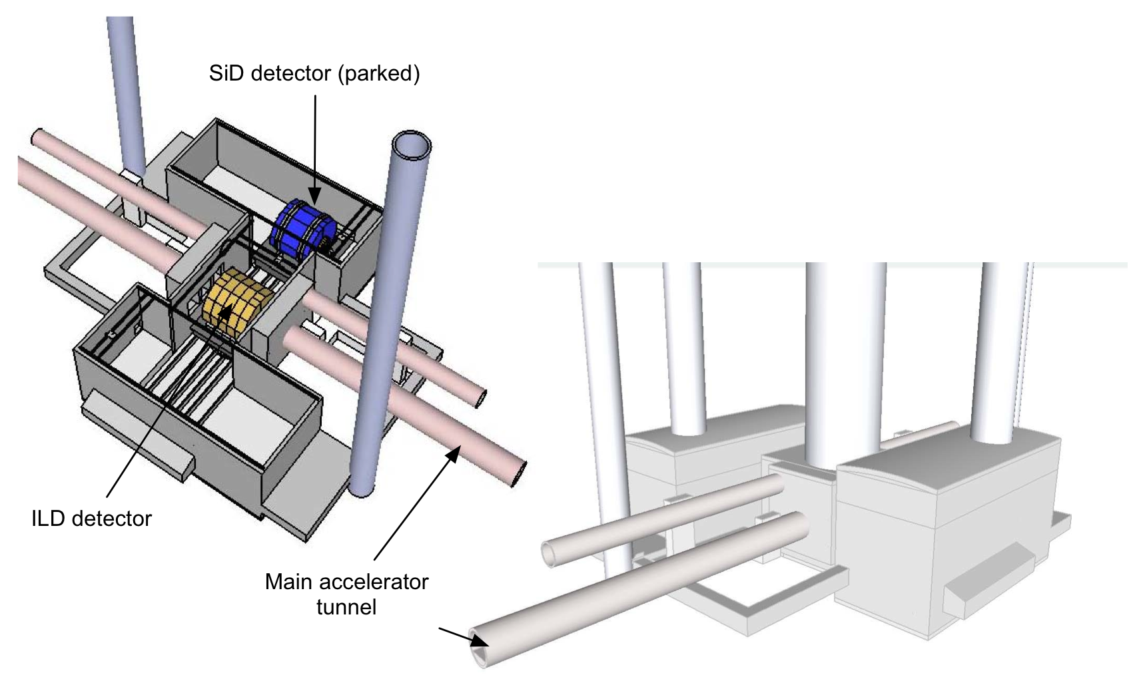
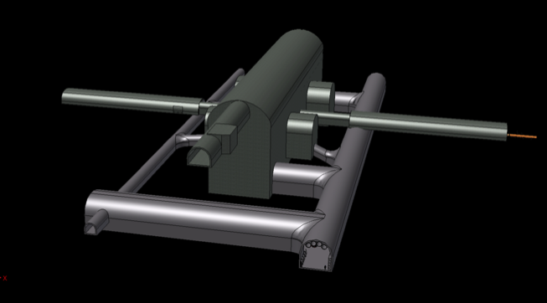
Detector Hall CFS Review
Review Questions:
  Criteria understood?
  Design satisfy the criteria?
  What are the cost-drivers?
  What are the outstanding issues?
Presentations:
  Alignment requirements (special tunnels)
  Underground Assembly schemes
  Cryogenic systems
  Cost roll-up
Report to be written.
Flat-topography
detector hall concept
Mountainous topography detector hall

Slide 14
SLD/ILD Engineering and Detector
Interface Working Meeting
SiD Cyrogenics
Wes Craddock
SLAC
December 12, 2011

Slide 15
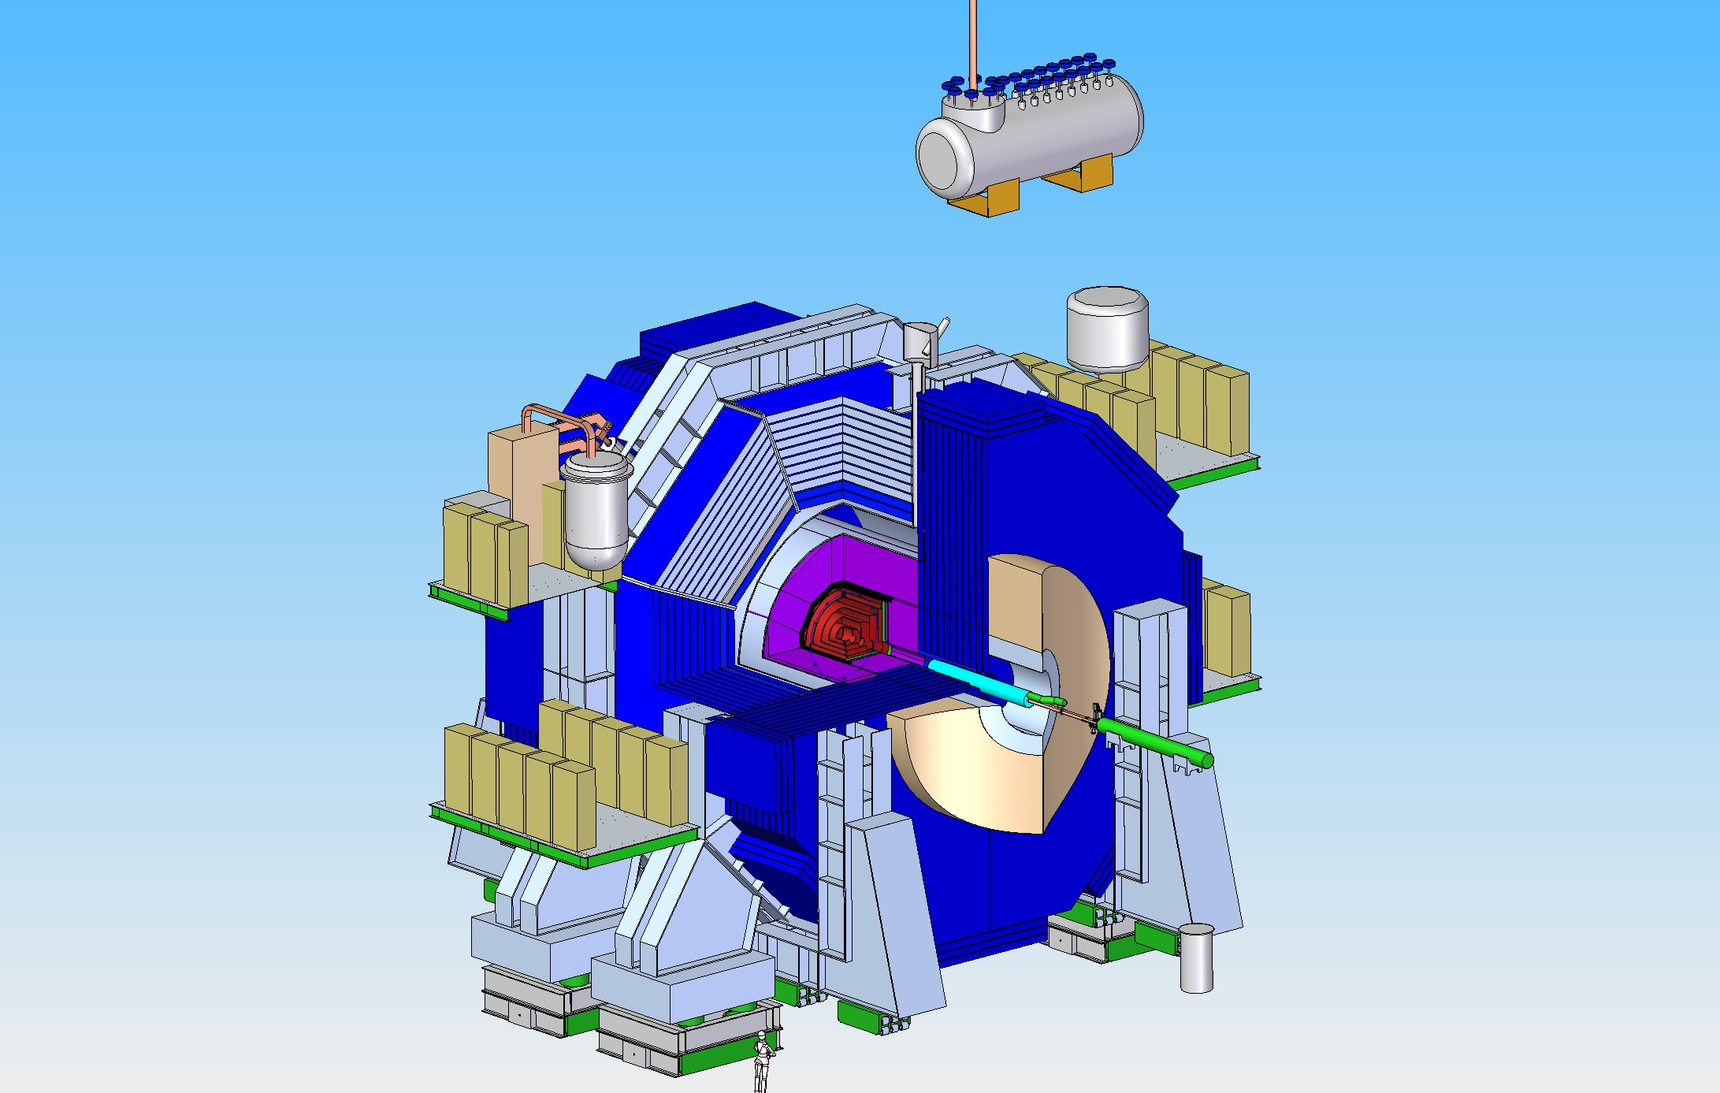

Slide 16
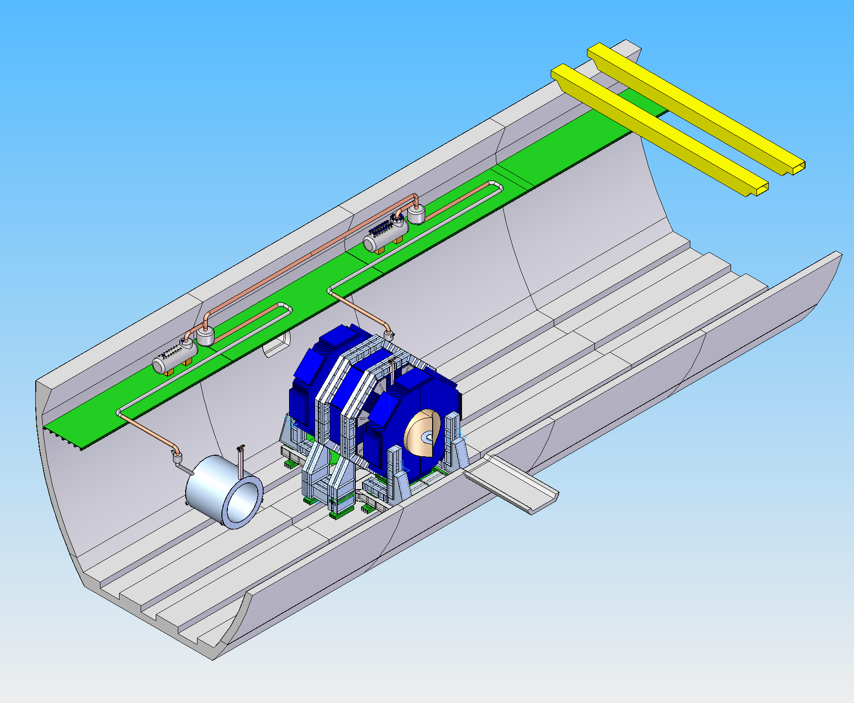

Slide 17
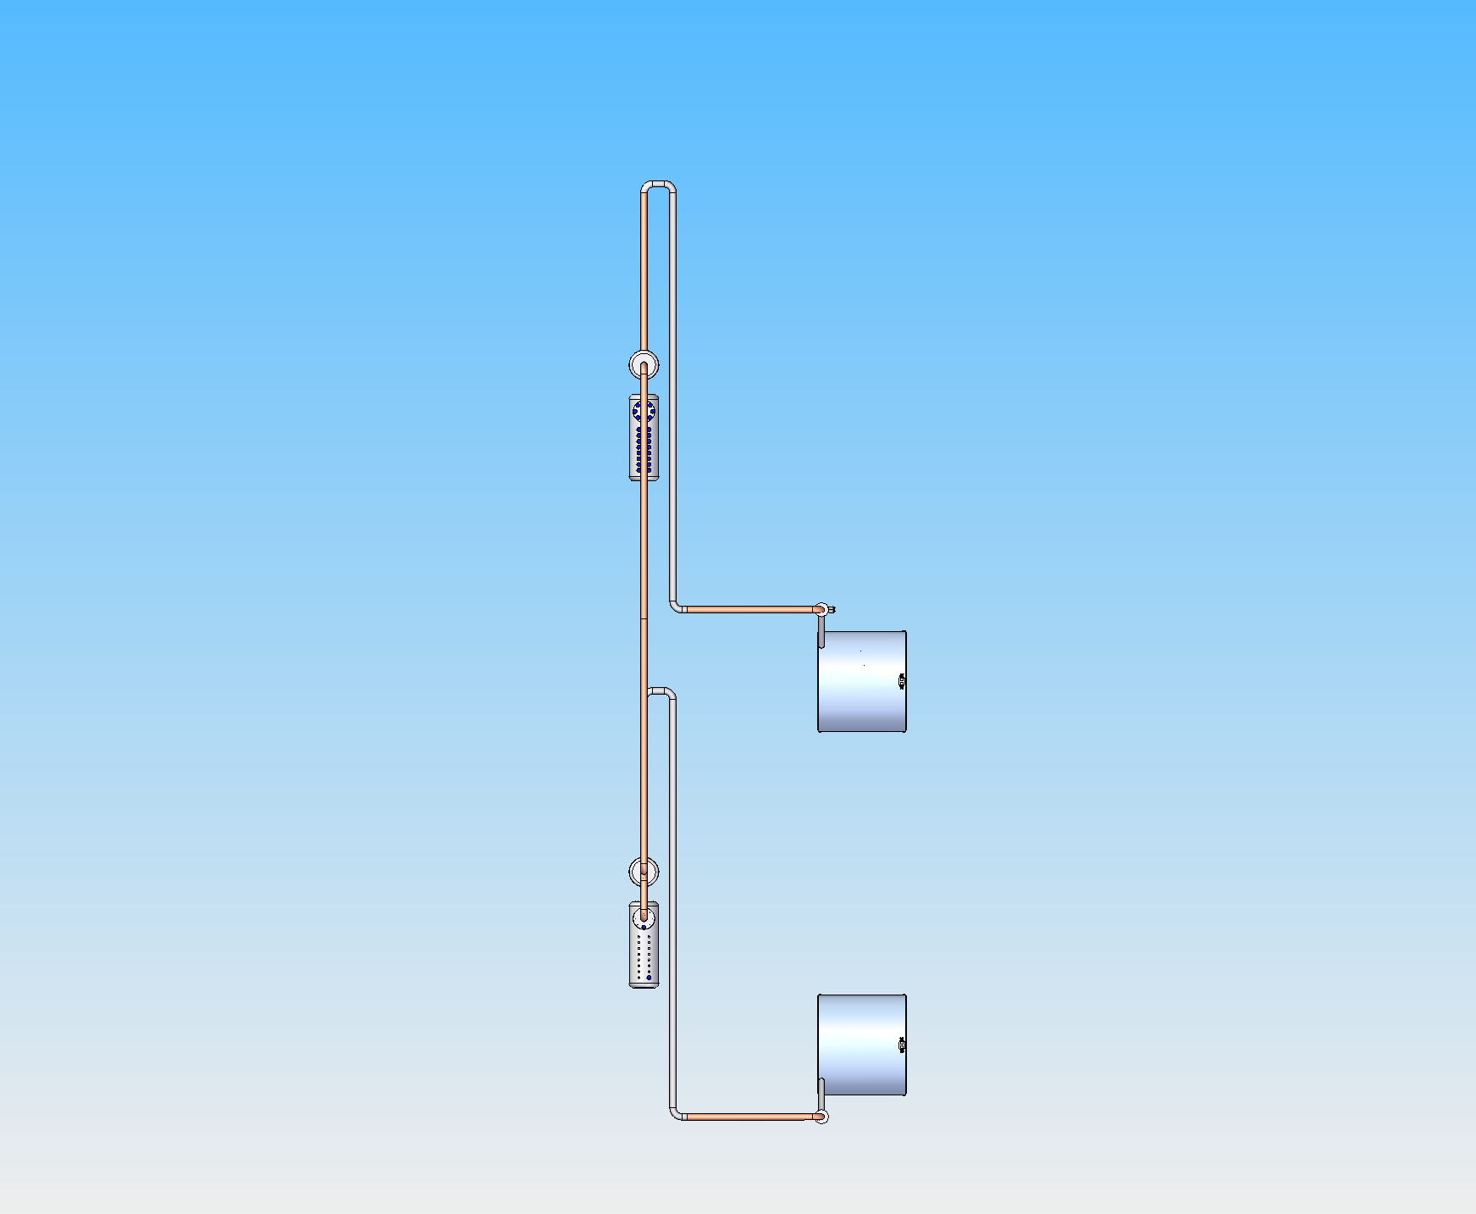

Slide 18
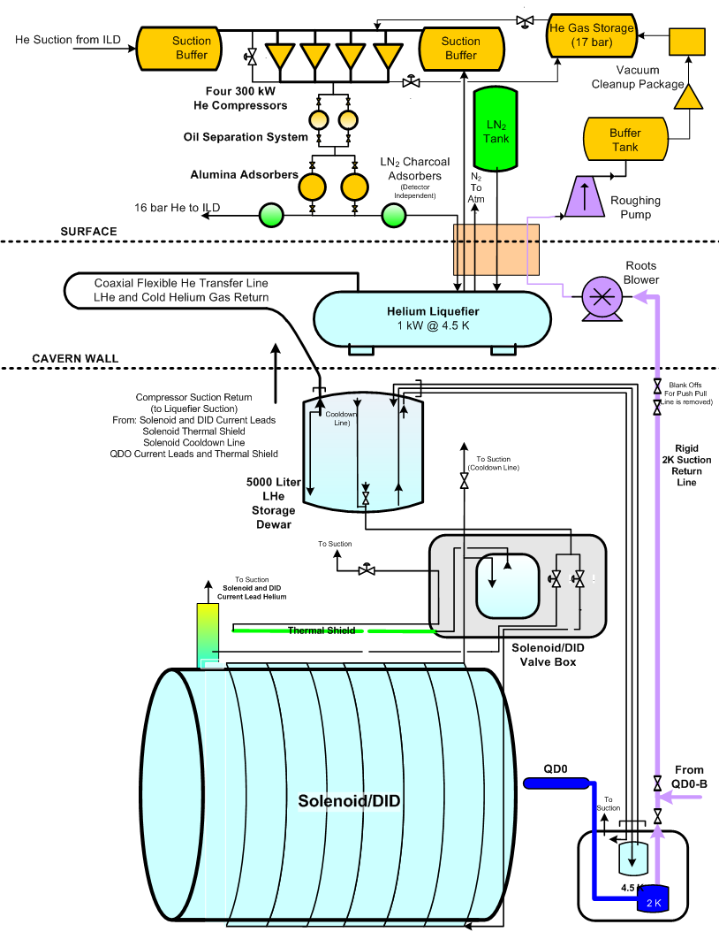

Slide 19
SiD Cryo Questions
QDO:
Can we use only one LHe supply to QD0? Do we really need LN2 and a separate cooldown line?
  Comment by AY: to be discussed later, not LN2 use.
Does the LHe connection from the LHe storage dewar to QD0 every need to be removed for detector servicing?
  Comment by AY: we need to understand better the detector opening scenario.
What is the routing of the 4 K LHe line to QD0? Is it rigid, flex or a combination?
  Comment by AY: rigid is better for stability, but probably combination,
QDO 2K Vacuum Pumping System:
Is it possible to use the ILC vacuum pumping system ???
  Comment by AY: Probably independent line for reliablity to each other.
How is the 2 K suction line made and run, rigid or flex???
  Comment by AY: at least it should be vacuum isolated transfer-line.
LN2 System:
What is the elevation of the LN2 tank? If it is at a great elevation, a pressure reduction system is needed.
  Comment by AY: We will not plan to use LN2 because of safety in long, underground tunnel.

Slide 20
Cryogenic System of Interaction Region
(SiD, ILD, QD0, QF1, Crab Cavity) in the Japanese Mountain Site
WebEx meeting : ILC Central Region Cryogenics
June 1, 2012
Updated, June 13, 2012
KEK IPNS/Cryogenic Group
T. Okamura, Y. Makida, and M. Kawai

Slide 21
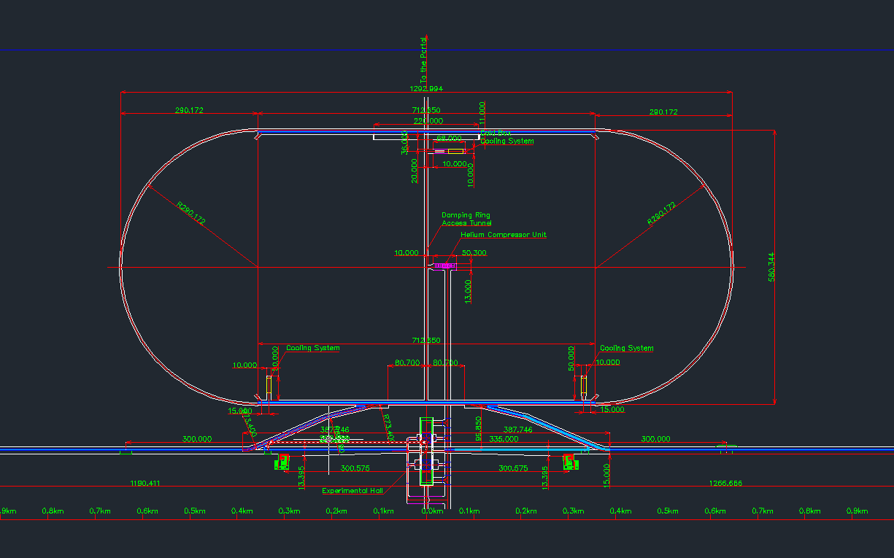
Overall layout of Interaction Region
Damping Ring
Superconducting equipment (RF, Wiggler)
CB room for DR
Compressor Cavern
Main Linac
Experimental Hall
(Superconducting instruments SID, ILD, QD0, QF1, CC)

Slide 22
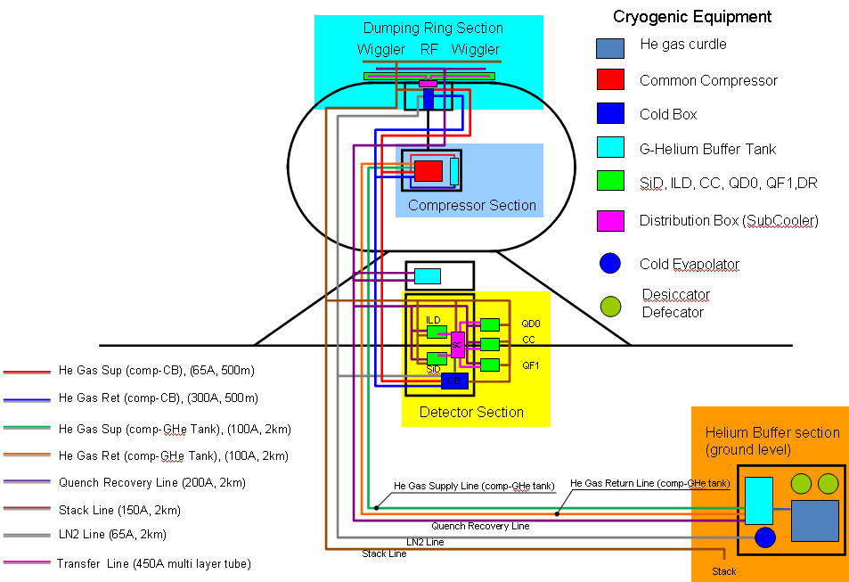
Cryogenic overall block diagram example
Cryogenic system for IR including dumping rings is composed of four sections.
1. Compressor cavern
2. CB cavern for DR
3. Experimental Hall for detectors.
4. Helium buffer tank section.
All compressors for SiD/ILD, QD0, QF1 and CC are installed
in the compressor cavern.

Slide 23
Baseline design of central region commented by AY
3 cold boxes; one for ILD+QD0s, one for SiD+QD0s, and one for QF1s and crab cavities (The scenario has been agreed by both SiD and ILD side
There are two possibilities of the location of CBs for detectors
  On the detector/platform (see P3) ⬅ Cryogenic Scenario of mountain site
    300K flexible tube along the cable chain in the cable pit or on 6F utility floor
    (depends on the bending radius)
  On the side wall (see P4)
    CB on 5F or 6F utility floor
    4K flexible transfer tube on 6F utility floor
      There is no need to prepare large space for multiple TRT.
    CB and flexible transfer tube locate above the entrance of the access tunnel in order not to disturb the detector assembly
Choice of the location of the CB is up to each detector group >> not recommended
  Still need to be discussed and agreed, also with accelerator, because of QD0 (should be common)
Capacity of the compressor for three CBs has to be defined before AD&I meeting

Slide 24
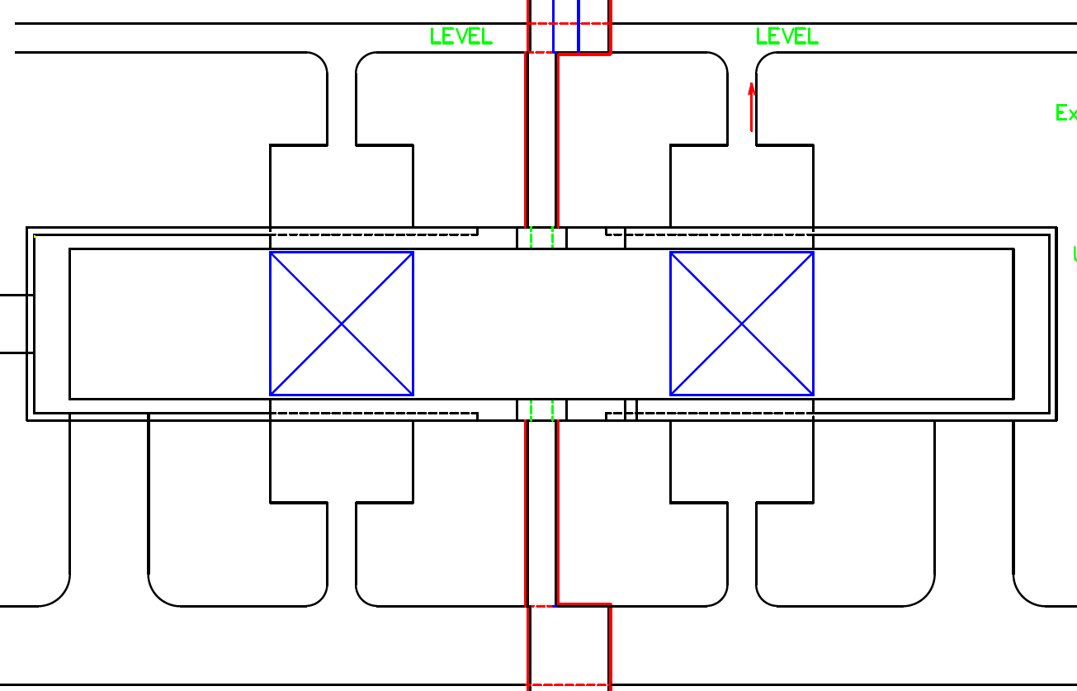
Cryogenic Layout in the experimental hall
CB3 and distribution boxes for CC and QF1 are installed on the 6F.
CB1, 2, distribution boxes and PSs are installed on the each platform for detector
Several numbers of ordinary flexible tubes have to be employed. (see P8 & P10)
Cooling capacity of each CB =2kW @4K
CB1
(2kW)
CB2
(2kW)
CB3
(2kW)
Cold Boxes (CB1,2,3)
Distribution box (4.2 K)
Distribution box for detector (4.2 K)
SiD, ILD, CC, QD0, QF1
Conventional TRT
Subcooler for 2.0K saturated HeII
7K Helium Gas Line

Slide 25
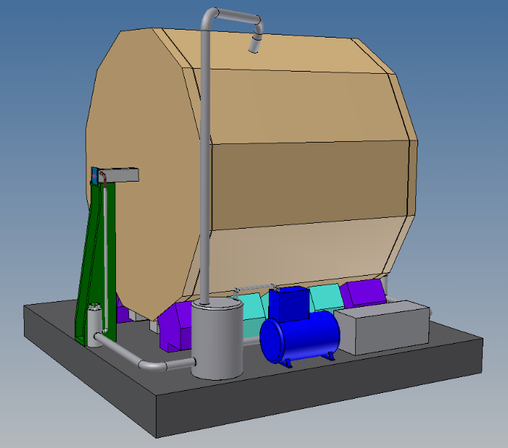
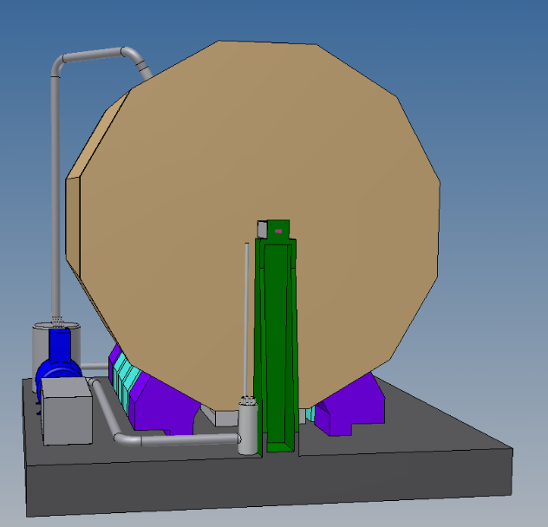
Schematic 3D view of Plan-B
Transfer tube for ILD @ two phase flow 4.5 K (OD=457.2mm)
ILD
ILD
PS
Distribution box (4.5K)
Cold box @ 2.0 kW
D=2.0m, H=3.5m, W=6m, Weight=5 ton
Transfer tube for QD0
Subcooler for QD0 (2.0K)
Vibration Reduction Method
・ Optimization of support post for QD0 by means of modal analysis
・ Application of high vibration reduction material such as D2052 etc.
The optimal location of cold box has to be reconsidered.

Slide 26
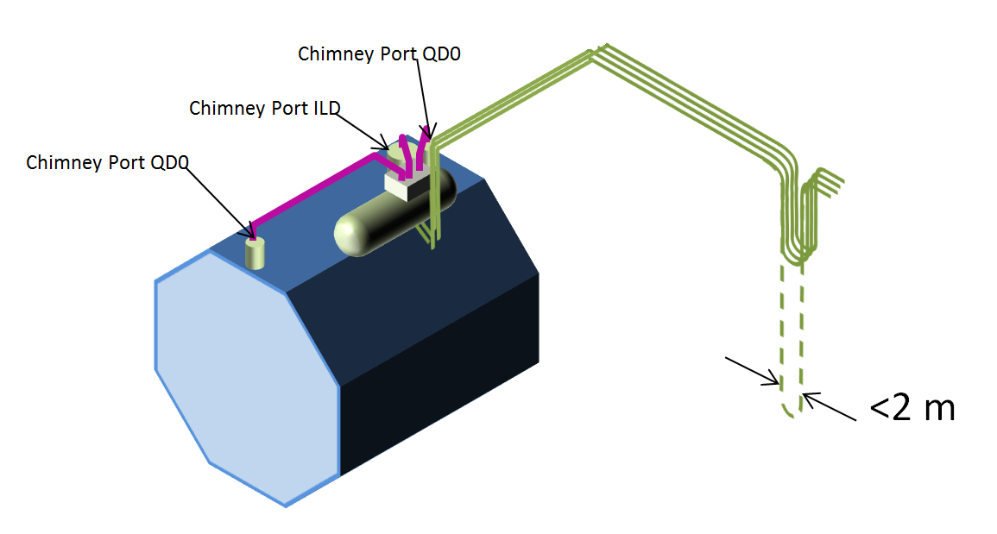
Schematic view example of SiD/ILD cryo

Slide 27
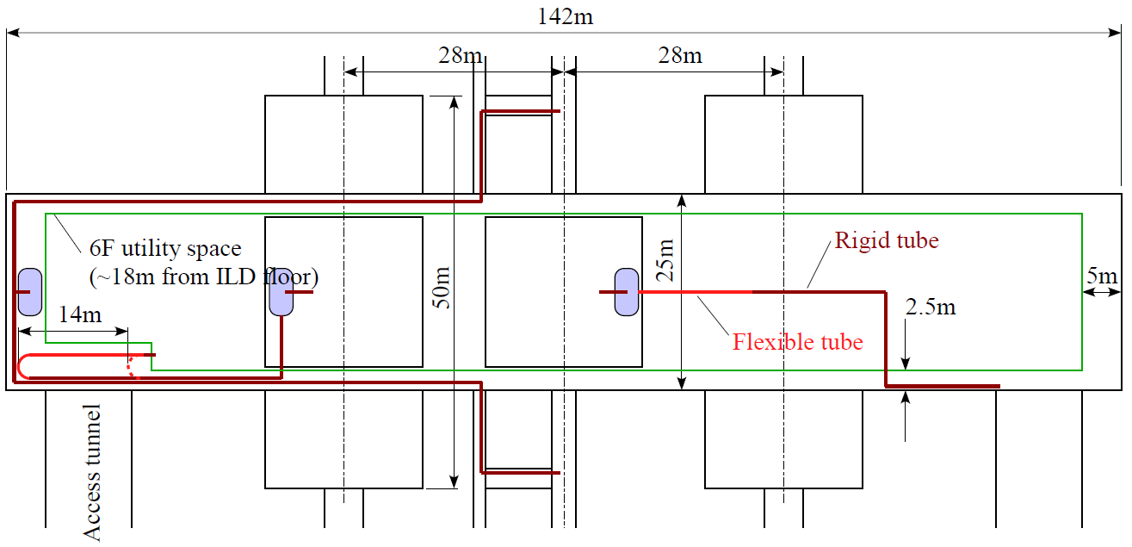
Detector CBs on the detector/platform
Ordinary flexible tubes
Ordinary flexible tubes
(can bent vertically)

Slide 28
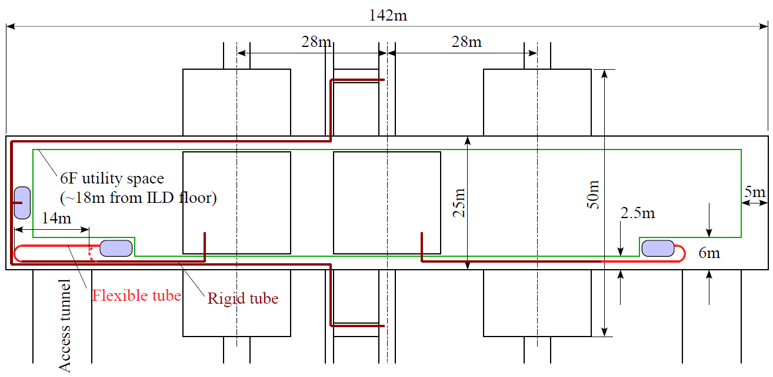
Detector CBs on the side wall

Slide 29
Schematic Flow Diagram for ILD/SiD+QD0
Shield Return
CL cooling for detector and QD0
to suction
CL
Compressor Cavern
Shield Supply
Quench Recovery Line (QRL)
Storage Tank
Oil separator
1st ~ 5th
VP
Flexible
to buffer tank
CL
Flexible tube
for LP
Flexible tube
for HP
Flexible
Tubes
HEX
T1
TRT(4)
LHe 4.5K
to QRL
Adsorber
TRT(2)
QRV for detector
70 K shield
Adsorber
T2
Distribution box
HEX
Turbine cooler (cooling water)
HEX
TRT(5)
4K Detector Cooling channel
Shield Supply
T3
Shield Return
Shield Supply
70 K shield cooling channel
Shield Return
Detector 4.5 K
HEX
T4
to QRL
QRV for QD0
HEX
4 K shield
Shield Return
He II 2.0K
Shield Supply
Pressurized HeII
7K Supply
70 K shield
7K Return
Vacuum line for 2K refrigerator
2K refrigerator
TRT(6)
QD0
Cold box is installed on the top of the detector.
The area surrounded by red line indicates Platform for Detector

Slide 30
Schematic Flow Diagram for CC+QF1
Shield Return
Compressor Cavern
Shield Supply
Quench Recovery Line (200A)
Storage Tank
Oil separator
1st ~ 5th
VP
Flexible
to buffer tank
QRV of distribution box
CL
HEX
T1
LHe 4.5K
Adsorber
TRT(2)
70 K shield
Adsorber
T2
Distribution box
HEX
Turbine cooler (cooling water)
TRT(5)
TRT(5)
to opposite side of QF1 and CC
HEX
CL lead cooling
Shield Supply
T3
Shield Return
HEX
QRV of QF1
QRV of CC
T4
70 K shield supply and return
4 K shield supply and return
HEX
2 K return line
Shield Return
Saturated He II 2 K supply line
Shield Supply
Pressurized He II
Cooling channel
7K Supply
7K Return
2K refrigerator
QF1
CC
Vacuum line for 2K refrigerator
Cold box is installed on the utility space

Slide 31
Ordinary Flexible Tube for each detector
Following ordinary single layer flexible tubes are adopted for pushpull operation per each detector.
 | Diameter of Flex. tube | Number | Bending radius (mm) | References
Helium gas supply line | OD ~ 60.5mm | 1 | 225 mm | Allowable pressure ~ 2.0 MPa
Helium gas return line | OD ~ 200 mm | 1 | 750 mm | Allowable pressure ~ 2.0 MPa
Helium gas vacuum line | OD ~ 200 mm | 1 | 750 mm | Allowable pressure ~ 0.2 MPa
Cooling water for turbine | OD ~ 30 mm | 2 | 145 mm | Supply & Return
Quench relief line | OD ~ 128 mm | 1 | 350 mm | Allowable pressure ~ 2.0 MPa
Return line for Current lead cooling | OD ~ 30 mm | 1 | 180 mm | Allowable pressure ~ 2.0 MPa
Referred bending radius is the value of Tuf Omega Tube which is commodity description

Slide 32
Action Item for DBD
We have to estimate following items.
  Total Heat Load
  Practical Flow Diagram and Design of Cryogenic equipment.
  Cost estimation
  Vibration reduction of QD0
    Fundamental research of vibration source
    Modal analysis of QD0
    Development of absorption scheme.
  Laid down method of ordinary flexible tubes (see previous page)
  Now we consider the several schemes.
    5F and 6F by means of Cable chain
    6F utility space
    On the floor of experimental hall

Slide 33
Proposal and Home Work
Cryogenics Layout in the Central Region
  Distributed cold boxes and centralized main compressor banks for individual cryoplant
    Unified interface to CFS, better isolated from detector
    Be an important consensus, today !
  Individual Cryoplant/cold box to QD0+ anti-solenoid + Detector Solenoid
Push-pull/Movable option
  Home work to have common flexible pipe-line design
    Either cold or warm flexible line
    Common design needed to adapt it also to adapt to QF0.

Slide 34
Again, This is outcome from Intensive Meetings, since early 2012
February GDE, ADI and cryogenics meetings
March: GDE Cryogenics Meeting
April: KILC12, Central Region Session
May : GDE/Detector Cryogenics Meeting
May: GDE ADI meeting
June: MDI/Detector Cryogenics Meetings (2~3)
Today: GDE ADI meeting
We would thank everyone’s much effort and contribution for better understanding and discussions.

