Slide 1
Update of pair background study
Akiya Miyamoto
KEK
20-June-2012
ILD Analysis & Software Meeting

Slide 2
Overview
At ILD WS in Kyushu, a large background hit occupancies in VXD were reported. New BCAL geometry was in question.
At the last software meeting, Aura reported a study with the old BCAL model (BCAL01) and found still large energy deposit especially in 1TeV case.
Later, Andre and Aura noticed that no Lorentz transformation is applied on pair particles in the latest Mokka, unless a useOldHEPLCIO is set to true.
In this report, hit rates of pair background in VXD and TPC are reported with Lorentz boosts on, using two BCAL models.

Slide 3
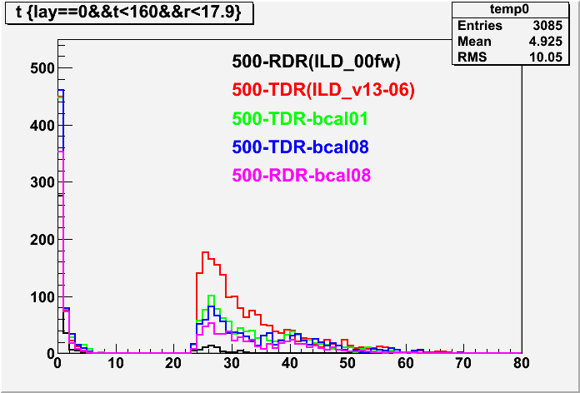
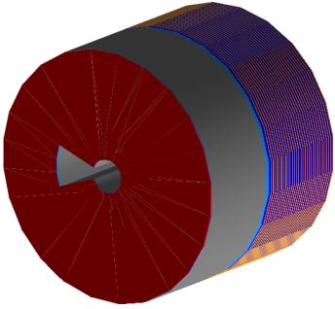
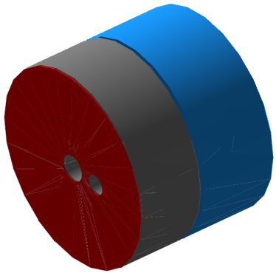
Time distribution of VXD first layer hits
L. B. | BCAL
Yes | 01
No | 08
Yes | 01
Yes | 08
Yes | 08
BCAL01
Hits/BX
BCAL08
nsec

Slide 4
Direct hits vs Backscatter
 |  |  |  |  |  |  | Layer0 Hits/BX
 | Detector | ilcsoft | FieldMap | Mokka | Lorentz Boost | BCAL | t<20ns | t>20ns | (t>20)/(t<20)
500-TDR | O1_v02 | v01-13-04 | fieldX03 | 07-07-p06 | No | bcal08 | 557 | 1576 | 2.83
 | O1_v03 | v01-13-05 | fieldX03 | 07-07-p07 | No | bcal08 | 568 | 1490 | 2.62
 | O1_v03 | v01-13-06 | fieldX03 | 07-07-p08 | No | bcal08 | 563 | 1800 | 3.20
 | O1_v03 | v01-13-06 | fieldX03 | 07-07-p08 | Yes | bcal08 | 602 | 894 | 1.49
 | O1_v03 | v01-13-06 | fieldX03 | 07-07-p08 | Yes | bcal01 | 592 | 1005 | 1.70
500-RDR | O1_v03 | V01-13-06 | fieldX03 | 07-07-p08 | Yes | bcal08 | 458 | 572 | 1.25
 | O1_v03 | v01-13-06 | fieldX03 | 07-07-p08 | Yes | bcal01 | 424 | 561 | 1.32
 | ILD_00fw |  | fieldX02 | 06-07-p02 | Yes | bcal01 | 650 | 150 | 0.23
1000-TDR | O1_v03 | V01-13-06 | fieldX03 | 07-07-p08 | No | Bcal01 | 1280 | 6359 | 4.97
 | O1_v03 | V01-13-06 | fieldX03 | 07-07-p08 | Yes | Bcal08 | 1573 | 4309 | 2.74
 | O1_v03 | V01-13-06 | fieldX03 | 07-07-p08 | Yes | Bcal01 | 1509 | 4519 | 2.99
500 GeV
With the Lorentz boost on, back scatter is reduced by about factor 2.
Back scattering with BCAL08 is about 10% smaller than BCAL01.
# of hits with 500-TDR is about factor 2 larger than “LOI estimation” with ILD_00fw
1000 GeV : Needs to reduce the background further

Slide 5
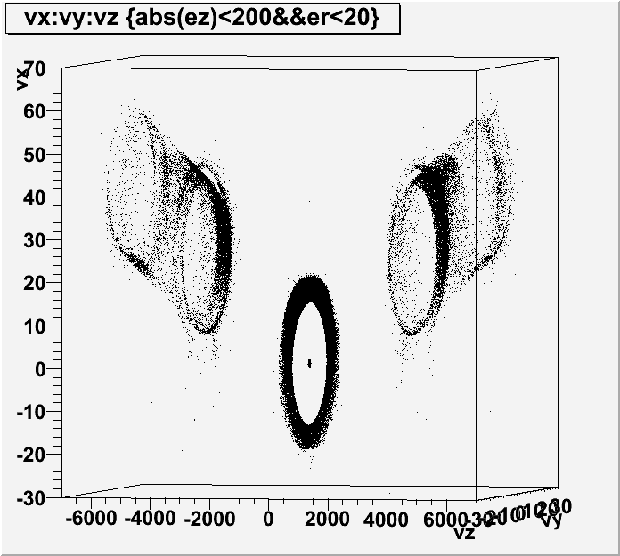
Origin of MCParticles which
end at VXD first layer or Beampipe. They are e+/e-
BCAL inner wall
Exit beampipe

Slide 6
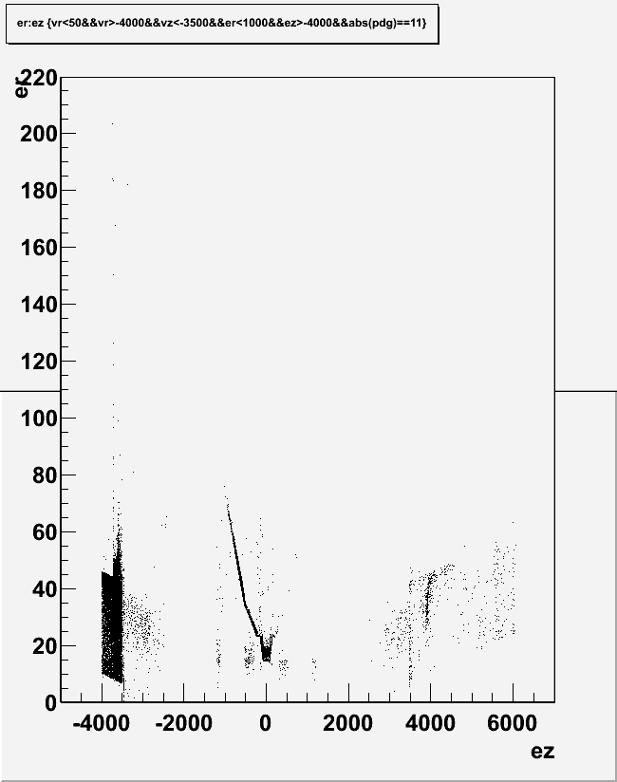
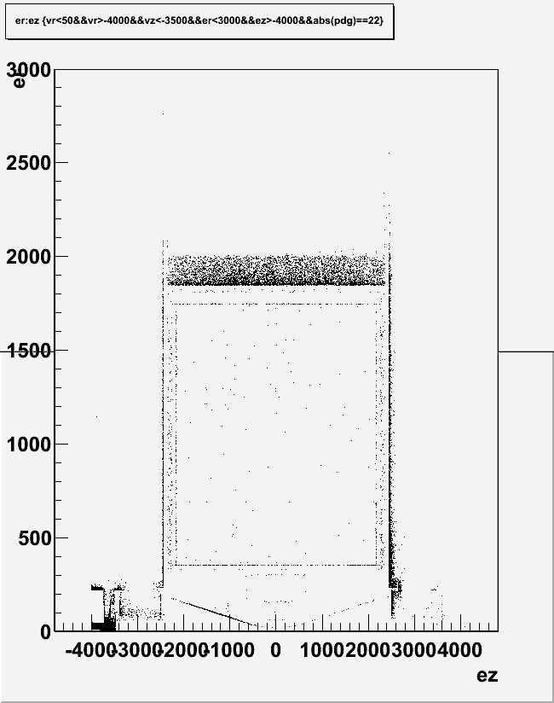
1 TeV, B1b_ws parameters, 7BX
End point of photons
which were created in BCAL region
End point of e+/e-
which were created in BCAL region
ECAL
Beam pipe
ECAL
TPC

Slide 7
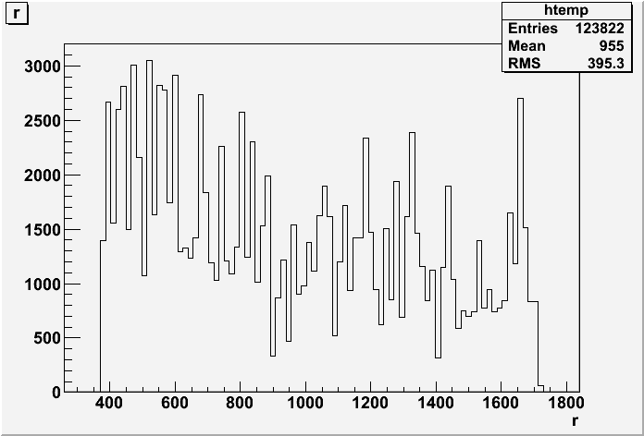
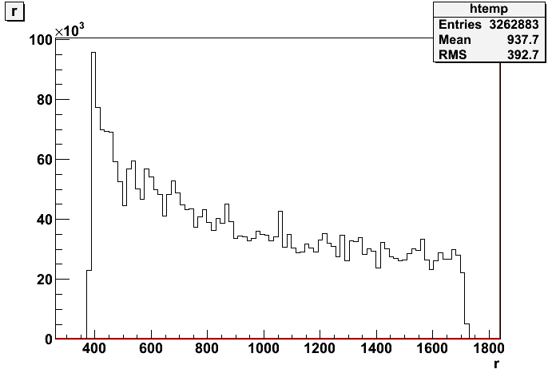
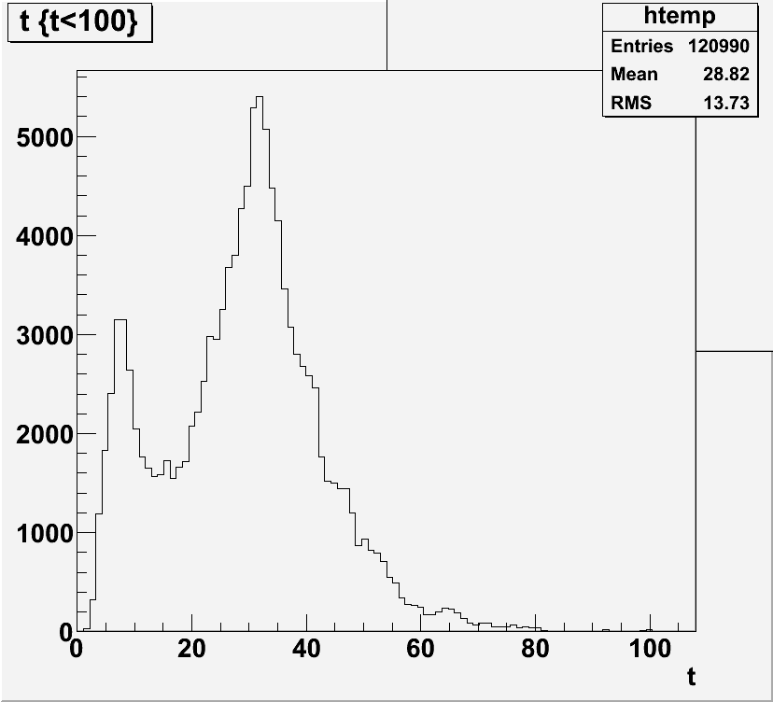
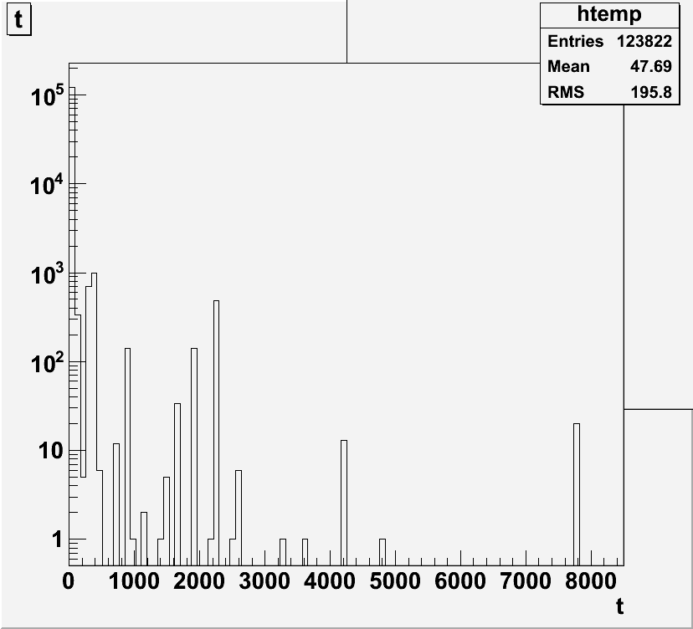
TPC background hits
Radial distribution of pair background hits
1 TeV B1b_ws, 30Bx
No L.B & BCAL08
1 TeV B1b_ws, 7Bx with L.B
R(mm)
R(mm)
163k hits/BX
17.7k hits/BX, with BCAL08
22.2k hits/BX, with BCAL01
time distribution
1 TeV B1b_ws, 7BX
with L.B & BCAL08
nsec
nsec

Slide 8
Summary
Pair background hit rates were studied with correct Lorentz boost, using BCAL08 or BCAL01 models.
500 GeV, TDR case, hits in VXD first layer by backscattering is about ½ of previous case ( 1500~1600 hits/BX)
Difference between BCAL01 and BCAL08 is small
Assuming a detector with pixel size 25^2um^2, 46us RO time, 9 pixels/hits, the hit occupancy of first layer is 4.6%.
1 TeV case,
~ 6000 hits/BX. The hit occupancies is ~20%, assuming the detector same as 500 GeV case.
TPC background hits at 1 TeV.
~1/10 of the previous results without L.B.
BCAL08 is ~20% less than BCAL01.

