Slide 1
ILC experimental hall cryogenics
2012/06/19
Yasuhiro Sugimoto

Slide 2
Baseline design
3 cold boxes; one for ILD+QD0s, one for SiD+QD0s, and one for QF1s and crab cavities
There are two possibilities of the location of CBs for detectors
  On the side wall
    CB on 5F or 6F utility floor
    7K or 4K flexible transfer tube on 6F utility floor
    CB and flexible transfer tube locate above the entrance of the access tunnel in order not to disturb the detector assembly
  On the detector/platform
    300K high pressure flexible tube along the cable chain in the cable pit or on 6F utility floor (depends on the bending radius)
Choice of the location of the CB is up to each detector group
Capacity of the compressor for three CBs has to be defined before AD&I meeting

Slide 3
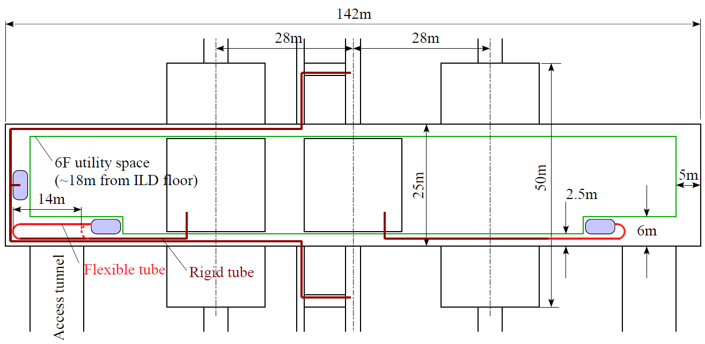
Detector CBs on the side wall

Slide 4
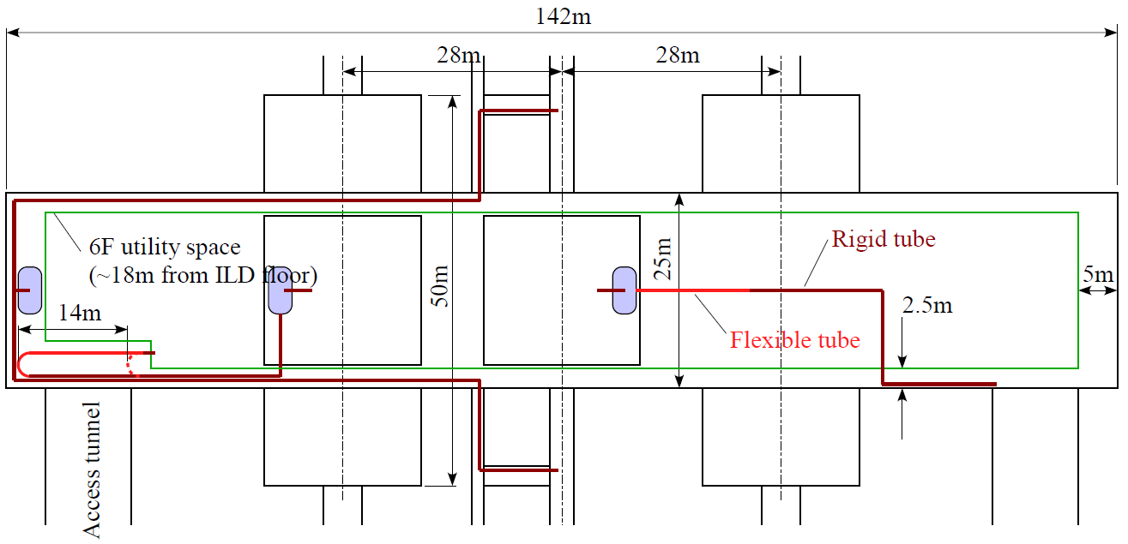
Detector CBs on the platform
Flexible tube
(can bent vertically)

Slide 5
Issues still to be studied
CB on the side wall
  Durability of the flexible transfer tube
  Heat load
CB on the detector
  Bending radius of the high pressure flexible tube
  Vibration effect

