Slide 1
ML-SCRF: Monthly WebEx Meeting
June 26, 2012
Reports from PMs
  Organization updated: Chris Adolphsen accepting the SCRF Associate PM
  GDE activity and meeting plan
Reports from TA Group Leaders (very briefly, if any? )
  Cavity, Cavity Integration, Cryomodule, Cryogenics, HLRF, ML
Special Discussions on
  Progress in TDR Drafting
Central region SCRF and Cryogenics
  A brief report from ADI meeting, June 20, 2012

Slide 2
ML & SCRF Action/Meeting Plan (2012)
Month | Day | Place | Meeting
June | 26 |  | ML-SCRF Monthly Meeting
July | 4-11 12-13 25 |  | 36th ICHEP (Melbourne) GDE-EC face-to-face Meeting (TDR draft discussed) ML-SCRF Meeting
Aug. | 22 |  | ML-SCRF Meeting
Sept. | 10-14 19 | Telaviv | Linac-2012 ML-SCRF meeting
Oct. | 22-26 29-30 | Texas Annaheim | LCWS (TDR draft to be finalized) IEEE-NS (LC event)
Nov. | 5-6 15 | JLab | TTC Final Draft of TDR
Dec. | 13-14 | KEK | ILC-PAC (@ KEK)

Slide 3
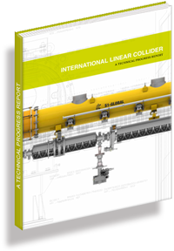
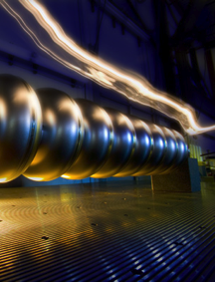
TDR Technical Volumes
2007
2011
2013*
TDR Part I:
R&D
~250 pages
Deliverable 2
ILC Technical Progress Report
(“interim report”)
AD&I
TDR Part II:
Baseline
Reference
Report
~300 pages
Deliverables 1,3 and 4
Technical Design Report
Reference Design Report
More discussed by J. Carwardine
On Jan. 20, tomorrow
* end of 2012 – formal publication early 2013

Slide 4
TDR Parts I and II
Milestones:
  First drafts 22.04 (KILC 12) Long gone!
  Melbourne EC 12-13.07 (deadline 9.07) 1st snapshot
  IWLC’12 22-26.10 (deadline 19.10) complete draft
  PAC submission 18.11 final draft
Approximately 40% of both Part I and II submitted
  First iteration editing – probably <10%

Slide 5
Editors being re-organized
Editor status:
  In work – Nan, Elsen, Burrows, Hitoshi
  Added and appreciated – Harrison, Adolphsen, Yokoya
  Coming soon/later: Foster (english/hyphens), Toge
Issues
  Piecewise editing of sections/chapters
    difficult to manage – John doing his best
  Real communications still to be done between editors
    Consistency between chapters/sections
    TEB ‘editing’ meetings ‘have not really started’ – poor attendance!
    JC will now schedule one per week (awareness raising!)
Second stage (iteration) across entire report will be needed
  PMs final sign off
  Consistency / quality control / English!

Slide 6
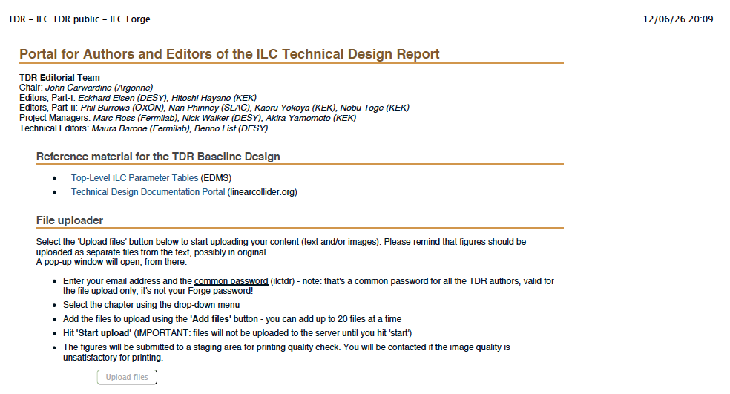
ILC TDR public https://forge.linearcollider.org/tdr
J. Carwardine, M. Barone

Slide 7
Status of TDR Part-1: Chap-3, SCRF
Chap. | Subject | Draft provided by | Status/Plan
3 | SCRF R&D
 | Development of Infrastructure | J. Kerby | Received
 | R&D toward mass production | J. Kerby | Received
 | Overview | A. Yamamoto | Received
 | High gradient cavity R&D | R. Geng | Received
 | Cavity Integration | H. Hayano | by end of June
 | S1-Global experiment | H. Hayano | to be received
 | CM, thermal balance / SCQ | P. Pierini, / J. Kerby | uploaded / TBD
 | RF-power and PDS | S. Fukuda, C. Nantista | just submitted
4 | Beam Test Facility ( SCRF related)
 | FLASH | J. Carwardine | by end of June
 | Quantum Beam | H. Hayano | to be received

Slide 8
Status of TDR Part-2: Chap-3,4,5, ML Technology
Chap. | Subject | Draft provided by | Status/Plan
3 | ML Technology (common)
 | ML Top-level parameters and general layout | C. Adolphsen
 | Cavity performance and production requirements | A. Yamamoto | by end of June
 | Cavity Integration (couplers, tuners, mag. shield) | H. Hayano | by end of June
 | CM design, SCQ, Cryog. | P. Pierini, J.K., T. Peterson | by end of July
 | RF-power source | S. Fukuda. C. Nantista | uploaded
 | Low-level RF control | J. Carwardine | by end of June
 | Cavity and CM tests | H. Hayano | by end of June
4 | ML for flat-topography layout
 | … Layout: Klystron Cluster RF Scheme (KCS) | C. Adolphsen
 | … Low-level RF for KCS | J. Cawardine | by end of June
 | … Power distribution system | C. Nantista | Receoved
5 | ML for mountainous-topography layout
 | … Layout: Distributed Klystron RF Scheme (DKS) | C. Adolphsen
 | … Low-level RF for DKS | S. Michizono | Received by JC
 | … Power distribution system | S. Fukuda | Received

Slide 9
ADI Action Items remaining:
Works still to be done w/ML-SCRF
 | # | Subjects | Prepared by | Status
SRF | 36 | Review local PDS design and cost estimate | S.F., C.N., A. Y, | done
 | 48 | Review/update He gas or liquid storage requirements | T. P, A.Y.,
 | 50 | Update CFS requirements to reflect Marx modulator | S.F., C.N. | done
MLI | 64 | Mechanical: Insulation for cavity RF loads
 | 65 | Documentation: Main linac layout for mountain topography. | A.E., A.Y., | done
 | 66 | Updated ML lattice file for Mountainous Topography site
 | 74 | RF power requirement accounting documentation (parameters) for EDMS KCS | M.R.
 | 75 | RF power requirement accounting documentation (parameters) for EDMS DKS | M.R.

Slide 10
ILC Central Region Cryogenics for
DR, BDS/MDI, and Detectors
Akira Yamamoto (GDE-PM)
in cooperation with
SCRF, BDS, DR, Detector groups, and PMs
GDE-ADI meeting, June 20, 2012

Slide 11
This is outcome from Intensive Meetings, since early 2012
February GDE, ADI and cryogenics meetings
March: GDE Cryogenics Meeting
April: KILC12, Central Region Session
May : GDE/Detector Cryogenics Meeting
May: GDE ADI meeting
June: MDI/Detector Cryogenics Meetings (2~3)
Today: GDE ADI meeting
We would thank everyone’s much effort and contribution for better understanding and discussions.

Slide 12
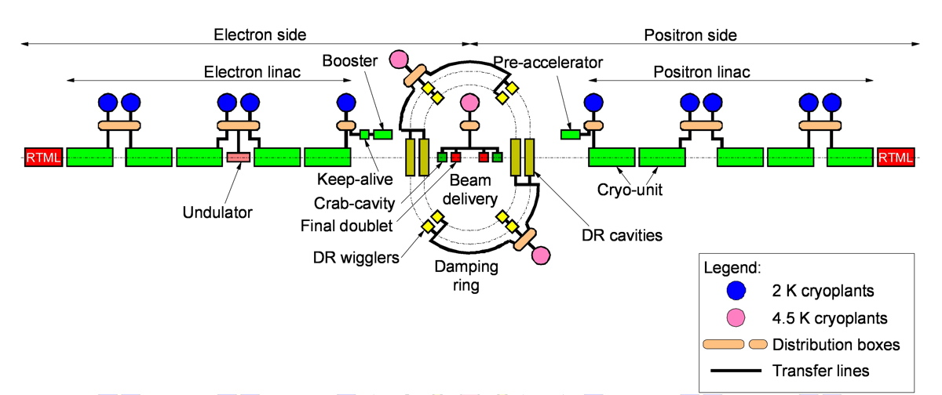
RDR cryogenics layout, for reference

Slide 13
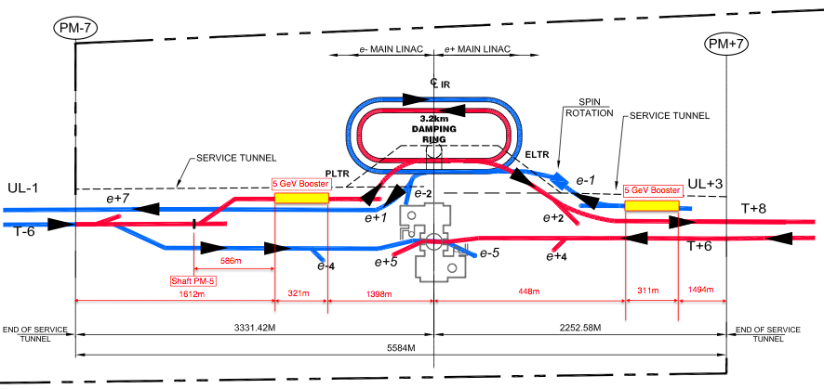
5 GeV booster linac locations
ILC GDE Cryo, Tom Peterson 31 May 2012

Slide 14
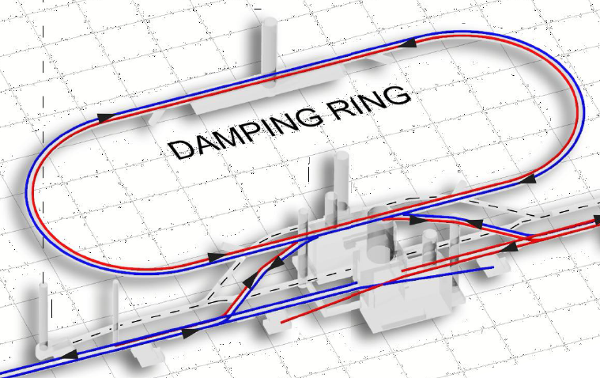
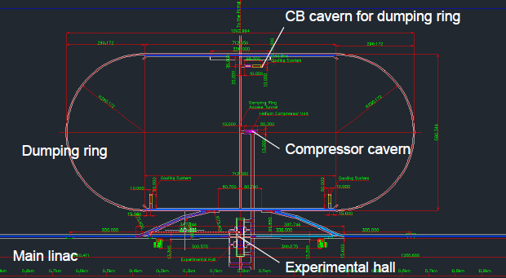
Cryogenics Location in Central Region
Flat Topography
Cryogenics at Central Region
Damping Ring
e- source: Booster Linac
e+source: Booster Linac
Focusing (QF1) + Crab Cavity
Focusing (QD0) + Comp. Sol. + SiD Solenoid
Focusing (QD0) + Comp. Sol. + ILD Solenoid
An important Concept suggested:
Distributed Refrigerators (Cold-Boxes)
  Best efficiency in themodynamics
Centralized Main-compressor station
  Well isolated from detector hall
    Major vibration source distanced
  CFS interface to be unified
    electricity and water-cooling
Main Compressors
on surface
Mountainous Topography
Damping Ring
Main Compressors,
underground

Slide 15
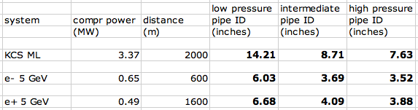
Helium pipe sizes for remote compressor locations
Piping from the central campus to relatively small cryogenic plants such as boosters is not a problem
  3 1/2 inch (100 mm) pipe installed cost est in 2006 is $148/meter
  6 inch (150 mm) pipe installed cost in 2006 is $275/meter
  12 inch (300 mm) pipe installed cost est in 2006 is $716/meter
Main Linac compressors may be located away from cold boxes with room temperature piping
  Need to check cost tradeoffs for large pipes versus locations of compressors
ILC GDE Cryo, Tom Peterson 31 May 2012

Slide 16
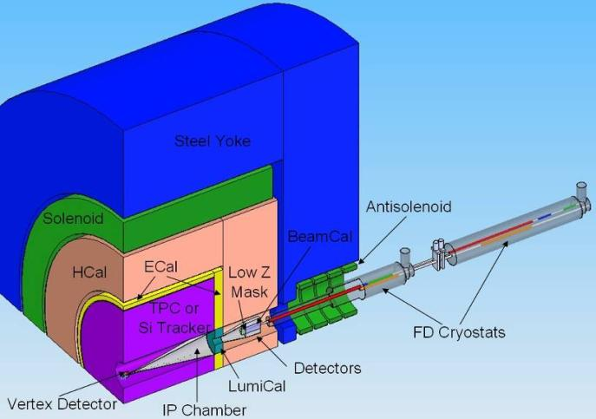
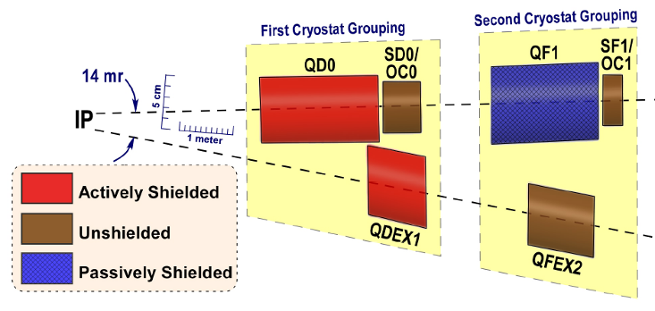
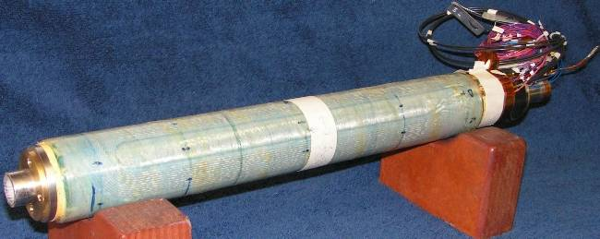
IR Region and Final Doublet
FD arrangement for push pull
  different L*
  ILD 4.5m, SiD 3.5m
Short FD for low E_{cm}
  Reduced β_{x}*
    increased collimation depth
  “universal” FD
    avoid the need to exchange FD
    conceptual - requires study
Many integration issues remain
  requires engineering studies beyond TDR
  No apparent show stoppers
BNL prototype of self shielded quad
Notes:
Short FD effectively increases collimation depth (SR fan from FD). Universal FD (to prevent having to exchange cryostats) still requires proof of principle design.
Still many integration issues for IR/MDI. Requires engineering studies (beyond TDR).

Slide 17
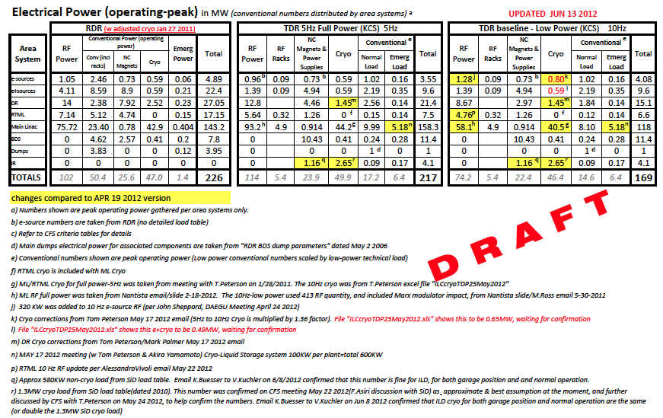
ILC-TDR: CFS Electric Power Balance

Slide 18
Tom’s Conclusions as of May 31, 2012
Piping to 5 GeV booster linacs and other central region cryogenics from one central compressor location looks practical
Next step is detailing cryogenic supply to undulators and some of the small isolated devices in the central region
  Energy compressor, spin rotator solenoids
  Add those cryogenic cooling powers to total
Document helium warm pipe lengths and cold transfer line lengths
  Refine total heat load estimates
  Include in cost estimates
18

Slide 19
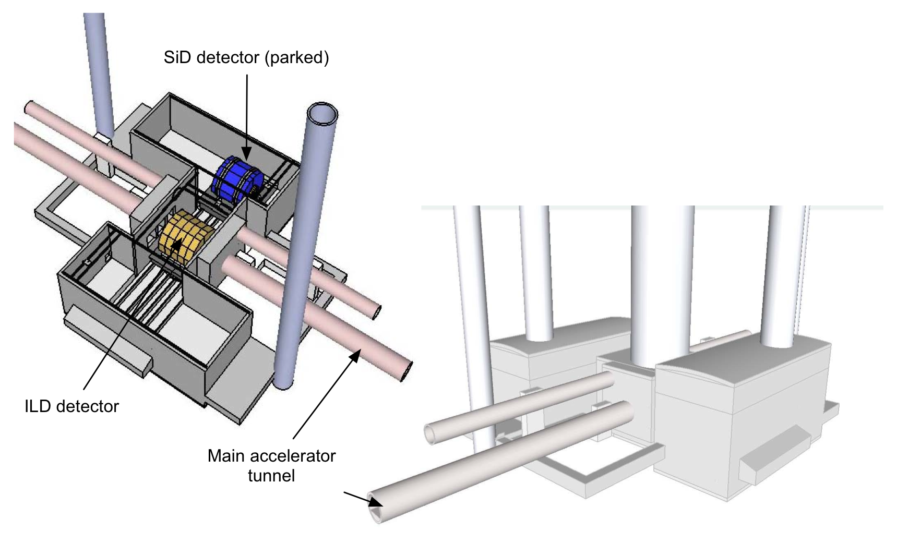
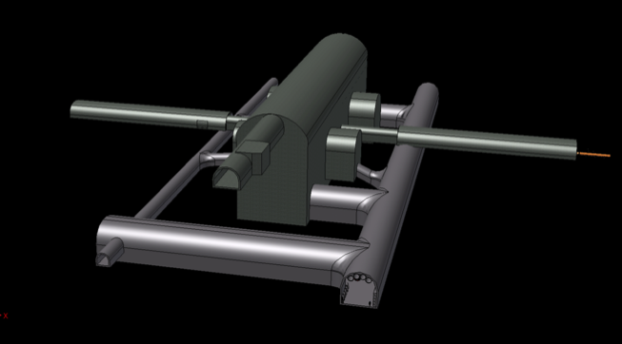
Detector Hall CFS Review
Review Questions:
  Criteria understood?
  Design satisfy the criteria?
  What are the cost-drivers?
  What are the outstanding issues?
Presentations:
  Alignment requirements (special tunnels)
  Underground Assembly schemes
  Cryogenic systems
  Cost roll-up
Report to be written.
Flat-topography
detector hall concept
Mountainous topography detector hall

Slide 20
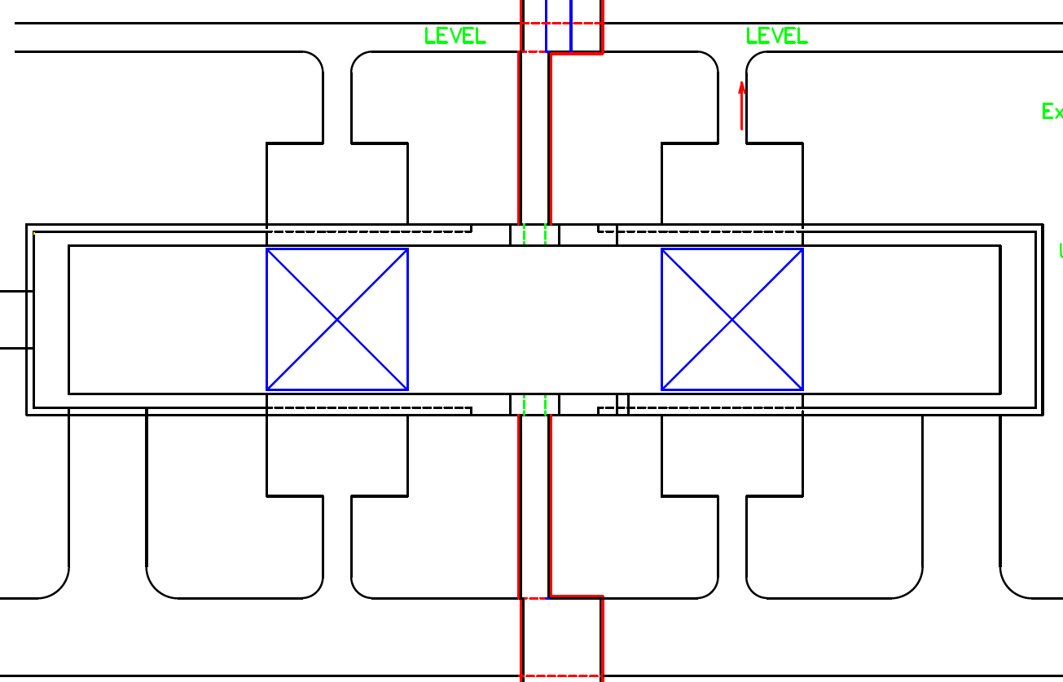
Cryogenic Layout in the experimental hall
CB3 and distribution boxes for CC and QF1 are installed on the 6F.
CB1, 2, distribution boxes and PSs are installed on the each platform for detector
Several numbers of ordinary flexible tubes have to be employed. (see P8 & P10)
Cooling capacity of each CB =2kW @4K
CB1
(2kW)
CB2
(2kW)
CB3
(2kW)
Cold Boxes (CB1,2,3)
Distribution box (4.2 K)
Distribution box for detector (4.2 K)
SiD, ILD, CC, QD0, QF1
Conventional TRT
Subcooler for 2.0K saturated HeII
7K Helium Gas Line

Slide 21
Proposal and Home Work by AY as of June 20, 2012
Cryogenics Layout in the Central Region
  Distributed cold boxes and centralized main compressor banks for individual cryoplant
    Unified interface to CFS, better isolated from detector
    Be an important consensus, today !
  Individual Cryoplant/cold box to QD0+ anti-solenoid + Detector Solenoid
Push-pull/Movable option
  Home work to have common flexible pipe-line design
    Either cold or warm flexible line
    Common design needed to adapt it also to adapt to QD0.

Slide 23
TDR Publication and Review
First-draft sections | * 23 April *
Complete edited draft | 22 October (LCWS 12)
Final draft (for PAC) | 15 November
PAC review | 15-16 December
Expect international reviews:
Both technical and cost
(Q1-22 2013)
Formal publication at Lepton Photon Conf.
(SF, June 2013)

Slide 24
Status (JC +update)
Milestones:
  Melbourne EC <3 weeks
  IWLC’12 ~19 weeks
  18.11 PAC deadline ~24 weeks
Approximately 40% of both Part I and II submitted
  First iteration editing – probably <10%

Slide 25
Work flow and resources
Responsibility:
  Authors
  TEB (Carwardine)
  Project Managers
  Director / EC
Ask John for formalise this
PM’s must read everything for technical content
  before going to EC
(Note “dual hats” everywhere – but nothing unusual)
Again: chapter by chapter submission will not be final report!!
  but should be close.

